Slide 1
QC tutorials for beginners
By
Khairani Md Khalid
100581
14 April 2022

Slide 2
OBJECTIVE
Introduction to Lab Quality
Basic steps in setting control limits (Mean, SD, CV, LJ graphs, establishing qc ranges, plotting)
QC terminologies : Accuracy, precision, bias
Westgard rules
Hands-on

Slide 3
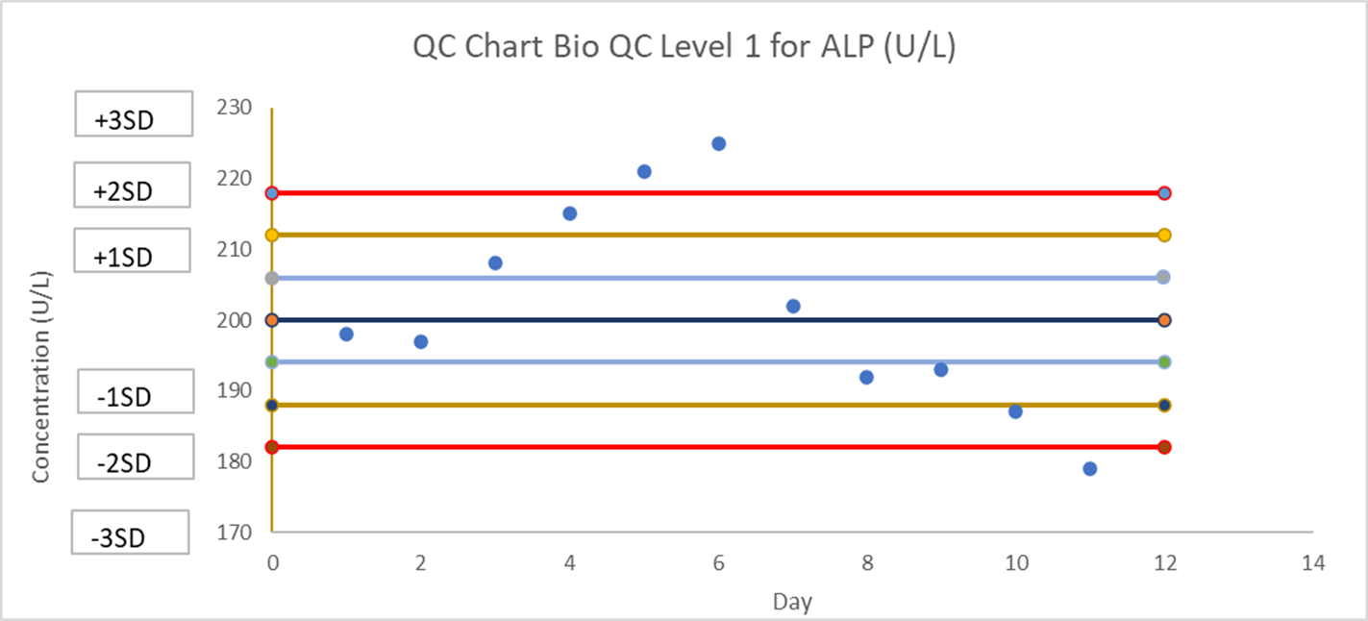
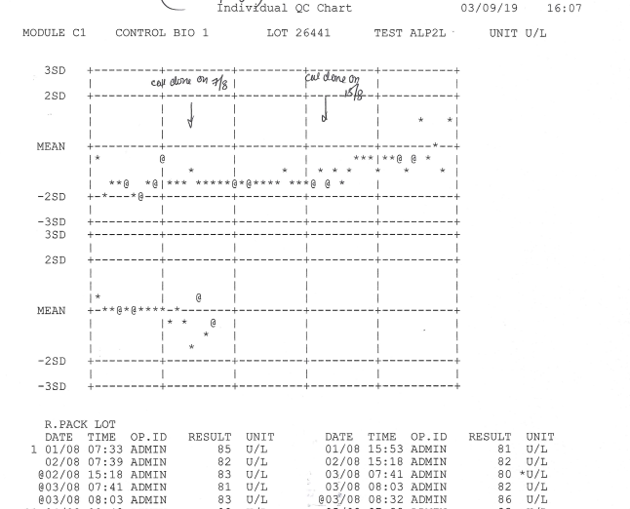
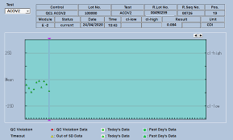
QC Charts in Lab
QC in chemistry lab is visualized in graphical form or charts. By using Westgard rules, the positions of QC data from target mean and the patterns formed would provide a way to detect if random or systematic errors has occurred . This determines the acceptance or rejection of the test run.
Notes:
QCs in laboratory is basically a measure of accurate and precision. Interpretation of QC is usually in chart or graphical form. In chemistry lab QCs are visualiswd with levey Jenning chart such as this. The Lj graph consists of QC concentration of QC on y-axis versus time on x-axis.

Slide 4
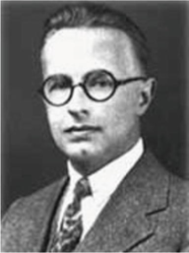
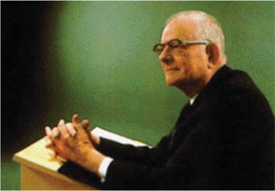


Brief History of QC
1924-1949
1924-Development of “Process Control” by Walter Shewhart”.
W. Edward Deming became the foremost champion and proponent of Shewhart's work. He developed PDCA or Deming cycle which he referred to it as “Shewhart Cycle”.
1950- 1979
Stanley Levey and Εlmer R. Jennings introduced Levey-Jennings chart
Rausch and Freier introduced that serum pools should be used in place of samples from patients
In 1954, E.S. Page of the University of Cambridge introduced the sequential analysis technique known as the cumulative sum control chart (CUSUM).
The use of patient results for quality control only started during 1960–1970 by Japanese statistician Kaoru Ishikawa
In 1965, Michael Waid and Robert Hoffmann introduced the unique “Average of normals” (AON) method
1980-1999
1981- Westgard Rules was born
1994- The “OPSpecs charts” concept was proposed by Westgard. Non-analytical errors, that is, errors that occur before or after analysis, were also discussed extensively during the 1990s. Configuration of laboratory information systems (LISs) led to the prevention of post-analytical errors and some types of pre-analytical errors.
Later on, Westgard introduced the six sigma theory in clinical chemistry, which proved to be another method of establishing quality specifications
Notes:
Brief history of QC. QC was importanct in manufacturing industries. The LJ graph was adapted from Shewhart chart or precess control chart which created by Walter Shewhart in 1924 who worked for Bell telephone. His work on process control was championed by William Deming who created Deming Cycle (Plan-Do-Study-Act) although Deming referred to it as Shewhart cycle which is a breakthrough in continual improvement process.
In 1950, pathologists Stanley Levey and E, Jennings adapted Shewhart chart into Levey jenning chart for medical laboratories. And 1981, James E Westgard created Westgard multirules (actually modified Western Electric rules)- processs to detect out of control condition in control chart.

Slide 5

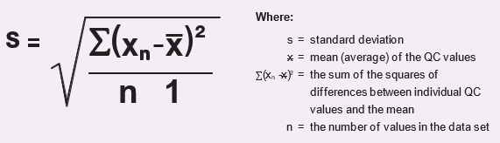
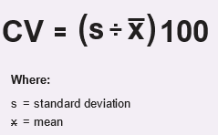
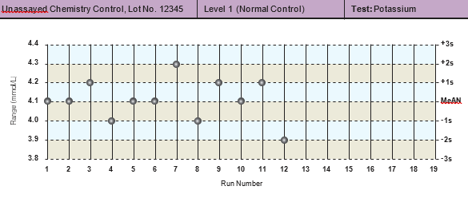
Basic steps in setting control limits (Mean, SD, LJ graphs, plotting and CV)
Term | Definition | Formula
Mean | Average of a set of data
Standard Deviation (SD) | Standard deviation is a measure of imprecision. It also indicates dispersion of result values about the mean.
Coefficient of Variation (CV) | CV indicates extent of variation in percentages. A higher CV indicates a relatively poorer precision.
Levey- Jenning (LJ) graph | Graph – display qc lab performance,is a graph with the mean and SD plotted on the Y-axis, and the days of the month or times of the runs plotted on the X-axis
Notes:
Cv-Measures degree of variation

Slide 6
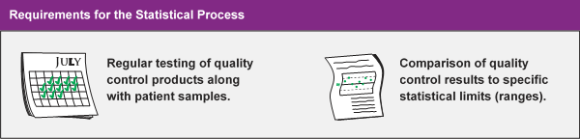
INTRO: QUALITY SYSTEM IN LABORATORY
Quality control in the medical laboratory is a statistical process used to monitor and evaluate the analytical process that produces patient results.
OTHER REQUIREMENTS
EQA PERFORMANCE IQC REVIEW BASED ON PEERS METHODS ARE COMPLYING WITH CURRENT STANDARDS (e.g. ISO 15189)
How to establish Qc range?
The first step in using a control material is to establish the control range. To establish a control range, repeated measurements (20 or more) of the control is performed at least once each day for multiple days.. The mean and standard deviation of these results are calculated and the control range is defined as the range of values around the mean ± 2SD.
Don’t you know?
Testing two levels of QC once per day has been the fixed minimum for many U.S. laboratories which complies CLSI requirement (C24 A4)
Notes:
This is another definition of QC in lab. In the past, Laboratory QC process consisted of 2 elements: regular testing of QC and comparisons of QC to the ranges. But today it has other requirement such as EQA performance, IQC reviews and compliances with international or national standards. Since QCs are represented in graphical format, you will need to know how to create the Levey Jenning graph and establish Qc ranges.

Slide 7
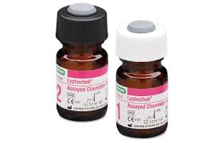
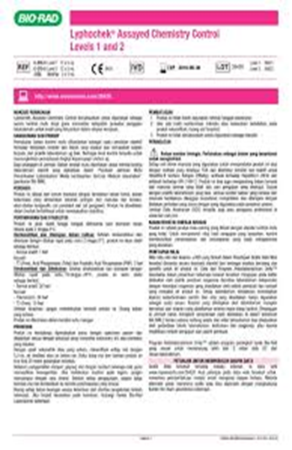
QC materials and establishing a range
CV
CV is useful tool in determining or comparing precision of a test or an instrument.
Also used in comparing manufacturer claims, RCPA results and peer group report.
However, CV doesn’t give information on bias of a test.
The smaller the CV, the higher precision!
QC material criteria
Long shelf life
Covers medical decision level
Box pricing
Interlaboratory Comparison program
Start with QC material
Third party QCs are common in use e.g Biorad.
Manufacturer of QC has set up range (most time it’s too wide)
Before starting the QC, it is needed to run 20 times (obtain at least 20 results for each level QC per machine) over a period. (e.g twice daily for 2 weeks)
Derive mean, SD and CV from 20 data. Check the CV if within manufacturer specification. Check if data within manufacturer range.
If all passed, then construct an LJ graph!!
Notes:
3rd party Qcs are common in many labs because they have a platform for peer comparisons

Slide 8
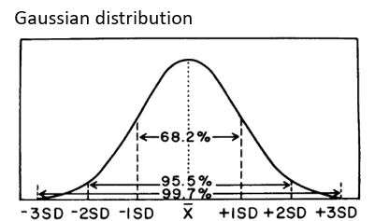
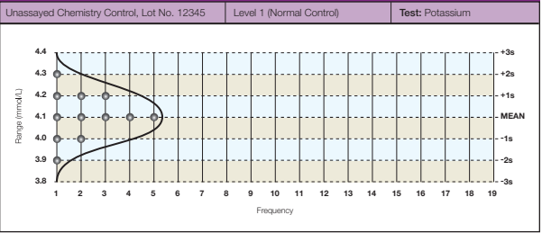
LEVEY JENNINGS QC CHART
History
Walter A. Shewhart at Bell Telephone Laboratories set up a control limits
Levey and Jennings- developed quality standards for laboratories
Westgard – established rules for monitoring quality control
Gaussian Distribution
Quality control data usually displaying a normal or Gaussian distribution around the mean where it would be expected that about
68.3 % of the points fall within 1 SD of the mean
95.5 % within 2 SD of the mean
99.7% within 3 SD of the mean.
A control chart also has the mean and standard deviations indicated but they are shown on the y axis (as if you turned this Gaussian distribution on its side.)

Slide 9
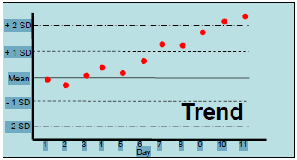
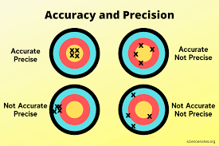
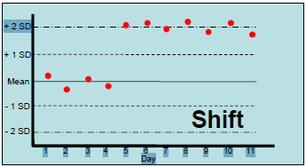
Important Definitions
ACCURACY
Degree of closeness of one measurement to it’s true or actual value
Trend
Indicates gradual loss of reliability of system
PRECISION
Reproducibility or repeatability (how close the repeated measurement to each other)
Shift
Abrupt changes in control mean
Sytematic Error
Reproducible inaccuracies that are consistently in the same direction.
Random Error
Statistical fluctuations (in either direction) e.g. 1-3s, R-4s

Slide 10
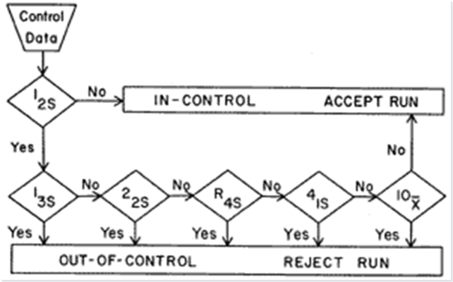
Westgard Rules
Introduction
Developed by Westgard and utilises series of control rules to interpret qc data.
Requires control chart with mean, ± 1sd, ± 2sd and ± 3sd. At least 2 different levels of control material at medical decision levels and/or across analytical measurement range
Westgard Interpretation
When controls fall within 2 sd’s, accept the run.
“Warning Rule” - One control ± 2 sd limit or 1-2s, hold patient results while inspecting control data with the 1-3s , 2-2s , R-4s , 4-1s , and 10x rules. If any of these additional rules indicates that the run is “out of control”, reject the run.
Rule | Definition
1-2s 1-3s 2-2s R-4s 4-1s 10X | 1 QC exceeds ± 2SD 1 QC exceeds ± 3SD 2 consecutive QCs (within or across )exceed ± 2SD 1 QC exceeds -2SD, other QC exceed +SD of within run 4 consecutive QCs (within or across) exceed ± 1SD on the same side 10 consecutive QCs (within or across) on the same side

Slide 11
Understand concept within run and across run
Within run
  affects all control results obtained for the current analytical run.
Across run
  Affects control results obtained from different analytical run
+3
s
+3
s
+2
s
+2
s
+1
s
+1
Across run
s
M
M
Within run
-1
s
-1
s
-2
s
-2
s
-3
s
RUN
1
2
3
4
5
6
7
8
9
10
-3
s
RUN
1
2
3
4
5
6
7
8
9
10
Level 1
Level 2

Slide 12

Single rule vs Multirules
Single rule: 1-2s or 1-3s
1-2s: practiced in 1960-1970. High error detection but with high false rejection rate.
1-3s: low false rejection rate but with low error detection. Usually deployed based on QC Strategy/ 6 sigma
Multirules
Multirules, although more complicated than single rule, offer better performance than single rule alone, they can keep the false rejection low while at the same time maintaining high error detection.
This is done by selecting individual rules that have very low levels of false rejection, then building up the error detection by using these rules together.

Slide 13
12S
Westgard Multirules
+3
s
+2
s
+1
when the QC exceeds ± 2SD
As a warning rule
s
M
1
2
s
Rule
-1
s
-2
s
-3
s
RUN
1
2
3
4
5
6
7
8
9
10
Level 1
+3
13S
s
+2
when the QC exceeds ± 3SD.
Rejection rule.
May indicate random or large systematic error.
s
+1
s
1
3
s
Rule
M
-1
s
-2
s
-3
s
RUN
1
2
3
4
5
6
7
8
9
10
Level 1
22S
+3
s
+3
s
+2
s
+2
when the 2 consecutive QCs (of within or across run) exceeds ± 2SD
Rejection rule.
Indicate Systematic error.
s
+1
s
+1
s
2
Rule
2
s
M
2
2
s
Rule
M
-1
s
-1
s
-2
s
-2
s
-3
s
-3
s
RUN
1
2
3
4
5
6
7
8
9
10
RUN
1
2
3
4
5
6
7
8
9
10

Slide 14
R4S
+3
Rejection rule.
Identifies Random error. Only applicable in within run. When 1 QC level exceeds +2SD and another level QC exceeds -2SD
s
+2
s
+1
s
M
R
Rule
4
s
-1
s
-2
s
41S
-3
s
RUN
1
2
3
4
5
6
7
8
9
10
Rejection rule.
Identifies systematic error.
Within Run: 2 consecutive QCs of two level QC exceeds 1SD on the same side.
Across Run: 4 consecutive QCs of same level exceeds 1SD on the same side.
Level 1
Level 2
+3
+3
s
s
+2
+2
s
s
+1
+1
s
s
4
1
s
Rule
M
4
Rule
M
-1
s
1
s
-1
s
-2
s
-2
s
-3
s
-3
s
RUN
1
2
3
4
5
6
7
8
9
10
RUN
1
2
3
4
5
6
7
8
9
10
10X
Rejection rule
Identifies systematic error where 10 control results are on the same side of the mean regardless of the specific standard deviation in which they are located.
Within Run: 5 consecutive QCs of two level QCs on the same side.
Across Run: 10 consecutive QCs of same QC levels on the same side.
Within Run
Across Run
+3
s
+3
s
10
+2
x
Rule
s
+2
s
+1
s
+1
s
M
M
10
-1
s
x
Rule
-1
s
-2
s
-2
s
-3
s
-3
s
RUN
1
2
3
4
5
6
7
8
9
10
RUN
1
2
3
4
5
6
7
8
9
10

Slide 15
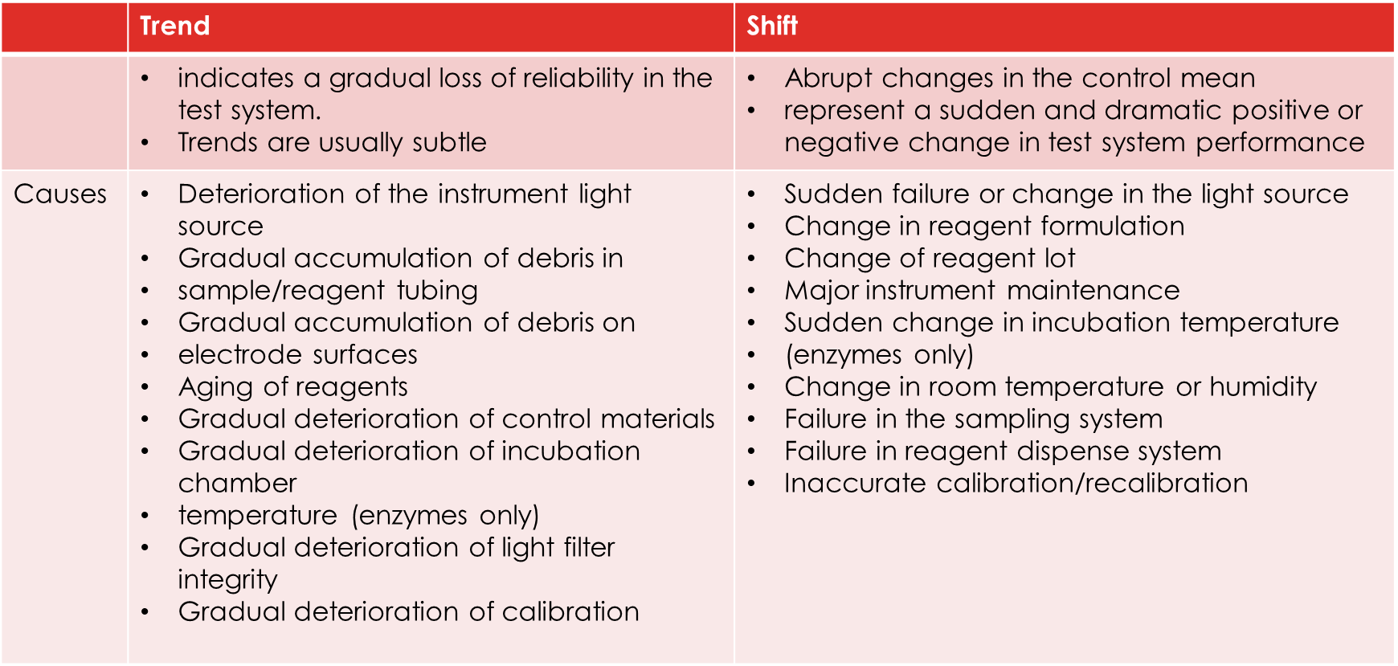
Causes of trend and shift

Slide 16
Hands-on exercise!
Derive Mean and SD. Design your own LJ graph and QC range.
For practice purpose, 4 data set is given for you to establish qc range and it’s LJ graph.
In reality, 20 data points are needed to establish the range for each level qc.
Data | ALP (U/L) for Bio QC Level 1
1 | 205
2 | 192
3 | 204
4 | 198

Slide 17
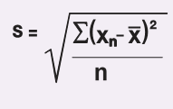

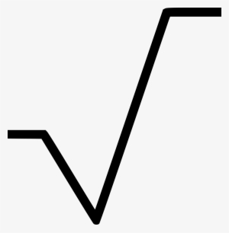

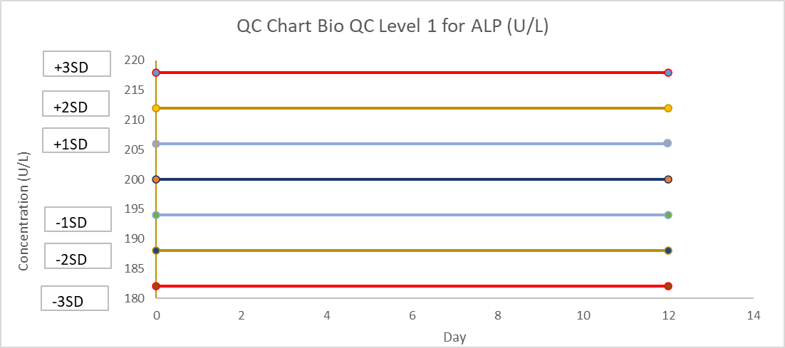
Step 1: Calculate the Mean and SD
2. Difference: Observation - mean
Observation -mean |  | Differences
205-200 | → | 5
192-200 | → | -8
204-200 | → | 4
198-200 | → | -2
3. Square the differences
4. Sum of squared difference
 | (Difference)²
 | 25
 | 64
 | 16
 | 4
Sum | 109
5. Divide by (N-1)
6. Square root
SD= | 109
 | (4-1)
= | 36.33
= | 6 u/L
1. Determine the Mean
No. of data | Result
1 | 205
2 | 192
3 | 204
4 | 198
Mean: | 200
(rounded to zero decimal)
Step 2: Design your LJ graph
Determine your y-axis in LJ graph:
Determine your +/- 1SD, 2SD, 3SD
Mean | 200 |  | calculation
+1SD | 206 |  | 200+6
+2SD | 212 |  | 200+12
+3SD | 218 |  | 200+18
-1SD | 194 |  | 200-6
-2SD | 188 |  | 200-12
-3SD | 182 |  | 200-18
Mean

Slide 18
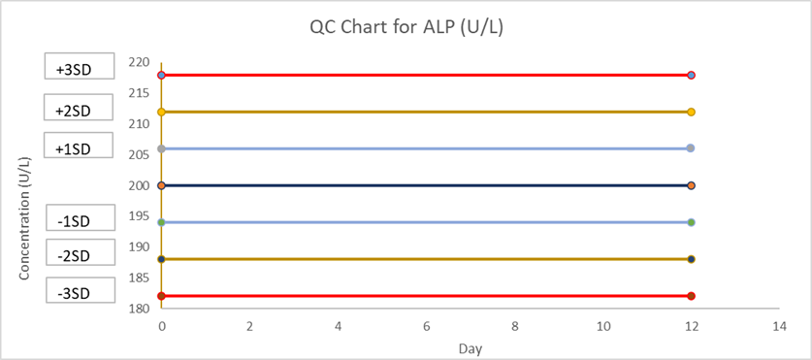
Try plotting the following QC results in the LJ chart
Mean

Slide 19
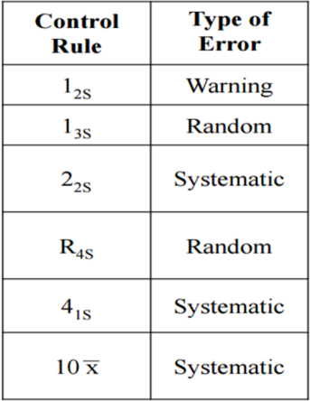
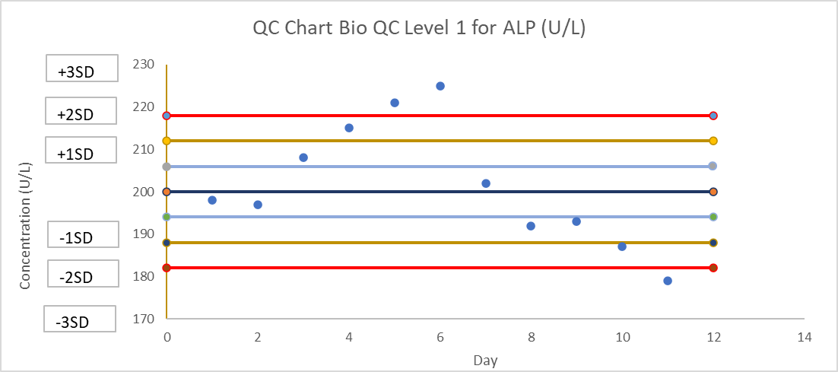
What control rule can detect?
Westgard Multirule
Multirule QC use combination of QC rules to determine your qc acceptable or not

Slide 20
Calculate the Mean and SD for AST for QC BIO1

Slide 21
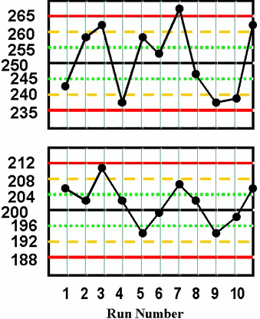
Case A- Part 1
Describe the daily QC based on Westgard multirules and decide if the QCs are acceptable or not
LDH QC Bio Level 1 (U/L)
Day | Bio L1 | Bio L2 | Comment
1
2
3
4
5
6
7
8
9
10
LDH QC Bio Level 2 (U/L)

Slide 22
The End
Good luck in post CME exams!

