Slide 1
Cytology (Non-gynae) Specimen Management
Prepared by :
Nazirah Noordin,
Employee No : 101109
Cytopathology Lab, SJMC.

Slide 2
Contents :
● Introduction
● Types of specimen fixation
● Reference guide for specimen fixation
● Common specimen rejection
● Summary

Slide 3
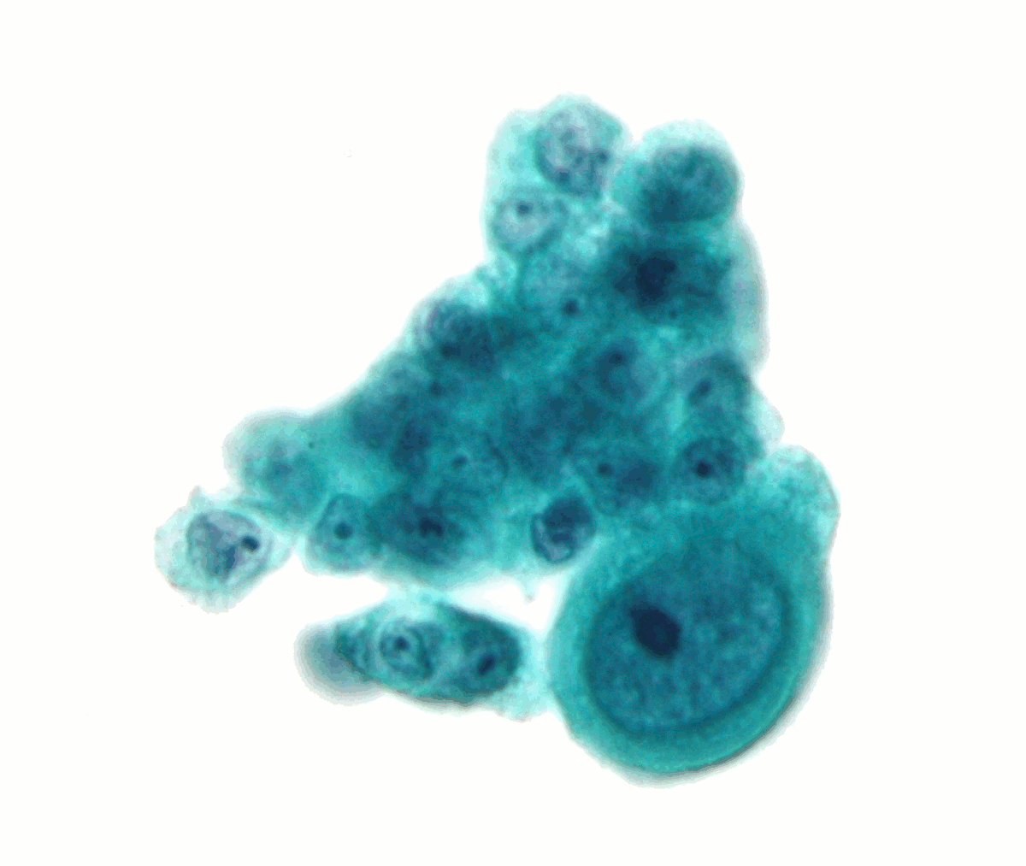
INTRODUCTION
What is Cytology?
Study of cells in terms of its structure and function.
What is Cytopathology?
Study of cells to determine a cause and nature of a disease.

Slide 4
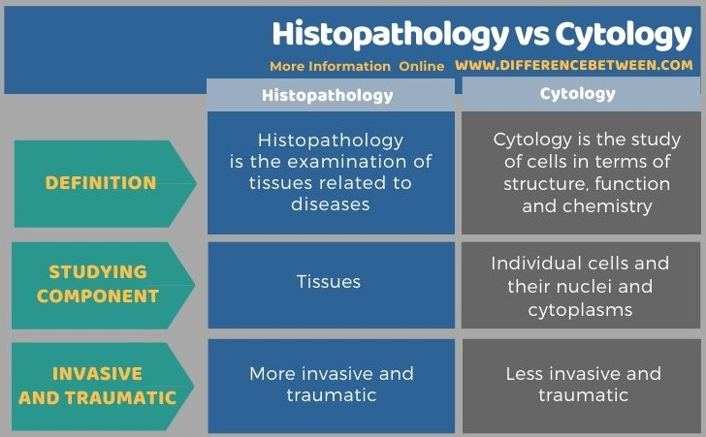

Slide 5
TYPES OF SPECIMEN FIXATION IN CYTOLOGY
● Rapid fixation of smears is necessary to preserve cytological detail. Any delays affect preservation of cells, which may result in miss diagnosis.
● Alcohol fixed smear / Cytospray:
- Immediate fixation is utmost important.
- A minimum fixation of 15 minutes in 95% alcohol.
● Air-dried smears
- Allow slides to completely dry for 15 minutes before placing in slide container.
● Cytolyt solution
A clear fixative fluid for the collection of fluid specimens or fine needle aspiration.

Slide 6
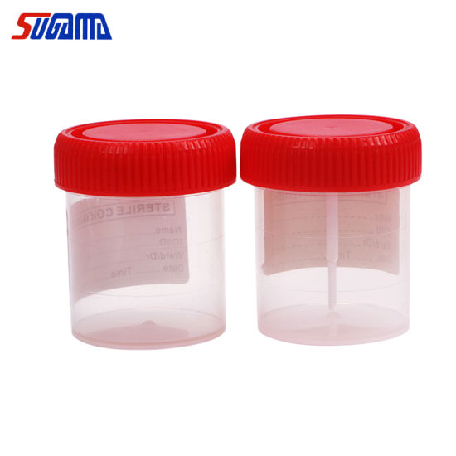
Reference guide for specimen fixation
LARGE VOLUME SPECIMENS
Type of samples : Abdominal and pelvic washings, Body cavity fluid (pleural / peritoneal), Urine, Bronchial washing, Gastric / Eosophangeal washing.
Put in sterile urine container
OR
Cytolyt solution
- Refrigerate (4-6° C)
- Send over using cooler bag/ice pack.
- Ratio : 1 to 1
- Room temperature

Slide 7
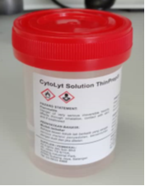
SMALL VOLUME SPECIMENS
Type of samples : FNA (eg: thyroid, breast, LN, parotid), Breast fluid, Cyst fluid, Synovial fluid.
Rinse in Cytolyt solution

Slide 8
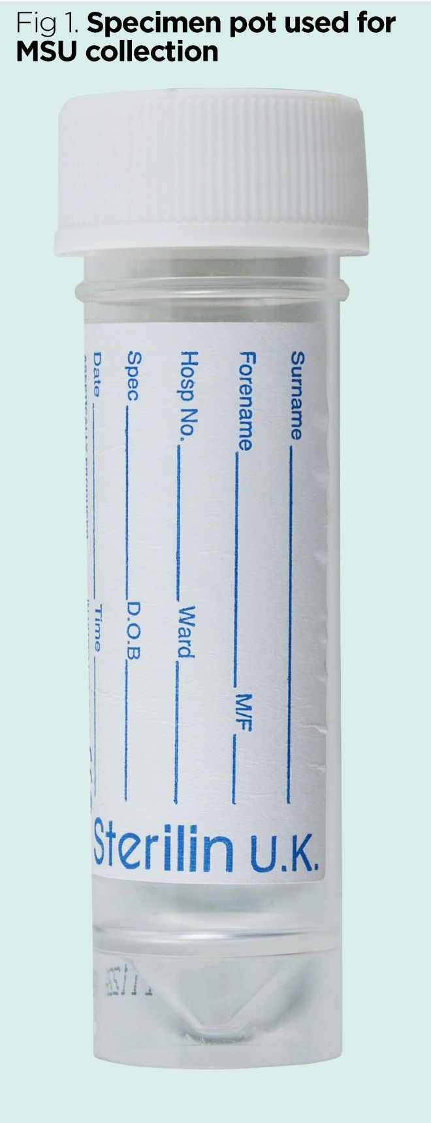
SMALL VOLUME CRITICAL SPECIMENS
Type of samples : CSF and eye discharge
Put in small sterile container ( at least 1ml of fluid)
Cytospin + cell block
- Refrigerate (4-6° C)
- Send over using cooler bag/ice pack.
Note : Since cellular deterioration for CSF is rapid, immediate transportation to the Lab is required.

Slide 9
DIRECT SMEARS
Type of samples : FNA (eg: thyroid, breast, LN, parotid), brushings, nipple discharge, vulva smears
95% alcohol : Slides should be immersed in the alcohol for a minimum of 15 minutes
Cytospray: Hold the bottle of spray 3-4 inches from the slide and disperse an even layer of fixative over the slide.
1.
OR
Air dry : Leave smears until completely dry before placing in slide holder
2.

Slide 10
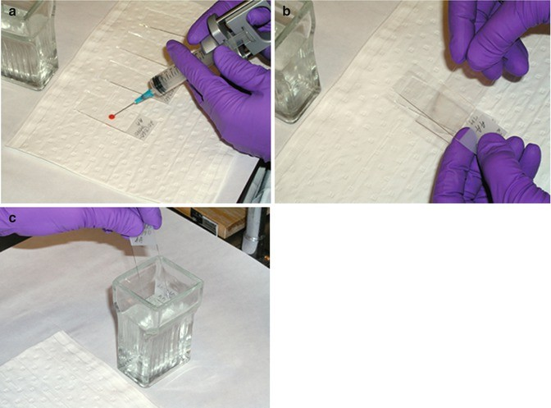
Fine Needle Aspiration (FNA) smearing technique
1) Put one drop of aspirated material on a slide.
2) Use another slide to
make a thin layer of smear.
3) Immediately fix slides in 95% alcohol.
4) Rinse the balance of aspirated material into Cytolyt.

Slide 11
SPECIMEN LABELLING
On slide, MUST LABEL:
Patient’s name
DOB / MRN
On slide holder / container, MUST LABEL:
Patient’s name
DOB / MRN
Collection date and time
3. Nature & Site (Right /Left) of specimen
4. Alcohol fixed / air dry (for slide container)

Slide 12
COMMON SPECIMEN REJECTION IN CYTOLOGY.
1. The sample and/or form are not properly labeled with following information :
- Nature & Site of specimen (Right or Left side, if any).
- Fixation method (alcohol fixed or air dry).
2. No clinical history provided on the form.
3. Specimen leaking.
Request order will NOT be processed until corrective action has been taken.
TAT for processing of orders that have been rejected will be delayed.

Slide 13

SUMMARY
● The importance of following correct protocols when handling or transporting medical specimens cannot be overstated.
● If the integrity of a specimen has been compromised during any phase— including collection, transport or receiving — the result will be compromised.
● Testing errors may lead to misdiagnosis, inappropriate treatment, patient injury or possibly death.
● Every attempt should be made to ensure patient specimens arrive for testing intact, at the correct temperature, with proper documentation in the shortest time possible.

Slide 14
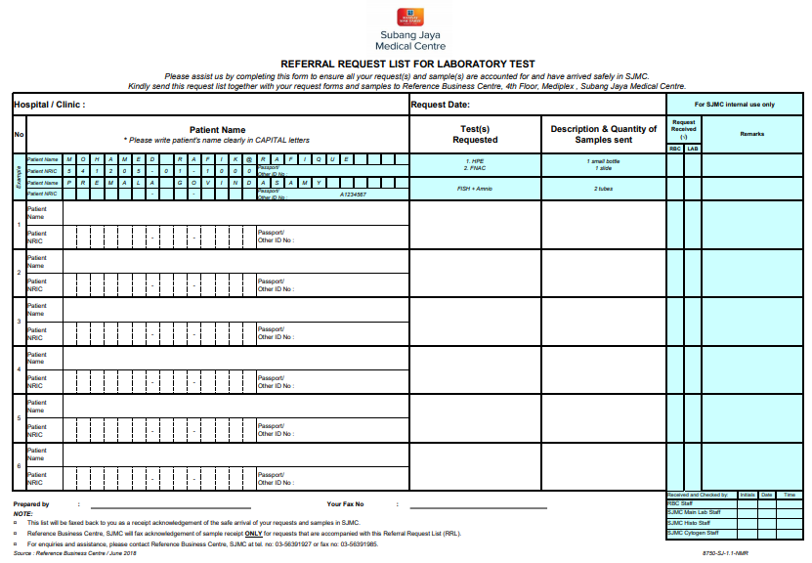
Referral Request List (RRL) for external clients need to be completed before sending to SJMC.

Slide 15
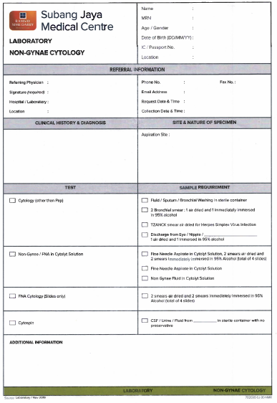
NON-GYNAE CYTOLOGY FORM
Site & Nature of Specimen MUST be tally with specimen bottle

