Slide 1
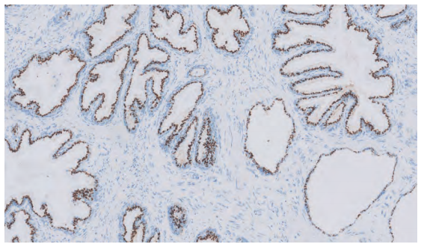
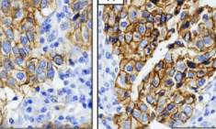
Role of control in ihc
Mariammah simmanchalam
103369
mls1

Slide 2
introduction
Immunohistochemistry is widely used in biomedical research to localize specific epitopes of molecules in cells and tissues.
The validity of interpretations based on immunohistochemistry requires appropriate positive and negative controls that are often not reported in publications.
This omission may lead to incorrect interpretations and irreproducible results in the literature and contribute to wasted time, effort, and resources as well as erosion of confidence in scientific investigation by the general public, legislative bodies and funding agencies.
Valid interpretation immunohistochemical assays cannot be made in the absence of minimally appropriate controls.

Slide 3
Why are controls used in histochemical?
To confirm that the observed staining pattern is true, accurate and reliable.
To support the validity of the staining pattern.
To exclude experimental artefacts.
To ensuring consistent performance as variation in experimental conditions
Controls are essential component of experimental design in all scientific investigations.

Slide 4
Antigen (tissue) controls
Positive control
Negative control
A section from a tissue known to express the protein of interest.
A positive result from the positive control, even if the samples are negative, will indicate that the procedure is working and optimized.
It will verify that any negative results are valid.
A section from a tissue known not to express the target antigen.
This is to check for non-specific signal and false positive results.

Slide 5
Antigen (tissue) controls continue…
Endogenous tissue background control
A section from the tissue before applying the primary antibody.
Certain tissues have inherent properties that result in background staining, which could affect the interpretation of results.
For example, certain tissues contain endogenous fluorescent molecules that could be confused for positive staining during fluorescent IHC.
The tissue should be checked under the microscope using either fluorescent or bright-field illumination (for fluorescent or chromogenic labels, respectively) to ensure that there is no endogenous background.

Slide 6
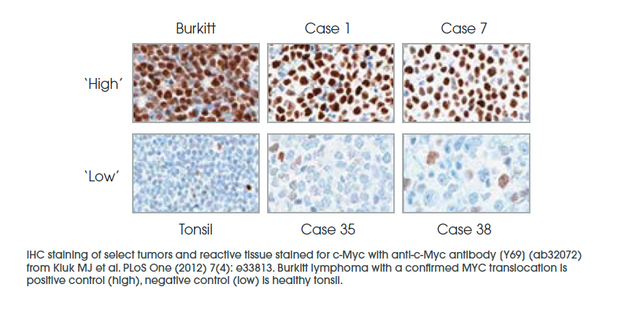
FIGURE 1

Slide 7
How to choose the perfect control for your immunohistochemistry
Controls constitute a ubiquitous part of a well-designed scientific experiment.
Selecting proper controls for immunohistochemistry (IHC) is essential to get reliable and reproducible results as a basis for good scientific practice.
Primary antibody controls intend to verify the specificity of the primary antibody binding to the antigen of interest
Controls for the primary antibody are applied to confirm the correctness of the preanalytical IHC phase related to sample preparation, such as fixation, post-fixation, storage, and processing
Primary antibody controls must be included for each new antibody, protocol, and application that you test.

Slide 8
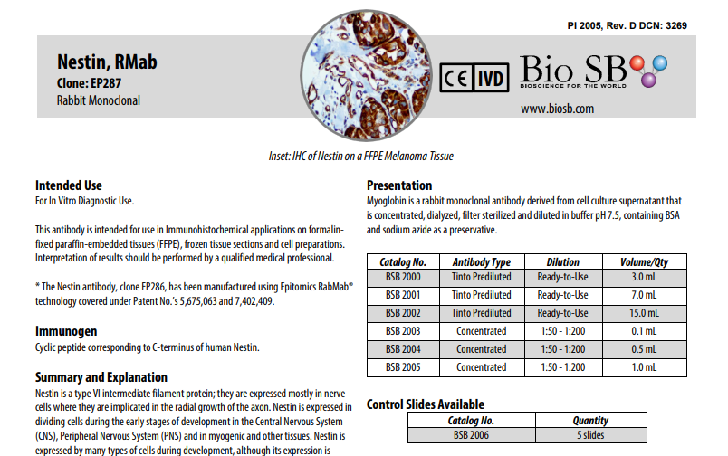
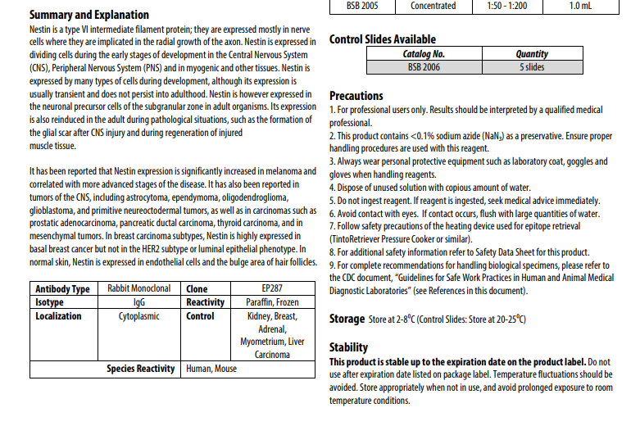
Package insert
FIGURE 2

Slide 9
proper control & validation
As per mention in the package insert, choose an appropriate control for the selected IHC.
Run a validation test on the selected control and antibody
Send the validation test slide to pathologist , get their approval.
Refer to the package insert.
Know the staining pattern of the selected control and antibody.
Repeat the validation with new control, if the previous one is not approved.

Slide 10
Staining pattern in ihc control
Immunohistochemistry is an efficient and accurate method of detecting subcellular localization of a protein.
Subcellular localization refers to the presence site of a protein in the cell, for example, in the nucleus, cytoplasm or cell membrane

Slide 11
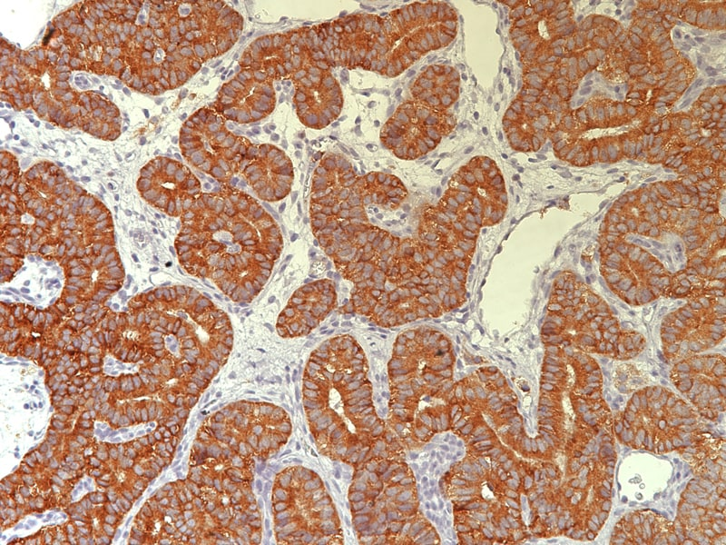
CYTOPLASMIC STAINING
If a protein locates in the cytoplasm, the cytoplasm will be stained, while other locations will not be stained.
Figure 3 : Cytoplasmic staining pattern (inhibin):
stain is diffuse within cytoplasm

Slide 12
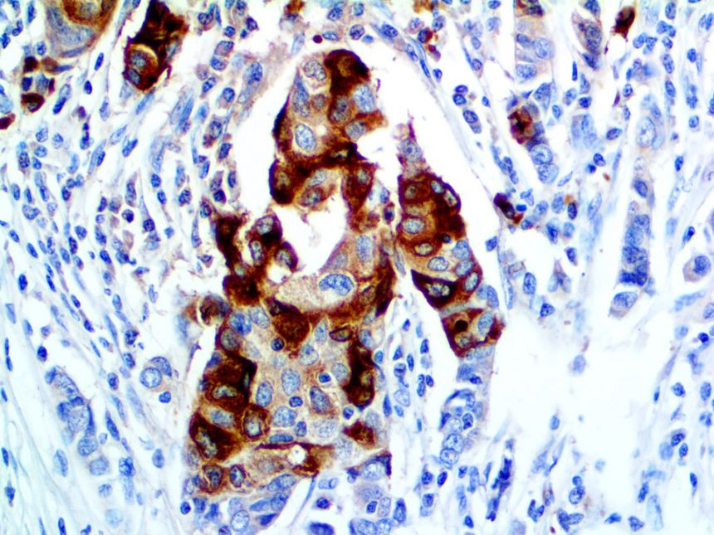
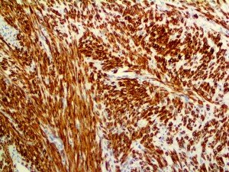
Examples of cytoplasmic staining
Figure 4 : Cytoplasmic staining pattern (mammaglobin)
Figure 5 : Cytoplasmic staining pattern (desmin)

Slide 13
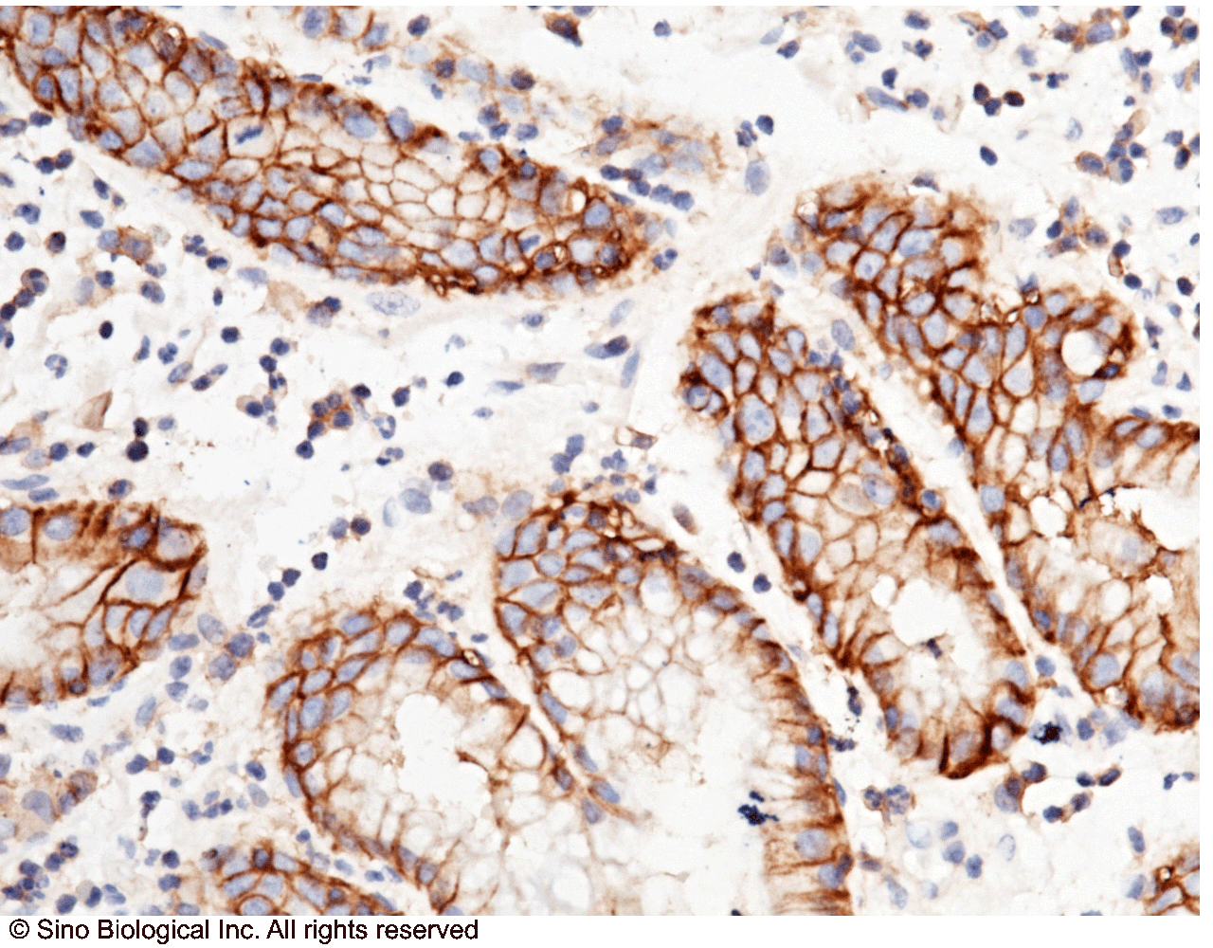
Membranous staining
If a protein locates in the cell membrane, the membrane will be stained, while other locations will not be stained
Figure 6 : Immunochemical staining of human CD147 in human gastric cancer with mouse monoclonal antibody (1:100, formalin-fixed paraffin embedded sections). The image showing membrane staining of epithelium cell.

Slide 14
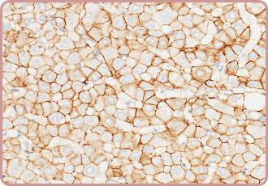
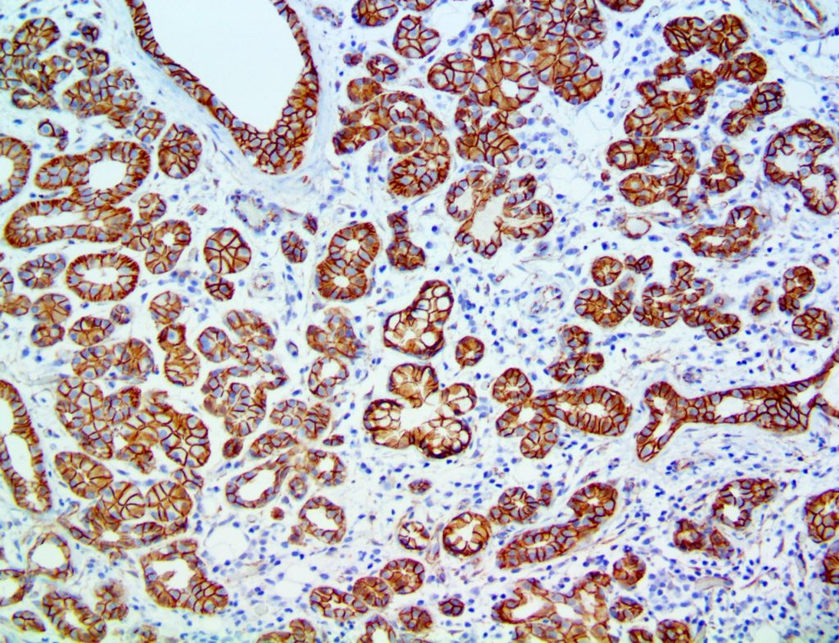
Examples of membranous staining
Figure 7 : Immunochemical staining of human E-cad in human liver with rabbit polyclonal antibody (1 µg/mL, formalin-fixed paraffin embedded sections).The image showing cytomembrane staining.
Figure 8 : Immunochemical staining of human Beta catenin in salivary gland tissue. The image showing cytomembrane staining.

Slide 15
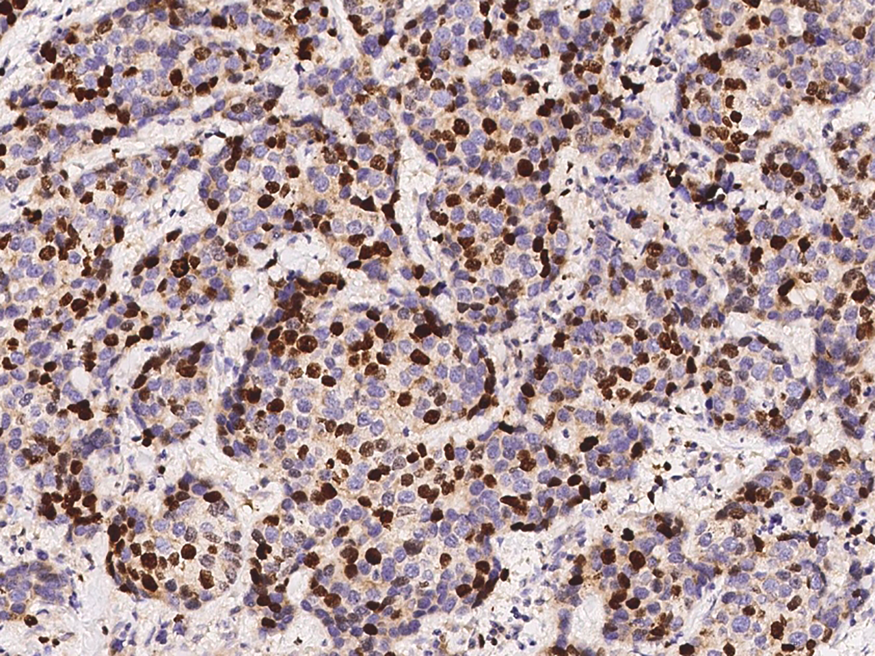
Nuclear staining
If a protein locates in the nucleus, the nucleus will be stained, while other locations will not be stained
Figure 9: Immunochemical staining of human KI-67 in human breast carcinoma with mouse monoclonal antibody

Slide 16
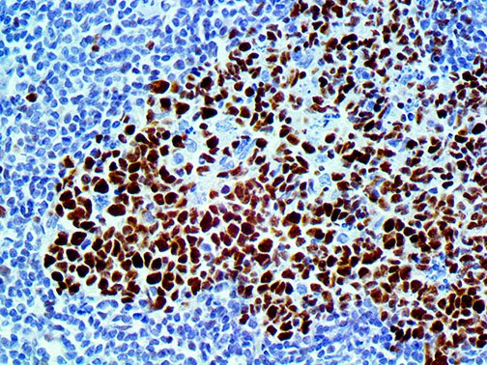
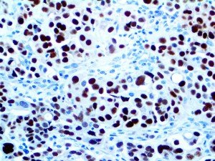
Examples of nuclear staining
Figure 11: Immunochemical staining of human Pax 8 in human ovarian carcinoma with rabbit monoclonal antibody
Figure 10: Immunochemical staining of human BCL 6 in human tonsil with mouse monoclonal antibody

Slide 17
Control selection
Refer package insert
Always try to find control from a normal tissue instead of carcinoma tissues that are tested positive for IHC,
Make sure the tissues are fully fixed
Avoid taking necrotic or calcified tissue as control
Avoid taking over fixed tissue

Slide 18
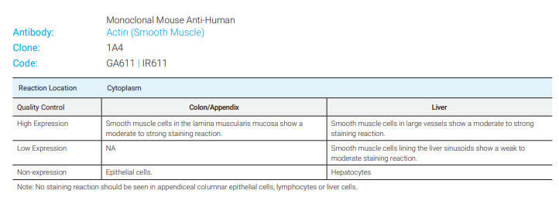
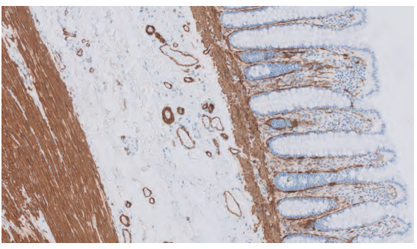
Basic control used in sjmc histopathology lab
Colon 20X

Slide 19
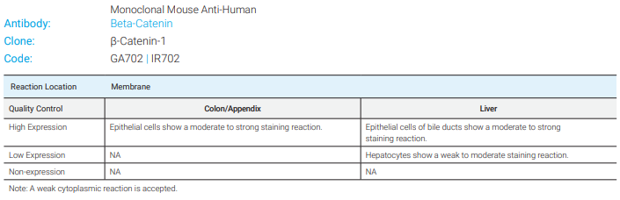
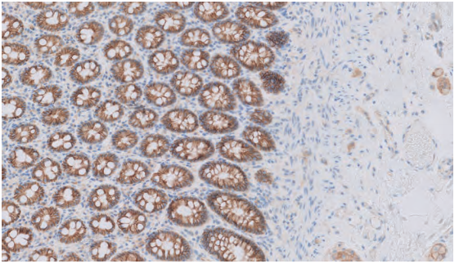
Basic control used in sjmc histopathology lab
Colon 10X

Slide 20
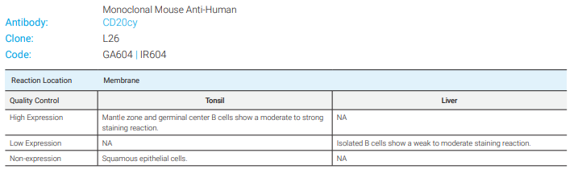
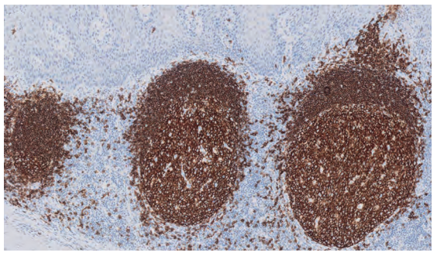
Basic control used in sjmc histopathology lab
Tonsil 10X

Slide 21
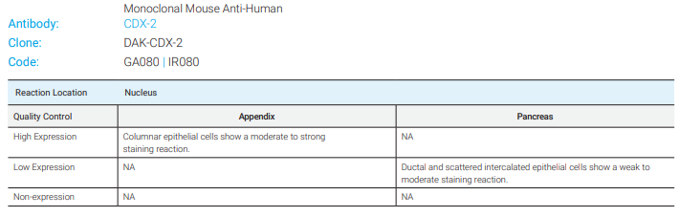
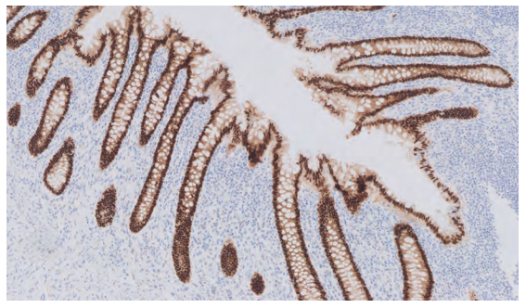
Basic control used in sjmc histopathology lab
Appendix 10X

Slide 22
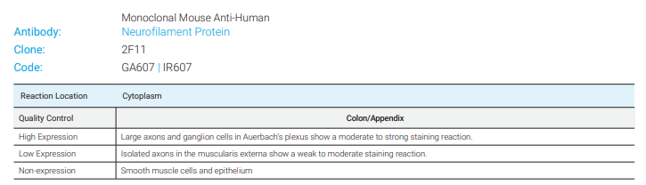
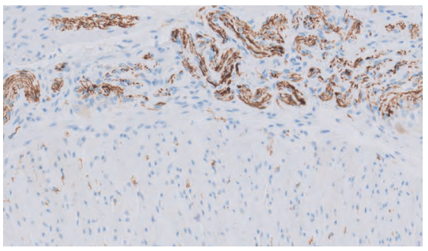
Basic control used in sjmc histopathology lab
Colon 10X

Slide 23
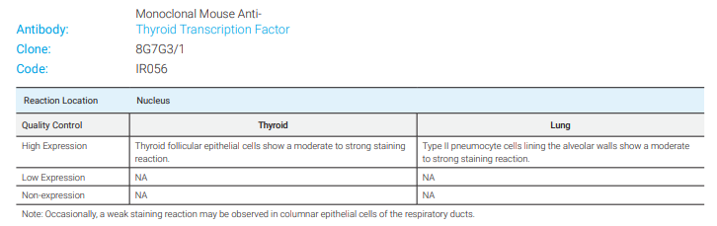
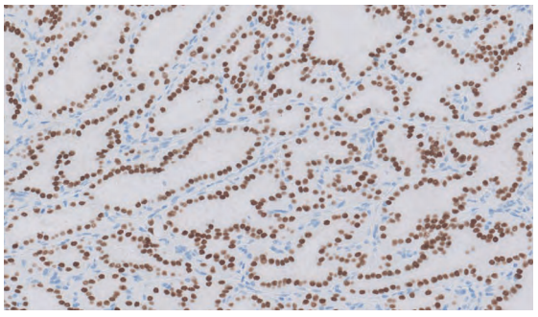
Basic control used in sjmc histopathology lab
Thyroid 20X

Slide 24
Question 1
Which of the following are true about antigen control?
Positive control verifies any negative results invalid
Positive results from positive control indicates that the procedure is optimized
Endogenous fluorescent molecules gives a positive staining
Negative control is used to check nonspecific signal and false positive results
I and II only
II and IV only
I , II and IV only
None of the above
ANSWER : B

Slide 25
QUESTION 2
Controls are used in immunohistochemistry for
To confirm the stain procedure is valid
To exclude cellular artefact
To ease the diagnosis
To increase the endogenous background
ANSWER : A

Slide 26
Question 3
Subcellular localization refers to presence site of a protein a cell which is/are
Golgi apparatus
Microorganism
Nucleus
Membranous
I and II only
II , III and IV only
I , III and IV only
III and IV only
ANSWER : D

Slide 27
Question 4
In order to choose a proper control, a technician must
Review the package insert
Review the SDS
Run a validation on the antibody only
Run a validation on the selected antibody and its IHC
I and II only
II and III only
I and IV only
I , II and IV only
ANSWER : C

Slide 28
Question 5
When an antibody stains the rim of the cell membrane, it is known as
Subcellular staining
Cytoplasmic staining
Golgi apparatus staining
Membranous staining
ANSWER : D

Slide 29
Question 6
The image on the left shows a staining pattern. Which of the statement is true about the staining?
Known as membranous staining
Stains diffusely in the cytoplasm
Known as cytoplasmic staining
Doesn’t stain any other area except membranes
I and II only
I, II and IV only
II and III only
I and IV only
ANSWER : C

Slide 30
Question 7
A good selection of control includes
Decalcified positively stained bone tumor tissues
Tumor necrotic area of a tissue
Brittle tissue
Fully formalin fixed tissue
ANSWER : D

Slide 31
Question 8
Given below are the possible controls that will stain Actin (smooth muscle) except;
Colon
Appendix
Breast
Liver
ANSWER : C

Slide 32
Question 9
Given below are the possible controls that will stain thyroid transcription factor () except;
Thyroid
Lung
Breast
Liver
I and II only
II and III only
I only
I , II and IV only
ANSWER : A

Slide 33
Question 10
Large axons and ganglion cells in Auerbach’s plexus show a moderate to strong staining reaction. This statement refers to
CDX-2 marker
Cd20y marker
Neurofilament protein
Beta catenin
ANSWER : C

Slide 34
Thank you
Presented by mariammah simmanchalam
103369 (mls 1)

