Slide 5
Cryostat

Slide 6
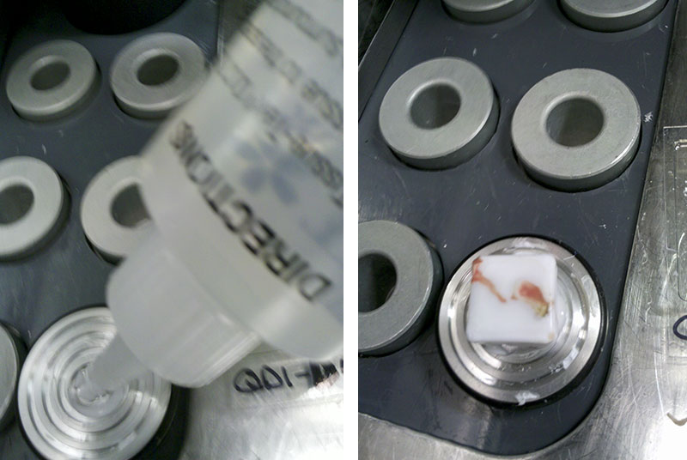
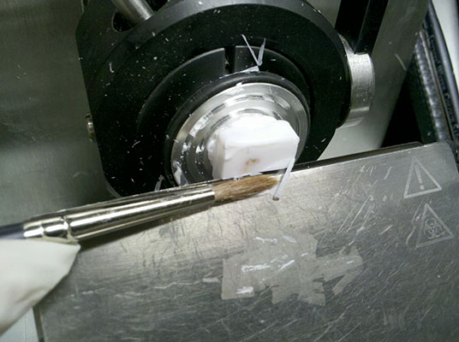
Sectioning (done in cryostat) Once it froze,the tissue part is place onto a ‘chuck’ and fix it at chuck holder, to do 4 sections at 4 micron thickness. 1) 2) 3) 4)

