Slide 1
EUCAST and CLSI
05/12/2016

Slide 2
Website: www.eucast.org

Slide 3
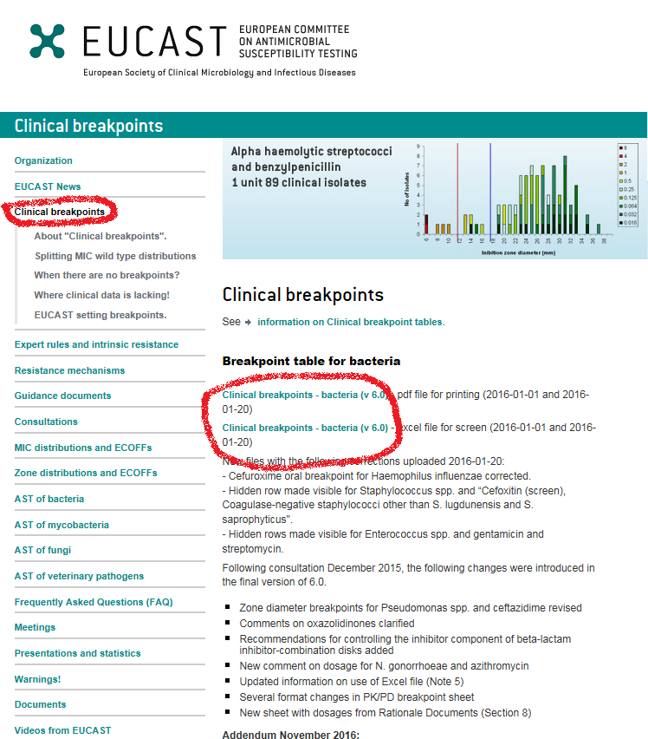

Slide 4
EUCAST
Formed in 1996 and revamped in 2001
EUCAST Laboratory Network
National Antimicrobial Susceptibilty Testing Committees (NACs)
Clinical Breakpoints and Epidemiological Cut Off (ECOFF)
Epidemiological Cut Off (ECOFF) use
As a tool in the determination of clinical breakpoint
For sensitive detection of resistance
For surveillance of Antimicrobial resistance
Clinical breakpoints
S ≤ Y mg/L
R > Y mg/L
Note:
“-” DO NOT TEST
“IE” Insufficient evidence

Slide 5
EUCAST
Tools for determining breakpoints
Dose & mode of administration
Clinical targets
Target organisms
MIC distributions of target organisms
Resistance mechanisms of clinical importance in target organism
Pharmacokinetics of agent in target
Pharmacodynamics of agent in relation to target organism
Clinical outcome data for target infection

Slide 6
EUCAST
Susceptible (S)
a micro-organism is defined as susceptible by a level of antimicrobial activity associated with a high likelihood of therapeutic success
Intermediate (I)
a micro-organism is defined as intermediate by a level of antimicrobial agent activity associated with uncertain therapeutic effect.
Resistant (R)
·a micro-organism is defined as resistant by a level of antimicrobial activity associated with a high likelihood of therapeutic failure.

Slide 7
EUCAST
Breakpoints are determined by
Medicines agents
Committees (ESCMID & ECDC)
Bacteria without breakpoints
Aerococcus species (A. sanguinicola and urinae) in consultation for Version 7 2017
Kingella kingae – in consultation for Version 7 2017
Mycobacterium tuberculosis
Actinomyces
Nocardia
Antibiotics without breakpoints
Spiramycin
Josamycin
Cefoperozone-sulbactam

Slide 8
EUCAST VS CLSI
EUCAST | CLSI
Can ask for breakpoints
Antibiotics Cefazolin – NO Cefalexin – Yes for UTI | Antibiotics: Cefazolin - Yes for UTI only Cefalexin – NO
Disk strength: Ampicillin 2µg Aug 2-1µg Piptaz 30-6µg Ceftriaxone 5µg Ceftazidime 10µg Nit 100µg E. faecalis | Disk strength: Ampicillin10µg Aug 20-10µg Piptaz 100-10µg Ceftriaxone 30µg Ceftazidime 30µg Nit 300µg E. faecium
MIC testing: Fixed concentration of 2 mg/L | MIC testing: 2:1 ratio
Breakpoints: MIC: S ≤ 1mg/L, R >2mg/L Zone: S ≥ 21mm, R < 18mm Generally higher to avoid wild types | Breakpoints: MIC: S ≤ 1mg/L, R >4mg/L Zone: S ≥ 21mm, R ≤ 18mm

Slide 9
EUCAST VS CLSI
EUCAST | CLSI
Media: MH agar – Enterobactericeae, Pseud, Staph & Enterococcus MH-F agar – Fastidious organism | Media: MH agar MH with SB
Incubation Time: 16-20 hrs @ 35±1˚C for all organisms MH in O2 MH-F in CO2 | Incubation Time: 16-18 hrs or 20-24 hrs MH in O2 MH-SB in CO2
QC strains: Different | QC strains: Different
Use “QC tables” on website to compare between EUCAST and CLSI

Slide 10
EUCAST
The 15-15-15 rule
Use inoculum within 15 mins, apply disks within 15 mins, incubate within 15 mins.
Always complete within 60 mins.
Reading zones
MH agar – read zones from back of plate against dark background with illuminated light
MH-F – read zones by removing lid and read from front of plate
Read with unaided eye held at 30cm from eye

Slide 11
Enterococcus
Enterococcus & Vancomycin
Examine with plate held up to light
Fuzzy zone = Report Vanc as Resistant
If fuzzy zone and ≥ 12mm zone size = may need to investigate further
Enterococcus in urine:
E. faecalis – Nitrofurantoin 100µg
E. faecium – Nitrofurantoin 300µg

Slide 12
Enterobacteriaceae
Enterobacteriaceae and Fosfomycin
Fosfomycin is only validated for E. coli
Ignore isolated colonies within the inhibition zone and read the outer zone edge

Slide 13
Proteus species
Ignore swarming when reading inhibition zone diameters

Slide 14
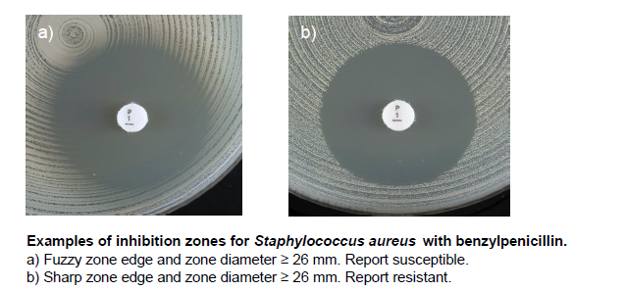
Staphylococcus aureus
S. aureus & Benzylpenicillin
Examine with plate held up to light
Fuzzy edge zone ≥ 26mm = Susceptible
Sharp edge zone ≥ 26mm = Resistant

Slide 15
Stenotrophomonas maltophilia
S. maltophilia & Cotrimoxazole
Ignore growth within the zone
S ≥ 16mm
R = no sign of inhibition
**These are for when zone sizes are greater than the Breakpoints**

Slide 16
Streptococcus species
For haemolytic organisms, read inhibition of growth and NOT inhibition of haemolysis
Β-haemolysis is usually free from growth whereas there is often growth within areas of α-haemolysis
To better differentiate between haemolysis and growth, tilt the plate back and forth and measure the zone diameters

Slide 17
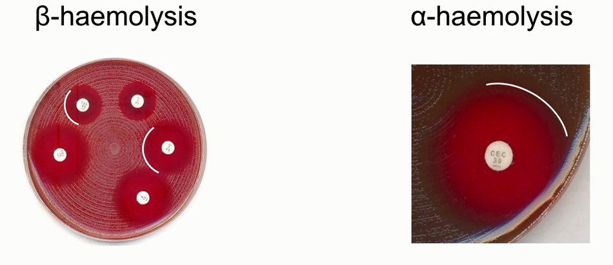

Slide 18
Bacteriostatic
EUCAST: Read inhibition zone where NO growth occurs or as per guidelines
CLSI: Read inhibition zone at 80% of growth

Slide 19
Kestral
There will be a few antibiotics disc with different concentrations. E.g.
Pen1 and Pen10
Amp2 and Amp10
Aug3 and Aug30
Nit100 and Nit300
Be careful when reading
Always extrapolate when there is a number at the end of the antibiotic name.
Don’t release the ones with the numbers at the end.

