Slide 1
Advanced Beneficiary Notice (ABN)
Billing, Collectors, Sales, Accessioning, and Client Services

Slide 2
What is an ABN?
An ABN, form CMS-R 131, is a written notice that must be issued to a Medicare Patient BEFORE providing certain items or services.
ABNs are also generated in COPIA for all Self-Pay patients BEFORE providing any services.

Slide 3
When are ABNs generated?
When services provided may not be reimbursed by Medicare
A service is requested more than the number of services that Medicare allows in a specific period
Tests have a diagnosis code that may not allow for a reimbursement
If the provider believes that Medicare will not pay for some or all the items or services
Not considered safe or effective
When a patient is Self-Pay

Slide 4
What does an ABN from COPIA look like?

Slide 5
Why do we care about ABNs?
REIMBURSEMENT!!!!!!!!!!!!!!!!!!!!!!
Accepting Medicare means, we acknowledge ABN’s must be filled out
What happens if ABNs are not completed?
We can’t bill Medicare
We can’t bill the patient
We lose money!

Slide 6
What are the Benefits of an ABN?
Protects the patient from unexpected financial liability in cases where Medicare denies payment
The ABN serves as proof that the patient knew prior to getting a service that Medicare might not pay
The ABN helps the patient make an informed decision about services
The ABN allows the claim reviewed by Medicare and if payment is denied the patient is liable for the payment and protects the provider or supplier from liability

Slide 7
Process for ABNs
When a patient is registered, an ABN will be generated by COPIA
Items must be clearly written or printed
MUST be signed PRIOR to any provided service or procedure
If the ABN is not signed, we cannot bill the patient and it will have to be written off if denied by Medicare
The patient must receive a hard copy and the provider must retain the original

Slide 8
Options Patient Can Choose From
Option 1. I want the laboratory tests listed above. You may ask to be paid now, but I also want Medicare billed for an official decision on payment, which is sent to me on a Medicare Summary Notice (MSN). I understand that if Medicare doesn’t pay, I am responsible for payment, but I can appeal to Medicare by following the directions on the MSN. If Medicare does pay, you will refund any payments I made you, less co-pays or deductibles. (applies to self-pay and Medicare)
Option 2. I want the laboratory tests listed above, but do not bill Medicare you may ask to be paid now as I am responsible for payment. I cannot appeal if Medicare is not billed. (applies only to Medicare)
Option 3. I don’t want the laboratory tests listed above. I understand with this choice I am not responsible for payment, and I cannot appeal to see if Medicare would pay. (applies to self-pay and Medicare)

Slide 9
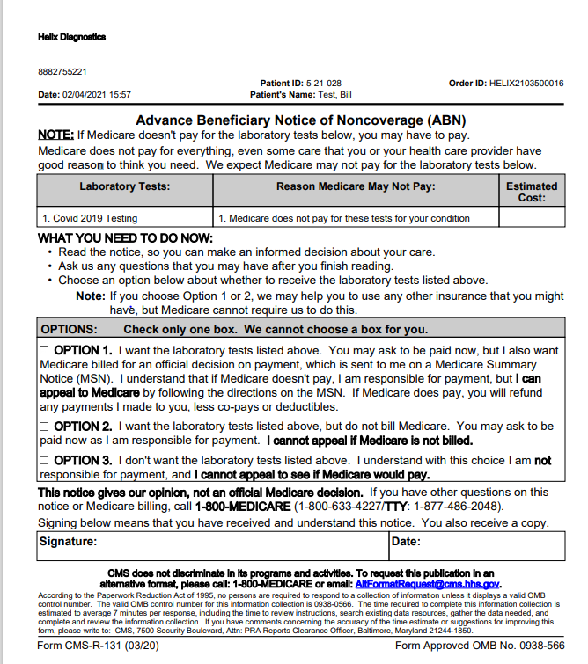
Proper ABN Completion
B
A
C
Mandatory fields
Clinic name
Patient name
Identification number
Service
Reason Medicare may not pay
Estimated Cost
One Option chosen
Patient or representative signature
Date of signature
D
F
E
E
G
H
I

Slide 10
Who may sign an ABN?
The patient
An authorized representative
Must be a legally appointed representative
Examples
Foster parent
Medical Power of attorney
Legal Guardian

Slide 11
Scripting Scenario 1:
Mrs. Test has an order from Dr. Hello for a COVID PCR test with a diagnosis code that will not allow Medicare to cover the testing.
Mrs. Test, as Dr. Hello mentioned, we have reason to believe that Medicare will not pay for the COVID19 testing due to the diagnosis code provided. You have a few options. You can choose to have us bill Medicare and assume any left over costs, Ask your provider to give us a new order with a better suited diagnosis code or you can refuse the testing. This form is your acknowledgement that you understand what we’ve just reviewed and that you are electing to continue with the service. (The last sentence can be changed depending on the option the patient chooses.

Slide 12
Scripting Scenario 2:
Mr. Jones has an order for a CBC and Prostate Screen for the third time this year.
Mr. Jones, Medicare has generated a notification that they may not be willing to cover a third PSA for this calendar year, but your CBC should be covered. You can elect to have the testing done and assume any extra cost, elect to have only the CBC done as that is covered, you can pay out of pocket for all the testing, or your can decline all testing. Please be advised choosing the first option will mean they expect you to cover the cost of your adjustments. Please make your selection and sign at the bottom.

Slide 13
Scripting Scenario 3:
Ms. Bob’s doctor has ordered a COVID-19 test. Ms. Bob would like to pay for this test out of pocket.
Ms. Bob, I understand you would like to be self-pay for your COVID-19 testing. I need to have you sign an Advanced Beneficiary Notice to acknowledge that we are not billing an insurance for this test and you will be assuming the full cost of the service. If you chose to accept this, please check option 1 and sign at the bottom. If you would like to decline the testing, please chose option 2 and sign at the bottom.

Slide 14
Notes to remember
Must be filled BEFORE the service is given
If not filled out, we cannot bill for the services should Medicare not pay the full amount
Must have only one of the choices selected
Billing clinic, Name, ID number, Services, Estimated Cost, Reason testing may not be covered, Signature, and Date
Patient receives a copy, and the provider of services will keep the original
ABNs are MANDATORY

Slide 15
Resources
https://www.cms.gov/Medicare/Medicare-General-Information/BNI/ABN
https://www.cms.gov/Outreach-and-Education/Medicare-Learning-Network-MLN/MLNProducts/ABN-Tutorial/formCMSR131tutorial111915f.html
https://www.cms.gov/Regulations-and-Guidance/Guidance/Manuals/Downloads/clm104c30.pdf

