Slide 1
Creating a Manifest and Collection List

Slide 2
Manifest List vs. Collection List
Manifest List
Collection List
- A Manifest allows a group of samples to be tracked together to the testing location with one tracking ID and information.
A Collection List can be used to keep track of your orders.(ex.Draw Log) This is not required but is a helpful tool for your office.

Slide 3
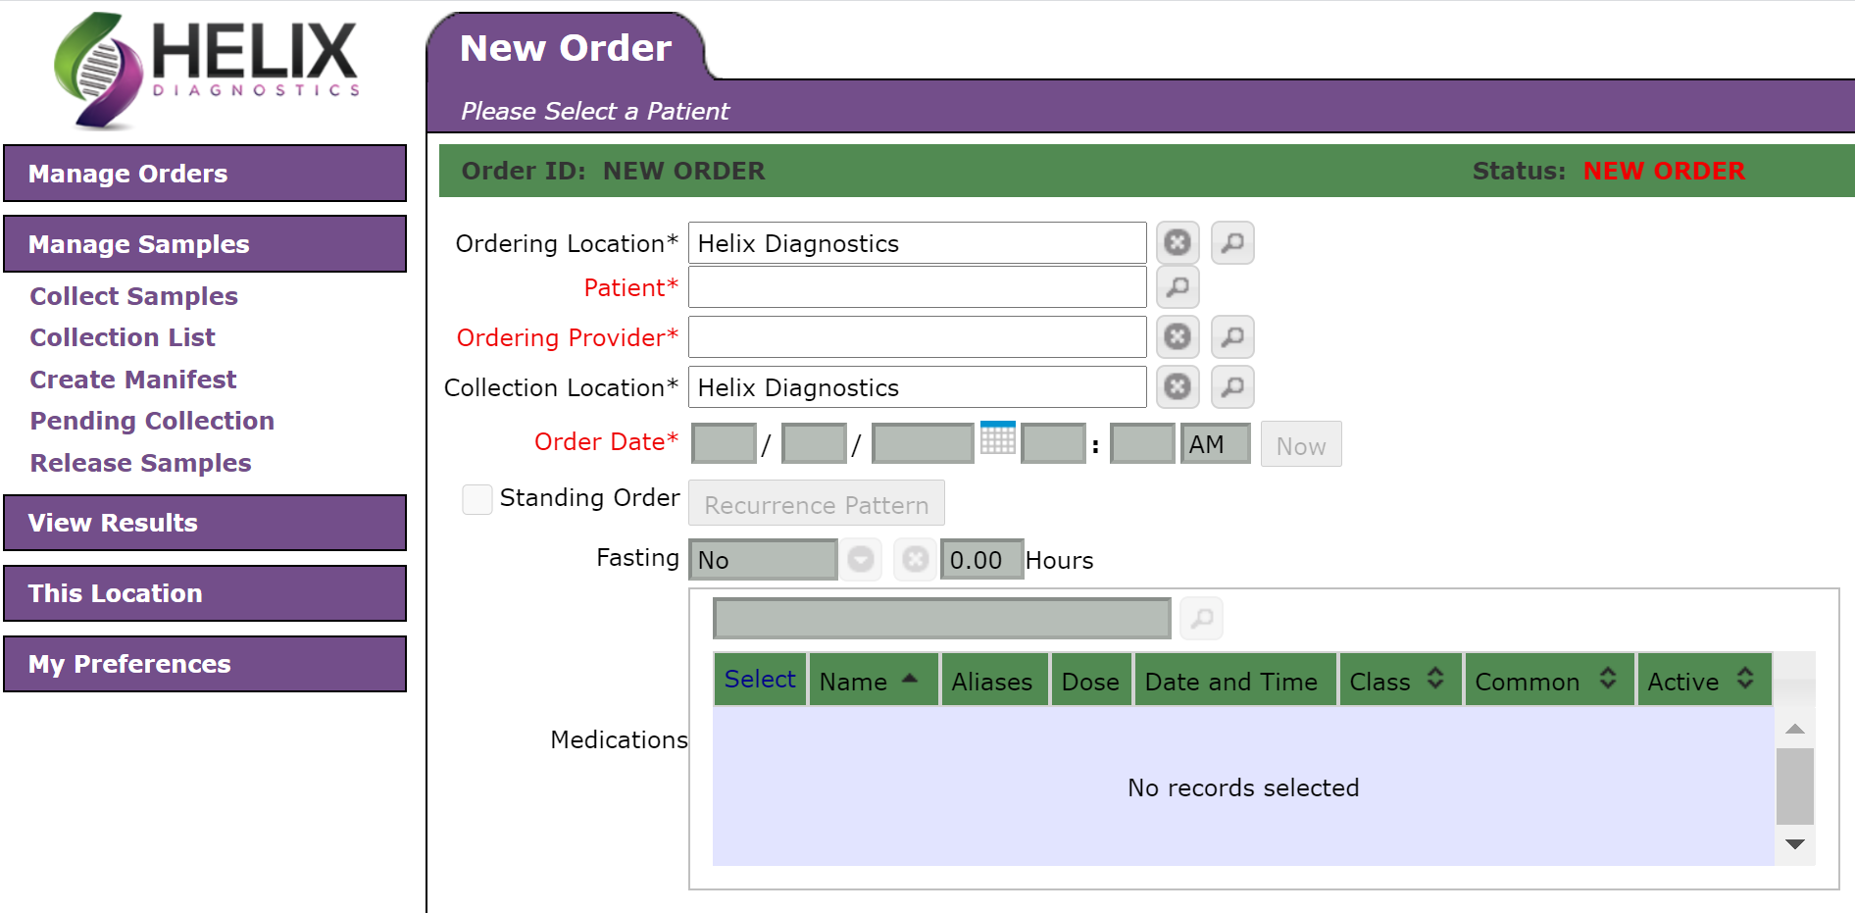
Creating a Manifest List
You must choose the lab before creating the manifest.

Slide 4
Select the samples that are being packaged for delivery or shipping to the laboratory. Then select “CREATE MANIFEST.”
This form can be printed and packed with the samples for pick – up by courier or when being shipped.

Slide 5
You can print the manifest at this screen. Click “Print Manifest.” When done click “Review Manifest” and it will take you back to the Create Manifest Screen where you can review the manifest created or view other manifest.
To view your manifest or other manifests click on “View Existing Manifests.” You can review and reprint manifests.

Slide 6
Creating a Collection List
A Collection List can be used to keep track of your orders.(ex.Draw Log) This is not required but is a helpful tool for your office. Click “Collection List” under Manage Samples. Choose your location and select a date range.
Scroll down to the bottom of the page and select the orders for that date and then click “Create Collection List.”

Slide 7
Example of a Collection List - This list can be printed. Click back to collection list to get out of this screen.

