Slide 1
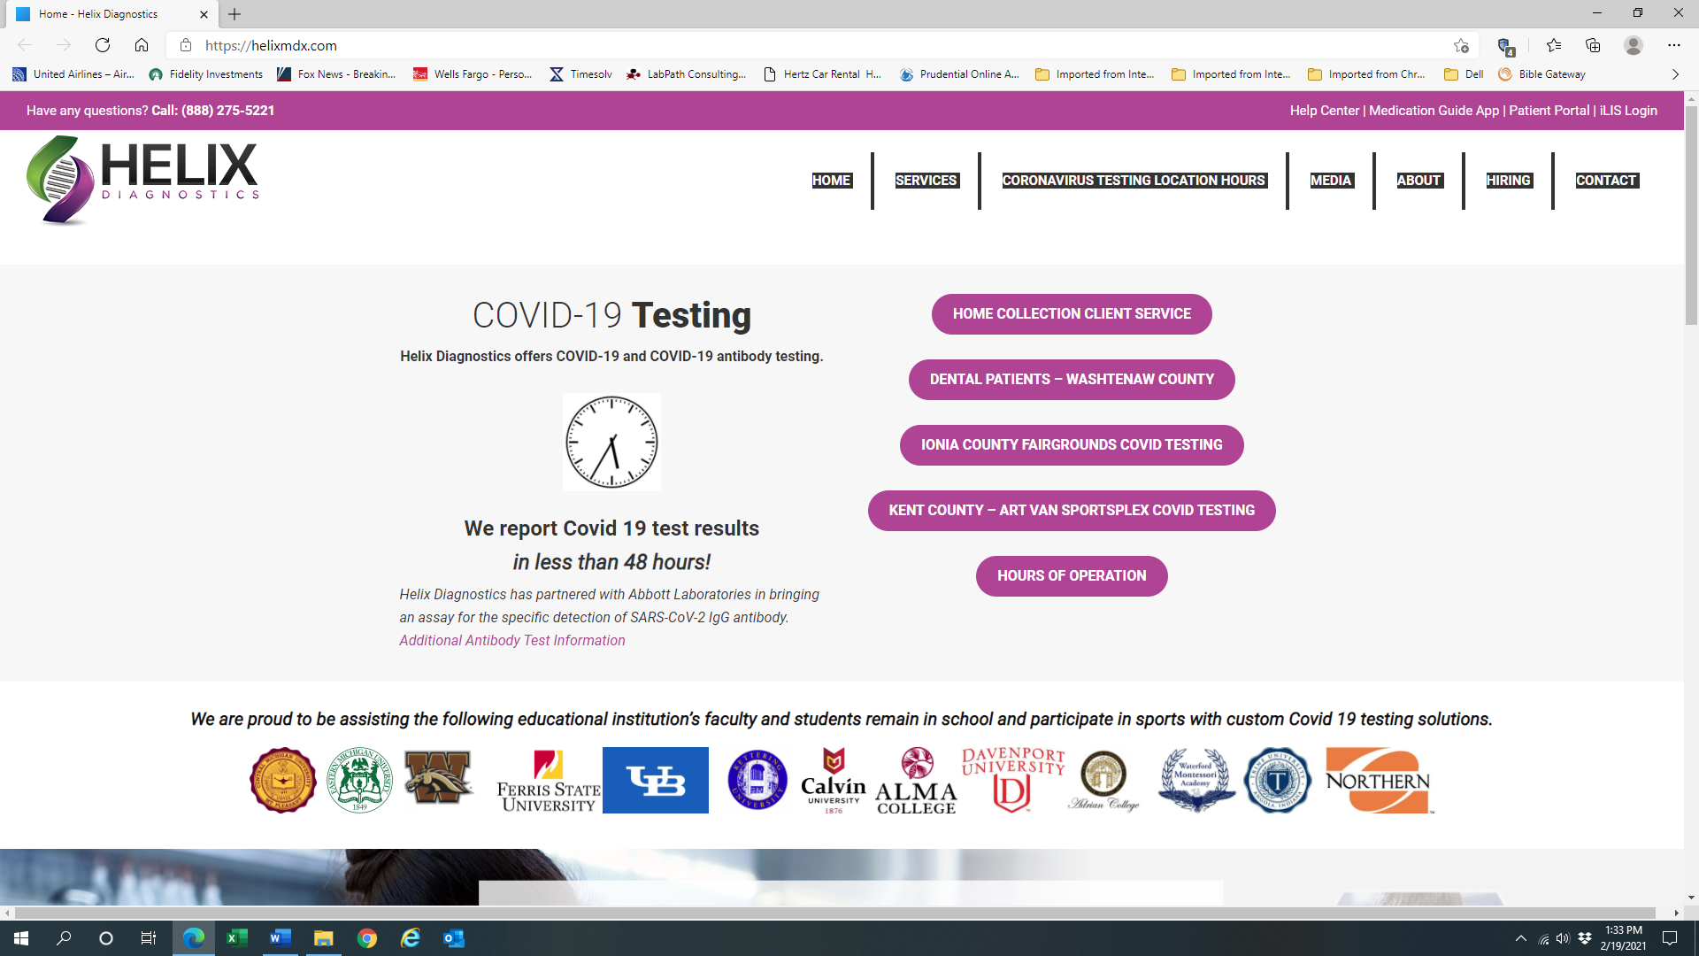
In-Office Collector Compliance Training
January 2023

Slide 2

Welcome
Executive Leadership Message
Helix Diagnostics (“the Company”) is committed to provide quality clinical laboratory services to its customers, while observing the highest standards of legal and business ethics, in growing a successful business.
The purpose of our Compliance Program is to (a) provide a framework for conducting acceptable business practices in an honest and ethical manner, in conformance with the laws, rules, and regulations that govern the laboratory industry and (b) serve as the foundation for establishing a culture within the Company that promotes service excellence and the prevention, detection, and resolution of unlawful or improper conduct.
There is ZERO tolerance for non-compliant activities.
Jim Grossi, Owner

Slide 3
Purpose
To detail your responsibility as an employee of Helix Diagnostics to comply with all applicable Federal, State and Company policies pertaining to In-Office Laboratory Collections.
To provide the applicable Laws that govern the placement of In-Office Laboratory staff and describe what “CAN” and “CANNOT” be performed as an employee of Helix Diagnostics
To define the process for placing an In-Office Collector and stress the importance of proper placement processes and monitoring.

Slide 4

Federal Anti-Kickback Statute (AKS)
Penalizes “anyone” (physician, laboratory representative, sales representative, etc.) who knowingly and willfully solicits, receives, offers or pays remuneration in cash or in kind to induce the referral of an individual for testing of diagnostic services, which is payable under the Medicare or Medicaid program.
  Cash kickbacks, bribes, or rebates
  Free laboratory testing
  Waiver of co-pays
  Space rental agreements
  Free computer equipment
  Free general use supplies
  Free non-laboratory pickups
  Business purchase or lease arrangements
Penalty
The AKS is a criminal statute and the penalties for violations of the law can be severe. They include fines of up to $25,000 per violation, felony conviction punishable by imprisonment up to five years, or both, as well as possible exclusion from participation in Federal Healthcare Programs.
Penalties apply equally to the service provider and referring practitioner
Pay Here
B. Braun 2011 Compliance Video
https://www.youtube.com/watch?v=cjvPfBNHNNU

Slide 5
“Stark Anti-Self Referral Law”
Financial Relationship
Prohibits a physician from referring a Medicare or Medicaid patient to a clinical laboratory with which the physician or an immediate family member has an inappropriate “financial relationship” with.
Stark defines a “financial relationship” as either
  An ownership/investment interest relationship through equity, debt or other means or a compensation relationship.
  A focus compensation arrangement with anything of value (cash, goods, or services) being exchanged between a physician (or an immediate family member of the physician) and a provider of laboratory healthcare services.
Severe Penalties Include:
Refund of monies received, civil penalties of up to $15,000 for each service, and three times the amount of improper payment the entity received from the Medicare program;
Exclusion from Medicare and/or state healthcare programs including Medicaid;
Payment of civil penalties for attempting to circumvent the law of up to $100,000 for each circumvention scheme.

Slide 6
2014 Fraud Alert
In 2014, the Office of Inspector General (OIG), issued a special advisory opinion that described 2 trends they believed, presented a substantial risk of fraud and abuse under the Anti-Kickback Statute.
They recommended specific agreements be drafted that detail exact duties that will be performed by Collectors placed in physician offices.
Both the Collector and the Physician responsible for the practice sign these agreements and the activities of the Collector are monitored periodically for compliance.
Any deviation in duties from the agreement CAN put both the Laboratory and the Physician practice at risk for violating the Anti-Kickback Statute and fines can be levied.

Slide 7
Process
Helix Diagnostics obtains a signed Technical Service Agreement (TSA) with the physician practice as well as a signed Phlebotomist/Collector Agreement & Provider Agreement.
All details of the duties to be performed by the Collector are discussed PRIOR to placement of the Collector at the site.
No Collector should be placed in the practice until all required agreements are signed.

Slide 8
Process - Ordering
Collector is expected to submit all samples with a complete order from the provider, including desired test(s), diagnosis codes (from the provider), demographics, and insurance information.
All orders submitted should also include the ID Number for the Collector that performed the collection.
If using Standing Orders, the Standing Order paperwork should accompany the sample every time that one is submitted.
Under no circumstance should the collector be determining the diagnosis code(s) for the sample, nor should they interpret narratives to determine a diagnosis code. (I.e. Cough)
If a Job Aide is posted at the site, it needs to be created and approved by the Compliance Department and on Helix letterhead. Cheat sheets and sticky notes are strictly prohibited. If there are either of these or you are unsure, reach out to your Supervisor or the Compliance Department ASAP.

Slide 9
What to do if you suspect a violation?
If you suspect that an activity that you have been asked to perform or are performing is a violation of ANY of these above regulations, you MUST report it immediately to your Supervisor and Compliance Department.
Knowingly performing duties outside of the Phlebotomist/Collector agreement will result in Corrective Action.
  Examples of non-compliant duties: Dog walking, taking patient vitals, cheat sheets.

Slide 10
Responsibilities
Collector: Will complete this training module and annually sign Phlebotomist/Collector Agreement stating they understand the expectations & limitations of their role.
Collector: Will report to Helix Management & Lab Compliance any duties they are asked to perform that do not comply with the agreement.
Sales: Will report any duties that deviate from the Phlebotomist/Collector Agreement immediately to Lab Leadership.
Lab Leadership: Will investigate promptly and correct process if warranted.

Slide 11
Responsibilities
Collector Leadership: Will ensure placement process is completely executed prior to employee placement at collection location.
Collector Leadership & Compliance Leadership: Will ensure periodic monitoring of In-Office Collectors for compliance.
Compliance Leadership: Always accessible for In-Office Collector concerns related to non-compliance.

Slide 12
Reporting Process & Open Lines of Communication
Employee’s Obligation
If there is any situation that you believe may be or is in violation of the provisions of the Code, this Manual or any other Company policies or procedures, you should immediately contact your supervisor, another member of the management team, or the Compliance Officer.
Open Door Non-Retaliation Policy
Any employee who reports a violation can be assured that no retaliation will be taken against them for reporting possible violations of Company policies, including the Code. Each employee is responsible for ensuring compliance.
Notes:
.

Slide 13
Code of Business Conduct and Ethics Requirements
Honesty - Deal honestly and ethically in all Company matters, both internally and externally.
Integrity - Comply with all laws, rules and regulations applicable to my work responsibilities.
Commitment - Advance the Company’s business interests whenever the opportunity arises.
Conflict of Interest - Avoid actual or apparent dealings that may be in conflict with the Company’s interests.
Trustworthiness - Protect the Company’s assets and promote their efficient and legitimate business use.
Confidentiality - Protect the Company’s confidential information and the confidential information of the Company’s customers, patients and others.
Health and Safety - Protect the health and safety of all Company employees.
Honor & Respect – Strive to create an enthusiastic work environment that fosters teamwork, creativity, individual initiative, and personal achievement, with honor, respect, and fairness for fellow employees and the customers we serve.
Communication & Reporting - Report to a Company manager and or Compliance Officer, any actual or possible wrongdoing, misconduct, or violation of the Code.

Slide 14
Ways to Report Concerns
Your supervisor, manager, director, or senior leadership team member over your work area will have the most knowledge & experience to address the compliance issue internally.
For confidential reporting, please feel free to contact:
    Compliance@helixmdx.com or (888) 275-5221 Ext. 135

