Slide 1
Employee
Ethics & Compliance Training
MSU Health Care Laboratories
April 2024

Slide 2
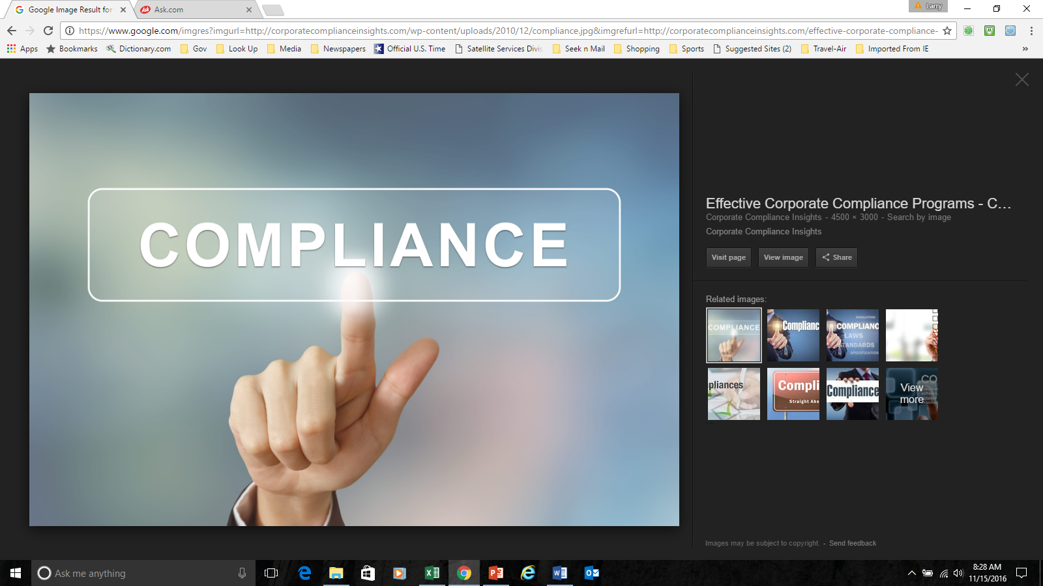
Welcome
Executive Leadership Message
MSU Health Care Laboratories (“the Company”) is committed to provide quality clinical laboratory services to its customers, while observing the highest standards of legal and business ethics, in growing a successful business.
The purpose of our Compliance Program is to (a) provide a framework for conducting acceptable business practices in an honest and ethical manner, in conformance with the laws, rules, and regulations that govern the laboratory industry and (b) serve as the foundation for establishing a culture within the Company that promotes service excellence and the prevention, detection, and resolution of unlawful or improper conduct.

Slide 3
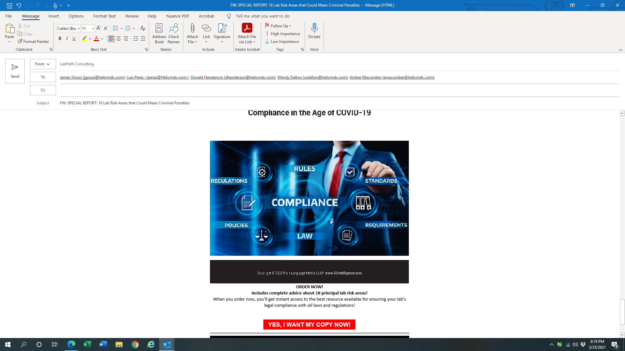
Ethics & HIPAA Compliance Program
What is the “Value”?
We are living in an era of increased regulation and enforcement efforts.
The risks of non-compliance can be “crushing” with devastating penalties.
A “well-balanced” Ethics and Compliance program will help ensure that the organization is:
  Working in harmony to provide service excellence,
  Keep customers happy,
  Grow the business, and
  Achieve the company’s mission for success.

Slide 4
Training Objectives
The objective of this training program is to help everyone understand the purpose of the Company’s Compliance & Ethics Program and its value in building a successful business.
Government Authorities
Ground Rules For Compliance
Laws & Regulations that govern the laboratory industry
Fraud, waste, and abuse
Enforcement Actions & Settlements
HIPAA Privacy & Security Compliance
“Office of Ethics & HIPAA Compliance”
7 elements of an “effective” Ethics & Compliance Program
Reporting of Concerning Issues
“Code of Business Conduct and Ethics”

Slide 5
History
In 1992 the OIG (Office of Inspector General) shook the lab industry with a rampant enforcement climate.
There was an entirely new emphasis on medical necessity as a basis for bringing actions against labs.
Today, government and private insurance companies, as well as consumers, are aggressively reviewing sales, marketing, and billing practices throughout the healthcare industry to identify wrongdoing.
The healthcare industry is highly regulated by government agencies and there are many complex laws unique to the laboratory and pathology diagnostic services industry. All organizations that receive funds from Medicare and Medicaid are required to have an effective compliance plan.

Slide 6
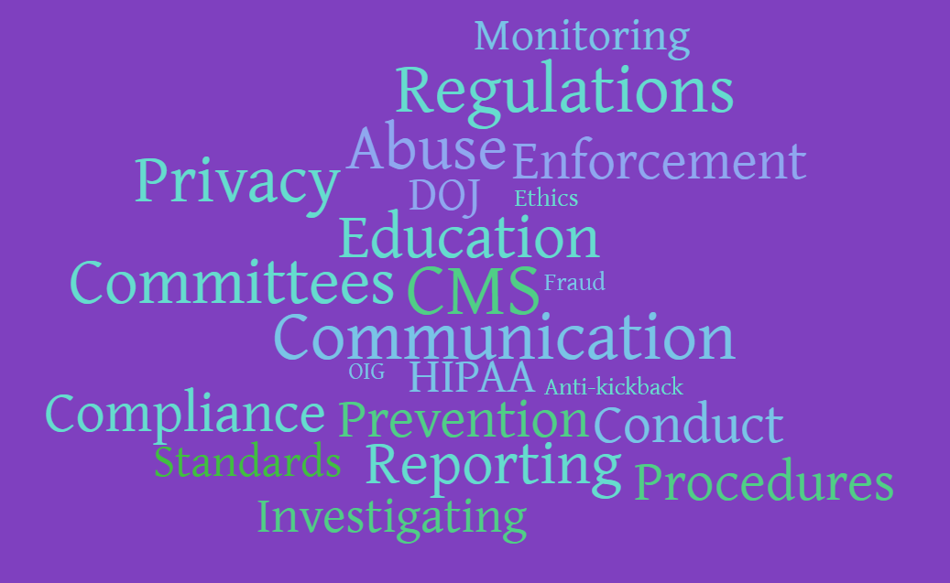
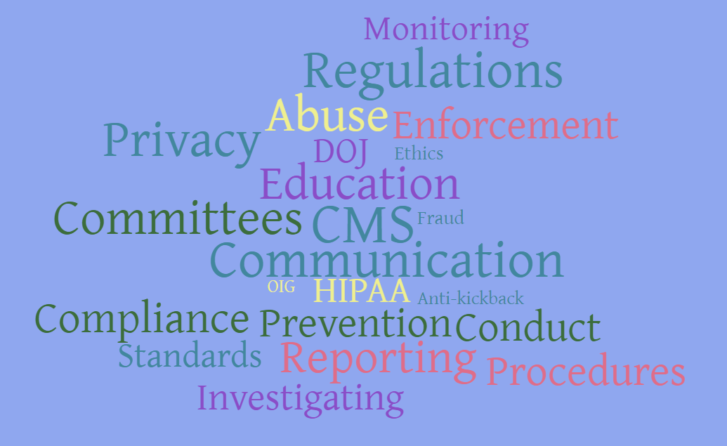

Slide 7
Laboratory Compliance Ground Rules
CMS will only pay for
  Medically necessary laboratory services,
  Ordered by a physician or authorized individual,
  Accurately performed by a certified laboratory, and
  Reported with valuable diagnostic information
  If all of these requirements are not met, the government could consider the claim to be classified as fraud, waste, and abuse (FWA)
Notes:
1st Bullet: ….and in the next couple of slides, we’ll explain what an “effective” program is.
In 1992 the OIG (Office of Inspector General) awakened the lab industry to an rampant enforcement climate.
There was an entirely new emphasis on medical necessity as a basis for bringing actions against labs.
Today, government and private insurance companies, as well as consumers, are aggressively reviewing sales & marketing and billing practices throughout the healthcare industry to identify wrongdoing.
The healthcare industry is highly regulated by government agencies and there are many complex laws unique to the laboratory and pathology diagnostic services industry. All organizations that receive funds for Medicare and Medicaid are required to have an effective compliance plan.
2nd Bullet: The purpose of an effective compliance program is to prevent, detect and correct fraud, waste and abuse by using internal controls to monitor adherence to applicable statutes, regulations and Medicare program requirements
3rd Bullet: The Company’s reputation for providing the highest quality services, as well as conducting business with integrity, is of the utmost importance. We strive to provide the highest standards of care and premium service levels, to create long-term beneficial relationships with clients and their patients based on honesty, integrity, and trust.
Because of this…………read bullet #4
Here’s some more information on the case for an effective compliance program: (next slide)

Slide 8

Fraud, Waste, & Abuse (FWA)
Fraud – Intentional deception or misrepresentation that could result in some unauthorized benefit or payment
  (Example) Billing for tests or services not ordered, performed or reported
Waste – Payments that should not have been paid
  Medically unnecessary or duplicated services
Abuse – Payment for services through improper behaviors or billing practices when there is no legal entitlement to that payment
  Billing a diagnosis that was not obtained from the patient’s medical record

Slide 9
Federal Law Basics
_
+
$
$
False Claim Act
  Billing for something you don’t deserve
Shell Lab (70/30 Rule)
  Sending out more tests than are performed onsite
Anti-kickback (Inducement)
  Giving away something of value to encourage business
Stark Law
  An inappropriate financial relationship
The purpose of these laws is to prevent fraud to the government or improper inducements to refer testing, that is reimbursed by the federal government.

Slide 10
False Claims Act (FCA)
  It is a crime for any person or organization
  To knowingly or with reckless disregard, present a false or fraudulent claim for payment by the federal government; or
  To use a false record or statement to influence the payment of a false or fraudulent claim.
  Example
    Billing for tests not performed or reported
    Encouraging the ordering of test(s) that are not medically necessary
    Billing with an ICD-10 diagnosis code “not obtained” from the physician
  Penalties
  FCA violations will result in a civil penalty per false claim, of not less than $11,181 and not more than $22,363, plus triple the government’s actual damages.
  A person who violates the FCA will also be held liable for the government’s costs for bringing a civil action to recover any penalty or damages.
Notes:
Responsible if we “know or should have known” that they’re doing something wrong. There is not excuse of “I didn’t know!”
One of the reasons we have the Regulatory Compliance Program is that even the best of intentions can go astray.
It’s too hard for 1 person to do this for the whole company – that is why we’re a team and we rely on you as employees to report and make us aware so that we can address non-compliance issues.

Slide 11
False Claim Act
CMS Claim Filing Requirements
Valid Order – Order received from a physician or individual with a valid National Provider Identification (NPI), who has not been debarred, sanctioned, or excluded from federally-funded programs
Physician Signature – Orders must be signed by the physician or non-physician practitioner (NPP) or the ordering physicians or NPPs may be required to furnish medical record evidence of the order upon any internal or external audit to confirm the existence of an order.
Date of Service (DOS) – The date that the specimen was collected.
Requisition Design – Fully disclosed non-deceptive marketing practices with an emphasis on choice.
Physician Notice and Diagnosis Information - Ensure physician awareness of the need to 1) only order medically necessary testing, 2) provide ICD-10 symptomatic diagnosis codes supported in the patient’s medical record, and 3) provide a signed Advance Beneficiary Notice (ABN) if required.
Result Report – Delivered with valuable diagnostic information
Notes:
1st Bullet: ….and in the next couple of slides, we’ll explain what an “effective” program is.
In 1992 the OIG (Office of Inspector General) awakened the lab industry to an rampant enforcement climate.
There was an entirely new emphasis on medical necessity as a basis for bringing actions against labs.
Today, government and private insurance companies, as well as consumers, are aggressively reviewing sales & marketing and billing practices throughout the healthcare industry to identify wrongdoing.
The healthcare industry is highly regulated by government agencies and there are many complex laws unique to the laboratory and pathology diagnostic services industry. All organizations that receive funds for Medicare and Medicaid are required to have an effective compliance plan.
2nd Bullet: The purpose of an effective compliance program is to prevent, detect and correct fraud, waste and abuse by using internal controls to monitor adherence to applicable statutes, regulations and Medicare program requirements
3rd Bullet: The Company’s reputation for providing the highest quality services, as well as conducting business with integrity, is of the utmost importance. We strive to provide the highest standards of care and premium service levels, to create long-term beneficial relationships with clients and their patients based on honesty, integrity, and trust.
Because of this…………read bullet #4
Here’s some more information on the case for an effective compliance program: (next slide)

Slide 12

Federal Anti-Kickback Statute (AKS)
Penalizes anyone (physician, laboratory representative, sales representative, etc.) who knowingly and willfully solicits, receives, offers or pays remuneration in cash or in kind to induce the referral of an individual for testing of diagnostic services, which is payable under the Medicare or Medicaid program.
  Cash kickbacks, bribes, or rebates
  Free laboratory testing
  Waiver of co-pays
  Space rental agreements
  Free computer equipment
  Free general use supplies
  Free non-laboratory pickups
  Business purchase or lease arrangements
Penalty
The AKS is a criminal statute and the penalties for violations of the law can be severe. They include fines of up to $25,000 per violation, felony conviction punishable by imprisonment up to five years, or both, as well as possible exclusion from participation in Federal Healthcare Programs.
Penalties apply equally to the service provider and referring practitioner
Pay Here
B. Braun 2011 Compliance Video
https://www.youtube.com/watch?v=cjvPfBNHNNU

Slide 13
Federal Anti-Kickback Statute
Safe Harbor Regulations
The safe harbor regulations describe various payment and business practices that, although they potentially implicate the Federal anti-kickback statute, are not treated as offenses under the statute.
  Space rental agreements, commercially reasonable
  Purchase arrangements
  Consulting arrangements

Slide 14
Stark Anti-Self Referral Law
Financial Relationship
Prohibits a physician from referring a Medicare or Medicaid patient to a clinical laboratory with which the physician or an immediate family member has an inappropriate financial relationship with.
Stark defines a financial relationship as either
  An ownership/investment interest relationship through equity, debt or other means or a compensation relationship.
  A focus compensation arrangement with anything of value (cash, goods, or services) being exchanged between a physician (or an immediate family member of the physician) and a provider of laboratory healthcare services.
Severe Penalties Include:
Refund of monies received, civil penalties of up to $15,000 for each service, and three times the amount of improper payment the entity received from the Medicare program;
Exclusion from Medicare and/or state healthcare programs including Medicaid;
Payment of civil penalties for attempting to circumvent the law of up to $100,000 for each circumvention scheme.

Slide 15
Stark Law “Exemptions”
Stark Exceptions
The Stark Law mandatory exemptions detail a number of financial relationships and focus arrangements between physicians and designated health service (DHS) providers that do not result in violations of federal law.
Exemption Conditions
The arrangement must be in writing, signed by the parties, and specify the goods or services to be provided;
The written arrangement must specify a timeframe;
The compensation for goods or services must be set in advance, equivalent to fair market value, and must not depend on the value or volume of any referrals made between the parties;
The arrangement must be commercially reasonable; AND
The arrangement must not violate the Anti-Kickback Statute or any other state or federal law.
Existing Exceptions
    In-office ancillary services (i.e. in-office testing, X-ray, etc.),
    Personal service arrangements,
    Rental of equipment and office space, and
    Fair market value compensation.

Slide 16
Enforcement Actions & Settlements
Medical Economics
December 21, 2023
The federal government continues to collect record amounts from providers that find themselves on the wrong side of enforcement actions and subsequent settlements.
  In fiscal year 2022, the federal government reported that it had won or negotiated over $2.2 billion in health care fraud judgments and settlements.
  In fiscal year 2022, the Department of Health and Human Services (DHHS), the Office of Inspector General (OIG), and the Department of Justice (DOJ) allocated over $958 million to combat health care fraud and abuse.

Slide 17
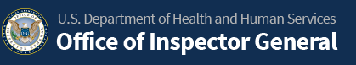
  OIG leads the fight against fraud, waste, and abuse in HHS programs and holds wrongdoers accountable for their actions.
  In FY 2021, OIG brought criminal actions against 680 individuals or organizations engaging in crimes against HHS programs and the beneficiaries they serve, and an additional 774 civil actions.
  OIG also excluded 2,322 individuals and entities from participation in Federal healthcare programs.
  OIG 2022 Annual Report
OIG expects $4.0 billion in investigative recoveries for FY 2020
Notes:
Responsible if we “know or should have known” that they’re doing something wrong. There is not excuse of “I didn’t know!”
One of the reasons we have the Regulatory Compliance Program is that even the best of intentions can go astray.
It’s too hard for 1 person to do this for the whole company – that is why we’re a team and we rely on you as employees to report and make us aware so that we can address non-compliance issues.

Slide 18
HIPAA Privacy & Security Compliance

Slide 19
Health Insurance Portability and Accountability Act (HIPAA)
HIPAA Initiation
Health and Human Services (HHS) regulation initially passed in 1996
Entitled “Standards for Privacy of Individually Identifiable Health Information”
  Commonly known as the “Privacy Rule”
  Designed to ensure that patient Protected Health Information (PHI) is secure and confidential
  Applicable to all healthcare providers (covered entities)
HIPAA Expansion
March 26, 2013 – HIPAA Omnibus Rule (aka Mega Rule or HITECH Act )
  Privacy
  Security
  Breach Notification Rules (BNR)
  Enforcement
Enforcement Agency
The Department of Health and Human Services Office of Civil Rights (OCR)

Slide 20

What is patient Protected Health Information (PHI)?
  Personal information related to the patient, the patient’s health care, or payment
  Examples:
    Patient’s name, address, phone numbers
    Patient’s date of birth
    Patient’s social security number
    Patient’s medical record number or health diagnosis
Types PHI Breaches
  Discarded paper documents, computer hard drives, flash drives, etc.
  Emails sent to the wrong recipient or inappropriately attached to an email.
  Lost or stolen paper documents, laptops, flash drives, etc.
  Sold for monetary gain.
  Disclosed due to actions of a computer virus.
  Posted or access provided on a web server.

Slide 21
How Can I Help Protect PHI?
Access only the minimum necessary PHI required to perform your job.
Protect paper records from theft, misplacement and unauthorized access.
Double check mail, faxes, and emails containing PHI, so that the information doesn’t go to unauthorized individuals.
When sending PHI to emails outside of the organization, ensure that the email is encrypted.

Slide 22

Reporting PHI Breaches
Breaches Happen!!
All breaches must be reported so that the company can investigate and correct the root cause and report the incident if necessary.
If you are aware of an intentional breach, you must contact your manager and submit an incident report.
If you’re unsure whether or not an incident is a breach, please report it!
Notes:
Read through bullets.
Even the most careful employee may be involved in a situation that leads to a breach.
Disclosures that are determined to meet the definition of incidental disclosure are not reportable breaches
It is VITAL that any breach of PHI be reported IMMEDIATELY to your manager, or any senior member of management.

Slide 23
HIPAA Violation Penalties
  Tiers of Culpability (Liability)
  Tier A - No knowledge of the violation
    $100-$50,000 per occurrence fine, with $25,000 annual limit
  Tier B - Reasonable Cause
    By exercising reasonable diligence, should have known.
    $1,000-$50,000 per occurrence fine, with $100,000 annual limit
  Tier C - Willful Neglect – Breach Issue corrected
    Conscious, intentional failure or reckless indifference
    $ 10,000-$50,000 per occurrence fine, with $250,000 annual limit
  Tier D - Willful Neglect – Breach issue left uncorrected
    Conscious, intentional failure or reckless indifference
    $ 50,000-$250,000 per occurrence fine, with $1.5 million annual limit

Slide 24
Ethics & Compliance Program Overview

Slide 25
OIG Compliance Program
OIG believes by implementing an effective compliance program, a lab will: 1) Achieve better quality control over claims submission and
2) Reduce the risk of future criminal and civil liabilities.
Plan to assist laboratories in preventing and correcting fraudulent activity.
OIG has zero tolerance towards fraud and abuse.
OIG will use its extensive statutory authorities to reduce fraud.
An effective Compliance Program promotes continual improvement

Slide 26
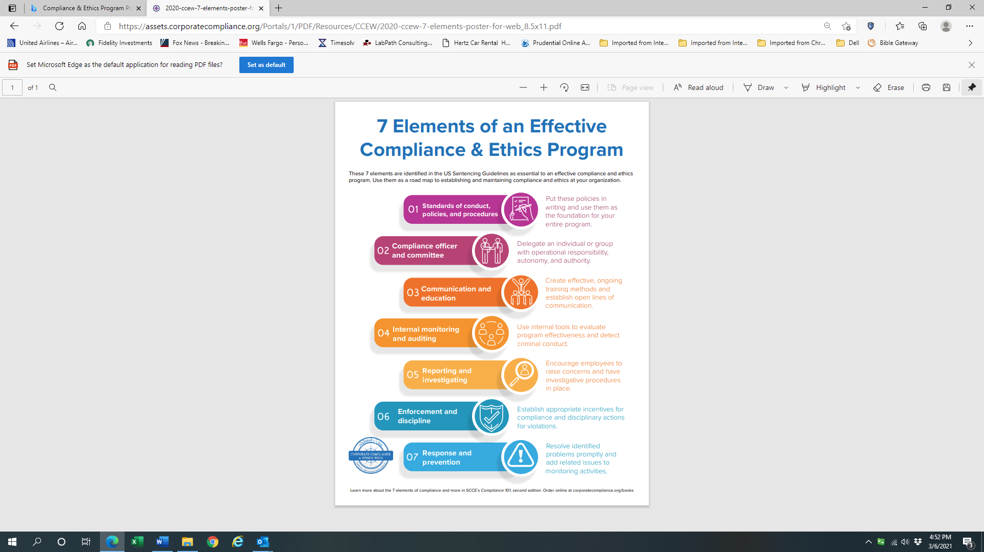
7 Essential Elements of an “Effective”
Compliance & Ethics Program
These 7 elements are identified in the US Sentencing Guidelines as essential to an effective compliance and ethics program. Use them as a road map to establishing and maintaining compliance and ethics at your organization.
Standards of conduct, policies, and procedures - Put these policies in writing and use them as the foundation for your entire program
  Compliance officer and committee - Delegate an individual or group with operational responsibility, autonomy, and authority.
Communication and education - Create effective, ongoing training methods and establish open lines of communication.
  Internal monitoring and auditing - Use internal tools to evaluate program effectiveness and detect criminal conduct.
Reporting and investigating - Encourage employees to raise concerns and have investigative procedures in place.
  Enforcement and discipline - Establish appropriate incentives for compliance and disciplinary actions for violations.
Response and prevention - Resolve identified problems promptly and add related issues to monitoring activities.

Slide 27
Office of Ethics & HIPAA Compliance
Ethics & Compliance Commitment
MSU Health Care Laboratories is committed to provide quality clinical laboratory services to its customers, while observing the highest standards of legal and business ethics, in growing a successful business.
To create a workplace that values the Company’s commitment to honesty, fairness, and compliance with the law, all employees must be familiar with and abide by these standards of conduct.
Ethics and HIPAA Compliance Program Manual
To further these goals, the Company has adopted a Manual, which articulates the corporate policies and standards
Designed to protect and promote Company-wide integrity and enhance our ability to achieve our mission.

Slide 28
Ethics & HIPAA Compliance Leadership (cont.)
  Corporate Compliance Committee
  Kim Collison, President
  Brian Dora, Principal, Auxo Investment Partners
  Heather Harris, Director of Business Development
  Lonnie Riley, Director of Client Success
  Andrea Bratton, Manager, Billing
  Wendy Dalton, Director of Quality and Compliance
  Stephanie Battjes, Operations Director
  Nikki Klein, Manager of Accounts Payable
  Emily Heyt, Manager IT
  Amro Almradi, Medical Director
  Ad hoc members:
  Matt Edgar, Manager of Support Services
  Michele Ziegler, Manager of Human Resources
  Duties & Responsibilities – This Committee is comprised of a team of selected Company leaders who will meet periodically (quarterly or semi-annually), to assist and advise the Ethics & Compliance Officer in the implementation and maintenance of an “effective” compliance program.

Slide 29
Compliance and Billing Audit Assessment
Purpose
  Identify any compliance deficiencies or areas requiring improvement,
  Provide recommendations to improve compliance, and
  Measure the level of compliance of each regulated practice reviewed.
Approach
Will be performed with the assistance of the DCO, to evaluate the policies, procedures, and practices, related to ~80 different issues, which are included in the following areas:

Slide 30
Reporting Process & Open Lines of Communication
Employee’s Obligation
If there is any situation that you believe may be or is in violation of the provisions of the Code, this Manual or any other Company policies or procedures, you should immediately contact your supervisor, another member of the management team, or the Compliance Department.
Open Door Non-Retaliation Policy
Any employee who reports a violation can be assured that no retaliation will be taken against them for reporting possible violations of Company policies, including the Code. Each employee is responsible for ensuring compliance.
Notes:
.

Slide 31
Code of Business Conduct
Team effort - Creating a workplace culture that values integrity, a commitment to honesty, equity, and compliance with the law is a team effort.
Key to achieve our mission the Company has established an Ethics and Compliance Program, which includes a Code of Business Conduct and Ethics.
Promote legal & ethical conduct - The Company’s Code of Conduct is designed to assist its management, employees, contractors, business partners and affiliated providers in complying with applicable state and federal laws and conducting business in an ethical manner.
Commitment - Everyone must be familiar with and committed to abiding by these standards of conduct and report concerning issues and practices.

Slide 32
Code of Business Conduct and Ethics Requirements
Honesty - Deal honestly and ethically in all Company matters, both internally and externally.
Integrity - Comply with all laws, rules and regulations applicable to my work responsibilities.
Commitment - Advance the Company’s business interests whenever the opportunity arises.
Conflict of Interest - Avoid actual or apparent dealings that may be in conflict with the Company’s interests.
Trustworthiness - Protect the Company’s assets and promote their efficient and legitimate business use.
Confidentiality - Protect the Company’s confidential information and the confidential information of the Company’s customers, patients and others.
Health and Safety - Protect the health and safety of all Company employees.
Honor & Respect – Strive to create an enthusiastic work environment that fosters teamwork, creativity, individual initiative, and personal achievement, with honor, respect, and fairness for fellow employees and the customers we serve.
Communication & Reporting - Report to a Company manager and or Compliance Officer, any actual or possible wrongdoing, misconduct, or violation of the Code.

Slide 33

Ways to Report Concerns
Your supervisor, manager, director, or senior leadership team member over your work area will have the most knowledge & experience to address the compliance issue internally.
For confidential reporting, please feel free to contact:
    Compliance@msuhealthlabs.com or (888) 275-5221 Ext. 135
MSU Health Care Laboratories prohibits retaliating against anyone who makes a report!!

