Slide 1
This Photo by Unknown Author is licensed under CC BY-ND

Slide 2
Objectives
The participant will be able to recognize the symptoms of burnout after this presentation
2. Following the presentation, the participant will be informed of the resources available at MDACC to help prevent burnout.

Slide 3
A state of emotional, mental and physical exhaustion caused by excessive and prolonged stress state.

Slide 4
What is Burnout?
Coined by the psychologist, Herbert Freudenberger in the 1970s, burnout describes a severe stress condition that leads to severe physical, mental, and emotional exhaustion.
Much worse than ordinary fatigue, burnout makes it challenging for people to cope with stress and handle day-to-day responsibilities.
People experiencing burnout often feel like they have nothing left to give and may dread getting out of bed each morning. They may even adopt a pessimistic outlook toward life and feel hopeless.
Burnout doesn’t go away on its own and, if left untreated, it can lead to serious physical and psychological illnesses like depression, heart disease, and diabetes.

Slide 5
Who Gets Burnout?
Anyone who is continually exposed to high levels of stress can experience burnout.
People at risk of burnout include:
Healthcare professionals
People caring for children can also have this type of extreme exhaustion.
Individuals needing to be in control, perfectionists, and with Type A personalities.
Business Executives

Slide 6
Is it Burnout or Am I lazy?
A person who is lazy doesn't ever feel like working. There is no history of participation or dedication, but rather a history of inaction, lack of interest, and indolence.
Burnout happens as a result of too much. Too much work, too much intensity, too much stress.

Slide 7
STRESS CONTINUUM

Slide 8
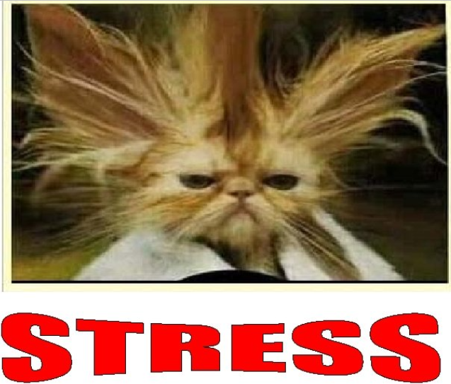

Slide 9
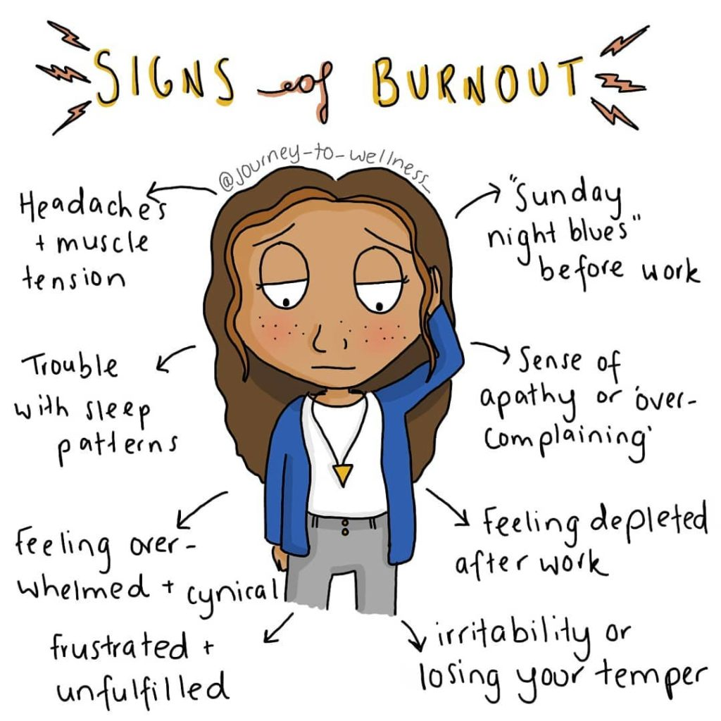

Slide 10
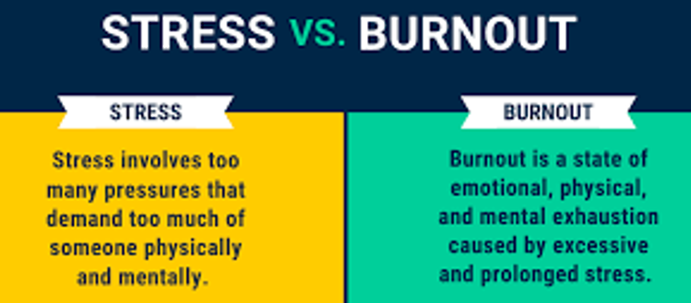
UNDERSTAND THE DIFFERENCE

Slide 11
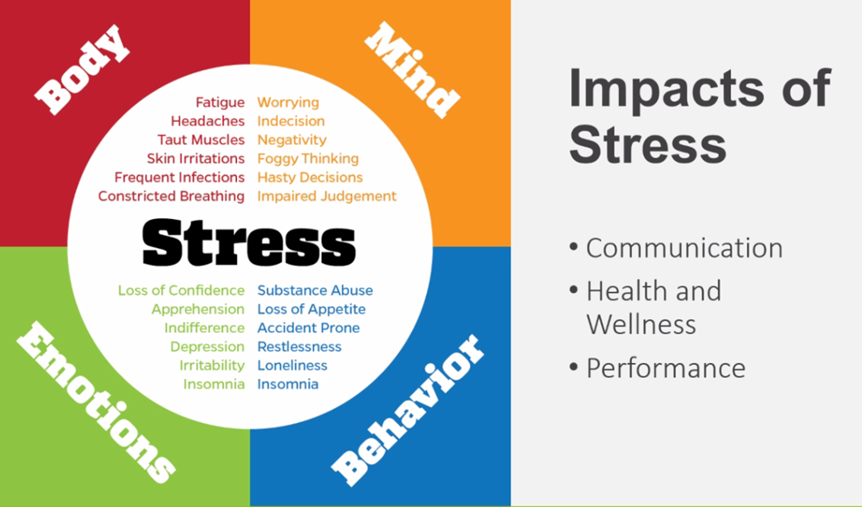

Slide 12
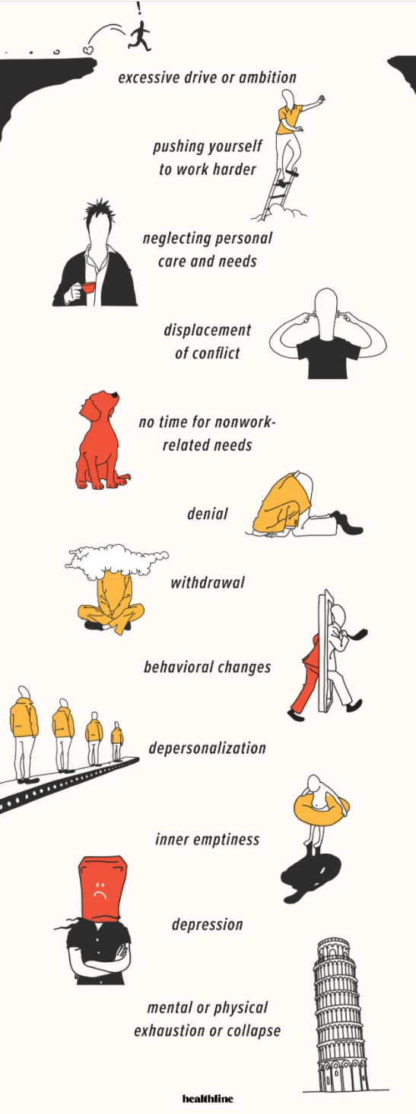
The 12 Stages of BURNOUT

Slide 13
The 12 Stages of BURNOUT
Excessive drive/ambition. Common for people starting a new job or undertaking a novel task, too much ambition can lead to burnout.
Pushing yourself to work harder. Ambition pushes you to work harder.
Neglecting your own needs. You begin to sacrifice self-care like sleep, exercise, and eating well.
Displacement of conflict. Instead of acknowledging that you’re pushing yourself to the max, you blame your boss, the demands of your job, or colleagues for your troubles.
No time for nonwork-related needs. You begin to withdraw from family and friends. Social invitations to parties, movies, and dinner dates start to feel burdensome, instead of enjoyable.
Denial. Impatience with those around you mounts. Instead of taking responsibility for your behaviors, you blame others, seeing them as incompetent, lazy, and overbearing.
Withdrawal. You begin to withdraw from family and friends. Social invitations to parties, movies, and dinner dates start to feel burdensome, instead of enjoyable.
Behavioral changes. Those on the road to burnout may become more aggressive and snap at loved ones for no reason.
Depersonalization. Feeling detached from your life and your ability to control your life.
Inner emptiness or anxiety. Feeling empty or anxious. You may turn to thrill seeking behaviors to cope with this emotion, such as substance use, gambling, or overeating.
Depression. Life loses its meaning and you begin to feel hopeless.
Mental or physical collapse. This can impact your ability to cope. Mental health or medical attention may be necessary.

Slide 14
Takeaway
Continual exposure to high levels of stress can lead to burnout.
Potential signs of burnout: Disengagement, distant emotions, sense of helplessness, loss of motivation, feelings of depression, emotional tolling, irritability, trouble sleeping, feeling overwhelmed, headaches & muscle tension.
Resources at M.D. Anderson available to team members include: the Employee Assistance Program, Health & Wellness, MyHR, Crisis Text Hotline, National Suicide Prevention Hotline, Title IX Office, UT Police, 2-STOP.

Slide 15
MD Anderson Resources
National Suicide Prevention Hotline: 800-273-8255
Crisis Text Hotline: text HOME to 741741
UT Police Department: 713-795-2890
MD Anderson EAP: 713-745-6901
MD Anderson myHR: 713-745-6947
MD Anderson Title IX Office: 832-750-5500
MD Anderson 2-STOP: 713-792-7867
Health & Wellness

Slide 16
References
https://mdandersonorg.sharepoint.com/sites/Home/SitePages/Make-plans-to-take-time-off.aspx
https://mdandersonorg.sharepoint.com/sites/Home/SitePages/Wellness-Taking-time-for-you.aspx
https://slidetodoc.com/running-on-empty-stress-burnout-and-refueling-sandra/
https://www.healthline.com/health/tips-for-identifying-and-preventing-burnout#whats-burnout
https://www.forbes.com/sites/forbescoachescouncil/2021/05/10/three-leadership-super-skills-to-master-to-help-address-burnout/?sh=4dee149a5e2f
https://mdandersonorg.sharepoint.com/teams/healthandwell-being/
Recognizing and Managing Burnout: https://www.youtube.com/watch?v=3wKwwMN-BC8
How to Recover from Being Burned Out [Restore Motivation!] | Brian Tracy: https://www.youtube.com/watch?v=5IaT5KlzTOg
UT System SkillPort Library: https://utsystem.skillport.com/skillportfe/main.action?path=summary/COURSE_TOPIC/pd_30_a03_bs_enus_t12#search/1e369581-1acc-4e23-9100-ee5cd38c0c8b

