Slide 1
Wellness: Take time for you to avoid burnout

Slide 2
Objectives
The participant will be knowledgeable of the dimensions of wellness after this presentation.
Following the presentation, the participant will be informed of different ways to help maintain wellness.

Slide 3
DIMENSIONS OF WELLNESS
SOCIAL CONNECTEDNESS
EXERCISE
NUTRITION
SLEEP
MINDFULNESS

Slide 4
SOCIAL CONNECTEDNESS
Connecting with friends or loved ones is a great way to help improve your physical and mental health.
Take 10 minutes out of your day to call someone you’ve been thinking about.
This is a great way to connect and catch up with the people that matter the most to you.

Slide 5
EXERCISE
Even 20 or 30 minutes of daily exercise can have a positive impact on your overall sense of well-being and help improve your mood.
Don’t know where to start?
-Try a brisk walk on your lunch break
-Opt for the stairs instead of the elevator when you can.

Slide 6
NUTRITION
By adding wholesome ingredients to your plate, you’ll be taking steps towards becoming a healthier you.
Some food for thought:
-Pack an apple and some raw veggies in your bag to keep as a handy snack. This may help you avoid vending machines or fast food when you’re on the go.

Slide 7
SLEEP
Consider your sleep hygiene.
Avoid caffeine after 12pm, include quiet and calm activities before going to bed.
Wake up at the same time every day
These are simple ways you can begin your journey towards becoming a successful sleeper.

Slide 8
MINDFULNESS
Did you know that practicing mindfulness is good for the body and mind, helps with focus and also changes the brain?
-Take a moment right now to consider your own mind and how you are feeling.
-The more you tap into your own thoughts, the more you may become aware of how you react to stressful events
-So start practicing mindfulness today!

Slide 9
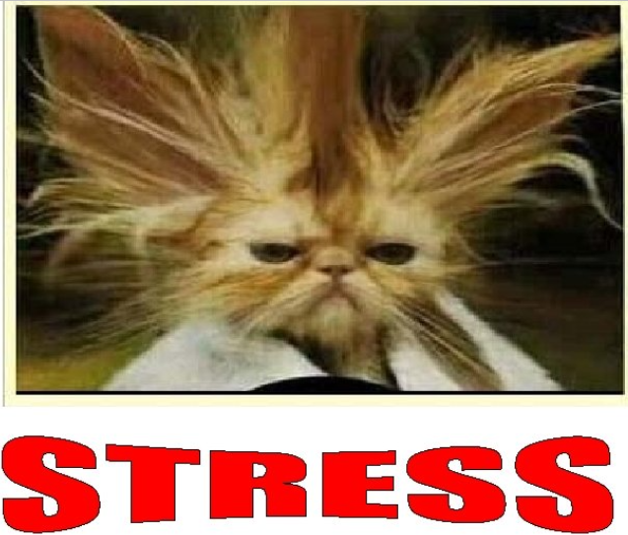

Slide 10
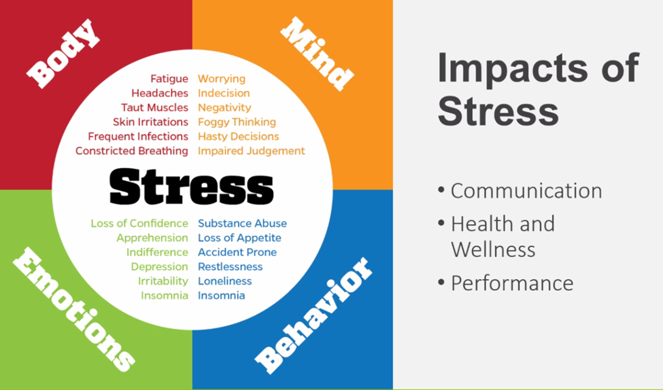

Slide 11
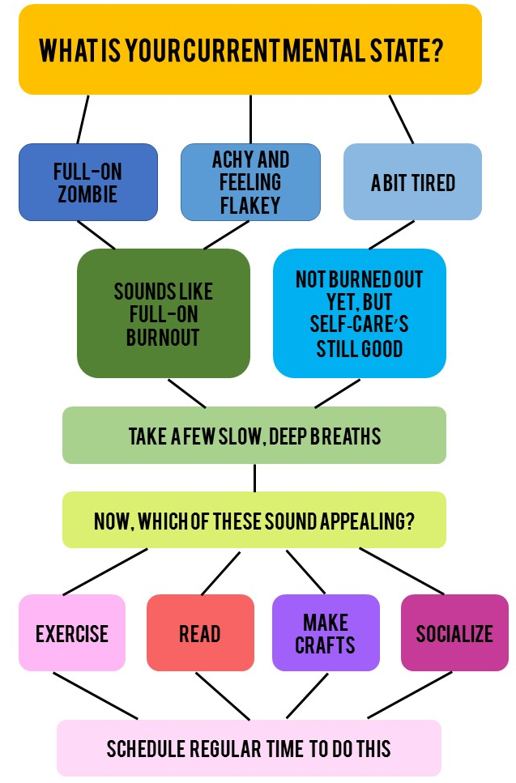
What to do about Burnout

Slide 13
Taking Time Off
Taking your PTO is vital for you to feel renewed, refreshed and revitalized. MD Anderson patients – and your teams – need you at your best, and that isn’t possible if you’re burned out.
Yolan Campbell, associate vice president of HR Operations, says that all work is done best when you’ve had some time to step away – even if you’ve been working remotely.
“Taking time off allows you the opportunity to take a step back and focus on things in life other than work,” says Campbell. “Then when you come back to work, you have a renewed sense of energy and are more productive.”

Slide 14
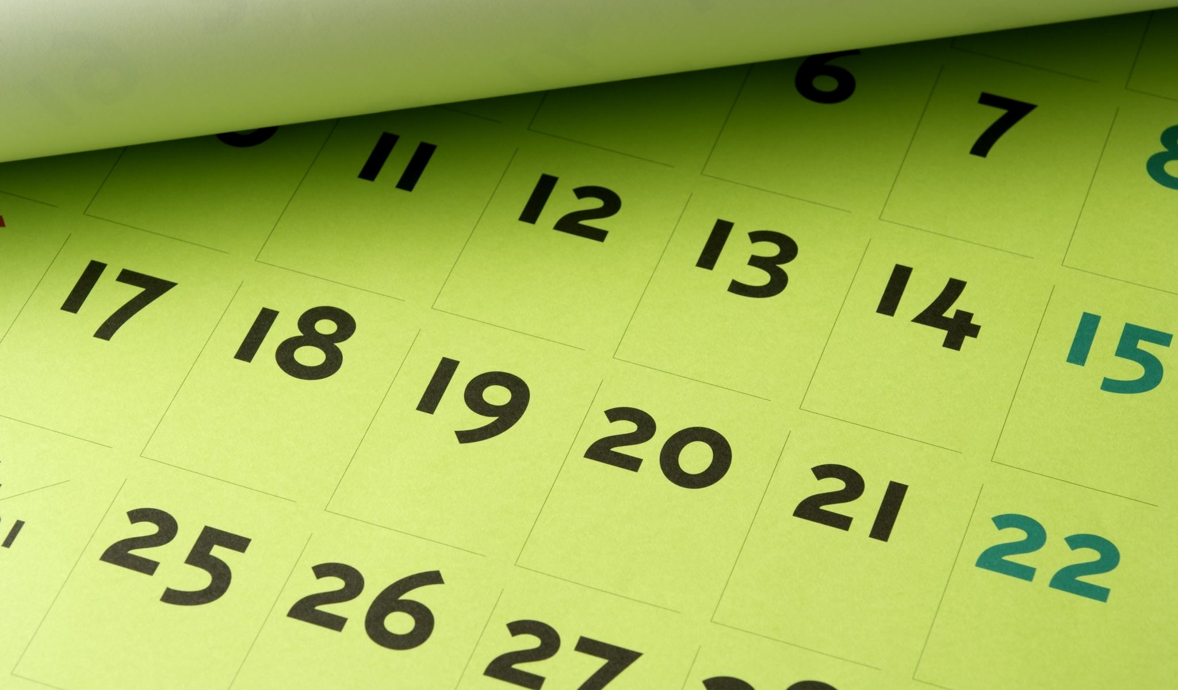
Plan Ahead
When it comes to planning your time off, remember to prioritize your time, coordinate with your coworkers, discuss your schedule with your manager and follow your department’s time-off procedures.
Now, go make some plans.

Slide 15
Wellness Leave
16 Extended Illness Bank (EIB) hours, pro-rated by full-time equivalency, for use for wellness activities each fiscal year. Wellness must be scheduled in advance. These activities could include but aren’t limited to:
Annual wellness exam Mental and/or physical health support
Wellness educational events Wellness events (e.g., 5K, MS150, triathlon, etc.)
“As the premier cancer center, MD Anderson models the way in putting patients first. But this often comes at a price for our people – a lack of self-care,” says Bret Belfer, director of Employee Wellness and Recognition. “We are fortunate to have leaders who not only recognize the importance of initiatives such as this, but who can see clearly the correlation between the wellness of our people and the tremendous impact it has on our patients and their families.”
Follow-up physician appointments Preventive screenings (e.g., cancer, A1C, cholesterol, etc.)

Slide 16
Free Counseling Through MDLIVE
MDLIVE extends many of the same services offered by providers in an office but with a $0 co-pay.
Services are available 24 hours a day, 365 days a year.
In addition to virtual appointments with psychiatrists and therapists, treatment also is offered by physicians with expertise in primary care, pediatrics, and more.
Health & Wellness

Slide 17
Mental Health
Taking a mental health break – or a mental reset – can be from 1 minute to 10.
Jose David, senior EAP specialist says:
“The key is to take smaller breaks during the day and work it into the week.”
“Take some time back for yourself”. “We at MD Anderson give so much of ourselves to our mission, patients and each other, and that gives us purpose. But we are better when we reset.”
He also suggests closing your eyes and counting to 10 slowly. During that time, think about resetting your emotions, leveling your head, and focusing in on a solution to whatever problem you’re facing or an issue that’s been on your mind.

Slide 18
Takeaway
Dimensions of wellness are social connectedness, exercise, nutrition, sleep, and mindfulness.
Remember combat burnout through stress management strategies. Schedule time to walk, exercise, meditate or to talk/get together with friends. Engage in hobbies, listen to music, practice mindfulness, take time to watch enjoyable TV programs, eat a healthy diet and get appropriate levels of sleep. Plan ahead and schedule some time off.
Reach out to Health & Wellness at MDACC for other stress-relieving activities and assistance.

Slide 19
MD Anderson Resources
National Suicide Prevention Hotline: 800-273-8255
Crisis Text Hotline: text HOME to 741741
UT Police Department: 713-795-2890
MD Anderson EAP: 713-745-6901
MD Anderson myHR: 713-745-6947
MD Anderson Title IX Office: 832-750-5500
MD Anderson 2-STOP: 713-792-7867
Health & Wellness

Slide 20
References
https://www.pfizer.com/health-wellness/wellness/what-is-wellness
https://mdandersonorg.sharepoint.com/sites/Home/Shared%20Documents/Forms/AllItems.aspx?id=/sites/Home/Shared%20Documents/support%20resource%20guide.pdf&parent=/sites/Home/Shared%20Documents
https://mdandersonorg.sharepoint.com/sites/Home/SitePages/Make-plans-to-take-time-off.aspx
https://mdandersonorg.sharepoint.com/sites/Home/SitePages/Wellness-Taking-time-for-you.aspx
https://slidetodoc.com/running-on-empty-stress-burnout-and-refueling-sandra/
https://www.healthline.com/health/tips-for-identifying-and-preventing-burnout#whats-burnout
https://www.forbes.com/sites/forbescoachescouncil/2021/05/10/three-leadership-super-skills-to-master-to-help-address-burnout/?sh=4dee149a5e2f
https://mdandersonorg.sharepoint.com/teams/healthandwell-being/
Recognizing and Managing Burnout: https://www.youtube.com/watch?v=3wKwwMN-BC8
How to Recover from Being Burned Out [Restore Motivation!] | Brian Tracy: https://www.youtube.com/watch?v=5IaT5KlzTOg
UT System SkillPort Library: https://utsystem.skillport.com/skillportfe/main.action?path=summary/COURSE_TOPIC/pd_30_a03_bs_enus_t12#search/1e369581-1acc-4e23-9100-ee5cd38c0c8b

