Slide 1

Diagnostic Services Team Anderson
Core Values and Department Goals
Huddle and Staff Feedback
Notes:
Review of core values

Slide 2

MD Anderson Core Values
1. Caring: By our words and actions we create a caring environment for everyone.
2. Integrity: We work together to merit the trust of our colleagues and those we serve.
3. Discovery: We embrace creativity and seek new knowledge.
4. Safety: We provide a safe environment – physically and psychologically- for our patients, for our colleagues and for our community.
5. Stewardship: We protect and preserve our institutional reputation and the precious resources-people, time, financial and environmental- entrusted to us.

Slide 3
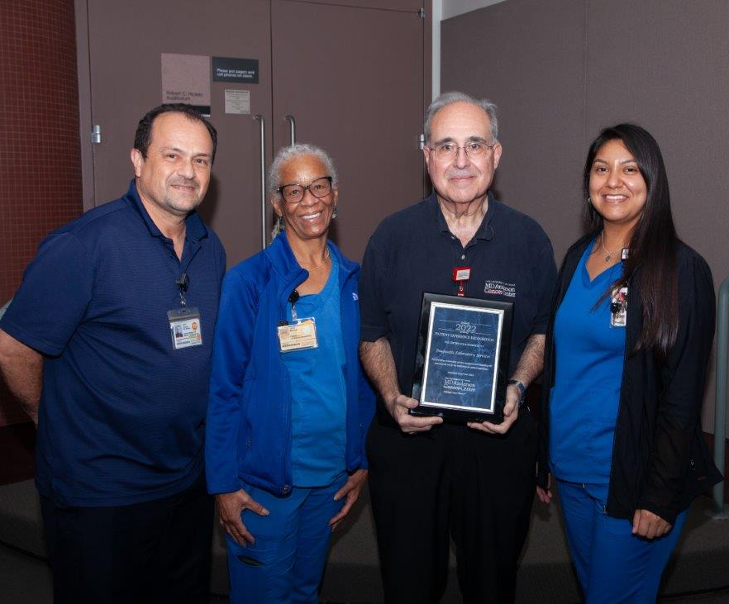
Our 4 Department Goals
1. Patient Safety/Staff Safety
2. Patient Experience
3. Respectfulness
4. Accountability

Slide 4
1. Patient Safety/Staff Safety
Keeping our Patients and ourselves safe. This is part of our Safety Core Values
In what areas can improvements be made in patient safety and/or staff safety?

Slide 5
2. Patient Experience
Continue to provide an outstanding Patient Experience for our Patients
Part of our Caring Core Value
What can you do to support this goal for the department?
What can our department do to support this goal?

Slide 6
3. Respectfulness
Treat our patients and each other with respect and dignity
Part of our Integrity Core Value
How would you like to be treated if you were a patient?
Do you feel treated with respect by co-workers?
How do you show respect to your co-workers?
What suggestions do you have to improve your work area?

Slide 7
4. Accountability
As essential staff members of MD Anderson Cancer Center, we strive to provide patient care in a professional and courteous manner.
Part of our Discovery Core Value
Do we take corrective feedback personally?
Are we open to suggestions for improvement?

Slide 8
Feedback – Print this sheet and submit
Your feedback is valuable. We hear you!
Comments (Please write below) | Ideas (Please write below)

Slide 9
Next steps.
Choose 1 of the following:
Submit your feedback online through Med training.
Arrange meeting with your direct Supervisor to discuss your concerns.
Submit feedback through the Suggestion Box anonymously. Check with your Supervisor for location in your work area.
Active participation in area huddles through verbal feedback.

