Slide 1
Diagnostic Laboratory Services
Phlebotomy Wellness FY24

Slide 2
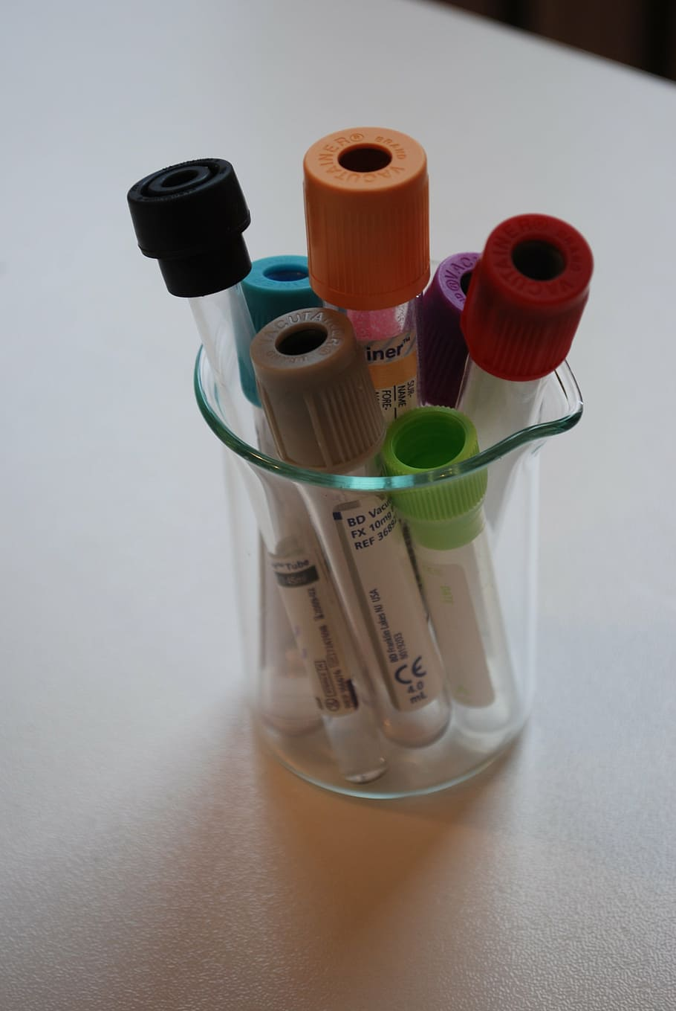
1. Be Well for Self 2. Be Well for Others 3. Be Well for the Institution

Slide 3
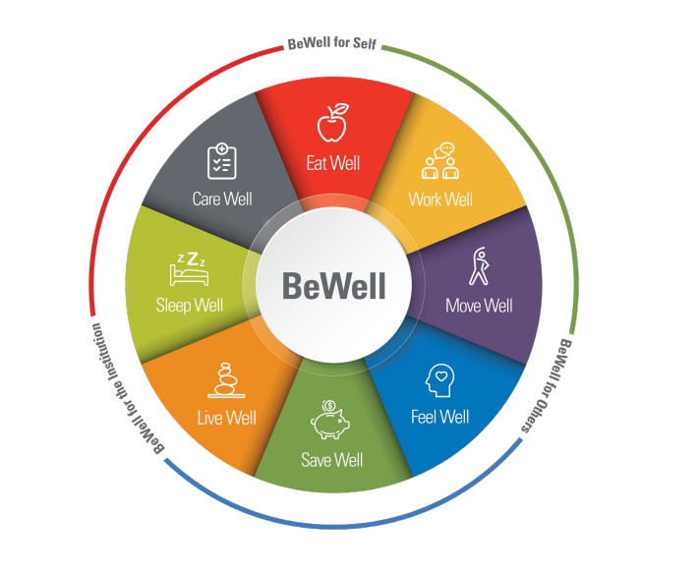
BEWELL Model of Wellness
https://mdandersonorg.sharepoint.com/sites/be-well

Slide 4
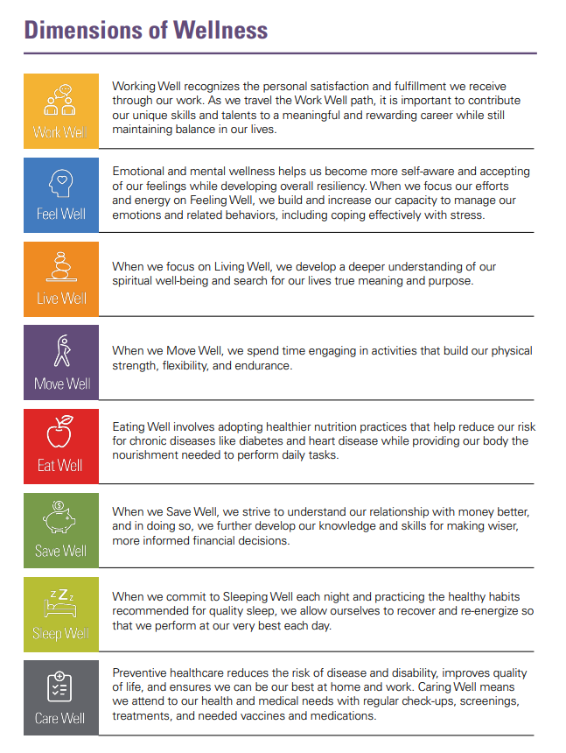

Slide 5
Wellness FY24 Goal
Teams will demonstrate a culture of wellness by Participating and completing 2 Exercises:
Review the FY24 power point in Medtraining. 1. Exercise 1 - Complete the MDA 3 min Mindfulness video in Med training.
2. Exercise 2 - Complete 1 of 3 options. Answer all questions in Medtraining by July 31, 2024.
Notes:
Overall Goal as written

Slide 6
Exercise 1- Meditation Moment
Click the link below and complete the 3-minute practice.
Log into Med training and answer Yes or No that you have completed exercise 1.
MINDFUL BREATHING: PRACTICING SELF CARE 3 MINUTE PRACTICE
https://youtu.be/DLkoZtiXeqQ?si=_5ZvXNUsnsL8xrDJ
Notes:
Can be used for team to complete 1 activity if applicable.
Option 1.
If not can use the medication moment in Exercise 1 next. This can be implemented in Med training.

Slide 7
Exercise 2 – Complete 1 option only
Option 1: Log into your BlueCross/Blue Shield account
HTTPS://WWW.BCBSTX.COM/ or HTTPS://MDANDERSONORG.SHAREPOINT.COM/SITES/BE-WELL (if you do not have BlueCross/Blueshield)
Review the various well programs
Option 2: Attend a 20 min Wellness Presentation scheduled by your Supervisor/Manager.
Option 3: Schedule 1:1 Wellness meetings with Your Supervisor/Manager/Bewell champion (Nadara)
LOG INTO MED TRAINING AND ANSWER YES OR NO THAT YOU HAVE COMPLETED EXERCISE 2
Notes:
This can be for everyone to complete.
Can create an exercise in Med training for staff to answer yes or no for the various activities.

Slide 8
(optional)-Feel Well Meditation Moment
Practice this exercise if you are looking for a longer Medication practice. This is optional.
https://www.linkedin.com/learning-login/share?account=2164658&forceAccount=false&redirect=https%3A%2F%2Fwww.linkedin.com%2Flearning%2Fthe-headspace-guide-to-everyday-stress%3Ftrk%3Dshare_ent_url%26shareId%3Dd71uOu1oQ3i786t1qdTa5w%253D%253D
Notes:
Can be implemented in med training – MDA YouTube meditation exercise for staff.

Slide 9
Update your FY24 Team Anderson Goal
Update your FY24 Performance Evaluation by logging into Oracle.
https://mdandersonorg.sharepoint.com/sites/Home/SitePages/Staff-Performance-Reviews.aspx
Notes:
Supervisor and Managers can decide how they want to confirm that staff complied –
1 Report from Medtraining
2. Have their staff email them what 2 activities they did.
3. Upload email to their evaluation or they can enter in their evaluation.

