Slide 1
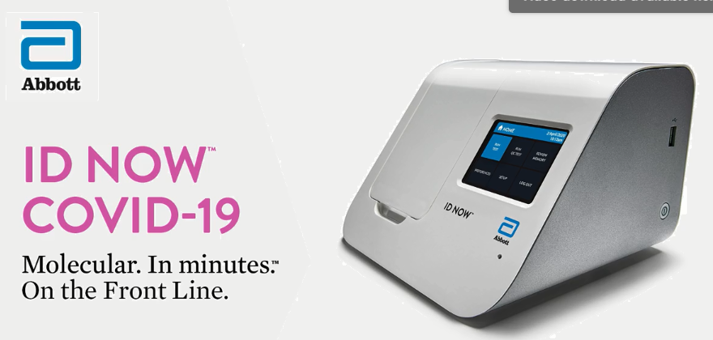

Slide 3
Points to remember:
Sample type: Naso-pharyngeal swab (DO NOT USE VTM)
Nasal swab mid-turbinate
Perform Testing within one hour of collection
Perform both levels of Quality Control with:
New Reagent Lot number
New operator
Every 30 days
If Analyzer is ever moved
Clean Analyzer and surrounding counter Daily with:
70% Ethanol or
10% Bleach

