Slide 1
BRIDGEPORT HOSPITAL (BC & MC)
ANATOMIC PATHOLOGY
QUALITY ASSURANCE MEETING
DECEMBER 2022

Slide 2
OLD BUSINESS
\\Ynhh.org\src\BH - Laboratory\AP\! AP QA\AP QA Meetings\2022\2022 AGENDA & MEETING MINUTES\December 15, 2022\minute meeting for month of OCTOBER.docx

Slide 3
BRIDGEPORT CAMPUS
Intraoperative Diagnosis vs. Final/ Amendments & Histology):
\\Ynhh.org\src\BH - Laboratory\AP\! AP QA\AP QA Meetings\2022\2022 AGENDA & MEETING MINUTES\December 15, 2022\ANATOMIC QA December 29 2022.docx
Consensus Conference :
\\Ynhh.org\src\BH - Laboratory\AP\! AP QA\AP QA Meetings\2022\2022 Concensus Conferene Daily Log\Consensus Conference Daily Log November 2022.pdf

Slide 4
Milford Campus
November, 2022

Slide 5
November 2022 Frozen Stats
-Frozen: 1 - Parts that Meet Threshold: 1
-Blocks: 1
-Touch Preps: 0 -% of Parts that Meets Threshold 100% -Slides: 0 Adj. % of Parts that Meets Threshold: 83
-Cases: 1
Threshold of 20 min./ block – only one case met the 20 minutes threshold
Number of discrepancies: 0

Slide 6
Routine Surgical Biopsies TAT Within 2 Days
70 % Benchmark

Slide 7
Non-Gyn Case Volume & TAT ≤ 5 Days

Slide 8
BC & MC AP VOLUME( January-November 2022)

Slide 9
Surgical Pathology TAT 90% < 3days 2022

Slide 10
Frozen Section TAT 100% <20 minutes (single block cases)

Slide 11
Floaters
January 2021 – November 2022

Slide 12
Floaters by Month 11/30/2021-11/30/2022
2 of 1831 cases (0.109%)
2 of 7735 blocks (0.026%)
2 of 14268 slides (0.014%)
Benign
Malignant
+ Emails sent and saved

Slide 13
Type of Floater & Site of Contamination
TISSUE | TISSUE | MAIL | MALIGNANT | PHOTO | ON | PROX | FLOATER | SAME CASE | DIFFERENT CASE
PATIENT | FLOATER | EMAIL |  | EMAIL | LEVELS | REP | ORIGIN
Ascending colon | Gastric | No | No | No | Yes | Yes | Prelab | Yes | No
Ureter Mass | Colon/bowel fragment | no | no | no | no | yes | Waterbath | no | yes

Slide 14
62 CONTAMINANTS IN BLOCKS (01/01/2020- 11/30/2022)

Slide 15
H&E Performance Log
\\Ynhh.org\src\BH - Laboratory\AP\! AP QA\AP QA Meetings\2022\2022 Quality of Slide Performance Log\November 2022 Daily performance log.pdf

Slide 16
Tissue Processor Verification
\\Ynhh.org\src\BH - Laboratory\AP\! AP QA\AP QA Meetings\2022\2022 Tissue Processor Verification\11. November 2022 Tissue processor verification.pdf

Slide 17
Internal audits : 5/ Month
\\Ynhh.org\src\BH - Laboratory\AP\! AP QA\AP QA Meetings\2022\2022- 5 Audit cases Monthly\November 2022 audit cases.pdf

Slide 18
Challenges and Opportunities for Improvement Anatomic Pathology (Before Final Dx)
October 2022

Slide 19
Histology Processing Issues

Slide 20
Histology Processing Issues

Slide 21
CYTOLOGY SPECIMENS
SENT TO YSM FOR PROCESSING

Slide 22
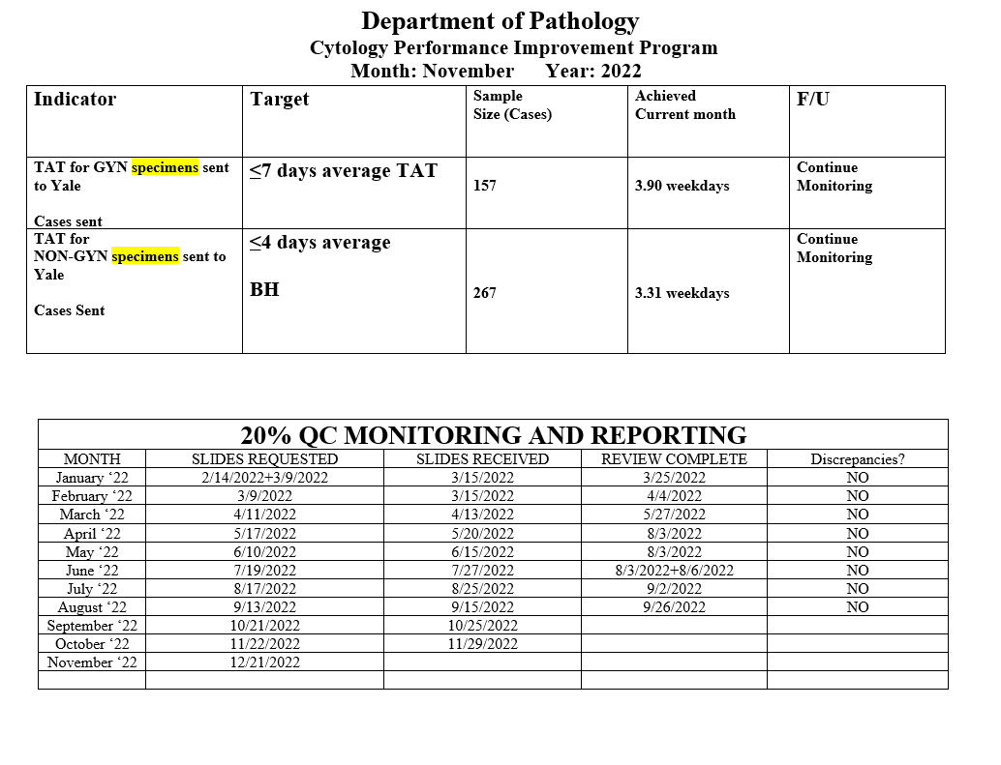
Notes:
The NON GYN TAT is due to staffing issues at YSM, extended leaves, vacations, and cross training in processing. May impact June.
We are up to date on QC review, April and May are with Dr. Cohen. We’ve had no discrepancies.

Slide 23
Notes:
Combined volume for May 459. Error rate is 0.22%

Slide 24
Competency Checklist
\\Ynhh.org\src\BH - Laboratory\AP\! AP QA\AP QA Meetings\COMPETENCY LOG TO UPDATE MONTHLY\Monthly Competency.xlsx

Slide 25
Reports:
Policy and Procedures for signature Review (ongoing)
Ongoing...
PM for all other equipment
\\Ynhh.org\src\BH - Laboratory\AP\Maintenance & Service Reports\Current Instrument List.xlsx
Significant issues
Summary of the Anatomic Pathology Quality Assurance meeting will be presented at Quality Council and Professional and Quality Committee of the Board, and at every full Board meeting, with a more in depth discussion of any significant issues (every six months).Confirm Minutes from Quality Council and Professional and Quality Committee of the Board – Laura Buhlmann.
The P&Q and Quality council- replaced by CRSQ
The exact wording from the AOC:
“A summary of the monthly AP QA meeting will be presented monthly at Quality Council and P&Q Committee of the Board and at every Board meeting with a more in depth discussion of any significant issues, for at least one year”.

Slide 26
Non-Conforming Events
\\Ynhh.org\src\BH - Laboratory\AP\! AP QA\AP QA Meetings\Irreplaceable Specimen Templates\IS Update for BH goals 2022\IS Update for BH goals month of November 2022 data - Copy.pptx

Slide 27
New Business
RLs in November 2022
Stones
Personnel Update
Pathology Candidate
Students (HTL, HT, PA)
Recognition

