Slide 1
BRIDGEPORT HOSPITAL
(BC & MC)
ANATOMIC PATHOLOGY
QUALITY ASSURANCE MEETING
January 2022
for the Month of December

Slide 2
OLD BUSINESS
\\Ynhh.org\src\BH - Laboratory\AP\! AP QA\AP QA Meetings\2023\January 19, 2023\minute meeting for month of November.docx

Slide 3
BRIDGEPORT CAMPUS
Intraoperative Diagnosis vs. Final/ Amendments & Histology):
\\Ynhh.org\src\BH - Laboratory\AP\! AP QA\AP QA Meetings\2023\January 19, 2023\ANATOMIC QA January 19 2022.docx
Consensus Conference :
\\Ynhh.org\src\BH - Laboratory\AP\! AP QA\AP QA Meetings\2022\2022 Consensus Conference Daily Log\Consensus Conference Daily Log November 2022.pdf

Slide 4
Milford Campus
December, 2022

Slide 5
November 2022 Frozen Stats
-Frozen: 3 - Parts that Meet Threshold: 3
-Blocks: 3
-Touch Preps: 0 -% of Parts that Meets Threshold 100% -Slides: 0 Adj. % of Parts that Meets Threshold: 83
-Cases: 1
Threshold of 20 min./ block – only one case met the 20 minutes threshold
Number of discrepancies: 0

Slide 6
Routine Surgical Biopsies TAT Within 2 Days
70 % Benchmark

Slide 7
Non-Gyn Case Volume & TAT ≤ 5 Days

Slide 8
BC & MC AP VOLUME( January-December 2022)

Slide 9
Surgical Pathology TAT 90% < 3days
2022

Slide 10
Frozen Section TAT 100% <20 minutes (single block cases)

Slide 11
Floaters

Slide 12
Floaters by Month
11/30/2021-12/31/2022
5 of 1892 cases (0.264%)
5 of 7623 blocks (0.066%)
5 of 14435 slides (0.035%)
Benign
Malignant
+ Emails sent and saved

Slide 13
Type of Floater & Site of Contamination
TISSUE | TISSUE | MAIL | MALIGNANT | PHOTO | ON | PROX | FLOATER | SAME CASE | DIFFERENT CASE
PATIENT | FLOATER | EMAIL |  | EMAIL | LEVELS | REP | ORIGIN
Rectum | Stomach | no | no | no | yes | yes | Grossing/Embedding | yes | no
Endocervical Bx | Pancreas | no | no | no | no | yes | Waterbath | no | yes
Endometrium | Endometrium | no | no | no | no | yes | Waterbath | yes | no
Fallopian Tube | Hilar Cells | no | no | no | yes | yes | Prelab | yes | no
Hymen | Breast | no | no | no | no | yes | Waterbath | no | yes

Slide 14
64 CONTAMINANTS IN BLOCKS
(01/01/2020- 12/31/2022)

Slide 15
Step Where Contamination Occurred
2022

Slide 16
H&E Performance Log
P:\Laboratory\AP\! AP QA\AP QA Meetings\2022\2022 Quality of Slide Performance Log\December 2022 Daily Performance Log.pdf

Slide 17
Tissue Processor Verification
P:\Laboratory\AP\! AP QA\AP QA Meetings\2022\2022 Tissue Processor Verification\12. December 2022 Tissue processor verification.pdf

Slide 18
Internal audits : 5/ Month
P:\Laboratory\AP\! AP QA\AP QA Meetings\2022\2022- 5 Audit cases Monthly\December 2022 audit cases.pdf

Slide 19
Challenges and Opportunities for Improvement
Anatomic Pathology
(Before Final Dx)
  December 2022

Slide 20
Histology Processing Issues

Slide 21
Histology Processing Issues

Slide 22
CYTOLOGY SPECIMENS
SENT TO YSM FOR PROCESSING

Slide 23
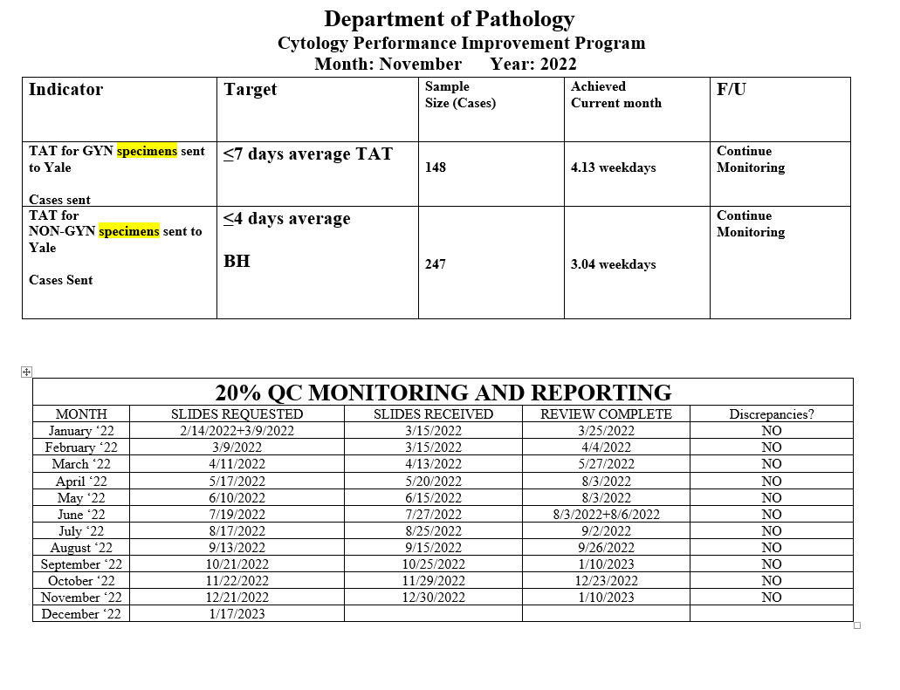
Notes:
The NON GYN TAT is due to staffing issues at YSM, extended leaves, vacations, and cross training in processing. May impact June.
We are up to date on QC review, April and May are with Dr. Cohen. We’ve had no discrepancies.

Slide 24
Notes:
Combined volume for May 459. Error rate is 0.22%

Slide 25
Competency Checklist
\\Ynhh.org\src\BH - Laboratory\AP\! AP QA\AP QA Meetings\COMPETENCY LOG TO UPDATE MONTHLY\Monthly Competency.xlsx

Slide 26
Reports:
Policy and Procedures for signature Review (ongoing)
Ongoing...
PM for all other equipment
\\Ynhh.org\src\BH - Laboratory\AP\Maintenance & Service Reports\Current Instrument List.xlsx
Significant issues
  Summary of the Anatomic Pathology Quality Assurance meeting will be presented at Quality Council and Professional and Quality Committee of the Board, and at every full Board meeting, with a more in depth discussion of any significant issues (every six months).Confirm Minutes from Quality Council and Professional and Quality Committee of the Board – Laura Buhlmann.
The P&Q and Quality council- replaced by CRSQ
The exact wording from the AOC:
“A summary of the monthly AP QA meeting will be presented monthly at Quality Council and P&Q Committee of the Board and at every Board meeting with a more in depth discussion of any significant issues, for at least one year”.

Slide 27
Non-Conforming Events
\\Ynhh.org\src\BH - Laboratory\AP\! AP QA\AP QA Meetings\Irreplaceable Specimen Templates\IS Update for BH goals 2022\IS Update for BH goals month of december 2022.pptx

Slide 28
New Business
RLs in December 2022
Stones
Personnel Update
Pathology Candidate
Students (HTL, HT, PA)
Recognition

