Slide 1
BRIDGEPORT HOSPITAL
(BC & MC)
ANATOMIC PATHOLOGY
QUALITY ASSURANCE MEETING
February 16, 2023
for the Month of January 2023

Slide 2
OLD BUSINESS
\\Ynhh.org\src\BH - Laboratory\AP\! AP QA\AP QA Meetings\2023\January 19, 2023\minute meeting for month of November.docx

Slide 3
BC & MC AP VOLUME( October 22- January 23)

Slide 4
BRIDGEPORT CAMPUS
Intraoperative Diagnosis vs. Final/ Amendments & Histology):
\\Ynhh.org\src\BH - Laboratory\AP\! AP QA\AP QA Meetings\2023\2023 AGENDA & MEETING MINUTES\February 16, 2023\ANATOMIC QA February 16 2023.docx
\\Ynhh.org\src\BH - Laboratory\AP\! AP QA\AP QA Meetings\2023\2023 Consensus Conference Daily Log\January 2023 Consensus.pdf

Slide 5
Milford Campus
JANUARY 2023

Slide 6
January 2023 Frozen Stats
-Frozen: 2 - Parts that Meet Threshold: 1
-Blocks: 3
-Touch Preps: 0 -% of Parts that Meets Threshold 50% -Slides: 0 Adj. % of Parts that Meets Threshold: 83
-Cases: 1
Threshold of 20 min./ block – only one case met the 20 minutes threshold
Number of discrepancies: 0

Slide 7
Routine Surgical Biopsies TAT Within 2 Days
70 % Benchmark

Slide 8
Non-Gyn Case Volume & TAT ≤ 5 Days

Slide 9
Frozen Section TAT 100% <20 minutes (single block cases)

Slide 10
Floaters

Slide 11
Floaters by Month
12/31/2022-01/31/2023
3 of 1814 cases (0.165%)
3 of 7643 blocks (0.039%)
3 of 14795 slides (0.020%)
Benign
Malignant

Slide 12
Type of Floater & Site of Contamination
December
TISSUE | TISSUE | MAIL | MALIGNANT | PHOTO | ON | PROX | FLOATER | SAME CASE | DIFFERENT CASE
PATIENT | FLOATER | EMAIL |  | EMAIL | LEVELS | REP | ORIGIN
Rectum | Stomach | No | No | No | Yes | Yes | Grossing/embedding | Yes | No
Endocervical bx | Pancreas | No | No | No | No | Yes | Waterbath | No | Yes
Endometrium | Endometrium | No | No | No | No | Yes | Waterbath | Yes | No
Fallopian tube | Hilar cells | No | No | No | Yes | Yes | Prelab | Yes | No
Hymen | Breast | No | No | No | No | Yes | Waterbath | No | Yes
Breast | Breast | Yes | Yes | Yes | Yes | Yes | Embedding | No | Yes
Lymph Node | Breast | Yes | Yes | Yes | Yes | Yes | Embedding | No | Yes

Slide 13
Type of Floater & Site of Contamination
January 2023
TISSUE | TISSUE | MAIL | MALIGNANT | PHOTO | ON | PROX | FLOATER | SAME CASE | DIFFERENT CASE
PATIENT | FLOATER | EMAIL |  | EMAIL | LEVELS | REP | ORIGIN
Bone | Colon | No | No | No | Yes | Yes | Embedding | No | Yes
Lymph node | Gastric | No | No | No | Yes | Yes | Grossing | No | Yes
Prostate | Bladder tumor | Yes | Yes | Yes | Yes | Yes | Embedding | No | Yes

Slide 14
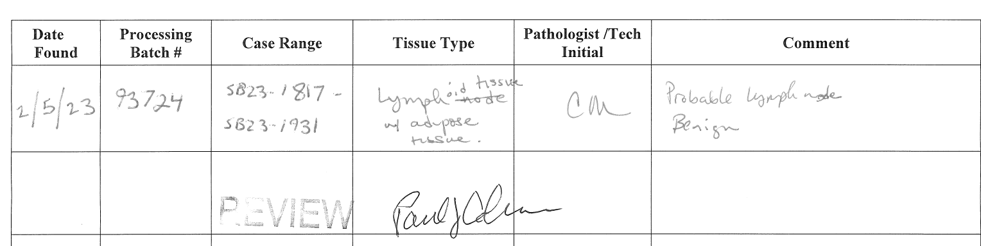
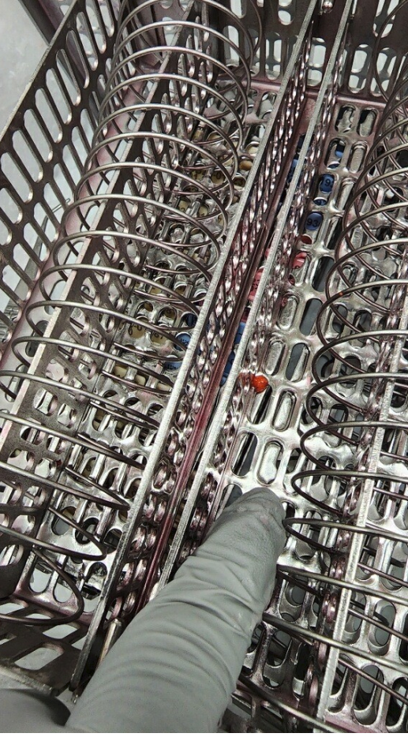
Tissue Found in Processor

Slide 15
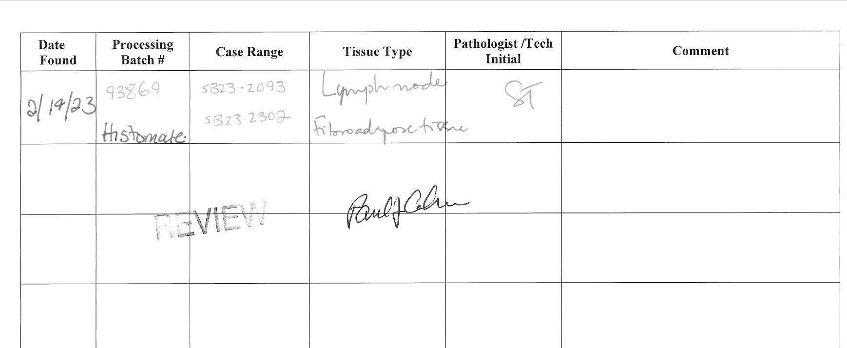
Tissue Found in Histosmate

Slide 16
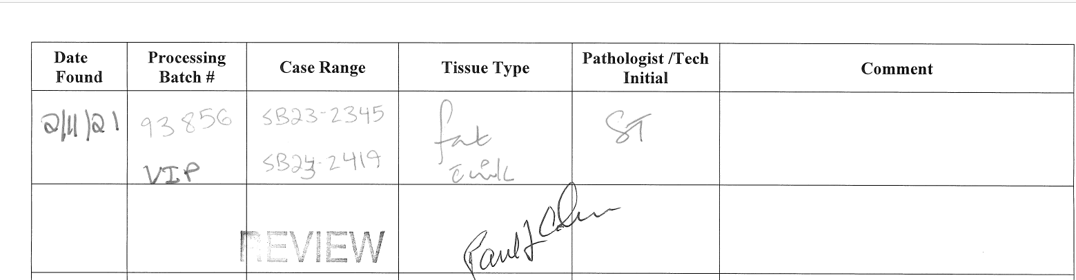
Tissue Found Processor

Slide 17
69 CONTAMINANTS IN BLOCKS
(01/01/2020- 01/31/2023)

Slide 18
Step Where Contamination Occurred

Slide 19
H&E Performance Log
P:\Laboratory\AP\! AP QA\AP QA Meetings\2023\2023 Quality of Slide Performance\January 2023 Daily Slide Quality.pdf

Slide 20
Tissue Processor Verification
P:\Laboratory\AP\! AP QA\AP QA Meetings\2023\2023 Tissue processor verification and monthly data logs\January 2023 Tissue processor verification and monthly data logs.pdf

Slide 21
Internal audits : 5/ Month
P:\Laboratory\AP\! AP QA\AP QA Meetings\2023\2023 5 audit cases monthly\January 2023 audit cases.pdf

Slide 22
Challenges and Opportunities for Improvement
Anatomic Pathology
(Before Final Dx)
  January 2023

Slide 23
Histology Processing Issues

Slide 24
Histology Processing Issues

Slide 25
CYTOLOGY SPECIMENS
SENT TO YSM FOR PROCESSING

Slide 28
Notes:
Combined volume for May 459. Error rate is 0.22%

Slide 29
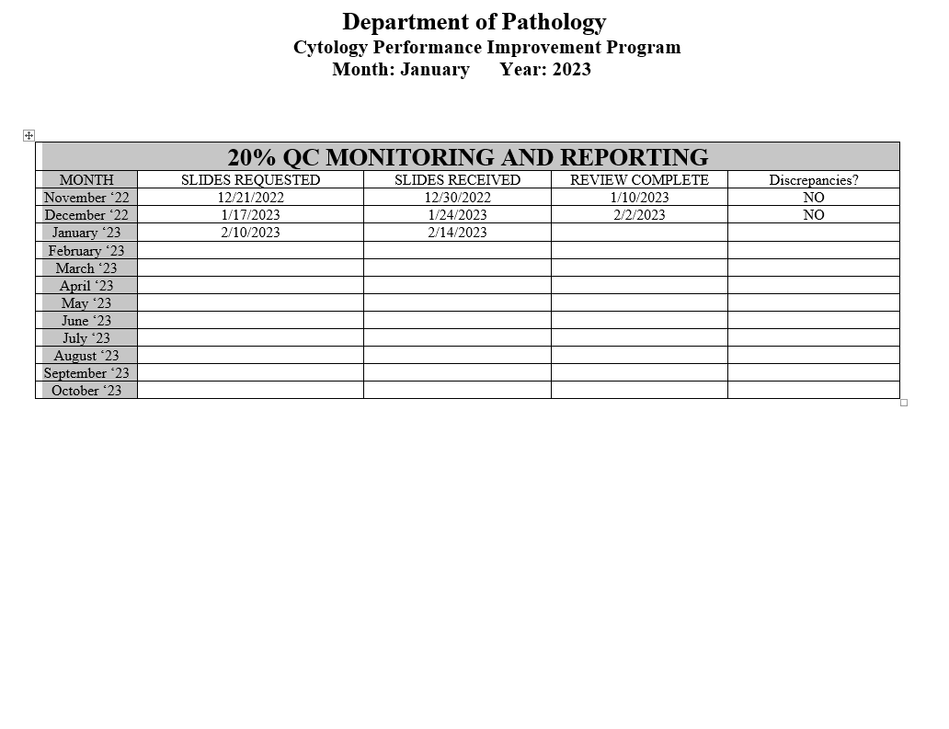
Notes:
The NON GYN TAT is due to staffing issues at YSM, extended leaves, vacations, and cross training in processing. May impact June.
We are up to date on QC review, April and May are with Dr. Cohen. We’ve had no discrepancies.

Slide 30
Competency Checklist
\\Ynhh.org\src\BH - Laboratory\AP\! AP QA\AP QA Meetings\COMPETENCY LOG TO UPDATE MONTHLY\Monthly Competency.xlsx

Slide 31
Reports:
Policy and Procedures for signature Review (ongoing)
Ongoing...
PM for all other equipment
\\Ynhh.org\src\BH - Laboratory\AP\Maintenance & Service Reports\Current Instrument List.xlsx
Significant issues
  Summary of the Anatomic Pathology Quality Assurance meeting will be presented at Quality Council and Professional and Quality Committee of the Board, and at every full Board meeting, with a more in depth discussion of any significant issues (every six months).Confirm Minutes from Quality Council and Professional and Quality Committee of the Board – Laura Buhlmann.
The P&Q and Quality council- replaced by CRSQ
The exact wording from the AOC:
“A summary of the monthly AP QA meeting will be presented monthly at Quality Council and P&Q Committee of the Board and at every Board meeting with a more in depth discussion of any significant issues, for at least one year”.

Slide 32
Non-Conforming Events
\\Ynhh.org\src\BH - Laboratory\AP\! AP QA\AP QA Meetings\Irreplaceable Specimen Templates\IS Update for BH goals 2023 presentations\IS Update for BH goals month of February 2023.pptx

Slide 33
New Business
RLs in January 2023
- RL#472564
Stones
Lab enhancement/renovation
- Plexi-glass work# 1136840
- Pathology Office Renovation
-SPOT cameras are ordered. (#233358)
- Microscopes PO# 30415485-PRO
Personnel Update
Pathology Candidate
Students (HTL, HT, PA)
Recognition
Re- assign the accessioning, embedding, grossing and floater policies to all AP staff.
The proximity report must be run and confirmed by two individuals
Come up with a safeguard when reporting detached fragments.

