Slide 1
BRIDGEPORT HOSPITAL (BC & MC)
ANATOMIC PATHOLOGY
QUALITY ASSURANCE MEETING
March 16, 2023
for the Month of February 2023

Slide 2
OLD BUSINESS
\\Ynhh.org\src\BH - Laboratory\AP\! AP QA\AP QA Meetings\2023\January 19, 2023\minute meeting for month of November.docx

Slide 3
BC & MC AP VOLUME( October 22- March)

Slide 4
BRIDGEPORT CAMPUS
Intraoperative Diagnosis vs. Final/ Amendments & Histology):
\\Ynhh.org\src\BH - Laboratory\AP\! AP QA\AP QA Meetings\2023\2023 AGENDA & MEETING MINUTES\March 12, 2023\ANATOMIC QA March 23 2023.docx
\\Ynhh.org\src\BH - Laboratory\AP\! AP QA\AP QA Meetings\2023\2023 Consensus Conference Daily Log\February 2023 Consensus.pdf

Slide 5
Milford Campus
March

Slide 6
Marh 2023 Frozen Stats
-Frozen: 3 - Parts that Meet Threshold: 3
-Blocks: 5
-Touch Preps: 0 -% of Parts that Meets Threshold 100% -Cases: 1
Threshold of 20 min./ block – only one case met the 20 minutes threshold
Number of discrepancies: 0

Slide 7
Routine Surgical Biopsies TAT Within 2 Days (FY23)
70 % Benchmark

Slide 8
Non-Gyn Case Volume & TAT ≤ 5 Days

Slide 9
Contaminant/Floater/Extraneous
TISSUE

Slide 10
Type of Floater & Site of Contamination January 2023
TISSUE | TISSUE | MAIL | MALIGNANT | PHOTO | ON | PROX | FLOATER | SAME CASE | DIFFERENT CASE
PATIENT | FLOATER | EMAIL |  | EMAIL | LEVELS | REP | ORIGIN
Bone | Colon | No | No | No | Yes | Yes | Embedding | No | Yes
Lymph node | Gastric | No | No | No | Yes | Yes | Grossing | No | Yes
Prostate | Bladder tumor | Yes | Yes | Yes | Yes | Yes | Embedding | No | Yes
NOT A CONTAMINANT

Slide 11
Floaters by Month 2/28/2022-02/28/2023
7 of 1890 cases (0.37%)
7 of 7659 blocks (0.091%)
7 of 14909 slides (0.047%)
Benign
Malignant
Benchmark: 1.5% of cases, 0.8% of blocks, 0.6% of slides. Gephardt GN, Zarbo RJ. Extraneous tissue in surgical pathology: a College of American Pathologists Q-Probes study of 275 laboratories. Arch Pathol Lab Med 1996 Nov; 120(11):1009-14.

Slide 12
Type of Floater & Site of Contamination February 2023
TISSUE | TISSUE | MAIL | MALIGNANT | PHOTO | ON | PROX | FLOATER | SAME CASE | DIFFERENT CASE
PATIENT | FLOATER | EMAIL |  | EMAIL | LEVELS | REP | ORIGIN
Anal bx | Lymph Node | No | Yes | No | No | Yes | Microtomy | No | Yes
Endometrial bx | Colon Adenoma | No | No | No | No | Yes | Grossing | No | Yes
Esophagus | Epithelial cells | No | No | No | No | Yes | Microtomy | No | Yes
Esophagus | Small Bowel | No | No | No | Yes | Yes | Prelab | Yes | No
Toe | Placenta | No | No | No | Yes | Yes | Microtomy | No | Yes
Axillary Sentinal Lyph Node | Benign Epithelial Tissue | No | No | No | No | Yes | Emb/Tissue processor | No | Yes
Esophagus | Duodenum | No | No | No | No | Yes | Prelab | Yes | No

Slide 13
Step Where Contamination Occurred

Slide 14
Tissue Found in Processor

Slide 15
Tissue Found in Histosmate

Slide 16
Tissue Found Processor

Slide 17
Tissue Found Processor

Slide 18
72 CONTAMINANTS IN BLOCKS (01/01/2020- 01/31/2023)

Slide 19
H&E Performance Log
\\Ynhh.org\src\BH - Laboratory\AP\! AP QA\AP QA Meetings\2023\2023 Quality of Slide Performance\February 2023 Daily Slide Quality .pdf

Slide 20
Tissue Processor Verification
\\Ynhh.org\bh\Laboratory\AP\! AP QA\AP QA Meetings\2023\2023 AGENDA & MEETING MINUTES\March 12, 2023\February 2023 Tissue processor verification.pdf

Slide 21
Internal audits : 5/ Month
\\Ynhh.org\bh\Laboratory\AP\! AP QA\AP QA Meetings\2023\2023 AGENDA & MEETING MINUTES\March 12, 2023\February 2023 audit cases.pdf

Slide 22
Challenges and Opportunities for Improvement Anatomic Pathology (Before Final Dx)
January 2023

Slide 23
Histology Processing Issues

Slide 24
Histology Processing Issues

Slide 25
CYTOLOGY SPECIMENS
SENT TO YSM FOR PROCESSING

Slide 28
Notes:
Combined volume for May 459. Error rate is 0.22%

Slide 29
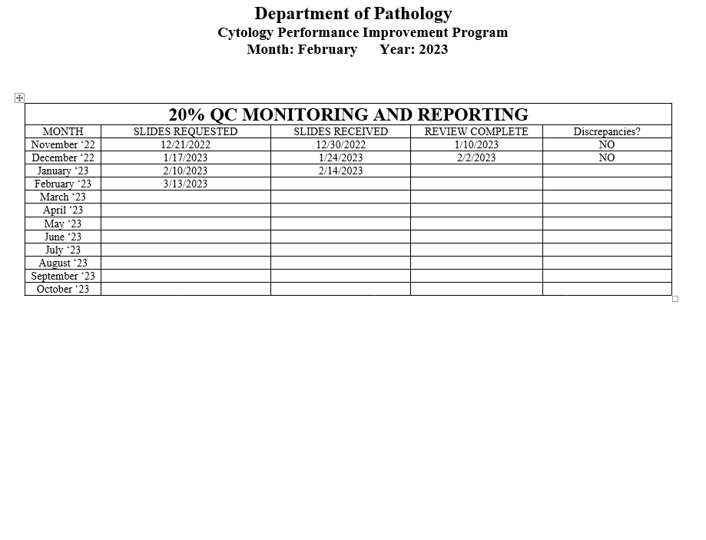
Notes:
The NON GYN TAT is due to staffing issues at YSM, extended leaves, vacations, and cross training in processing. May impact June.
We are up to date on QC review, April and May are with Dr. Cohen. We’ve had no discrepancies.

Slide 30
Competency Checklist
\\Ynhh.org\src\BH - Laboratory\AP\! AP QA\AP QA Meetings\COMPETENCY LOG TO UPDATE MONTHLY\Monthly Competency.xlsx

Slide 31
Reports:
Policy and Procedures for signature Review (ongoing)
Ongoing...
PM for all other equipment
\\Ynhh.org\src\BH - Laboratory\AP\Maintenance & Service Reports\Current Instrument List.xlsx
Significant issues
Summary of the Anatomic Pathology Quality Assurance meeting will be presented at Quality Council and Professional and Quality Committee of the Board, and at every full Board meeting, with a more in depth discussion of any significant issues (every six months).Confirm Minutes from Quality Council and Professional and Quality Committee of the Board – Laura Buhlmann.
The P&Q and Quality council- replaced by CRSQ
The exact wording from the AOC:
“A summary of the monthly AP QA meeting will be presented monthly at Quality Council and P&Q Committee of the Board and at every Board meeting with a more in depth discussion of any significant issues, for at least one year”.

Slide 32
Non-Conforming Events
\\Ynhh.org\src\BH - Laboratory\AP\! AP QA\AP QA Meetings\Irreplaceable Specimen Templates\IS Update for BH goals 2023 presentations\IS Update for BH goals month of February 2023.pptx

Slide 33
New Business
RLs in February 2023
- MARCH -479708
Stones
Lab enhancement/renovation
- Plexi-glass work# 1136840
- Pathology Office Renovation
-SPOT cameras are ordered. (#233358)
- Microscopes PO# 30415485-PRO
Personnel Update
Pathology Candidate
Students (HTL, HT, PA)
Recognition

