Slide 1
BRIDGEPORT HOSPITAL (BC & MC)
ANATOMIC PATHOLOGY
QUALITY ASSURANCE MEETING
April 20, 2023
for the Month of March 2023

Slide 2
OLD BUSINESS
\\Ynhh.org\src\BH - Laboratory\AP\! AP QA\AP QA Meetings\2023\2023 AGENDA & MEETING MINUTES\March 12, 2023\minutes for month of February held on March 23.docx

Slide 3
BC & MC AP VOLUME( October 22- March)

Slide 4
BRIDGEPORT CAMPUS
Intraoperative Diagnosis vs. Final/ Amendments & Histology):
\\Ynhh.org\src\BH - Laboratory\AP\! AP QA\AP QA Meetings\2023\2023 AGENDA & MEETING MINUTES\April 20, 2023\ANATOMIC QA April 20 2023.docx
\\Ynhh.org\src\BH - Laboratory\AP\! AP QA\AP QA Meetings\2023\2023 Consensus Conference Daily Log\March 2023 Consensus.pdf

Slide 5
Milford Campus
March

Slide 6
Marh 2023 Frozen Stats
-Frozen: - Parts that Meet Threshold:
-Blocks:
-Touch Preps: -% of Parts that Meets Threshold -Cases:
Threshold of 20 min./ block – only one case met the 20 minutes threshold
Number of discrepancies: 0

Slide 7
Routine Surgical Biopsies TAT Within 2 Days (FY23)
70 % Benchmark

Slide 8
Non-Gyn Case Volume & TAT ≤ 5 Days

Slide 9
Contaminant/Floater/Extraneous
TISSUE

Slide 10
Floaters by Month 2/28/2022-02/28/2023
2 of 2048 cases (0.098%)
2 of 7659 blocks (0.024%)
2 of 14909 slides (0.001%)
Benign
Malignant
Benchmark: 1.5% of cases, 0.8% of blocks, 0.6% of slides. Gephardt GN, Zarbo RJ. Extraneous tissue in surgical pathology: a College of American Pathologists Q-Probes study of 275 laboratories. Arch Pathol Lab Med 1996 Nov; 120(11):1009-14.

Slide 11
Type of Floater & Site of Contamination February 2023
TISSUE | TISSUE | MAIL | MALIGNANT | PHOTO | ON | PROX | FLOATER | SAME CASE | DIFFERENT CASE
PATIENT | FLOATER | EMAIL |  | EMAIL | LEVELS | REP | ORIGIN
Bone | Skin-right hallux wound | No | No | No | Yes | Yes | Grossing | Yes | No
Breast | Endometrium | No | No | No | Yes | Yes | Grossing | No | Yes

Slide 12
Tissue Found (Processor)

Slide 13
Tissue Found (Processor)

Slide 14
Tissue Found (Processor)

Slide 15
Tissue Found (Grossing)

Slide 16
74 CONTAMINANTS IN BLOCKS (01/01/2020- 03/31/2023)

Slide 17
H&E Performance Log
P:\Laboratory\AP\! AP QA\AP QA Meetings\2023\2023 Quality of Slide Performance\March 2023 Daily performance Log.pdf

Slide 18
Tissue Processor Verification
P:\Laboratory\AP\! AP QA\AP QA Meetings\2023\2023 Tissue processor verification and monthly data logs\March 2023 Tissue prpocessor verification.pdf

Slide 19
Internal audits : 5/ Month
P:\Laboratory\AP\! AP QA\AP QA Meetings\2023\2023 5 audit cases monthly\March 2023 audit cases.pdf

Slide 20
Challenges and Opportunities for Improvement Anatomic Pathology (Before Final Dx)
March 2023

Slide 21
Histology Processing Issues

Slide 22
Histology Processing Issues

Slide 23
CYTOLOGY SPECIMENS
SENT TO YSM FOR PROCESSING

Slide 26
Notes:
Combined volume for May 459. Error rate is 0.22%

Slide 27
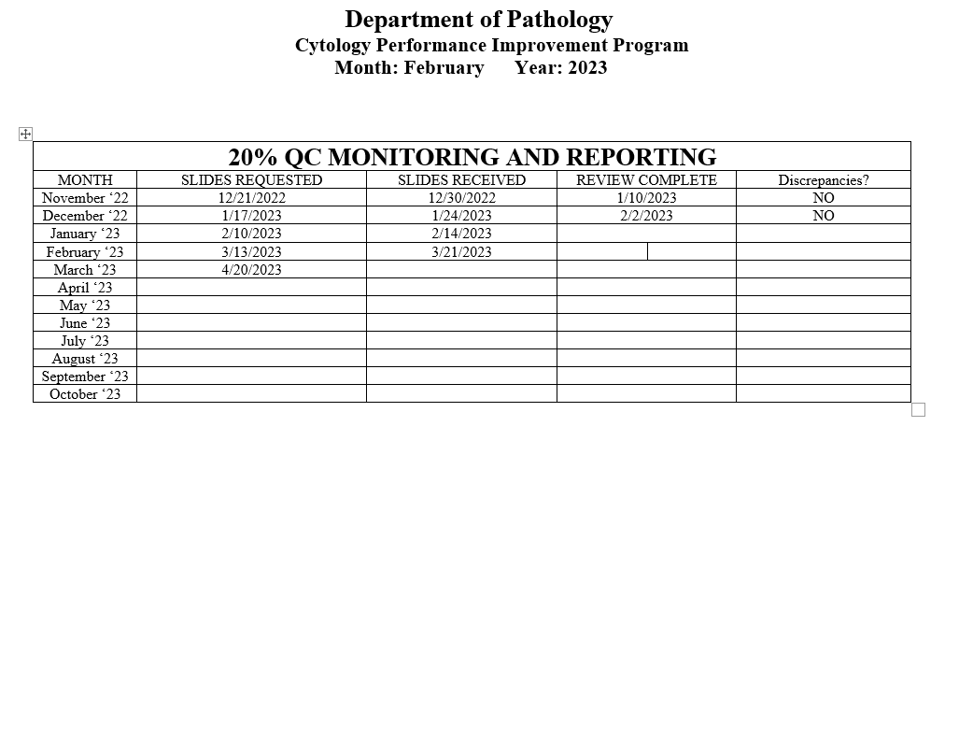
Notes:
The NON GYN TAT is due to staffing issues at YSM, extended leaves, vacations, and cross training in processing. May impact June.
We are up to date on QC review, April and May are with Dr. Cohen. We’ve had no discrepancies.

Slide 28
Competency Checklist
\\Ynhh.org\src\BH - Laboratory\AP\! AP QA\AP QA Meetings\COMPETENCY LOG TO UPDATE MONTHLY\Monthly Competency.xlsx

Slide 29
Reports:
Policy and Procedures for signature Review (ongoing)
Ongoing...
PM for all other equipment
\\Ynhh.org\src\BH - Laboratory\AP\Maintenance & Service Reports\Current Instrument List.xlsx
Significant issues
Summary of the Anatomic Pathology Quality Assurance meeting will be presented at Quality Council and Professional and Quality Committee of the Board, and at every full Board meeting, with a more in depth discussion of any significant issues (every six months).Confirm Minutes from Quality Council and Professional and Quality Committee of the Board – Laura Buhlmann.
The P&Q and Quality council- replaced by CRSQ
The exact wording from the AOC:
“A summary of the monthly AP QA meeting will be presented monthly at Quality Council and P&Q Committee of the Board and at every Board meeting with a more in depth discussion of any significant issues, for at least one year”.

Slide 30
Non-Conforming Events
\\Ynhh.org\src\BH - Laboratory\AP\! AP QA\AP QA Meetings\Irreplaceable Specimen Templates\IS Update for BH goals 2023 presentations\IS Update for BH goals month of March [Autosaved].pptx

Slide 31
New Business
RLs in March 2023
- MARCH -479708
Stones
Lab enhancement/renovation
- Plexi-glass work# 1136840
- Pathology Office Renovation
-SPOT cameras are ordered. (#233358)
- Microscopes PO# 30415485-PRO
Personnel Update
Pathology Candidate
Students (HTL, HT, PA)
Recognition

