Slide 1
BRIDGEPORT HOSPITAL (BC & MC)
ANATOMIC PATHOLOGY
QUALITY ASSURANCE MEETING
May 11, 2023
for the Month of March 2023

Slide 2
OLD BUSINESS
\\Ynhh.org\src\BH - Laboratory\AP\! AP QA\AP QA Meetings\2023\2023 AGENDA & MEETING MINUTES\March 12, 2023\minutes for month of February held on March 23.docx

Slide 3
BC & MC AP VOLUME( October 22- April 2023

Slide 4
BRIDGEPORT CAMPUS
Intraoperative Diagnosis vs. Final/ Amendments & Histology):
\\Ynhh.org\src\BH - Laboratory\AP\! AP QA\AP QA Meetings\2023\2023 AGENDA & MEETING MINUTES\May 18, 2023\ANATOMIC QA May 11 2023 (002).docx
\\Ynhh.org\src\BH - Laboratory\AP\! AP QA\AP QA Meetings\2023\2023 Consensus Conference Daily Log\April 2023 Consensus.pdf

Slide 5
Milford Campus
APRIL

Slide 6
April 2023 Frozen Stats
-Frozen:3 - Parts that Meet Threshold: 3
-Blocks: 3
-Touch Preps: 0 -% of Parts that Meets Threshold: 100% -Cases: 1
Threshold of 20 min./ block – only one case met the 20 minutes threshold
Number of discrepancies: 0

Slide 7
Routine Surgical Biopsies TAT Within 2 Days (FY23)
70 % Benchmark

Slide 8
Non-Gyn Case Volume & TAT ≤ 5 Days

Slide 9
Contaminant/Floater/Extraneous
TISSUE

Slide 10
Floaters by Month 2/28/2022-02/28/2023
2 of 1907 cases (0.105%)
2 of 7627 blocks (0.026%)
2 of 15574 slides (0.013%)
Benign
Malignant
Benchmark: 1.5% of cases, 0.8% of blocks, 0.6% of slides. Gephardt GN, Zarbo RJ. Extraneous tissue in surgical pathology: a College of American Pathologists Q-Probes study of 275 laboratories. Arch Pathol Lab Med 1996 Nov; 120(11):1009-14.

Slide 11
Type of Floater & Site of Contamination February 2023
TISSUE | TISSUE | MAIL | MALIGNANT | PHOTO | ON | PROX | FLOATER | SAME CASE | DIFFERENT CASE
PATIENT | FLOATER | EMAIL |  | EMAIL | LEVELS | REP | ORIGIN
Femoral Neck | Sinus Contents | No | No | No | Yes | Yes | Embedding | No | Yes
Hernia Sac | Foveolar Epithelium | No | No | No | Yes | Yes | Grossing | No | Yes

Slide 12
Tissue Found (Processor)

Slide 13
Tissue Found (Processor)

Slide 14
76 CONTAMINANTS IN BLOCKS (01/01/2020- 04/30/2023)

Slide 15
H&E Performance Log
P:\Laboratory\AP\! AP QA\AP QA Meetings\2023\2023 Quality of Slide Performance\March 2023 Daily performance Log.pdf

Slide 16
Tissue Processor Verification
P:\Laboratory\AP\! AP QA\AP QA Meetings\2023\2023 Tissue processor verification and monthly data logs\March 2023 Tissue prpocessor verification.pdf

Slide 17
Internal audits : 5/ Month
P:\Laboratory\AP\! AP QA\AP QA Meetings\2023\2023 5 audit cases monthly\March 2023 audit cases.pdf

Slide 18
Challenges and Opportunities for Improvement Anatomic Pathology (Before Final Dx)
March 2023

Slide 19
Histology Processing Issues

Slide 20
Histology Processing Issues

Slide 21
CYTOLOGY SPECIMENS
SENT TO YSM FOR PROCESSING

Slide 24
Notes:
Combined volume for May 459. Error rate is 0.22%

Slide 25
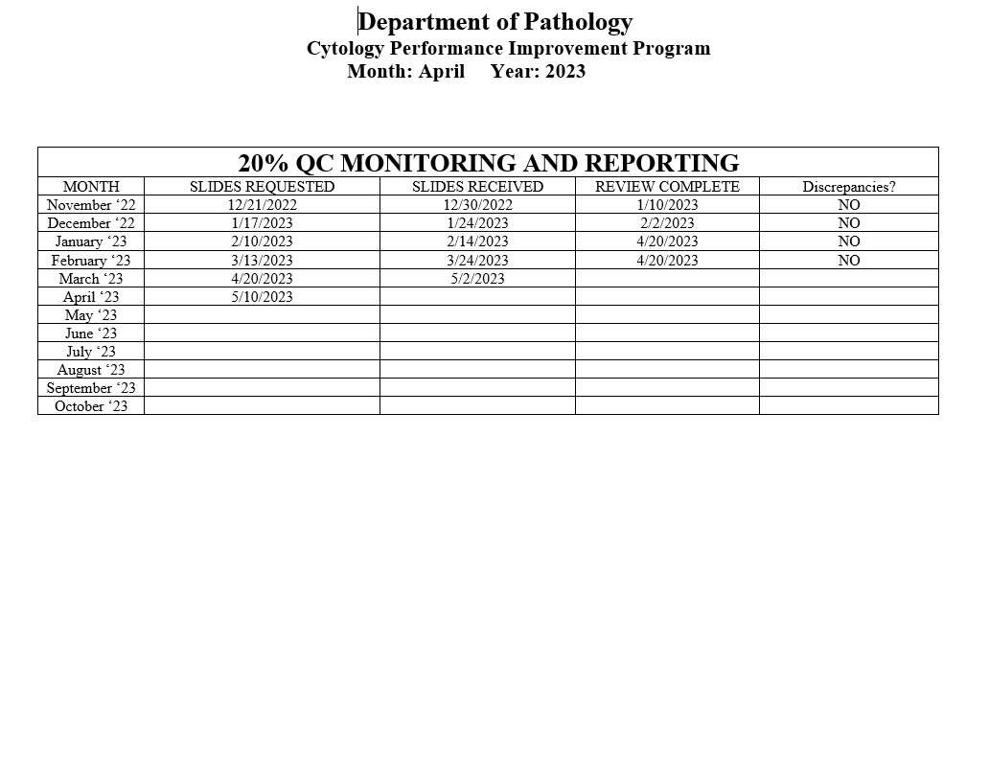
Notes:
The NON GYN TAT is due to staffing issues at YSM, extended leaves, vacations, and cross training in processing. May impact June.
We are up to date on QC review, April and May are with Dr. Cohen. We’ve had no discrepancies.

Slide 26
Competency Checklist
\\Ynhh.org\src\BH - Laboratory\AP\! AP QA\AP QA Meetings\COMPETENCY LOG TO UPDATE MONTHLY\Monthly Competency.xlsx

Slide 27
Reports:
Policy and Procedures for signature Review (ongoing)
Ongoing...
PM for all other equipment
\\Ynhh.org\src\BH - Laboratory\AP\Maintenance & Service Reports\Current Instrument List.xlsx
Significant issues
Summary of the Anatomic Pathology Quality Assurance meeting will be presented at Quality Council and Professional and Quality Committee of the Board, and at every full Board meeting, with a more in depth discussion of any significant issues (every six months).Confirm Minutes from Quality Council and Professional and Quality Committee of the Board – Laura Buhlmann.
The P&Q and Quality council- replaced by CRSQ
The exact wording from the AOC:
“A summary of the monthly AP QA meeting will be presented monthly at Quality Council and P&Q Committee of the Board and at every Board meeting with a more in depth discussion of any significant issues, for at least one year”.

Slide 28
Non-Conforming Events
\\Ynhh.org\src\BH - Laboratory\AP\! AP QA\AP QA Meetings\Irreplaceable Specimen Templates\IS Update for BH goals 2023 presentations\IS Update for BH goals month of March [Autosaved].pptx

Slide 29
New Business
RLs in April 2023
RCA
Stones------------RITM0104218
Lab enhancement/renovation
- Plexi-glass work# 1136840-
- Pathology Office Renovation
-SPOT cameras are ordered. (#233358)
- Microscopes PO# 30415485-PRO
Personnel Update
Pathology Candidate
Students (HTL, HT, PA)
Recognition

Slide 30
Action | Date started | Date to be Completed | Responsible Party/Comments
Event and Event Rewind will be shared with all staff in the Pathology department and system-wide in regards to how HRO behaviors would have prevented this incident. Specifics about which CHAMP behaviors (attention to detail; 200% accountability) would have prevented the event and education about skill-based errors shared with all staff. (Immediate Mitigation) | 2/14/23 | 4/15/23 completed | J. Clerveau; T. Lee
Created bins for GI, Prostate, Breast, Other to clearly separate sample types prior to accessioning. (Immediate mitigation) | 2/28/23 | 3/2/23 completed | J. Clerveau
​Policy updated that if non-GI tract biopsy cases must be accessioned back-to-back, the case will be flagged throughout the specimen processing process for additional awareness. | 3/22/23 | TBD 4/21/2023 completed | J. Clerveau; C. Minerowicz, MD
Feasibility of implementing a breast inking policy for all breast biopsies to standardize across the system. | 4/4/23 | 6/1/23 Discussed at 4/25 pathology meeting. In progress | C. Minerowicz, MD; J. Gibson, MD; P. Cohen, MD; Krishnamurthi MD; Listed as ON HOLD in CAP; pending feasibility
Perform training and competency of all histotechnologists to ensure single case scanning and cleaning of work station between cases are being followed according to policy. Bi-weekly audits, including live and video surveillance, of a minimum of three patients in a row will be performed and documented over a three month period by the histology supervisor or designee. After the three month period, on-going auditing will resume as previously done. | 3/22/23 | 6/30/23 Make appointment before May 3 | J. Clerveau; C. Minerowicz MD, T. Lee
Implementation of a policy for embedding technologists to alternate the colors of the cassettes for breast and prostate biopsies while embedding when possible to prevent the same specimen type from being embedded back to back . (Immediate Mitigation)​ | 4/21/2023 | 4/21/2023 completed | J. Clerveau

Slide 31
Action | Date started | Date to be Completed | Responsible Party/Comments
​Plan completed for space consideration and financial cost to purchase more forceps with the goal to implement a single use forceps policy to standardize across the system. | 4/5/23 | 5/1/23 | V. Fraser; J. Clerveau; T. Lee; M. Hills
Safety coach implementation to ensure 200% accountability throughout the laboratory. | 3/22/23 | 3/29/23 | T. Lee; J. Clerveau; J. Bigelow
Determine feasibility of a HAT alert when an embedder scans a new case number to assist the embedder in reminding them to clean their work area. | 3/22/23 | 6/1/23 In progress .. | J. Clerveau; Not included in Listed as ON HOLD in CAP; pending feasibility
Policy updated: 1. Assigned scribe (pathologist) to ensure that all cases and outcomes discussed at Clinical Consensus Conference (CCC) are written on the CCC Log. 2. Implementation of a formally documented double-check for proximity reports where a clinically significant floater or contaminant is suspected. Policy updated to reflect new practice. (Immediate Mitigation) | 3/22/23 | 4/5/23 completed | J. Clerveau; C. Minerowicz MD
Implementation of an internal (LIS) automated electronic notification process across BH and YM when a clinically significant floater or contaminant is identified. | 3/22/23 | 6/1/23 SYSTEM | J. Gibson, MD; V. Fraser; P. Gershkovich, MD
Policy for escalation of DNA testing formalized and implemented to ensure DNA testing occurs when needed. | 3/22/23 | 6/1/23 | J. Gibson, MD; C. Minerowicz MD, V. Fraser

