Slide 1
Laboratory Medicine – January 2024
February 29, 2024

Slide 2
Bridgeport and Milford Campuses Turnaround Time Goals
Mean determined from median TAT across the Yale New Haven Health System delivery networks
Bridgeport and Milford Campuses – Bridgeport Hospital, Greenwich Hospital, Lawrence Memorial Hospital, Westerly Hospital, St. Raphael and York Street Campus – Yale New Haven Hospital and Shoreline Medical Center
Standard Deviation calculated
2 SD Range established and represents the upper and lower limits
If data set within control range, no corrective actions are necessary

Slide 3
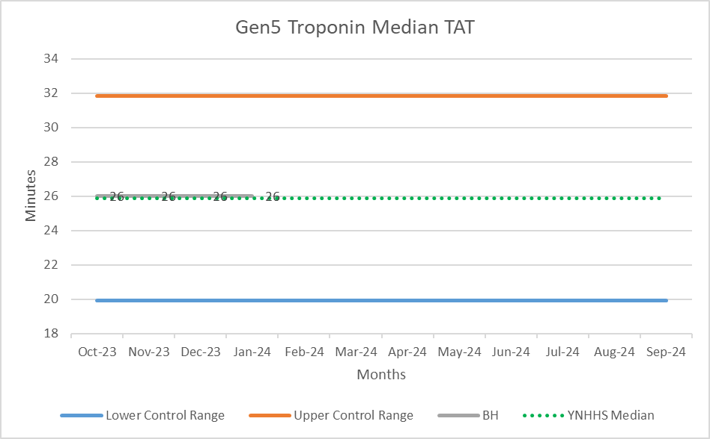
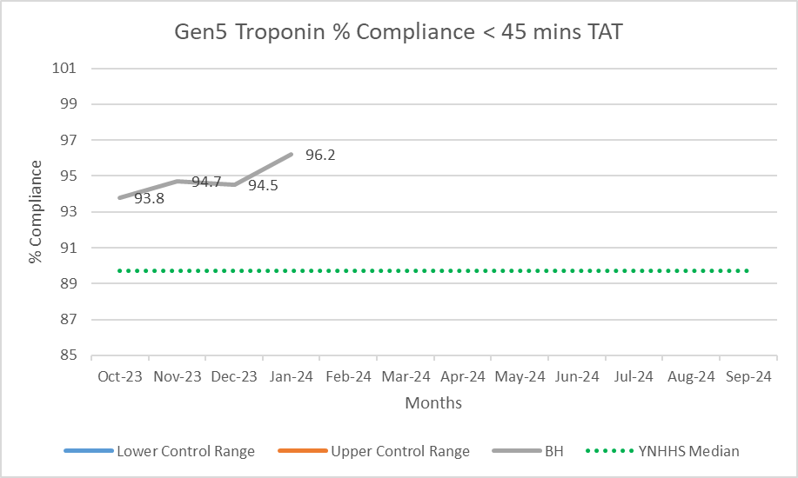
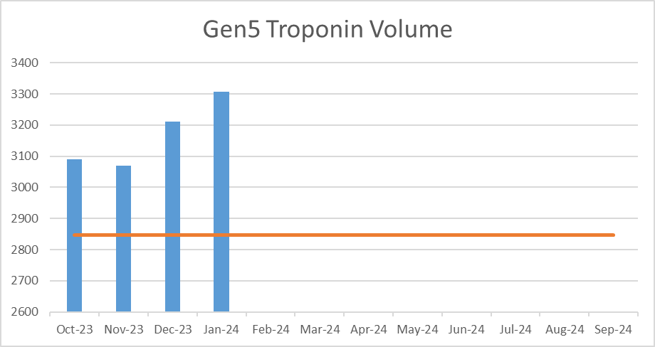
Bridgeport Campus – Gen 5 Troponin TAT

Slide 4
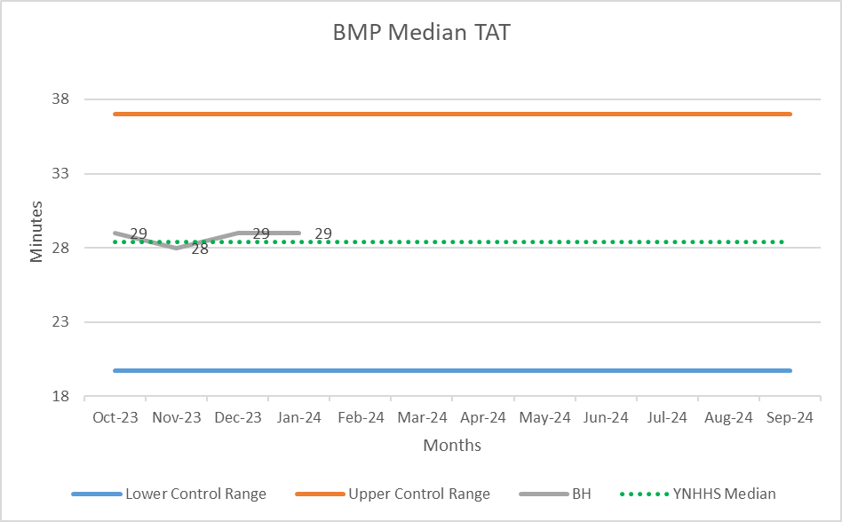
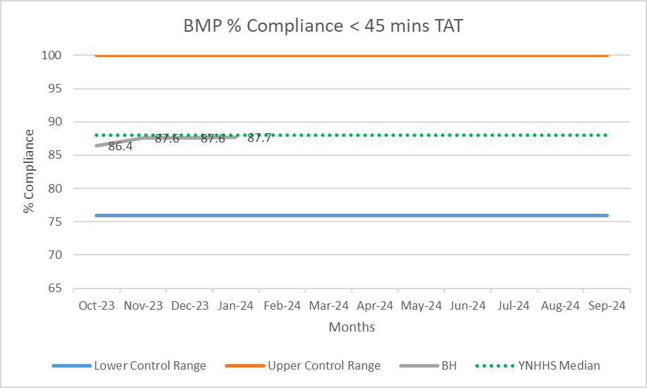
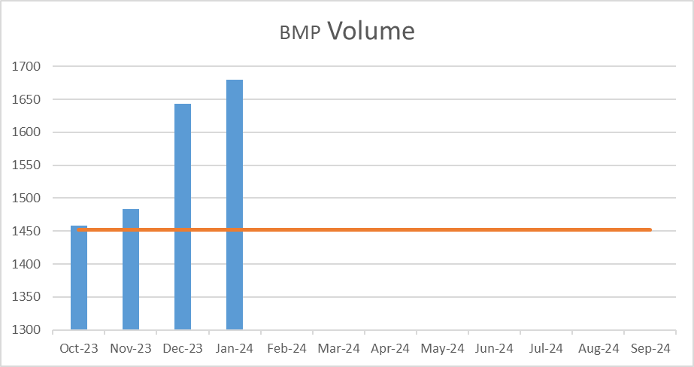
Bridgeport Campus – Basic Metabolic Panel (BMP) ED TAT

Slide 5
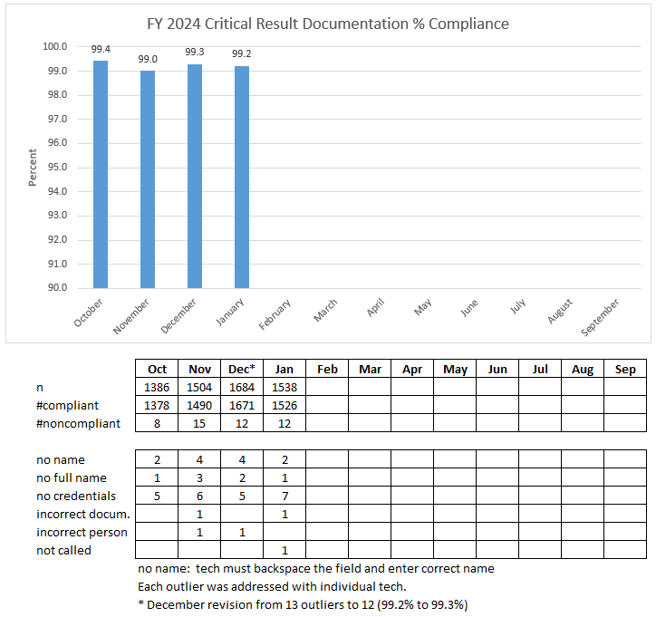
Chemistry

Slide 6
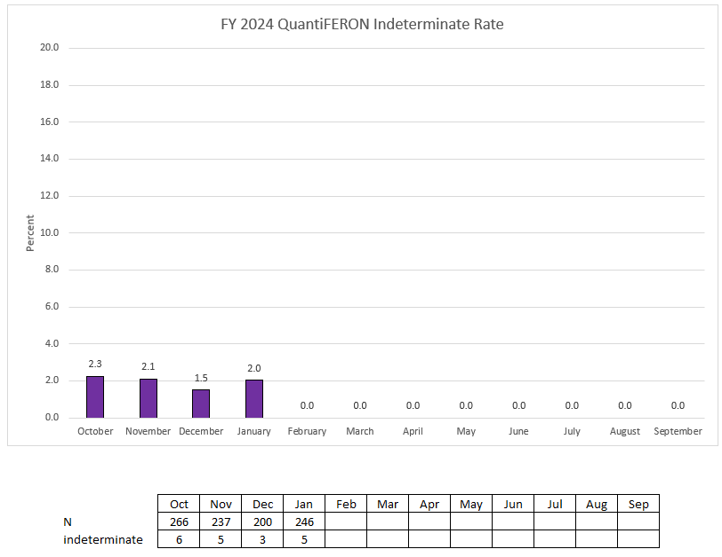
Chemistry

Slide 7
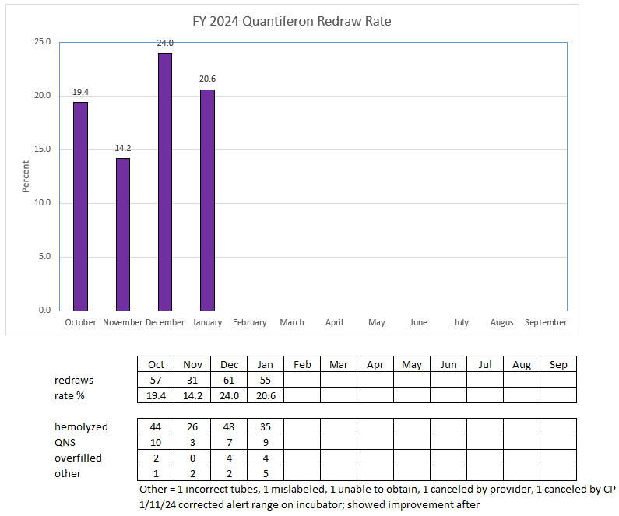
Chemistry

Slide 8
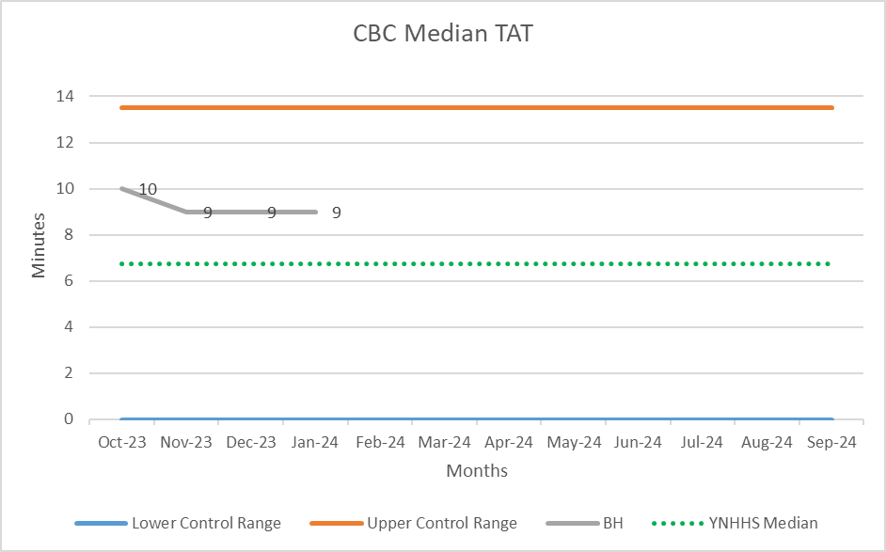
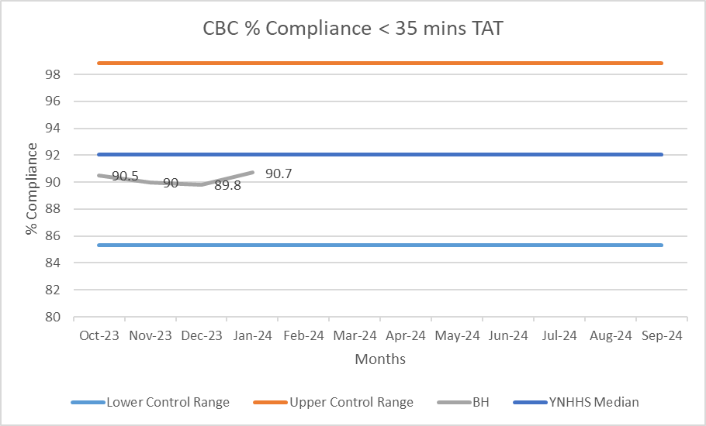
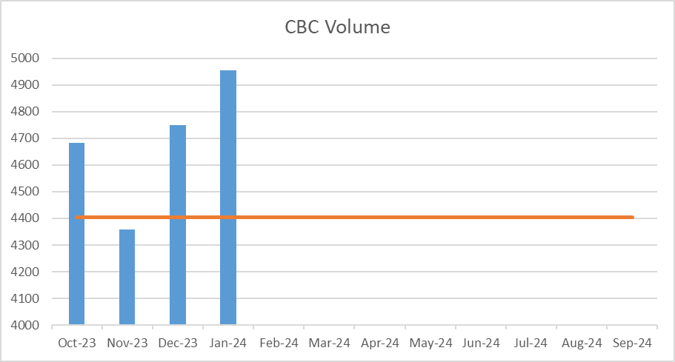
Bridgeport Campus – Complete Blood Count (CBC) ED TAT

Slide 9
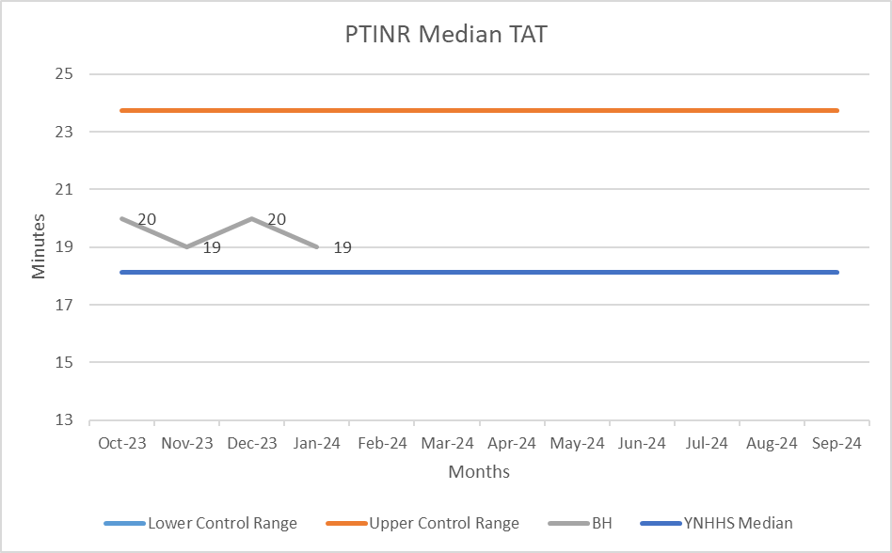
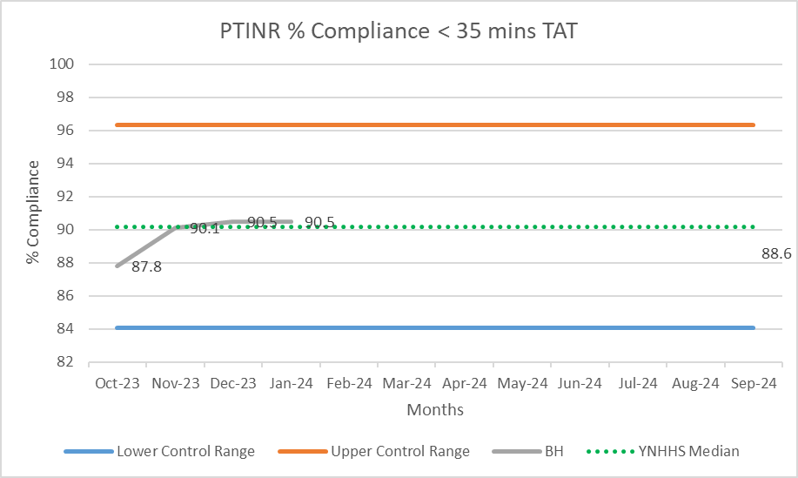
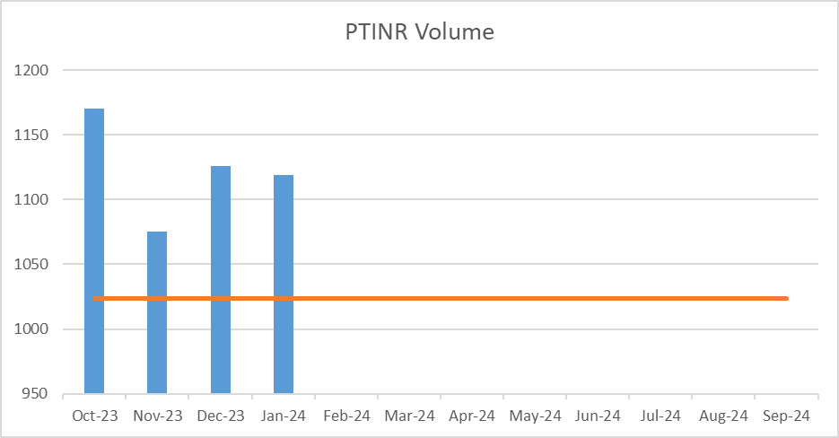
Bridgeport Campus – PTINR ED TAT

Slide 10
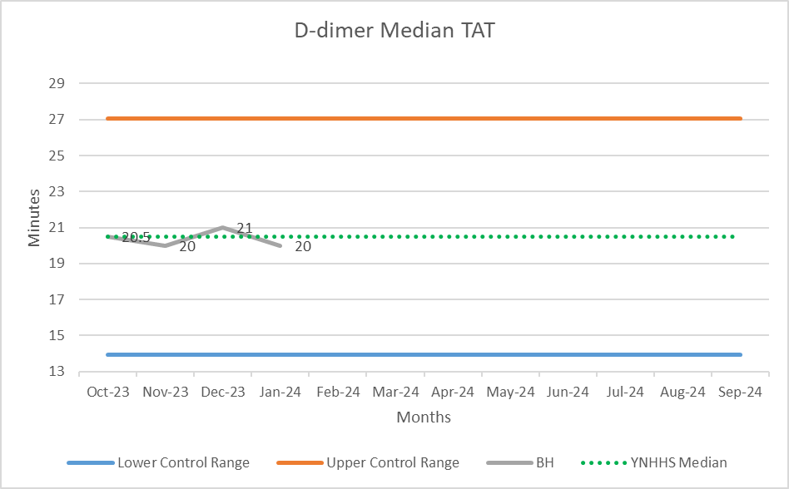
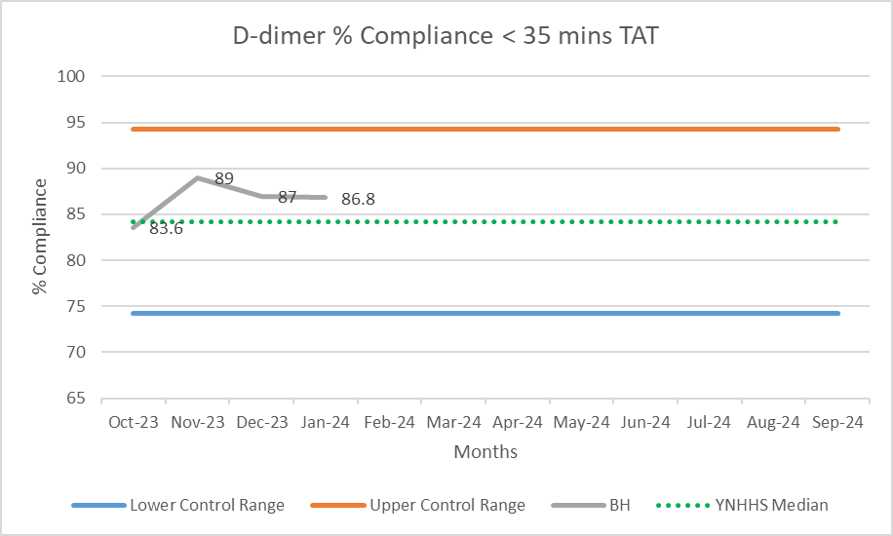
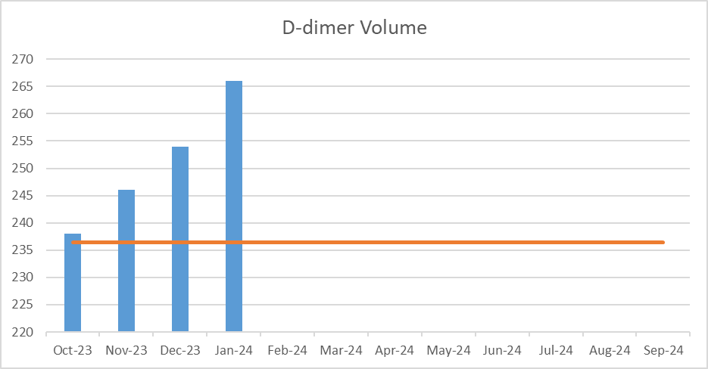
Bridgeport Campus – D-dimer ED TAT

Slide 11
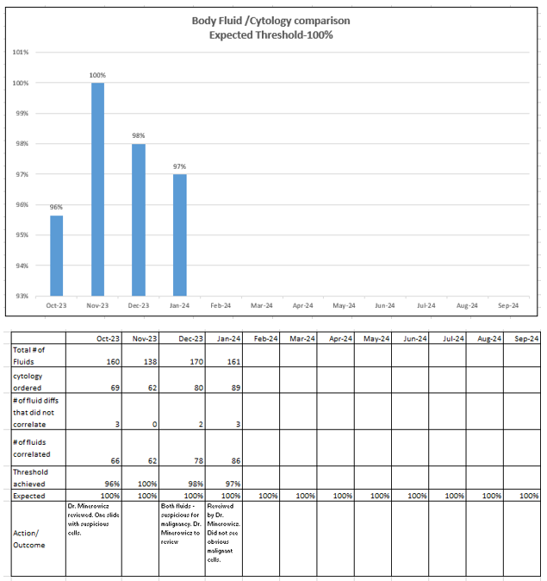
Aspect of Care

Slide 12
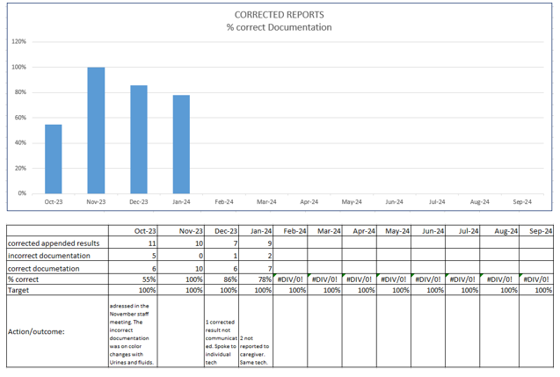
Aspect of Care

Slide 13
Aspect of Care

Slide 14
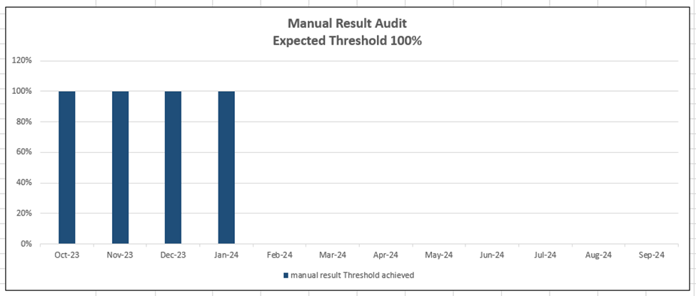
Aspect of Care

Slide 15
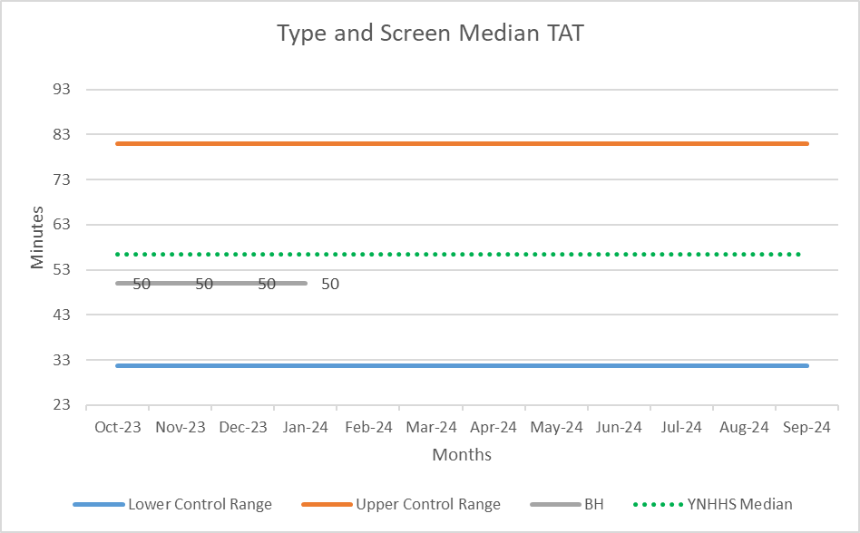
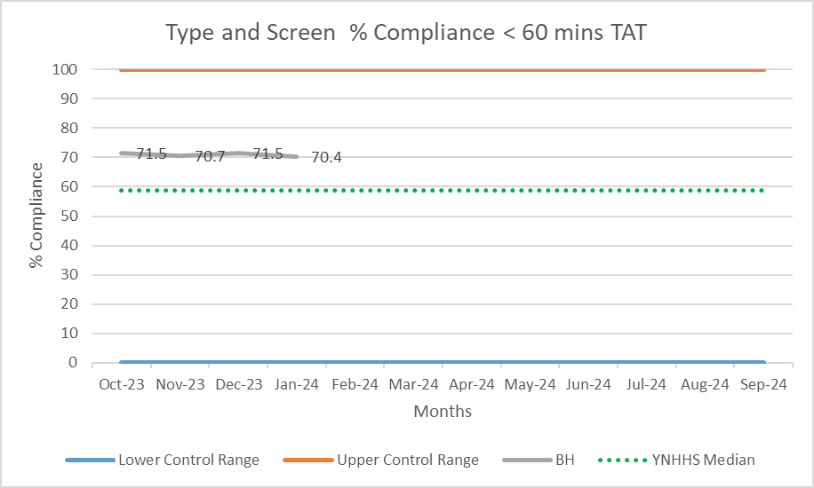
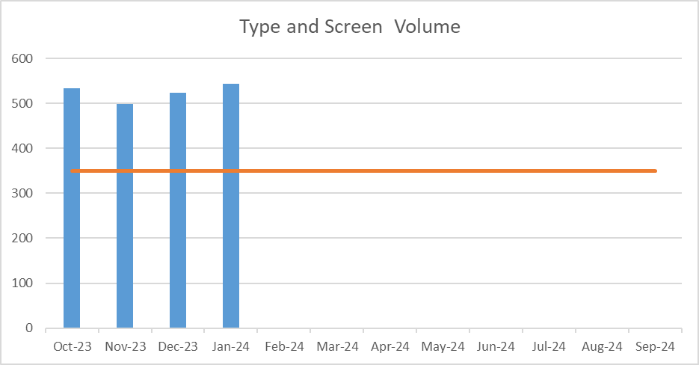
Bridgeport Campus – Type and Screen ED TAT

Slide 16
QA Report: Department Pathology
2/14/2024
Bridgeport Hospital and Milford Campus
Laboratory Blood Bank
Edward Snyder MD, Christine Minerowicz MD, Lisa Krause, Melissa Morales, Teodorico Lee, Laura Buhlmann

Slide 17
Bridgeport Hospital Transfusion Reactions FY24
Months | Total | Allergic | Febrile | Anaphy | TACO | TRALI | TAD | Hemolytic Intravascular | Hemolytic Extravascular | Delayed Serologic | Septic | Underlying Disease
 | BH | BH | BH | BH | BH | BH | BH | BH | BH | BH | BH | BH
Oct | 6 | 0 | 2 | 0 | 0 | 0 | 1 | 0 | 1 | 1 | 0 | 1
Nov | 4 | 1 | 2 | 0 | 0 | 0 | 0 | 0 | 0 | 0 | 0 | 1
Dec | 1 | 0 | 1 | 0 | 0 | 0 | 0 | 0 | 0 | 0 | 0 | 0
Jan | 7 | 0 | 4 | 0 | 0 | 0 | 0 | 1 | 0 | 1 | 0 | 1
Feb | 0
Mar | 0
Apr | 0
May | 0
Jun | 0
Jul | 0
Aug | 0
Sep | 0
Total | 18 | 1 | 9 | 0 | 0 | 0 | 1 | 1 | 1 | 2 | 0 | 3
Notes:
Make pie chart

Slide 19
Bridgeport Hospital

Slide 20
Bridgeport Hospital Blood Bank - FY24
RBC Utilization
 | Oct | Nov | Dec | Jan | Feb | Mar | Apr | May | Jun | Jul | Aug | Sep | Total | Mean ± SD | Total Amount
Transfused | 450 | 503 | 419 | 466 |  |  |  |  |  |  |  |  | 1838 | 460 ± 35 | $487,989.00
Discarded | 4 | 3 | 2 | 1 |  |  |  |  |  |  |  |  | 10 | 3 ± 1 | $1,858.50
Expired* | 0 | 1 | 0 | 0 |  |  |  |  |  |  |  |  | 1 | 0.3 ± 1 | $0.00
Wasted** | 4 | 2 | 2 | 1 |  |  |  |  |  |  |  |  | 9 | 2 ± 1 | $1,858.50
% Discarded | 0.88% | 0.59% | 0.48% | 0.21%
Total | 454 | 506 | 421 | 467 | 0 | 0 | 0 | 0 | 0 | 0 | 0 | 0 | 1848 | 462 ± 35 | $490,644.00
Discarded = Expired + Wasted
*Expired – Unit reached expiration date on shelf during storage
** Wasted – Returned unit(s) discarded following, and due to, clinical issues encountered by the clinical team after product released by the blood bank
Notes:
Add percent discarded for all tables. Discarded divided by total. Add line after wasted.

Slide 21
Bridgeport Hospital

Slide 22
Bridgeport Hospital Blood Bank - FY24
FFP Utilization
 | Oct | Nov | Dec | Jan | Feb | Mar | Apr | May | Jun | Jul | Aug | Sep | Total | Mean ± SD | Total Amount
Transfused | 35 | 43 | 26 | 56 |  |  |  |  |  |  |  |  | 160 | 40 ± 13 | $6,222.40
Discarded | 7 | 24 | 22 | 18 |  |  |  |  |  |  |  |  | 71 | 18 ± 8 | $2,761.19
Expired* | 0 | 0 | 0 | 0 |  |  |  |  |  |  |  |  | 0 | 0 ± 0 | $0.00
Wasted** | 7 | 24 | 26 | 18 |  |  |  |  |  |  |  |  | 75 | 19 ± 9 | $2,916.75
% Discarded | 17% | 36% | 46% | 24%
Total | 42 | 67 | 48 | 74 |  |  |  |  |  |  |  |  | 231 | 57 ± 15 | $8,983.59
Discarded = Expired + Wasted
*Expired – Unit reached expiration date on shelf during storage
** Wasted – Returned unit(s) discarded following, and due to, clinical issues encountered by the clinical team after product released by the blood bank
Notes:
Add mean and sd for the total line

Slide 23
Bridgeport Hospital

Slide 24
Bridgeport Hospital Blood Bank - FY24
Cryo
 | Oct | Nov | Dec | Jan | Feb | Mar | Apr | May | Jun | Jul | Aug | Sep | Total | Mean ± SD | Total Amount
Transfused | 5 | 9 | 7 | 0 |  |  |  |  |  |  |  |  | 21 | 5 ± 4 | $6,961.50
Discarded | 4 | 1 | 0 | 1 |  |  |  |  |  |  |  |  | 6 | 2 ± 2 | $1,989.00
Expired | 2 | 1 | 0 | 0 |  |  |  |  |  |  |  |  | 3 | 1 ± 1 | $994.50
Wasted | 2 | 0 | 0 | 1 |  |  |  |  |  |  |  |  | 3 | 1 ± 1 | $994.50
% Discarded | 44% | 10% | 0% | 100%
Total | 9 | 10 | 7 | 1 |  |  |  |  |  |  |  |  | 27 | 7 ± 4 | $8,950.50
Discarded = Expired + Wasted
*Expired – Unit reached expiration date on shelf during storage
** Wasted – Returned unit(s) discarded following, and due to, clinical issues encountered by the clinical team after product released by the blood bank

Slide 25
Bridgeport Hospital

Slide 26
Bridgeport Hospital Blood Bank
FY24
BH Platelet Utilization
 | Oct | Nov | Dec | Jan | Feb | Mar | April | May | June | July | Aug | Sept | Total | Mean ± SD | Total Amount
Total | 93 | 96 | 81 | 101 |  |  |  |  |  |  |  |  | 371 | 92 ± 9 | $249,805.43
Transfused | 42 | 55 | 39 | 42 |  |  |  |  |  |  |  |  | 178 | 45 ± 7 | $119,852.74
Discarded | 51 | 41 | 42 | 59 |  |  |  |  |  |  |  |  | 193 | 48 ± 8 | $129,952.69
Expired | 51 | 41 | 42 | 59 |  |  |  |  |  |  |  |  | 193 | 48 ± 8 | $129,952.69
Wasted | 0 | 0 | 0 | 0 |  |  |  |  |  |  |  |  | 0 | 0±0 | $0.00
% Discarded | 55% | 43% | 52% | 58%
Discarded/Day | 1.65 | 1.37 | 1.40 | 1.97 |  |  |  |  |  |  |  |  |  |  | $450.21
Discarded = Expired + Wasted
*Expired – Unit reached expiration date on shelf during storage
** Wasted – Returned unit(s) discarded following, and due to, clinical issues encountered by the clinical team after product released by the blood bank
Notes:
Discard per day delete the entire row

Slide 27
Milford Hospital Transfusion Reactions FY24
Months | Total | Allergic | Febrile | Anaphy | TACO | TRALI | TAD | Hemolytic Intravascular | Hemolytic extravascular | Delayed Serological | Septic | Underlying Disease
 | MC | MC | MC | MC | MC | MC | MC | MC | MC | MC | MC | MC
Oct | 1 | 0 | 1 | 0 | 0 | 0 | 0 | 0 | 0 | 0 | 0 | 0
Nov | 0 | 0 | 0 | 0 | 0 | 0 | 0 | 0 | 0 | 0 | 0 | 0
Dec | 0 | 0 | 0 | 0 | 0 | 0 | 0 | 0 | 0 | 0 | 0 | 0
Jan | 1 | 1 | 0 | 0 | 0 | 0 | 0 | 0 | 0 | 0 | 0 | 0
Feb | 0
Mar | 0
Apr | 0
May | 0
Jun | 0
Jul | 0
Aug | 0
Sep | 0
Total | 2 | 1 | 1 | 0 | 0 | 0 | 0 | 0 | 0 | 0 | 0 | 0
Notes:
Make pie chart

Slide 29
Milford Hospital

Slide 30
Milford Hospital Blood Bank FY24
RBC Utilization
 | Oct | Nov | Dec | Jan | Feb | Mar | Apr | May | Jun | Jul | Aug | Sep | Total | Mean ± SD | Total Amount
Transfused | 82 | 45 | 54 | 79 |  |  |  |  |  |  |  |  | 260 | 65 ± 19 | $69,030.00
Discarded | 0 | 2 | 0 | 1 |  |  |  |  |  |  |  |  | 3 | 1 ± 1 | $796.50
Expired | 0 | 1 | 0 | 0 |  |  |  |  |  |  |  |  | 1 | 0.3 ± 1 | $265.50
Wasted | 0 | 1 | 0 | 1 |  |  |  |  |  |  |  |  | 2 | 1 ± 1 | $531.00
% Discarded | 0% | 4% | 0% | 1%
Total | 82 | 47 | 54 | 80 |  |  |  |  |  |  |  |  | 263 | 65 ± 18 | $69,826.50
Discarded = Expired + Wasted
*Expired – Unit reached expiration date on shelf during storage
** Wasted – Returned unit(s) discarded following, and due to, clinical issues encountered by the clinical team after product released by the blood bank

Slide 31
Milford Hospital

Slide 32
Milford Hospital Blood Bank FY24
FFP Utilization
 | Oct | Nov | Dec | Jan | Feb | Mar | Apr | May | Jun | Jul | Aug | Sep | Total | Mean ± SD | Total Amount
Transfused | 4 | 0 | 0 | 0 |  |  |  |  |  |  |  |  | 4 | 1±2 | $155.56
Discarded | 7 | 8 | 6 | 6 |  |  |  |  |  |  |  |  | 27 | 7±1 | $1,050.03
Expired | 0 | 8 | 6 | 6 |  |  |  |  |  |  |  |  | 20 | 5±4 | $777.80
Wasted | 7 | 0 | 0 | 0 |  |  |  |  |  |  |  |  | 7 | 2±4 | $272.23
% Discarded | 64% | 100% | 100% | 100%
Total | 11 | 8 | 6 | 6 |  |  |  |  |  |  |  |  | 31 | 8 ± 2 | $1,205.59
Discarded = Expired + Wasted
*Expired – Unit reached expiration date on shelf during storage
** Wasted – Returned unit(s) discarded following, and due to, clinical issues encountered by the clinical team after product released by the blood bank

Slide 33
Milford Hospital

Slide 34
Milford Hospital Blood Bank FY24
Cryo Utilization
 | Oct | Nov | Dec | Jan | Feb | Mar | Apr | May | Jun | Jul | Aug | Sep | Total | Mean ± SD | Total Amount
Transfused | 1 | 0 | 0 | 0 |  |  |  |  |  |  |  |  | 1 | 0±1 | $331.50
Discarded | 0 | 0 | 0 | 0 |  |  |  |  |  |  |  |  | 0 | 0±0 | $0.00
Expired | 0 | 0 | 0 | 0 |  |  |  |  |  |  |  |  | 0 | 0±0 | $0.00
Wasted | 0 | 0 | 0 | 0 |  |  |  |  |  |  |  |  | 0 | 0±0 | $0.00
% Discarded | 0% | 0% | 0% | 0%
Total | 1 | 0 | 0 | 0 |  |  |  |  |  |  |  |  | 1 | 0±1 | $331.50
Discarded = Expired + Wasted
*Expired – Unit reached expiration date on shelf during storage
** Wasted – Returned unit(s) discarded following, and due to, clinical issues encountered by the clinical team after product released by the blood bank

Slide 35
Milford Hospital
WCP*
WCP* = Wastage Control Program

Slide 36
Milford Hospital Blood Bank FY24
Platelet Utilization
 | Oct | Nov | Dec | Jan | Feb | Mar | Apr | May | Jun | Jul | Aug | Sep | Mean ± SD | Total | Total Amount
Total | 19 | 19 | 9 | 1 |  |  |  |  |  |  |  |  | 12 ± 9 | 48 | $32,319.84
Transfused | 3 | 2 | 1 | 1 |  |  |  |  |  |  |  |  | 2 ± 1 | 7 | $4,713.31
Discarded | 16 | 17 | 8 | 0 |  |  |  |  |  |  |  |  | 10 ± 8 | 41 | $27,606.53
Expired | 16 | 17 | 8 | 0 |  |  |  |  |  |  |  |  | 10 ± 8 | 41 | $27,606.53
Wasted | 0 | 0 | 0 | 0 |  |  |  |  |  |  |  |  | 0 ± 0 | 0 | $0.00
% Discarded | 84.21% | 89.47% | 88.89% | 0.00%
Discarded/Day | 0.5161 | 0.5484 | 0.2581 | 0.0000 |  |  |  |  |  |  |  |  |  |  | $890.53
WCP*
WCP* = Wastage Control Program
Discarded = Expired + Wasted
*Expired – Unit reached expiration date on shelf during storage
** Wasted – Returned unit(s) discarded following, and due to, clinical issues encountered by the clinical team after product released by the blood bank
Notes:
Delete discarded per day.

Slide 37
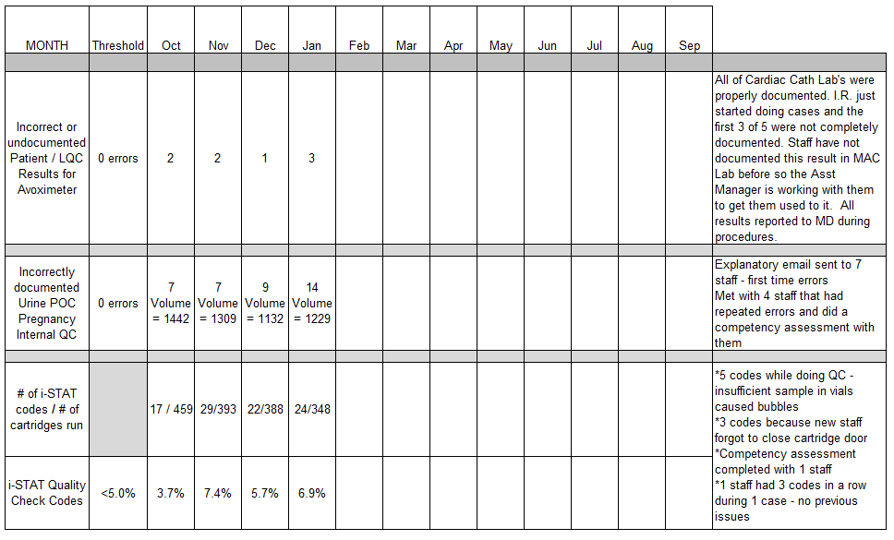
Bridgeport Campus FY 2023 – 2024 POCT QA Performance Report Summary

Slide 38
C-RSQ Report Out
Committee of Regulatory, Safety, & Quality
January 2024
Bridgeport Hospital
Department of Laboratory Medicine
Teodorico Lee MPH
Christine Minerowicz M.D.
Edward Snyder M.D.
Laura Buhlmann M.S.
Melissa Morales B.A.

Slide 39
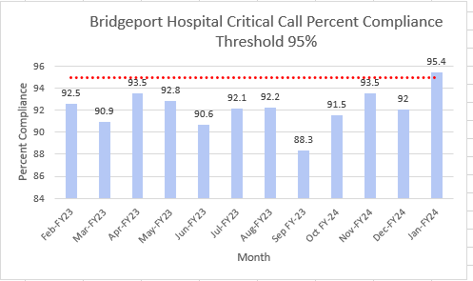
NPSG.02.03.01 EP3 Evaluate the timeliness of reporting the critical results of tests and diagnostic procedures
SMART Aim | Increase the critical result notification compliance with our 30-minute goal to 95% for inpatient & ED patients & 60 minutes for Outpatients at Bridgeport Hospital by September 2024 Note: The 30/60-minute time period is from the moment the critical value is final verified to the moment the communication log in Epic is completed.
Key drivers & Interventions | Decrease the time from result verification to communication log completion. Increase performance of correct workflow (verify result first and then notify provider). Timely communication of outpatient critical values
Interventions | Standardize critical call list workflow Provided re-education and tips and tricks for the correct workflow. Identified a process to streamline outpatient critical calls (work with specific practices with known notification issues).
We are currently at 95.4% compliance for inpatients as a department & 97.5% for outpatients
Note: There is an additional system project to standardize critical result notification workflow.
Will allow reports and metrics to be standardized as well
Notes:
Accomplishments
July 2022 had a 94.9% compliance (highest in the12 month period of July 2022-June2023).
Department of Laboratory Medicine averages approximately 1500 critical calls per month.

Slide 40
Critical Call Percent Compliance Inpatient within 30 minutes 2/1/2023-1/31/2024 BH & MCBH=94% BH=94.0% MCBH=93.8%
Bridgeport Campus
95.0% compliance January
Milford Campus
97.5% compliance January

Slide 41
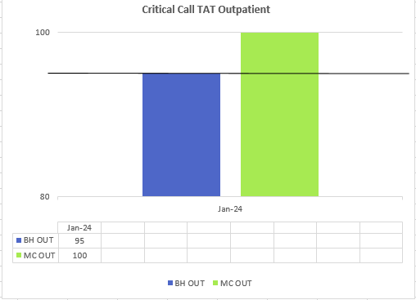
Critical Call Percent Compliance Outpatient within 60 minutes* *New QM 1/2024
Bridgeport Campus 95%
Milford Campus 100%

Slide 42
C-RSQ Report Out
Committee of Regulatory, Safety, & Quality
FY24 Jan
Bridgeport Hospital
Laboratory Blood Bank
Edward Snyder MD
Christine Minerowicz MD
Lisa Krause
Melissa Morales B.A.
Teodorico Lee MPH
Laura Buhlmann M.S.

Slide 43
PI.01.01.01 EP6 The hospital collects data on the following: The use of blood and blood components. (See also LD.03.07.01, EP 2)

Slide 44
PI.01.01.01 EP6 The hospital collects data on the following: The use of blood and blood components. (See also LD.03.07.01, EP 2)
 | Total Products | LRC | FFP | CRYO Reduced Plasma | Thawed Plasma | Total Plasma | SDP | PR PLT | Total Platelets | CRYO
Feb - FY23 | 504 | 380 | 32 | 0 | 4 | 36 | 1 | 67 | 68 | 20
Mar - FY23 | 500 | 417 | 27 | 0 | 0 | 27 | 0 | 24 | 24 | 1
Apr - FY23 | 542 | 435 | 41 | 0 | 2 | 43 | 0 | 32 | 32 | 12
May - FY23 | 666 | 437 | 139 | 0 | 4 | 143 | 0 | 53 | 53 | 10
Jun - FY23 | 539 | 414 | 43 | 0 | 0 | 43 | 0 | 48 | 48 | 16
Jul - FY23 | 477 | 377 | 31 | 0 | 6 | 37 | 0 | 32 | 32 | 10
Aug - FY23 | 555 | 420 | 45 | 0 | 3 | 48 | 0 | 62 | 62 | 0
Sep - FY23 | 479 | 332 | 58 | 0 | 9 | 67 | 0 | 42 | 42 | 7
Oct - FY24 | 555 | 450 | 28 | 0 | 7 | 35 | 1 | 41 | 42 | 5
Nov - FY24 | 610 | 503 | 35 | 0 | 8 | 43 | 1 | 54 | 55 | 9
Dec - FY24 | 514 | 419 | 26 | 0 | 23 | 49 | 0 | 39 | 39 | 7
Jan - FY24 | 589 | 466 | 44 | 0 | 12 | 56 | 0 | 42 | 42 | 0

Slide 45
PI.01.01.01 EP7 The hospital collects data on the following: All reported and confirmed transfusion reactions. (See also LD.03.07.01, EP 2; LD.03.09.01, EP 3)
 | Allergic | Febrile | Anaphylactic | TACO | TRALI | TAD | Septic | Hemolytic Intravascular | Hemolytic Extravascular | Delayed Serologic | Underlying Disease | Total
Feb- FY23 | 0 | 0 | 0 | 0 | 0 | 0 | 0 | 0 | 1 | 0 | 1 | 2
Mar-Fy23 | 0 | 1 | 0 | 0 | 0 | 0 | 0 | 0 | 0 | 0 | 0 | 1
Apr-FY23 | 1 | 2 | 0 | 1 | 0 | 0 | 0 | 0 | 0 | 0 | 0 | 4
May - FY23 | 1 | 1 | 0 | 0 | 0 | 0 | 0 | 0 | 0 | 0 | 2 | 4
Jun - FY23 | 0 | 0 | 0 | 0 | 0 | 0 | 0 | 0 | 0 | 0 | 2 | 2
July - FY23 | 0 | 0 | 0 | 0 | 0 | 0 | 0 | 0 | 0 | 0 | 0 | 0
Aug - FY23 | 0 | 2 | 0 | 0 | 0 | 0 | 0 | 0 | 0 | 0 | 0 | 2
Sep - FY23 | 1 | 1 | 0 | 0 | 0 | 0 | 0 | 0 | 0 | 0 | 0 | 2
Oct - FY24 | 0 | 2 | 0 | 0 | 0 | 1 | 0 | 0 | 1 | 1 | 1 | 6
Nov - FY24 | 1 | 2 | 0 | 0 | 0 | 0 | 0 | 0 | 0 | 0 | 1 | 4
Dec - FY24 | 0 | 1 | 0 | 0 | 0 | 0 | 0 | 0 | 0 | 0 | 0 | 1
Jan - FY24 | 0 | 4 | 0 | 0 | 0 | 0 | 0 | 1 | 0 | 1 | 1 | 7

Slide 46
PI.01.01.01 EP6 The hospital collects data on the following: The use of blood and blood components. (See also LD.03.07.01, EP 2)

Slide 47
PI.01.01.01 EP6 The hospital collects data on the following: The use of blood and blood components. (See also LD.03.07.01, EP 2)
 | Total Products | LRC | FFP | CRYO Reduced Plasma | Thawed Plasma | Total Plasma | SDP | PR PLT | Total Platelets | CRYO
Feb- FY23 | 95 | 90 | 1 | 0 | 0 | 1 | 0 | 4 | 4 | 0
Mar-FY23 | 83 | 76 | 2 | 0 | 0 | 2 | 0 | 4 | 4 | 1
Apr-FY23 | 121 | 114 | 1 | 0 | 0 | 1 | 0 | 6 | 6 | 0
May - FY23 | 91 | 87 | 1 | 0 | 0 | 1 | 0 | 3 | 3 | 0
Jun-FY23 | 121 | 113 | 0 | 0 | 0 | 0 | 0 | 8 | 8 | 0
July - FY23 | 51 | 51 | 0 | 0 | 0 | 0 | 0 | 0 | 0 | 0
Aug - FY23 | 56 | 53 | 1 | 0 | 0 | 1 | 0 | 2 | 2 | 0
Sep - FY23 | 56 | 55 | 0 | 0 | 0 | 0 | 0 | 1 | 1 | 0
Oct - FY24 | 90 | 82 | 4 | 0 | 0 | 4 | 0 | 3 | 3 | 1
Nov - FY24 | 47 | 45 | 0 | 0 | 0 | 0 | 0 | 2 | 2 | 0
Dec - FY24 | 55 | 54 | 0 | 0 | 0 | 0 | 0 | 1 | 1 | 0
Jan - FY24 | 80 | 79 | 0 | 0 | 0 | 0 | 0 | 1 | 1 | 0

Slide 48
PI.01.01.01 EP7 The hospital collects data on the following: All reported and confirmed transfusion reactions. (See also LD.03.07.01, EP 2; LD.03.09.01, EP 3)
 | Allergic | Febrile | Anaphylactic | TACO | TRALI | TAD | Septic | Hemolytic Intravascular | Hemolytic Extravascular | Delayed Serologic | Underlying Diesease | Total
Feb- FY23 | 0 | 0 | 0 | 0 | 0 | 0 | 0 | 0 | 0 | 0 | 0 | 0
Mar-FY23 | 0 | 0 | 0 | 0 | 0 | 0 | 0 | 0 | 0 | 0 | 0 | 0
Apr-FY23 | 0 | 0 | 0 | 0 | 0 | 0 | 0 | 0 | 0 | 0 | 0 | 0
May - FY23 | 0 | 0 | 0 | 0 | 0 | 0 | 0 | 0 | 0 | 0 | 0 | 0
Jun - FY23 | 0 | 0 | 0 | 0 | 0 | 0 | 0 | 0 | 0 | 0 | 0 | 0
July - FY23 | 0 | 0 | 0 | 0 | 0 | 0 | 0 | 0 | 0 | 0 | 0 | 0
Aug - FY23 | 0 | 0 | 0 | 0 | 0 | 0 | 0 | 0 | 0 | 0 | 0 | 0
Sep - FY23 | 0 | 0 | 0 | 0 | 0 | 0 | 0 | 0 | 0 | 0 | 0 | 0
Oct - FY24 | 0 | 1 | 0 | 0 | 0 | 0 | 0 | 0 | 0 | 0 | 0 | 1
Nov - FY24 | 0 | 0 | 0 | 0 | 0 | 0 | 0 | 0 | 0 | 0 | 0 | 0
Dec - FY24 | 0 | 0 | 0 | 0 | 0 | 0 | 0 | 0 | 0 | 0 | 0 | 0
Jan - FY24 | 1 | 0 | 0 | 0 | 0 | 0 | 0 | 0 | 0 | 0 | 0 | 1

Slide 49
Performance Improvement Plan
Lab Outreach Pre-Analytical Quality Indicator Monthly Review
January 2024

Slide 50
Average Wait Times
Section | Lab Outreach/Phlebotomy
Phase | Pre-Analytical
Title | Average Wait Times
Objective | Calculate the average times from patient check-in/registration to the point of specimen collection for each DN. This metric ensures patient satisfaction and monitors phlebotomists' productivity in each draw station location.
Method | Report from Helix – YNHHS Lab Blood Draw Wait Times report
Definitions | The YNHHS Lab Blood Draw Wait Times report will be pulled monthly across all draw stations.
Expected Actions | To assess each draw station patient, wait-times vs the total number. A summary report will be prepared for the Director. Feedback will be provided to the draw stations.
Benchmarks | Overall rate for patient wait time goal for 15 minutes.

Slide 51
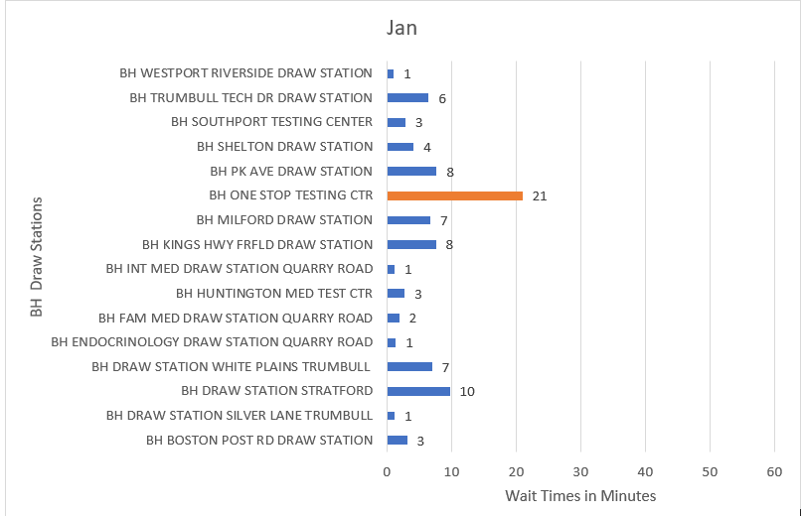
Summary:
October: Overall goal for the month was met. In October, BH draw stations averaged 5 minutes wait-time overall.
November: Overall goal for the month was met. In November, BH draw stations averaged 5 minutes wait-time overall. All locations were able to maintain an average of 10 minutes wait-time. BH One Stop one of the busiest locations has a wait time of 17 minutes.
December: Overall goal for the month was met. In December, BH draw stations averaged 5 minutes wait-time overall. Majority of locations were able to maintain wait times less than 10 minutes. BH One Stop had its lowest average wait time since March.
January: Overall goal reached for the month. January metrics are BH draw station average 5 minutes overall. One Stop location wait-time was the only location outside of the 15-minute wait time goal.

Slide 52
Butterfly Needle Usage Rate
Section | Lab Outreach/Phlebotomy
Phase | Pre-Analytical
Title | Butterfly Needle Usage Rate
Objective | Monitors the butterfly needle usage in the outpatient draw stations. Studies have shown that decreased butterfly needle usage results in less sample hemolysis, decreased costs, and less needlestick exposures.
Method | McKesson Supply Report or Infor Supply Report and Helix Reports – Collection Metrics monthly.
Definitions | We will be measuring the rate of butterfly needle usage vs total encounters.
Expected Actions | To assess each draw station butterfly usage rate. A summary report will be prepared for the Director. Feedback will be provided to the draw stations regarding butterfly usage rates.
Benchmarks | Overall rate for 20% butterfly needle usage rate.

Slide 53
Summary
October: Overall goal met for the month. Across the BH locations 24 boxes of butterfly needles were ordered, this month there was a significant increase in blood draws therefore the percentage of usage remained at 11% as the previous month.
November: Overall goal for the month was met. Across the BH locations 20 boxes of butterfly needles were ordered, 4 boxes less than the previous month resulting in a 10% butterfly usage rate.
December: Overall goal for the month was met. Across the BH locations 16 boxes of butterfly needles were ordered, 4 boxes less than the previous month resulting in 8% butterfly usage rate.
January : Overall goal reached for the month. Across all the BH locations 24 boxes of butterfly needles were ordered over the course of the month resulting in the butterfly usage rate of 11%.
 | Oct | Nov | Dec | Jan
Number of Butterfly Needles | 1200 | 1000 | 800 | 1200
Total Number of Patient Draws | 10601 | 10275 | 9960 | 10584
ALL DRAW STATIONS | 11% | 10% | 8% | 11%

Slide 54
Cancel/Redraw Rates
Section | Lab Outreach/Phlebotomy
Phase | Pre-Analytical
Title | Cancel/Redraw Rates
Objective | Monitors the cancel/redraw rates in the draw stations by measuring the number of cancel/redraws to overall samples collected as a percentage rate.
Method | Report on Helix – Redraw Rejection Cancellation and Lab Outreach Collection Metrics reports monthly.
Definitions | This metric will identify any collection procedure noncompliance and identify any areas that phlebotomists need retraining in. The redraw rates will be pulled monthly and compared to the 2022 metrics.
Expected Actions | To assess draw station locations, cancel/redraw rates. A summary report will be prepared for the Director to be discussed monthly. Feedback will be provided to the draw stations for improvements.
Benchmarks | Overall redraw rate goal of 5%.

Slide 55
Summary:
October: Overall goal for the month was met. Across all the BH draw stations the cancel/redraw rate is at 2.2% the lowest it has been all year. This is a 0.6% decrease from the previous month.
November: Overall goal for the month was met. Across all the BH draw stations the cancel/redraw rate is 3.0%.
December: Overall goal for the month was met. Across all the BH draw stations the cancel/redraw rate is 2.8%.
January : Overall goal reached for the month. Majority of locations had a cancellation rate of 4% or less. The overall cancel redraw rate for January was 2.5%.
 | Oct | Nov | Dec | Jan
BH BOSTON POST RD DRAW STATION | 1.1% | 1.9% | 2.1% | 1.2%
BH DRAW STATION SILVER LANE TRUMBULL | 2.5% | 2.7% | 5.5% | 0.8%
BH DRAW STATION STRATFORD | 1.2% | 2.5% | 2.1% | 1.4%
BH DRAW STATION WHITE PLAINS TRUMBULL | 3.6% | 4.3% | 6.1% | 3.5%
BH ENDOCRINOLOGY DRAW STATION QUARRY ROAD | 0.9% | 0.8% | 1.5% | 0.0%
BH FAM MED DRAW STATION QUARRY ROAD | 3.1% | 4.9% | 3.7% | 4.8%
BH HUNTINGTON MED TEST CTR | 3.7% | 2.4% | 2.3% | 2.0%
BH INT MED DRAW STATION QUARRY ROAD | 4.4% | 5.7% | 2.8% | 3.5%
BH KINGS HWY FRFLD DRAW STATION | 1.8% | 2.1% | 2.5% | 1.8%
BH MILFORD DRAW STATION | 1.1% | 1.4% | 4.3% | 2.7%
BH ONE STOP TESTING CTR | 4.9% | 5.6% | 4.1% | 4.8%
BH PK AVE DRAW STATION | 1.7% | 2.5% | 3.4% | 2.5%
BH SHELTON DRAW STATION | 2.6% | 1.8% | 1.9% | 3.6%
BH SOUTHPORT TESTING CENTER | 0.3% | 0.0% | 0.3% | 1.6%
BH TRUMBULL TECH DR DRAW STATION | 2.5% | 6.4% | 1.5% | 3.4%
BH WESTPORT RIVERSIDE DRAW STATION | 0.3% | 2.3% | 0.4% | 2.0%
ALL DRAW STATION AVERAGE | 2.2% | 3.0% | 2.8% | 2.5%

Slide 56
Centrifuge Compliance
Section | Lab Outreach/Phlebotomy
Phase | Pre-Analytical
Title | Centrifuge Compliance
Objective | Ensures centrifuges in the draw station are functioning as intended which will result in better quality samples and decrease processing errors and specimen rejections.
Method | Auditing centrifuges and record service reports. BioMed (TriMedx) service reports will save in DN specific folders.
Definitions | Every month each DN will be audited on the number of compliant centrifuges and be given a compliance percentage. For example, if all 32 centrifuges in the YNH area are serviced before the due date then they will be at 100% compliance every month.
Expected Actions | The team will also be keeping centrifuge records up-to-date for compliance across all Delivery Networks. A summary report will be prepared for the Director.
Benchmarks | Overall centrifuge compliance goal of 100%.

Slide 57
Summary
October: Overall goal met for the month. All centrifuges are up-to-date.
November: Overall goal met for the month. All centrifuges are up-to-date.
December: Overall goal met for the month. All centrifuges are up-to-date.
January : Overall goal for the month was met. All centrifuges are up-to-date with inspections.
 | Oct | Nov | Dec | Jan
Number of Compliant Centrifuges | 20 | 20 | 20 | 20
Total Number of Centrifuges | 20 | 20 | 20 | 20
ALL DRAW STATIONS | 100% | 100% | 100% | 100%

Slide 58
Patient Satisfactory Survey
Section | Lab Outreach/Phlebotomy
Phase | Pre-Analytical
Title | Patient Satisfactory Survey
Objective | Achieving high levels of satisfaction is directly dependent on the high-quality patient care provided by phlebotomists in draw stations. In order to find out the pain-points of patients, whether there’s any room for improvement, and what measures can be implemented to enhance services.
Method | Key Survey Reports and Press Ganey surveys scores
Definitions | The Key Survey report will be pulled monthly.
Expected Actions | To assess each draw station the patient experience surveys or scores. A summary report will be prepared for the Director. Feedback will be provided to the draw stations to make improvements to help increase patient satisfaction.
Benchmarks | Overall patient satisfaction rate 90%.

Slide 59
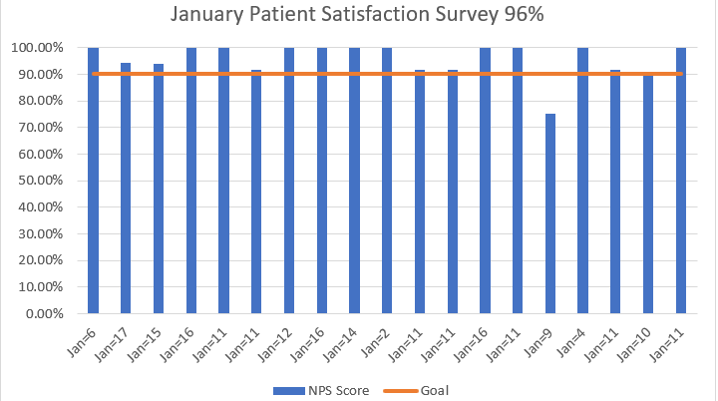
Summary
October: Overall goal for the month was met. Across BH draw station locations 97% of patients were likely to recommend our facilities to a friend, 99% of patients felt our facilities were neat and clean, and 96% of patients felt they were treated with respect during their visit.
November: Overall goal for the month was met. Across BH draw station locations 97% of patients were likely to recommend our facilities to a friend, 98% of patients felt our facilities were neat and clean and 97% of patients felt they were treated with respect during their visit.
December: Overall goal for the month was met. Across BH draw station locations 96% of patients were likely to recommend our facilities to a friend, 98% of patients felt our facilities were neat and clean and 98% of patients felt they were treated with respect during their visit.
January : Overall goal met for the month. January patient satisfaction rate was 96%. Across a portion of the draw station locations 96% of patients were likely to recommend our facilities to a friend, 98% of patients felt our facilities were neat and clean, and 96% of patients felt they were treated with respect during their visit.

Slide 60
Transcription Accuracy Rate
Section | Lab Outreach/Phlebotomy
Phase | Pre-Analytical
Title | Transcription accuracy rate
Objective | Monitors the accuracy of the phlebotomist's transcriptions into EPIC from paper requisitions.
Method | Report run by Lab Billing department daily.
Definitions | Report is run by Lab Billing, and they randomly select up to 5 transcribed requisitions from each DN daily. The areas evaluated for accuracy will be the provider's name, tests ordered, scanning of req into EPIC and charges. Lab Billing will track the requisitions selected and errors in a separate spreadsheet on the YNH :/L shared drive.
Expected Actions | To assess each draw station transcription accuracy. A summary report will be prepared for the Director. Feedback will be provided to the draw stations.
Benchmarks | Overall rate for 90% transcription accuracy.

Slide 61
Summary
October: Overall goal for the month was met. For the month of October, the # of providers transcribed 110/110, sum of tests transcribed correctly 389/390 and # of requisitions scanned in EPIC 109/109.
November: Overall goal for the month was met. For the month of November, the # of providers transcribed 104/104, sum of tests transcribed correctly 354/354 and # of requisitions scanned in EPIC 104/104.
December: Overall goal for the month was met. For the month of December, the # providers transcribed 97/97, sum of tests transcribed correctly 304/306 and # of requisitions scanned in EPIC 95/95.
January : Overall goal reached for the month. For the month of January the # of providers transcribed correctly 104/104, sum of tests transcribed correctly 328/328 and # of requisitions scanned in EPIC 104/104.
 | Oct | Nov | Dec | Jan
ALL DRAW STATION AVERAGE | 100% | 100% | 100% | 100%

Slide 62
FY 2024 QA
Microbiology and Central Processing
February 2024

Slide 63
Microbiology Quality Measures 2024

Slide 64
Microbiology Test Volumes

Slide 65
Blood Culture Bottle Volumes – Above Optimal volume

Slide 66
Blood Culture Bottle Volumes – Below Optimal volume

Slide 67
FY 2024 Blood Culture Volume Above Optimal Range

Slide 68
FY 2024 Blood Culture Volume Below Optimal Range

Slide 69
Micro Molecular Statistics
Date | Tests | Sample size | Positive Count | % Positivity | Lower Limit | Upper Limit | Environment Monitoring | Epidemiological Trends | Evaluation Notes
Jan-24 | C. difficile Assay | 200 | 33 | 16.5% | 14% | 26% | Negative | None | None
Jan-24 | Group A Strep PCR | 808 | 149 | 18.4% | 2% | 26% | Negative | None | None
Jan-24 | Group A Strep PCR | 808 | 149 | 18.4% | 2% | 26% | Negative | None | None
Jan-24 | Influenza A/B RNA, NAAT | 174 | 29 | 16.7% | 0% | 19% | Negative | None | None
Jan-24 | Influenza/RSV by RT-PCR | 2,461 | 438 | 17.8% | 0% | 19% | Negative | None | None
Jan-24 | MRSA Colonization Status | 423 | 49 | 11.6% | 5% | 18% | Negative | None | None
Jan-24 | MRSA/SAUR Blood PCR | 29 | 6 | 20.7% | 15% | 51% | Negative | None | None
Jan-24 | MTB w/rflx Rifampin PCR | 5 | 0 | 0.0% | 0% | 77% | Negative | None | None
Jan-24 | Resp Virus PCR Panel | 180 | 28 | 15.6% | 2% | 51% | Negative | None | None
Jan-24 | Respiratory Virus PCR Panel | 184 | 11 | 6.0% | 0% | 32% | Negative | None | None
Jan-24 | SARS CoV-2 (COVID-19) RNA | 3,382 | 527 | 15.6% | 0% | 20% | Negative | None | None
Jan-24 | Stool Pathogens PCR | 109 | 10 | 9.2% | 0% | 21% | Negative | None | None

Slide 70
BH & MC Blood Culture contamination rate

Slide 71
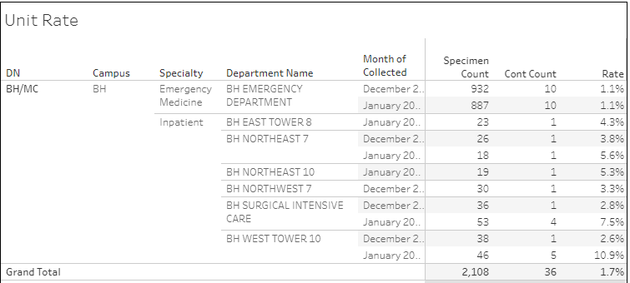
Blood Contamination rate—BH

Slide 72
Blood Culture Contamination Rate—BH ED

Slide 73
Blood Culture Contamination Rate—all other units

Slide 74
Blood Culture Contamination Rate—MC

Slide 75
Blood Culture Contamination Rate—MC ED

Slide 76
Blood Culture Contamination Rate—all other units

Slide 77
Blood Culture Contamination Rate DN’s Comparison

Slide 78
Quest TAT
The TAT calculations include
accessions that have been through the "test in question" process, or tests that have been
corrected, repeated, reflexed, confirmed, or added on after the original order.

Slide 79
Quest Rejected Tests

Slide 80
Mayo Rejected Tests

Slide 81
FY2024 Draw Station Errors

Slide 82
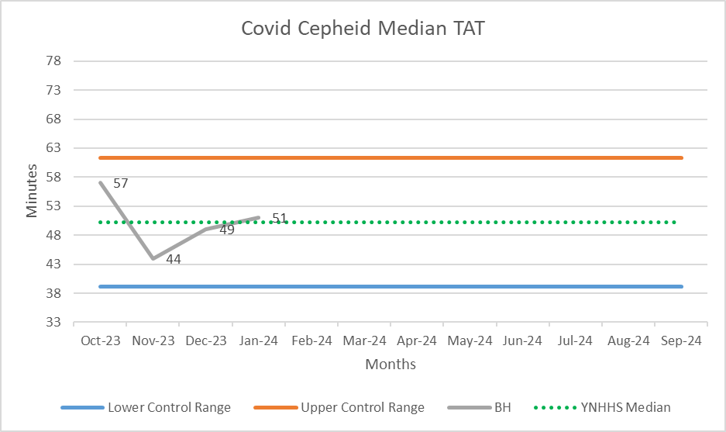
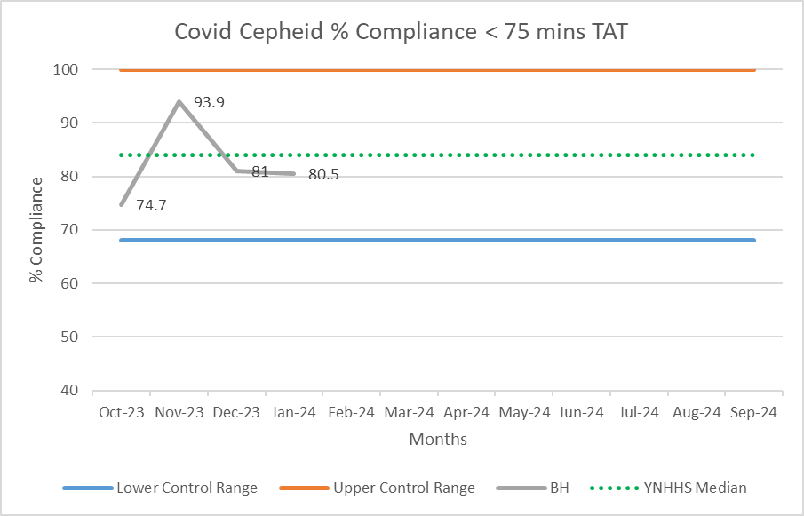
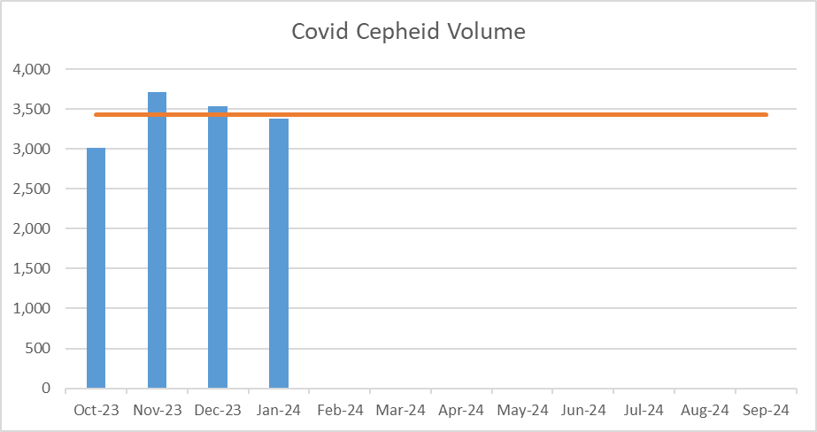
Bridgeport Campus – COVID-19 Cepheid

Slide 83
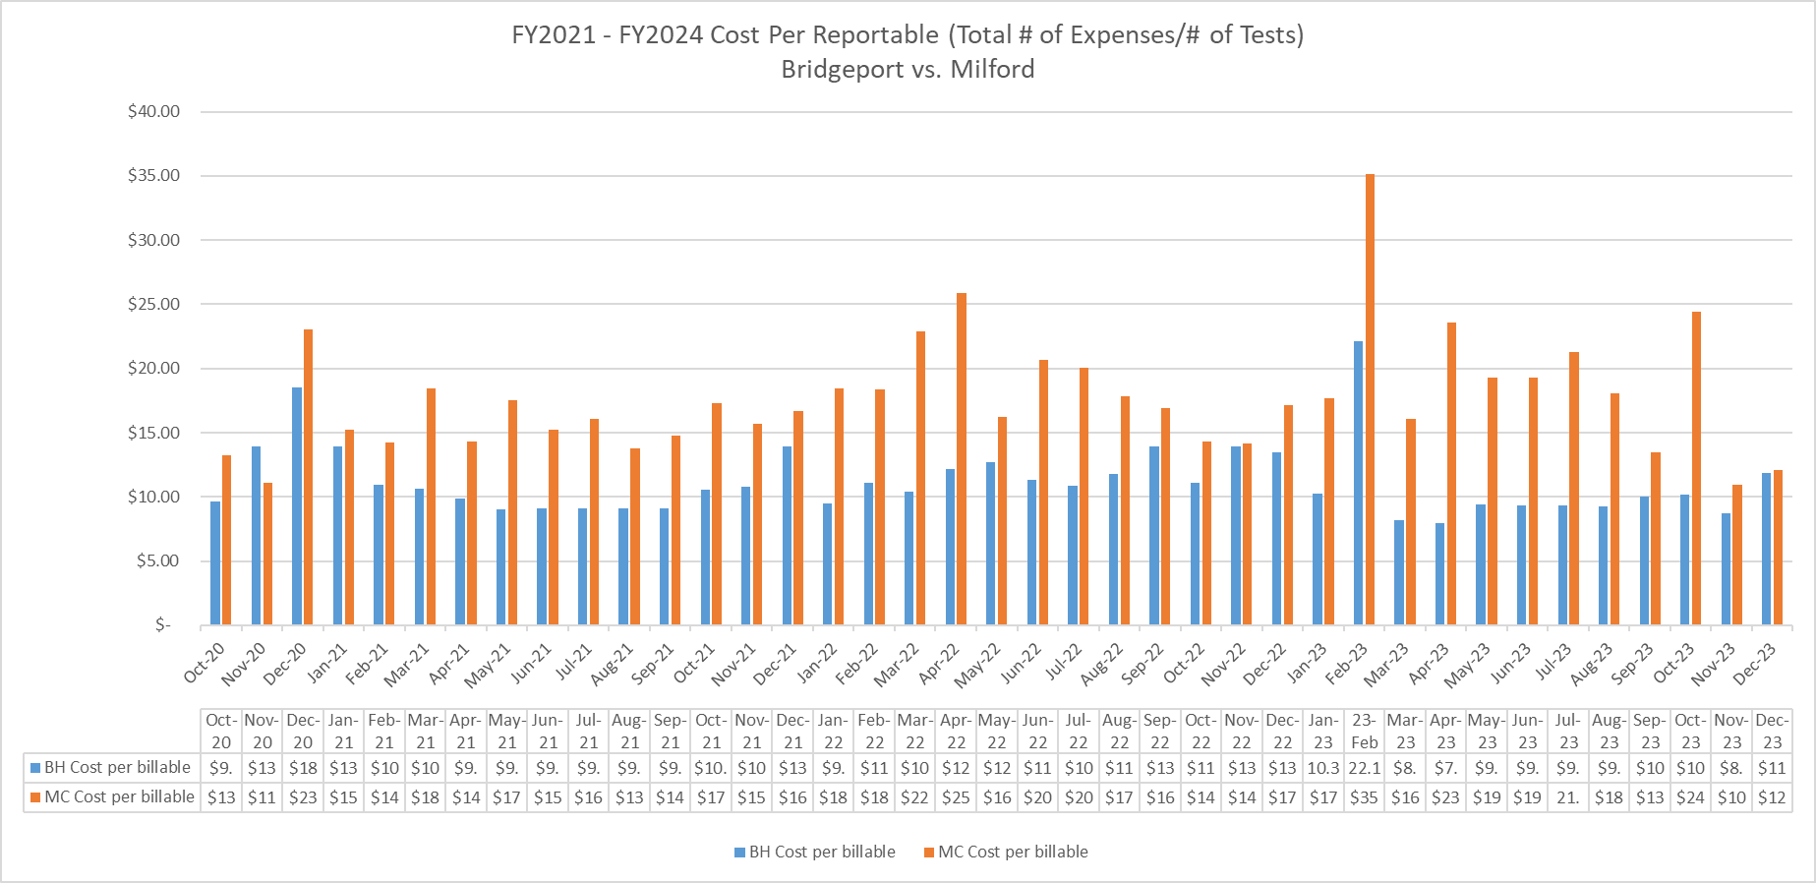
Cost Per Billable

Slide 84
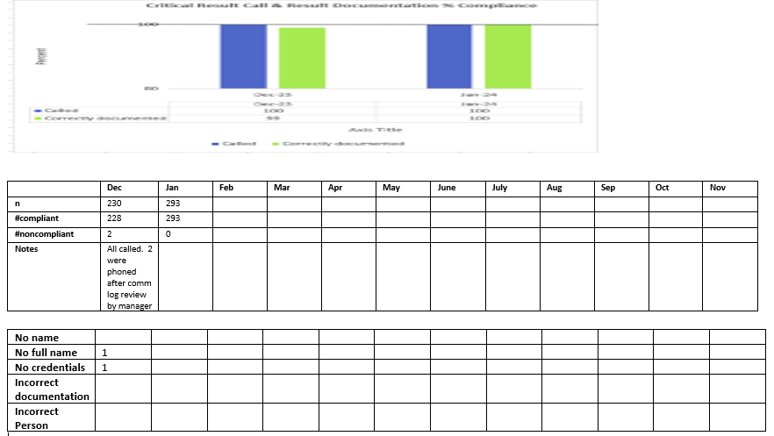
MCBH Critical Result Calls & Documentation

Slide 85
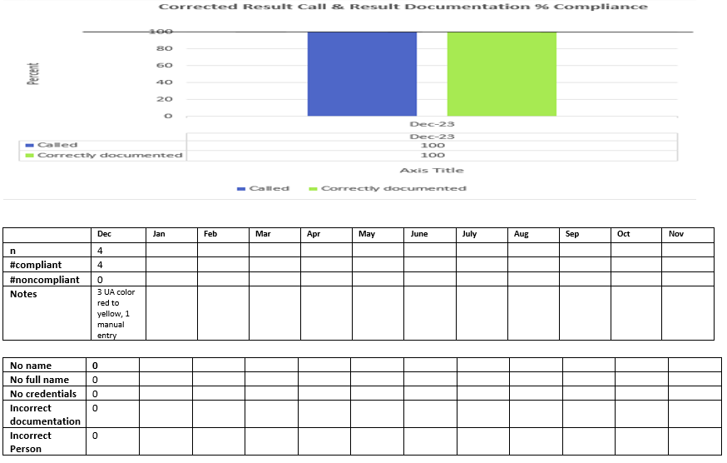
MCBH Critical Result Calls & Documentation

Slide 86
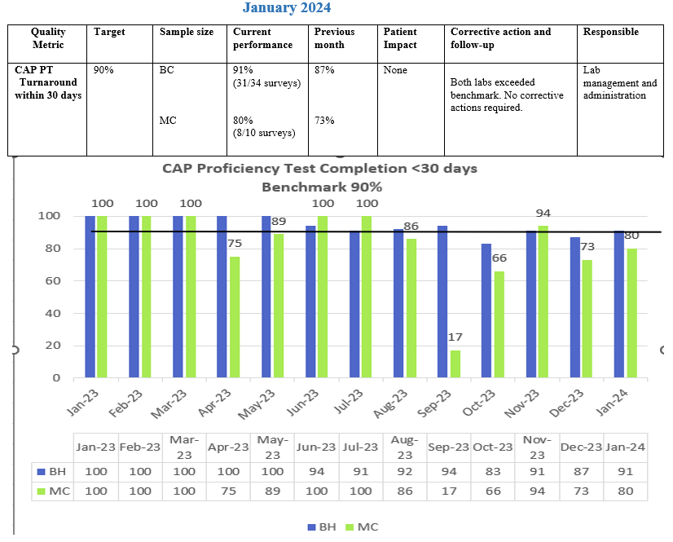
Lab General
BH CL07D0099572/CAP1191901
MCBH CL07D0097265/CAP 1189901

Slide 87
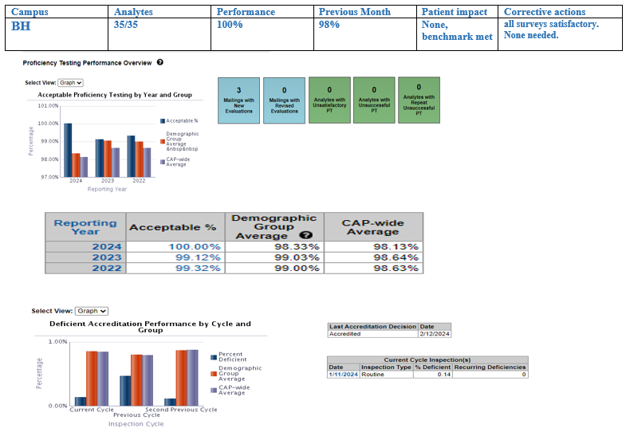
Bridgeport Proficiency Performance Testing Target 98% & Accreditation Overview

Slide 88
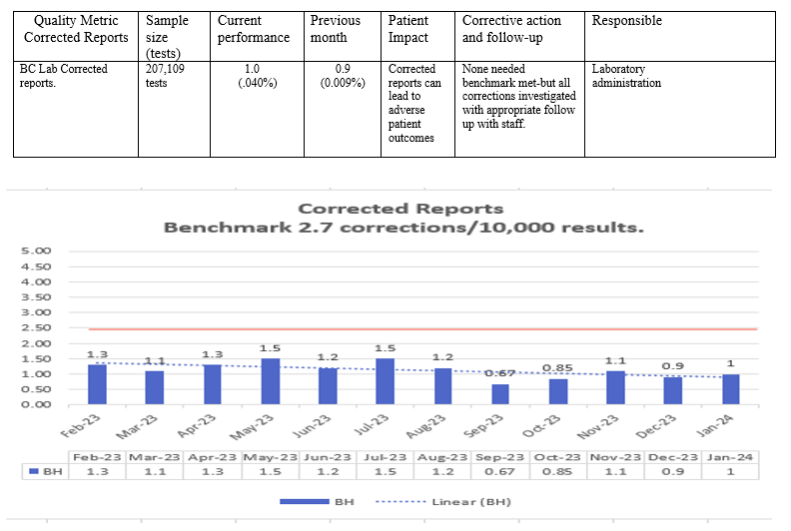
Lab General BH Corrected Reports Target <2.7/10,000 results

Slide 89
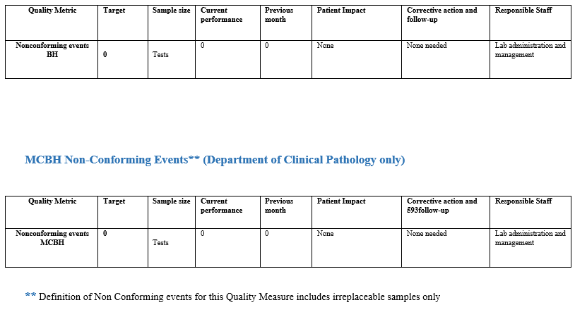
BH Non-Conforming Events** (Department of Clinical Pathology only)

Slide 90
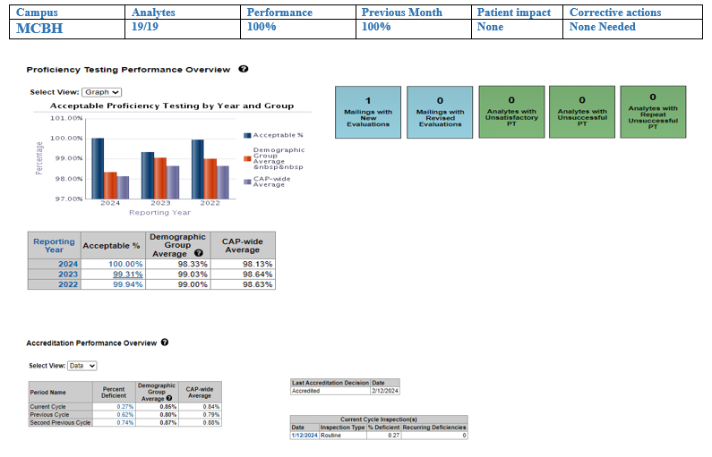
MCBH Proficiency Testing Target 98% & Accreditation Overview

Slide 91
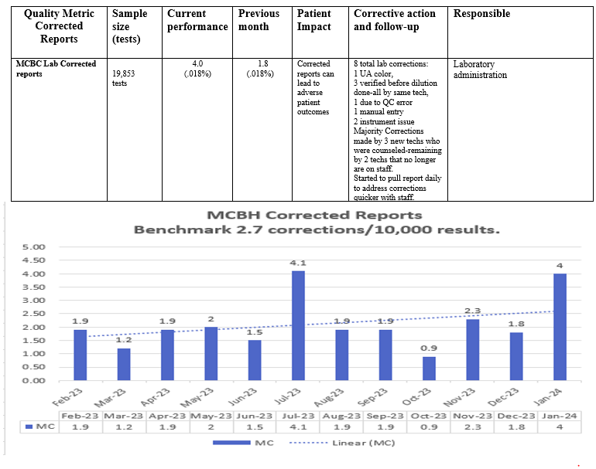
MCBH Corrected Reports Target <2.7/10,000 results

Slide 92
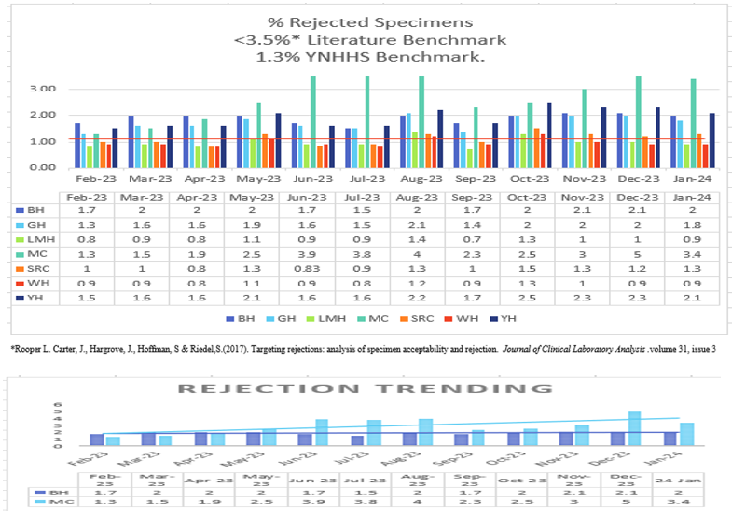
Laboratory General

Slide 93
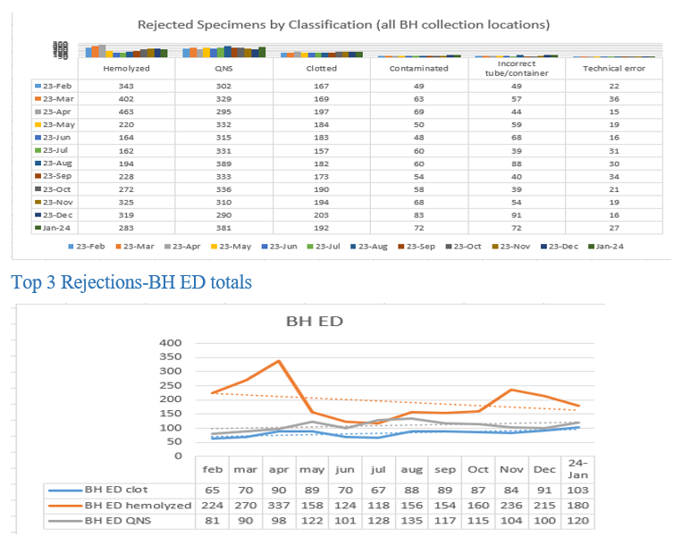
Laboratory General

Slide 94
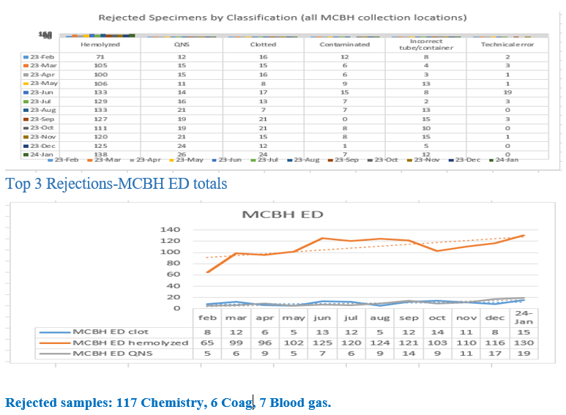
Laboratory General

Slide 95
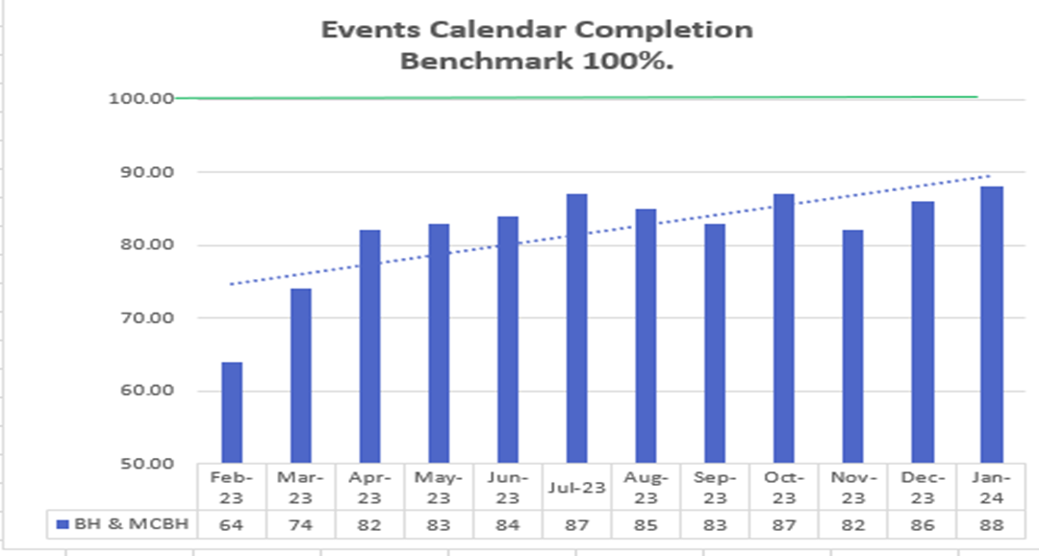
Laboratory General BH & MCBH Events Calendar Completion 88% Benchmark 100%
Overdue competencies/training on per diem and staff on FMLA.

Slide 96
SAFER Monthly Events January 2024

Slide 97
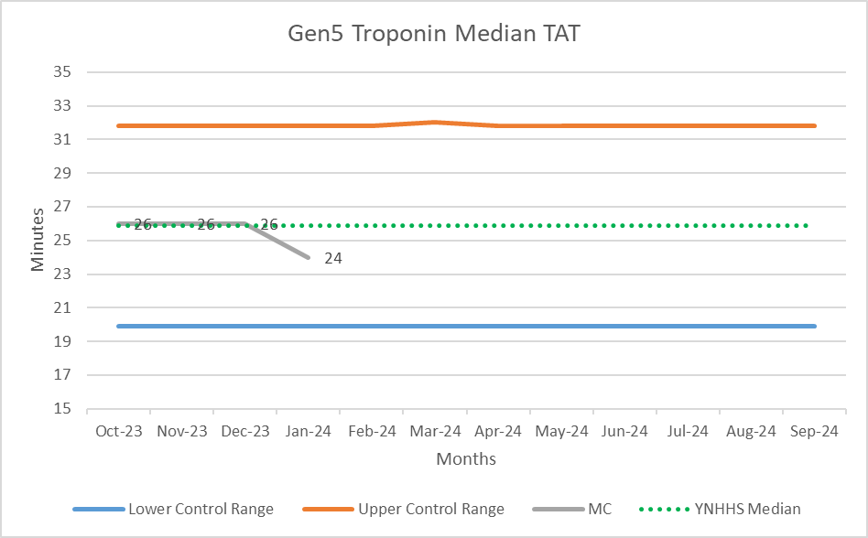
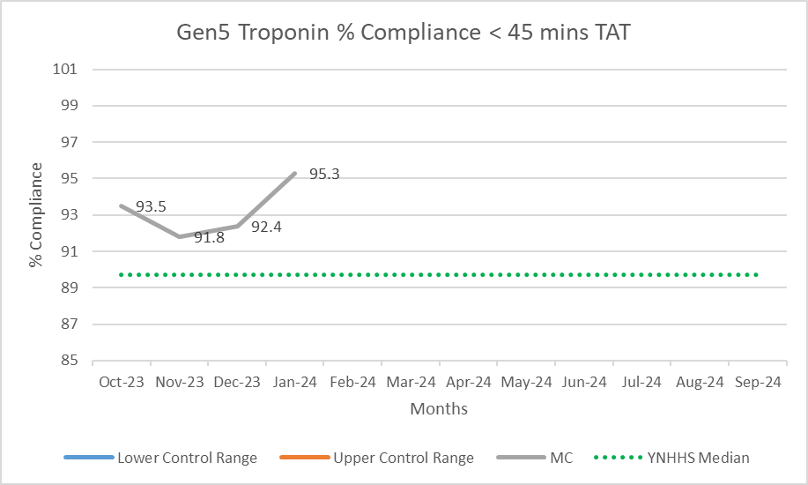
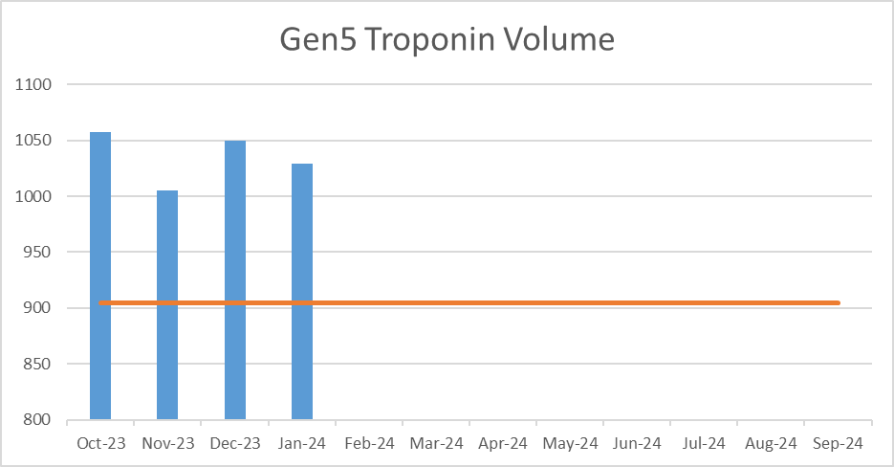
Milford Campus – Gen 5 Troponin TAT

Slide 98
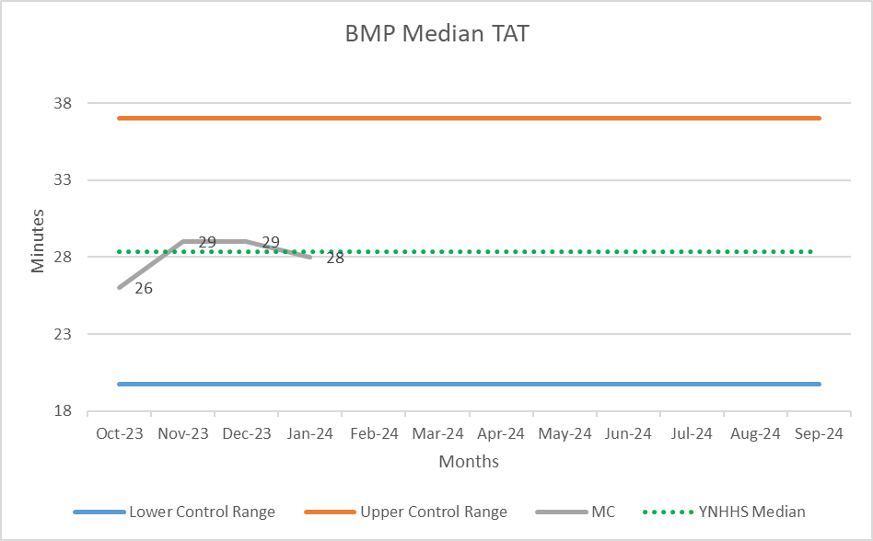
Milford Campus – Basic Metabolic Panel (BMP) ED TAT

Slide 99
Milford Campus – Complete Blood Count (CBC) ED TAT

Slide 100
Milford Campus – PTINR ED TAT

Slide 101
Milford Campus – D-dimer ED TAT

Slide 102
Milford Campus – Type and Screen ED TAT

Slide 103
Milford Campus – COVID Cepheid PCR TAT

Slide 104
Milford Campus Molecular Dashboard

