Slide 1
BRIDGEPORT HOSPITAL (BC & MC)
ANATOMIC PATHOLOGY
QUALITY ASSURANCE MEETING
January 23, 2024
for the Month of December 2023

Slide 2
OLD BUSINESS
\\Ynhh.org\src\BH - Laboratory\AP - BH 38030\! AP QA\AP QA Meetings\2023\2023 AGENDA & MEETING MINUTES\January 17, 2024\minutes for month of November held on December 20th 2023.docx

Slide 3
BC & MC AP VOLUME( January- November 2023)

Slide 4
BRIDGEPORT CAMPUS
Intraoperative Diagnosis vs. Final/ Amendments & Histology):
\\Ynhh.org\src\BH - Laboratory\AP - BH 38030\! AP QA\AP QA Meetings\2023\2023 AGENDA & MEETING MINUTES\January 17, 2024\ANATOMIC QA January 23 2024.docx
\\Ynhh.org\src\BH - Laboratory\AP - BH 38030\! AP QA\AP QA Meetings\2023\2023 Consensus Conference Daily Log\December 2023 Consensus.pdf

Slide 5
Milford Campus December 2023 Frozen Stats
-Frozen: 0 - Parts that Meet Threshold: 0
-Blocks: 0
-Touch Preps: 0 -% of Parts that Meets Threshold: 0% -Cases: 0
Threshold of 20 min./ block – only one case met the 20 minutes threshold
Number of discrepancies: 0

Slide 6
Biopsies TAT Within 2 Days (FY23)
70 % Benchmark

Slide 7
Non-Gyn Case Volume & TAT ≤ 5 Days

Slide 8
2023 SYSTEM QUALITY METRIC

Slide 9
GI Biopsy TAT 80% </= 2 business days (received to sign out)

Slide 10
Breast Biopsy TAT 80% </= 2 business days (received to sign out)

Slide 11
Prostate TAT (received to sign out) % <=5 business days (track)

Slide 12
2023 Lung TAT (received to sign out) 90% <= 2 business days

Slide 13
Contaminant/Floater/Extraneous
TISSUE

Slide 14
Contaminants by Month 12/31/2022-12/31/2023
5 of 1,877 cases (0.27%)
5 of 8,322 blocks (0.06%)
5 of 15,312 slides (0.03%)
Benign
Malignant
Benchmark: 1.5% of cases, 0.8% of blocks, 0.6% of slides. Gephardt GN, Zarbo RJ. Extraneous tissue in surgical pathology: a College of American Pathologists Q-Probes study of 275 laboratories. Arch Pathol Lab Med 1996 Nov; 120(11):1009-14.
* Microtomy

Slide 15
Type of Floater & Site of Contamination December 2023
TISSUE | TISSUE | MAIL | MALIGNANT | PHOTO | ON | PROX | FLOATER | SAME CASE | DIFFERENT CASE
PATIENT | FLOATER | EMAIL |  | EMAIL | LEVELS | REP | ORIGIN
Esophagus | Duodenum | No | No | No | Yes | Yes | Prelab | Yes | No
Esophagus | Columnar tissue | No | No | No | Yes | Yes | Prelab | Yes | No
Stomach | Squamous tissue | No | No | No | Yes | Yes | Prelab | Yes | No
Colon | Atrophic oxyntic mucosa | No | No | No | Yes | Yes | Prelab | Yes | No
Colon | Adipose tissue | No | No | No | No | Yes | Microtomy/waterbath | No | Yes

Slide 16
2023 Contaminants/ Floaters Bridgeport Hospital

Slide 17
90 CONTAMINANTS IN BLOCKS (01/01/2020- 12/31/2023)

Slide 18
H&E Performance Log
Starting December 2023, the Daily Slide Quality Log is part of the Daily Consensus Conference Log.

Slide 19
Tissue Processor Verification
\\Ynhh.org\bh\Laboratory\AP - BH 38030\! AP QA\AP QA Meetings\2023\2023 Tissue processor verification and monthly data logs\December 2023 Tissue processor verification.pdf

Slide 20
Internal Audits / Corrective Action Plan 3 Consecutive Cases Biweekly
\\Ynhh.org\bh\Laboratory\AP - BH 38030\! AP QA\AP QA Meetings\2023\2023 5 audit cases monthly\December 2023 Audit cases.pdf

Slide 21
Challenges and Opportunities for Improvement Anatomic Pathology (Before Final Dx)

Slide 22
Histology Processing Issues

Slide 23
Histology Processing Issues

Slide 24
CYTOLOGY SPECIMENS
SENT TO YSM FOR PROCESSING

Slide 27
Notes:
Combined volume for May 459. Error rate is 0.22%

Slide 28
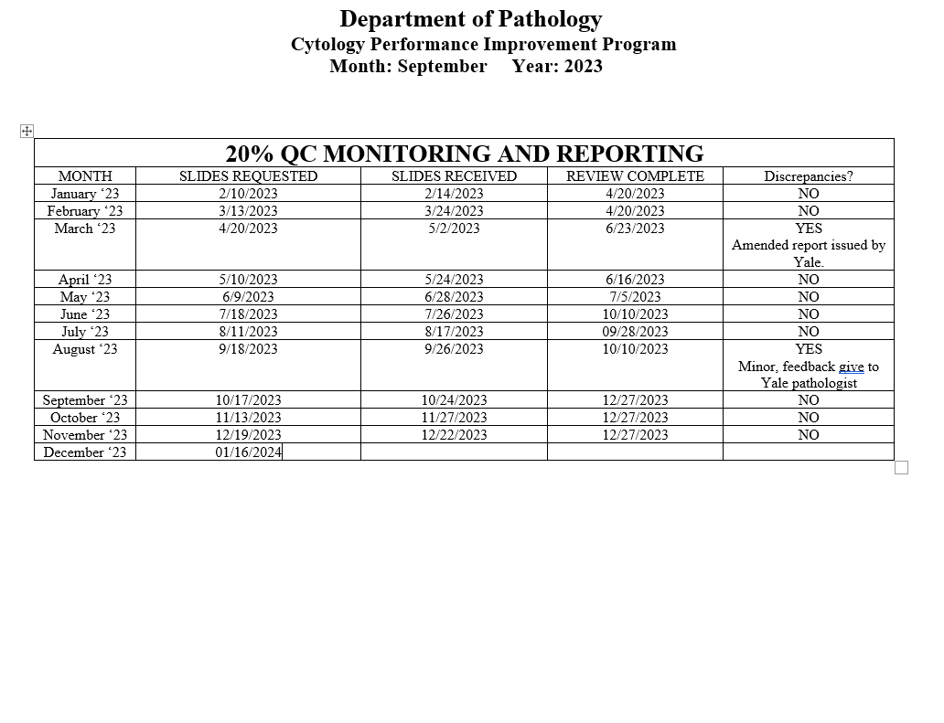
Notes:
The NON GYN TAT is due to staffing issues at YSM, extended leaves, vacations, and cross training in processing. May impact June.
We are up to date on QC review, April and May are with Dr. Cohen. We’ve had no discrepancies.

Slide 29
Competency Checklist
\\Ynhh.org\src\BH - Laboratory\AP - BH 38030\! AP QA\AP QA Meetings\COMPETENCY LOG TO UPDATE MONTHLY\Monthly Competency.xlsx

Slide 30
Reports:
Policy and Procedures for signature Review (ongoing)
Ongoing...
PM for all other equipment
\\Ynhh.org\bh\Laboratory\AP - BH 38030\Maintenance & Service Reports\Current Instrument List.xlsx
Significant issues
Summary of the Anatomic Pathology Quality Assurance meeting will be presented at Quality Council and Professional and Quality Committee of the Board, and at every full Board meeting, with a more in depth discussion of any significant issues (every six months).Confirm Minutes from Quality Council and Professional and Quality Committee of the Board – Laura Buhlmann.
The P&Q and Quality council- replaced by CRSQ
The exact wording from the AOC:
“A summary of the monthly AP QA meeting will be presented monthly at Quality Council and P&Q Committee of the Board and at every Board meeting with a more in depth discussion of any significant issues, for at least one year”.

Slide 31
Non-Conforming Events
\\Ynhh.org\src\BH - Laboratory\AP - BH 38030\! AP QA\AP QA Meetings\Irreplaceable Specimen Templates\IS Update for BH goals 2023 presentations\IS Update for BH goals month of December 2023.pptx

Slide 32
New Business
Align QA metrics with System for 2024
Personnel Update
Pathology Candidate
Students (HTL, HT, PA)
Recognition

