Slide 1
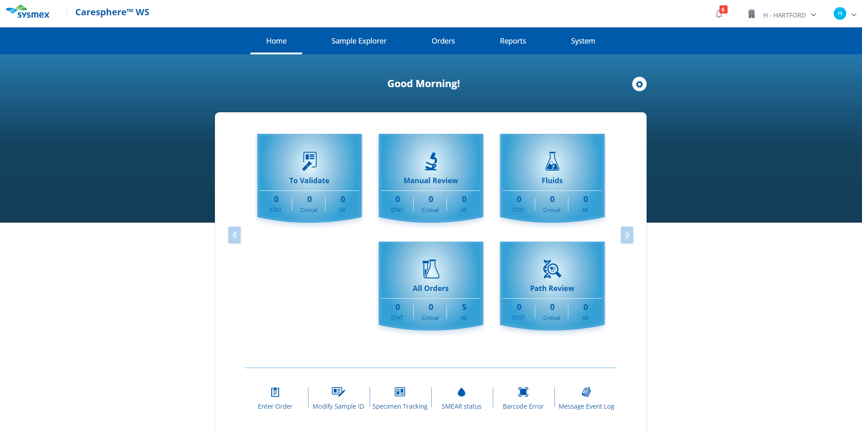
Click on the To Validate tile to view the list of pending specimens.

Slide 2
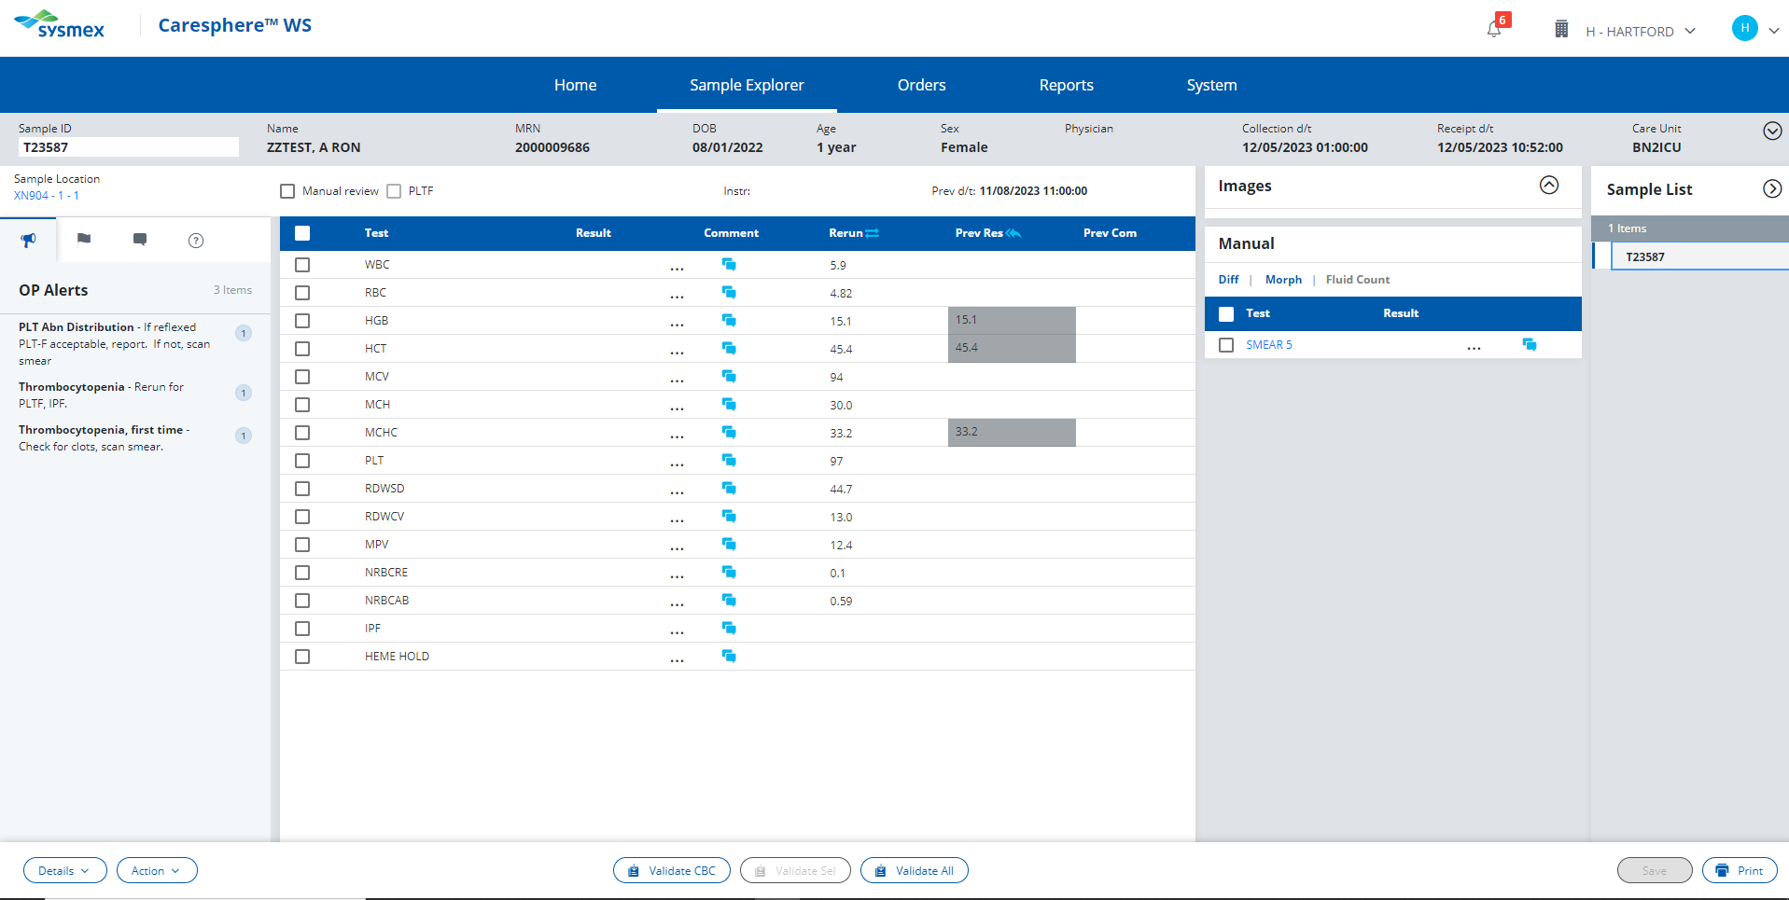
Select the abnormal result to review corresponding procedural action rules.

Slide 3
That value is within the normal reference range. Refer to the HH Reference Range Procedure to find the abnormal value.
Click here to try again!

Slide 4
PLT <100
Actions;
Check sample for clot. If no clotting is observed, enter a NCLOT (no clot) comment.
Rerun the sample for the Platelet F.
Review the patient history. If this is the first occurrence of the PLT result falling below 100, perform platelet estimate.
OR
If patient has a history of PLT results falling below 100 and the PLT does not have an asterisk flag, release result.
Rough draft slide, to be deleted.

Slide 5
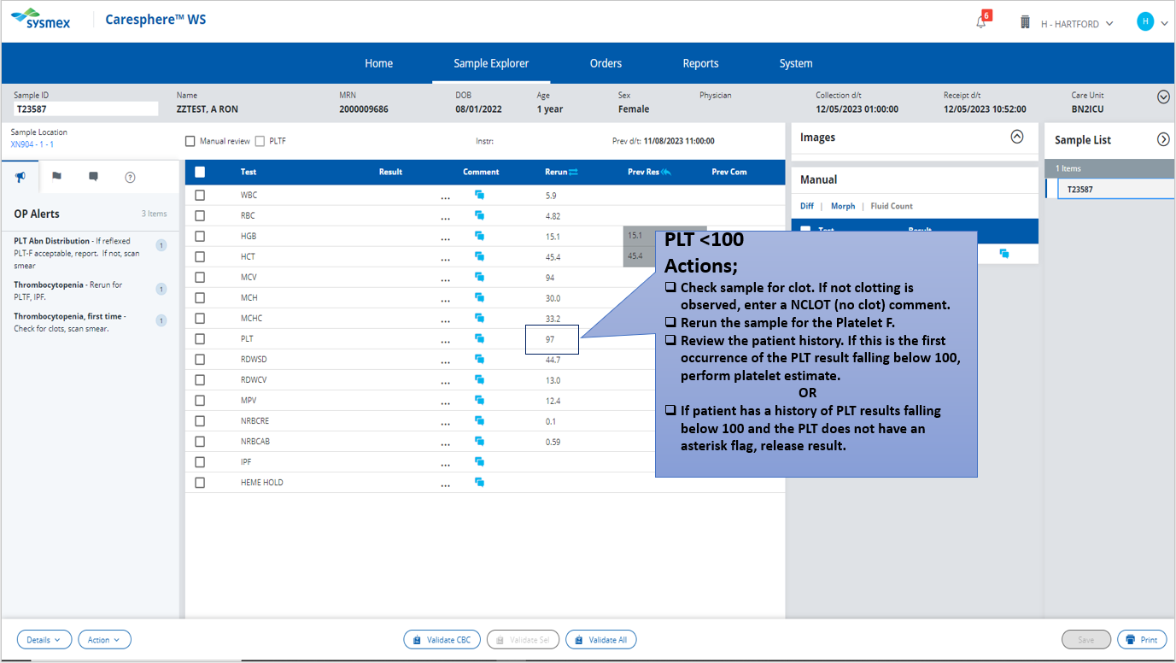
Click here to proceed with first action

Slide 6
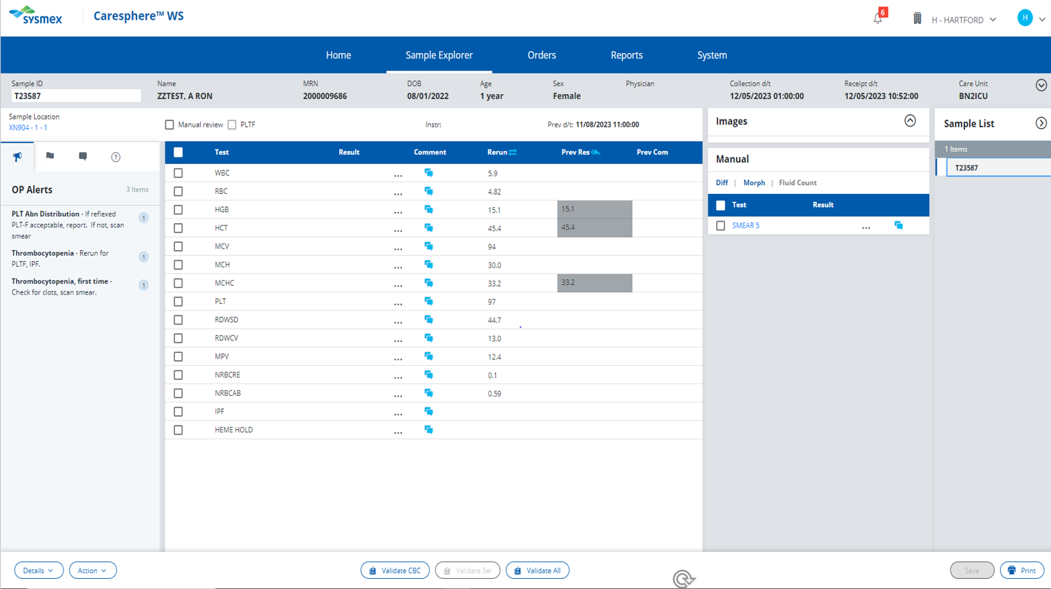
You have checked the sample for a clot and saw no signs of clotting. Enter a NCLOT (no clot) comment

Slide 7
These are the external comment buttons. Comments entered here will be seen by the provider when viewing the patient’s results.
The “no clot” comment is for internal lab use only.
Click here to try again!

Slide 8
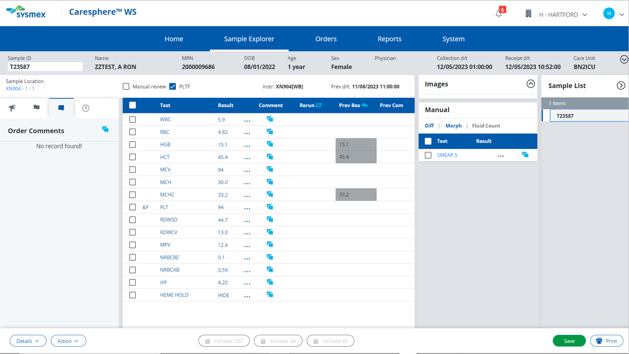

Slide 9
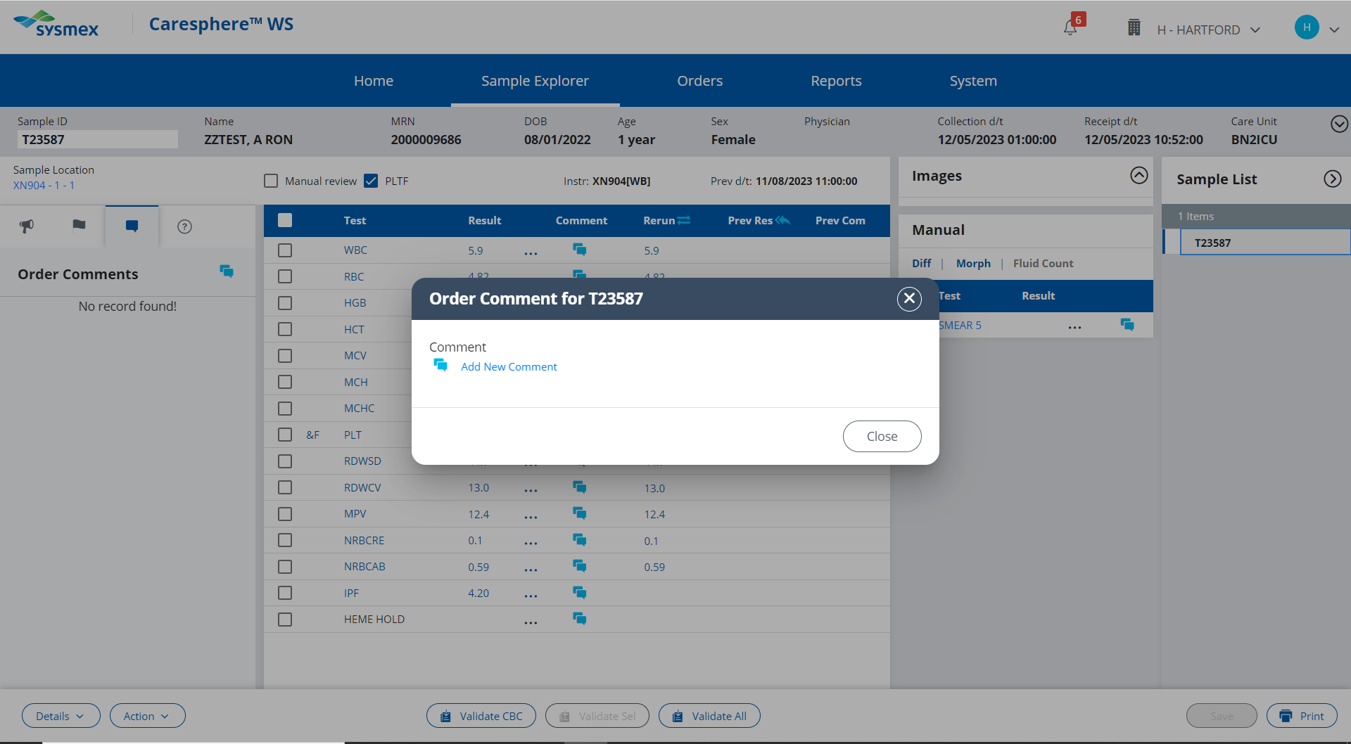

Slide 10
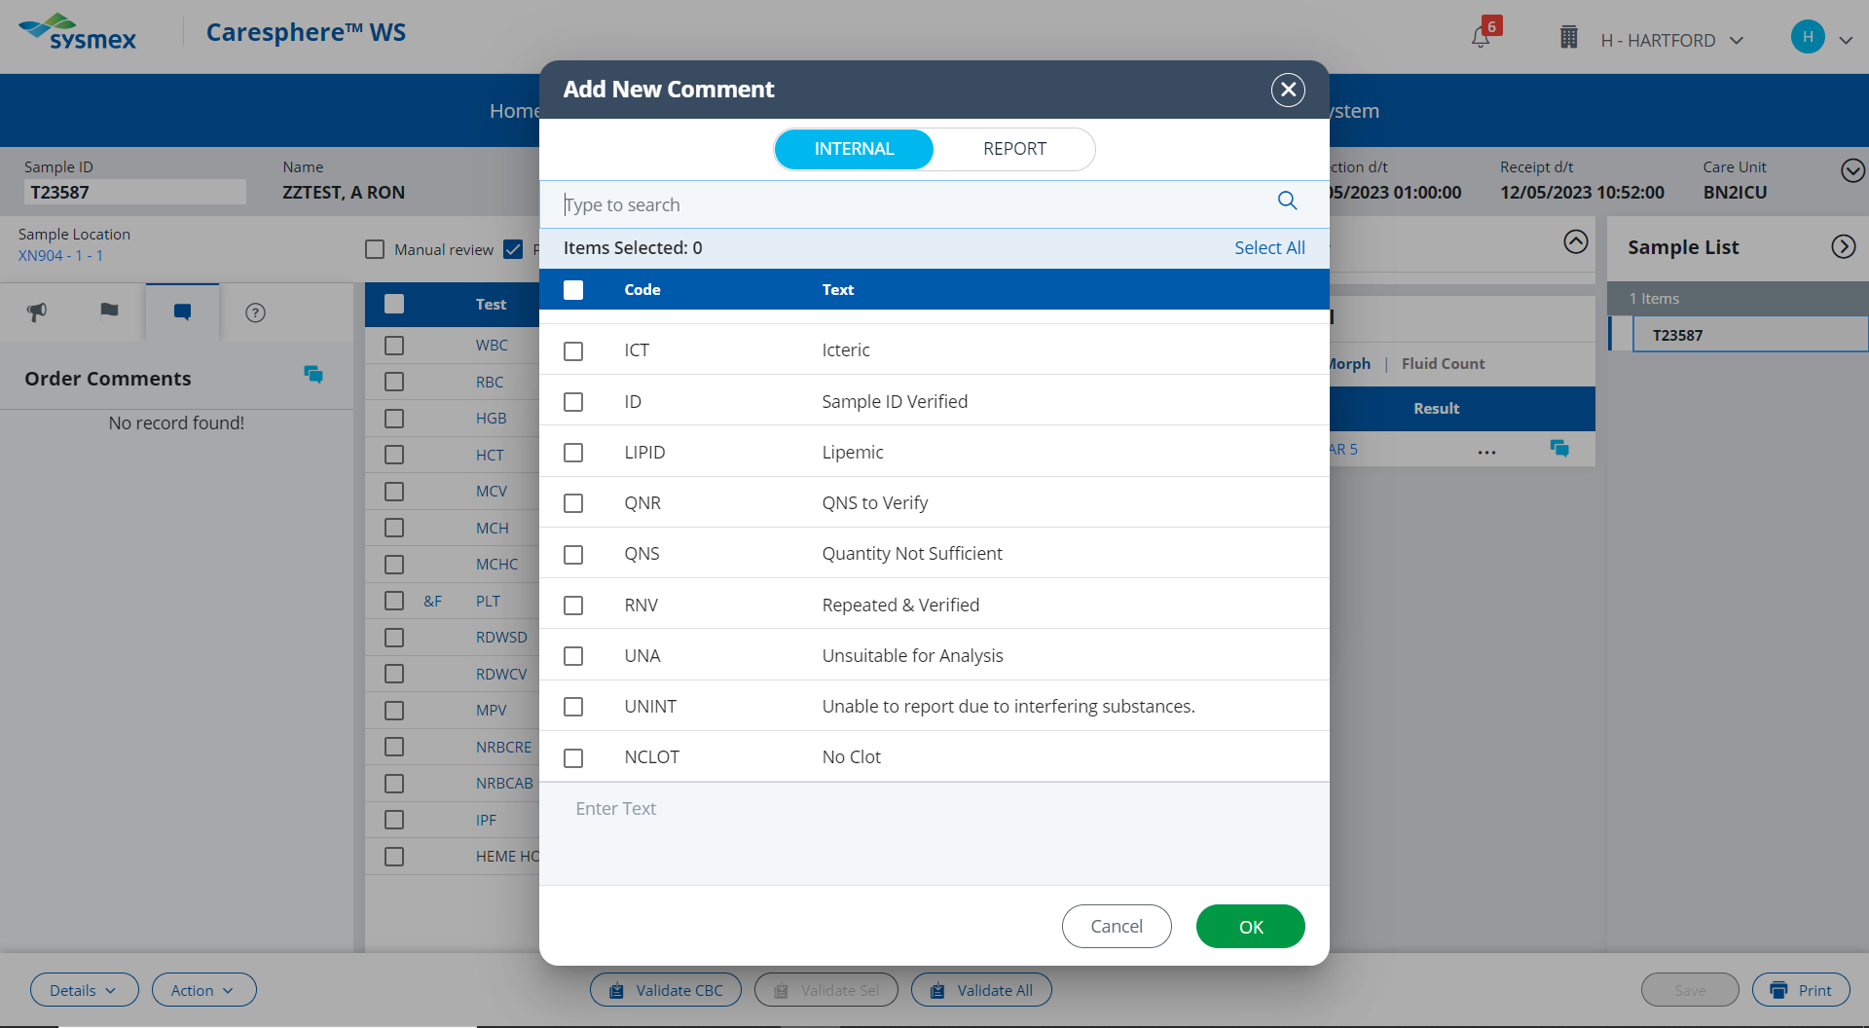

Slide 11
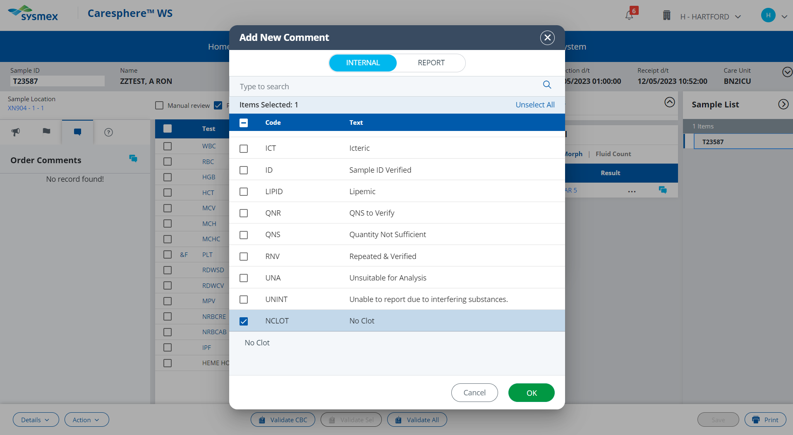

Slide 12
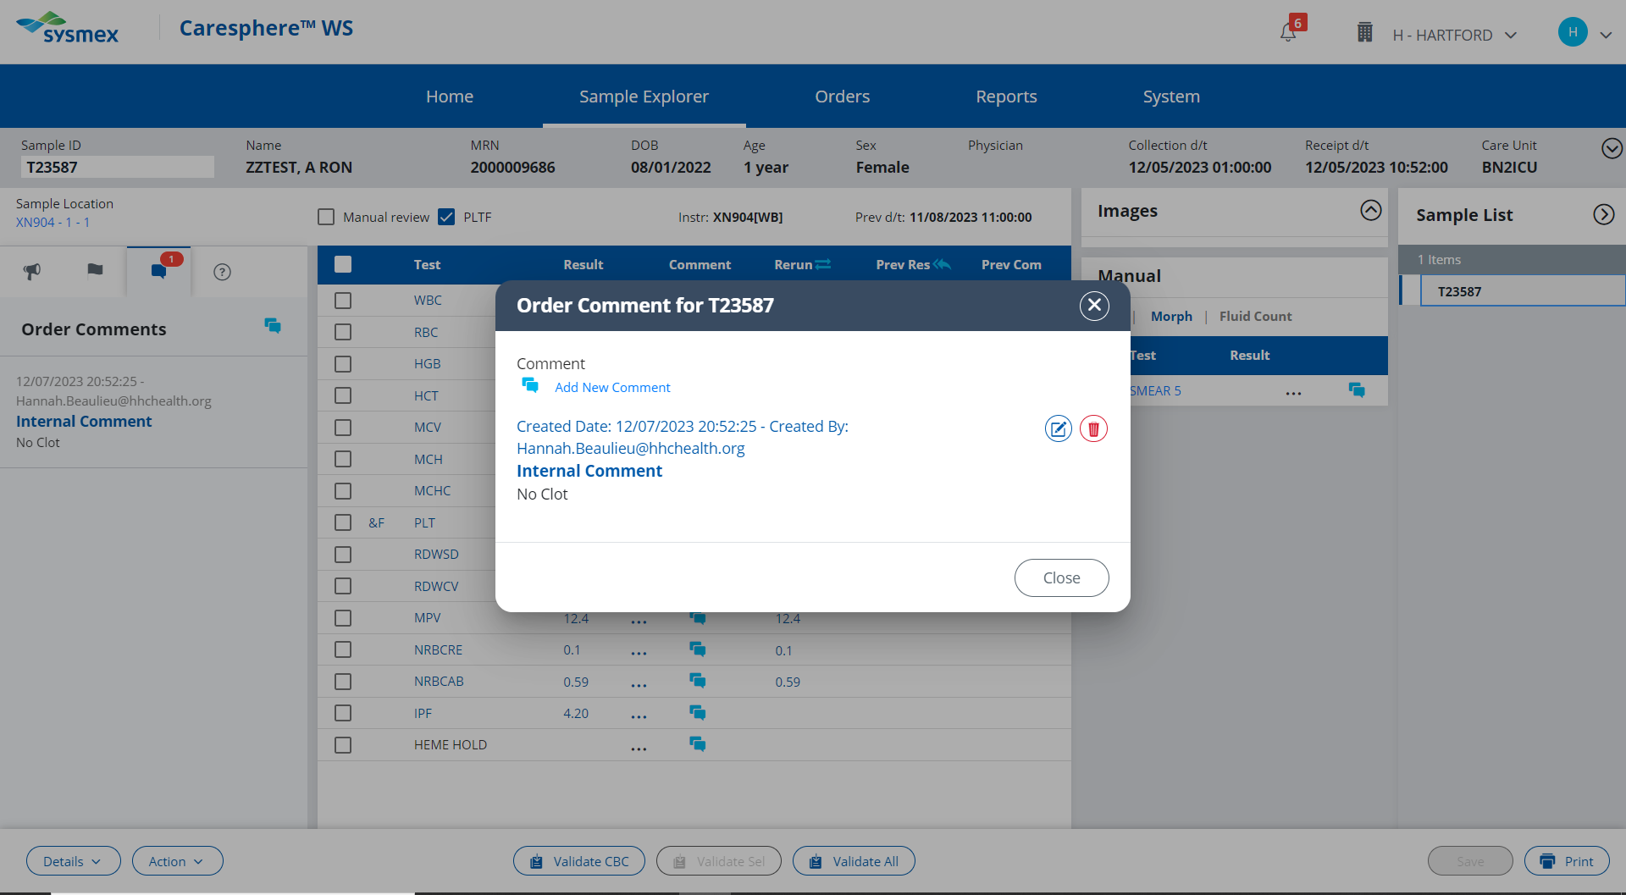

Slide 13
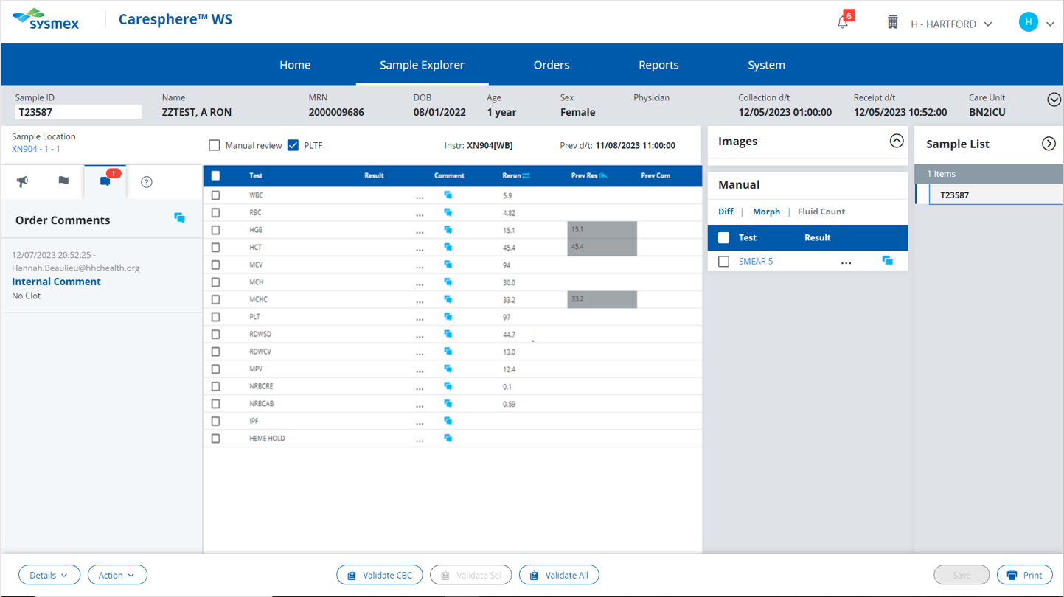
PLT <100
Actions;
Check sample for clot. If no clotting is observed, enter a NCLOT (no clot) comment.
Rerun sample for Platelet F.
Review the patient history. If this is the first occurrence of the PLT result falling below 100, perform platelet estimate.
OR
If patient has a history of PLT results falling below 100 and the PLT does not have an asterisk flag, release result.
Click here to see results of rerun.

Slide 14
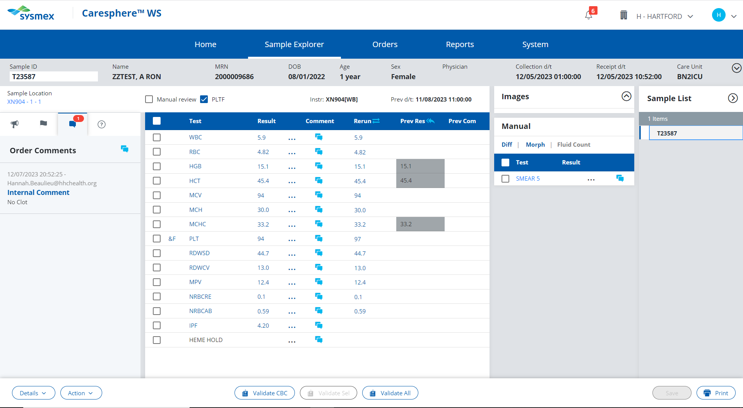
PLT <100
Actions;
Check sample for clot. Comment in Caresphere “NCLOT” if no clotting is observed.
Run sample with Platelet F.
Review the patient history. If this is the first occurrence of the PLT result falling below 100, perform platelet estimate.
OR
If patient has a history of PLT results falling below 100 and the PLT does not have an asterisk flag, release result.
Click here to proceed with the next action.

Slide 15
View the patient’s previous results to see if they have a history of their platelet results falling below 100.

Slide 16
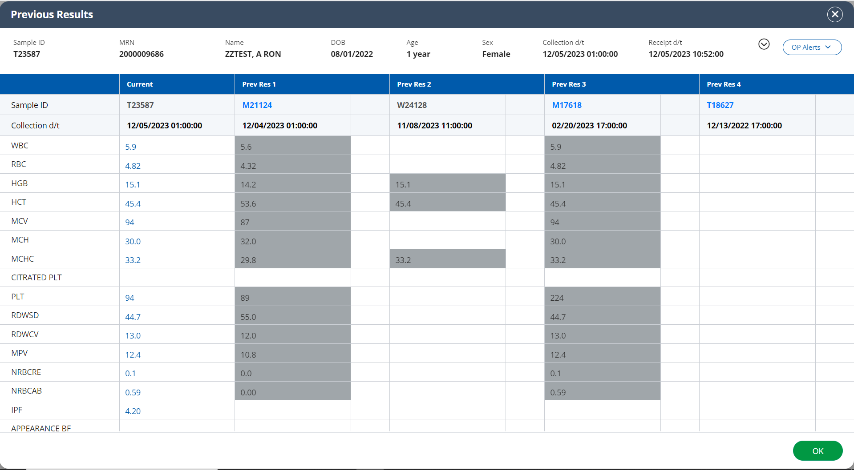

Slide 17
PLT <100
Actions;
Check sample for clot. Comment in Caresphere “NCLOT” if no clotting is observed.
Run sample with Platelet F.
Review the patient history. If this is the first occurrence of the PLT result falling below 100, perform platelet estimate.
OR
If patient has a history of PLT results falling below 100 and the PLT does not have an asterisk flag, release result.
Click here to proceed with releasing the results.

Slide 18
Validate the patient’s results.

Slide 19
Because a smear was ordered by the Sysmex, results must be released from the Validate All button.
Click here to try again!

Slide 20
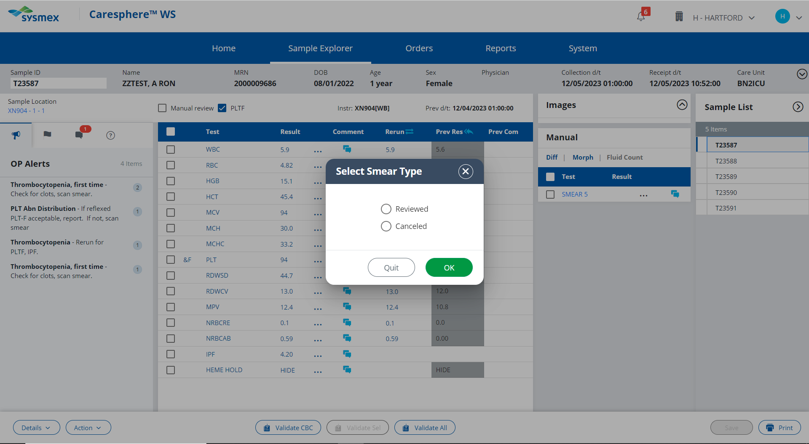

Slide 21
This slide was not reviewed. A platelet estimate was not necessary due to the patient’s history of low platelets.
Click here to try again

Slide 22
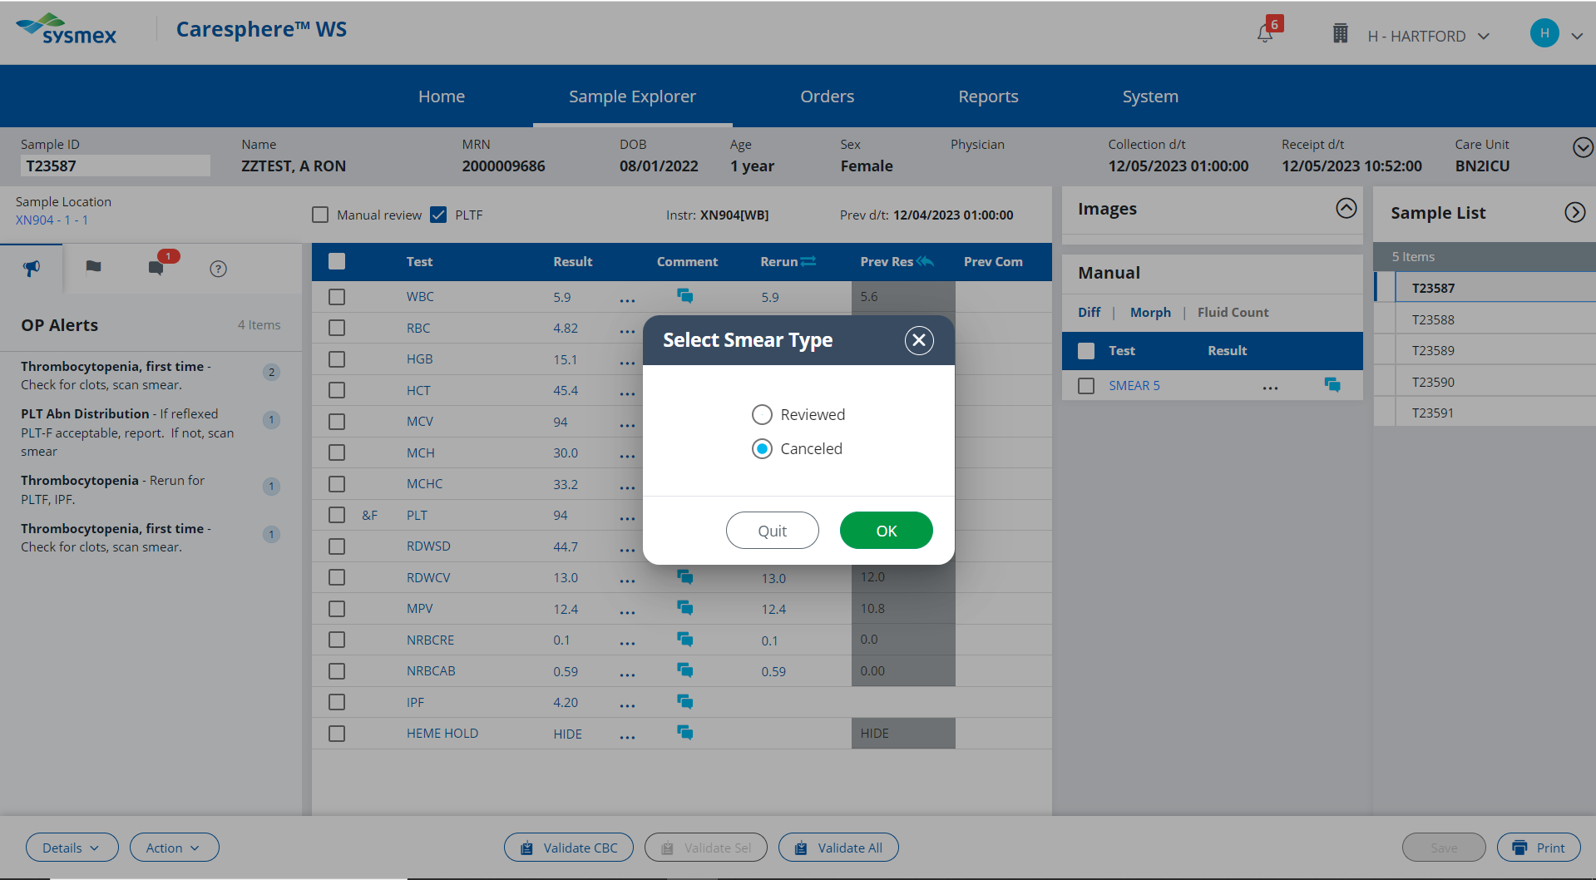

Slide 23
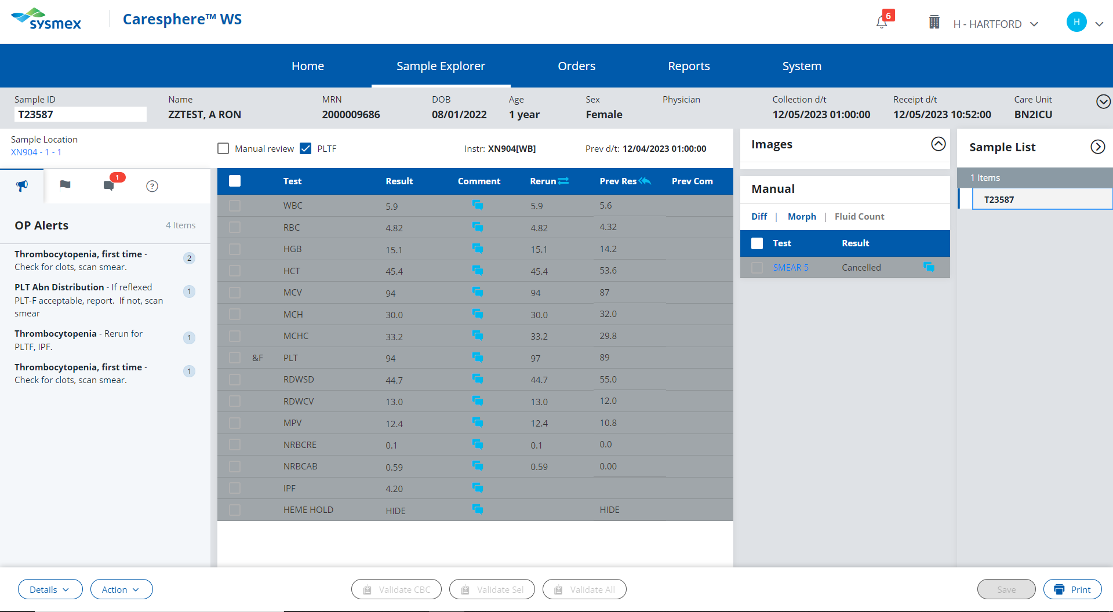
Click here to proceed to the next pending sample.

Slide 24
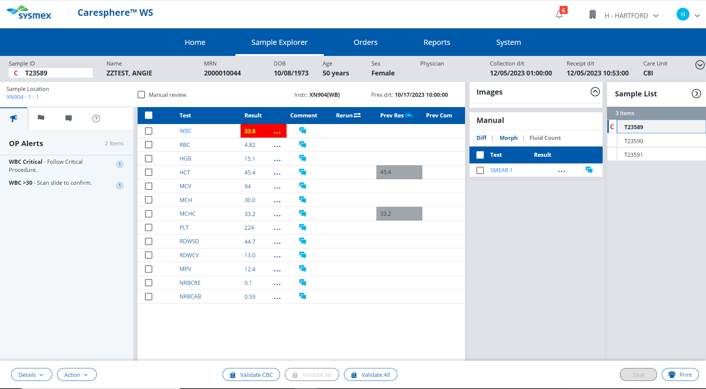
Click on the critically high result.

Slide 25
That value is within the normal reference range. Refer to the HH Critical Result Procedure to find the critical value.
Click here to try again!

Slide 26
WBC >30.0
Actions;
Review patient history.
If this is the first time the patient’s WBC is >30, scan smear for abnormalities, add an RE (results verified by smear) comment and release.
OR
If the patient has a history of having a WBC >30, add an RCRP (recurring critical previously phoned) comment and release.
Click to proceed with the first action

Slide 27
View the patient’s previous results to see if they have a history of their WBC being >30.

Slide 28
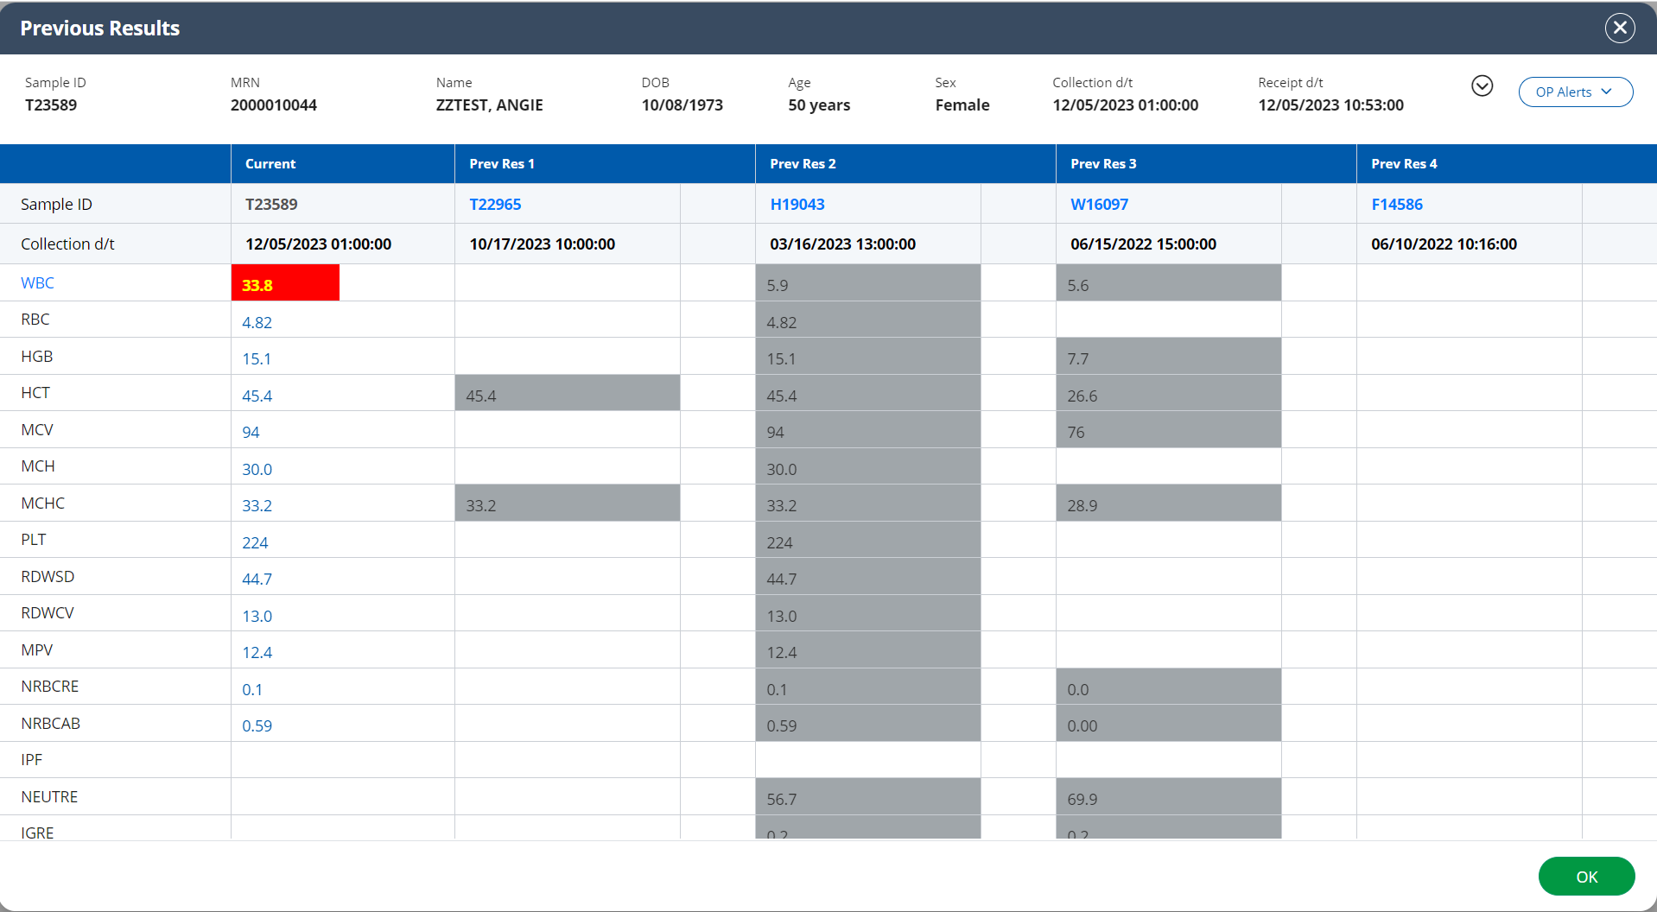

Slide 29
WBC >30.0
Actions;
Review patient history.
If this is the first time the patient’s WBC is >30, scan smear for abnormalities, add an RE (results verified by smear) comment and release.
OR
If the patient has a history of having a WBC >30, add an RCRP (recurring critical previously phoned) comment and release.
Click here to scan slide for WBC abnormalities

Slide 30
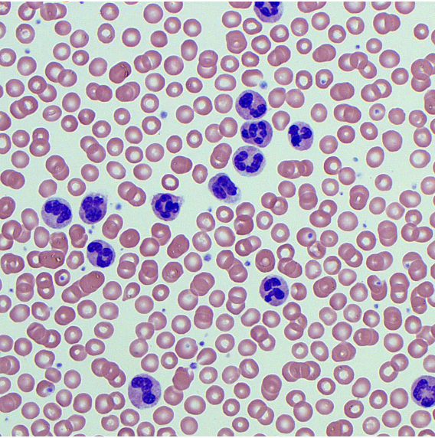
Do you see any WBC abnormalities?
Yes
No

Slide 31
Incorrect. This field shows normal neutrophils.
Click here to return to result validation

Slide 32
Correct! This field shows normal neutrophils.
Click here to return to result validation

Slide 33
WBC >30.0
Actions;
Review patient history.
If this is the first time the patient’s WBC is >30, scan smear for abnormalities,
Add an RE (results verified by smear) comment
Release results
Click here to proceed with the next action.

Slide 34
Add an RE (results verified by smear review) comment against the WBC result

Slide 35
This comment section is for internal comments only. Comments placed here will not be visible to the person reviewing the patient’s results.
In this instance you want the provider to be able to see your comment and know that you reviewed the slide.
Click here to try again!

Slide 36
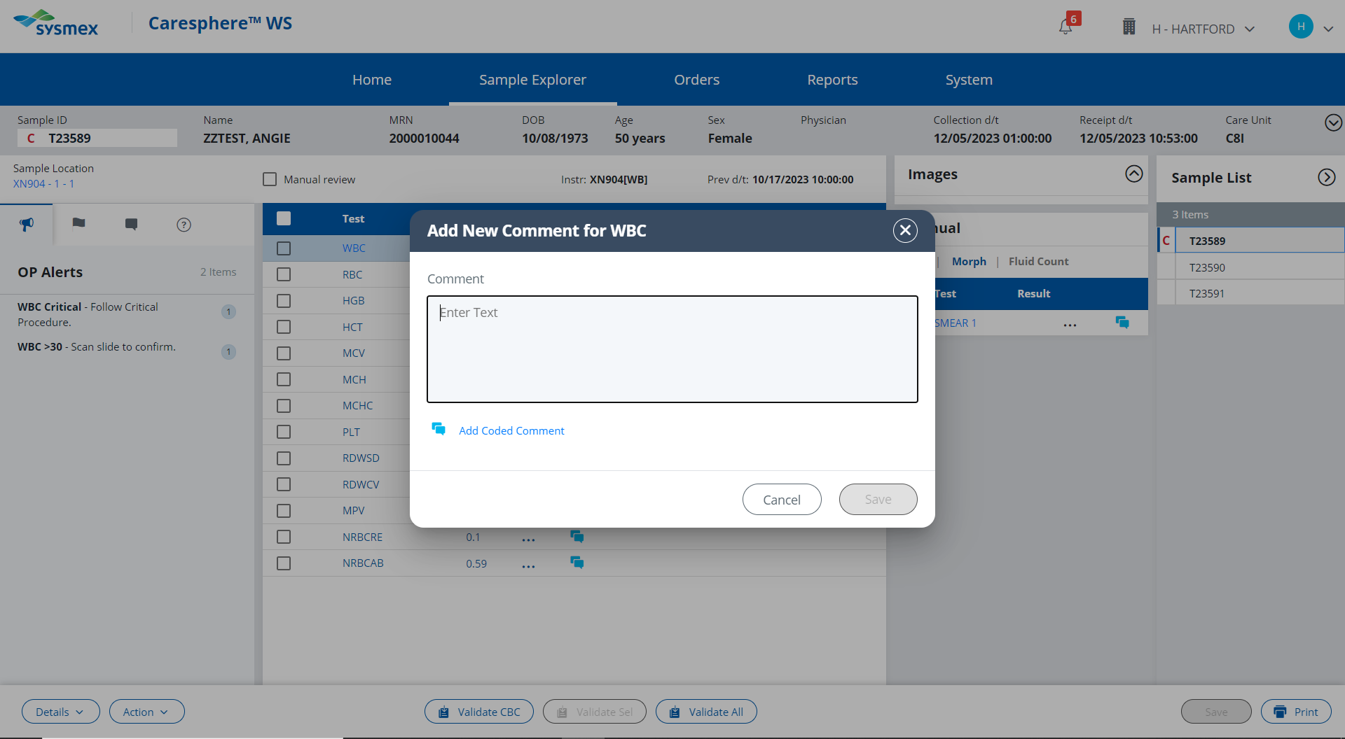

Slide 37
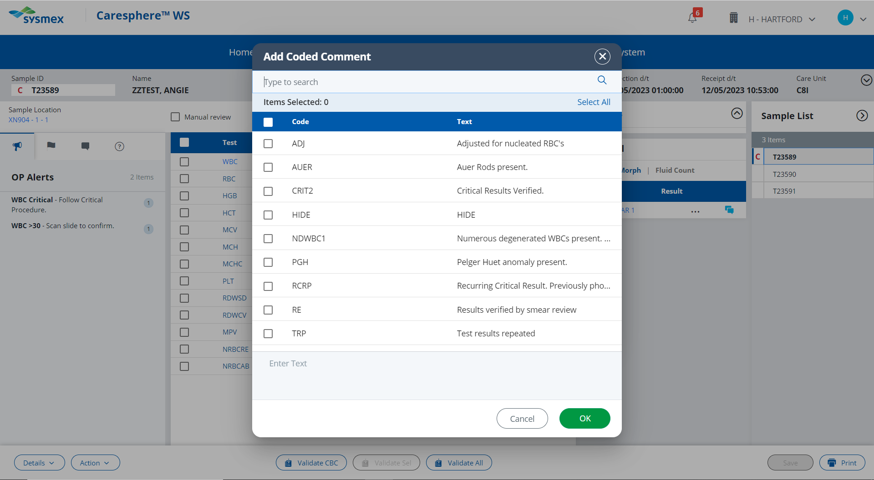

Slide 38
This patient doesn’t have a history of having a critically high WBC. Therefore you cannot use the RCRP comment.
Click here to try again

Slide 39
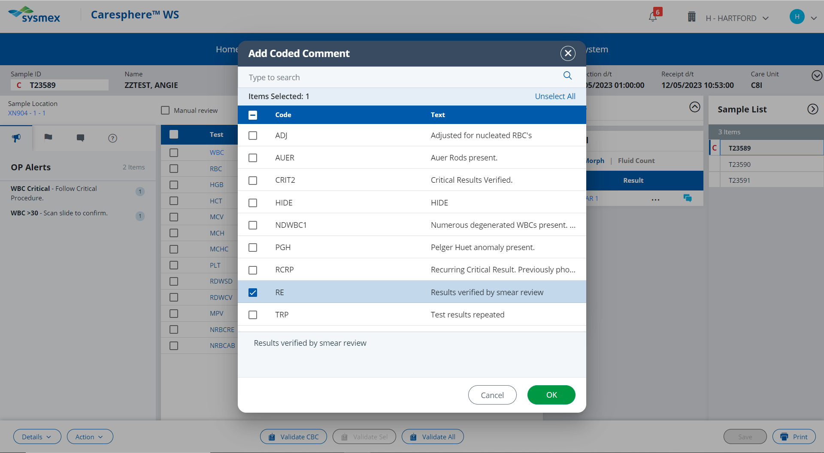

Slide 40
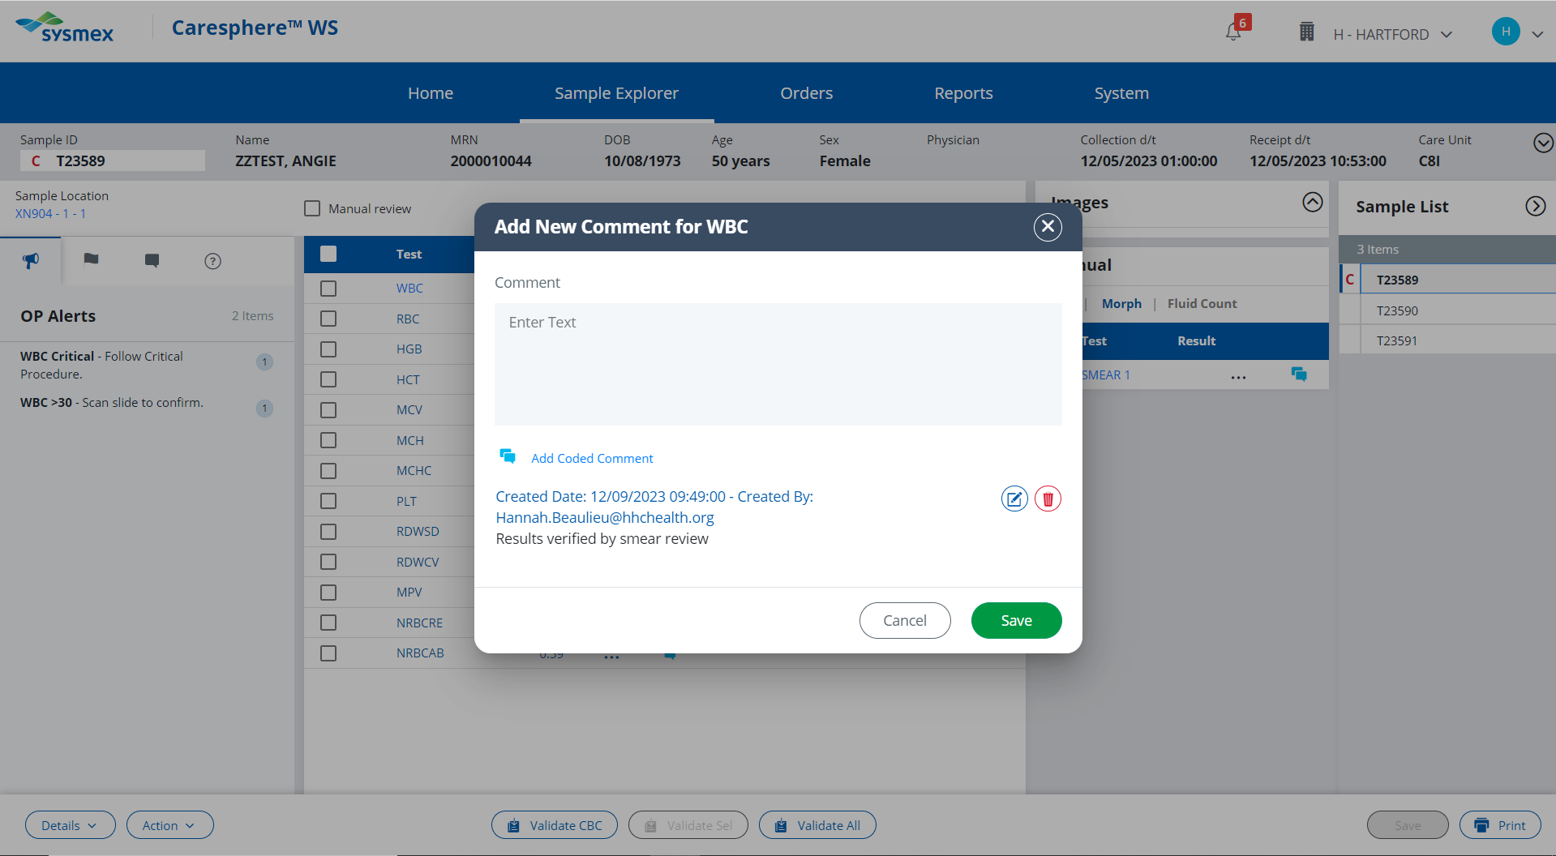

Slide 41
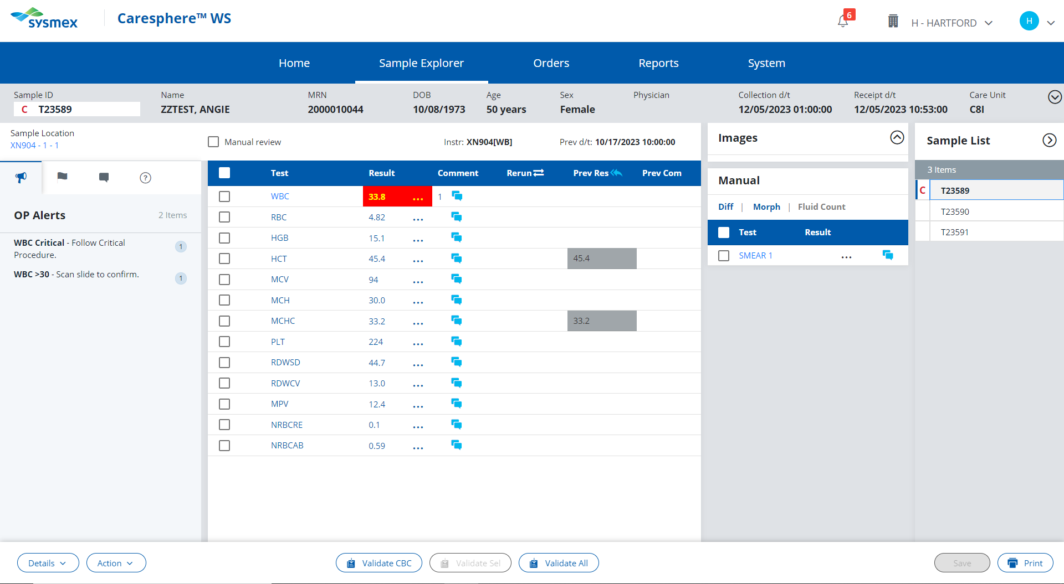
WBC >30.0
Actions;
Review patient history.
If this is the first time the patient’s WBC is >30, scan smear for abnormalities,
Add an RE (results verified by smear) comment
Release results
Release Results

Slide 42
Because a smear was ordered by the Sysmex, results must be released from the Validate All button.
Click here to try again!

Slide 43
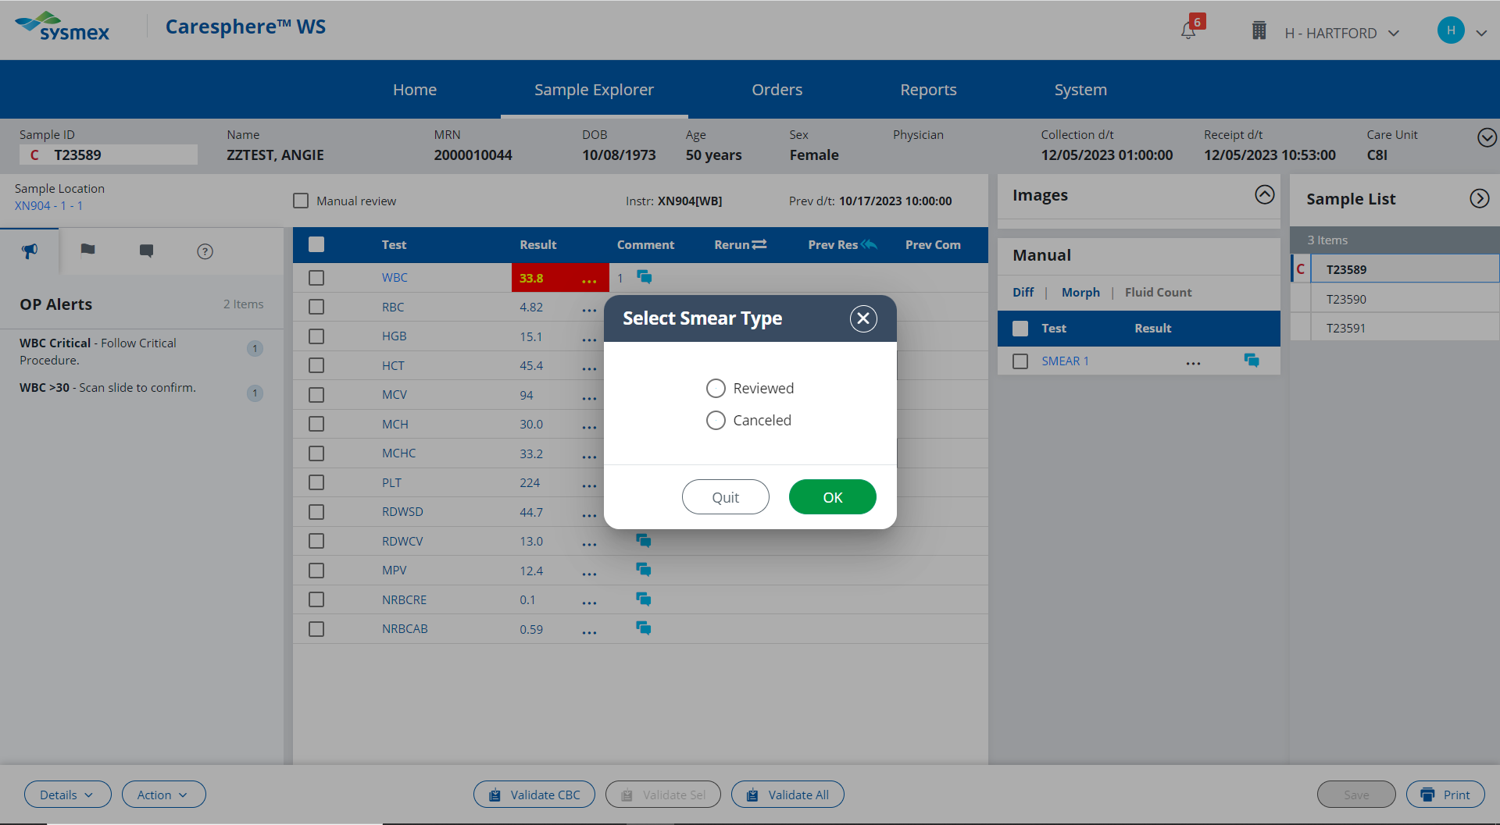

Slide 44
The slide was reviewed for WBC abnormalities.
Click here to try again

Slide 45
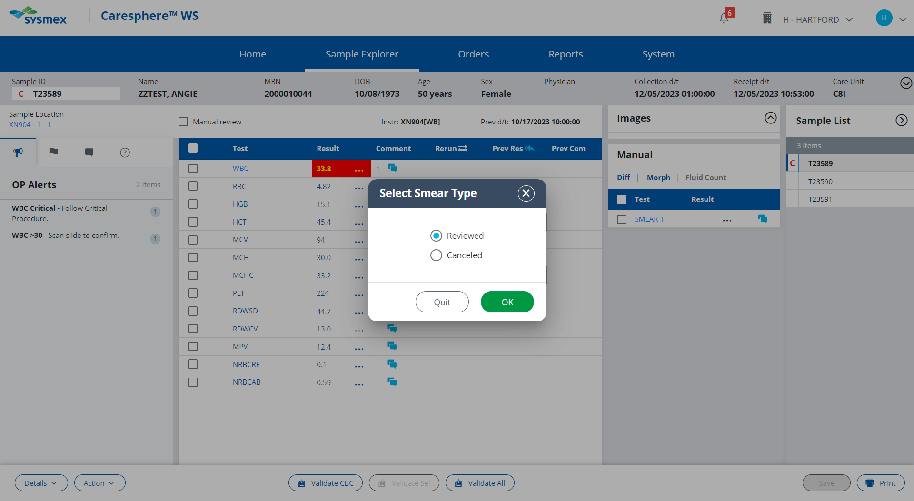

Slide 46
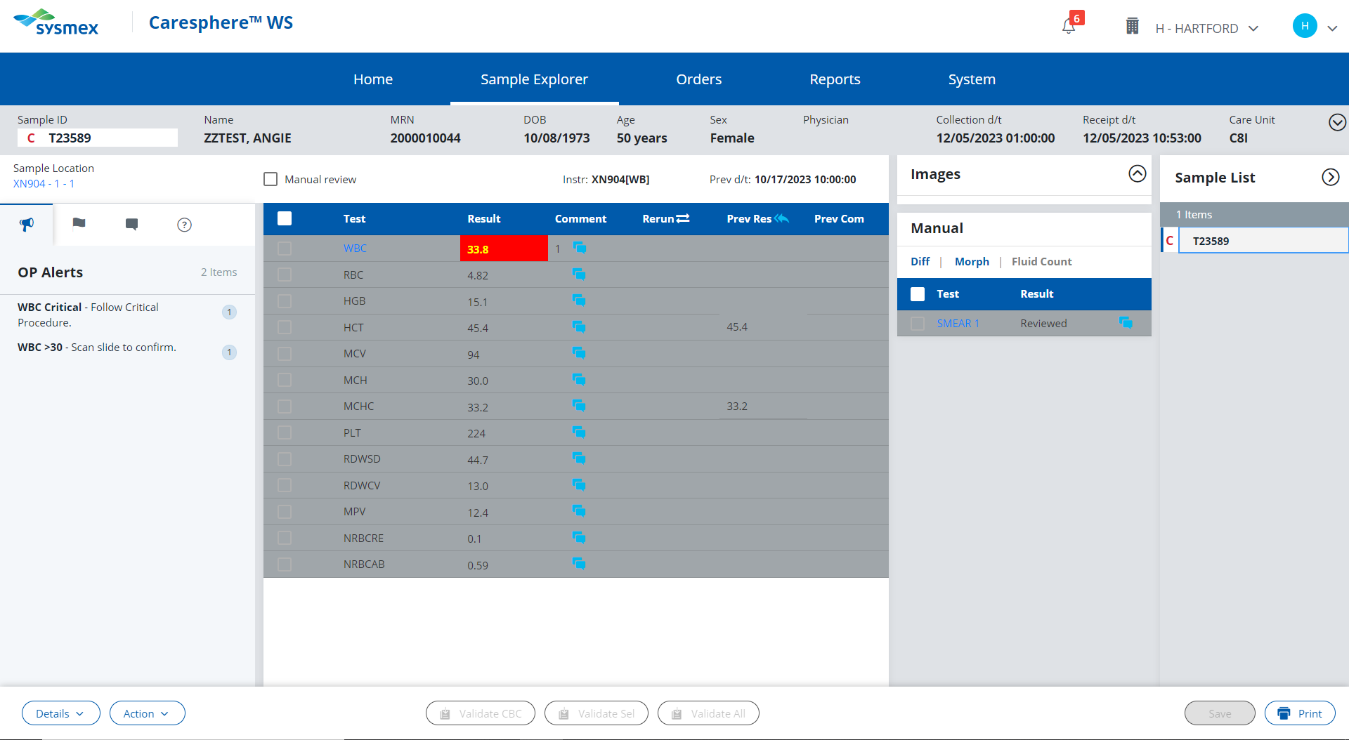
Click here to proceed to next pending sample.

Slide 47
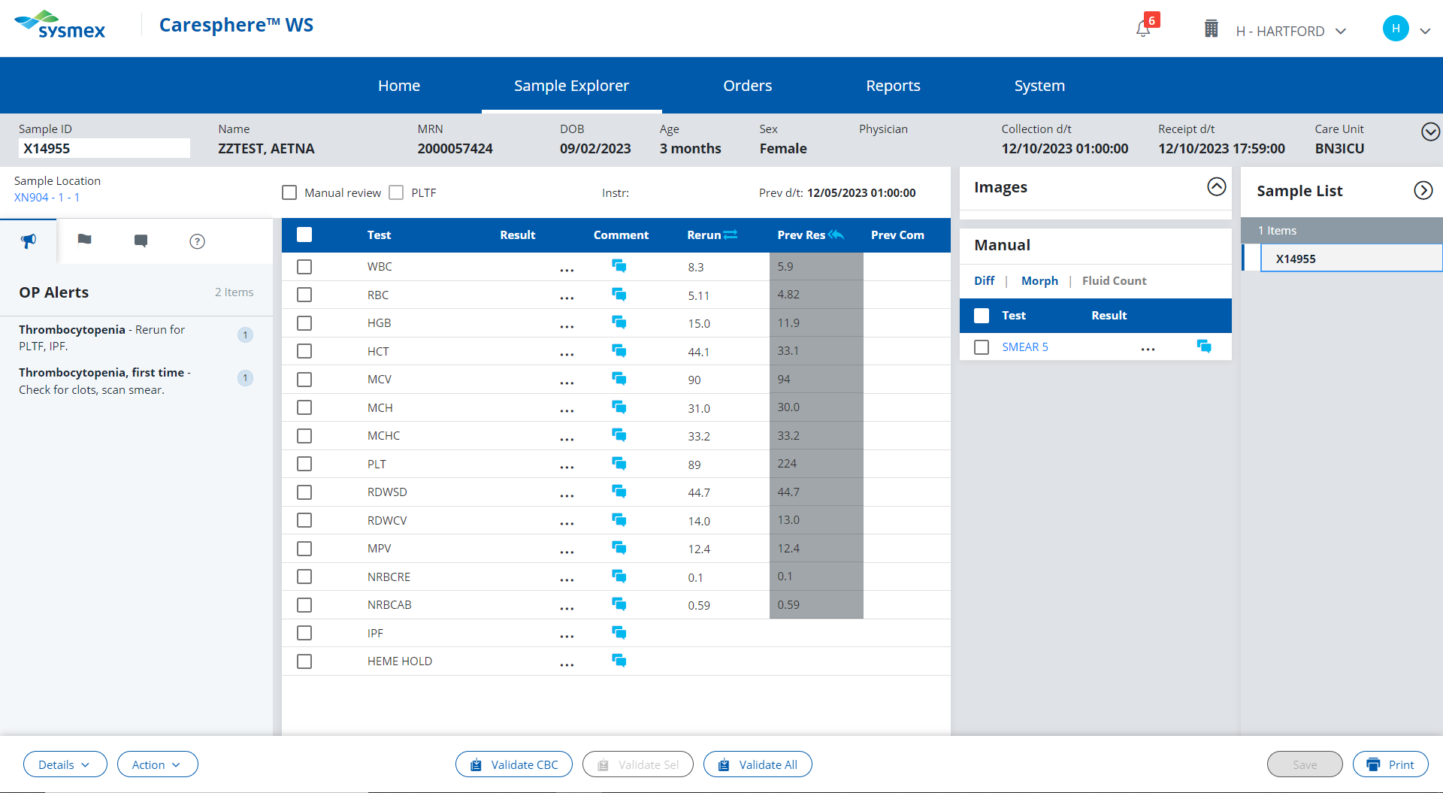
Select the abnormal result to review corresponding procedural action rules.

Slide 48
That value is within the normal reference range. Refer to the HH Reference Range Procedure to find the abnormal value.
Click here to try again!

Slide 49
PLT <100
Actions;
Check sample for clot. If no clotting is observed, enter a NCLOT (no clot) comment.
Rerun the sample for the Platelet F.
Review the patient history. If this is the first occurrence of the PLT result falling below 100, perform platelet estimate.
OR
If patient has a history of PLT results falling below 100 and the PLT does not have an asterisk flag, release result.
Click here to proceed with first action

Slide 50
You have checked the sample for a clot and saw no signs of clotting. Enter a NCLOT (no clot) comment

Slide 51
These are the external comment buttons. Comments entered here will be seen by the provider when viewing the patient’s results.
The “no clot” comment is for internal lab use only.
Click here to try again!

Slide 52
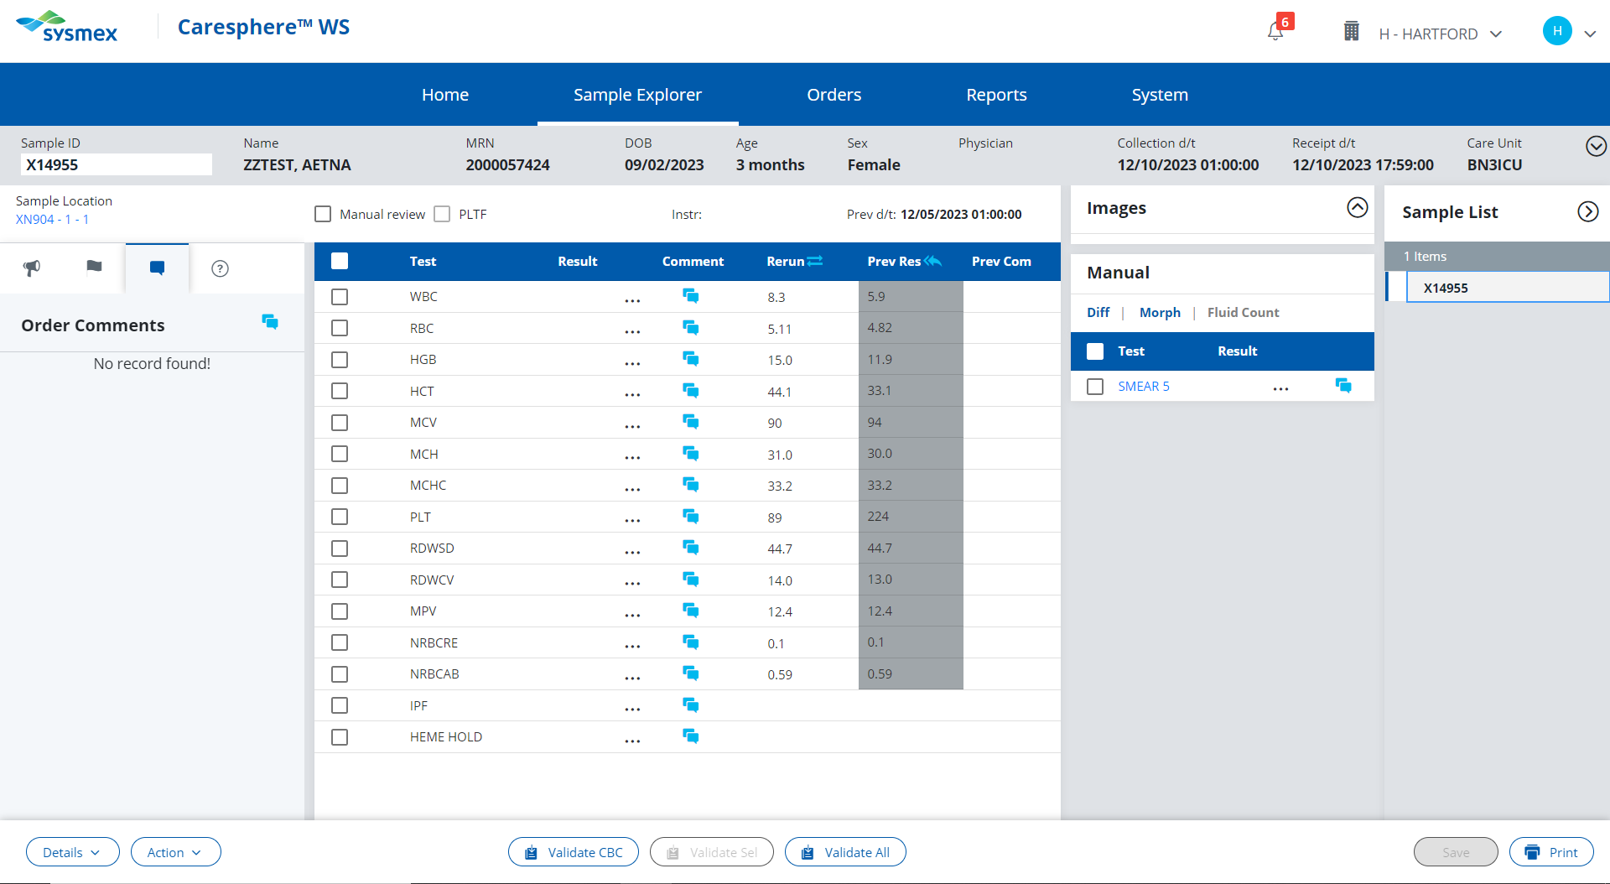

Slide 53
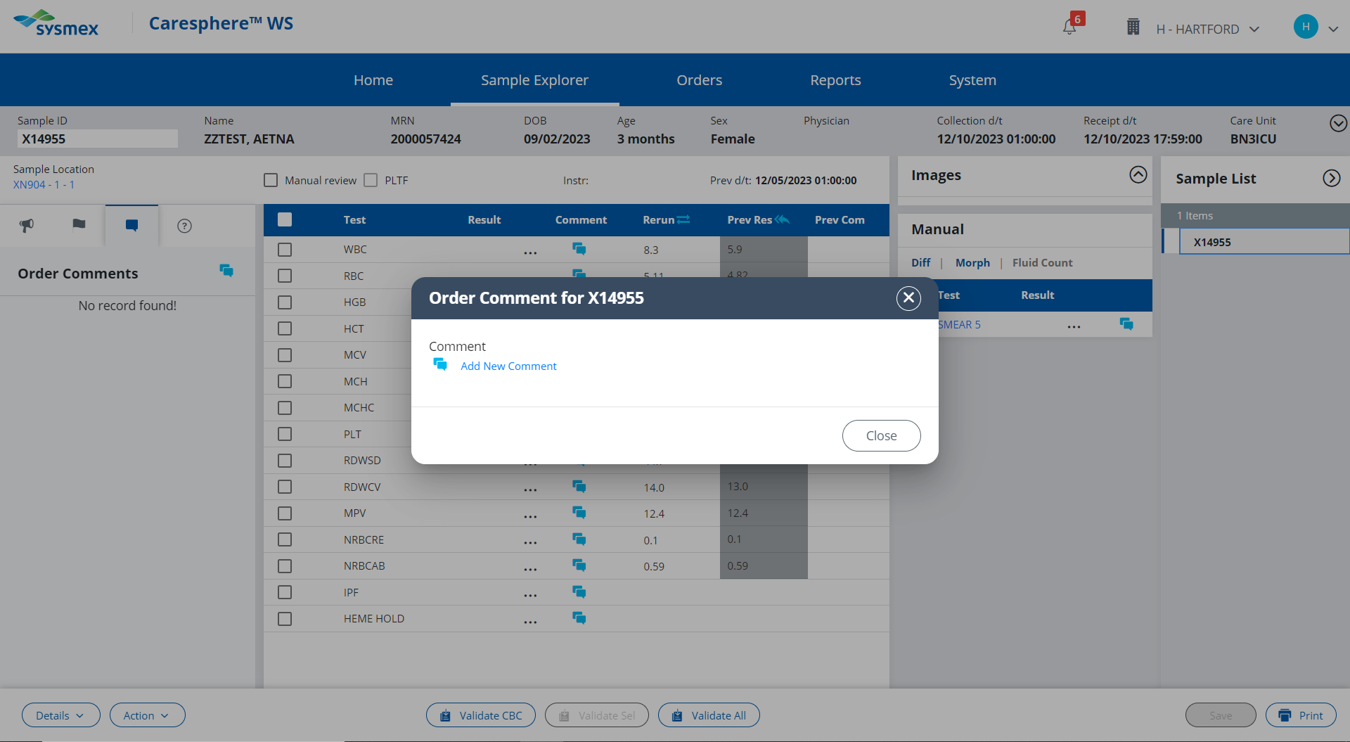

Slide 54
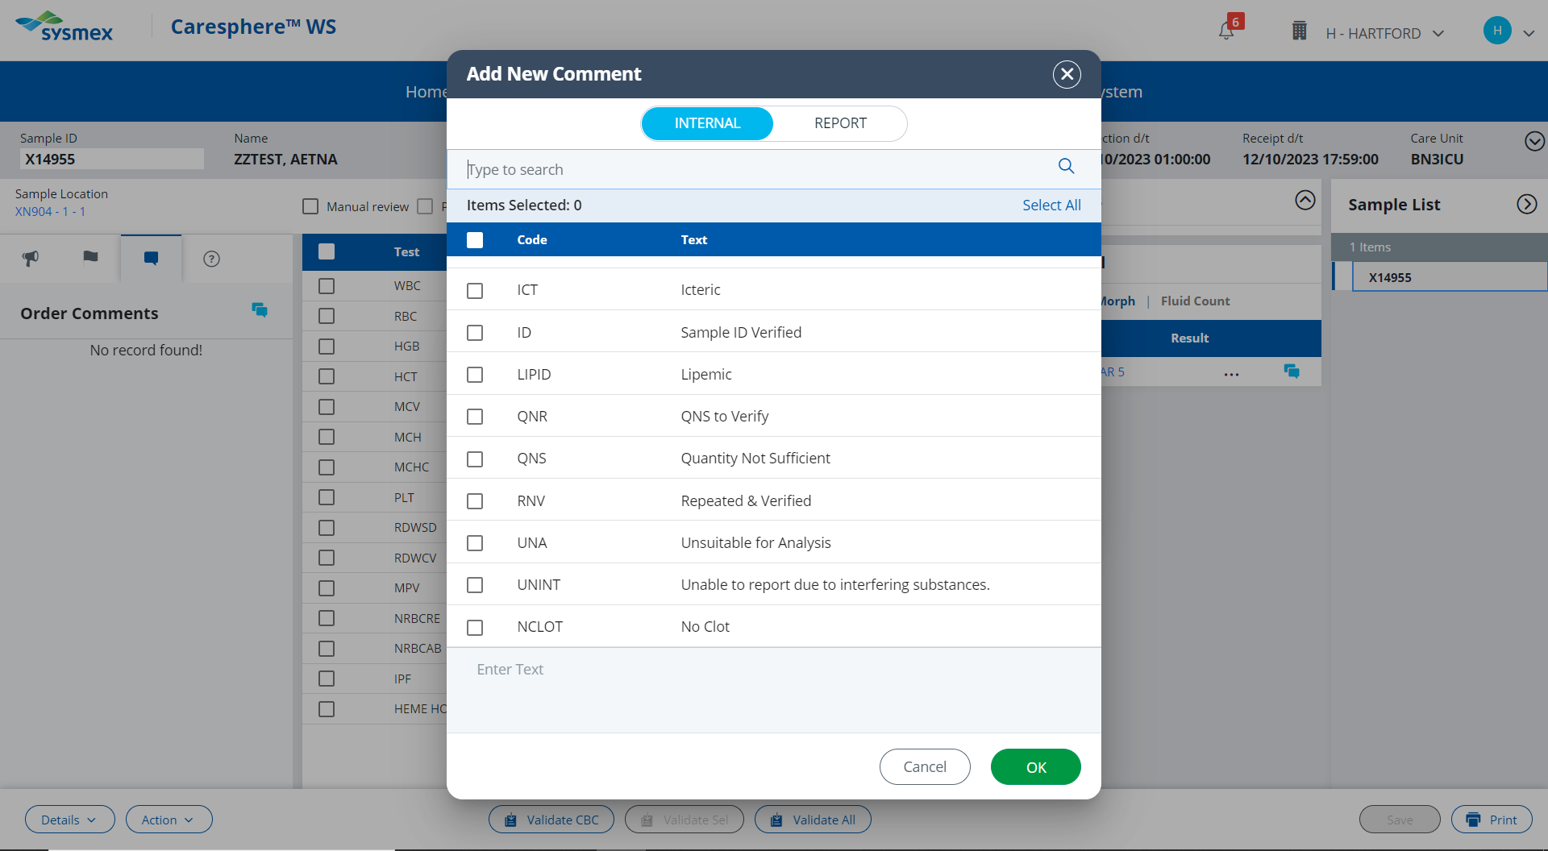

Slide 55
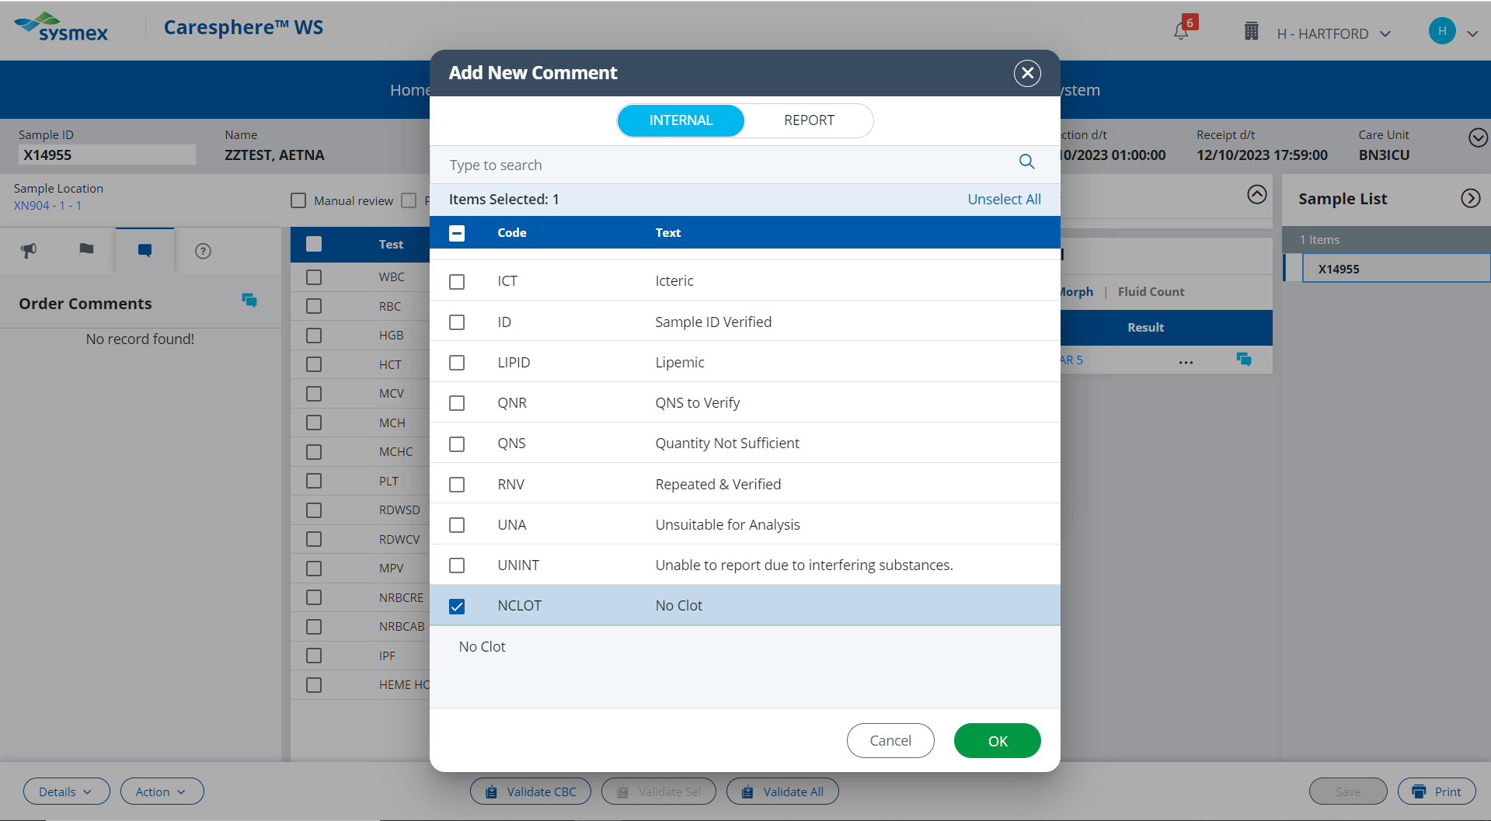

Slide 56
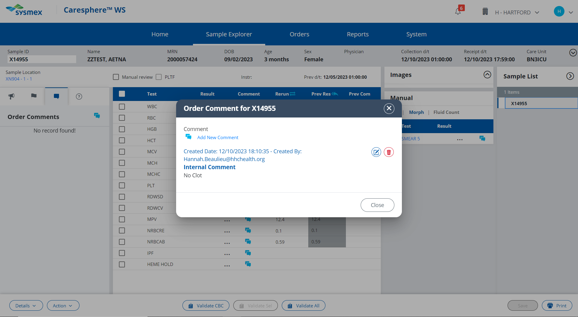

Slide 57
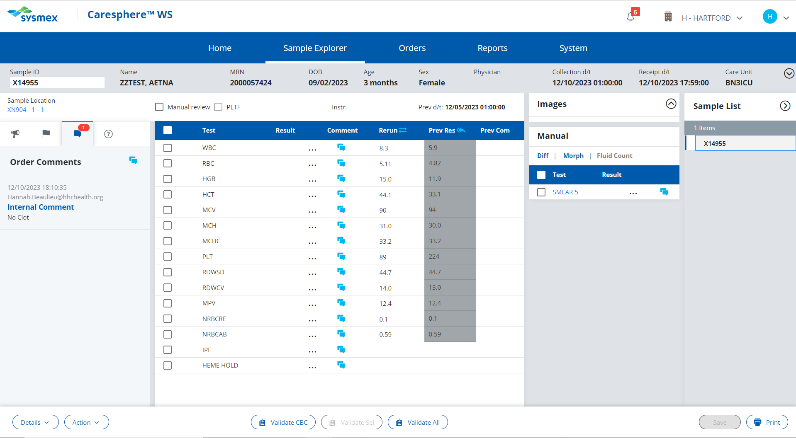
PLT <100
Actions;
Check sample for clot. If no clotting is observed, enter a NCLOT (no clot) comment.
Rerun sample for Platelet F.
Review the patient history. If this is the first occurrence of the PLT result falling below 100, perform platelet estimate.
OR
If patient has a history of PLT results falling below 100 and the PLT does not have an asterisk flag, release result.
Click here to see results of rerun.

Slide 58
PLT <100
Actions;
Check sample for clot. Comment in Caresphere “NCLOT” if no clotting is observed.
Run sample with Platelet F.
Review the patient history. If this is the first occurrence of the PLT result falling below 100, perform platelet estimate.
OR
If patient has a history of PLT results falling below 100 and the PLT does not have an asterisk flag, release result.
Click here to proceed with the next action.

Slide 59
View the patient’s previous results to see if they have a history of their platelet results falling below 100

Slide 60
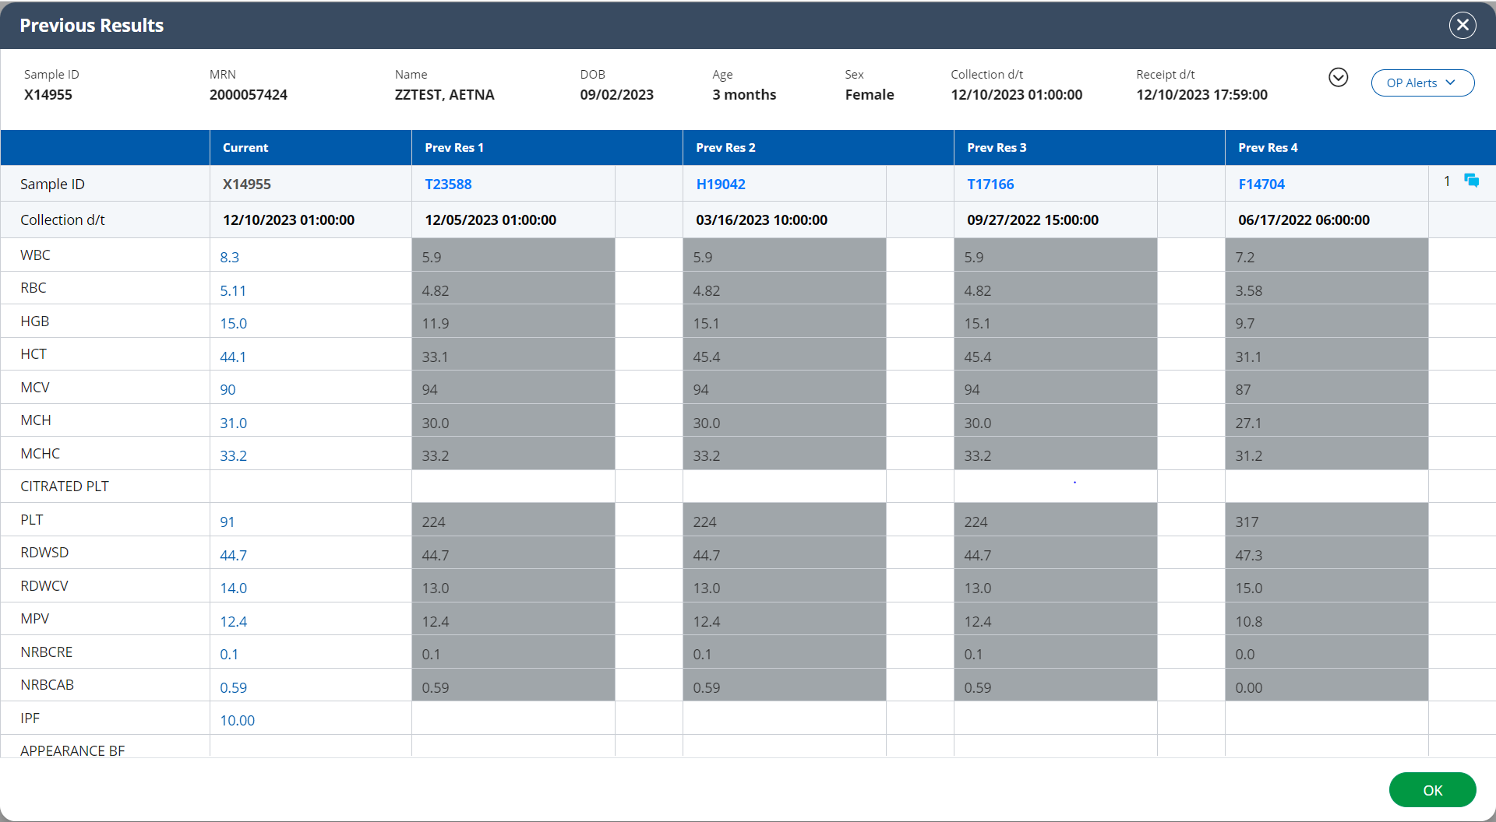

Slide 61
PLT <100
Actions;
Check sample for clot. Comment in Caresphere “NCLOT” if no clotting is observed.
Run sample with Platelet F.
Review the patient history.
If this is the first occurrence of the PLT result falling below 100, perform platelet estimate.
OR
If patient has a history of PLT results falling below 100 and the PLT does not have an asterisk flag, release result.
Click here to perform platelet estimate.

Slide 62
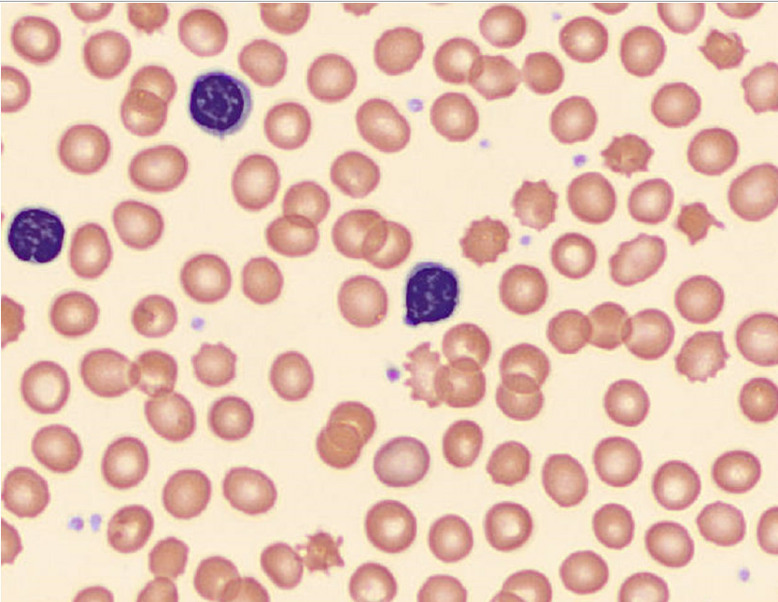
Perform a platelet estimate on the provided 100X fields.
Is your platelet estimate within +20% of the Sysmex platelet count of 91?
Click here for the next field

Slide 63
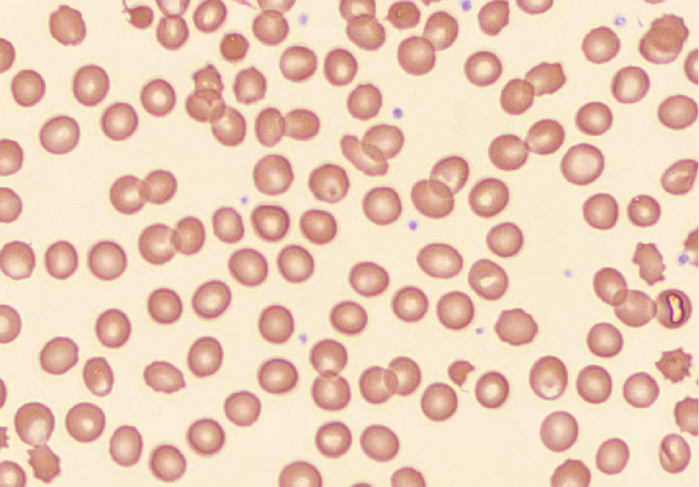
Perform a platelet estimate on the provided 100X fields.
Is your platelet estimate within +20% of the Sysmex platelet count of 91?
Click here for the next field

Slide 64
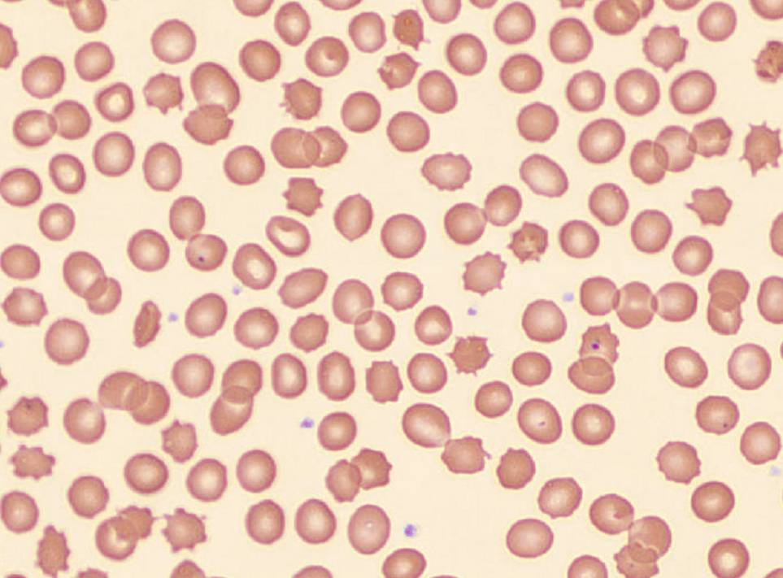
Perform a platelet estimate on the provided 100X fields.
Is your platelet estimate within +20% of the Sysmex platelet count of 91?
Click here for the next field

Slide 65
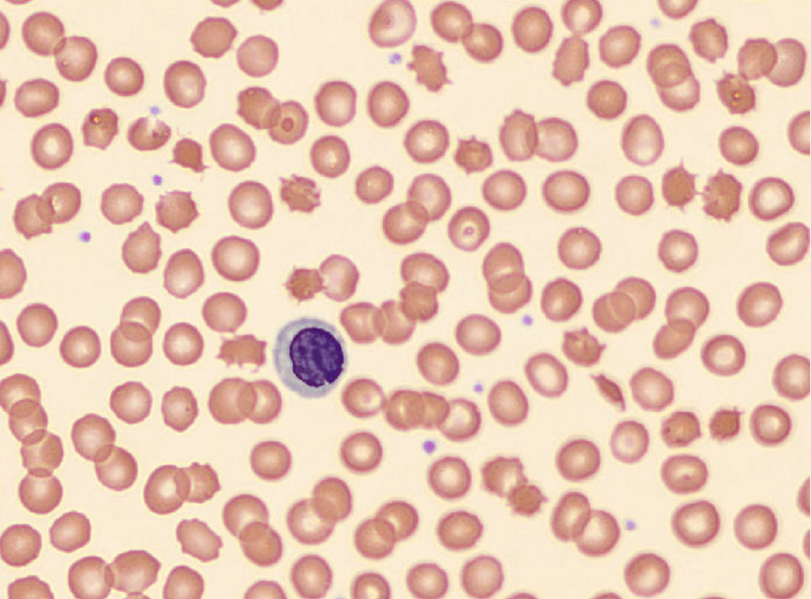
Perform a platelet estimate on the provided 100X fields.
Is your platelet estimate within +20% of the Sysmex platelet count of 91?
Click here for the next field

Slide 66
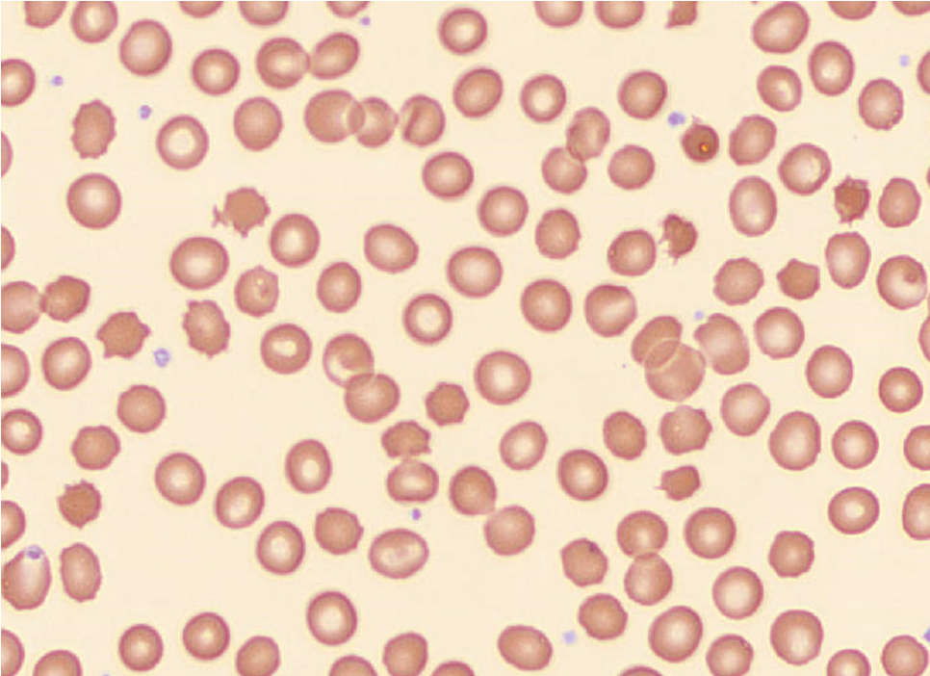
Perform a platelet estimate on the provided 100X fields.
Is your platelet estimate within +20% of the Sysmex platelet count of 91?
Yes
No

Slide 67
Incorrect. Try performing your platelet estimate again.
Click here to try again.

Slide 68
Correct! The platelet estimate of the provided slides is approximately 92.
Click here to return to result validation

Slide 69
PLT <100
Actions;
Check sample for clot. Comment in Caresphere “NCLOT” if no clotting is observed.
Run sample with Platelet F.
Review the patient history. If this is the first occurrence of the PLT result falling below 100, perform platelet estimate.
If the platelet estimate agrees within +20% of the sysmex result, add an RE comment and release results.
Click here to proceed to the next action.

Slide 70
Add an RE (results verified by smear review) comment against the PLT result

Slide 71
This comment section is for internal comments only. Comments placed here will not be visible to the person reviewing the patient’s results.
In this instance you want the provider to be able to see your comment and know that you reviewed the slide.
Click here to try again!

Slide 72
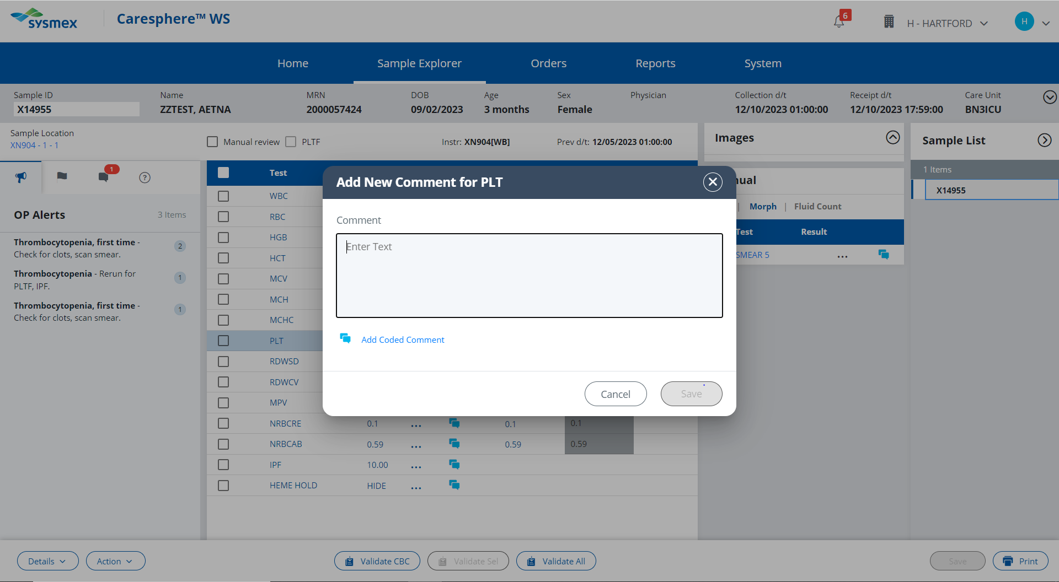

Slide 73
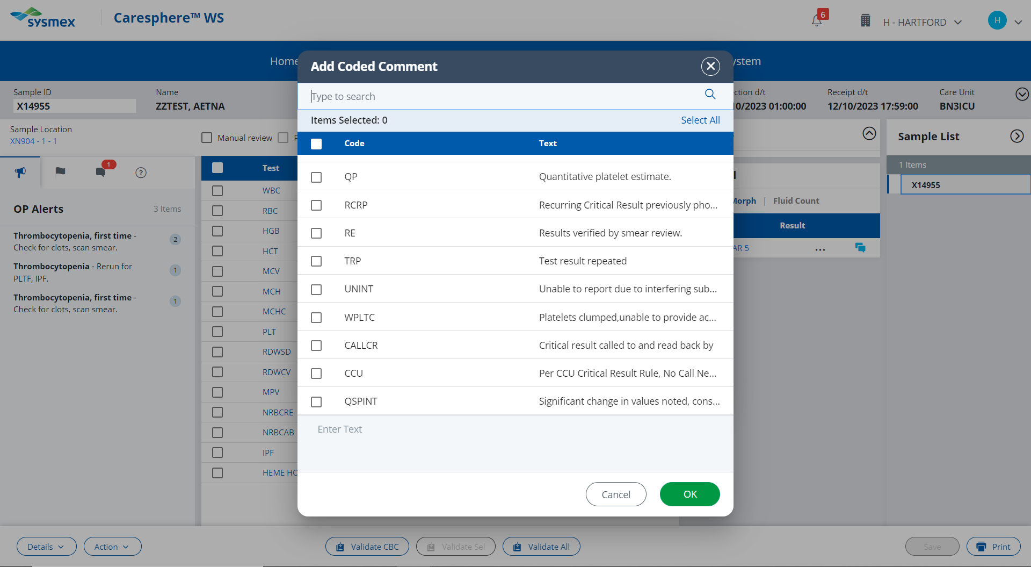

Slide 74
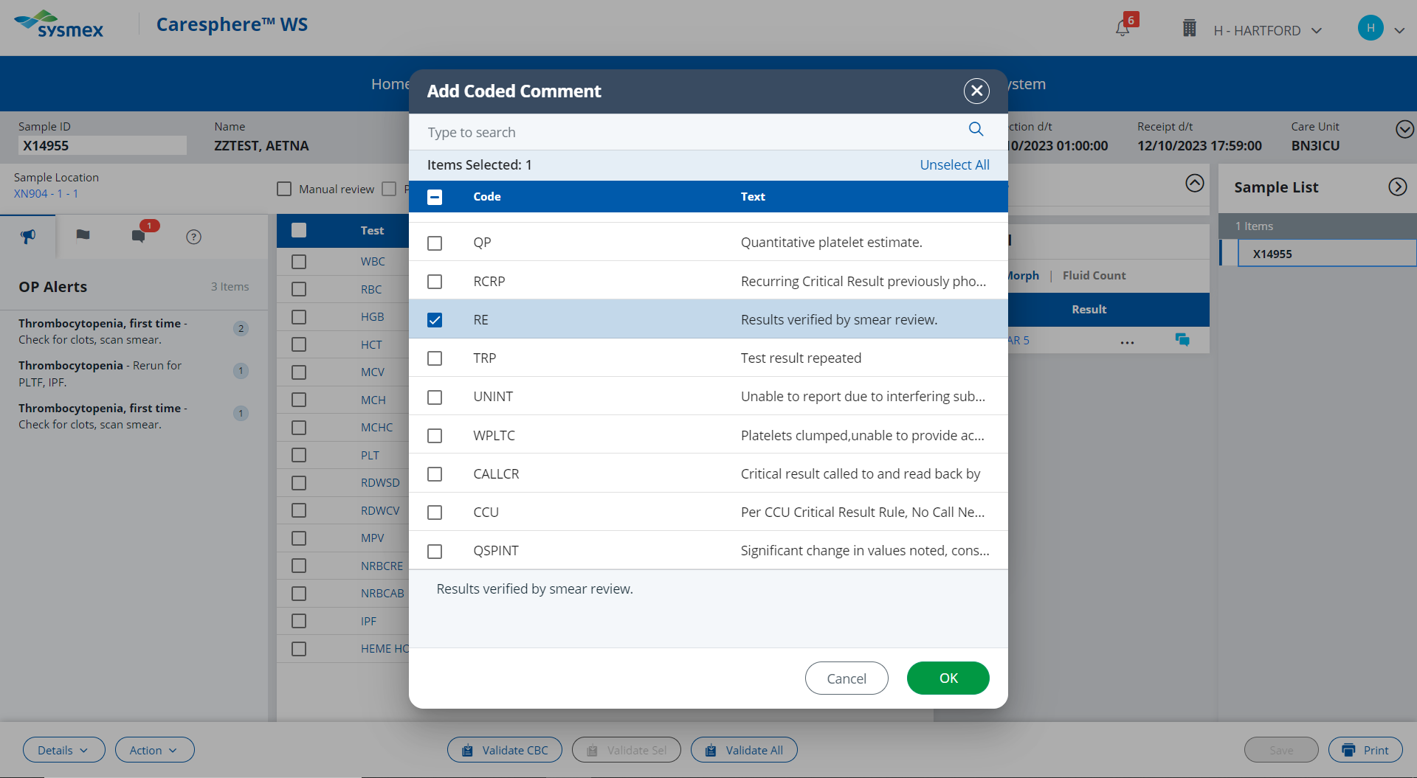

Slide 75
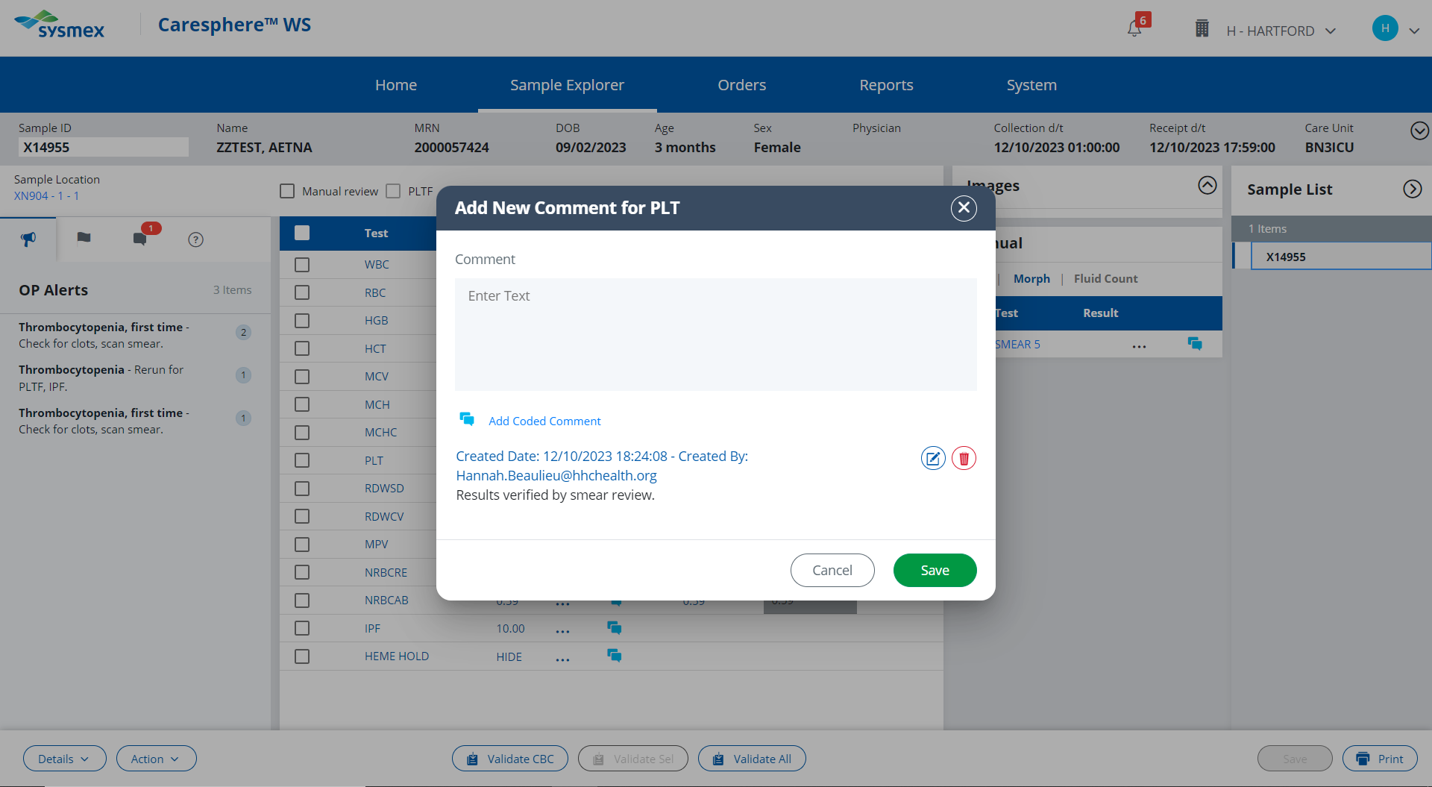

Slide 76
Validate the patient’s results.

Slide 77
Because a smear was ordered by the Sysmex, results must be released from the Validate All button.
Click here to try again!
Validate the patient’s results.

Slide 78
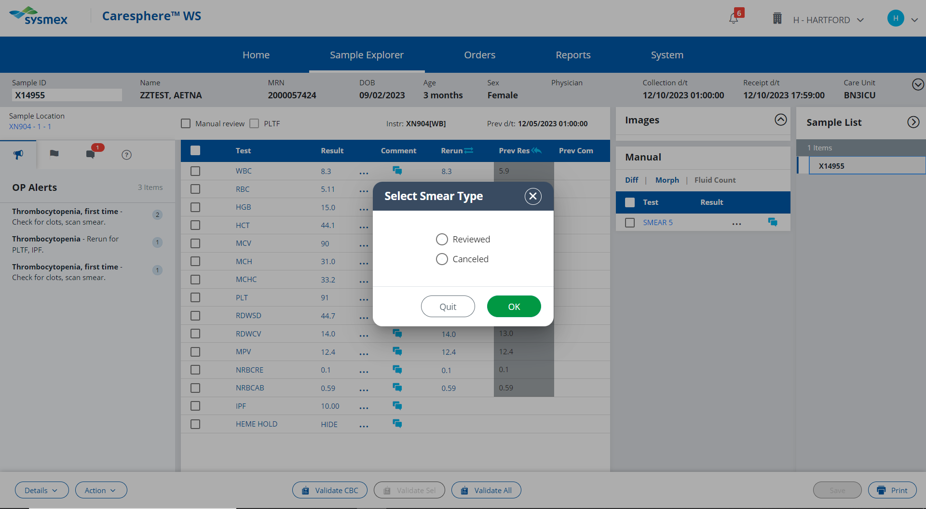

Slide 79
Incorrect. The slide was reviewed for a platelet estimate.
Click here to try again!

Slide 81
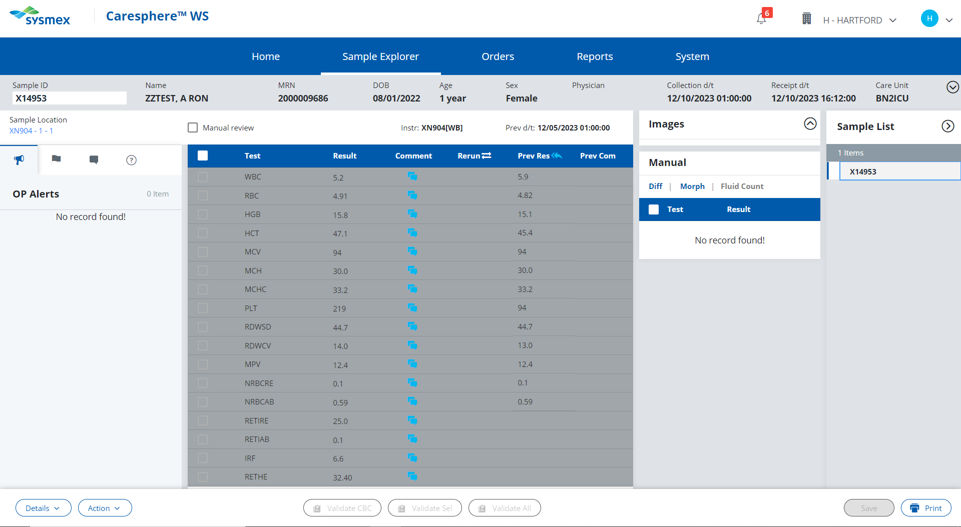
Click here to proceed to next pending sample.

Slide 82
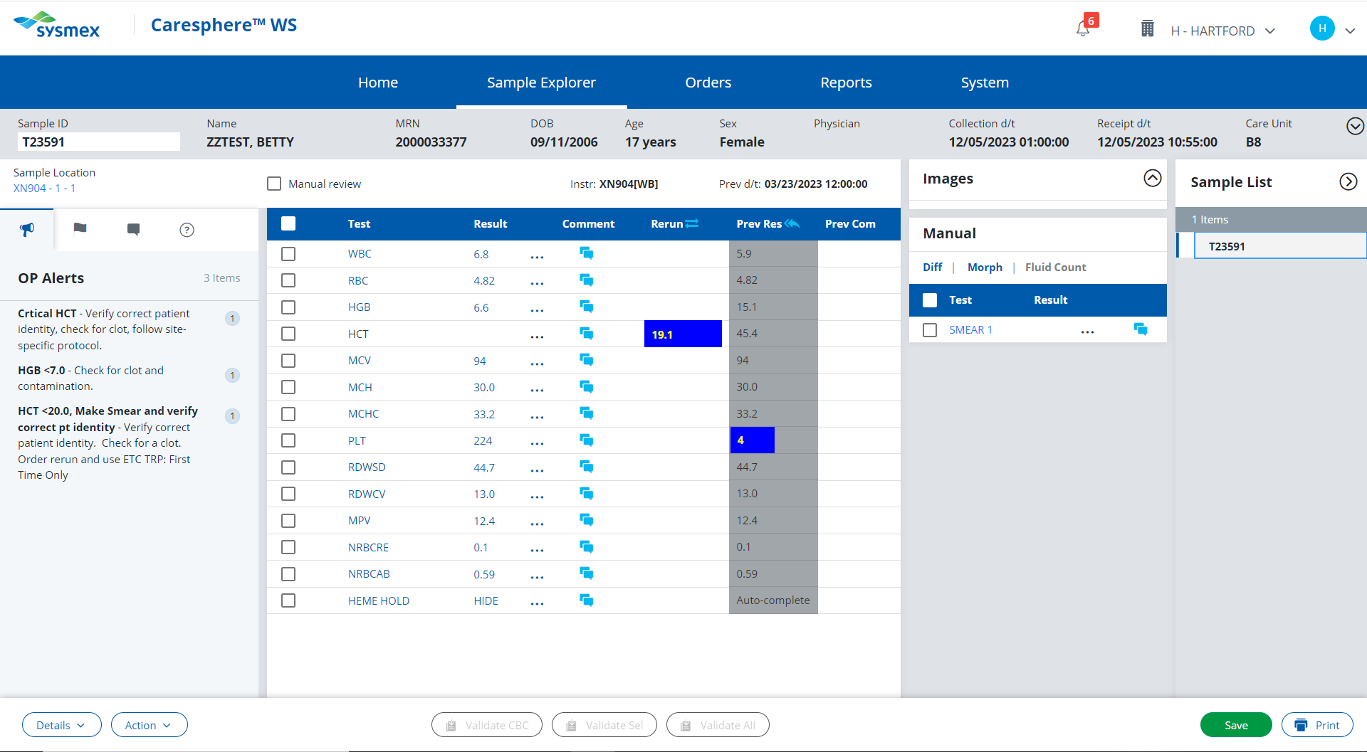
Click on the critically low result.

Slide 83
That value is within the normal reference range. Refer to the HH Critical Result Procedure to find the critical value.
Click here to try again

Slide 84
HCT <20
Actions;
Check sample for a clot. If there is no clotting observed, enter a NCLOT (No Clot) comment.
Order a rerun and run the sample again. Enter a TRP (Test Results Repeated) comment.
Review patient’s history.
If the patient has a history of having a hematocrit <20, release the results.
OR
If this is the patient’s first occurrence with a hematocrit <20, review slide for signs of hemolysis. Add appropriate comments and release results.
Click to proceed with first action

Slide 85
You checked the sample for a clot, and didn’t observe any clotting. Enter a NCLOT (no clot) comment

Slide 86
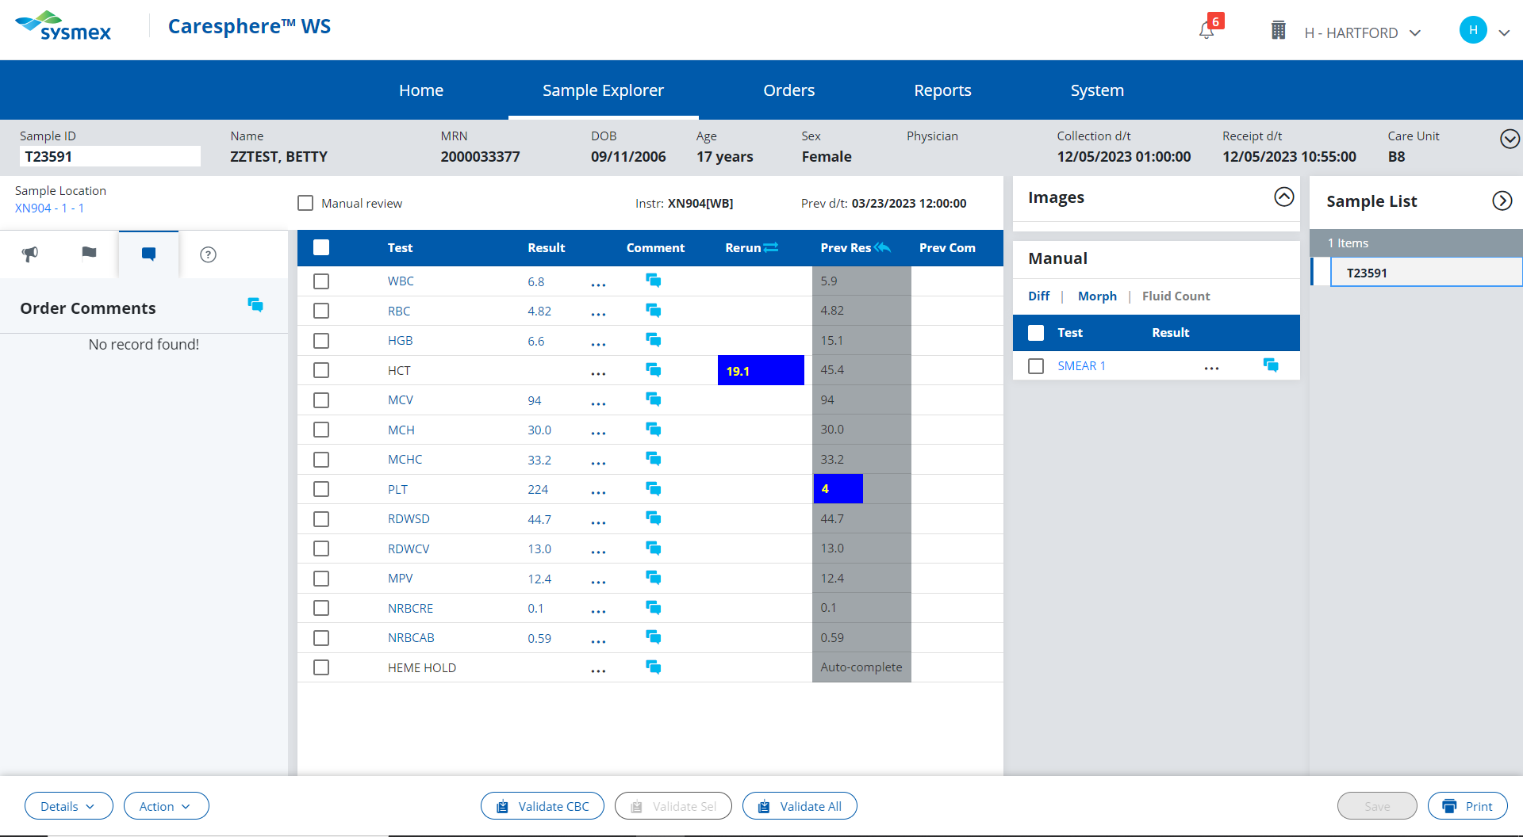
These are the external comment buttons. Comments entered here will be seen by the provider when viewing the patient’s results.
The “no clot” comment is for internal lab use only.
Click here to try again!

Slide 87
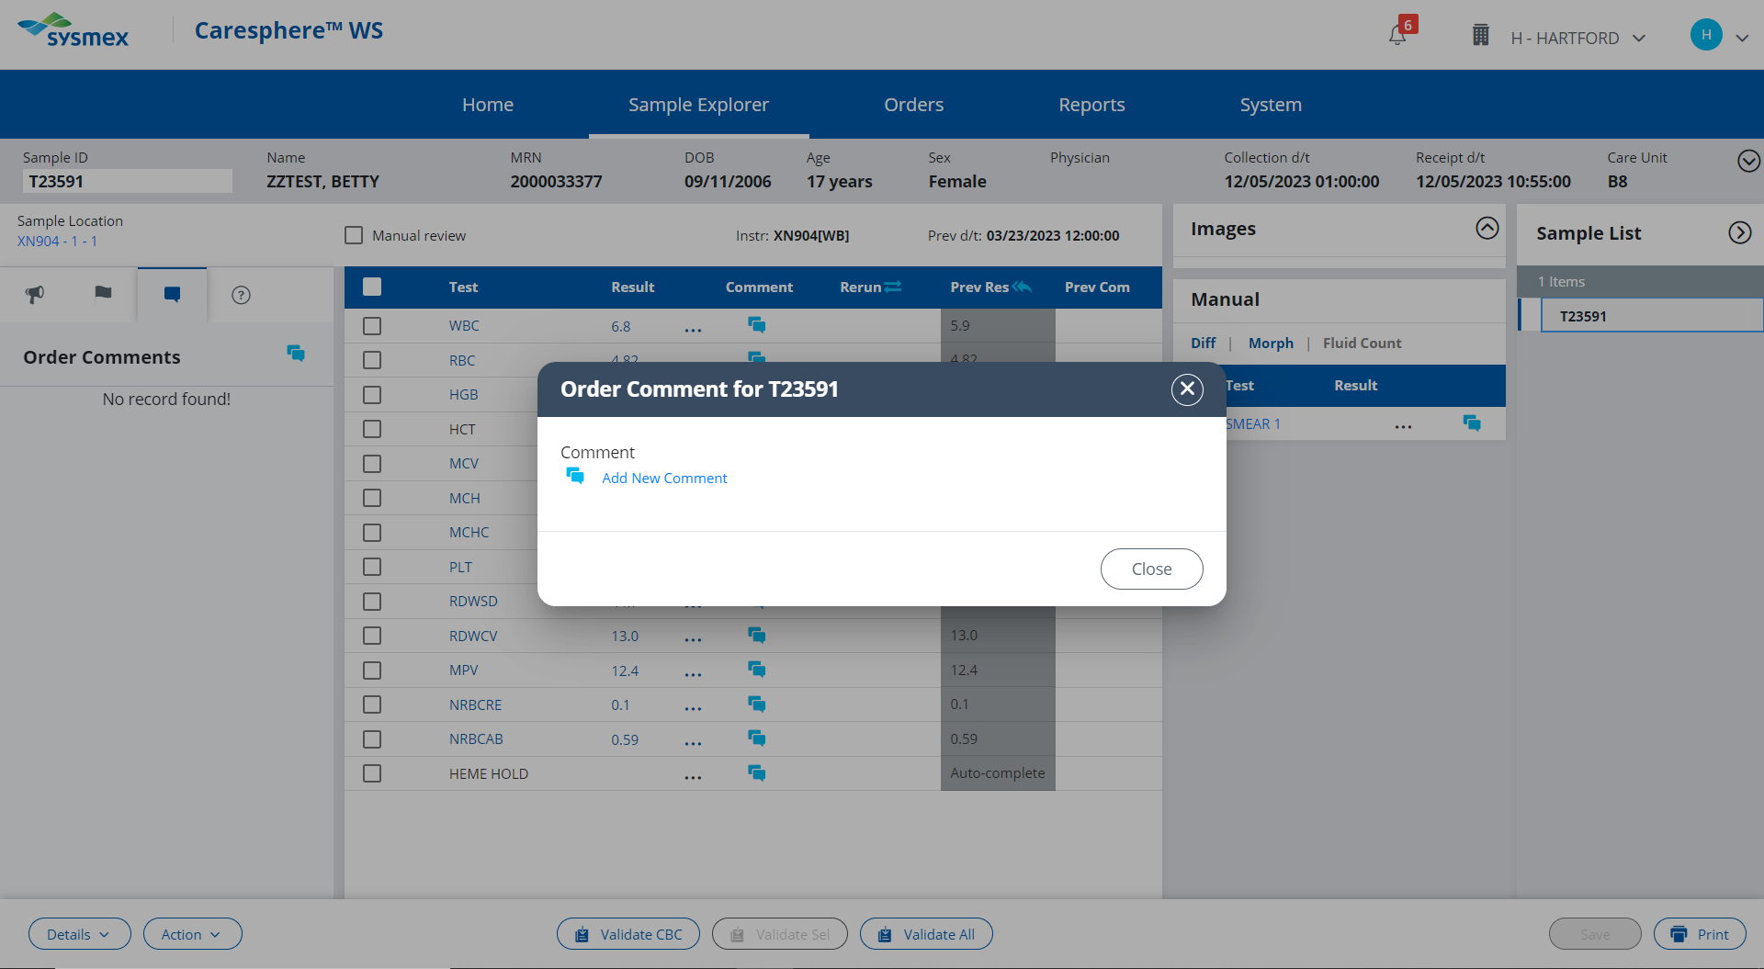

Slide 89
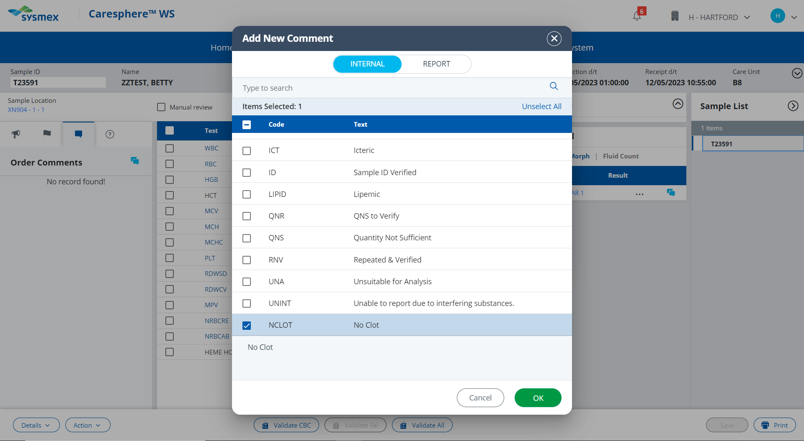

Slide 90
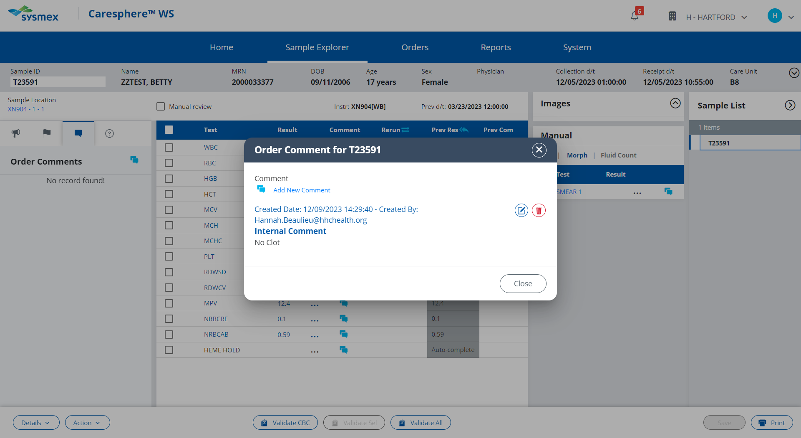

Slide 91
HCT <20
Actions;
Check sample for a clot. If there is no clotting observed, enter a NCLOT (No Clot) comment.
Order a rerun and run the sample again. Enter a TRP (Test Results Repeated) comment.
Review patient’s history.
If the patient has a history of having a hematocrit <20, release the results.
OR
If this is the patient’s first occurrence with a hematocrit <20, review slide for signs of hemolysis. Add appropriate comments and release results.
Click here to proceed with next action

Slide 92
Order a rerun for this sample.

Slide 94
Click here to see results of rerun.

Slide 95
Enter a TRP (Test Results Repeated) comment against the Hematocrit Result

Slide 96
This comment section is for internal comments only. Comments placed here will not be visible to the person reviewing the patient’s results.
In this instance you want the provider to be able to see your comment and know that you reviewed the slide.
Click here to try again!

Slide 101
HCT <20
Actions;
Check sample for a clot. If there is no clotting observed, enter a NCLOT (No Clot) comment.
Order a rerun and run the sample again. Enter a TRP (Test Results Repeated) comment.
Review patient’s history.
If the patient has a history of having a hematocrit <20, release the results.
OR
If this is the patient’s first occurrence with a hematocrit <20, review slide for signs of hemolysis. Add appropriate comments and release results.
Click here to proceed with the next action

Slide 102
Review patient’s history to see they have a history of their hematocrit falling below 20

Slide 104
HCT <20
Actions;
Check sample for a clot. If there is no clotting observed, enter a NCLOT (No Clot) comment.
Order a rerun and run the sample again. Enter a TRP (Test Results Repeated) comment.
Review patient’s history.
If the patient has a history of having a hematocrit <20, release the results.
OR
If this is the patient’s first occurrence with a hematocrit <20, review slide for signs of hemolysis. Add appropriate comments and release results.
Click here to review slide for signs if hemolysis

Slide 105
Do you see any visible signs of hemolysis when reviewing the RBC morphology?
Yes
No

Slide 106
Incorrect. Signs of hemolysis include; schistocytes, spherocytes and sickle cells. This RBC morphology is normal.
Click here to return to result validation.

Slide 107
Correct! This RBC morphology is normal.
Click here to return to result validation.

Slide 108
HCT <20
Actions;
Check sample for a clot. If there is no clotting observed, enter a NCLOT (No Clot) comment.
Order a rerun and run the sample again. Enter a TRP (Test Results Repeated) comment.
Review patient’s history.
If this is the patient’s first occurrence with a hematocrit <20, review slide for signs of hemolysis.
Add an RE (results verified by smear) comment and validate results.
Click here to proceed with the next action

Slide 109
Add an RE (results verified by smear) comment against the hematocrit.

Slide 110
This comment section is for internal comments only. Comments placed here will not be visible to the person reviewing the patient’s results.
In this instance you want the provider to be able to see your comment and know that you reviewed the slide.
Click here to try again!

Slide 115
Validate the results.

Slide 116
Because a smear was ordered by the Sysmex, results must be released from the Validate All button.
Click here to try again.

Slide 118
Incorrect. The slide was reviewed for signs of hemolysis.
Click here to try again.

Slide 120
Click here to proceed to next pending sample.

Slide 121
Select the abnormal result to review corresponding procedural action rules.

Slide 122
That value is within the normal reference range. Refer to the HH Reference Range Procedure to find the abnormal value.
Click here to try again!

Slide 123
PLT <50
Actions;
Check sample for clot. If no clotting is observed, enter a NCLOT (no clot) comment.
Rerun the sample for the Platelet F.
Review the patient history. If this is the first occurrence of the PLT result falling below 50, perform platelet estimate.
OR
If patient has a history of PLT results falling below 50 and the PLT does not have an asterisk flag, release result.
Click here to proceed with first action

Slide 124
You have checked the sample for a clot and saw no signs of clotting. Enter a NCLOT (no clot) comment

Slide 125
These are the external comment buttons. Comments entered here will be seen by the provider when viewing the patient’s results.
The “no clot” comment is for internal lab use only.
Click here to try again!

Slide 131
PLT <50
Actions;
Check sample for clot. If no clotting is observed, enter a NCLOT (no clot) comment.
Rerun sample for Platelet F.
Review the patient history. If this is the first occurrence of the PLT result falling below 50, perform platelet estimate.
OR
If patient has a history of PLT results falling below 50 and the PLT does not have an asterisk flag, release result.
Click here to see results of rerun.

Slide 132
PLT <50
Actions;
Check sample for clot. If no clotting is observed, enter a NCLOT (no clot) comment.
Rerun sample for Platelet F.
Review the patient history. If this is the first occurrence of the PLT result falling below 50, perform platelet estimate.
OR
If patient has a history of PLT results falling below 50 and the PLT does not have an asterisk flag, release result.
Click here to proceed with the next action.

Slide 133
View the patient’s previous results to see if they have a history of their platelet results falling below 50

Slide 135
PLT <50
Actions;
Check sample for clot. If no clotting is observed, enter a NCLOT (no clot) comment.
Rerun sample for Platelet F.
Review the patient history. If this is the first occurrence of the PLT result falling below 50, perform platelet estimate.
OR
If patient has a history of PLT results falling below 50 and the PLT does not have an asterisk flag, release result.
Click here to perform platelet estimate.

Slide 136
Perform a platelet estimate on the provided 100X fields.
Is your platelet estimate within +20% of the Sysmex platelet count of 43?
Click here for the next field

Slide 137
Perform a platelet estimate on the provided 100X fields.
Is your platelet estimate within +20% of the Sysmex platelet count of 43?
Click here for the next field

Slide 138
Perform a platelet estimate on the provided 100X fields.
Is your platelet estimate within +20% of the Sysmex platelet count of 43?
Click here for the next field

Slide 139
Perform a platelet estimate on the provided 100X fields.
Is your platelet estimate within +20% of the Sysmex platelet count of 43?
Click here for the next field

Slide 140
Perform a platelet estimate on the provided 100X fields.
Is your platelet estimate within +20% of the Sysmex platelet count of 43?
Yes
No

Slide 141
Incorrect. Try performing your platelet estimate again.
Click here to try again.

Slide 142
Correct! The platelet estimate of the provided slides is approximately 42.
Click here to return to result validation

Slide 143
PLT <100
Actions;
Check sample for clot. Comment in Caresphere “NCLOT” if no clotting is observed.
Run sample with Platelet F.
Review the patient history. If this is the first occurrence of the PLT result falling below 50, perform platelet estimate.
If the platelet estimate agrees within +20% of the sysmex result, add an RE comment and release results.
Click here to proceed to the next action.

Slide 144
Add an RE (results verified by smear review) comment against the PLT result

Slide 145
This comment section is for internal comments only. Comments placed here will not be visible to the person reviewing the patient’s results.
In this instance you want the provider to be able to see your comment and know that you reviewed the slide.
Click here to try again!

Slide 150
Validate the patient’s results.

Slide 151
Because a smear was ordered by the Sysmex, results must be released from the Validate All button.
Click here to try again!

Slide 153
Incorrect. The slide was reviewed for a platelet estimate.
Click here to try again!

Slide 155
Click here to proceed to next pending sample.

Slide 156
Click on the abnormal result.

Slide 157
The CBC results have already filed, because the results are normal. This is why the results appear in gray.
Click here to try again!

Slide 158
Retic% greater than linearity (>23.0)
Actions;
Dilute sample 1:2 with Cellpack DCL and rerun.
If the repeat agrees, result as >23.0
Click here to proceed with the first step.

Slide 159
Order a rerun for this sample.

Slide 161
Incorrect. You are diluting the sample before you rerun it, so you need to order a Rerun with Dilution so that Caresphere performs the calculation on the dilution automatically.
Click here to try again

Slide 162
Use the keypad to enter the dilution factor

Slide 163
Incorrect. You manually diluted the sample 1:2 with Cellpack DCL. Therefore the dilution factor is 2.
Click here to try again.

Slide 165
Click here to see the result of the rerun

Slide 166
Retic% greater than linearity (>23.0)
Actions;
Dilute sample 1:2 with Cellpack DCL and rerun.
If the repeat agrees, result as >23.0
Click here to proceed with next action.

Slide 167
Change the RETICRE result to >23.0, by clicking on the 3 dots next to the result.

Slide 168
Click here to override the instrument result with >23.0

Slide 170
Save the new RETICRE result.

Slide 171
Validate the results.

Slide 172
Incorrect. The CBC results have already been released. That is why they appear darker gray. Use the validate all button to release the Retic results
Click here to try again!

Slide 173
Click here to proceed to next pending sample.

Slide 174
Select the abnormal result to review corresponding procedural action rules.

Slide 175
That value is within the normal reference range. Refer to the HH Reference Range Procedure to find the abnormal value.
Click here to try again!

Slide 176
PLT <50
Actions;
Check sample for clot. If no clotting is observed, enter a NCLOT (no clot) comment.
Rerun the sample for the Platelet F.
Review the patient history. If this is the first occurrence of the PLT result falling below 50, perform platelet estimate.
OR
If patient has a history of PLT results falling below 50 and the PLT does not have an asterisk flag, release result.
Click here to proceed with first action

Slide 177
You have checked the sample for a clot and saw no signs of clotting. Enter a NCLOT (no clot) comment

Slide 178
These are the external comment buttons. Comments entered here will be seen by the provider when viewing the patient’s results.
The “no clot” comment is for internal lab use only.
Click here to try again!

Slide 184
PLT <50
Actions;
Check sample for clot. If no clotting is observed, enter a NCLOT (no clot) comment.
Rerun the sample for the Platelet F.
Review the patient history. If this is the first occurrence of the PLT result falling below 50, perform platelet estimate.
OR
If patient has a history of PLT results falling below 50 and the PLT does not have an asterisk flag, release result.
Click here to see results of rerun.

Slide 185
PLT <50
Actions;
Check sample for clot. If no clotting is observed, enter a NCLOT (no clot) comment.
Rerun the sample for the Platelet F.
Review the patient history. If this is the first occurrence of the PLT result falling below 50, perform platelet estimate.
OR
If patient has a history of PLT results falling below 50 and the PLT does not have an asterisk flag, release result.
Click here to proceed with the next action.

Slide 186
View the patient’s previous results to see if they have a history of their platelet results falling below 50

Slide 188
PLT <50
Actions;
Check sample for clot. If no clotting is observed, enter a NCLOT (no clot) comment.
Rerun the sample for the Platelet F.
Review the patient history.
If this is the first occurrence of the PLT result falling below 50, perform platelet estimate.
OR
If patient has a history of PLT results falling below 50 and the PLT does not have an asterisk flag, release result.
Click here to proceed with releasing the result.

Slide 190
Click here to proceed to next pending sample.

Slide 191
Click on the operator flag to review the corresponding procedural action rules.

Slide 192
RBC Agglutination
MCHC > 37.5
Actions;
Order a rerun on the sample
Warm sample at 37C for 15-30 minutes before re-running.
Scan warm smear
If warmed run has an MCHC <37.5, append comment CAGG to HCT.
Release Result.
Click here to proceed with first action

Slide 193
Order a rerun. The sample will be rerun after sitting in the heating block at 37C for 15-30 minutes to try to resolve the possible RBC agglutination.

Slide 195
Click here to see the results of the warmed rerun.

Slide 196
RBC Agglutination
MCHC > 37.5
Actions;
Order a rerun to be performed warmed.
Warm sample at 37C for 15-30 minutes
Scan warm smear
If warmed run has an MCHC <37.5, append comment CAGG to HCT.
Release Result.
Click here to review the smear.

Slide 197
Smear of sample at room temperature shows RBC agglutination.
Smear of sample after being warmed shows the RBC agglutination resolved
Click here to return to result validation

Slide 198
RBC Agglutination
MCHC > 37.5
Actions;
Order a rerun to be performed warmed.
Warm sample at 37C for 15-30 minutes
Scan warm smear
If warmed run has an MCHC <37.5, append comment CAGG to HCT.
Release Result.
Click here to proceed with the next action.

Slide 199
Enter a CAGG comment against the HCT result

Slide 204
Validate the Results.

Slide 205
Because a smear was ordered by the Sysmex, results must be released from the Validate All button.
Click here to try again.

Slide 207
Incorrect. The slide was reviewed for RBC agglutination.
Click here to try again!

Slide 209
Click here to proceed to next pending sample.

Slide 210
Click on the operator flag to see the corresponding procedure action rules.

Slide 211
PLT Clump Flag
Actions;
Check sample for clot. If no clotting is observed, enter a NCLOT (no clot) comment.
Rerun for the Platelet F.
If the PLT-F does not have a platelet clump flag or asterisk, release result.
OR
If the PLT-F run has an asterisk or platelet clump flag, perform a platelet estimate and scan smear for platelet clumps, fibrin strands, and large or giant platelets.
Click here to proceed with the first action.

Slide 212
You checked the sample, and did not observe any clotting. Enter a NCLOT (no clot) comment.

Slide 213
These are the external comment buttons. Comments entered here will be seen by the provider when viewing the patient’s results.
The “no clot” comment is for internal lab use only.
Click here to try again!

Slide 219
PLT Clump flag
Actions;
Check sample for clot. If no clotting is observed, enter a NCLOT (no clot) comment.
Rerun for the Platelet F.
If the PLT-F does not have a platelet clump flag or asterisk, release result.
OR
If the PLT-F run has an asterisk or platelet clump flag, perform a platelet estimate and scan smear for platelet clumps, fibrin strands, and large or giant platelets.
Click here to see the results of the rerun.

Slide 220
PLT Clump flag
Actions;
Check sample for clot. If no clotting is observed, enter a NCLOT (no clot) comment.
Rerun for the Platelet F.
If the PLT-F does not have a platelet clump flag or asterisk, release result.
OR
If the PLT-F run has an asterisk or platelet clump flag, perform a platelet estimate and scan smear for platelet clumps, fibrin strands, and large or giant platelets.
Click here to review the slide.

Slide 221
Click here to return to result validation

Slide 222
PLT Clump flag
Actions;
Check sample for clot. If no clotting is observed, enter a NCLOT (no clot) comment.
Rerun for the Platelet F.
If the PLT-F run has an asterisk or platelet clump flag, perform a platelet estimate and scan smear for platelet clumps, fibrin strands, and large or giant platelets.
If platelet clumping is present, delete the PLT result and replace with platelet clump comment.
Delete the MPV result and replace with HIDE comment
Release the results.
Click here to proceed with the next action.

Slide 223
Click on the 3 dots next to the platelet value to modify the result and replace with a platelet clump comment. When platelets are clumped, the instrument result may be falsely decreased, because clumps of many platelets are being counted as one.

Slide 224
Delete!

Slide 227
Save your modified platelet result.

Slide 228
PLT Clump flag
Actions;
Check sample for clot. If no clotting is observed, enter a NCLOT (no clot) comment.
Rerun for the Platelet F.
If the PLT-F run has an asterisk or platelet clump flag, perform a platelet estimate and scan smear for platelet clumps, fibrin strands, and large or giant platelets.
If platelet clumping is present, delete the PLT result and replace with platelet clump comment.
Delete the MPV result and replace with HIDE comment
Release the results.
Click here to proceed with the next action.

Slide 229
Click on the 3 dots next to the MPV result to delete the result and replace with comment HIDE. When platelets are clumped, the MPV can be artificially high because the instrument counts the clump as one large platelet.

Slide 230
Delete!

Slide 233
Save your modified MPV result.

Slide 234
Validate the results.

Slide 235
Because a smear was ordered by the Sysmex, results must be released from the Validate All button.
Click here to try again!

Slide 237
The slide was reviewed for the platelet clump flag.
Click here to try again.

Slide 239
Click here to proceed to next pending sample.

Slide 240
Click on the operator flag to see the corresponding procedure action rules.

Slide 241
Ret Abn Scattergram
Retic *
Actions;
Order a rerun with dilution.
Dilute the sample 1:2 with cellpack DCL and run.
If no flags are present on the rerun, report the diluted run.
OR
If the flag remains after the dilution, append the RETPER with comment INTSUB and release the results.
Click here to proceed with the first action.

Slide 242
Order a rerun with dilution to see if the retic abnormal scattergram flag can be resolved.

Slide 244
Click here to enter a dilution factor of 2, so that Caresphere will perform the math for us!

Slide 246
Click here to see the results of the rerun.

Slide 247
Ret Abn Scattergram
Retic *
Actions;
Order a rerun with dilution.
Dilute the sample 1:2 with cellpack DCL and run.
If no flags are present on the rerun, report the diluted run. OR
If the flag remains after the dilution, append the RETPER with comment INTSUB and release the results.
Click here to proceed with the next action.

Slide 248
Since the Retic flags did not resolve in the diluted run, add an INTSUB comment against the RETIRE result.

Slide 253
Validate the patient’s results.

Slide 254
Because a smear was ordered by the Sysmex, results must be released from the Validate All button.
Click here to try again!

Slide 256
Incorrect. The slide was not reviewed.
Click here to try again!

Slide 258
Click here to proceed to next pending sample.

Slide 259
Select the critical result to review corresponding procedural action rules.

Slide 260
That value is within the normal reference range. Refer to the HH Critical Results Procedure to find the abnormal value.
Click here to try again!

Slide 261
PLT <20
Actions;
Check sample for clot. If no clotting is observed, enter a NCLOT (no clot) comment.
Rerun the sample for the Platelet F.
Review the patient history. If this is the first occurrence of the PLT result falling below 20, perform platelet estimate.
OR
If patient has a history of PLT results falling below 20 and the PLT does not have an asterisk flag, release result.
Click here to proceed with first action

Slide 262
You have checked the sample for a clot and saw no signs of clotting. Enter a NCLOT (no clot) comment

Slide 263
These are the external comment buttons. Comments entered here will be seen by the provider when viewing the patient’s results.
The “no clot” comment is for internal lab use only.
Click here to try again!

Slide 269
PLT <20
Actions;
Check sample for clot. If no clotting is observed, enter a NCLOT (no clot) comment.
Rerun the sample for the Platelet F.
Review the patient history. If this is the first occurrence of the PLT result falling below 20, perform platelet estimate.
OR
If patient has a history of PLT results falling below 20 and the PLT does not have an asterisk flag, release result.
Click here to see results of rerun.

Slide 270
PLT <20
Actions;
Check sample for clot. If no clotting is observed, enter a NCLOT (no clot) comment.
Rerun the sample for the Platelet F.
Review the patient history. If this is the first occurrence of the PLT result falling below 20, perform platelet estimate.
OR
If patient has a history of PLT results falling below 20 and the PLT does not have an asterisk flag, release result.
Click here to proceed with the next action.

Slide 271
View the patient’s previous results to see if they have a history of their platelet results falling below 20.

Slide 273
PLT <20
Actions;
Check sample for clot. If no clotting is observed, enter a NCLOT (no clot) comment.
Rerun the sample for the Platelet F.
Review the patient history.
If this is the first occurrence of the PLT result falling below 20, perform platelet estimate.
OR
If patient has a history of PLT results falling below 20 and the PLT does not have an asterisk flag, release result.
Click here to perform platelet estimate.

Slide 274
Perform a platelet estimate on the provided 100X fields.
Is your platelet estimate within +20% of the Sysmex platelet count of 11?
Click here for the next field

Slide 275
Perform a platelet estimate on the provided 100X fields.
Is your platelet estimate within +20% of the Sysmex platelet count of 11?
Click here for the next field

Slide 276
Perform a platelet estimate on the provided 100X fields.
Is your platelet estimate within +20% of the Sysmex platelet count of 11?
Click here for the next field

Slide 277
Perform a platelet estimate on the provided 100X fields.
Is your platelet estimate within +20% of the Sysmex platelet count of 11?
Click here for the next field

Slide 278
Perform a platelet estimate on the provided 100X fields.
Is your platelet estimate within +20% of the Sysmex platelet count of 11?
Yes
No

Slide 279
Incorrect. Try performing your platelet estimate again.
Click here to try again.

Slide 280
Correct! The platelet estimate of the provided slides is approximately 10.
Click here to return to result validation

Slide 281
PLT <20
Actions;
Check sample for clot. If no clotting is observed, enter a NCLOT (no clot) comment.
Rerun the sample for the Platelet F.
Review the patient history.
If this is the first occurrence of the PLT result falling below 20, perform platelet estimate.
If the platelet estimate agrees with the Sysmex value within +20%, add RE comment
Release results.
Click here to proceed to next step

Slide 282
Add an RE (results verified by smear review) comment against the PLT result

Slide 283
This comment section is for internal comments only. Comments placed here will not be visible to the person reviewing the patient’s results.
In this instance you want the provider to be able to see your comment and know that you reviewed the slide.
Click here to try again.

Slide 288
Click here to proceed with releasing the result.

Slide 290
Because a smear was ordered by the Sysmex, results must be released from the Validate All button.
Click here to try again.

Slide 292
Incorrect. The slide was reviewed for a platelet estimate.
Click here to try again!

