Slide 1
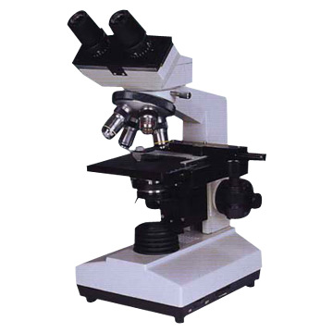
Fern Test
Provider Performed Testing

Slide 2
Course Goal and/or Objectives
This course will review the procedure for performing Fern Tests.
This course will include:
  Test principle
  Supplies needed
  Specimen collection
  Patient testing
  Ordering and result reporting
  Limitations

Slide 3
Test Principle
Vaginal fluid from patients in labor and delivery or the OB/GYN clinic will be examined for the presence of ferning (arborization) as determined by the practitioner. The presence of ferning may indicate leakage of amniotic fluid (ruptured of membranes) during pregnancy. Production of the fern shaped pattern is due to relative concentrations of sodium chloride, proteins, and carbohydrates in the fluid. Normal vaginal secretions that do not contain amniotic fluid will not show the ferning pattern.

Slide 4
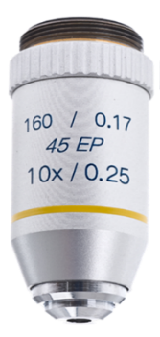
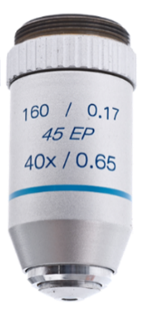
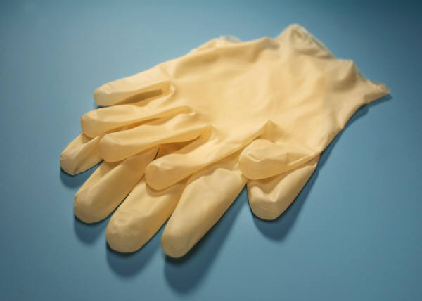
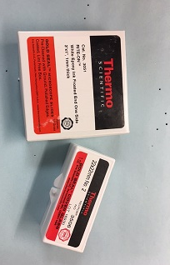
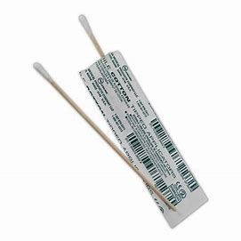
Supplies
Microscope with 10X & 40X objectives
Microscope slides
Gloves
Sterile cotton swab

Slide 5
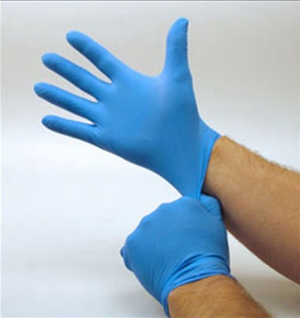
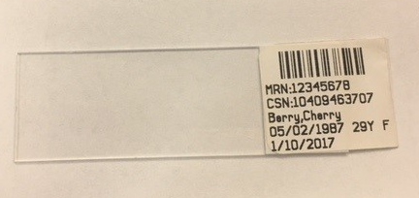
Specimen Collection
PPE: gloves MUST be worn
Identify the patient with name and numeric identifier (DOB or MRN)
Label the microscope slide with 2 identifiers or EPIC label

Slide 6
Specimen Collection
Sample Collection: DO NOT handle glass slides with ungloved hands. Sweat from fingers can contaminate the slide and may result in a false positive fern test.
Vaginal fluid is obtained by the provider using a sterile cotton tipped swab.
After collection, immediately roll the swab across a clean glass slide while applying pressure to express the fluid creating a thin smear.
Air dry slide until the sample is completely dried (approximately 3 to 5 minutes).

Slide 7
Patient Testing
  Place slide on microscope and examine under 10X. Scan entire slide using an “S” shaped viewing pattern to look for any evidence of a fernlike pattern.
  Observe the slide under high power (40X) magnification to confirm ferning pattern.
  If amniotic fluid is present in the sample, crystallization and a fern leaf pattern will be observed.

Slide 8
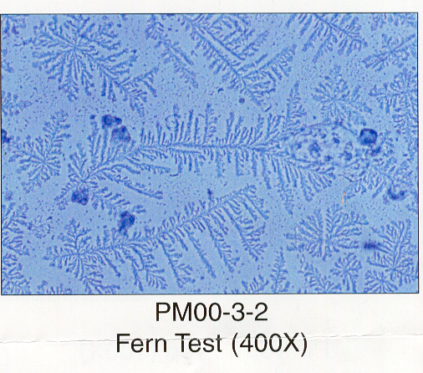
Microscope Examples
Positive Fern Test
The fern-like pattern indicates the presence of
amniotic fluid.
Fern Test (400X)

Slide 9
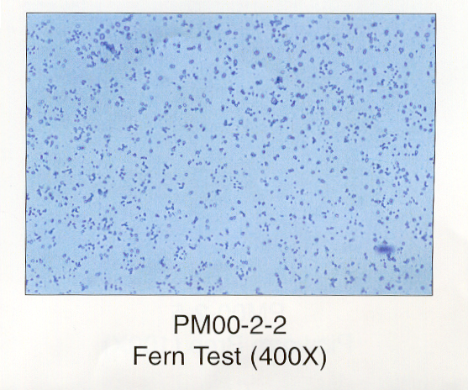
Microscope Examples
Negative Fern Test
Lack of fern-like
pattern indicates
the absence of
amniotic fluid.
Fern Test (400X)

Slide 10
Ordering and Result Reporting
Order POC Fern Test in EPIC.
Once ordered, POC Fern Test will be available in EPIC Enter/Edit Results tab.
Select POC Fern Test in Enter/Edit Results tab and enter result in chart.
See next slide for example in EPIC.

Slide 11
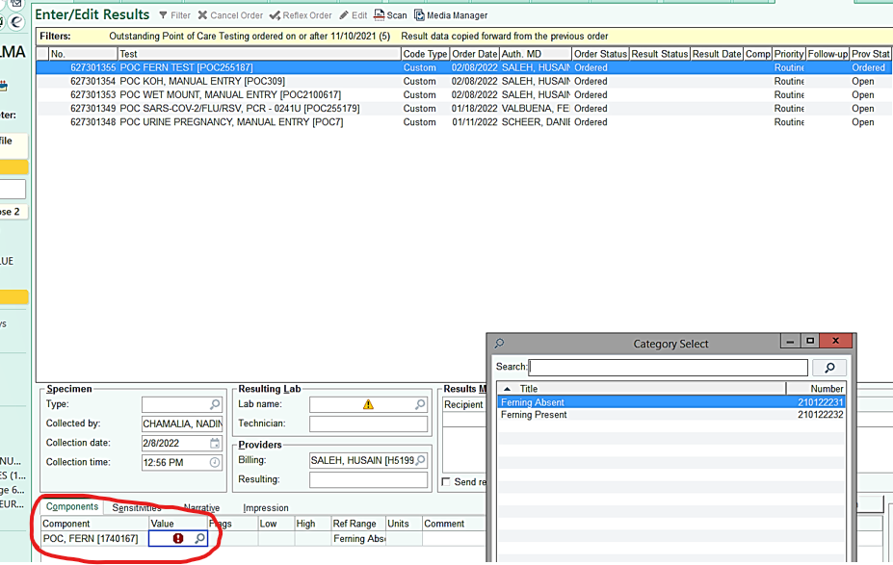
EPIC Example

Slide 12
Limitations
If the sample is moderately to grossly bloody, the ferning pattern may be obscured or absent even with amniotic fluid present.

Slide 13
Questions?
Contact Point of Care Testing:
Brian Castle: 313-916-4054
Jackie Hirst: 313-916-8949
Emily Morrow: 313-916-4114

