Slide 1
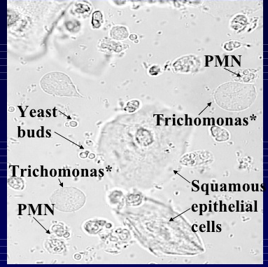
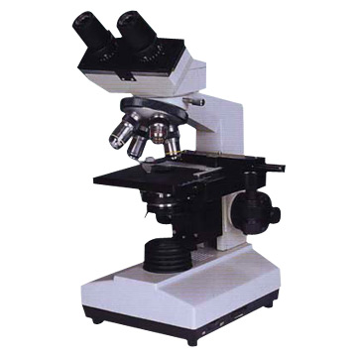
VAGINAL WET MOUNT/KOH
Provider Performed Testing

Slide 2
Read Policy
Please read the HFH Wet Mount/KOH policy located on OneHenry:
  Provider Performed Testing (hfhs.org)
  *if using this link off site, you will be asked to sign in with your corporate account ID and password.
  (Type: CORP\username)

Slide 3
Course Goal and/or Objectives
This course will review the procedure for performing microscopic examination for Vaginal Wet Mount KOH Prep.
This course will include:
  Test principle
  Supplies needed
  Specimen collection
  Patient testing
  Microscopic findings review
  Ordering and result reporting
  Limitations

Slide 4
Test Principle
The wet mount and potassium hydroxide (KOH) microscopy procedure is an important tool in the evaluation of vaginitis. The microscopic observation of a “wet” slide preparation of vaginal secretions allows for the rapid detection of the presence of the following:
Trichomonas vaginalis: a common parasite causing vaginitis.
Clue cells: indicative of Gardnerella vaginalis infection or bacterial vaginosis.
White Blood cells: indicative of a potential bacterial infection.
Fungal elements: observed using KOH to dissolve extraneous materials for easier identification.

Slide 5
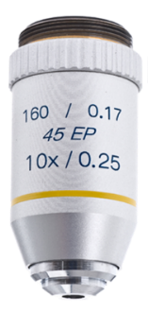
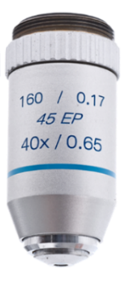
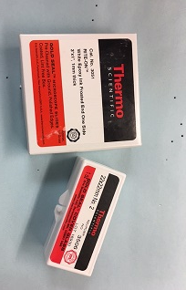
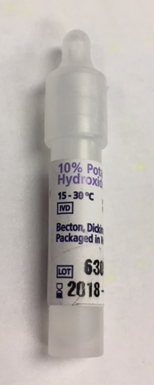
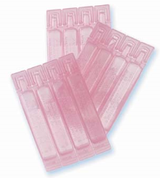
Supplies
Microscope with 10X & 40X objectives
Microscope slides
Coverslips
Sterile cotton swab /culturette
Gloves
Normal Saline
KOH reagent (10% KOH)
08/06/18
PATHOLOGY AND LABORATORY MEDICINE

Slide 6
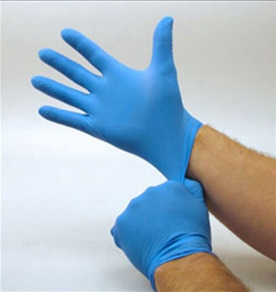
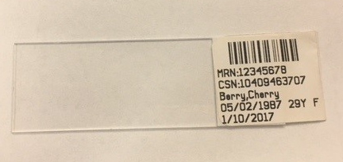
Specimen Collection
PPE: gloves MUST be worn
Identify the patient with name and numeric identifier (DOB or MRN)
Label the microscope slide with 2 identifiers or EPIC label

Slide 7
Specimen Collection
Patient preparation: none.
Fluid from the genital area is obtained by the provider.
A drop is placed on a clean labeled microscope slide.
Transport specimen immediately to location of microscope.

Slide 8
Patient Testing – Wet Mount
Add 1 drop of saline directly on top of the specimen and coverslip, if needed.
Place slide on microscope and examine under 10X. Keep the light low and the condenser lowered. Scan entire slide to look for any bacteria, white blood cells, squamous cells, trichomonas and fungi.

Slide 9
Patient Testing – Wet Mount continued
Switch to the high-power objective 40X to identify any objects. Read at least 10 fields using an “S” shaped viewing pattern.
Discard microscope slide and coverslip into sharps container

Slide 10
Patient Testing – Potassium Hydroxide (KOH) 10%
Place 1 drop of specimen on clean, labeled microscope slide.
Add 1 drop of 10% KOH directly on top of the specimen and coverslip.
Place slide on microscope and examine under 10X. Keep the light low and the condenser lowered. Scan entire slide to look for any fungal elements

Slide 11
Patient Testing – Potassium Hydroxide (KOH) 10%
Switch to the high-power objective 40X to identify any objects. Examine for budding yeast or yeast with hyphae or psuedohyphae. Read at least 10 fields using an “S” shaped viewing pattern.
Discard microscope slide and coverslip into sharps container.

Slide 12
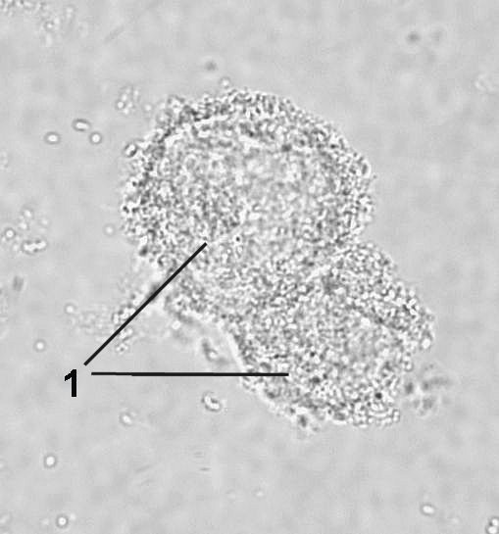
Epithelial Cells and Clue Cells Examples
Squamous epithelial cells: nucleus is well defined. The edge of the cell membrane and the cytoplasm are clearly visible.
Clue cells: are squamous epithelial cell that are mostly or totally covered with bacteria. The edge of the cell is “fuzzy” and difficult to distinguish. The nucleus is often obscured by bacteria. The presence of clue cells is diagnostic of bacterial vaginosis.

Slide 13
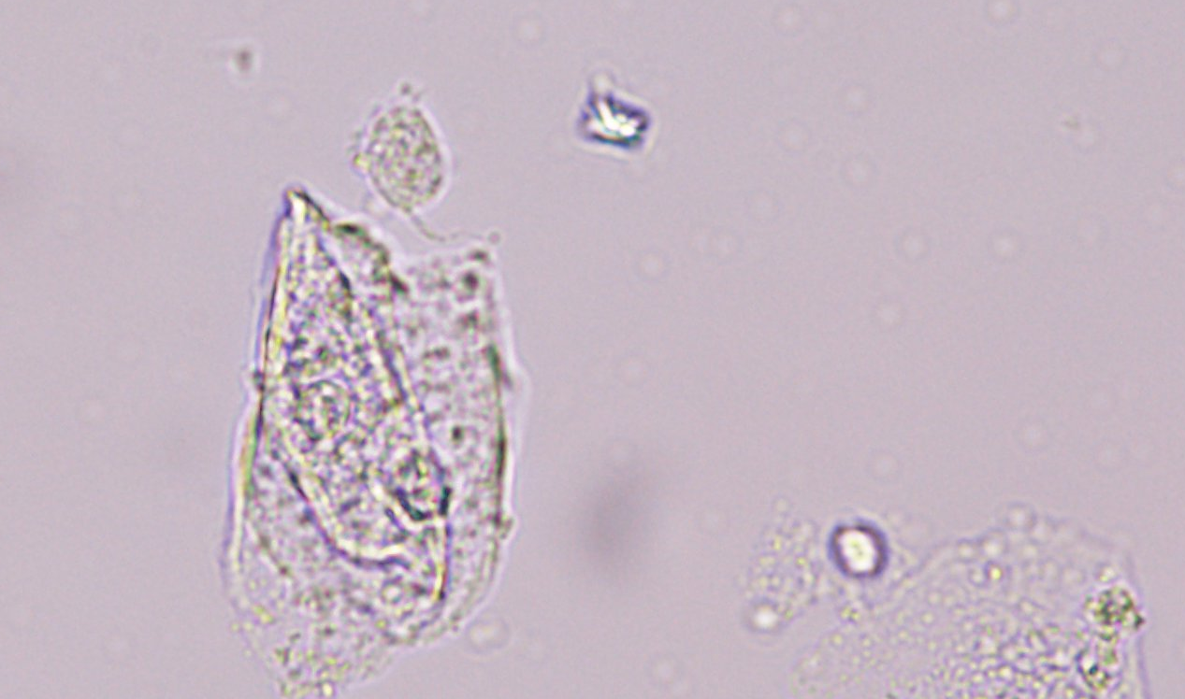
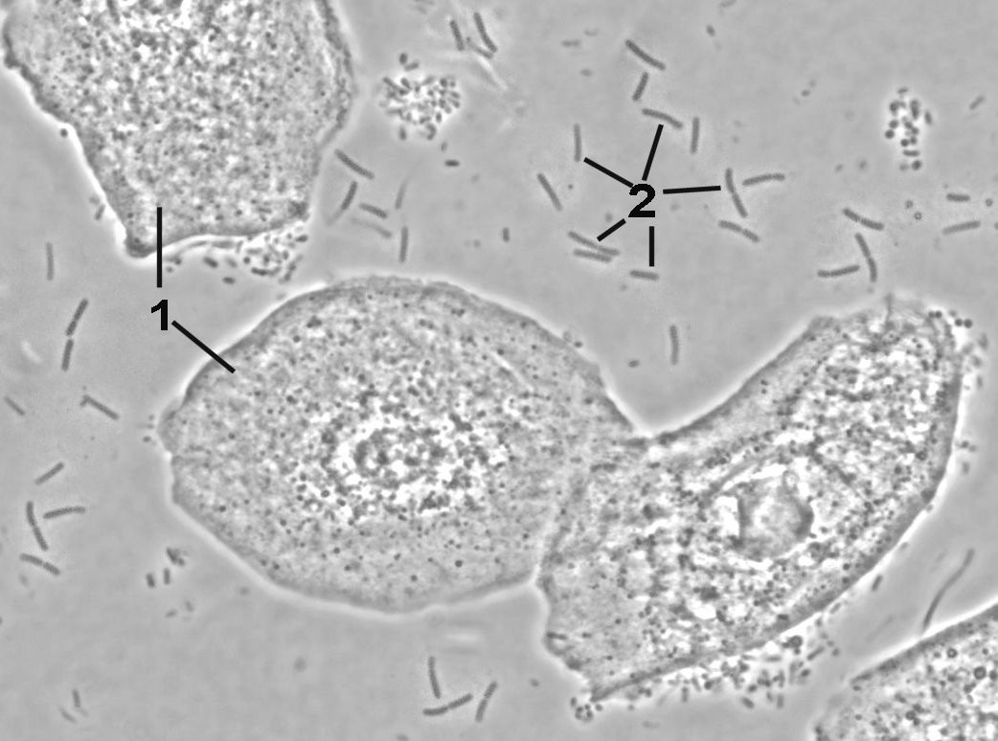
Trichomonas and Bacteria Examples
Bacteria: the arrowed objects (2) are examples of bacteria.
Trichomonas: can be identified by its characteristic flagella (6 o’clock position).
On a wet mount sample, Trichomonas is easily recognizable by its typical jerky motility.

Slide 14
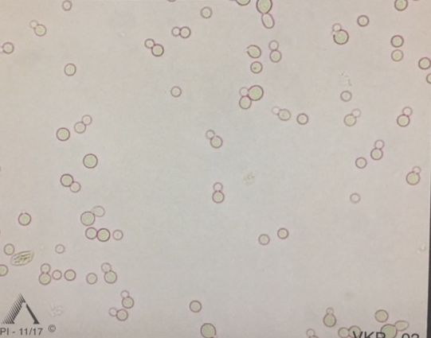
Yeast: Budding and Pseudohyphae Examples
Yeast: may appear round, slightly oval, or have an elongated, "rice" appearance. Size varies with many in the RBC size range. On microscopic exam, “only” budding yeast or pseudohyphae can be reported.
Psuedohyphae: appear like an elongated filament-like string of attached cells.

Slide 15
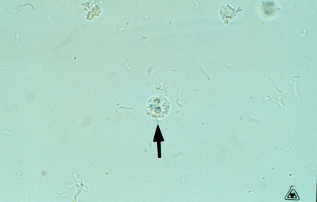
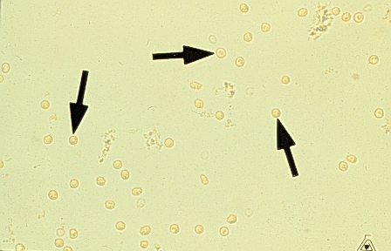
White Blood and Red Blood Cell Examples
Leukocytes (WBCs) appear as granular spheres somewhat larger than an RBC or single yeast cell. Leukocytes contain distinct nuclei and granular cytoplasm.
Red blood cells appear as pale discs. They are sometimes confused with single yeast cells.
RBCs – look for central pallor or soft cell margins
Yeast Cells – look for budding

Slide 16
Reference Range
No yeast or hyphal elements seen
No trichomonas seen
No clue cells seen

Slide 17
Ordering and Result Reporting
Order POC Wet Mount, Manual Entry and POC KOH, Manual Entry in EPIC.
Once ordered, POC Wet Mount, Manual Entry and POC KOH, Manual Entry will be available for resulting in the EPIC Enter/Edit Results tab.
Select POC Wet Mount, Manual Entry Enter/Edit Results tab and enter result in chart.
There are no results to enter for POC KOH, Manual Entry; this just documents that KOH was used.
See next slides for example in EPIC.

Slide 18
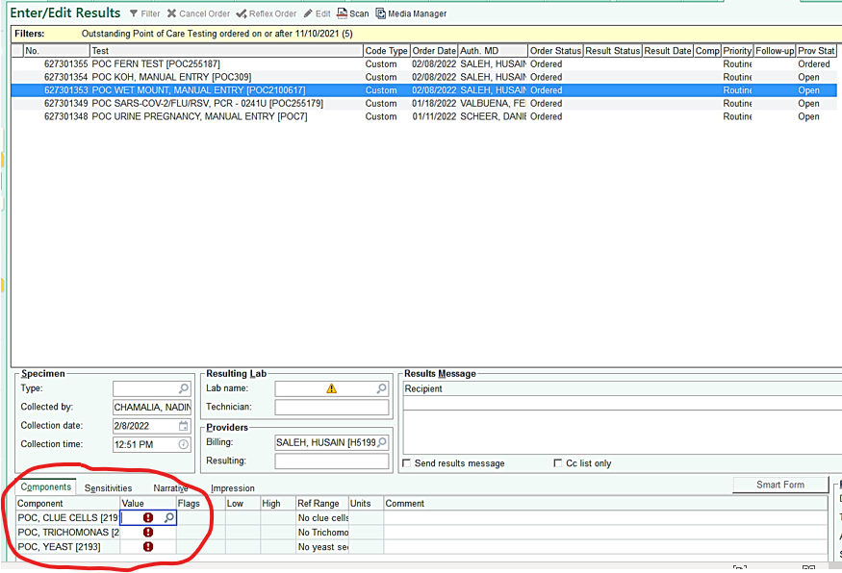
EPIC Example – POC Wet Mount

Slide 19
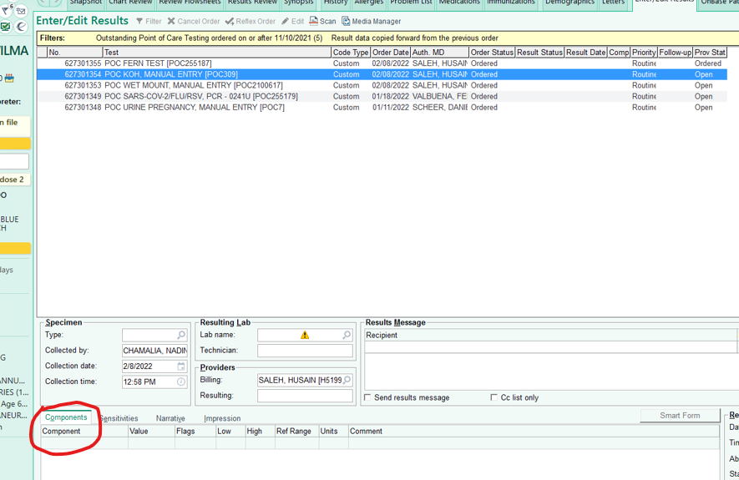
EPIC Example – POC KOH

Slide 20
Limitations
Microscopic lighting is critical as too much light can wash out fungi and other cellular elements, resulting in false negatives.
Many artifacts are generated by the action of KOH on cellular material so care must be taken to ensure true fungi are observed.
Examine the entire cover slipped area. Random examination of smears may result in a false negative result.

Slide 21
Questions?
Contact Point of Care Testing:
Brian Castle: 313-916-4054
Jackie Hirst: 313-916-8949
Emily Morrow: 313-916-4114

