Slide 1
Introduction
This PowerPoint will give you step-by-step instructions on ordering and resulting PPM orders in EPIC

Slide 2
Open Patient Schedule Find the patient on your schedule and double click to open their chart.

Slide 3
Select ‘Manage Orders’ Tab

Slide 4
Search for the desired test in the top right corner, i.e., ‘POC’ or ‘POC fern’ ,etc. Choose the test from the listed options.

Slide 5
Once all needed orders are placed, ‘Sign’ the orders

Slide 6
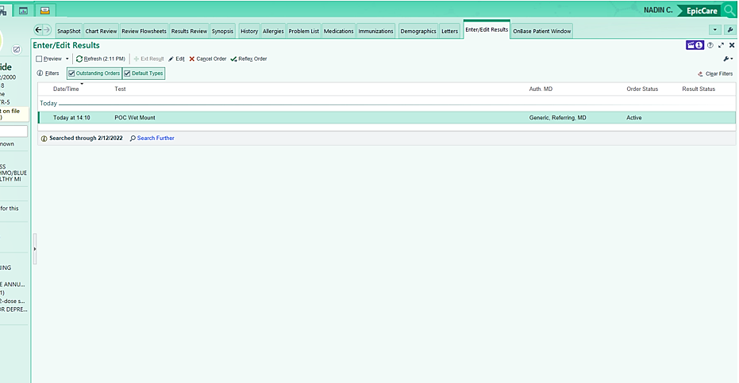
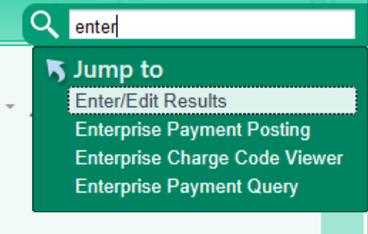
Open the ‘Enter Edit’ function. Your ordered test(s) should be listed. **If it’s not on your listed tabs, use the Search function in the top right corner to look for ‘Enter/Edit’

Slide 7
To result your orders: Select the test by double clicking on the test line. You will need to answer Specimen type, Resulting Lab, enter the Value of your results, and select the appropriate Status. Once the parameters are entered – ‘Accept’ the results.

Slide 8
Enter/Edit for Ferning (Present or Absent)

Slide 9
Once your results have been entered and Accepted, you will be able to view the PPM results under the patient’s ‘Labs’ tab in EPIC.

Slide 10
Thank you
POCC Team

