Slide 1


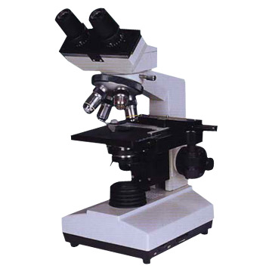
Provider Performed Testing
Fern Test

Slide 2


Read Policy
Please read the HFH Fern Test policy located on OneHenry (link below):
Provider Performed Testing (hfhs.org)
*if using this link off site, you will be asked to sign in with your corporate account ID and password.
(Type: CORP\username)

Slide 3
Course Goal and/or Objectives
This course will review the procedure for performing Fern Tests.
This course will include:
Test principle
Supplies needed
Specimen collection
Patient testing
Ordering and result reporting
Limitations

Slide 4
Test Principle
Vaginal fluid from patients in labor and delivery or the OB/GYN clinic will be examined for the presence of ferning (arborization) as determined by the practitioner.
The presence of ferning may indicate leakage of amniotic fluid (ruptured of membranes) during pregnancy.
Production of the fern shaped pattern is due to relative concentrations of sodium chloride, proteins, and carbohydrates in the fluid.
Normal vaginal secretions that do not contain amniotic fluid will not show the ferning pattern.

Slide 5
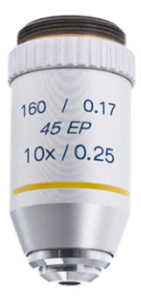
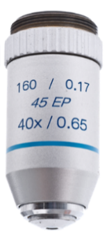
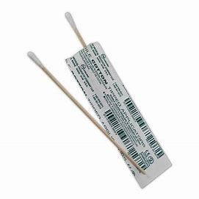
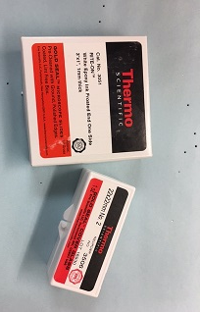
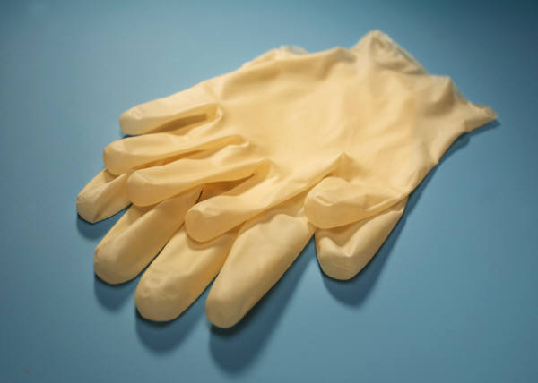
Supplies
Microscope with 10X & 40X objectives
Microscope slides
Gloves
Sterile cotton swab
PATHOLOGY AND LABORATORY MEDICINE

Slide 6
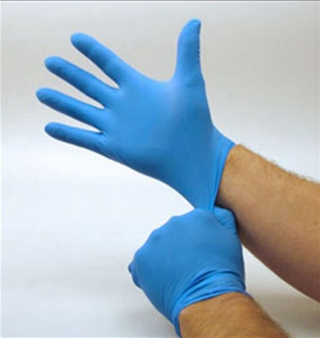
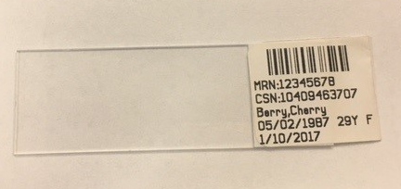
Specimen Collection
PPE: gloves MUST be worn
Identify the patient with name and numeric identifier (DOB or MRN)
Label the microscope slide with 2 identifiers or EPIC label

Slide 7
Specimen Collection, cont’d
Sample Collection: DO NOT handle glass slides with ungloved hands. Sweat from fingers can contaminate the slide and may result in a false positive fern test.
Vaginal fluid is obtained by the provider using a sterile cotton tipped swab.
After collection, immediately roll the swab across a clean glass slide while applying pressure to express the fluid creating a thin smear.
Air dry slide until the sample is completely dried (approximately 3 to 5 minutes).

Slide 8
Patient Testing
Place slide on microscope and examine under 10X.
1
Scan entire slide using an “S” shaped viewing pattern to look for any evidence of a fernlike pattern.
2
Observe the slide under high power (40X) magnification to confirm ferning pattern.
3
If amniotic fluid is present in the sample, crystallization and a fern leaf pattern will be observed.
4

Slide 9
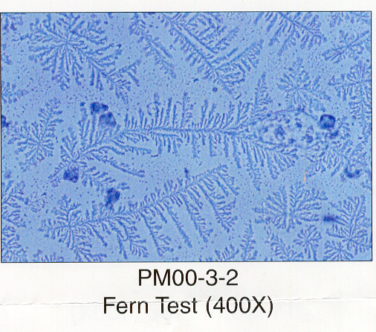
Microscope Examples
Positive Fern Test
The fern-like pattern indicates the presence of
amniotic fluid.
Fern Test (400X)

Slide 10
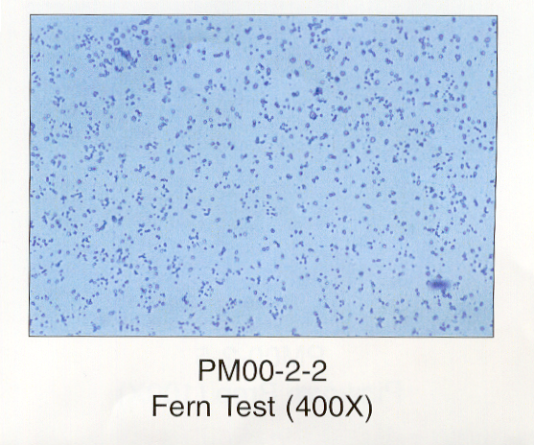
Microscope Examples
Negative Fern Test
Lack of fern-like
pattern indicates
the absence of
amniotic fluid.
Fern Test (400X)

Slide 11
Ordering and Result Reporting
Order
Order POC Fern Test in EPIC.
Record
Once ordered, POC Fern Test will be available for resulting in the EPIC Enter/Edit Results tab. Enter the findings into the patient’s Medical Record using Enter/Edit (see next slide for EPIC screen print).
Results
Normal Results: Ferming Absent
Abnormal results: Ferning Present

Slide 12
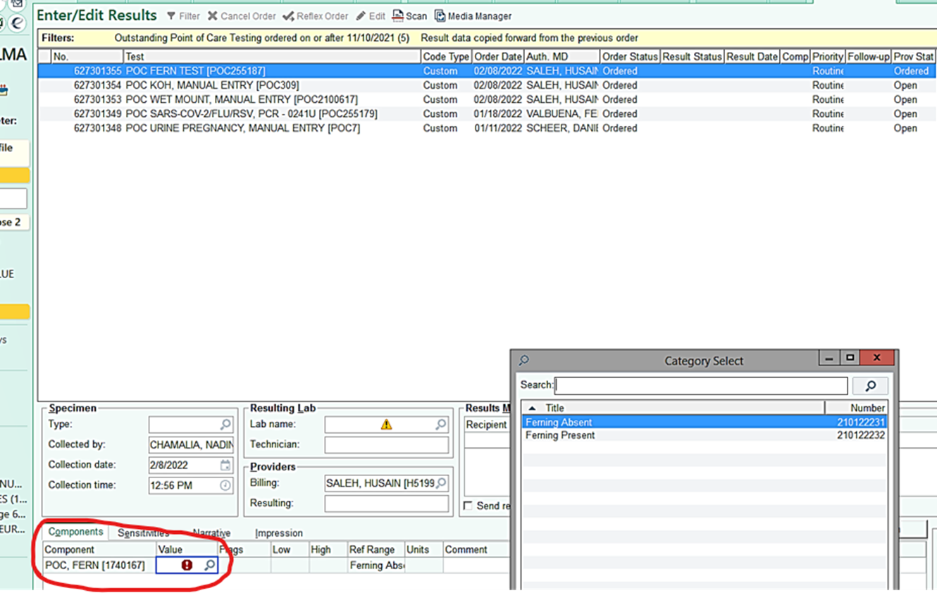
EPIC Example

Slide 13
Limitations
If the sample is moderately to grossly bloody, the ferning pattern may be obscured or absent even with amniotic fluid present.

Slide 14
Questions?
Contact the Point of Care Testing Department
313-725-7500
or
POCHFH@hfhs.org

