Slide 1
Diagnostic Parasitology- Blood Parasites
Created by: Dr Holly Huse PhD
Director, Harbor UCLA Medical Center Microbiology
Edited by: Qichao Stephen Ji, MS. MSc. MLS(ASCP)SBB, CLS, CQA(ASQ)
Clinical Laboratory Scientist Instructor

Slide 2
Blood Parasites
Plasmodium spp.
Babesia spp.
Trypanosoma spp.
Microfilaria (nematodes)

Slide 3
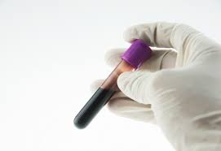
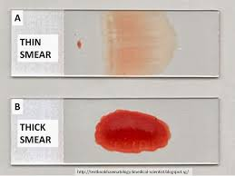
Diagnosis: Thick and Thin Blood Smears
Whole blood collected in EDTA
Should be run as a STAT test
Parasite morphology becomes distorted over time
Must do both thick and thin smears
Thick smears:
Examines a large volume of blood
Screen for parasites
Thin smears:
Can see RBC morphology and perform specific parasite identification
Quantify % parasitemia

Slide 4
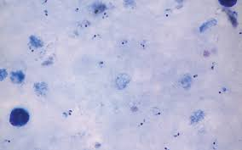
Thick and thin smears
Thin smear:
RBC morphology
Parasite ID
% Parasitemia
Thick smear:
Screen for parasites

Slide 5
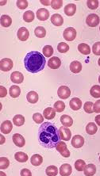
Blood smear-stains
Giemsa is the preferred stain
Allows for detection of certain morphologic features (Schüffner’s dots, Maurer’s clefts) that other stains (Wright, Wright-Giemsa) miss
Use fresh methanol for fixation
pH (7.2) is critical for staining (CAP requirement)
RBCs: pale red
WBCs: purple with pale purple cytoplasm
Neutrophilic granules stain dark purple
QC: perform with each batch of testing

Slide 6
Smear Examination
Examine both thin and thick on 10x
Examine a minimum of 300 thick and 300 thin fields under 100x before reporting a negative result
Quality Control should be performed with each specimen tested
Thin smear: report % parasitemia
Important for monitoring treatment
CAP requirement
# infected RBCs / total # RBCs counted X 100 = % infected RBCs
> 5% parasitemia is considered severe
One set of negative smears does not rule-out malaria
2-3 sets over 24 hours preferred

Slide 7
Malaria
Protozoan parasite
Transmitted by the Anopheles mosquito
> 200 million malaria cases per year
In United States, most infections are due to travel to endemic areas
Transmission also associated with transfusion, congenital, and shared contaminated needles
Anopheles

Slide 8
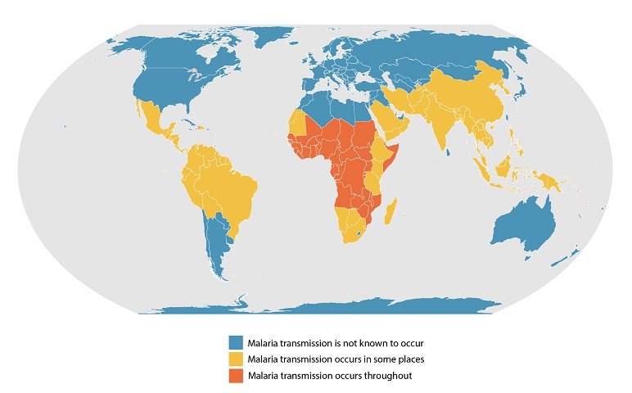
Endemic areas

Slide 9
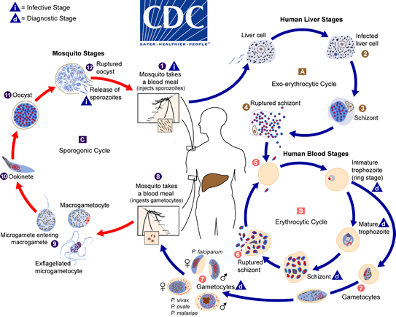

Slide 10
Malaria Symptoms
Fever pattern
Parasite | Disease
Plasmodium falciparum | Malignant tertian malaria
P. vivax | Benign tertian malaria
P. ovale | Benign tertian malaria
P. malariae | Quartan malaria
Tertian = q 48 hours (every other day) Quartan = q 72 hours
Slide credit: Dr. Margie Morgan

Slide 11
Clinical manifestations
Most frequent symptoms include fever and chills, which can be accompanied by headache, myalgias, arthralgias, weakness, vomiting, and diarrhea
P. falciparum
Most severe, potentially fatal
CNS involvement (cerebral malaria)
Acute renal failure (Blackwater Fever)
Severe anemia
Acute respiratory distress syndrome.

Slide 12
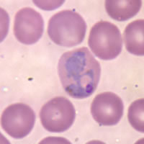
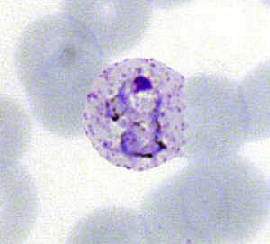
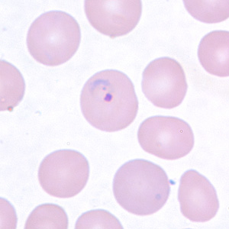
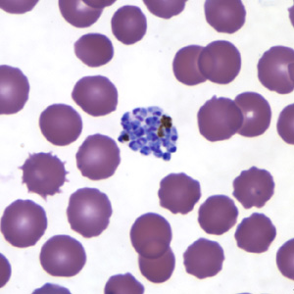
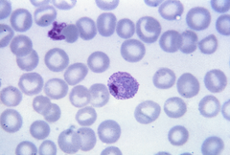
Plasmodium vivax
Benign tertian malaria
Untreated infections may remain dormant in the liver, and relapse can occur
Identification:
Infect young (enlarged) RBCs
Occasional Schuffner’s dots
Delicate young ring
Very Ameboid trophozoite
Mature schizont has 12-24 merozoites

Slide 13
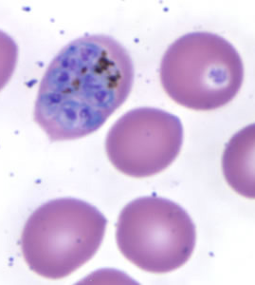
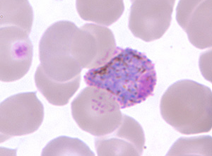
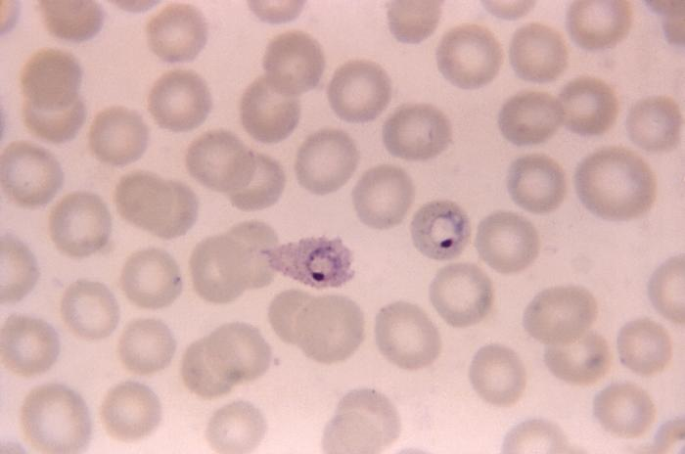
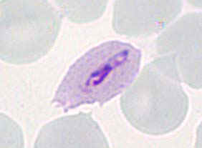
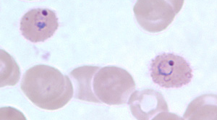
Plasmodium ovale
Benign tertial malaria
Relapse can occur
Characteristics:
Tends to infect young RBCs
Enlarged RBCs with fimbriated edges
Oval infected RBCs may be seen
Schuffner’s dots appear early in infected RBCs
Trophozoite more compact, less ameboid
Mature schizont has average 8 merozoites

Slide 14
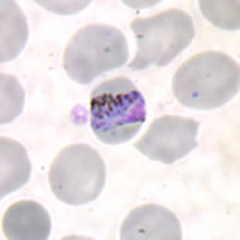
Plasmodium malariae
Quartan malaria
Characteristics:
Tends to infect old RBCs
Normal size RBCs
Thick ring, large nucleus
“Band” forms
Mature schizont contains 6-12 merozoites in “rosette” form

Slide 15
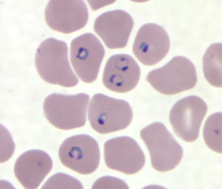
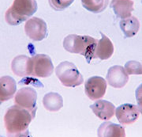
Plasmodium falciparum
Malignant tertian malaria
Due to the plugging of vessels in the internal organs:
“Cerebral Malaria”
“Blackwater Fever” & kidney failure
DIC
Multi-organ failure
Characteristics:
Tends to infect any RBCs
Maurer’s clefts, no Schuffner’s dots
Multiple rings per RBC
Rings may form “headphones”
Delicate rings, accole or applique forms
Schizonts and trophs not usually seen
Crescent-shaped gametocytes

Slide 16
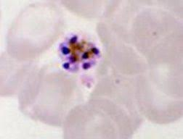
Special structures
Maurer’s clefts
Larger and more course than Schuffner’s dots
Schuffner’s dots
P. vivax & P. ovale
P. falciparum
Malaria pigment
P. vivax
P. malariae

Slide 17
Plasmodium knowlesi
Fifth pathogenic malaria species in humans
Periodically reported
Simian malarial parasite
Unknown: transmission from human to human via mosquito without intermediate host
Need specific travel history (Borneo, peninsular Malaysia, Indonesia and certain parts of Southeast Asia)
Microscopically similar to Plasmodium malariae or Plasmodium falciparum depending on blood stages seen
PCR assay needed for identification

Slide 18
Mixed Malarial Infections
More common in some parts of world
Thailand: 30% P. falciparum/P. vivax
Africa: P. falciparum/P. malariae
New Guinea: all 4 species (confirmed by PCR)
Anopheles mosquitoes: Can transmit two species at the same time.
Difficult to detect microscopically (different parasite levels, low parasitemia, confusing morphologic criteria), but PCR can differentiate to the species level

Slide 19
Immunoassay: BinaxNow Malaria
Targets HRPII antigen specific to P. falciparum
Targets pan-malarial antigen (aldolase)
Notes:
Only FDA approved RDT, but there are others out there.

Slide 20
BinaxNOW Malaria
NEGATIVE:
Control line must be positive for test to be valid
T1: Negative for Plasmodium falciparum antigen
T2: Negative for Plasmodium antigen
Negative results from the rapid malaria must be confirmed by thick and thin microscopy
POSITIVE:
Control line must be positive for test to be valid
T1: Plasmodium falciparum antigen detected
T2: Plasmodium species antigen detected
T1 and T2: Plasmodium falciparum or mixed Plasmodium antigen detected

Slide 21
Sensitivity and Specificity vs. Microscopy
High for P. falciparum: 94-97%
Lower for non-PF species: 67-86%

Slide 22
Limitations
A negative test does not rule out infection with malaria
Low parasitemia levels
Partial deletions in HRP antigen targets
Therefore, the BinaxNow Malaria must always be used in conjunction with thick and thin smears
Not used to monitor treatment, as plasmodium antigen may be detected for several days following elimination of the parasite and anti-malarial treatment
Cross-reaction with Rheumatoid Factor

Slide 23
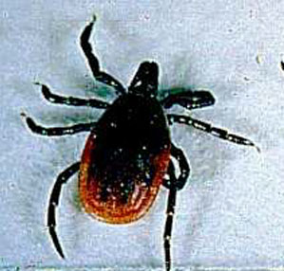
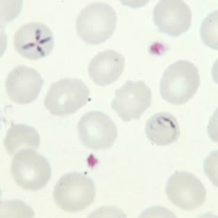
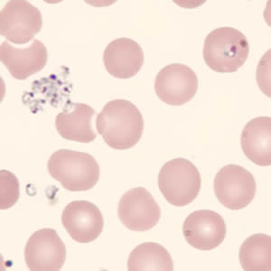
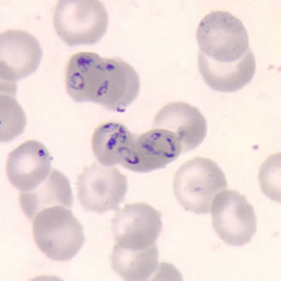
Babesia
Ixodes
Protozoan parasite
B. microti, B. divergens
Transmitted by the Ixodes tick (“Deer tick”)
Found worldwide
In the U.S., endemic to NE
Mimics malaria
Infects RBCs
Symptoms: fever (no periodicity) and chills
Diagnosis: Thick and thin blood films
Mimics P. falciparum
Pleomorphic ring like structures
Multiple rings/RBC
Differentiating features:
“Maltese Cross”
No malarial pigment
Can be extracellular

Slide 24
Trypanosomes
Hemoflagellates
African Trypanosomes
African Sleeping Sickness
Trypanosoma brucei gambiense (West)
Trypanosoma brucei rhodesiense (East)
American Trypanosomes
Chagas’ Disease
Trypanosoma cruzi

Slide 25
African Trypanosomiasis
Vector: Tsetse fly (Glossina)
Stage I (Acute)
Trypomastigotes seen at bite site (chancre) and in peripheral blood
Intermittent fevers
Lymph node swelling along posterior cervical chain (Winterbottom’s sign)
Stage II (Sleeping sickness)
CNS involvement-mental, motor, sensory, neural signs and symptoms
Sleep/wake cycle becomes reversed

Slide 26
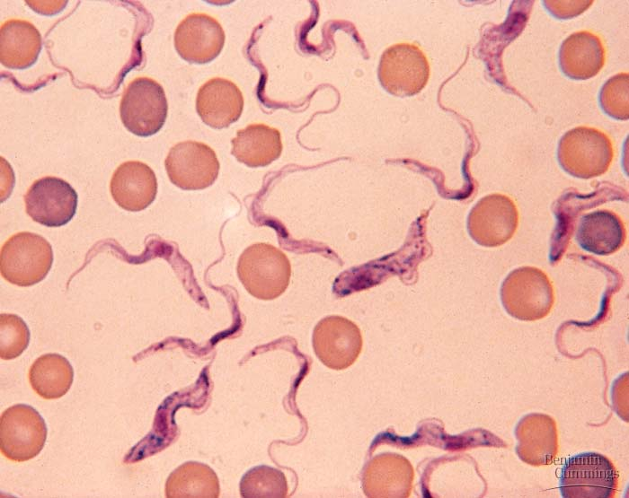
African Trypanosomes
Extracellular organisms
Move rapidly between RBCs
14-33 microns long and 1.5-3.5 microns wide
Small kinetoplast at posterior end
Flagellum and undulating membrane

Slide 27
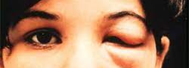
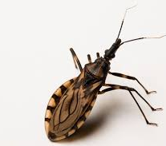
American Trypanosomiasis
AKA Chagas Disease
Vector: Reduviid Triatomid bug
AKA the “Kissing Bug”
Trypomastigotes released with feces during a blood meal
Acute Disease
Chagoma (Romana’s sign)
High fevers, hepatosplenomegaly, lymphadenopathy, acute cardiomyopathy
Trypomastigotes found in blood
Chronic
Amastigotes found in various tissues
Myocardial insufficiencies

Slide 28
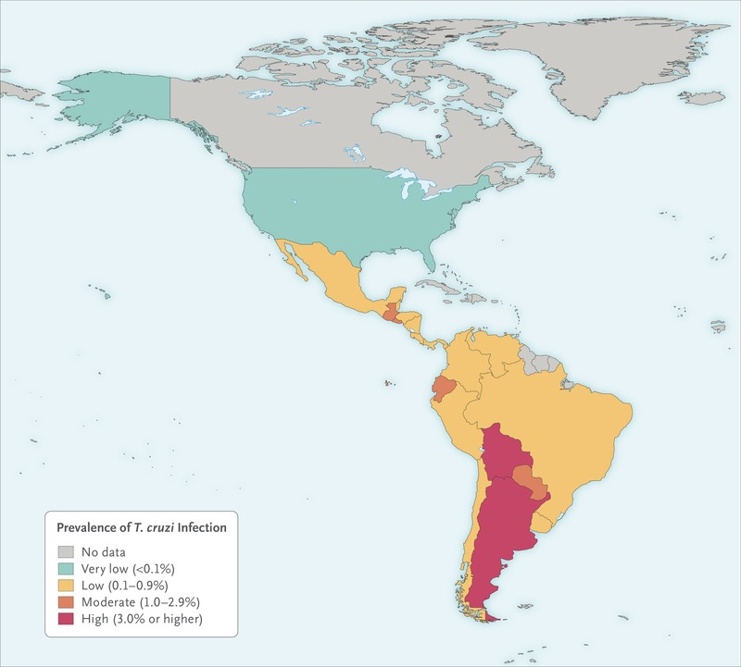
Prevalence

Slide 29
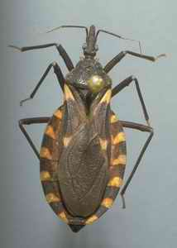
Transmission
Feces of Triatomid bug
Blood Transfusions
Congenital Infections
Organ transplantation

Slide 30
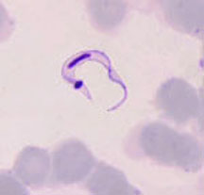
T. cruzi
Trypomastigotes:
Found in blood & CSF during acute infection
“C” or “U” shaped
20 microns in length
Central nucleus with a large oval kinetoplast
Undulating membrane and flagellum
Amastigotes
Chronic infection (heart tissue)
Single nucleus and kinetoplast
Cannot distinguish morphologically from Leishmania

Slide 31
Complications of American Trypanosomiasis
Chagas disease has an acute phase and chronic phase
Acute phase:
Usually asymptomatic, but can present with nonspecific somatic symptoms
Nodular lesions or furuncles, usually called chagomas, may develop around the vector’s feeding site.
Most acute cases resolve over a period of a few weeks or months into a subclinical chronic form of the disease
Chronic phase:
Reactivation of Chagas disease from this asymptomatic form may occur in patients with HIV or those receiving immunosuppressive drugs.
May include cardiac or GI involvement
Complications can lead to megaesophagus, megacolon, and dilated cardiomyopathy and can be fatal

Slide 32
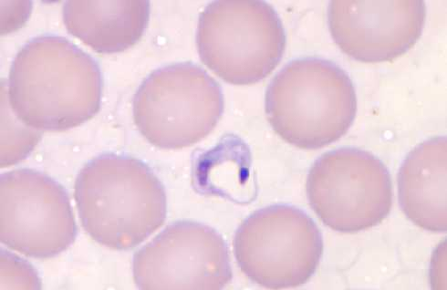
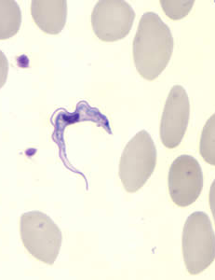
African vs. American Trypomastigotes

Slide 33
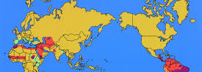
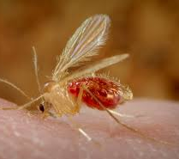
Leishmania
Obligate intracellular organisms
Amastigotes seen in tissue
Vector: Phlebotomus or Lutzomyia (Sandfly)
Clinical Disease Presentation
Cutaneous
Mucocutaneous
Visceral (“Kala Azar”)

Slide 34
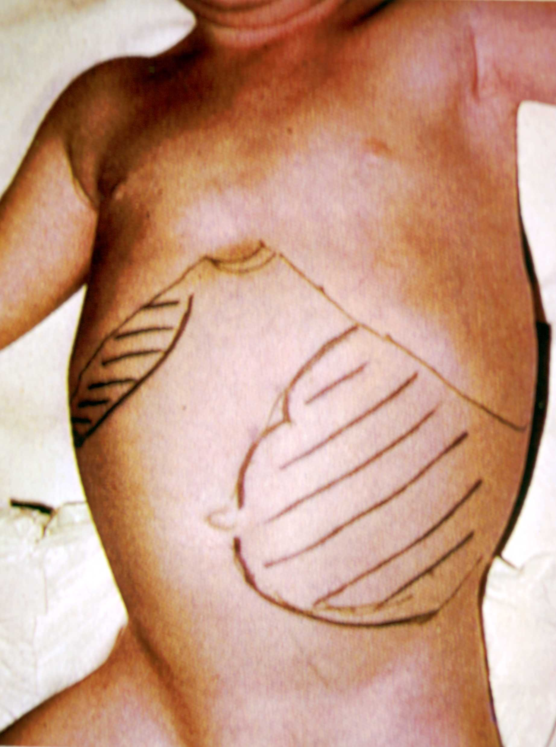
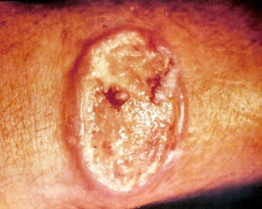
Leismaniasis: clinical presentations
Cutaneous:
Lesions develop at the site of bite that can ulcerate
Mucocutaneous:
Parasites disseminate to nasopharyngeal mucosa
Lesions partially or totally destroy membranes of the nose, mouth, throat, & surrounding tissues
Caused by different Leishmania species
Visceral:
Immunocompromised and children
Hepatosplenomegaly, anemia, cytopenias, systemic symptoms

Slide 35
 | Clinical Manifestations | Old World species | New World species
Cutaneous Leishmaniasis (CL) | Lesions develop at the site of bite that can ulcerate | L. tropica L. major L. aethiopica L. Infantum L. donovani | L. mexicana complex: L. mexicana L. Amazonensis L. venezuelensis Viannia subgenus: L. [V.] braziliensis L. [V.] guyanensis L. [V.] panamensis L. [V.] peruviana
Mucocutaenous Leishmaniasis (ML) | Parasites disseminate to nasopharyngeal mucosa; lesions partially or totally destroy membranes of the nose, mouth, throat, & surrounding tissues | L. aethiopica | Viannia subgenus: L. [V.] braziliensis L. [V.] guyanensis L. [V.] panamensis L. [V.] peruviana L. amazonensis
Visceral Leishmaniasis (VL; also known as kala-azar) | Dissemination of parasites to the visceral tissues; high fever, weight loss, swelling of spleen & liver, anemia | L. donovani L. infantum syn. L. chagasi | L. Infantum syn. L. chagasi
Diffuse Cutaneous Leishmaniasis | Presence of disseminated, chronic skin lesions | L. aethiopica | L. amazonensis
Post-Kala-azar dermal Leishmaniasis (PKDL) | Unique eruption that develops after treatment and apparent cure of VL | L. donovani | L. infantum syn. L. chagasi

Slide 36
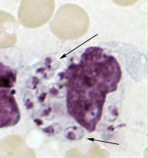
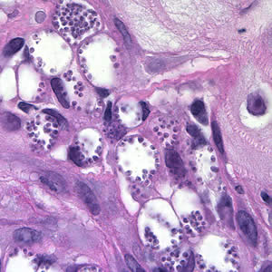
Laboratory Diagnosis
Cutaneous and Mucocutaneous Leishmaniasis
Demonstrate amastigotes in tissue biopsy or aspirate
Nucleus and kinetoplast
Molecular tests (CDC) for identification and speciation
Culture in NNN media
Must coordinate with the CDC in advance to have special media sent to the provider for collection
Visceral Leishmaniasis
Serology

Slide 37
Key points
Know vectors and what they transmit:
Anopheles: Plasmodium
Ixodes: Babesia
Tsetse fly: T. brucei
Triatomine: T. cruzi
Sandfly: Leishmania
Know characteristic features:
P. vivax: enlarged RBCs, ameboid trophozoite
P. ovale: enlarged RBCs, compact trophozoite in oval “comet-tail” RBC
P. malariae: normal RBCs, “band form” or “basket form” trophs
P. falciparium: most severe, CNS, kidneys, mostly ring forms, multiply infected RBCs, “headphones”, banana/crescent gametocytes
Babesia: maltese cross, extracellular forms
T. brucei: small kinetoplast
T. cruzi: trypomastigotes have “C-shape” and large kinetoplast
Leishmania: round amastigotes with nucleus and kinetoplast

Slide 38
Microfilariae
Nematodes
Wuchereria bancrofti
Brugia species
Loa loa
Mansonella species
Onchocerca volvulus
Mansonella streptocerca

Slide 39
Filarial Nematodes
Transmitted by arthropods
Mosquitoes: Anopheles, Culex, Aedes
Chrysops flies
Black flies
Biting midges
Adults reside in the subcutaneous tissue, deep connective tissue, lymphatic system or body cavities of humans
Female worms produce larvae found in blood or subcutaneous tissue of host
Larvae may exhibit periodicity

Slide 40
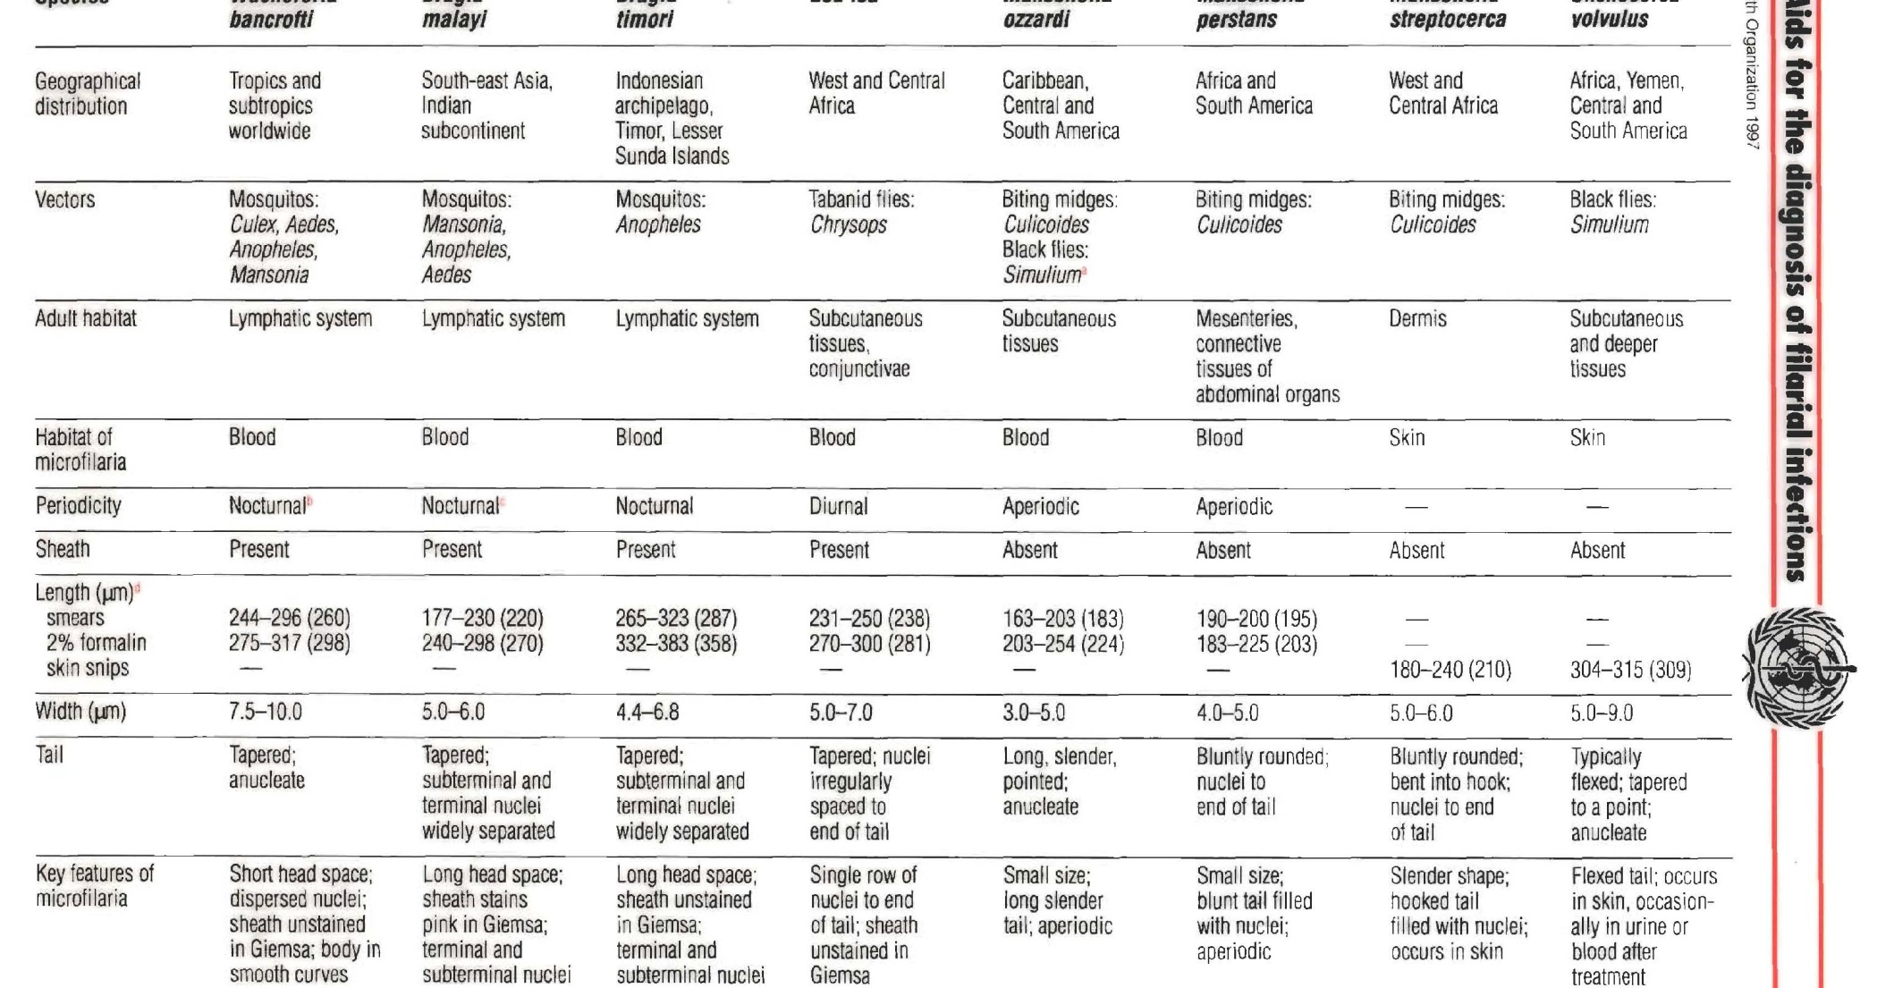
*

Slide 41
Microfilariae
Larvae found in the blood:
Wuchereria bancrofti
Brugia malayi
Loa loa
Mansonella species
Larvae found in tissue
Onchocerca volvulus
Mansonella streptocerca

Slide 42
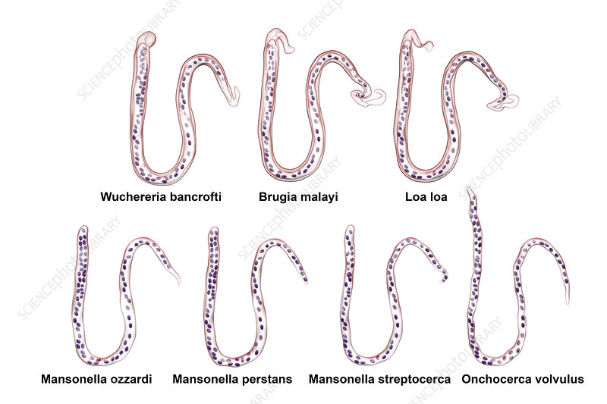
Microfilariae Identification
Based on presence of sheath and distribution of nuclei

Slide 43
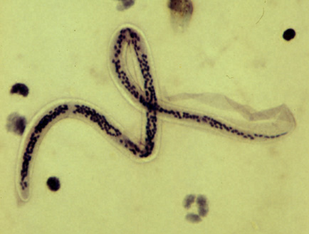
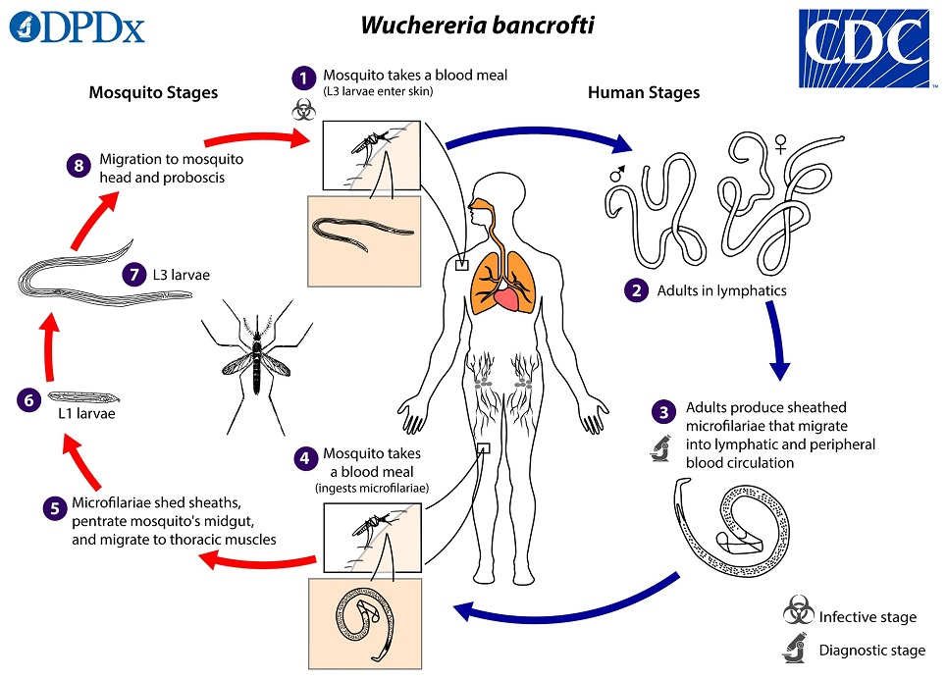
Wuchereria bancrofti
Lymphatic filariasis
Bite from mosquito
Nocturnal
Resides in lymph nodes
Sheathed larvae
Hydrocele and elephantiasis
Nuclei does not extend to tip of tail

Slide 44
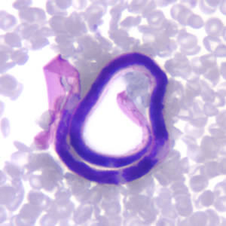
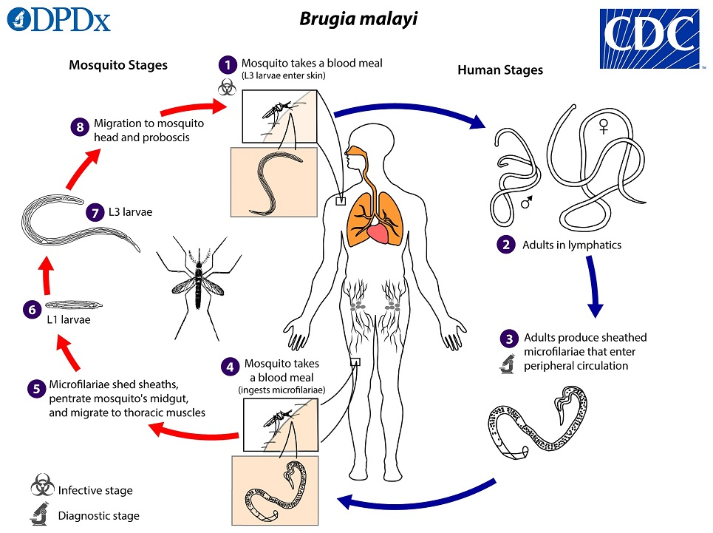
Brugia malayi
Lymphatic filariasis
Vector: mosquito
Asia
Resembles W. bancrofti, but smaller.
Sheath stains pink.
Additional manifestation: pulmonary tropical eosinophilia syndrome, with nocturnal cough and wheezing, fever, and eosinophilia.

Slide 45
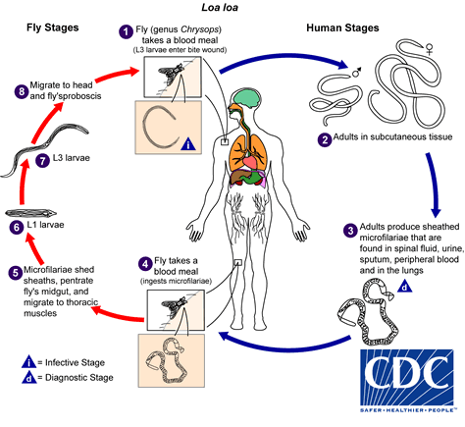
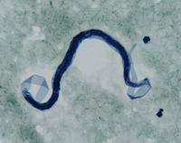
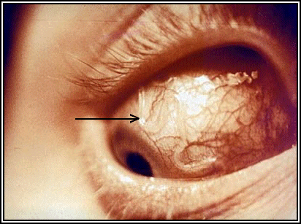
Loa loa
Subcutaneous filariasis
African Eye Worm
Deerfly (Chrysops)
Adults live in the conjunctival sac of eye
Sheathed, nuclei to tip of tail

Slide 46
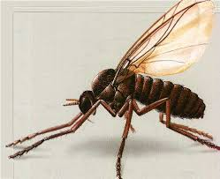
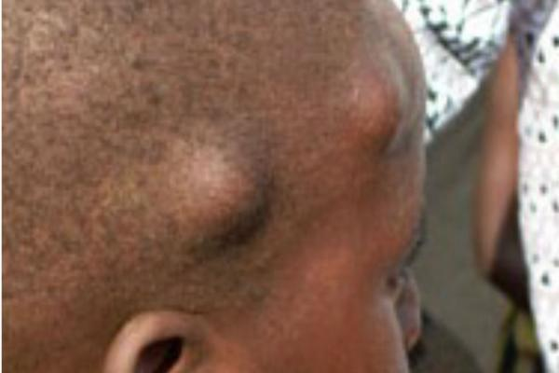
Onchocerca volvulus
~17 million people infected
Central Africa and parts of South America
Vector: Simulium (blackfly)
Subcutaneous filariasis:
Subcutaneous nodules
“River Blindness”
Usually found in skin snips or biopsy of nodules

Slide 47
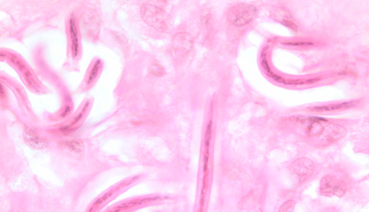
Onchocerca volvulus
Unsheathed
Tail tapers to a point and is often sharply bent
Nuclei do not extend to the tip of the tail
Microfilariae typically reside in skin but may be found in blood or urine during heavy infections
May also invade the eye and cause a condition known as river blindness

Slide 48
Key points
Know vectors for Microfilariae
Know key features of each Microfilariae

Slide 49
Bonus slides

Slide 50
Antiparasitic drugs
Drug family | Drug class/Use | Mechanism of Action/Comments
Antihelminths | Benzimidazoles (mebandezole, albendazole) | Inhibits the polymerization of tubulin into microtubules → prevents cellular division and the absorption of glucose
 | Macrocyclic lactones (milbemycin, ivermectin) | Kill by interfering with the target nervous system
Schistosomicides | Praziquantel | Disrupts the membrane of the schistosome that coats the parasite with host molecules
 | Artemisinin | Anti-malarial
Protozoacides | Human African Trypanosomiasis | Pentamidine and suramin-early stages of infection Melarsoprol-CNS stages
 | Human American Trypanosomiasis | Benznidazole-generate radical species and reductive metabolites that damage parasitic DNA
 | Leishmania | Liposomal Amphotericin B-complexes with ergosterol precursors in the cell membrane, forming pores that allow ions to enter the cell Aminosidine-Inhibits initiation and elongation during protein synthesis

Slide 51
Antimalarial drugs
Drug class | Mechanism of Action
Quinolines | Sequester the heme so that it cannot be made unreactive, resulting in the death of the parasite
Chloroquine | Chlorine atom attached to position 7 of the quinoline ring confers the greatest antimalarial activity
Hydroxychloroquine | One of the N-ethyl substituents of chloroquine is beta-hydroxylated
Mefloquine | Most effective for the treatment of chloroquine-resistant falciparum malaria Inhibits heme polymerization during hemoglobin digestion in the parasite food vacuole
Halfantrine | Most effective when mefloquine is ineffective
Primaquine | Kills the parasites dormant in liver tissues Frequently administered with other quinolines so that all of the Plasmodia in the body are eliminated
Artemisin | Sequiterpene; Highly hydrophobic, so binds to various parasitic membranes; Activated by heme to produce free radicals > membrane damage
Atovaquone | Interferes with mitochondrial function (ATP and pyrimidine biosynthesis) Proguanil enhances the membrane-collapsing activity of atovaquone (Atvaquone+Proguanil= Malarone)
Folate synthesis inhibitors | DNA synthesis is inhibited (e.g., sulfonamides, diaminopyrimidines)

Slide 52
Review

Slide 53
PathPrimer
A 12-year-old bone marrow transplant recipient presented to the emergency department with nonspecific influenza-like symptoms, including fever, chills, and myalgia. Initial laboratory test results were consistent with hemolytic anemia. The hematology technologist observed abnormal findings on the smear (see figures) and referred the slide to the microbiology laboratory. Relevant past medical history includes a blood transfusion 1 month before admission and no recent travel, although his parents confirmed a trip to the Ivory Coast 3 years ago. Which one of the following is the etiologic agent seen in the figures?
Plasmodium falciparum
Babesia microti
Toxoplasma gondii
Plasmodium ovale
Ehrlichia chaffeensis

Slide 54
PathPrimer
Which one of the following is the insect vector responsible for transmitting the organism seen in the figure?
Tsetse fly
Reduviid bug
Ixodes scapularis
Anopheline mosquito
Black fly

Slide 55
Practice question
Which microfilariae are usually not found circulating in the peripheral blood?
Brugia malayi
Wuchereria bancrofti
Onchocerca volvulus
Loa loa

