Slide 1
Diagnostic Parasitology - Intestinal Protozoan Parasites
Created by: Dr. Holly Huse PhD, D(ABMM)
Harbor UCLA Medical Center Clinical Microbiology Director
Edited by: Qichao Stephen Ji, MS., MSc., MLS(ASCP)SBB, CQA(ASQ)
Clinical Laboratory Scientist Instructor

Slide 2
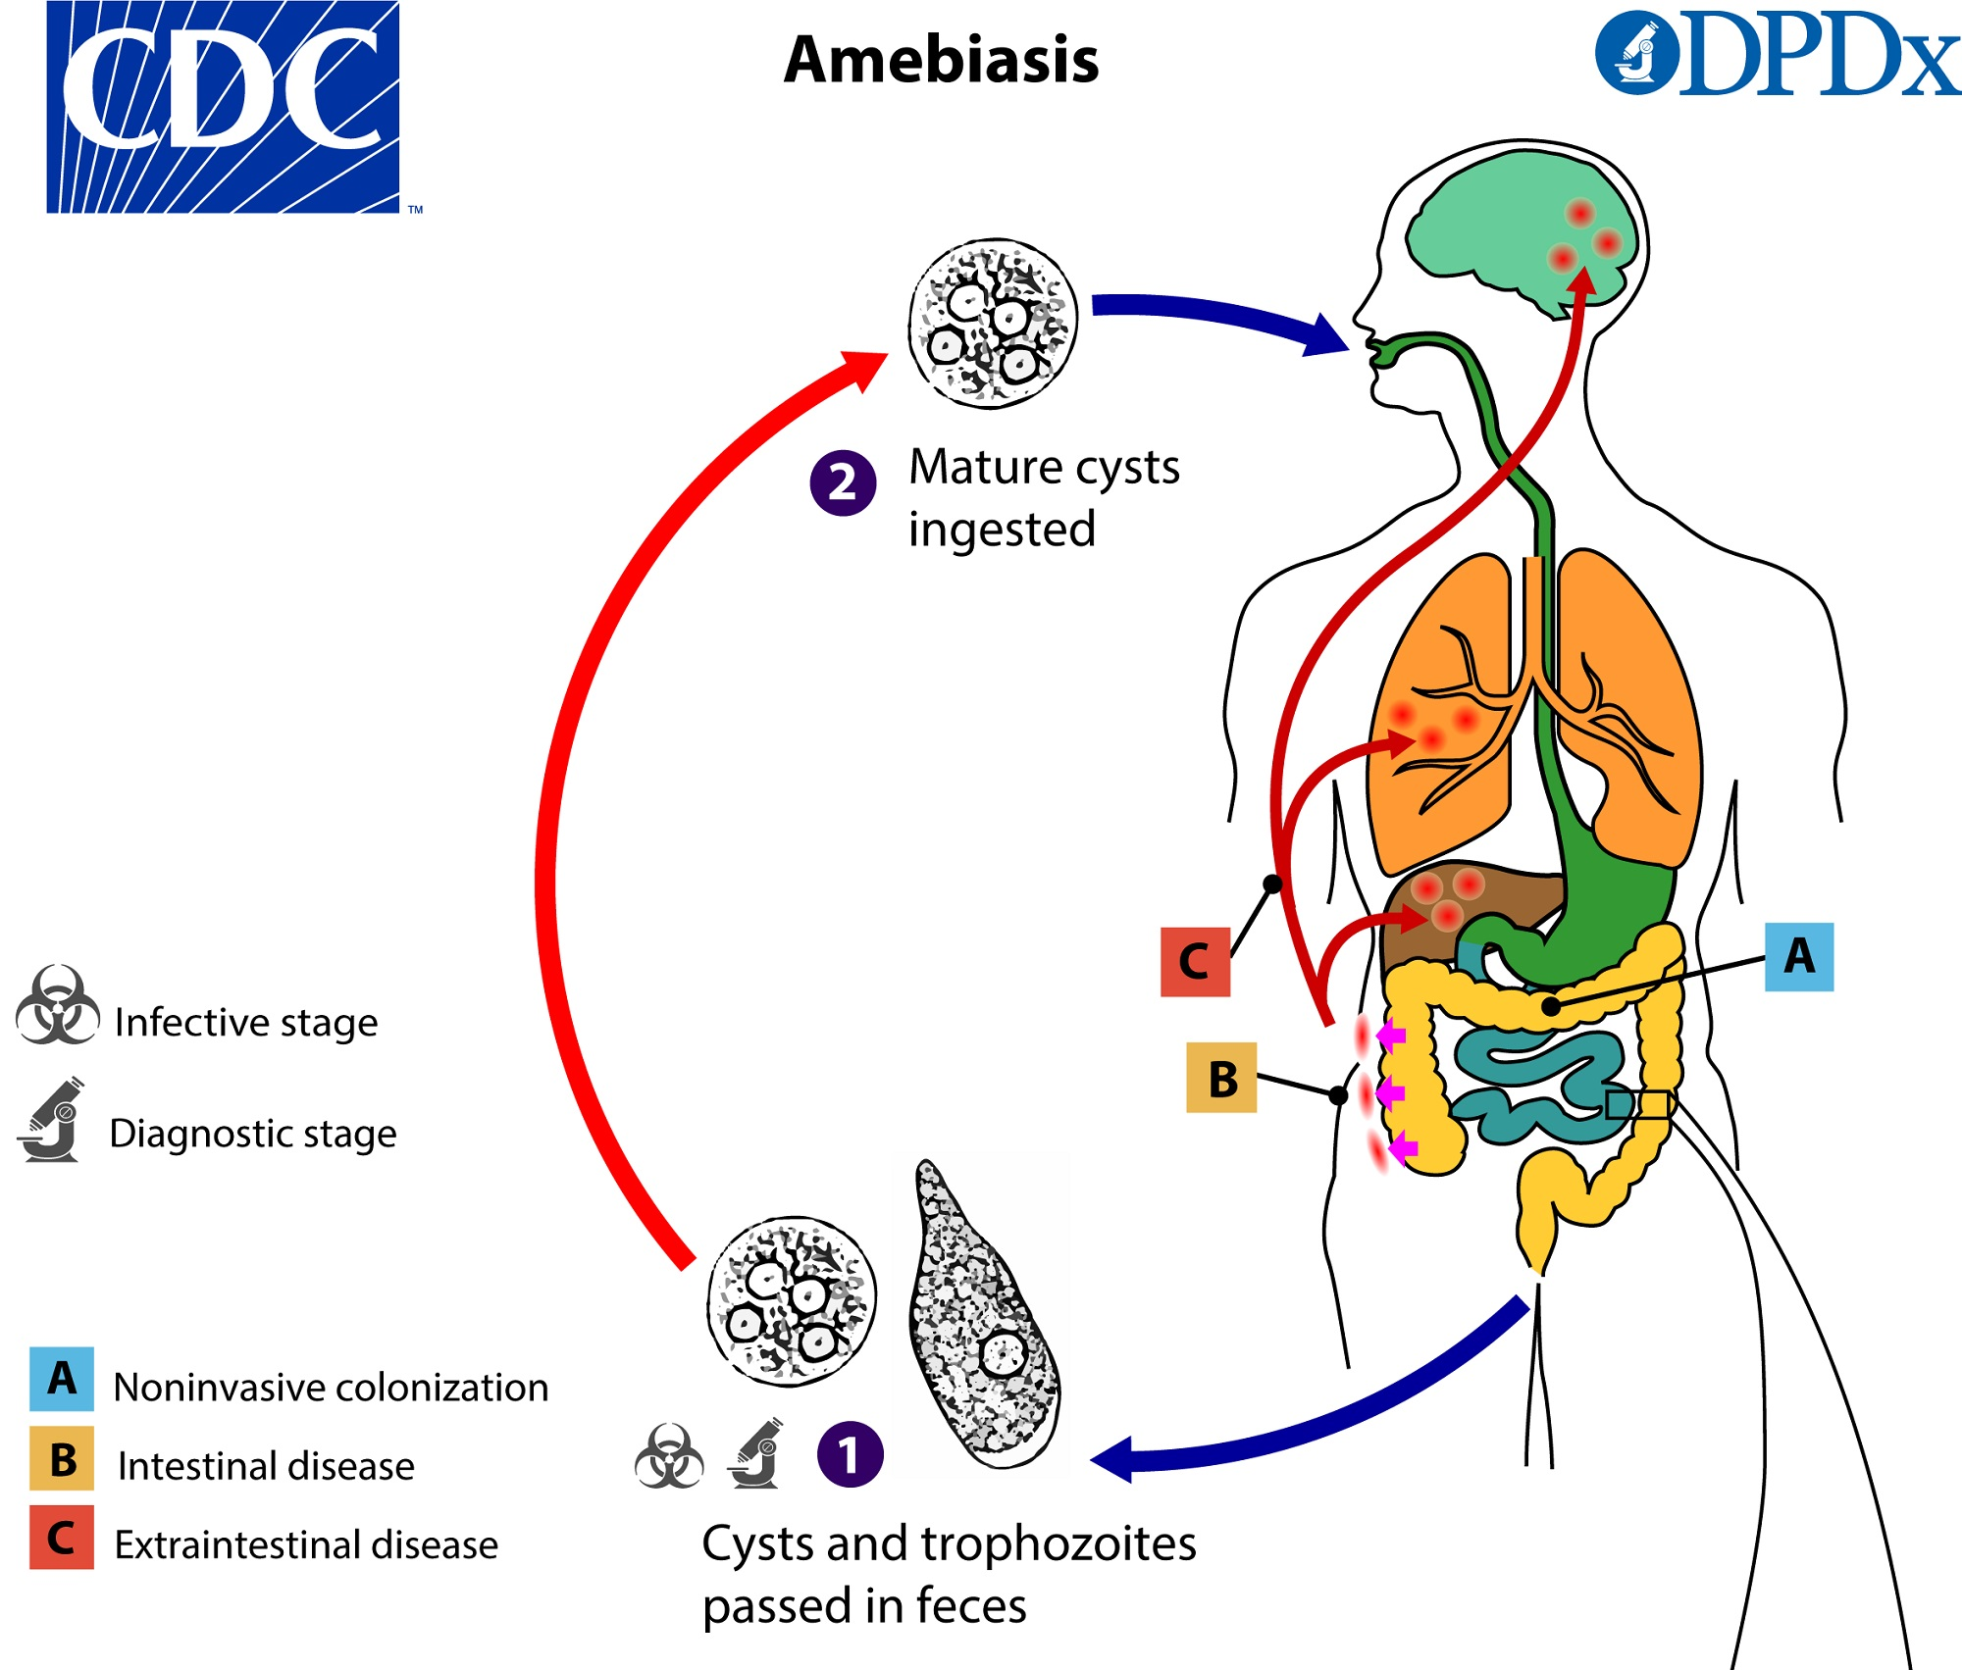
Amebiasis
Caused by Entamoeba histolytica
Associated with both intestinal and extraintestinal infections
Fecal-oral transmission
Majority of cases in developing countries
Industrialized countries: MSM, travelers, recent immigrants, immunocompromised, institutionalized
Extra-intestinal disease (2-8%)
Liver abscess – amebiasis with trophozoites in liver biopsy
Serology will be positive in most cases compared to <=50% of cases of intestinal only infection
Cyst=infectious
Trophs=invasive

Slide 3
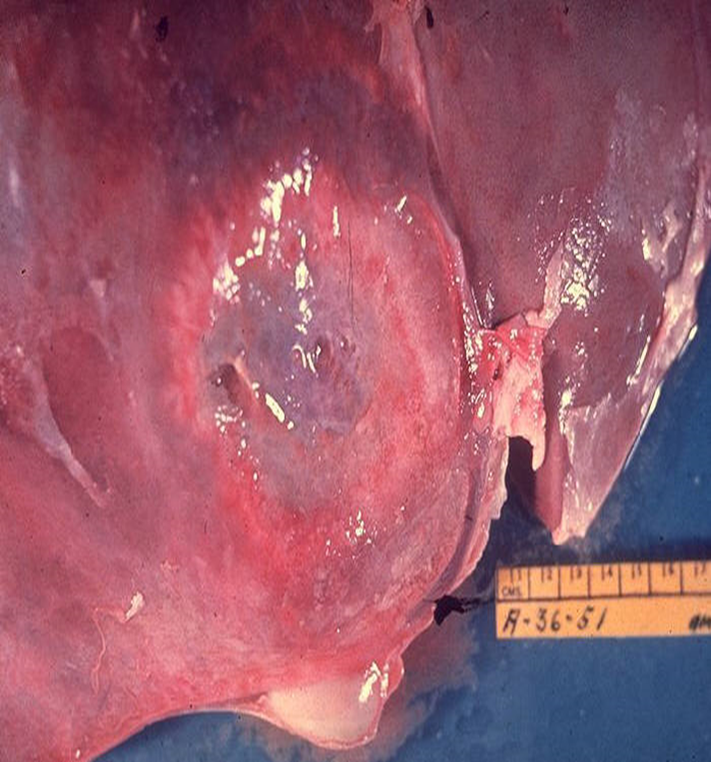
Entamoeba histolytica-liver abscess
Patients present with right upper quadrant pain and
tenderness
Abscess on radiologic scan
If undetected can spread to lungs, heart, skin and brain
High % serology positive in extraintestinal cases

Slide 4
Laboratory diagnosis
E. histolytica/dispar
cyst
E. histolytica/dispar
trophozoite
Intestinal
O&P: Permanent stain
Cannot morphologically distinguish between E. histolytica (pathogen) and E. dispar (non-pathogen)
E. histolytica Antigen Test or NAAT
Invasion of intestinal mucosa
Sigmoidoscopy
Colon biopsy shows ”flask-shaped” ulcers with trophozoites
Extraintestinal
Via blood to liver
Serology
Stain aspirate for trophozoites
E. histolytica antigen test

Slide 5
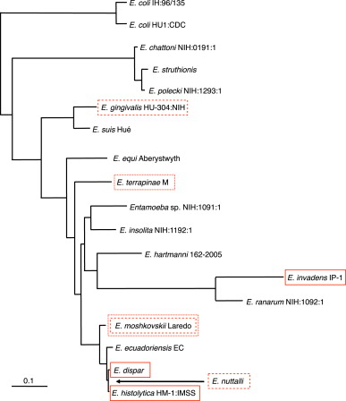
Entamoeba histolytica vs. Entamoeba dispar
Debate over pathogenic strains vs. non-pathogenic strains
DNA sequencing finally settled debate, two distinct species
Morphologically identical but different on a molecular level

Slide 6
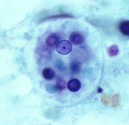
Entamoeba histolytica/dispar
Cysts:
10-20 microns
Spherical
May contain up to 4 nuclei
Chromatoidal bars: blunt, rounded, “cigar-shaped”
Trophs:
Active feeding stage
12-60 microns
Single nucleus
Compact central karyosome
Even peripheral chromatin
Sometimes see ingested RBCs
Cigar chromatoidal bar
Ingested RBCs
Compact karyosome

Slide 7
Invasive amebiasis
Flask-shaped ulcer
Trophozoite

Slide 8
Entamoeba hartmanni
Cysts:
Non-pathogenic
5-10 microns
Spherical cysts
1-4 nuclei
Blunt, rounded chromatoidal bars may be present
“Mini E. histolytica”
Trophozoites:
Non-pathogenic
5-12 microns
Single nucleus
Compact central karyosome
Even peripheral chromatin
RBCs not ingested
“Mini E. histolytica”

Slide 9
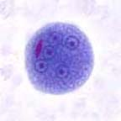
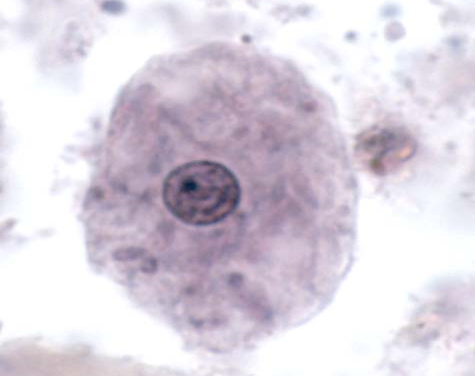
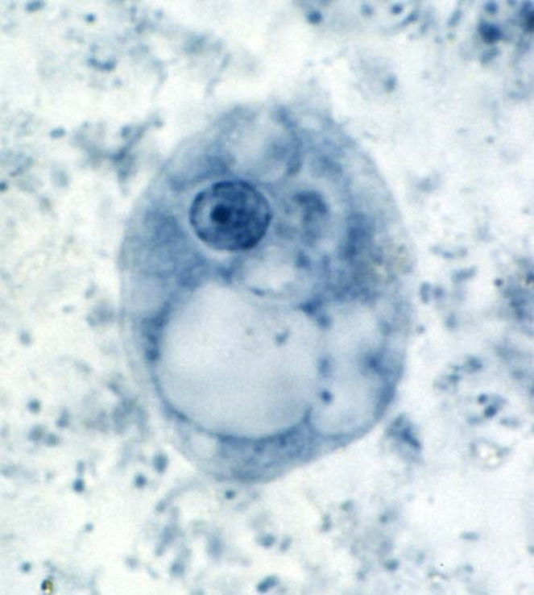
Entamoeba coli
Cysts
Non-pathogenic
More than 5 nuclei
Chromatoidal bars w/ splintered ends
Easier to identify on wet mount
Staining quality variable: dark to light (Ghost cells)
Trophozoites:
Non-pathogenic
15-50 microns
Single nucleus
Large, diffuse eccentric (off-center) karyosome
Uneven peripheral chromatin
“Junky” cystoplasm
Ingests bacteria and other debris, not RBCs

Slide 10
Endolimax nana
Cysts:
Non-pathogenic
Spherical and ellipsoidal
5-10 microns
4 large nuclei with no peripheral chromatin
Nuclei are not visible in unstained wet mounts
Trophozoites:
Non-pathogenic
6-12 microns
Single nucleus
Large karyosome, nuclear variation
No peripheral chromatin
May ingest bacteria

Slide 11
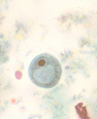
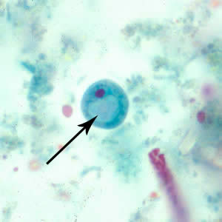
Iodamoeba butschlii trophozoites
Cysts
Non-pathogenic
5-20 microns
Oval to round cysts
Single nucleus
Large, compact glycogen vacuole present
Trophozoites:
Non-pathogenic
8-20 microns
Single nucleus
Large karyosome “Basket nucleus”
No peripheral chromatin
May ingest bacteria

Slide 12
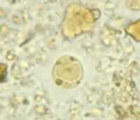
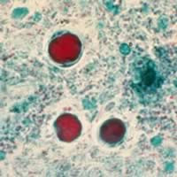
Blastocystis hominis
Pathogen: debatable
Most commonly recovered parasite in O&P exam
6-40 microns
Central body form
Large central mass, surrounded by
small multiple nuclei
Quantitate organism when reporting

Slide 13
Key points
Know clinical presentation of E. histolytica and preferred tests
Diarrhea, dysentery, liver abscess
Antigen test (EIA) or NAAT
Know morphology of cysts and trophs

Slide 14
Quick Review: Name that organism

Slide 15
Intestinal Protozoa-Flagellates
Giardia lamblia
Dientamoeba fragilis
Chilomastix mesnili

Slide 16
Flagellates found in stool
Pathogen

Slide 17
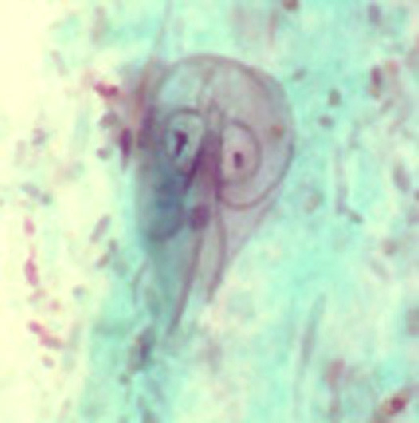
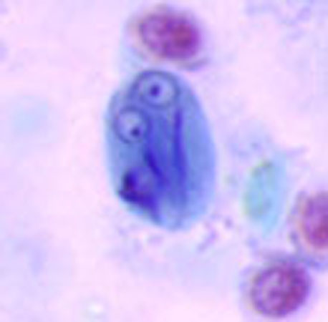
Giardiasis
Giardia lamblia
G. duodenalis, G. intestinalis
Foul, watery diarrhea
Mild to severe, maladsorption
Found more frequently in children or in groups that live in close quarters
Outbreaks
Poor sanitation, backpackers, travel
Waterborne transmission
Iodine treatment, filtration, boil
Ingestion of infective cysts
Treatment of choice: metronidazole
Troph
Cyst

Slide 18
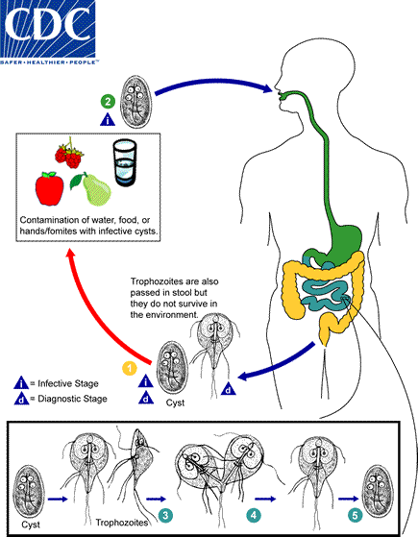
Life cycle

Slide 19
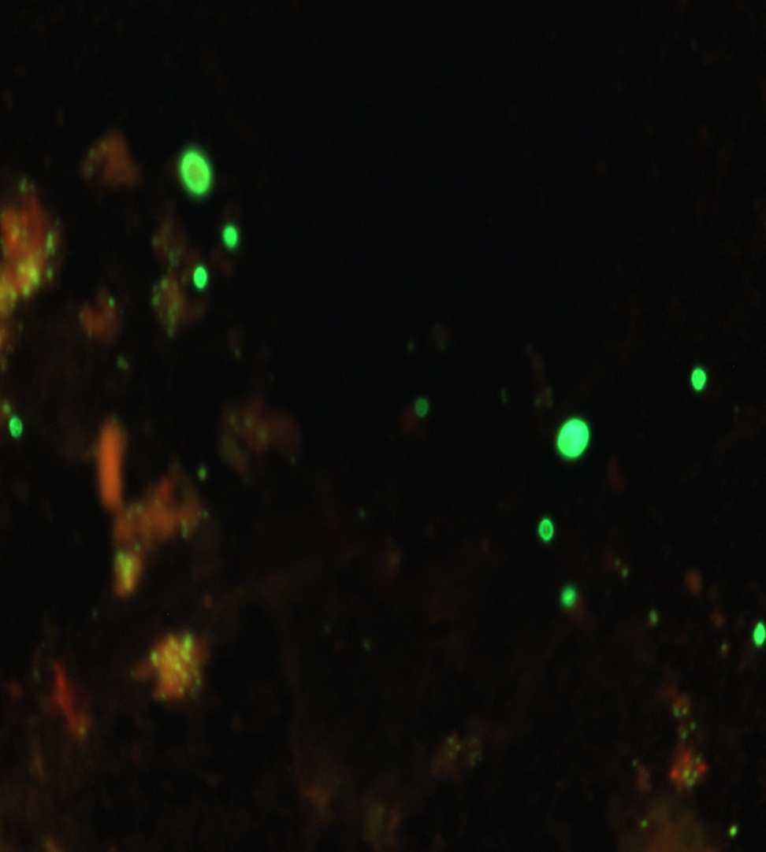
Laboratory diagnosis
DFA
Ova and Parasite
Cysts and trophozoites may be seen in stool
Concentrated wet mount
Permanent stain
Antigen test
Direct Fluorescent Antibody (DFA)
Enzyme immunoassay (EIA)
Immunochromatographic assay (IC)
Molecular tests
Antigen and molecular tests are more sensitive, so they are preferred over the Ova and Parasite
If stool specimens are negative and suspicion is still high, duodenal aspirate can be performed
Challenging:
Symptoms come and go
Organism is irregularly shed in stool
Immunochromatographic assay (IC)

Slide 20
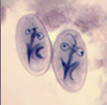
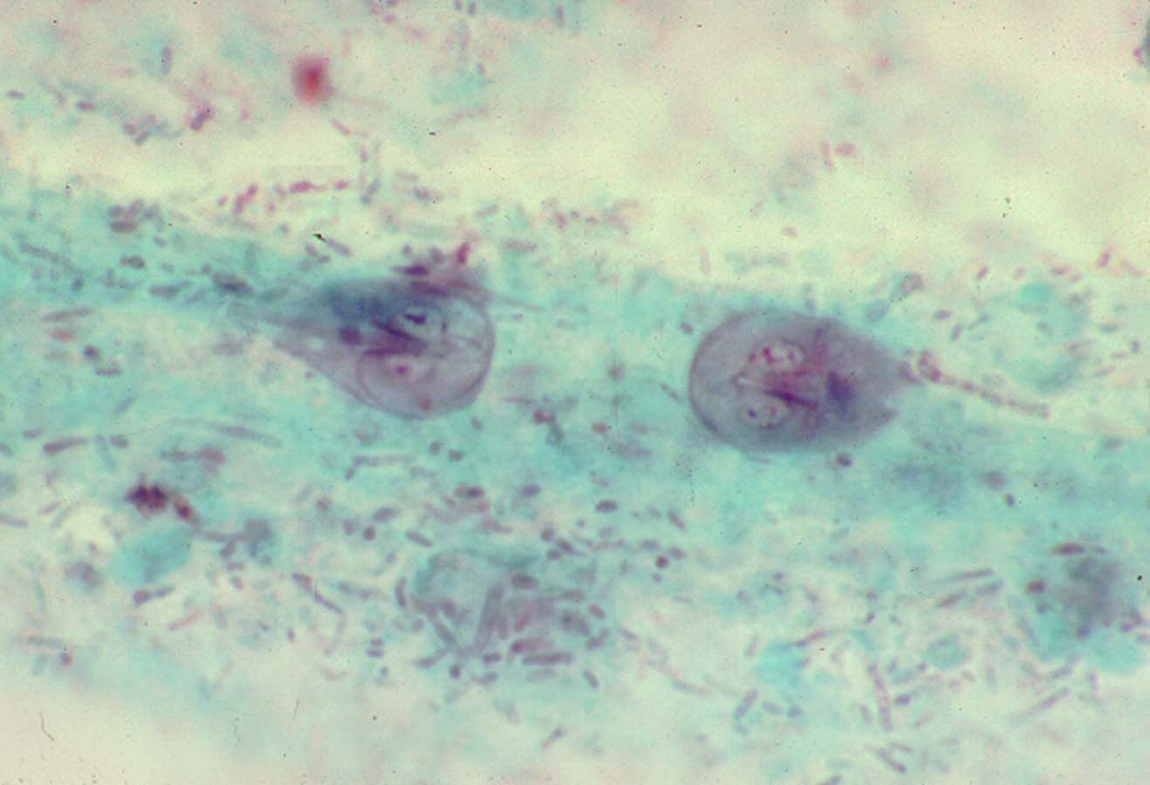
Giardia lamblia
Cysts:
Round or oval cyst
4 nuclei, 4 axonemes and
4 median bodies
Often shrunken or distorted when stained (“Halo Effect”)
11-14 microns in length and 7-10 microns in width
Trophozoites:
Teardrop shaped
Two nuclei, sucking disk, 4 pairs of flagella, 2 axonemes and 2 median bodies
10-20 microns in length and 9-12 microns in width

Slide 21
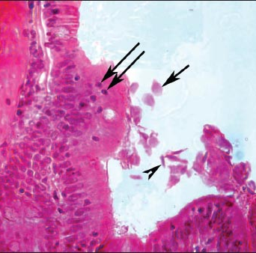
Duodenal mucosa
Cyst
Troph

Slide 22
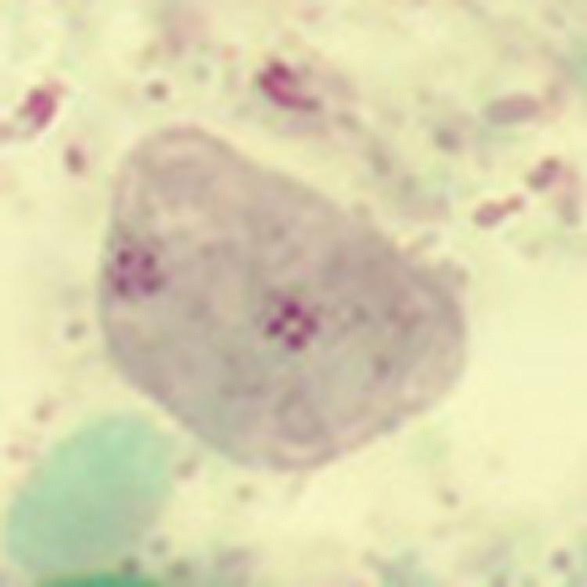
Dientamoeba fragilis
Pathogen
More commonly seen in children
Classified as a flagellate despite its name
Life cycle and mode of transmission
not well understood
Cysts are very rare; not well understood
Both asymptomatic and symptomatic infection have been reported
Clinical manifestations have sometimes been described as similar to those of colitis, appendicitis, or irritable bowel syndrome.

Slide 23
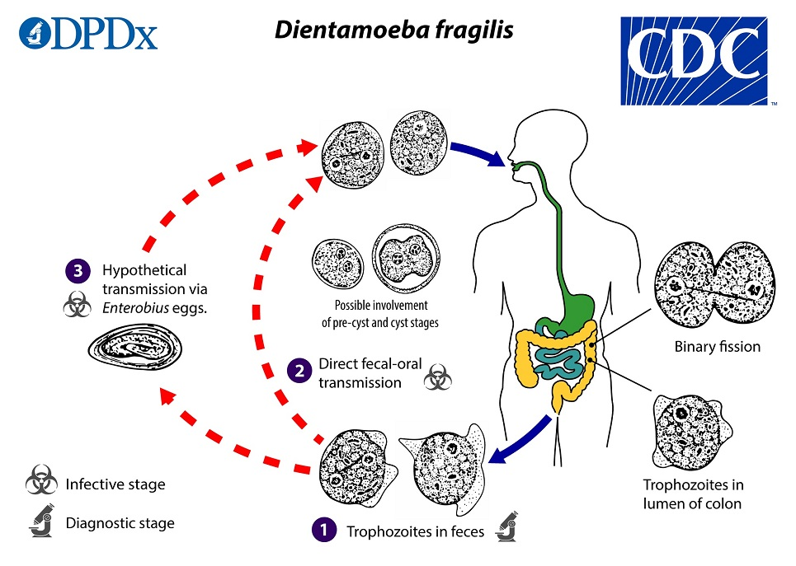
Life Cycle

Slide 24
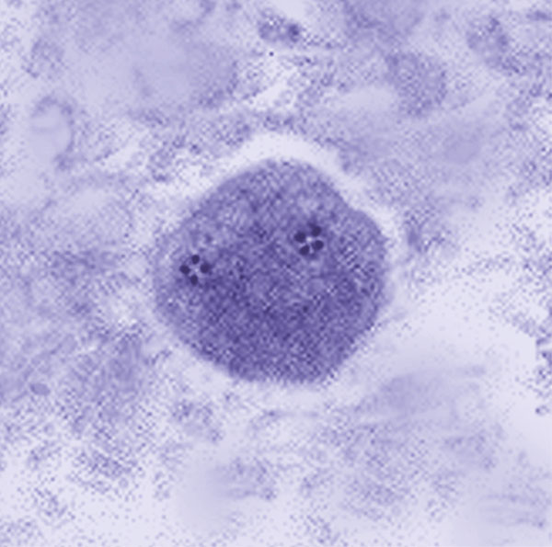
Dientamoeba fragilis
Shaped like an amoeba
1-2 fragmented nuclei (Tetrad nuclei)
No peripheral chromatin
5-15 microns in length and 9-12 microns in width
Permanent stain smear is mandatory to detect trophozoites

Slide 25
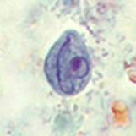
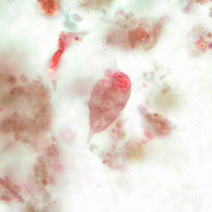
Chilomastix mesnili
Cysts:
Lemon shaped
6-10 microns in length and 4-6 microns in width
Single nucleus
Curved cytostomal fibril called the “Shepherd’s Crook”
Trophozoites:
Non-pathogenic
Single nucleus adjacent to the oral groove or cytostome
3 anterior flagella, 1 posterior; usually difficult to see on stain
6-24 microns in length and 4-8 microns in width

Slide 26
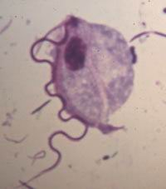
Trichomonas hominis (formerly Pentatrichomonas)
Non-pathogenic
No known cyst stage
Troph measures 5-15 microns in length and 7-10 microns in width
Pyriform shape with axostyle and an undulating membrane
Undulating membrane extends the entire length of organism

Slide 27
Intestinal Protozoa-Ciliates
Balantidium coli

Slide 28
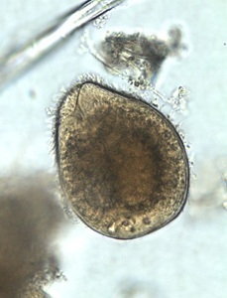
Balantidium coli
Only ciliate to infect humans
Associated with swine (pigs are main reservoir)
Infections rare in United States
Most cases are asymptomatic, but may present with acute or chronic abdominal symptoms
Complications of associated diarrhea or dysentery can occur in protracted infections
Symptoms may be severe or fatal in debilitated/immunocompromised persons.
Extraintestinal infection is rare but potentially serious and typically occurs secondary to intestinal infection.
Peritonitis and liver abscesses have been noted following intestinal perforation or rupture of fulminant colonic ulcers

Slide 29
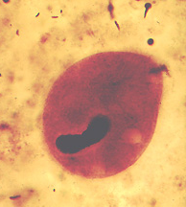
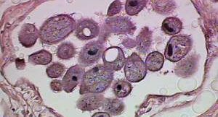
Balantidium coli-laboratory diagnosis
Cyst and trophozoite forms
Large, ovoid troph, 50-100 microns in length and 40-70 microns in width
Cytostome present
Kidney bean macronucleus
Easily seen in wet mount

Slide 30
Quick review: name that organism
A.
B.
C.
D.
E.
F.
G.

Slide 31
Intestinal Protozoa-Coccidia
Cryptosporidium species
Cyclospora cayentanensis
Cystoisospora (Isospora) belli
Microsporidia* (fungus)

Slide 32
Coccidia
Worldwide distribution
Immunocompetent Host
Immunocompromised Host
GI tract, other tissues
Therapy not well established
Transmission:
Fecal-oral
Person to Person
Waterborne
Zoonotic (Animal to Human)

Slide 33
Laboratory diagnosis
Routine O&P does NOT detect these organisms
Require special stain: Modified Acid Fast
Cryptosporidium spp.: Antigen, DFA, molecular
Cyclospora: molecular

Slide 34
Cryptosporidiosis
C. parvum and C. hominis are leading causes
Can infect a wide range of vertebrate hosts, including birds, reptiles, and mammals
Outbreaks in the U.S.:
Swimming pools, water playgrounds
Unpasteurized cider, juice, and milk
Contact with animals
Childcare settings
Camps
Ill food handlers
Wide range of signs and symptoms
Immunocompetent: self-limiting diarrhea, typically resolving within 2–3 weeks
Immunocompromised patients (HIV) may have more severe complications, such as life-threatening malabsorption and wasting
Extraintestinal cryptosporidiosis (e.g., in the pulmonary or biliary tract, rarely in the pancreas) has been reported

Slide 35
Life cycle

Slide 36
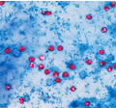
Cryptosporidium-lab diagnosis
Modified Acid Fast Stain
Oocysts are pink
4-6 microns with visible sporozoites
Immunoassay
DFA (shown, apple green)
EIA
Lateral flow
NAAT

Slide 37
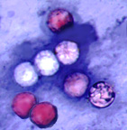
Cyclospora cayetanensis
Humans are only known host
Worldwide, but most common in tropical and subtropical areas
U.S.: majority of cases are reported during the spring and summer months
Fecal-Oral transmission
Contaminated water and various fresh produce (raspberries)
Symptoms vary from self-limiting watery diarrhea to dysentery
More severe in immunocompromised (HIV), can last for weeks
Treatment: oral trimethoprim/sulfamethoxazole

Slide 38
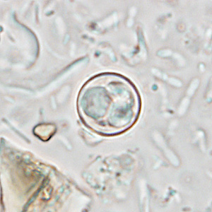
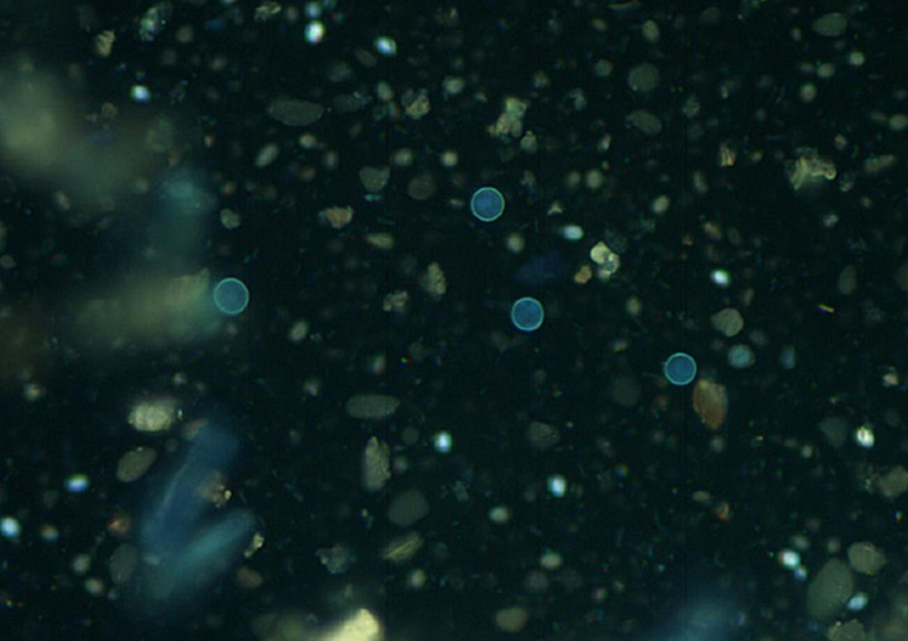
Laboratory Diagnosis
Concentrated Wet Mount Exam
Ova and Parasite Exam
Concentrated Wet Mount Exam
Glassy, refractile spheres, “wrinkled cellophane”, 8-10 microns
Autofluorescence
Modified Acid Fast Stain
Variation in stain intensity
“MAF variable”, light pink-deep red
Autofluorescence
Modified Acid Fast Stain

Slide 39
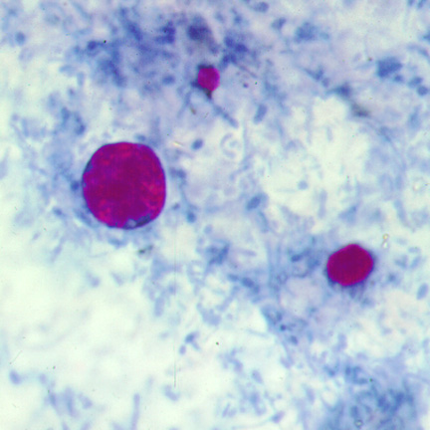
Cryptosporidium vs. Cyclospora
Cyclospora
Both modified acid fast (MAF) positive
Cyclospora
8-10 microns
MAF variable
Cryptosporidium
4-6 microns
Sporozoites seen within oocysts
Cryptosporidium

Slide 40
Cystoisospora (Isospora) belli
Infects epithelial cells of the small intestine
Transmission:
Fecal-oral
Ingestion of contaminated water or food containing oocysts
Oral-anal transmission
More severe in immunocompromised hosts
Presents as acute, nonbloody diarrhea with crampy abdominal pain, which can last for weeks and result in malabsorption and weight loss
Diarrhea can be severe in immunocompromised patients and in infants and children
Eosinophilia may be present (different from other protozoan infections)
Maladsorption mimics Giardia

Slide 41
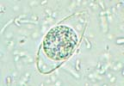
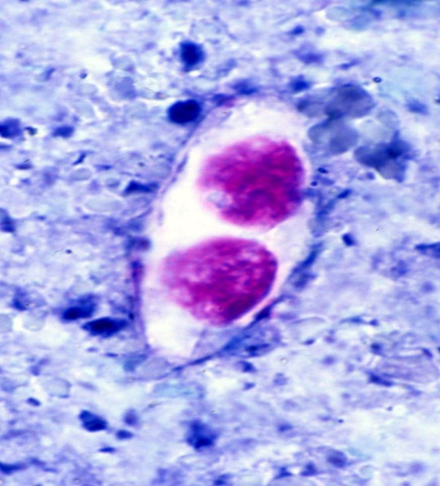
Laboratory diagnosis
Biopsy
Intestinal
Extraintestinal Dissemination
Stool
Wet mount exam
Oocysts are long and oval
20-33 microns in length and 10-19 microns in width
Immature sporont seen if specimen submitted in preservative
Modified Acid Fast stain

Slide 42
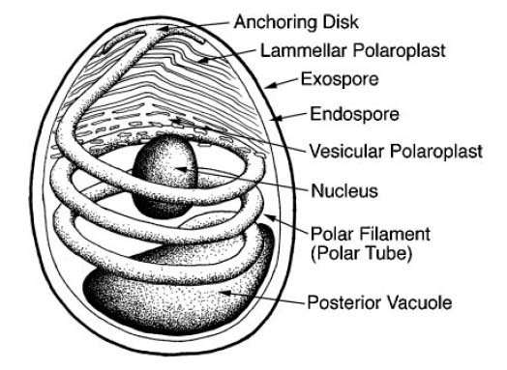
Microsporidia
Obligate intracellular fungal parasite
Emerging opportunistic infection in HIV patients
Chronic diarrhea
Can disseminate to cause myositis, hepatitis, peritonitis, keratitis, and biliary tract infection
Obligate intracellular fungal parasite
Seven genera, most common:
Enterocytozoon bieneusi
Encephalitozoon intestinalis

Slide 43
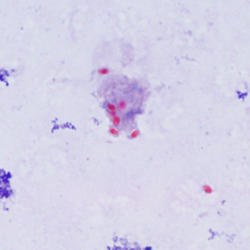
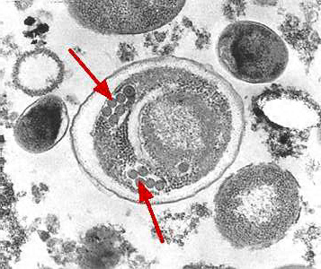
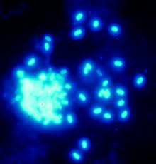
Microsporidia Stains
Modified Trichrome
Chemofluorescent Optical Brightening Agents
Calcofluor White
Electron Microscopy (Gold Standard)
Spores are 1.5-3 microns
Modified Trichrome
EM
Calcofluor

Slide 44
Free-living amebae
Naegleria fowleri
Acanthamoeba
Balamuthia

Slide 45
Naegleria fowleri
Causes primary amebic meningoencephalitis (PAM)
Inhabits fresh water and moist soil
Most cases in the United States have been associated with warm freshwater exposure in southern states
Enters body through olfactory epithelium when swimming/diviing
Rare, rapid onset, nearly always fatal within days
Headaches, nausea, vomiting, seizures, and coma

Slide 46
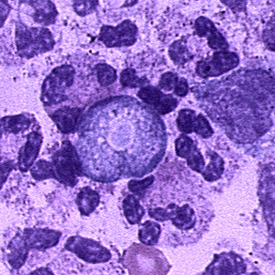
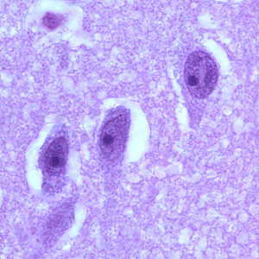
Laboratory Diagnosis
Direct wet prep of CSF
Never refrigerate specimen
Phase contrast microscopy
Stain
Giemsa or Wright’s stain
Culture on non-nutrient agar
Escherichia coli overlay
PCR available at specialty labs
Histologic preparation
Trophozoites

Slide 47
Acanthamoeba spp.
Fresh water sources
Resistant to high chlorine concentrations
Disease presentation
Granulomatous amebic encephalitis (GAE)
Unlike PAM, GAE has slower, more chronic onset
Signs and symptoms like meningitis and encephalitis
Keratitis (Contact lens wearers)
Cutaneous lesions

Slide 48
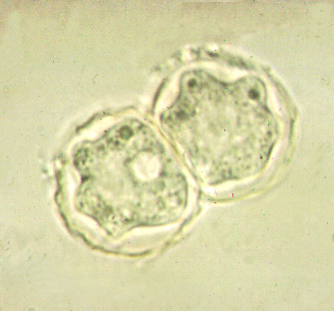
Laboratory diagnosis
Microscopic exam of cysts and trophozoites from stained smears of biopsy specimens (brain tissue, skin, cornea) or corneal scrapings
Wright’s stain, Lactophenol blue, acridine orange, silver, and calcofluor white stains have been used in diagnosis on histologic sections
Cultured on non-nutrient agar with Page’s saline and Escherichia coli overlay > makes “tracks” in culture
Trophozoites

Slide 49
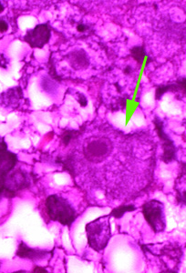
Balamuthia mandrillaris
Trophozoites
Isolated from soil, dust, and autopsy specimens of infected humans and animals
Mostly reported from Latin America
Clinical manifestations are similar to GAE: disease might appear mild at first but can become more severe over weeks to several months
High case fatality rate: 89%
Plaque-like skin lesions, most often on the face, may precede the development of neurological symptoms by weeks or months
Laboratory diagnosis is post-mortem
Immunofluoresence of tissue specimens
PCR

Slide 50
Protozoa-other
Trichomonas vaginalis
Toxoplasma gondii

Slide 51
Trichomonas vaginalis
Flagellate, does not appear to have a cyst form
Resides in the female lower genital tract and the male urethra and prostate
Sexually transmitted
Clinical presentation in women is frequently symptomatic
Most common: vaginitis with a frothy or milky discharge and amine odor
More severe: vulvar and cervical lesions, abdominal pain, dysuria and dyspareunia
In men, the infection is frequently asymptomatic
Occasionally, urethritis, epididymitis, and prostatitis

Slide 52
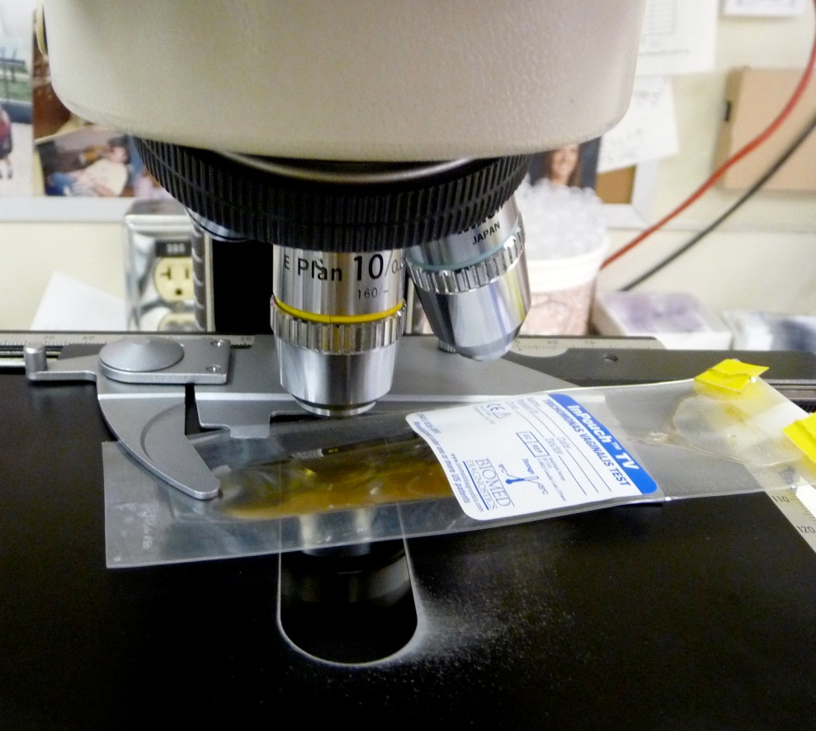
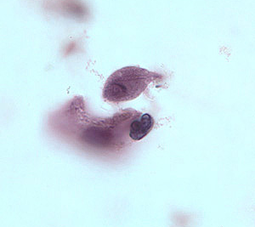
Laboratory Diagnosis: T. vaginalis
Wet mount
Must examine immediately for motile organisms (jerky movement)
Giemsa stain
Culture
InPouch TV
Antigen Detection-most common
Immunochromatographic
Molecular Testing

Slide 53
Toxoplasma gondii-Immunocompetent
Protozoan parasite that infects most species of warm-blooded animals
Mostly asymptomatic in immunocompetent persons
10% to 20% of patients with acute infection may develop cervical lymphadenopathy and/or a flu-like illness.
Clinical course is usually benign and self-limited; symptoms usually resolve within a few weeks to months.
In rare cases ocular infection with visual loss can occur.
Toxoplasmic lymphadenitis

Slide 54
Toxoplasma gondii-Immunocompromised
Immunodeficient patients often have central nervous system disease but may have retinochoroiditis, pneumonitis, or other systemic disease.
In patients with AIDS, toxoplasmic encephalitis is the most common cause of intracerebral mass lesions and is thought to usually be caused by reactivation of chronic infection
Toxoplasmosis in patients being treated with immunosuppressive drugs may be due to either newly acquired or reactivated latent infection.

Slide 55
Congenital Toxoplasmosis (TORCH)
Congenital toxoplasmosis results from an acute primary infection acquired by the mother during pregnancy.
The incidence and severity of congenital toxoplasmosis vary with the trimester during which infection was acquired.
Many infants with subclinical infection at birth will subsequently develop signs or symptoms of congenital toxoplasmosis.
Ocular Toxoplasma infection, an important cause of retinochoroiditis in the United States, can be the result of congenital infection, or infection after birth.
In congenital infection, patients are often asymptomatic until the second or third decade of life, when lesions develop in the eye.

Slide 56
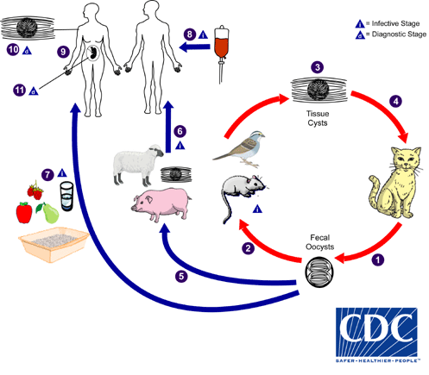
Life cycle
Unsporulated oocysts are shed in cat feces
Intermediate hosts in nature become infected after ingesting soil, water or plant material contaminated with oocysts
Oocysts transform into tachyzoites shortly after ingestion. Tachyzoites localize in neural and muscle tissue and develop into tissue cyst bradyzoites

Slide 57
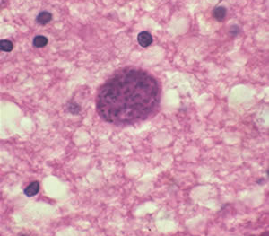
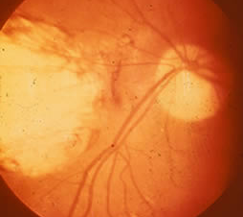
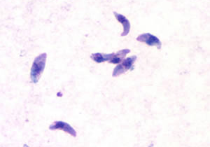
Laboratory Diagnosis
Cyst, brain tissue
Severe, active
retinochoroiditis
Serologic testing is the routine method of diagnosis
Observation of parasites in patient specimens
Giemsa peritoneal fluid:
Tachyzoites

Slide 58
REVIEW

Slide 59
PathPrimer
A 23-year-old woman presented to her doctor with a vaginal discharge that was frothy and malodorous (i.e., “fishy odor”). Which one of the following parasites (see figure) is the most likely cause of her infection?
Mobiluncus species
Gardnerella vaginalis
Trichomonas hominis
Trichomonas vaginalis
Treponema pallidum

Slide 60
PathPrimer
A 21-year-old female college student presented to the student clinic complaining of a 1-week history of diarrhea and stomach cramps. She had traveled to rural Central America for humanitarian purposes 1 month before presentation. Direct examinations of stained fecal material are shown in the figures. Which one of the following is the etiologic agent responsible for this patient’s gastrointestinal disease?
Blastocystis hominis
Entamoeba histolytica
Iodamoeba bütschlii
Endolimax nana
Entamoeba coli

Slide 61
PathPrimer
A 14-year-old boy presents to his pediatrician with a 1-week history of abdominal pain, diarrhea, and foul-smelling flatulence. Two weeks before presentation, he was camping with his scout troop and may have ingested water from a nearby stream. Direct examination of a fresh stool sample is shown in the figure. Which one of the following is the etiologic agent causing this patient's illness?
Cyclospora cayetanensis
Trichomonas hominis
Chilomastix mesnili
Cryptosporidium parvum
Giardia intestinalis

Slide 62
PathPrimer
A patient with HIV/AIDS presented to the hospital with a 2-week history of headaches, weakness, and slurred speech. The results of a computed tomography scan with contrast and a magnetic resonance imaging revealed multiple ring-enhancing lesions. Tissue from a brain biopsy was negative on an acid-fast stain. Serodiagnostic tests were positive for the etiologic agent. Which one of the following is the most likely infectious cause of the brain lesions in this patient?
Toxoplasma gondii
Balamuthia mandrillaris
Mycobacterium tuberculosis
Entamoeba histolytica
Cryptosporidium parvum

