Slide 1
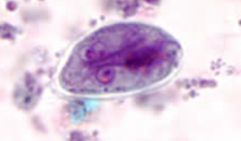
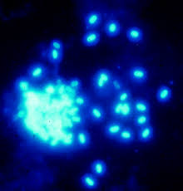
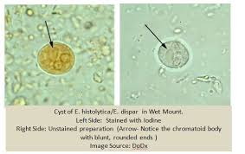
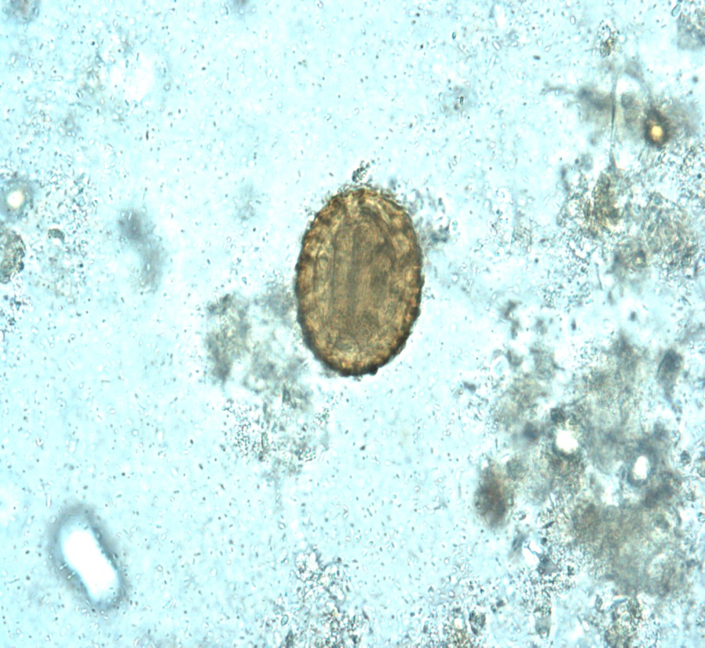
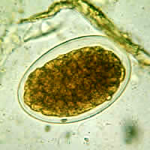
Diagnostic Parasitology Introduction and Specimen Processing
Created by: Dr. Holly Huse PhD, D(ABMM)
Harbor UCLA Medical Center Clinical Microbiology Director
Presented by: Qichao Stephen Ji, MS., MSc., MLS(ASCP)SBB, CQA(ASQ)
Clinical Laboratory Scientist Instructor
Notes:
Hello all, welcome to today’s lecture. Today we will talk about the topic of parasitology. Since the improvement in sanitation technology in water treatment, developed nations like the united states have eliminated a great number of parasites that still plague the developing world. In the LA County, patients with parasites comes from homeless populations, migrant populations, and people travelling to other areas of the US or the world. Athletes that competes in competitions such as Spartan race and Tough Mudder have also been experience parasitic infections.

Slide 2
Overview
Parasites
Intestinal
Protozoa
Helminths
Extraintestinal
Protozoa
Helminths
Amoeba
Flagellates
Cilliates
Sporozoa
Nematodes
Cestodes
Trematodes
Nematodes
Cestodes
Toxoplasma gondii
Leishmania
Acanthamoeba
Naegleria fowleri
Babesia
Trypanosoma
Trichomonas vaginalis
Plasmodium species
- falciparum
- malariae
- vivax
- ovale
Entamoeba
- histolytica
- dispar
- hartmanni
- coli
Endolimax nana
Blastocystis hominis
Dientamoeba fragilis
Giardia lamblia
Trichomonas hominis
Balantidium coli
Cryptosporidium
Cyclospora
Isospora belli
Echinococcus granulosus
Trichenella spiralis
Dracunculus medinensis
Filariae
Wuchereria bancrofti
Brugia malayi
Loa Loa
Onchocerca volvulus
Trichurs trichiura
Enterobius vermicularis
Necator americanus
Ancylostoma duodenale
Strongyloides stercoralis
Ascaris lumbricodes
Diphyllobothrium latum
Hymenolopsis nana
Taenia saginata
Taenia solium
Fasciolopsis buski
Fasciola hepatica
Clonorchis sinensis
Paragonimus westermani
Shistosoma mansoni
Shistosoma japonicum
Shistosoma haematobium
Notes:
This chart provides you the snapshot overview of the major parasites we can potentially encountered. The chart distinguished the parasites based on their areas of the body it is found in, bifurcated by protozoa or helminth, and individual sub family

Slide 3
Questions for diagnostic parasitology
How do you get the infection?
Where is the organism in the body and what are the symptoms?
What specimens should be collected?
What diagnostic test should be performed?
What is the diagnostic stage of the parasite?
How is the test result to be reported?
Notes:
In regards to diagnosing in parasitology, these are the important questions that will help you narrow down the potential parasites causing the infection in the patient.
How do you get the infection, is it from contaminated water, or through a ectoparasite vector, or contaminated food itemd.
Where is the organism, is it in the stool, or is it in blood, CSF, Synovial fluid, etc.
What specimens should be collected: stool or blood or the source it is from
What diagnostic test should be performed, should we use serology methods, or through staining or pcr.
What diagnostic stage of the parasite, is it an egg or is it a worm.
How is the test result to be reported.

Slide 4
Laboratory Diagnosis
Methods
Specimens
Microscopic exam: Ova and Parasite (O&P), which consists of:
  Direct wet mount
  Concentrated wet mount
  Permanent stain
Special stains
Select pathogens:
  Antigen tests
  Molecular tests
  Serology
Stool
Perianal specimen (Enterobius vermicularis)
Sigmoidoscopic specimen
Duodenal aspirates (Giardia)
Liver abscess (Echinococcus, Entamoeba histolytica)
Sputum (Ascaris, Strongyloides, Hookworm, Paragonimus)
Urine (Schistosoma haemotobium, Trichomonas vaginalis)
Urogenital (Trichomonas vaginalis)
Blood (Plasmodium, Babesia, Trypanosomes, Microfilaria)
Tissue (Trichinella, Taenia solium, Onchocerca)
Notes:
In regards to diagnosing in parasitology, these are the important questions that will help you narrow down the potential parasites causing the infection in the patient.
How do you get the infection, is it from contaminated water, or through a ectoparasite vector, or contaminated food itemd.
Where is the organism, is it in the stool, or is it in blood, CSF, Synovial fluid, etc.
What specimens should be collected: stool or blood or the source it is from
What diagnostic test should be performed, should we use serology methods, or through staining or pcr.
What diagnostic stage of the parasite, is it an egg or is it a worm.
How is the test result to be reported.

Slide 5
Infectious diarrhea caused by parasites
Patient history: travel or poor sanitation
Immunocompromised patients are at risk for more severe disease and infections caused by parasites that do not infect immunocompetent hosts
Enteritis, diarrhea, and dysentery:
  Giardia, Cryptosporidium spp., Entamoeba histolytica
  Abdominal pain, bloating, diarrhea
  Abundant, watery, foul-smelling diarrhea: Giardia
  Dysentery: E. histolytica
Invasive disease, nutritional depletion, mechanical obstruction
Waterborne and foodborne outbreaks
Notes:
Intestinal parasite most often causes diarrhea and spread through diarrhea from the host to contaminate water or food to spread in the community. There are parasites that targets immunocompromised patients causing severe symptoms where it will not affect immunocompetent hosts.
Enteritis, diarrhea and dysentery can be cause by parasites such as giardia, cryptosporidium and entamoeba histolytica,
Abdominal pain, bloating diarrhea.
Giardia is know to cause watery, foul-smelling diarrhea that comes in abundance.
Entamoeba histolytical is known to cause dysentery.
Intestinal parasites causes nutritional depletion and sometimes mechanical obstruction, and they are typically foodborne and waterborne.

Slide 6
2017 IDSA Clinical Practice Guidelines for the Diagnosis and Management of Infectious Diarrhea
Organism
Test
Specimen
Notes:
This slides shows the IDSA guideline for diagnosis and management of infectious diarrhea. As you can see, majority of the parasite is examined by permanent staining. But Nucleic Acid Amplification Tests can also be utilized to determine the parasitic culprit

Slide 7
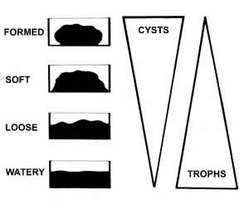
Stool specimens-specimen collection
Minimum of 3 specimens:
  One collected every other day within no more than 10 days
Collect the stool in a dry, clean, leakproof container
Fresh stool should be examined, processed, or preserved immediately
Preserve the specimen ASAP
  Add one volume of the stool specimen to three volumes of the preservative (see next slide)
Ensure that the specimen is mixed well with the preservative
  Formed stool needs to be well broken up.
Certain drugs and compounds interfere with testing
  Antacids, mineral oil and other oily materials, barium or bismuth, and gallbladder dyes
Notes:
Now let’s talk about stool specimens, specifically on specimen collection process.
Depending on hospital policy of course, but most often, minimum of 3 specimens were collected with 1 collected every other day but within a 10 day period. Specimen is collected in a leak proof container. Fresh stools are examined other wise should be processed or preserved immediately. It is important to mix the preservative well, as it will preserve the ova and parasitic structure later for examination. Interference substances includes drugs, antacids, mineral oilks and other materials, barium or bismuth (such as peptobismul), and gallbladder dyes.
Note in the illustration that hard formed stool will have more cyst, while water stool specimen will have more trophs.

Slide 8
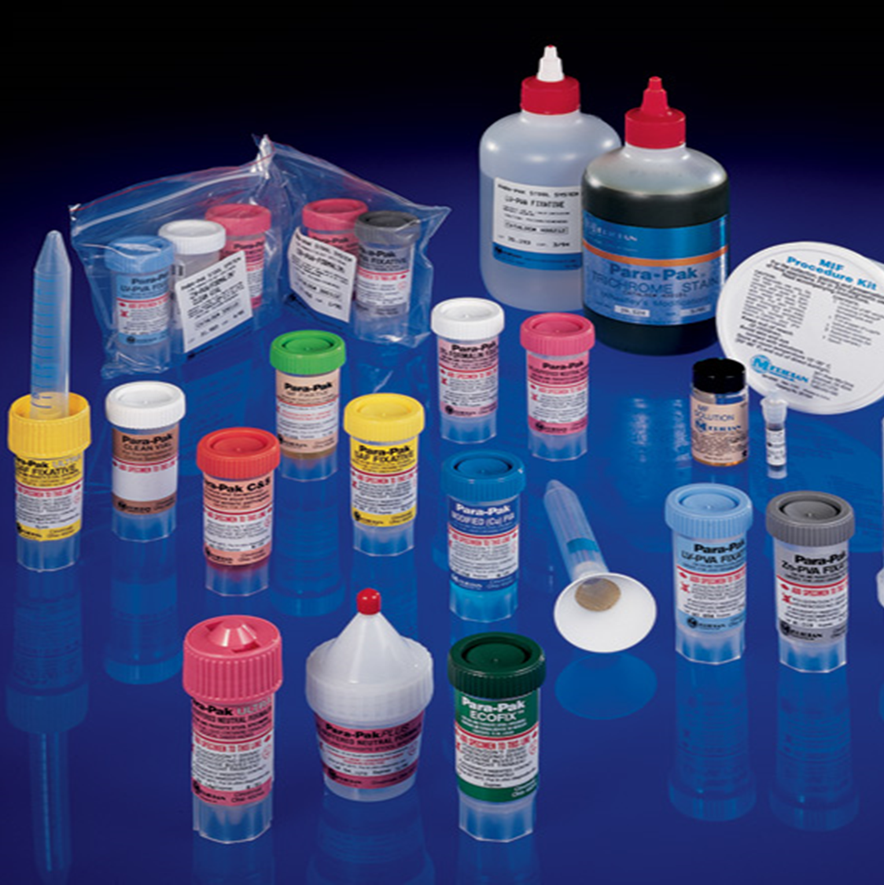
Preservatives
Usually two-vial collection kit for routine parasite exam
  Some one vial fixatives
  Preserve specimen for testing
  Different vials used for:
    Direct wet mount
    Concentrated wet mount
    Permanent stain
    Special stains
    Antigen testing
    NAAT testing
Notes:
Preservatives are essential to preserve the parasite in the stool sample and maintaining integral structure of the parasite. Most common is the two vial collection kit from routine parasite exam. While some choose just 1 vial with the fixative to preserve specimen for testing. Using different vials is typically indicated by the purpose of the testing intended such as direct wet mount typically use collection system that does not have any preservatives as the specimen is immediately analyzed, however, given that most hospital does not have a designated parasitology department, collection a specimen without preservative to perform direct mount is no longer feasible. Concentrated wet mount, special stains and permanent stains can be performed on preserved specimen and are use to make slights for microscopic examination.

Slide 9
Fixatives
Fixative | Advantages | Disadvantages
10% Formalin | All purpose fixative Easy to prepare Long shelf life Good preservation of morphology of helminth eggs, larvae, protozoan cysts, and coccidia Suitable for concentration procedures and UV fluorescence microscopy Suitable for acid-fast, safranin, and chromotrope stains Compatible with immunoassay kits and | Not suitable for some permanent smears stained with trichrome Inadequate preservation of morphology of protozoan trophozoites Can interfere with PCR, especially after extended fixation time
SAF (sodium acetate-acetic acid-formalin) | Suitable for both concentration procedures and preparation of permanent stained smears Easy to prepare Long shelf life Suitable for acid-fast, safranin, and chromotrope stains Compatible with immunoassay kits | Requires additive (e.g., albumin-glycerin) for adhesion of specimens to slides Permanent stains not as good as PVA
Modified Polyvinyl Alcohol (PVA) copper or zinc (PVA contains Hg) | Permanent smears can be made and stained with trichrome Zinc is preferred over copper No mercuric chloride | Staining not consistent Organism morphology may be poor Copper-morphology of cysts and trophozoites is poor Zinc-better morphology
One-Vial Fixatives (Ecofix, Parasafe, Unifix, Proto-fix, STF, Total-Fix) | Concentrate and permanent smear can be made out of one vial Immunoassays can be done on most No mercuric chloride | Certain one-vial fixatives must use certain stains Color difference of stain Staining not always consistent Sometimes more expensive
Notes:
This slides presents the advantages and disadvantages of various fixatives commonly used in parasitology specimen processing. At DHS, We utilize Total-Fix which is a one vial fixative, it can perform both concentrate and permanent smear from the same vial. Immuno assays can be done, and it does not have mercuric chloride, which is toxic. Disadvantages includes the type of stains can be used on the specimen, color difference of the stain may be affected such as staining inconsistencies. And it is more expensive than the others listed on this table.

Slide 10
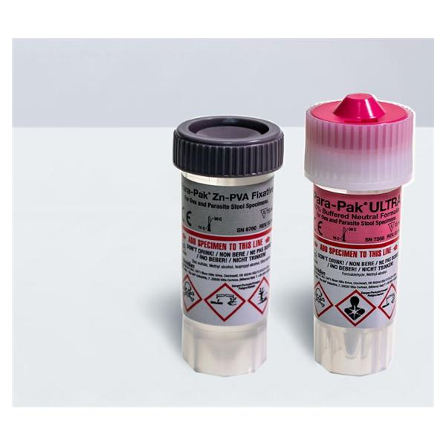
Example
Two vial system: PVA and 10% formalin
PVA
  Permanent stain for trophozoites and cysts
10% formalin
  Wet mount and/or iodine mount
  DFA
  NAAT
  Helminth eggs and larvae
  Microsporidia
  Protozoan cysts
Notes:
This slides shows you some example of the different preservative systems. Two vial system is typically poly vinyl alcohol and 10% formalin, PVA is used for permanent staining for trophozoites and cysts. 10 % formalin can be used for wet mount and iodine mount, Direct fluorescent antibody testing, Nucleic acid amplification testing. Helminth eggs and larvae identification, microsporidia and protozoan cyst identification.

Slide 11
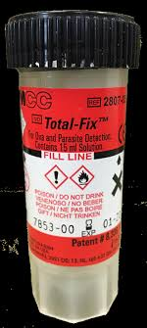
LA County DHS
Collect stool in Total-Fix (one vial system) and send to Olive View for O&P
10% formalin-send to Los Angeles County Public Health Lab for Modified Acid Fast
Notes:
For LA County DHS again, we collect in a 1 vial system with total fix which is send to Olive View for testing. 10 % formalin specimen are also collected to be sent to public health lab for modified acid fast staining.

Slide 12
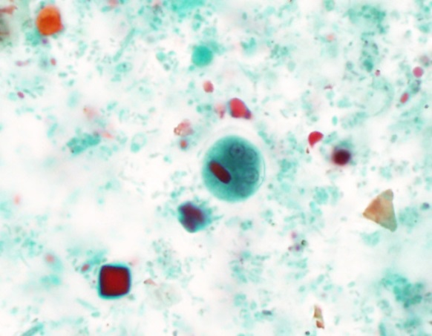
Ova and Parasite Exam
Wet mount + Iodine
Wet mount-Saline
3 parts:
1) Direct Wet Mount
  0.85% saline plus or minus iodine
2) Concentration
  Formalin Ethyl Acetate Sedimentation
  Zinc Sulfate Flotation
3) Permanent stained smear
  Trichrome
  Iron Hematoxylin
E. histolytica/dispar cysts
Permanent stain-Trichrome
Notes:
The processing of a stool specimen, once arrive at Olive view medical center will be subjected to 3 potential testing process, Direct wet mount with or without iodine, concentration using formalin ethyl acetate and permanent stain.

Slide 13
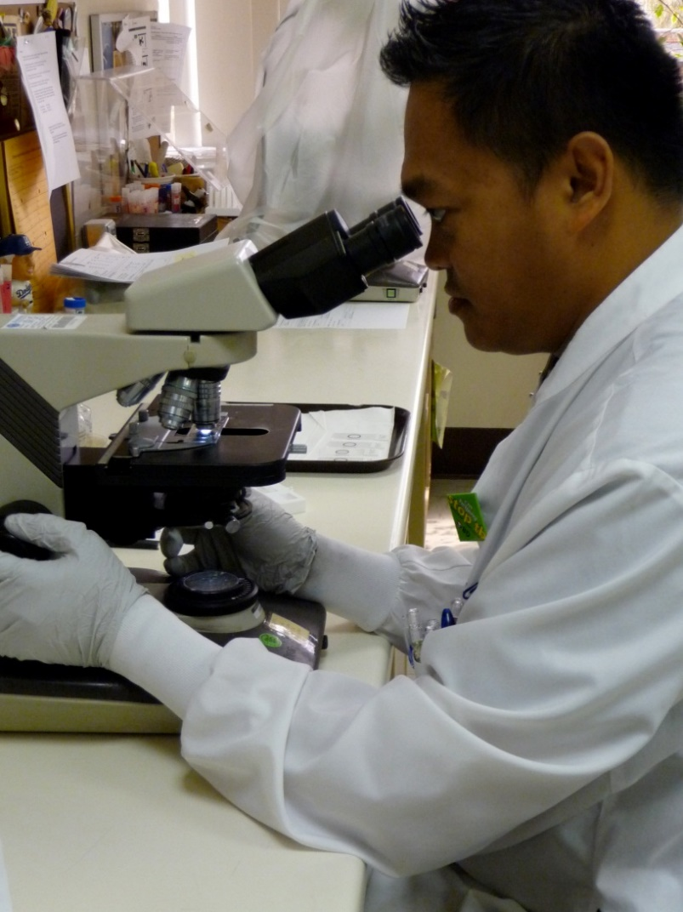
Direct Wet Mount
Fresh, unpreserved stool specimens that have not been refrigerated
  Emulsify stool in saline and coverslip
  Scan suspension with 10x and 40x objective for motility of protozoa and presence of helminth eggs
  Iodine can be added for color contrast however motility will be lost
Notes:
Once a Fresh specimen arrived, it can be mixed with a little bit of saline, to make a slide. Which can be observed under microscope directly with or without iodine. Iodine can provide better contrast to help identify key features leading to identification. This done with fresh, unpreserved stool specimen that has not been refrigerated. This is in the hope to observe living parasites with motility. Iodine while provides the contrast, it can kill the parasite, hence losing motility.
The following video shows you how to a direct wet mount slide is prepared.

Slide 14
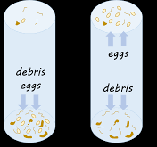
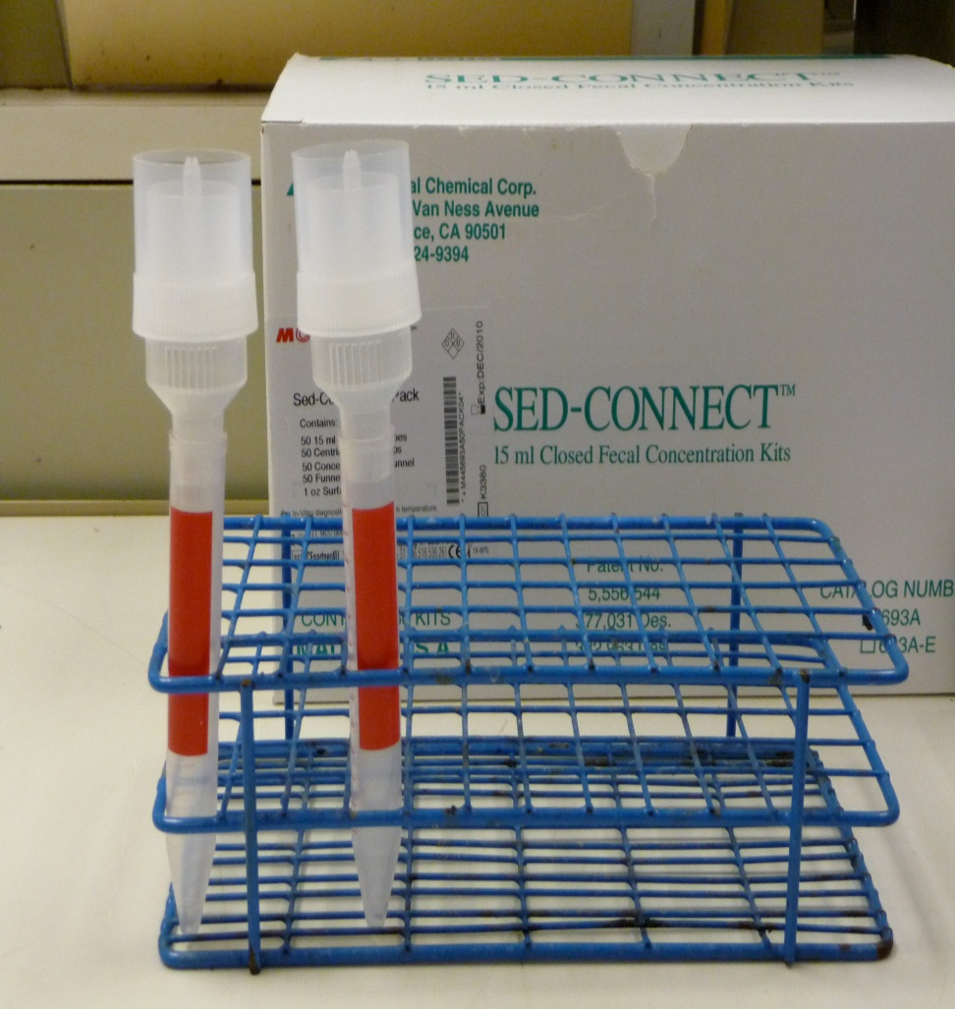
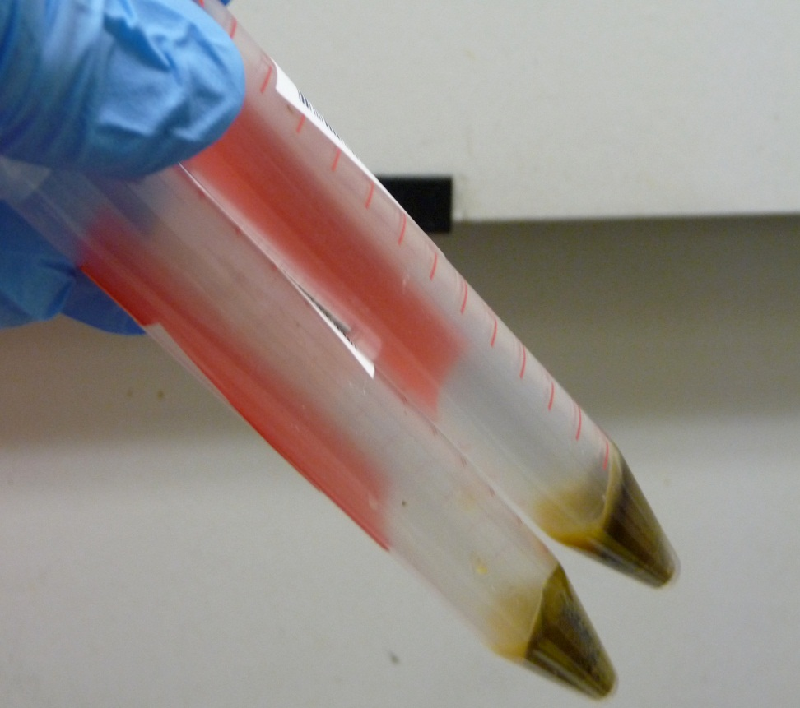
Concentrated wet mount
Zinc sulfate
Zinc Sulfate Flotation
Zinc sulfate has a higher specific gravity than the organisms to be floated
Organisms rise to the top and debris sinks to the bottom
Advantage: Less fecal debris in wet mount
Disadvantages:
Walls of eggs and cysts will often collapse
Some parasite eggs do not float
Formalin Ethyl Acetate Sedimentation
10 min @ 500 X g required
Advantage: All parasites in sediment
Disadvantage: More debris
10 min @ 500 X g required
Sedimentation
Notes:
Concentration can be done using sedimentation or flotation method. Both methods involve changing the specific gravity of the diluent that causes ova/parasite to float to the top or falls to the bottom.
Flotation: use solutions which have higher specific gravity than the organisms to be floated so that the organisms rise to the top and the debris sinks to the bottom. The main advantage of this technique is to produce a cleaner material than the sedimentation technique. The disadvantages of most flotation techniques are that the walls of eggs and cysts will often collapse, thus hindering identification. Also, some parasite eggs do not float.
Sedimentation: use solutions of lower specific gravity than the parasitic organisms, thus concentrating the latter in the sediment. Sedimentation techniques are recommended for general diagnostic laboratories because they are easier to perform and less prone to technical errors. The sedimentation technique used at CDC is the formalin-ethyl acetate technique, a diphasic sedimentation technique that avoids the problems of flammability of ether, and which can be used with specimens preserved in formalin, MIF or SAF.

Slide 15
Sediment Concentration
Notes:
These are Images of the Sed-Connect device used for concentration procedure. The following video shows you the performance of a concentration process, and making a concentrated wet mount.

Slide 16
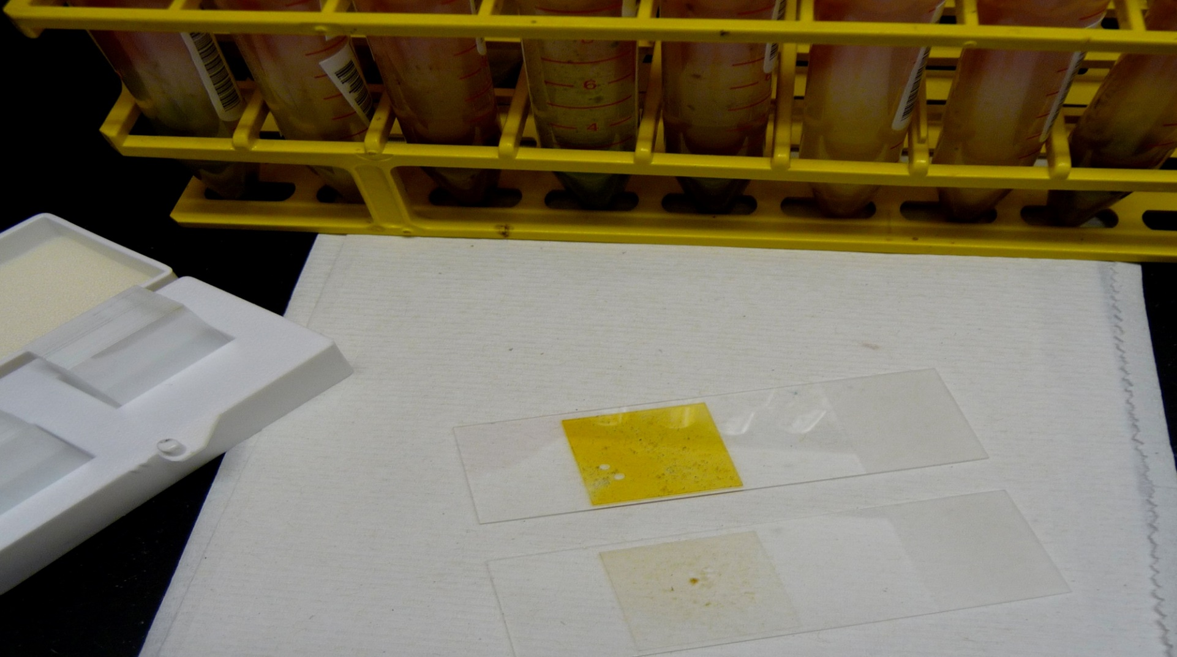
Concentrated Wet Mounts
+ Iodine
Notes:
This image compares between 2 wet mounts, 1 with iodine, and 1 without.

Slide 17
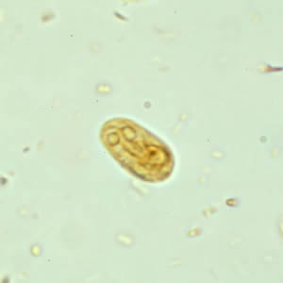
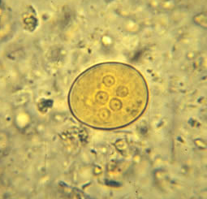
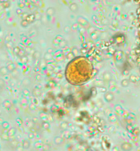
Concentrated Wet Mounts
Hookworm egg
Giardia cyst
All helminth eggs and larvae
Protozoan cysts
  Giardia lamblia
  Entamoeba coli
  Iodamoeba butschlii
E. coli cyst
I. butschlii cyst
Notes:
Concentrate wet mounts allows you to harvest higher level of parasites in all forms and stage of life cycle. Specifically effective in isolating eggs and larvae of helminth, and protozoan cysts. However, because concentrated wet mount may be performed on a preserved specimen, motility will not be present.

Slide 18
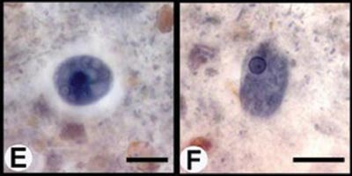
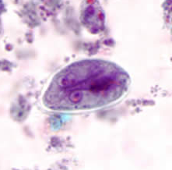
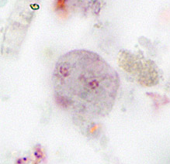
Permanent Stained Smears
Iron Hematoxylin
Iron Hematoxylin
Good with PVA or SAF fixed specimens
More difficult to perform staining
Critical timing
Trichrome
Most common
Easy to perform staining
Flexible timing
Best with PVA fixed specimens
Stains intestinal protozoa, human cells, yeast cells and artifact material
Not recommended for helminth eggs and larvae
E. histolytica/dispar cyst
E. histolytica/dispar
trophozoite
Trichrome
Giardia cyst
Dientamoeba fragilis
Notes:
Permanent staining are commonly done with iron hematoxylin or trichrome. The latter being the most common methods valued for its simplicity. Trichrome stains are best for protozoa. Helminth eggs and larvae is still best with direct wet mount.

Slide 19
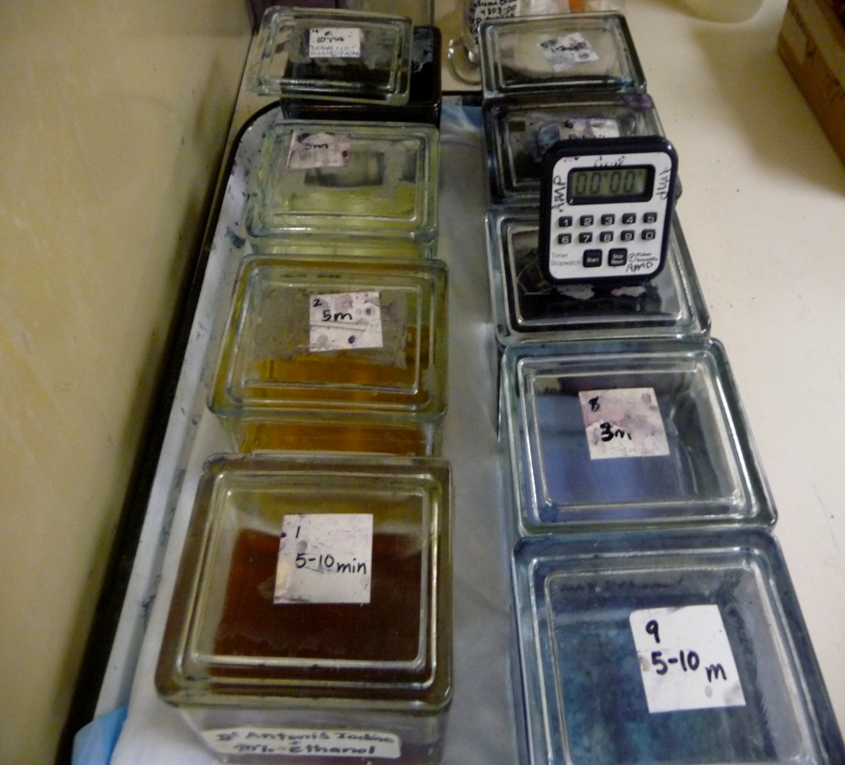
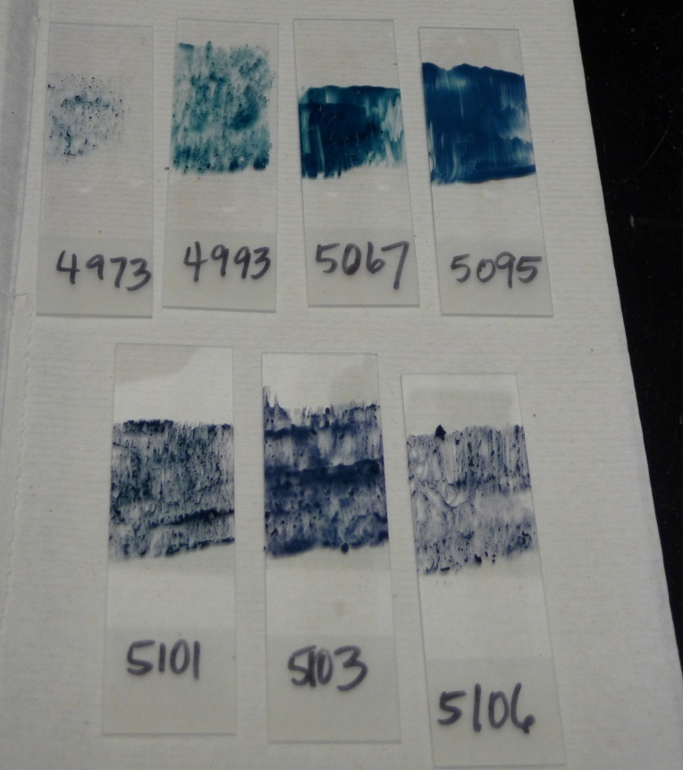
Trichrome Stain
Notes:
This image shows you what a typical trichrome stain station and the stained slides looks like. The following video will provide you with a brief overview of how trichrome staining is performed.

Slide 20
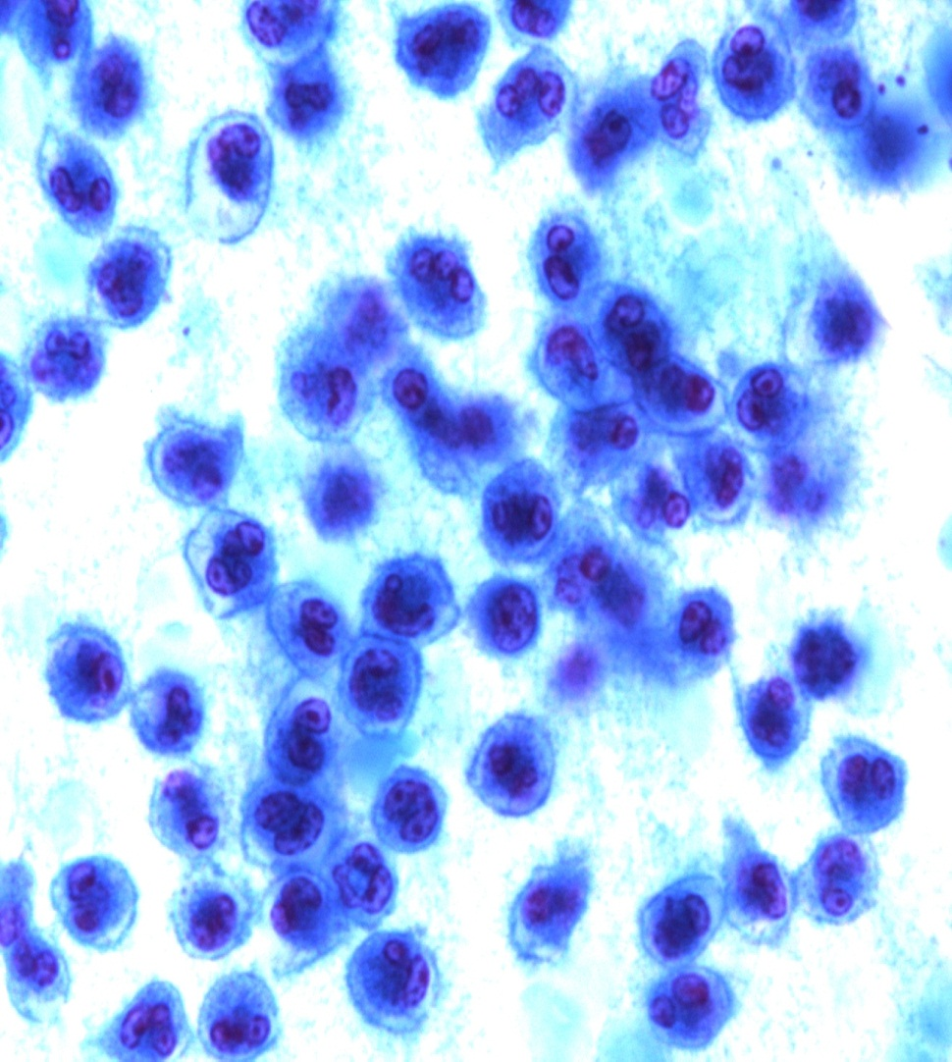
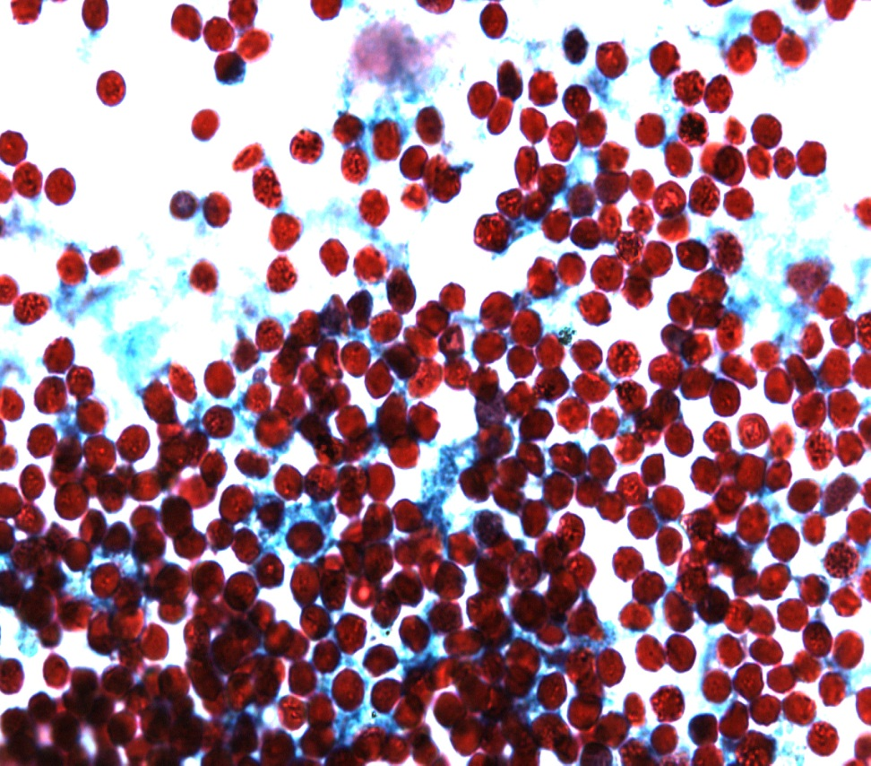
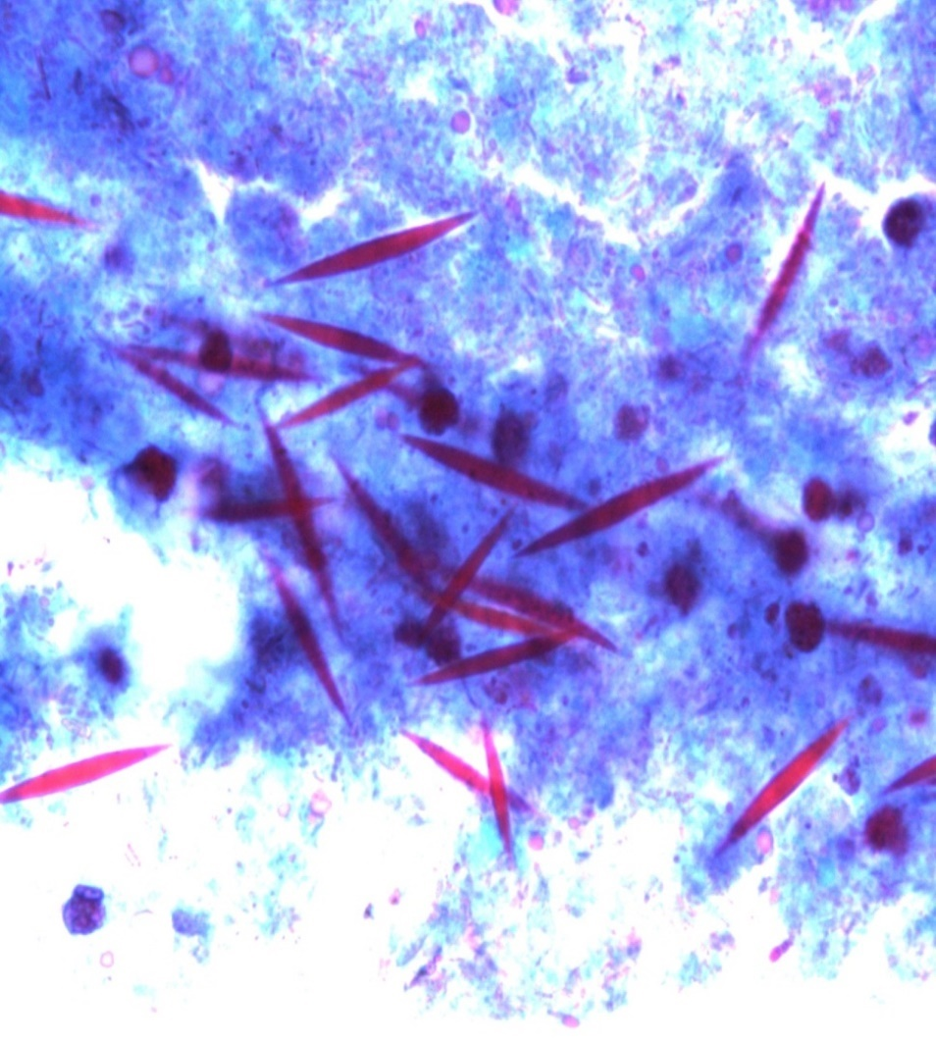
Trichrome Stain-human cells
Blood cells:
  Polymorphonuclear leukocytes (PMNs)
  Red blood cells (RBCs)
  Macrophages
  Eosinophils
  Quantitate cells when reporting
PMNs
  Indicate inflammation
  May be mistaken for amebic cysts
RBCs
  Indicates mucosal ulceration or other hemorrhagic problems
  May or may not be related to a parasitic infection
Eosinophils
  indicate a presence of an immune response
  May or may not be related to a parasitic infection
  May be present in tissue invading parasitic infections or allergic reactions
  Charcot Leydon Crystals (CLC) are disintegrated eosinophils
PMNs
RBCs
Eosinophils and CLCs
Notes:
While trichrome stains works well and it’s easier to use. However, it stains human cells. So it is important to be able to differentiate between human cells and structures from cysts, eggs and larvaes. Commonly encountered cells involves PMNs, RBCs Macrophages, and Eosinophils. Eosinophils of course, is the body’s immune defense against parasite. When eosinophils disintegrates it may appear in a elongated needle shape that can resemble a worm, but these are called charcot leydon crystals.

Slide 21
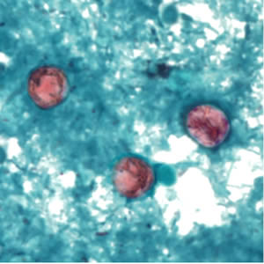
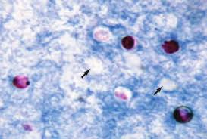
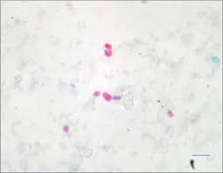
Special Stains
Safranin-
Cyclospora
Modified Acid Fast-
Cryptosporidium
Modified Acid Fast Stain
  Cryptosporidium
  Cyclospora
  Isospora
Safranin Stain
  Cyclospora
Modified Trichrome Stain
  Microsporidia
Calcofluor Stain
  Fluorescent stain for Microsporidia
Must order or request-not part of regular O&P
Modified Trichrome-
Microsporidia
Calcofluor-
Microsporidia
Notes:
Special staining can also be performed for certain parasites such as cryptosporidium with modified acid fast stain, Cyclospora with safranin, Microsporidia with modified trichrome and calcofluor with microsporidia. This is not typically part of routine O&P testing, and clinician must place order specifying for these test.

Slide 22
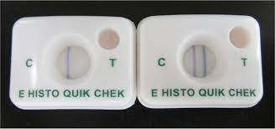
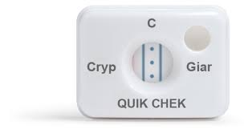
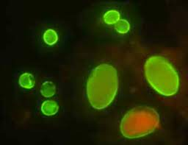
Antigen tests
E. histolytica LFA
Advantages:
  More sensitive than O&P
  Require less tech time
Types:
  Enzyme immunoassay (EIA)
  Direct fluorescent antibody (DFA)
  Lateral flow assay (LFA)
Entamoeba histolytica
  Differentiates E. histolytica from E. dispar (which cannot be done by O&P)
Giardia
Cryptosporidium
Some are combined tests for Giarda/Cryptosporidium
Giardia/Cryptosporidium LFA
Cryptosporidium
Giardia
Giardia/Cryptosporidium DFA
Notes:
Antigen testing, provides an easier and relatively quick way to determine if parasite is present. Advantages being high sensitivity and less time consuming. Test type can involve Enzyme immunoassay, direct fluorescent antibody, and lateral flow assay.
Entamoeba histolytica, giardia and cryptosporidium can have Lateral flow assay that simple to performed. When using DFA, it can be expected that both cyrtosporidium and giardia can appear.

Slide 23

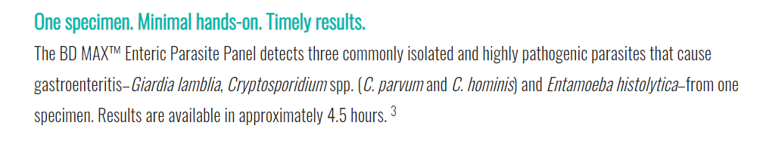
Molecular tests
Advantages:
  More sensitive than O&P
  Require less tech time
Part of multiplex PCR panels
Main targets:
  Giardia
  Cryptosporidium sp.
  Entamoeba histolytica
    Differentiate E. histolytica from E. dispar
Some also detect Cyclospora
Notes:
Molecular testing are very sensitive compare to O&P, and often is a load and go cases, and easy to performed. Most of these are done in the form of multiplex PCR panels. Main targets are typically Giardia, cryptosporidium and entamoeba histolytica.

Slide 24
Key points
Know body site of parasite to guide in specimen collection, i.e., for infectious diarrhea, collect stool
For stool collection: collect a minimum of 3 specimens every other day within 10 days using a preservative
Know how an Ova and Parasite exam works:
  Direct wet mount: look for helminths and their eggs
  Concentrated wet mount: look for helminth eggs and some protozoans
  Permanent stain: required for every test; detects protozoan parasites with some exceptions (see below*)
*Know when to use a special stain that is not in routine O&P:
  Cryptosporidium, Cyclospora, Isospora: Modified Acid Fast
  Microsporidium: Modified Trichrome
Know preferred test for each organism:
  Entamoeba histolytica: NAAT or antigen test
  Giardia: antigen (DFA or EIA) or NAAT
  Cryptosporidium: antigen (DFA or EIA) or NAAT
  Cyclospora: modified acid fast stain or NAAT
Notes:
So the take home message for this lecture is that
The site of the body where the parasite is isolated from can help narrow down the identification process.
Stools specimen should be minimum of 3 specimens every other day but within 10 days using a preservative.
3 method of O&P which are Direct wet with fresh specimen for helminths and eggs, Concentrated wet Mount for heminth eggs and protozoans
Permanent stain is required for every test, detects protozoan parasites.
Know when to use non routine special stains
Please visit the organism lectures after this.

Slide 25
Review
Notes:
Now let’s do some Review

Slide 26
Practice question
Charcot-Leyden crystals in stool may be associated with an immune response and are thought to be formed from the breakdown products of:
Neutrophils
Eosinophils
Monocytes
Lymphocytes
Notes:
Read Slide,
Answer is B Eosinophils

Slide 27
Practice question
Oocysts of Cryptosporidium spp. can be detected in stool specimens using:
Modified acid-fast stain
Gram stain
Trichrome stain
Modified Trichrome stain
Notes:
Read slide
Answer is A, Modified acid fast stain.

Slide 28
References
CDC DPDx-Laboratory Identification of Parasites of Public Health Concern
  http://www.cdc.gov/DPDx/
2017 IDSA Diagnosis and Management of Infectious Diarrhea
2018 IDSA Guidelines to Utilization of the Microbiology Lab
Garcia, L. S., Diagnostic Medical Parasitology, 5th ed., 2007 American Society for Microbiology Press, Washington DC.

