Slide 1
Diagnostic Parasitology Toxoplasma gondii
Created by: Dr Holly Huse PhD
Director, Harbor UCLA Medical Center Microbiology
Edited by: Qichao Stephen Ji, MS. MSc. MLS(ASCP)SBB, CLS, CQA(ASQ)
Clinical Laboratory Scientist Instructor

Slide 2
Toxoplasma
Coccidian parasite
The only known definitive hosts for Toxoplasma gondii are members of family Felidae (domestic cats and their relatives)
25-30% of the world’s population is infected (varies widely between countries)
Higher prevalence in Latin America and tropical Africa

Slide 3
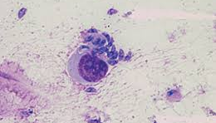
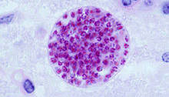
Life cycle-background
Tachyzoites
Cat family (Felidae) only definitive host for sexual stages of T. gondii (main reservoirs)
Three stages:
1) Tachyzoites (trophozoites)-rapidly proliferate and destroy cells during acute infection
2) Bradyzoites-multiply slowly in tissue cysts
3) Sporozoites-In oocysts (cats)
Tachyzoites and bradyzoites are found in human body tissues
Bradyzoites (tissue cysts)

Slide 4
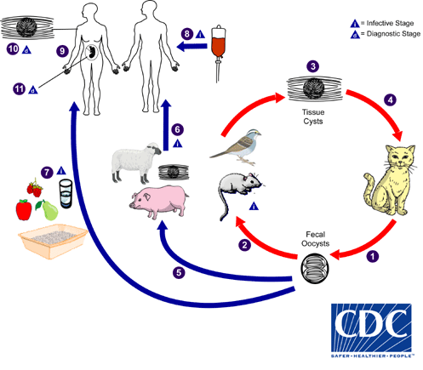
Life cycle-Cats
Tissue cysts or oocysts are ingested by the cat and invade epithelial cells of the small intestine
Undergo asexual cycle followed by sexual cycle = form oocysts which are excreted in cat feces
Unsporulated (uninfective) oocysts take 1-5 days to become sporulated (infective)
Cats shed oocsyts for 1-2 weeks but in large numbers
Oocysts survive in the environment
> 1 year
Resistant to disinfectants, freezing, drying
Killed by heat 70°C for 10 min

Slide 5
Life cycle-Humans
Upon ingestion, cyst wall is disrupted, organisms are released and invade the intestinal epithelium, disseminate and multiply intracellularly
Host cell dies when tachyzoites are released; invade adjacent cells
Tachyzoites are pressured by immune response to transform in bradyzoites and form tissue cysts (skeletal muscle, myocardium, and brain)
Cysts remain for life
Relapse occurs when host is immunosuppressed and cysts rupture

Slide 6
Transmission
Consumption of raw or undercooked mutton, lamb, beef, minced meat, pork, wild game
Oocyst contact through soil (raw or unwashed vegetables or cat litter)
Solid organ transplantation of tissue cysts (typically heart) or blood transfusion
Transplacentally, from mother to fetus (TORCH)

Slide 7
Clinical manifestations
Patient demographic | Clinical manifestations
Immunocompetent | 80% asymptomatic 10-20% flu-like, fever, lymphadenopathy 15% of child-bearing age women are seropositive
Immunocompromised patient (reactivation or primary infection) | CNS, myocarditis, pneumonitis AIDS = encephalitis (intracerebral mass)
Congenital Depends on stage of pregnancy | Severity of symptoms inversely correlates with infection timing (most severe in first trimester, asymptomatic in 80% of third trimester infections) First trimester-severe abnormalities, abortion, major brain and eye abnormalities, mental retardation, seizure, microcephalus, hydrocephalus Second trimester-epilepsy, anemia, retinochoroiditis Third trimester-delayed clinical retinochoroiditis Ocular-asymptomatic until 20-30 years of age Mental retardation, epilepsy

Slide 8
Laboratory Diagnosis
Challenge: determining acute vs. chronic infection
Patient | Disease setting | Diagnostic approach | Technique(s) | Sample(s)
Immunocompetent patient, transplant recipient, or pregnant woman | Primary infection or determination of immune status | Serology | Routine, IgG/IgM detection; IgG avidity, dye test | Serum
Fetus | Maternal primary infection | Prenatal diagnosis based on parasite detection | PCR, mouse assay | Amniotic fluid
Newborn | Maternal primary infection | Parasite detection | PCR, mouse assay | Placenta, cord blood
 |  | Serology | IgG/IgM/IgA detection | Cord blood serum and/or newborn serum
 |  |  |  | Neonate and mother sera in parallel
Immunocompromised patient | Cerebral or disseminated toxoplasmosis | Parasite detection | PCR, cell culture, mouse assay, and histology | Blood, CSF, BAL, tissue specimens
https://cmr.asm.org/content/25/2/264

Slide 9
Laboratory ID
Rare
Oocysts (cat):
9-11 x 9-14 µm
Contain 2 sporocysts, each with 4 sporozoites
Acute (humans)=trophs/tachyzoites in WBC or blood/CSF
Stain with Giemsa
Tachyzoites are crescent shaped (can be oval if degenerating)
Chronic infection
Cysts with bradyzoites in brain, eyes, skeletal, or cardiac muscle imprints; stain strongly with PAS

Slide 10
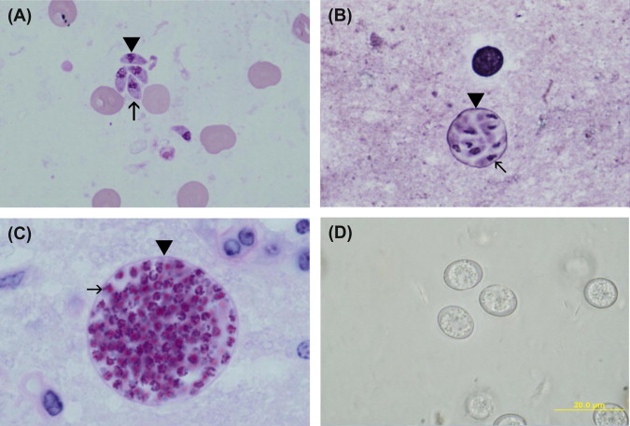
Lab ID
A) Tachyzoites (arrowhead) in smear. Giemsa stain. Note nucleus dividing into two nuclei (arrow).
B) A small tissue cyst in smear stained with Giemsa and a silver stain. Note the silver-positive tissue cyst wall (arrow head) enclosing bradyzoites that have a terminal nucleus (arrow).
C) Tissue cyst in section, PAS. Note PAS-positive bradyzoites (arrow) enclosed in a thin PAS-negative cyst wall (arrowhead).
D) Unsporulated oocysts in cat feces. Unstained.
https://www.sciencedirect.com/topics/biochemistry-genetics-and-molecular-biology/tachyzoite

Slide 11
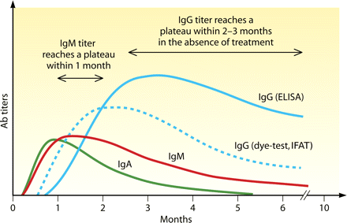
Serology-Antibody kinetics
High levels of IgG may persist for many years after primary infection
IgM-susceptible to false positives (use capture-ELISA)
IgA-more sensitive in babies
https://cmr.asm.org/content/25/2/264#sec-35

Slide 12
Serology
Remington Laboratory for Specialty Diagnostics (Palo Alto, CA)
Gold standard reference lab recommended by the CDC and FDA
Formerly known as the Toxoplasma Serology Laboratory

Slide 13
Serology-test types
Toxoplasma Serological Profile (TSP)
Sabin-Feldman Dye Test (DT), double sandwich IgM ELISA, IgA ELISA, IgE ELISA, and AC/HS test
Sabin-Feldman dye test (IgG)
Patient serum mixed with T. gondii tachyzoites and observed for exclusion of methylene blue (MB)
Positive-patient antibodies lyse parasite membrane, parasite is not stained by MB
Negative-no patient antibodies; parasite membrane intact; parasite stained by MB
Differential agglutination (AC/HS)
Uses 2 antigen preparations that express antigenic determinants found following acute infection (AC antigen) or in the later stages of infection (HS)
Ratios of titers using AC versus HS antigens are interpreted as acute, equivocal, non-acute, or non-reactive.
Helps differentiate acute from chronic infections
Avidity
The functional affinity of IgG antibodies is initially low after primary antigenic challenge and increases over time
Protein-denaturing reagents are used to dissociate antibody-antigen complexes
The avidity result is determined using the ratios of antibody titration curves of treated and untreated serum
Routinely used for TSP patients who are IgM positive or equivocal or acute/equivocal in AC/HS test

Slide 14
Serology, test types, continued
IgM antibodies
Prone to false positives from rheumatoid factor and antinuclear antibodies
Immuno-capture IgM-ELISA
IgA antibodies
More sensitive than IgM in babies
Newborn infants should be tested for both IgA and IgM using capture-ELISA

Slide 15
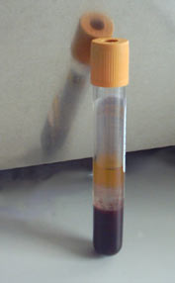
Serology-specimen collection and transport
Specimen collection (serum)
One sample for immune status
Acute and convalescent should be tested at the same time
Specimen storage and transport:
Store specimens at 4°C or less for several days
Ship at room temperature unless > 1 week transit or > 30°C
Long-term storage -20°C or below

Slide 16
Serology Interpretation

Slide 17
PCR
Performed at specialty reference laboratories
Fetus-amniotic fluid
Newborn-placental or cord blood
Immunocompromised patient-blood, CSF, tissue, BAL

Slide 18
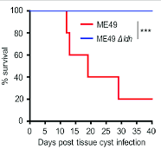
Other Tests
Mouse test
Tissue or fluids are inoculated into mice, and the mice are observed for 4-6 weeks
Culture
Amniotic fluid in MRC-5 tissue culture cells
Cytopathic effects within 48-96 hours
Perform Giemsa and/or IFA
EIA antigen detection-not sensitive, not recommended

Slide 19
Treatment
Healthy individuals should not be treated, as disease is self-limiting
Drugs target tachyzoites but not bradyzoites
Drugs of choice:
Pyrimethamine (folic acid antagonist) plus sulfadiazine
CNS toxoplasmosis in HIV-infected patients: Pyrimethamine plus sulfadiazine or clindamycin
Atovaquone plus pyrimethamine is an alternative for patients with sulfa allergies
Ocular-add corticosteroids for anti-inflammatory effect
Women in first trimester-spiramycin
In utero-Pyrimethamine plus sulfadiazine
Pyrimethamine is a teratogen and should be used only after the first trimester
Congenitally infected newborns-utero-Pyrimethamine every 2-3 days and sulfonamide for ~1 year

Slide 20
References
Laboratory Tests for the Diagnosis of Toxoplasmosis-A Guide For Clinicians
https://www.sutterhealth.org/services/lab-pathology/serology-forms
DPDx-Toxoplasmosis
https://www.cdc.gov/dpdx/toxoplasmosis/index.html
Epidemiology of and Diagnostic Strategies for Toxoplasmosis
Florence Robert-Gangneux, Marie-Laure Dardé
https://cmr.asm.org/content/25/2/264

