Slide 1
Diagnostic Parasitology Ectoparasites and Their Diseases
Created by: Dr Holly Huse PhD
Director, Harbor UCLA Medical Center Microbiology
Edited by: Qichao Stephen Ji, MS. MSc. MLS(ASCP)SBB, CLS, CQA(ASQ)
Clinical Laboratory Scientist Instructor

Slide 2
Rickettsial diseases

Slide 3
Disease | Organism | VectorI Reservoir | Locations | Key symptoms
Rocky Mountain Spotted Fever (RMSF) | Rickettsia rickettsii | Reservoir: ticks Dermacentor andersoni Dermacentor variabilis Rhipicephalus sanguineus | Western Hemisphere Carolinas Tennessee Oklahoma Arkansas | Most subclinical ~50% bite history Fever, headache, toxicity Rash starts on day 2-3 at periphery and moves centrally Rash includes palms and soles 5-7% mortality even when treated early
Rickettsialpox | R. akari | Reservoir: house mouse, wild rodents Mite: Liponyssoides sanguineus | NYC, Russia, | Eschar with surrounding induration Rash is scattered nonpruritic macules Rash spares palms and soles Lymphadenopathy May be mistaken for anthrax (absent nonpitting edema seen with anthrax) or chickenpox
Epidemic Typhus | R. prowazekii | Reservoir: humans, sometimes flying squirrels Body louse: Pediculus humanus corporis | Andes, Burundi, Ethiopia, Mexico, Brazil and sylvatic typhus in eastern USA . | Severe itractable headache, fever Rash spares palms, soles and face Pronounced toxemia 2-week fever Fatality 10-40% without treatment
Murine typhus | R. typhi | Reservoir: rats, opossums Rat flea: Xenopsylla cheopsis | Asia-Pacific, outbreaks in Los Angeles | Similar to typhus, less severe
Human Monocytic Ehrlichiosis | Ehrlichia chaffeensis | Reservoir: dogs and white-tailed deer Lone star tick: Amblyomma americanum | Worldwide | Fever, myalgia, anorexia +/- rash, may be confused with RMSF
Human Granulocytic anaplasmosis | Anaplasma phagocytophilum | Reservoir: white-footed mouse Ticks: lxodes scapularis and lxodes pacificus | Upper Midwest: Wisconsin, Minnesota, California | Fever, headache, malaise, vomiting Rash is rare
E. ewingii Ehrlichiosis (granulocytic) | Ehrlichia ewingii | Amblyomma americanum | Missouri | Fever, headache, malaise, vomiting Rash is rare

Slide 4
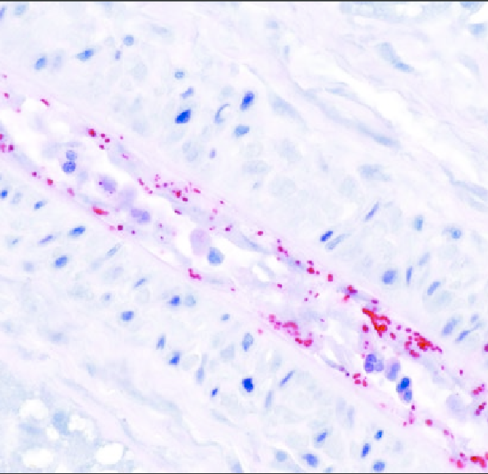
Rickettsia
Small, coccobacillary, Gram-negative bacteria
Obligately intracellular bacteria
Infect vascular endothelium
Humans are the accidental dead-end host
More than one family member may be affected: exposure to foci of infected ticks
  Family dog may also acquire disease
Immunohistochemical stain demonstrating Rickettsia rickettsii (red) in blood vessel endothelial cells

Slide 5
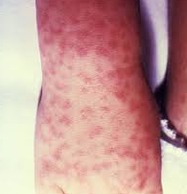
Clinical manifestations: RMSF
Incubation period: 5-10 days after tick bite
Early signs and symptoms are non-specific
Sudden onset of fever, headaches, chills, malaise, myalgia
Headaches are almost always reported and are severe
Rash occurs 2-4 days after onset of fever, earlier in children
The exanthem typically begins as small, blanching, pink macules on the ankles, wrists, or forearms that evolves to maculopapular and can include the palms and soles
In half of cases, may evolve to petechial rash
Patients with petechial rash are severely ill

Slide 6
Rickettsial Laboratory Diagnosis
Weil-Felix:
  heterophile agglutination reaction, non-specific
  Rickettsia antibodies agglutinate certain non-motile Proteus serotypes
PCR:
  Skin biopsy
  Usually only positive in extremely ill or deceased patients

Slide 7
Laboratory Diagnosis, continued
Gold standard: serology, indirect immunofluorescence antibody (IFA)
Diagnostic testing available through commercial labs and CDC
Detectable antibodies ~7-10 days after illness onset
IgM rises at the same time as IgG, can persist for > 12 months, and is prone to false-positives
  Therefore CDC does not use lgM results for routine diagnostic testing
IgG may also remain elevated due to past exposures
Therefore, the best evidence for current infection is a significant change (four-fold increase) on two appropriately timed specimens (2-4 weeks apart), where both tests are done in the same laboratory at the same time.

Slide 8
Cross-reactivity
NOT species-specific
If IFA reactive to R. rickettsii, then termed as "Spotted Fever Group" and can include other spotted species: R. akari, R. conorii, R. australis, R. sibrica
If IFA reactive to R. typhi, then termed as "Typhus Fever Group" and includes other typhi group species like R. prowazekii

Slide 9
Treatment
Diagnostic tests are usually negative within the first 7-10 days of illness
Other laboratory indicators, but not found in all patients:
  Thrombocytopenia
  Low sodium levels
  Elevated liver enzymes
Doxycycline
Administer immediately when RMSF is suspected

Slide 10
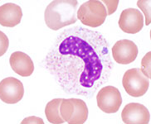
Ehrlichia and Anaplasma
Obligate intracellular Gram-negative pathogens
Propagate and reside in:
Granulocytes: Anaplasma and Ehrlichia ewingii
Monocytes: Ehrlichia chaffeensis
No peptidoglycan or ATP/ADP translocases
Use proline and glutamine as carbon sources
Morulae detected in a granulocyte on a peripheral blood smear, associated with A. phagocytophilum infection.

Slide 11
Ehrlichia
Human monocytic Ehrlichiosis (HME)
Transmitted by the Lonestar Tick (Amblyomma) in SE and SC U.S.
Incubation period: 1-2 weeks after tick bite
Mortality rate: 1.8%
Clinical manifestations:
  Fever, HA, muscle pain, malaise, chills, nausea/abdominal pain, cough, confusion
  Serious: difficulty breathing, bleeding disorders
  Rash: RARE
    If present, resembles RMSF

Slide 12
Anaplasma phagocytophilum
Human granulocytic Anaplasmosis (HGA)
Transmitted by Ixodes scapularis (black-legged tick) in NE and upper Midwestern U.S.
Incubation period: 1-2 weeks after tick bite
Mortality rate: < 1%
Clinical manifestations:
  Fever, HA, muscle pain, malaise, chills, nausea/abomdinal pain, cough, confusion
  Serious: difficulty breathing, hemorrhage, renal failure, neurological problems
  Rash: RARE
    If present, resembles RMSF

Slide 13
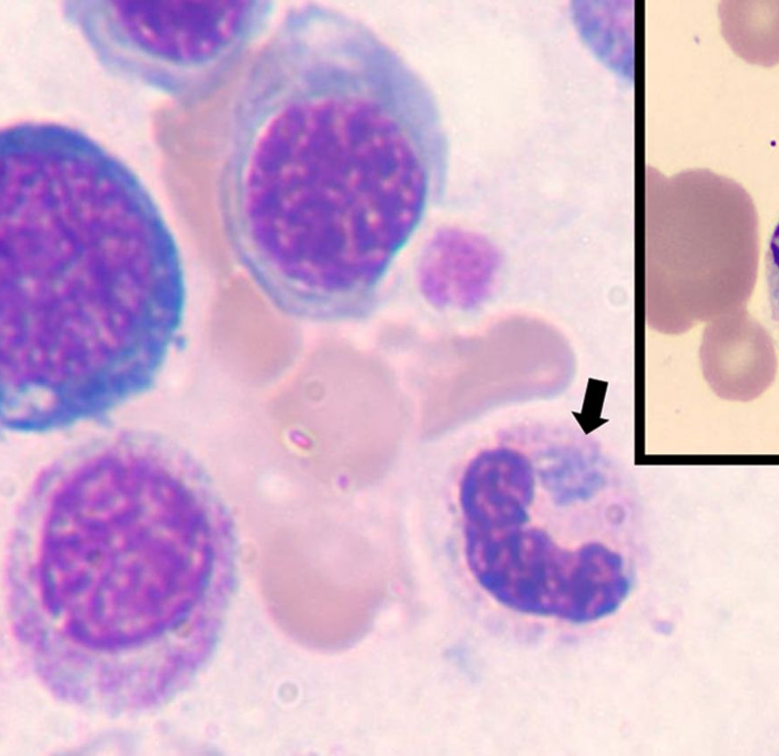
Laboratory diagnosis
Challenging!
Based on clinical signs and symptoms: do not delay treatment
Most sensitive: acute phase PCR on whole blood
  Most sensitive in first week of illness
  Negative does not rule out infection
Morulae (microcolonies of Ehrlichia) in blood smear
  ~20% of patients
  1-3 microns in diameter
  Examine 500 monocytes for Ehrlichia: only 0.2%-10% infected
  Examine 800-1000 granulocytes for Anaplasma, < 1% infected
  May provide insight, but not definitive

Slide 14
Ehrlichia/Anaplasma serology
Detectable antibodies 7-10 days after illness onset
IFA on paired sera, fourfold increase in titer
  Acute: first week of illness
  Convalescent: 3-6 weeks later
Antibodies to Ehrlichia spp and Anaplasma are highly cross-reactive (limited specificity for diagnosis)
IgM rise at the same time as IgG and remain elevated for months or longer; less specific than IgG
Up to 12% (Ehrlichia) or 5-10% (Anasplama) of healthy people in endemic areas have elevated antibody titers > paired sera

Slide 15
Treatment
Doxycycline should be initiated immediately if suspected

Slide 16
Major points
Rickettsia
  Serology: IFA, 4-fold increase in titers (no PCR, except on eschar!)
  Rickettsia=rash
  Rickettsia rickettsia: Dermacentor, Riphicephalus
  Rickettsia prowazekii=body louse
  Rickettsia typhi=flea
Ehrlichia/Anaplasma
  PCR for Ehrlichia or Anaplasma in first week of illness
  Serology is not specific
  Ehrlichia/Anaplasma: rash is rare
  Ehrlichia: Amblyomma “Lone star tick”
  Anaplasma: Ixodes
Treatment is doxycycline and should not be held while awaiting microbiology test results

Slide 17
Relapsing fever-louse or tick-borne
Characteristic | Louse-borne | Tick-borne
Clinical | More severe | Rash more common
Agent | Borrelia recurrentis | Borrelia hermsii Borrelia parkeri Borrelia turicatae
Epidemiology | Worldwide | Endemic
Vector | Pediculus humanis ssp. humanus | Ornithodoros spp. (soft ticks)
Mean duration of primary attack | 5.5 days | 3.1 days
Mean duration of asymptomatic interval | 9 days | 6 days
Mean number of relapses | 3 | 1
Mean duration of relapse | 2 days | 2.5 days

Slide 18
Clinical manifestations
Acute onset with high fever interspersed with afebrile, shaking chills, severe headache, nausea, myalgia and malaise.
There can be conjunctiva, effusion, petechiae (puritic), and abdominal tenderness.
Other symptoms with tick-borne include splenomegaly, hepatomegaly and jaundice but these occur less commonly.
Respiratory and CNS involvement
During pregnancy it can lead to congenital infection and fetal death

Slide 19
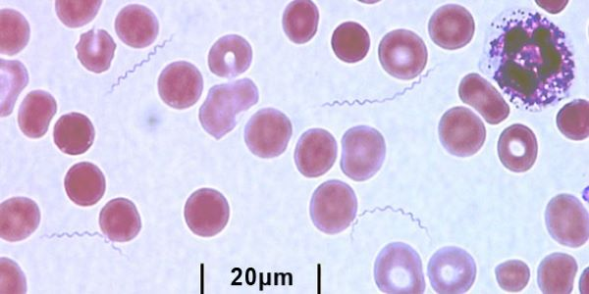
Laboratory diagnosis-gold standard
Definitive diagnosis: observation of Borrelia spirochetes in whole blood, CSF, or bone marrow in a symptomatic person
Dark-field microscopy is most sensitive but can also use Giemsa or Wright’s stain
Best detected during initial fever stage; spirochetes decrease over time

Slide 20
Serology for LBRF/TBRF
Not valuable for immediate diagnosis
Performed by some public health labs and private labs
Challenging due to variable expression of outer membrane proteins and treatment
Acute serum: 7 days within symptom onset
Convalescent serum: 21 days within symptom onset
Confirmation: 4-fold increase between acute and convalescent sera AND convalescent sera must be 2 standard deviations above negative pooled samples
Cross reacts with Lyme Disease

Slide 21
Treatment
Macrolides, tetracyclines, penicillins, cephalosporins
Drugs of choice: tetracyclines and erythromycin

Slide 22
Ticks

Slide 23
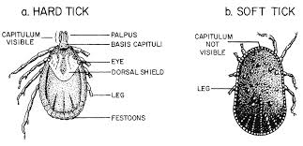
Ticks: hard tick vs. soft tick
*
*
*

Slide 24
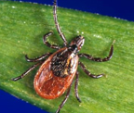
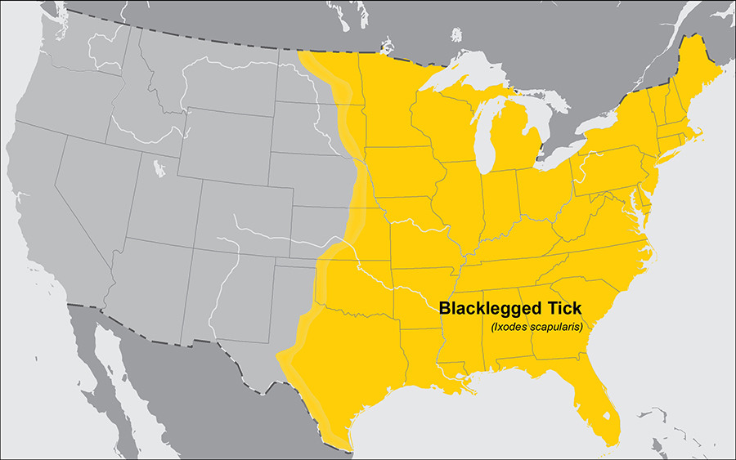
Hard ticks
Ixodes scapularis
  “Black-legged tick”
  Borrelia burgdorferi and Borrelia mayonii (Lyme disease)
  Anaplasma phagocytophilum (Anaplasmosis)
  Babesia microti (Babesiosis)
  Powassan virus
Greatest risk of being bitten exists in the spring, summer, and fall
Stages most likely to bite humans are nymphs and adult females

Slide 25
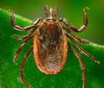
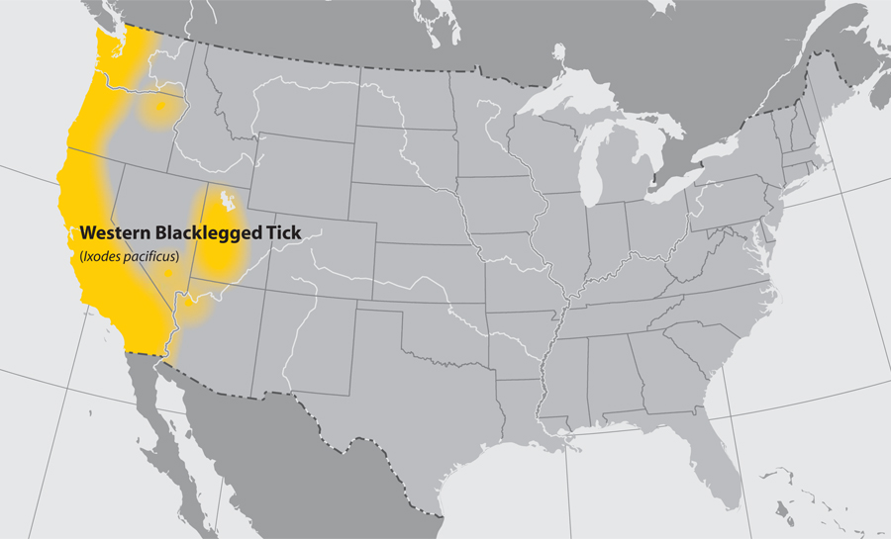
Hard ticks
Ixodes pacificus
  “Western black-legged tick”
  Borrelia burgdorferi and Borrelia mayonii (Lyme disease)
  Anaplasma phagocytophilum (Anaplasmosis)
Nymphs often feed on lizards, as well as other small animals
As a result, rates of infection are usually low (~1%) in adults.
Stages most likely to bite humans are nymphs and adult females

Slide 26
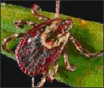
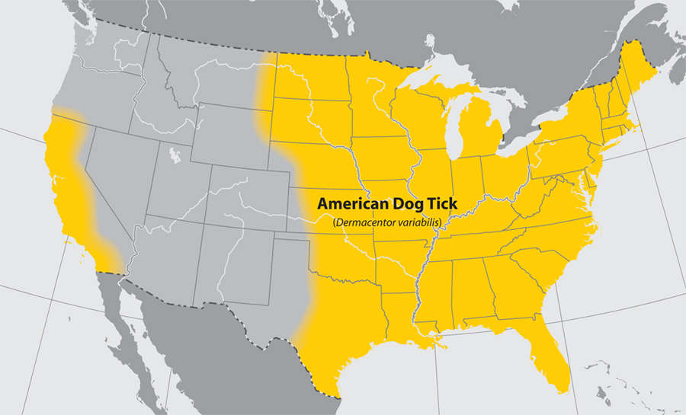
Hard tick
Dermacentor variabilis
  “American dog tick”
  Rickettsia rickettsia (Rocky Mountain Spotted Fever; RMSF)
  Francisella tularensis (tularemia)
The highest risk of being bitten occurs during spring and summer.
Dog ticks are sometimes called wood ticks.
Adult females are most likely to bite humans

Slide 27
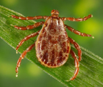
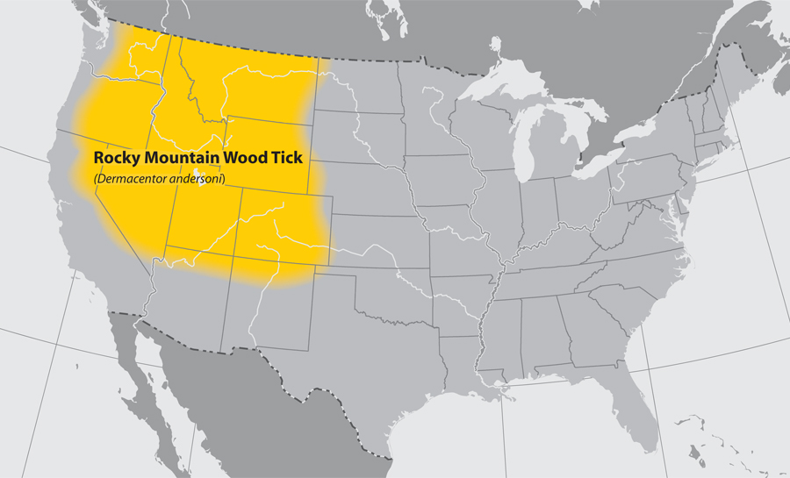
Hard ticks
Dermacentor andersoni
  Rocky Mountain wood tick
  RMSF
  Tularemia
  Colorado tick fever

Slide 28
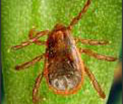
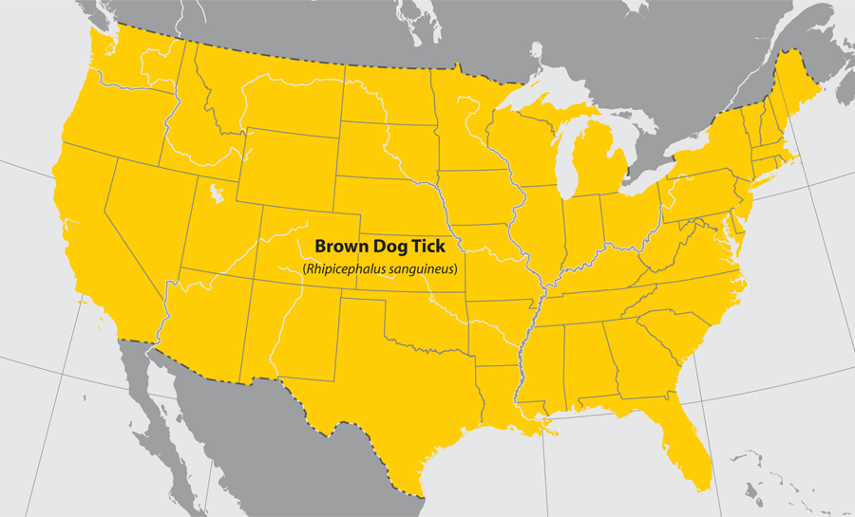
Hard ticks
Rhipicephalus sanguineus
  “Brown dog tick”
  RMSF
Dogs are the primary host for the brown dog tick in each of its life stages, but the tick may also bite humans or other mammals.

Slide 29
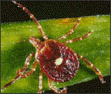
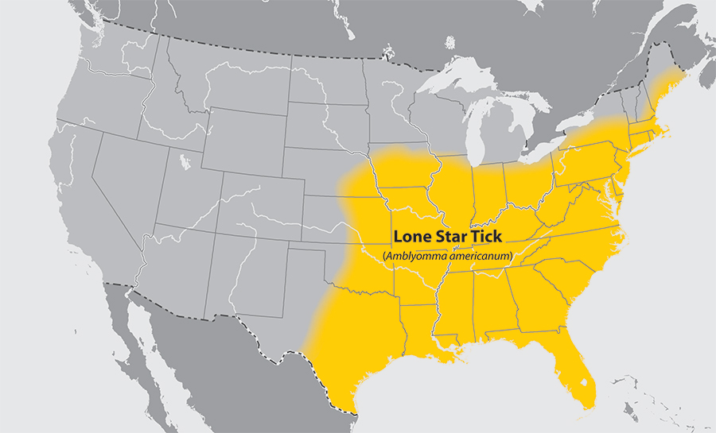
Hard tick
Amblyomma americanum
  “Lone star tick”
  Ehrlichia chaffeensis and Ehrlichia ewingii (Ehrlichiosis)
  Heartland virus
  Tularemia

Slide 30
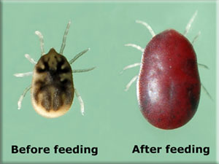
Soft ticks-Ornithodorus turicata
Borrelia sp. that cause tick-borne relapsing fever (TBRF)
  B. hermsii
  B. parkerii
  B. turicatae
Remember: also LBRF (B. recurrentis)

Slide 31
Vectors of parasites

Slide 32
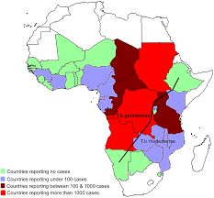
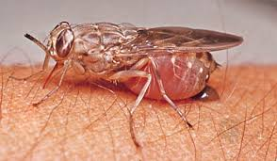
Tsetse fly
Scientific name: Glossina
Organisms:
  Trypanosoma brucei rhodesiense
  Trypanosoma brucei gambiense
Disease: African sleeping sickness

Slide 33
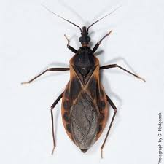
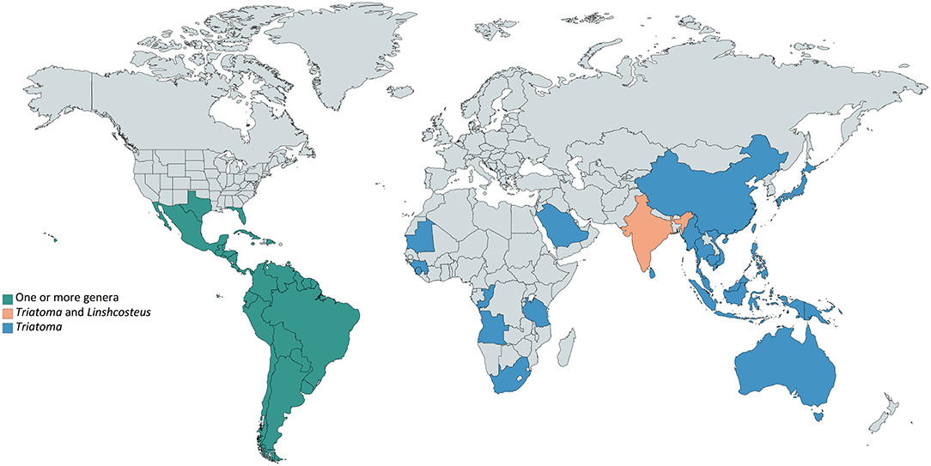
Kissing bug
Scientific name: Triatome/Reduviid bug
Organism: Trypanosoma cruzi
Disease:
  Chagas Disease

Slide 34
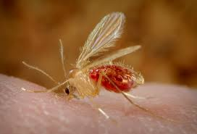
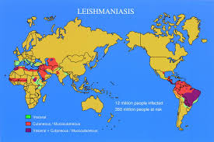
Sandfly
Scientific name:
  Phlebotomus or Lutzomyia
Organism: Leishmania
Disease: Leishmaniasis

Slide 35
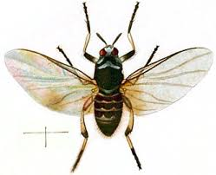
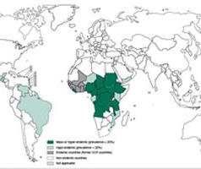
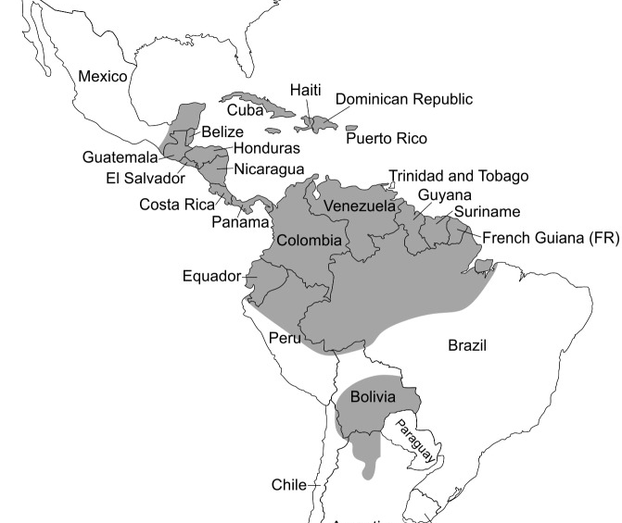
Black fly
Oncocerca volvulus
Mansonella ozzardi
Scientific name: Simulium
Organisms/disease:
  Onchocerca volvulus: River Blindness
  Mansonella ozzardi
    Non-specific symptoms: fever, arthralgia, headache, cold lower extremities, and itchy cutaneous rashes

Slide 36
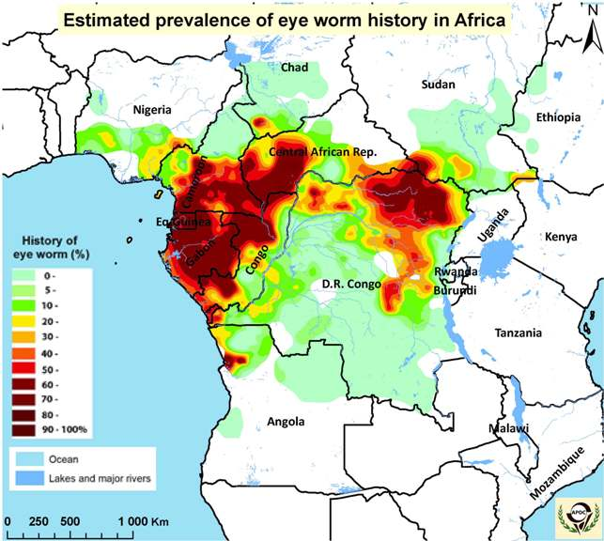
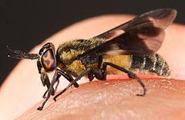
Deer fly
Scientific name: Chrysops
Organism: Loa loa (eye worm)

Slide 37
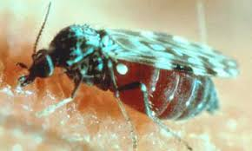
Biting midge
Culicoides
  Mansonella streptocerca
  Mansonella ozzardi
  Mansonella perstans

Slide 38
Mosquitoes

Slide 39
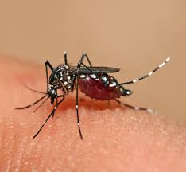
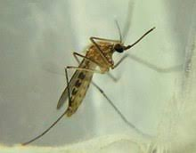
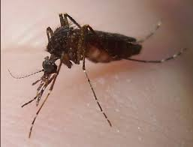
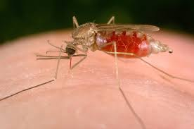
Mosquitoes
Aedes
Culex
Mansonia
Anopheles

Slide 40
Mosquito | Organism/Disease
Aedes | Viruses: Yellow fever virus Zika virus Dengue virus Chikungunya virus Rift valley fever virus Microfilariae (lymphatic filariasis) Wuchereria Brugia sp.
Anopheles | Plasmodium sp. Microfilariae (lymphatic filariasis) Wuchereria Brugia sp.
Culex | Viruses: West Nile fever virus Japanese encephalitis virus Microfilariae (lymphatic filariasis) Wuchereria
Mansonia | Microfilariae (lymphatic filariasis) Wuchereria Brugia sp.

Slide 41
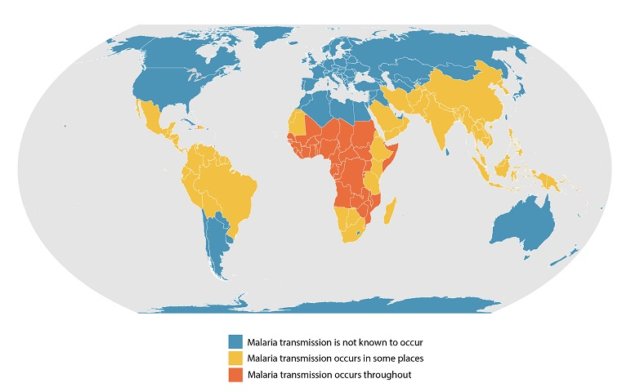
Geographic range of Anopheles

Slide 42
Geographic range of Aedes and Culex
https://www.researchgate.net/publication/327647818_History_of_ZIKV_Infections_in_India_and_Management_of_Disease_Outbreaks/download

Slide 43
Other Vectors

Slide 44
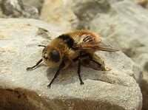
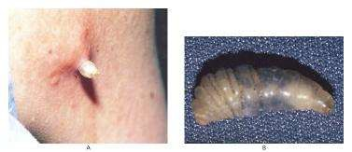
Bot fly
Bites humans
Larvae develop in subcutaneous areas
Larvae extrudes from the skin
Central and South America

Slide 45
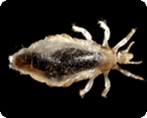
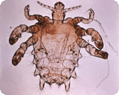
Louse
Body louse
Pediculus humanus corporis - Body louse
Bartonella quintana (trench fever),
Rickettsia prowazekii (epidemic louse-borne typhus fever)
Borrelia recurrentis (relapsing fever)
Phthirus pubis - Pubic louse/crab
Pubic louse/crab

Slide 46
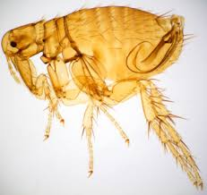
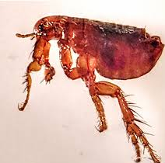
Flea
Xenopsylla cheopis
  Yersinia pestis (plague)
  Rickettsia typhi (murine typhus)

Slide 47
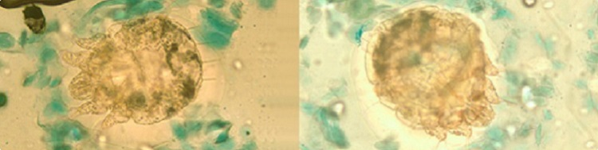
Sarcoptes scabiei
Cause scabies
Itching and skin rash
Patient must be under contact precautions
Diagnosed by skin scraping
Looks like the Millennium Falcon

Slide 48
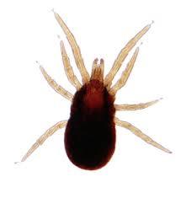
Mite
Scientific name: Liponyssoides sanguineus
“Mouse mite”
Organisms:
  Rickettsia akari (rickettsial pox)
  Rickettsia tsutsumagushi

Slide 49
Review

Slide 50
Tick | Organism/disease
Ixodes scapularis | Borrelia burgdorferi and Borrelia mayonii (Lyme disease) Anaplasma phagocytophilum (Anaplasmosis) Babesia microti (Babesiosis) Powassan virus
Ixodes pacificus | Borrelia burgdorferi and Borrelia mayonii (Lyme disease) Anaplasma phagocytophilum (Anaplasmosis)
Dermacentor variabilis | Rickettsia rickettsia (Rocky Mountain Spotted Fever; RMSF) Francisella tularensis (tularemia)
Rhipicephalus sanguineus | Rickettsia rickettsia (Rocky Mountain Spotted Fever; RMSF)
Amblyomma americanum | Ehrlichia chaffeensis and Ehrlichia ewingii (Ehrlichiosis) Heartland virus Francisella tularensis (tularemia)
Dermacentor andersoni | Rickettsia rickettsia (Rocky Mountain Spotted Fever; RMSF) Francisella tularensis (tularemia) Colorado tick fever
Ornithodorus turicata (soft tick) | Tick-borne relapsing fever: Borrelia hermsii, Borrelia parkerii, Borrelia turicatae

Slide 51
Vector | Scientific name | Organism | Disease
Tsetse Fly | Glossina | Trypanosoma brucei rhodesiense Trypanosoma brucei gambiense | African Sleeping Sickness
Kissing bug | Reduviid/Triatomine | Trypanosoma cruzi | Chagas disease
Sandfly | Phlebotomus or Lutzomyia | Leishmania | Leishmaniasis
Black fly | Simulium | Onchocerca volvulus Mansonella ozzardi | River blindness
Deer fly | Chrysops | Loa loa | Eye worm
Biting midge | Culicoides | Mansonella sp. | Varies-blood and tissue microfilariae
Louse | Pediculus humanus corporis | Bartonella quintana Rickettsia prowazekii Borrelia recurrentis | Trench fever Epidemic typhus Relapsing fever
Flea | Xenopsylla cheopsis | Yersinia pestis Rickettsia typhi | Plague Murine typhus

Slide 52
Mosquito | Organism/Disease
Aedes | Viruses: Yellow fever virus Zika virus Dengue virus Chikungunya virus Rift valley fever virus Microfilariae (lymphatic filariasis) Wuchereria Brugia sp.
Anopheles | Plasmodium sp. Microfilariae (lymphatic filariasis) Wuchereria Brugia sp.
Culex | Viruses: West Nile fever virus Japanese encephalitis virus Microfilariae (lymphatic filariasis) Wuchereria
Mansonia | Microfilariae (lymphatic filariasis) Wuchereria Brugia sp.

Slide 53

Practice questions

Slide 54
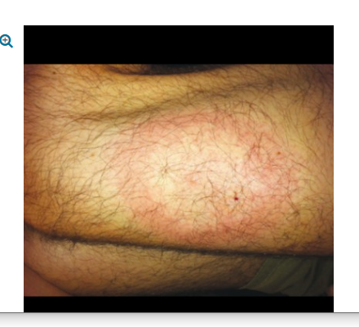
A 13-year-old boy presents to his primary care physician with joint pain, headache, and fatigue. He also has an erythematous rash on his left upper thigh that has been getting larger over the course of 3 weeks (see image). Recent travel history includes a trip to summer camp 6 weeks ago, where he went hiking, swimming, and rock climbing in the Pennsylvania woods. Which of the following is true regarding this infection?
Treatment with antibiotics does not affect the likelihood or severity of late complications.
The vector for this disease is the Ixodes tick.
The sensitivity of nucleic acid amplification techniques for the detection of the causative organism is 85-95% using synovial fluid.
IgG antibodies to this organism peak within 6-8 weeks after rash development.
Culture is the gold standard of diagnosis for this disease.
Notes:
Borrelia burgdorferi, B. garinii, and B. afzelii cause human Lyme disease, though B. burgdorferi is the major cause in the United States. Reservoir hosts for B. burgdorferi include the white-footed mouse and the white-tailed deer. These organisms are transmitted by hard ticks from the genus Ixodes. Clinical symptoms vary considerably among patients. Early localized infection, occurring after a 3-30 day incubation, appears as 1 or more erythematous, targetoid skin lesions at the site of the tick bite that expand over several weeks (erythema migrans). Hematogenous dissemination occurs in untreated patients, resulting in fatigue, headache, fever, malaise, arthritis, and myalgia, with possible cardiac dysfunction or neurologic involvement. Late complications include arthritis and acrodermatitis chronica atrophicans, a chronic skin manifestation. Diagnosis is mainly clinical, though nucleic acid amplification techniques or serology may be used for confirmation. Treatment of early disease is orally administered amoxicillin, doxycycline, or cefuroxime, though late-stage disease, cardiovascular dysfunction, or neurologic involvement may require parenteral therapy with IV ceftriaxone, cefotaxime, or penicillin G. Previously treated patients with chronic symptoms (so-called "post-Lyme disease syndrome") should not be given additional antibiotics, as there is no evidence that this improves symptoms.

Slide 55
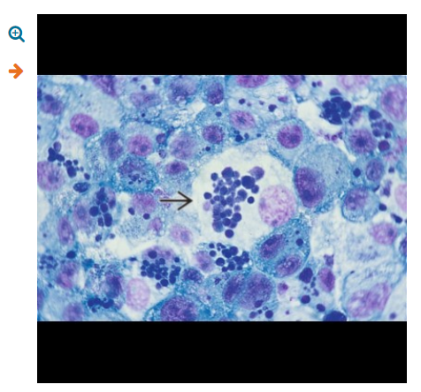
A 71-year-old bird watcher presented to the hospital with fever and myalgias. Initial laboratory work revealed platelets of 56 x 10⁹/L (reference range: 140-450 x 10⁹/L), white blood cells of 2.1 x10⁹/L (reference range: 3.4-10 x 10⁹/L) and elevated AST and ALT. Peripheral blood smear revealed organisms within a subset of the white blood cells. What is true of this infection?
Ehrlichiosis and anaplasmosis can be easily distinguished by clinical signs and symptoms.
Mortality from this infection is more than 15% without treatment.
The vector that transmits this organism is the same as the one that transmits Lyme disease.
The subset of white blood cells affected in this case are diagnostic of Anaplasma phagocytophilum.
The specificity of serologic testing for this organism is compromised by cross-reaction with other intracellular pathogens.

Slide 56
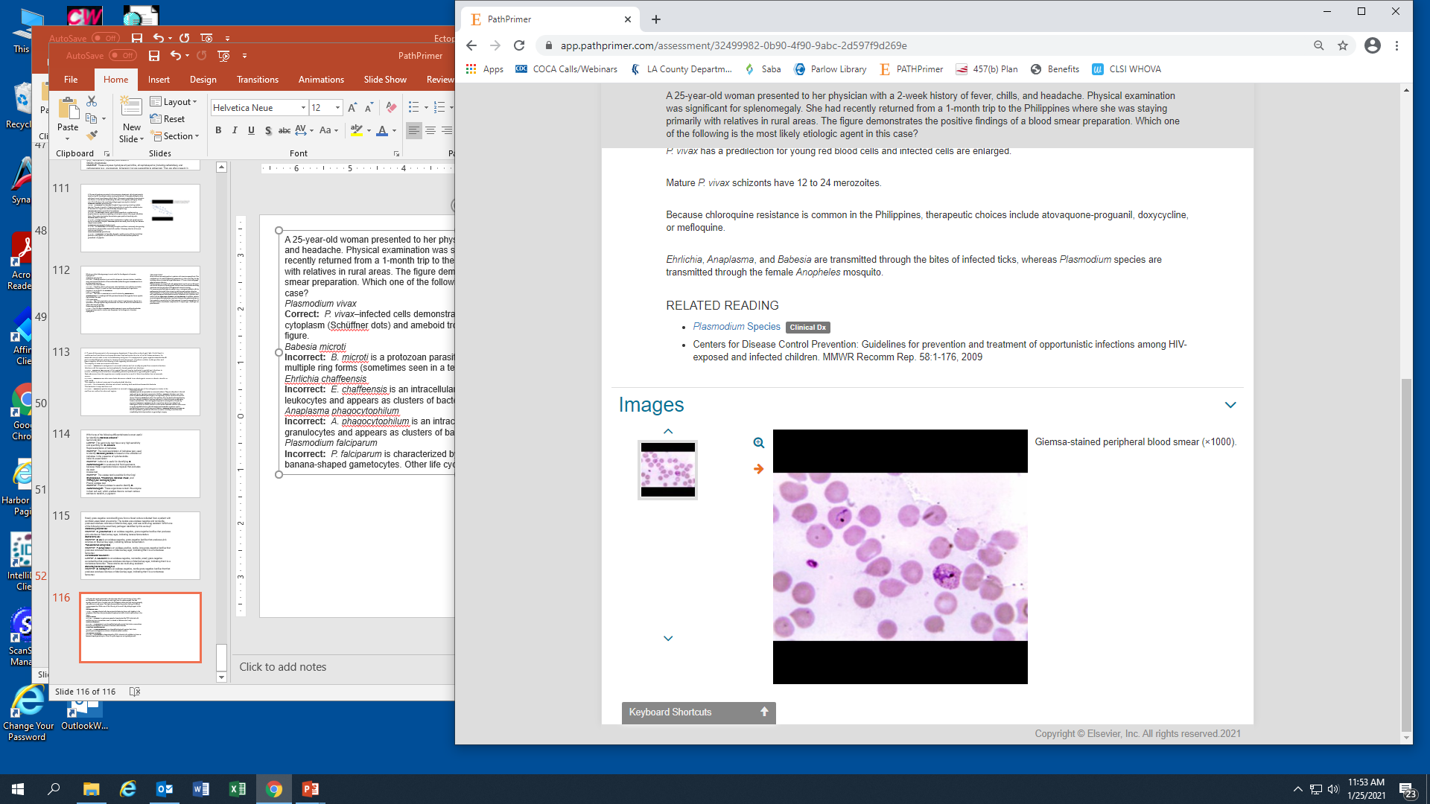
A 25-year-old woman presented to her physician with a 2-week history of fever, chills, and headache. Physical examination was significant for splenomegaly. She had recently returned from a 1-month trip to the Philippines where she was staying primarily with relatives in rural areas. The figure demonstrates the positive findings of a blood smear preparation. Which one of the following is the most likely etiologic agent in this case?
Plasmodium vivax
Babesia microti
Ehrlichia chaffeensis
Anaplasma phagocytophilum
Plasmodium falciparum

Slide 57
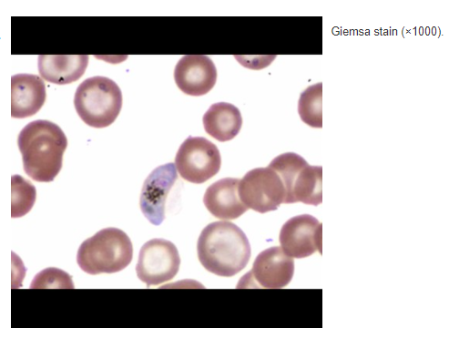
Which one of the following is the insect vector responsible for transmitting the organism seen in the figure?
Tsetse fly
Reduviid bug
Black fly
Ixodes scapularis
Anopheline mosquito

Slide 58
In June 2001, a girl aged 5 years was taken to an ED in Missouri with a 3-day history of
intermittent fever, headache, mild nausea, and a sore throat. On physical examination, the
patient had a fever of 105°F (40.6°C) and a maculopapular rash on her legs, including the soles
of her feet. The parents report that the patient may have had tick exposure. What is the best method of diagnosis for the suspected pathogen?
PCR on whole blood
Serology by IFA
Blood smear for spirochetes
Blood culture

