Slide 1
Blood Bank Specimen Collection

Slide 2
Learning Objectives
Identify the most common errors that can occur during the collection of pretransfusion specimens.
Describe the additional precautions required for pretransfusion specimen collection.
Describe the Zero Tolerance Policy of patient identification.
Discriminate between positive patient identification and passive identification.
Explain why blood is tested for typing and compatibility.
Correctly label pretransfusion specimens.

Slide 3
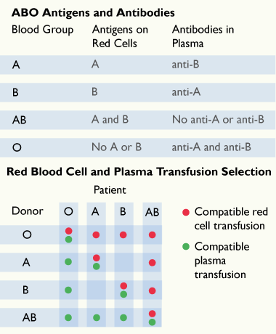
ABO
Blood is grouped by the identification of antigens present on the cell membrane of red blood cells.
There are many blood group systems to consider when typing blood. However, the most important group in transfusion medicine is the ABO blood group. The table at left illustrates the antigens present in the four ABO blood types and the possible transfusion selections for red blood cells.
When transfusing whole blood (red cells and plasma), the recipient must receive group-specific blood (e.g. type A recipient can only receive type A whole blood).
When transfusing red blood cells only, the donor red cells must lack the antigens to which the recipient has the antibody (e.g. type A patient can receive type A or type O red cells).
When transfusing plasma, the donor plasma must lack the antibodies against the patient's red cell antigens (e.g. type A patient can receive type A or AB plasma).

Slide 4
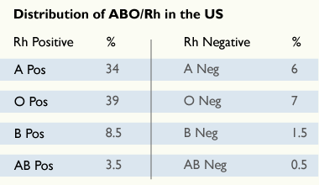
Rh
The Rh blood group system is the second most important blood group, especially for women of child bearing years. There are two Rh types, Rh Positive and Rh negative.
The table indicates the incidence of the two Rh types.

Slide 5
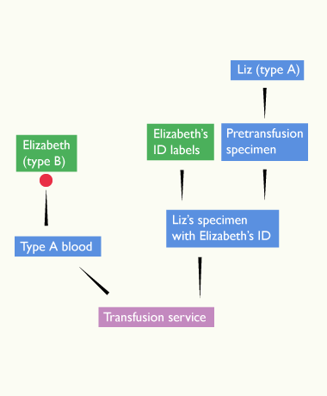
Error Scenario
Imagine that you were requested to draw a pretransfusion specimen from Elizabeth Smith. Elizabeth has type B blood. However, you drew a specimen from Liz Smith, who has type A blood.
You affix Elizabeth's labels to Liz's specimen.
The Transfusion Service will crossmatch and issue type A blood for Elizabeth with type B blood resulting in a hemolytic transfusion reaction for Elizabeth.
This error might be caught in Transfusion Service if Elizabeth has had previous blood transfusions and a lab record exists for her. However, if this is a first-time blood transfusion, she will not have a lab record and this mistake will lead to a severe reaction and possibly death.
It is far better to perform positive patient identification at every step of pretransfusion specimen collection.

Slide 6
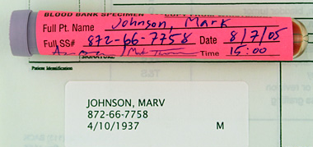
Zero Tolerance
A Zero Tolerance Policy for patient identification at the recommendation of the American Association of Blood Banks (AABB).
Zero tolerance means that blood specimens are not accepted by Transfusion Service unless all labels and paperwork attached to the specimen are complete, legible and without discrepancies.
If any discrepancies are present, the Transfusion Service will require the collection of another pretransfusion specimen, possibly delaying the transfusion.
Ideally, national acceptance of this standard of Zero Tolerance will help to reduce the number of transfusion reactions each year.
This specimen will be rejected because first names do not match.

Slide 7
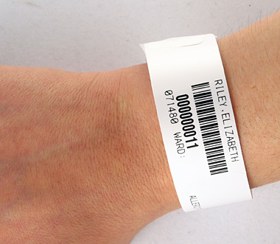
Identifying the Patient Overview
As any health care worker who has collected numerous specimens during a busy shift will testify, ensuring accuracy at every step of pretransfusion specimen collection requires concentration and a deliberate focus on safety.
For example, in one national study, it was found that in 8% of cases of transfusion reaction, discrepancies existed between patient ID, lab orders and specimen label information.
Blood collectors must be alert to detect and resolve any ID errors and inconsistencies before pretransfusion specimens are drawn. Standard operating procedures (SOP) regarding positive identification and labeling must be followed.
Never think that an emergency situation makes it acceptable to take shortcuts or to assume identity of a patient. Always take the time to correctly identify each patient.

Slide 8
Positive Patient ID
When identifying patients, always use positive, active communication. That is, the patient must actively and positively state their name and secondary identifier. For example:
Do not ask, "Are you Jim Smith?"
Instead ask, "Please state your full name spelling and date of birth." This forces the patient to state their name and secondary identifier instead of passively affirming incorrect ID.
Then match the patient's stated name and unique secondary identifier to the lab order and preprinted labels exactly before drawing the specimen.
Never assume a patient's ID, even when you know the patient.

Slide 9
Specimen Collection
Specimens are not to be drawn above an IV unless it has been paused for at least 2 minutes.
Port draws require a waste tube to be collected and discarded in sufficient volume to avoid contamination or dilution of the sample tube(s) being collected.
ALL specimens are to be completely, accurately, and legibly labeled before leaving the patient's bedside.
Once a specimen leaves the patient's side, labeling cannot be completed or corrected; a new specimen must be collected. This includes errors or omissions of BBID, date, time, and/or collector's initials or Meditech ID.

Slide 10
Unconscious Patients
Unconscious or incoherent Inpatients
If an unconscious patient is an inpatient, use their ID wristband to actively confirm their information with a nurse.
Do not proceed if the wristband is not attached to the patient's wrist or ankle. Wait to draw the patient specimen until a new wristband is attached.
ER patients ER patients must have a hospital ID band. If the patient's ID is unknown, a temporary (John or Jane Doe) band with hospital ID number (V#) should be affixed. Accounts will be merged once the patient is permanently identified.

Slide 11
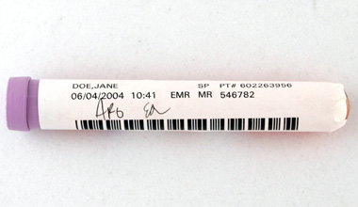
Labeling Tubes
The AABB requires that pretransfusion specimens have labels:
Permanently affixed to the specimen
Affixed before leaving the patient's bedside, as close to the point of collection as possible
Legibly labeled with:
Patient’s full name
Secondary identifier
Date and time of collection
Blood collector’s code or initials
Tubes that sit on a lab order for labeling later can roll or get mixed up with other unlabeled tubes.
Never set down a tube and go to the next patient without labeling the tube.
If pretransfusion specimen tube labels do not include complete, legible information, or if labels are loose or on top of another, Transfusion Service will discard the tube and request a new specimen.

Slide 12
Potential Errors
The following are examples of errors that can occur in the specimen collection process:
Assuming the patient identity
Incomplete or partial patient identification
Identification of patient from wristband taped on bed or wall
Misidentification of an ER patient without a wristband
Fail to catch and resolve ID info, such as conflicting secondary identifier
Label specimen incorrectly
Prelabel tube before actual draw
Use the patient room number for patient identification
Fail to label tubes in the presence of the patient
Delay specimen transport unnecessarily
Contamination of specimen with IV fluid
Collect specimen in the wrong tube
Collect specimen too early or too late

Slide 13
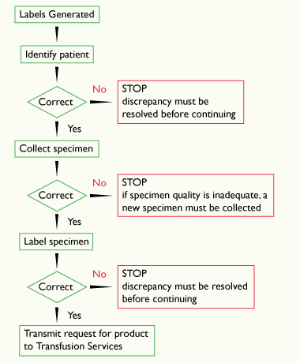
Summary
Transfusion therapy is a set of processes, not just an end product. Blood collectors must be aware of the process so that errors, omissions, and discrepancies can be noticed and resolved before blood collection.
Pretransfusion specimen collection occurs early in the transfusion process. It is one of the most important times to enforce Zero Tolerance Policy for errors to ensure a safe transfusion later.
Remember, patient safety during blood sampling, testing, and administration relies upon each person involved in the process to ensure accurate patient identification.

