Slide 1
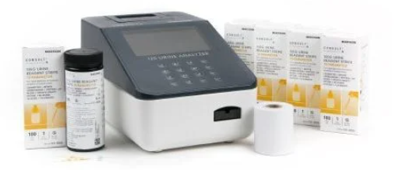
Urinalysis using mckesson 120 analyzer

Slide 2
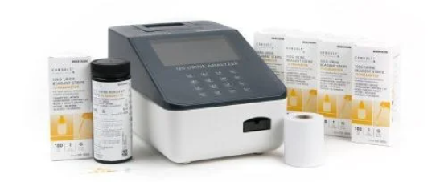
Overview* *NOT INTENDED TO REPLACE THE MANUFACTURER INSTRUCTIONS.
STORAGE AND STABILITY
SPECIMEN COLLECTION AND PREPARATION
MATERIALS
DIRECTIONS FOR USE
REPORTING

Slide 3
Materials required for automated testing
Strips Package insert Specimen collection container
McKesson120 analyzer

Slide 4
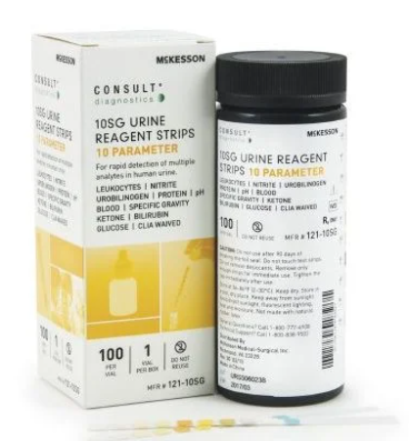
STORAGE AND HANDLING
Store at room temperature or refrigerated (2-30°C or 36-86°F). Keep out of direct sunlight.
Remove only enough strips for immediate use. Replace cap immediately Open Strip Canisters are stable for up to 3 months.

Slide 5
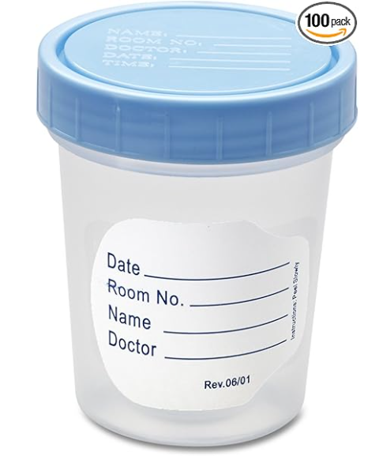
SPECIMEN COLLECTION AND PREPARATION
A urine specimen must be collected in a clean and dry container.
Label with the date, time, patient name and a 2nd identifier such as date of birth or medical record number. If testing cannot be done within an hour after collection, refrigerate the specimen immediately and let it return to room temperature before testing.

Slide 6
Quality control
The Normal and Abnormal controls must be run each time a new canister is opened and every 30 days after opening.
Compare the results with the ranges provided in the package insert.
If the values are out of range, clean the tray and repeat testing.
Check the expiration date of the strips and controls before repeating the test.
Open new strips or controls if quality control continues to fail.

Slide 7

DIRECTIONS FOR USE
Allow the strip, urine specimen, and/or controls to reach room temperature (15-30ºC) prior to testing.
Remove the strip from the closed canister and use it as soon as possible. Immediately close the canister tightly after removing the required number of strip(s). Completely immerse the reagent areas of the strip in fresh, well-mixed urine and immediately remove the strip to avoid dissolving the reagents.
While removing the strip from the urine, run the edge of the strip against the rim of the urine container to remove excess urine. Hold the strip in a horizontal position and bring the edge of the strip into contact with an absorbent material (e.g. a paper towel) to avoid mixing chemicals from adjacent reagent areas and/or soiling hands with urine.

Slide 8
DIRECTIONS FOR USE
4. Place the strip on the McKesson reader in the tray or manually read the results.
5. Record type of specimen, date and time of collection, color, clarity and chemical results in the patient’s medical record and retain any printouts or worksheets for two years.

Slide 9
TERMINOLOGY USED IN REPORTING RESULTS

Slide 10
Type of Specimen
Voided (non-clean catch)
Clean Catch midstream
Catheterized

Slide 11
COLOR
Straw
Blue
Yellow
Green
Amber
Orange
Bloody
Black
Brown

Slide 12
CLARITY
Clear Hazy Cloudy
Turbid Opaque

Slide 13
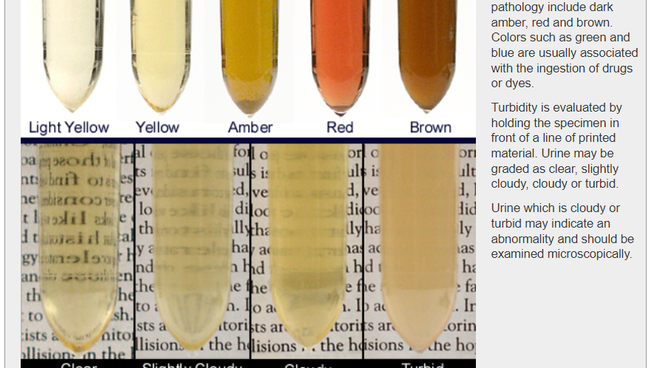

Slide 14
Specific Gravity
Report to the third decimal place, e.g., "l.020."

Slide 15

Thank you
Julie Aragon
505-916-6052
arajul322@gmail.com

