Slide 1
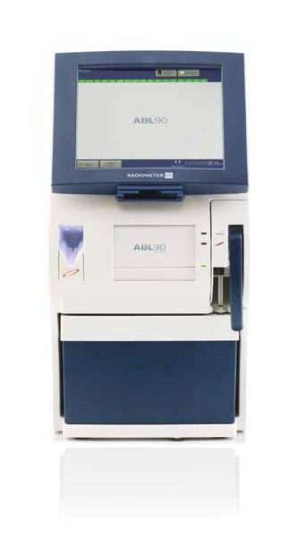
POCT: Radiometer ABL90 FLEX

Slide 2
Objectives
After completion of this course the learner will be able :
Identify the ABL90 FLEX components and their functions
Demonstrate how to replace a sensor cassette and solution pack
Demonstrate how to check internal QC and Calibrations and troubleshoot errors
Demonstrate how to run External Ampoule based QC
Demonstrate how to run a patient
Demonstrate routine maintenance procedures
Verbalize how to troubleshoot analyzer errors

Slide 3
Important Notes
A provider order is required PRIOR to performing any POCT testing.
Sample: Safe PICO syringe
Only approved Respiratory Therapy Personnel may operate the instrument.

Slide 4
ABL90 FLEX Overview
Printer and handle
Color touch screen
Integrated barcode reader
Self-cleaning inlet aspirates the sample in 5 seconds
Sensor cassette compartment behind the door
Solution pack with waste pouch, reagents and QC. The QC is built-in and automatic for accuracy and full regulatory compliance.
Fully operational on battery and optional rolling stand for added flexibility

Slide 5
ABL90 FLEX Rear Panel
Standby button
Latch for manual release of
the solution pack
Main power switch

Slide 6
ABL90 FLEX Consumables
Two consumables
  Sensor Cassette (SC)
  Solution Pack (SP)
Storage of Consumables
  Sensor Cassette (SC) : Refrigerate at 2 - 8◦ C
  Solution Pack(SP) : 2 - 25◦ C
  Stability: 30 days on board

Slide 7
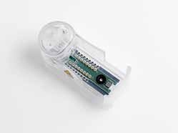
Sensor Cassette
Sensor Cassette (SC)
Reference sensor. Do not shake the sensor cassette! There is no need to mix the solution in the reference sensor.
Smart chip containing various information, no further scanning of product barcodes necessary
Board with sensors. Hemoglobin and bilirubin are measured by the oximetry module built into the analyzer.

Slide 8

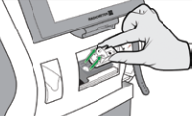
Changing Sensor Cassette (SC)
Enter Analyzer Status
  Consumables
  Replace
  Replace sensor cassette
Starting the video will open door to Sensor compartment
Remove cassette, press Action Completed.
NOTE: The analyzer needs to condition a new SC after it is installed. This process can take up to 4 hours.

Slide 9
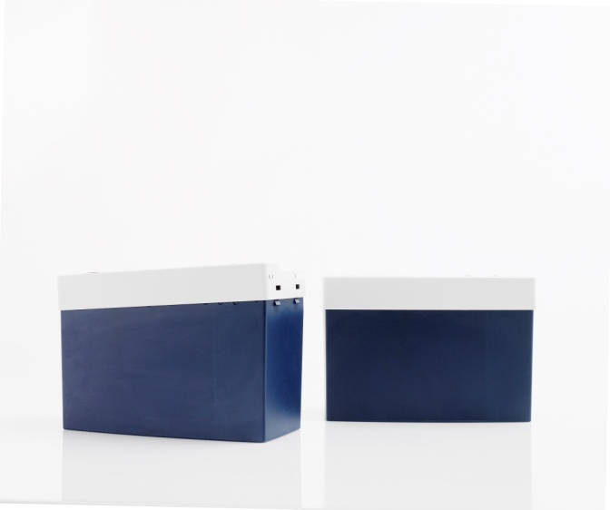
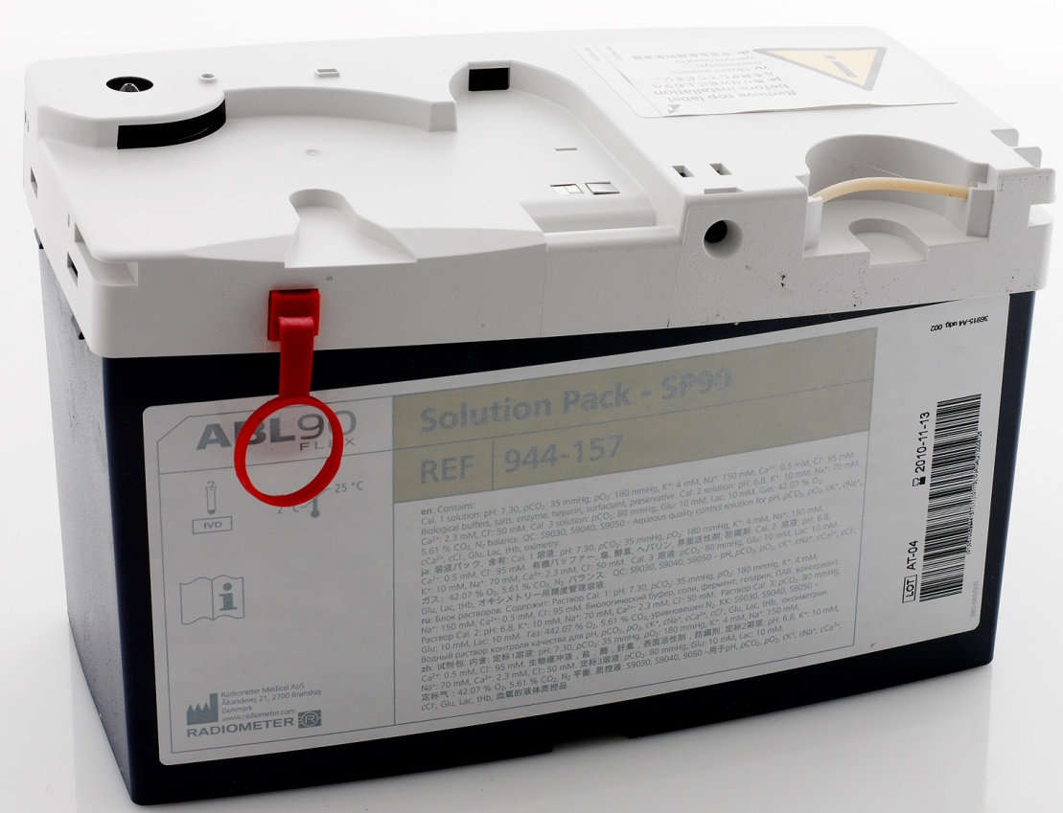
ABL90 FLEX Solution Pack
Memory chip
The chip stores lot number, expiration date, solutions calibration and QC data.
The analyzer writes the usage status and time onboard to the chip
If the SP is placed on another analyzer, all information is read from the chip.
The analyzer detects if the internal foil strip registers a current (occurs if solution has leaked).
New, unused solution pack
Solution pack ready for analyzer
Flow selector
The red plastic strip prevents the connection pins from opening the pouches.
The label contains all relevant SP information
Contains pouches with QC and calibration material, a gas mixture and closed containers to hold liquid waste

Slide 10
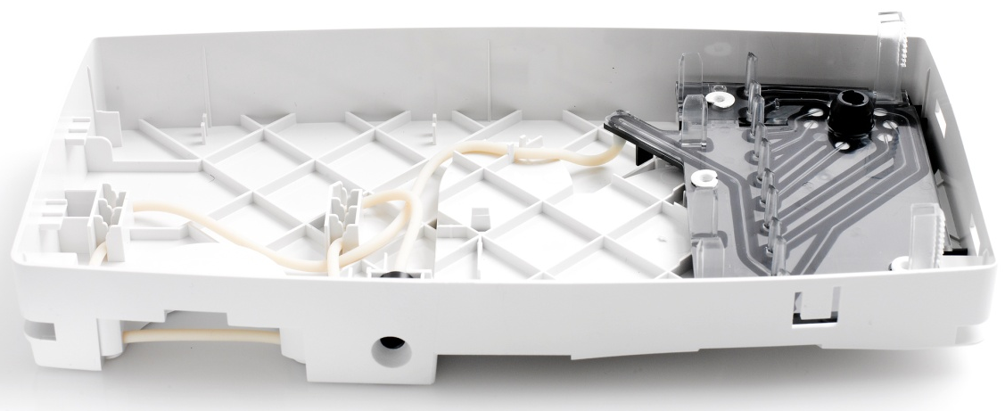
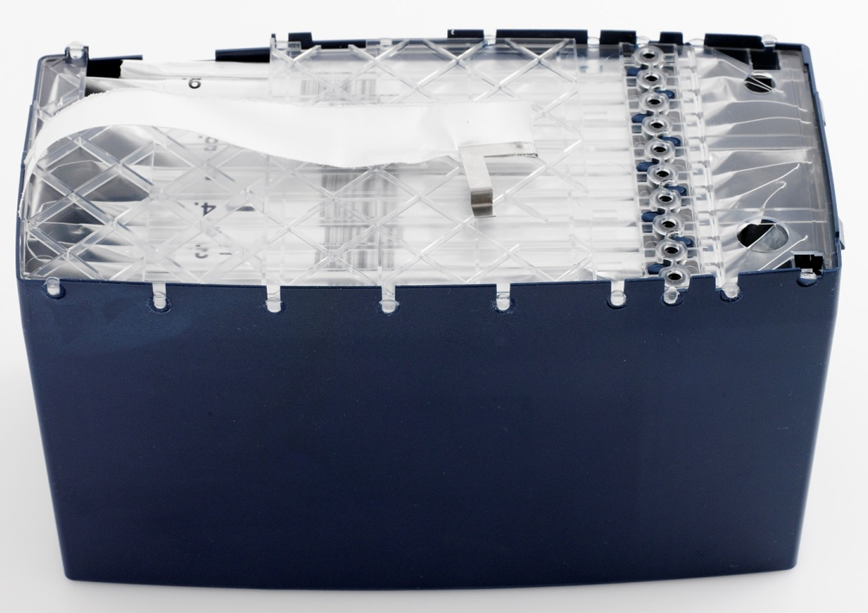
Inside of ABL90 FLEX Solution Pack
Flow selector controlled by analyzer
Barcodes on every solution pouch
Foil strip detects a current if solution leaks from pouch
BACK
Pump tubing
Connection tubes have different lengths and penetrate at different times to make it a lighter “press” when connecting the tubes
Connection to waste
Connection tubes press down into pouch
FRONT

Slide 11
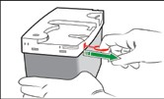
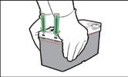
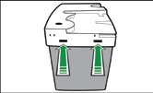
Activating New Solution Pack
Pull red pin out of the new solution pack
Place palms of hands over the edges of the lid as shown
Both tabs must click into place foe the solution pack to be activated correctly

Slide 12
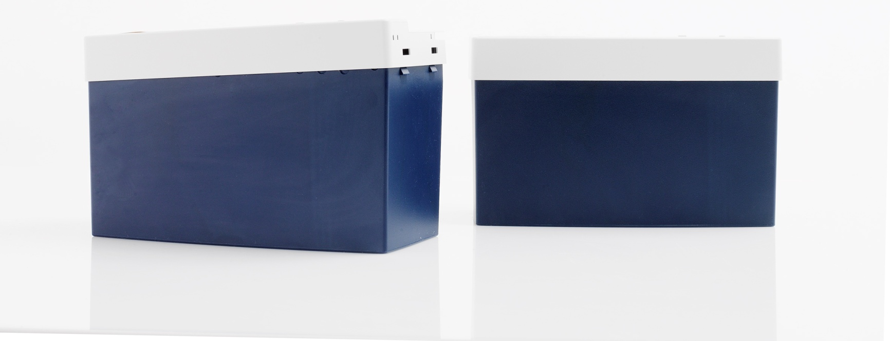
ABL90 FLEX Solution Pack
Before inserting the solution pack the airtight foil pouches must be opened and connected with the flow selector in the top
When the top is pressed down and completely horizontal the solution pack fits to the analyzer
Unused solution pack
Solution pack ready for analyzer

Slide 13
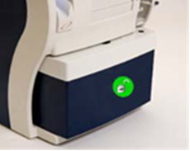
Changing The Solution Pack
Enter Analyzer Status
  Consumables
  Replace
  Replace Solution Pack
  Lift inlet to capillary position and wait for the solution pack to unlock
  Remove used solution pack
  Insert new activated solution pack by pushing in firmly until a click is heard
  When prompted by analyzer, close the inlet.

Slide 14
Analyzer Main Screen
Sensor cassette icon shows 9893 test remaining
Solution pack icon shows 24 tests remaining
Data Logs contain Patient Results, Calibrations, QC and replacements
Analyzer Status-the color of the traffic light on the button shows the overall status of the analyzer.

Slide 15
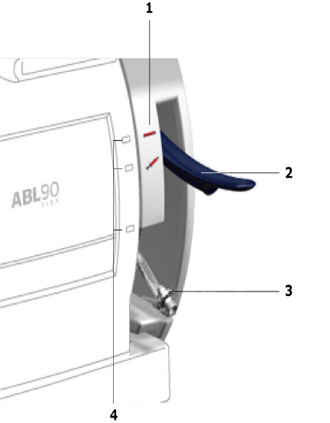
Analyzer Status
Check the top left corner of the screen to ensure READY mode
The analyzer will always tell you what it is doing
  Calibration
  QC Measurement
Green light at the sample port-Ready
Yellow light – Caution
Red light- Not operational

Slide 16
Analyzer status elements
The Analyzer Status button (traffic light) when clicked will open up to this screen so you can access detailed information.
  Recommended Actions
  Calibrations
  Quality Control
  Consumables
  Other Activities
  System Messages

Slide 17
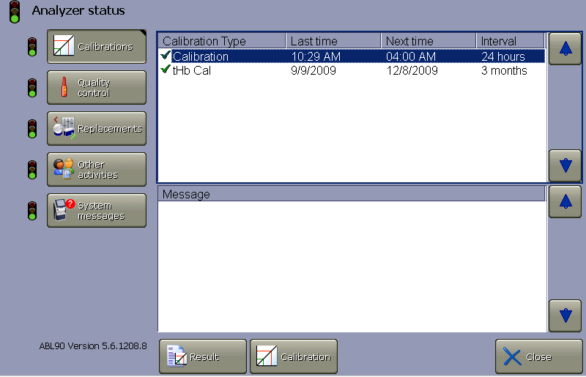
Calibrations
The green check (√) means the calibration was accepted
A red question mark (?) means there were errors during calibration
A clock means there are pending or overdue calibrations
To start a calibration highlight calibration type and then press Calibration
To view calibration results press Result

Slide 18
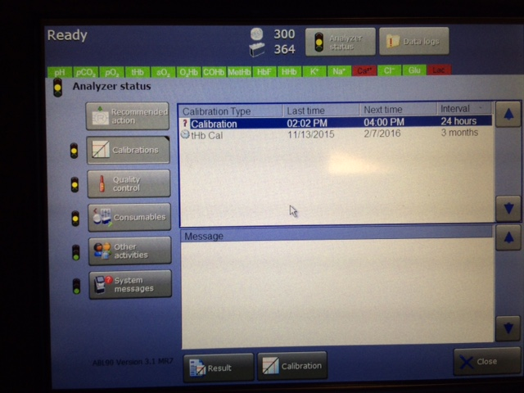
Calibrations with Errors
Notice the yellow traffic light
When the traffic light is clicked it opens this screen. You can see there is a problem with a calibration, QC and consumables.
tHb is overdue and the red question mark means there was an error during calibration
Click Result tab to see next screen

Slide 19
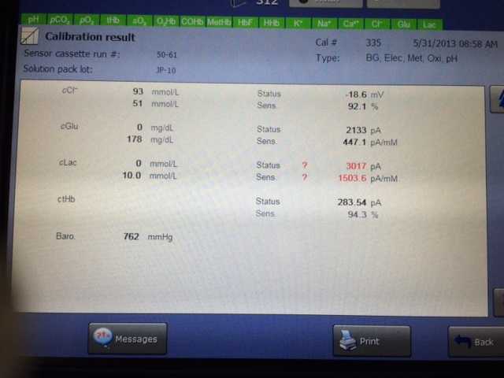
Troubleshooting Calibration Errors
The calibration results are shown here. In this example lactate shows an error.
For more information press Messages

Slide 20
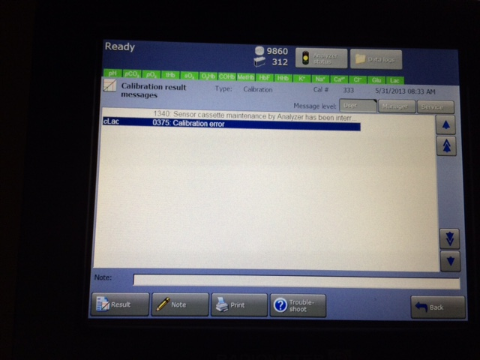
Troubleshooting Calibration Errors
This is the message shown for lactate.
Press Troubleshoot for more information

Slide 21
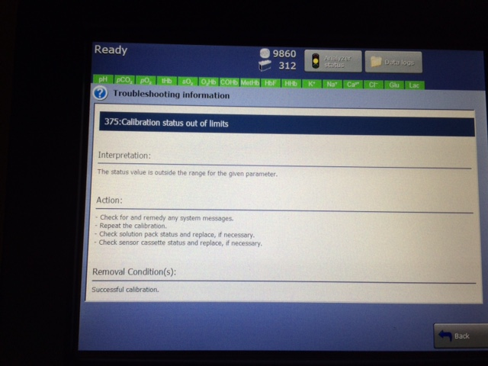
Troubleshooting Calibration Errors
The troubleshooting guide will give you an interpretation of the error and actions to take to correct the problem.

Slide 22
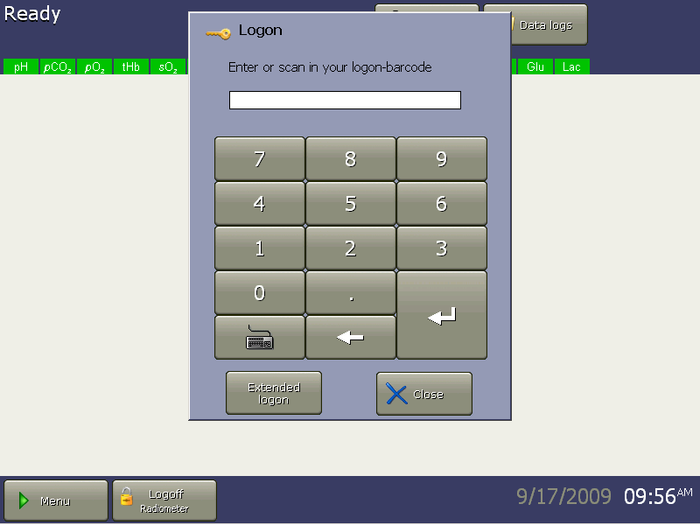
Logging On
Log on using your BARCODE ID. Sharing operator’s code is against the VA Rules of Behavior!

Slide 23
QC
Built-in QC is run every 8 hours (one of each level)
External QC is run after any major system maintenance including sensor and/or solution cartridges, after software upgrades and at least every 30 days.
Room temperature QC ampoules are shaken vigorously for 15 seconds and tapped so that all solution collects at bottom.
Use ampoule opener to break off ampoule neck.
Place in Qualicheck adapter, lift inlet to syringe position and select Ampoule-QC.
Place adapter tip against inlet gasket with “R” facing up
When prompted by analyzer, remove adapter and close inlet

Slide 24
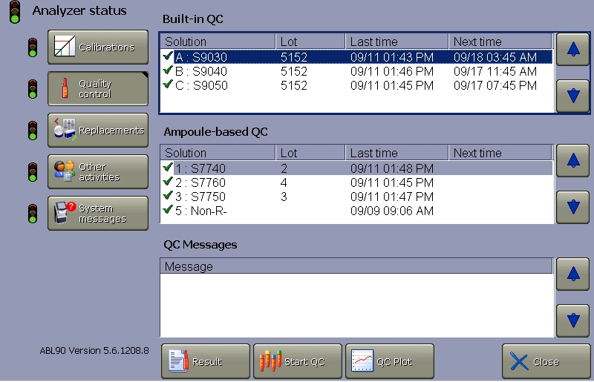
QC Status
The status for the both the built-in QC and the Ampoule-based QC is shown
A green check (√) means the last measurement was accepted
A red question (?) mark means there was an error in the last calibration or an analyzer error during the QC measurement
To repeat a built-in QC highlight the level to be run and then press Start QC

Slide 25
Running Patient Samples
Sample: Arterial, Venous or Mixed Venous specimen collected using a Safe PICO syringe
Labeling Requirements: Full Name & Full SSN ( Lab Policy 113-2)
Specimen Stability: 30 minutes after collection @ RT
Specimen Rejection: Clotted, Unlabeled or mislabeled, Large amount of bubbles, Insufficient specimen.

Slide 26
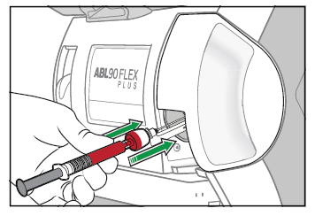
Sample Processing-Syringe mode
Lift the inlet to the syringe position until the green light appears
Align syringe with inlet gasket
Push the syringe onto the inlet applying pressure to depress the inlet gasket
Hold syringe in place while sample is automatically aspirated
Remove syringe from inlet when prompted

Slide 27
Running a patient -continued
When prompted by analyzer, remove syringe and close inlet.
Enter information on Patient Identification screen using the barcode reader.

Slide 28
Patient Results

Slide 29
Patient Results
No marking next to a parameter indicates that it was measured without any fault.
“?”- Indicates an error in last QC run or calibration, or sample problems
Single arrows( ) indicate a result outside reference or normal range
Double arrows ( ) indicate a result outside critical limit.(CAV result)
Triple arrows ( )indicate a result is outside reportable range

Slide 30
Reporting Results
Report all results in Vista
Turn around time: STAT & Critical = 30 minutes
Mandatory Critical Values Documentation:
Test Name
Provider’s name
Date & Time of call
Your initials
VRB-Read Back comment

Slide 31
Maintenance
Daily:
  Clean and Disinfect touch screen and analyzer exterior
Weekly:
  Clean the Inlet Gasket

Slide 32
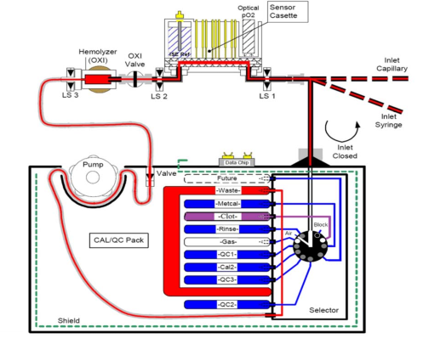
Troubleshooting ABL 90 FELX for Clots
Fluidic Path – Inlet to Solution Pack

Slide 33
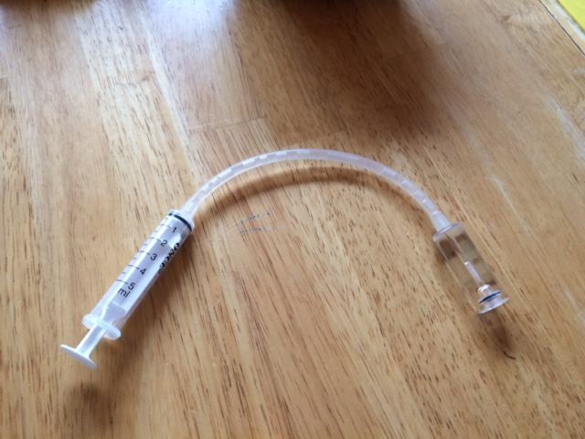
Troubleshooting ABL 90 FLEX
Flush Device for Clots
A flush device will be provided with each analyzer
ABL90 Flush Device

Slide 34
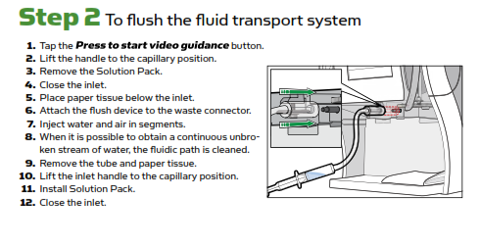
Troubleshooting ABL 90
Fluidic Path – Inlet to Solution Pack

Slide 35
Troubleshooting ABL 90 FLEX
If you are unable to resolve an instrument error, please contact Technical Service Hotline at
1-800-800-7005

