Slide 1
ALERE hCG Combo Cassette
Training

Slide 2
Ancillary Testing Coordinators North Florida South Georgia Veterans Health System
Sandra Pascual
Dolly A. Gonzalez
Diana Martir
Only the ATCs can administer initial, and annual training for Urine Pregnancy Test

Slide 3
Principle:
Alere hCG urine pregnancy test is designed for the qualitative detection of human chorionic gonadotropin (hCG) in urine at the sensitivity level of 25 miU/mL for early detection of pregnancy.
Human chorionic gonadotropin (hCG) is a glycoprotein hormone produced by the developing placenta shortly after fertilization. In normal pregnancy, hCG can be detected as early as 7 – 10 days after conception. hCG levels continue to rise very rapidly, frequently exceeding 100 mIU/mL by the first missed menstrual period and peaking in the 100,000-200,000 mIU/mL range about 10-12 weeks into pregnancy. The detection of hCG is an excellent marker for the early detection of pregnancy.

Slide 4
POC UPT CPRS ORDER REQUIRED! (See POC Ordering Memo Dated 4/9/2024)
A CPRS written Nursing Order, signed by an authorized provider, must be in place prior to perform UPT POC patient testing.
Confirm in CPRS prior testing.
Verbal orders for POC UPT are not acceptable.
Correct Order:
Incorrect point of care UPT order (This is a lab
Order only)

Slide 5
Specimen Collection
Specimen cup must be labeled with full name and full social of the patient.
Best sample: First urine morning specimen. This sample has the highest concentration of hCG.
Any urine sample collected may be used.
Collect urine in clean, dry plastic container without preservatives.
Urine samples with visible precipitates should be centrifuged or allowed to settle to obtain a clear sample.

Slide 6
Specimen Collection
Sample is stable for up to 2 hours room temp and up to 48 hours refrigerated (2-8℃)
Specimens should be at room temperature prior to testing

Slide 7
Materials needed (Test cartridges & controls supplied by Logistics)
Alere hCG Combo cassette
Pipettes provided with the kit
(Do not use any other pipettes!!!)
Stanbio Controls (Positive & Negative)
Timer
Thermometer or CheckPoint sensor
Urine Pregnancy Worksheet

Slide 8
Quality Control
Internal Controls:
A red line must appear in the control region C and background should appear white to light pink and not interfere with the reading of the test to be valid
This confirms sufficient sample volume and correct procedural technique.

Slide 9
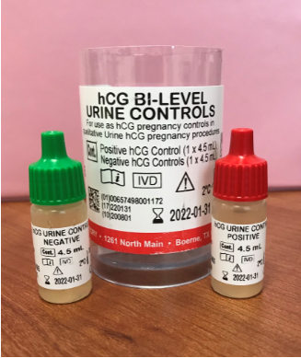
Quality Control
External Controls
StanbiohCG Bi-Level . Negative and Positive control
Controls are stored at room temperature
Controls are tested:
At a minimum monthly, every 30 days.
(On the day 10th of each month, +/- 3 days, that is between the day 7th thru the 13th of each month)
When opening a new box of cartridges
Control Results MUST be reported in WRX
QC is due the day 10
of each month, +/-
3 days.

Slide 10
Quality Control
External Controls
StanbiohCG Bi-Level . Negative and Positive control
The controls expire 90 days after opening, or upon manufacturer expiration date, whichever comes first.
Control bottle needs to be labeled with the new expiration date of 90 days.
90 days is not the same as 3 months!!!!
Expire 90 days after opening

Slide 11
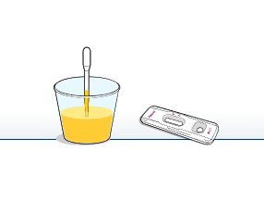
Testing Procedure
Label urine cup with full name and full social of the patient
Remove the test cassette from the sealed pouch when ready for testing.
Label device with full name and full social of the patient
Squeeze and release the Pipette to aspirate patient sample from the cup.

Slide 12
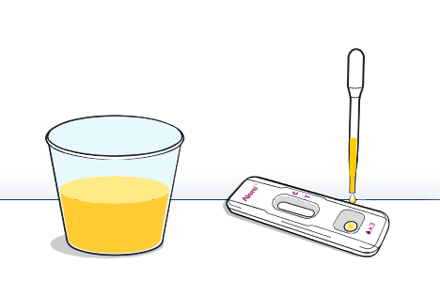
Testing Procedure
Transfer 3 drops of urine with the pipette provided with the kit.
Dispense 3 drops of urine to sample well of cartridge. Pipette needs to be vertical while doing this to ensure the correct amount is applied.

Slide 13
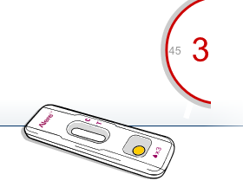
Testing Procedure
Set timer and read the results at 3 minutes

Slide 14
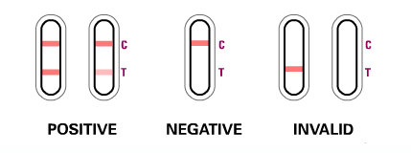
Interpretation of Results
After 3 minutes interpret the results as below
It is important that the background is clear before the result is read.
Do not interpret results after 3 minutes.

Slide 15
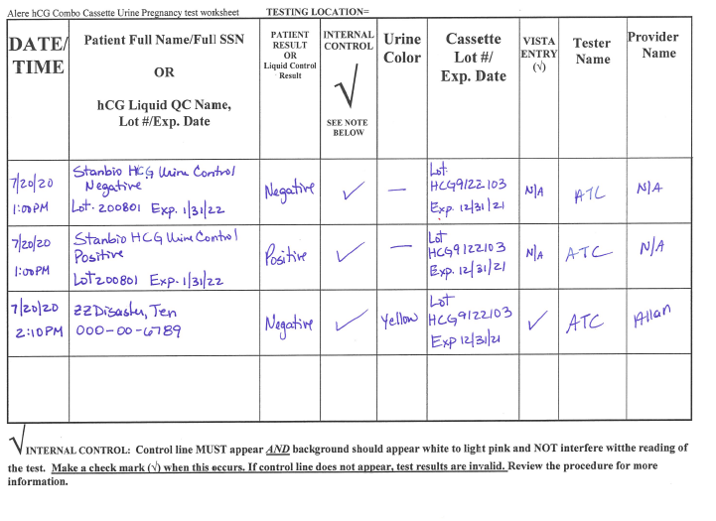
Documenting Results
Document all the required information in the Urine Pregnancy Worksheet, following the header’s guidelines.

Slide 16
Documenting Results
Date and Time of testing of controls is required.
Date and time of patient’s sample collection is required.
All columns must include the required information.

Slide 17
Documenting Results
When reporting in WRX you will always enter the collection date and time documented in the worksheet.
Always write the full name and full social of the patient

Slide 18
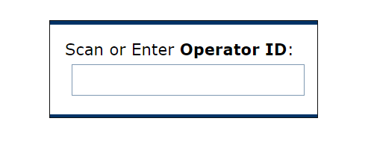
Reporting of Results (Controls & Patients)
To report, the user must have access to WRX:
Vhanflccawrx/rex/Login.aspx

Slide 19
Reporting Results WRX
Access WRX webpage from any computer with internet access. Vhanflccawrx/rex/Login.aspx
Type the Operator ID on the log-in screen (Operator ID=DUZ number)
View any messages after logging in and then click “Continue”.
Select option: 1-Patient Test or 2-Control Test
Type the patient’s Full SSN as the ID, ensuring the entered ID matches the ID documented on the worksheet and press “ENTER”.
Verify the patient’s ID for accuracy and select the Continue button
Select option 1-Ancillary Urine HCG
Select the performing location.

Slide 20
Reporting Results WRX
Use the calendar icon to select the urine’s collection date and time (Do not use the Current Date-Time option). The date and time should reflect the test date and time on the patient worksheet.
Type the patient ID (full SSN) again to confirm and click Enter.
Type the Cassette Lot Number and click enter.
Type the Cassette Expiration Date and click enter.
Select the Urine Color.
Select the Internal Control interpretation. (The internal control must be present for the test to be valid). If the Internal Control is Not Present, the test must be repeated with a new test cassette.
Select the Urine Pregnancy patient result.
Review the information and the result for acceptability. If the result and test information are correct, select the Accept button. If any incorrect information is identified go back by selecting the menus. Do not use internet back arrow.
Results should be successfully queued to the POC data management system and transferred to the LIS.
Click New Test, if subsequent results need to be entered, and follow steps a-q above.

Slide 21
Reporting Results in WRX
IF YOU HAVE ACCEPTED AN INCORRECT RESULT IN ERROR, YOU MUST CALL OR EMAIL THE ATC OFFICE TO MAKE A CORRECTED REPORT IMMEDIATELY.

Slide 22
Results Interpretation
The test has a sensitivity of 25 mIU/mL, and is capable of detecting pregnancy as early as 1 day after the first missed menses.
Negative results are expected in healthy non-pregnant women and healthy men. Healthy pregnant women have hCG present in their urine and plasma samples. The amount of hCG will vary greatly with gestational age and between individuals.

Slide 23
Procedure Notes
Do not use kit beyond expiration date imprinted on the outside of the kit carton and the individual sealed pouch.
Gloves must be worn during testing events, hand hygiene performed, and gloves changed between patients, according to Standard Precautions. Hands must be cleaned using an effective antimicrobial method.
Dispose all used cassettes and testing supplies in a proper biohazard container.
Discard cassette if pouch is found ripped or torn open or if cassette is damaged.
Urines tested at point-of-care in ancillary testing sites are not routinely stored for 24 hours. They are discarded after testing. Any follow-up tests necessary will require a new urine sample collection or a blood draw and send a blood test for hCG to the lab.

Slide 24
Limitations
Very dilute urine specimens may not contain representative levels of hCG
This test provides a presumptive diagnosis for pregnancy. A confirmed pregnancy diagnosis should only be made by a physician after all clinical and laboratory findings have been evaluated.
Other limitations are mentioned in the procedure manual

Slide 25
Procedure Manual
The procedure is in the UPT Procedure Manual binder and in the Pathology & Laboratory Medicine
SharePoint

Slide 26
Important!!!!! Email Monthly Worksheets to ATC promptly
The last day of each month, no later than the 5th day of the next month, email the worksheets with QC and patient documentation to the Ancillary Testing Coordinators
Send an encrypted email to
VHANFLATC@va.gov

