Slide 1
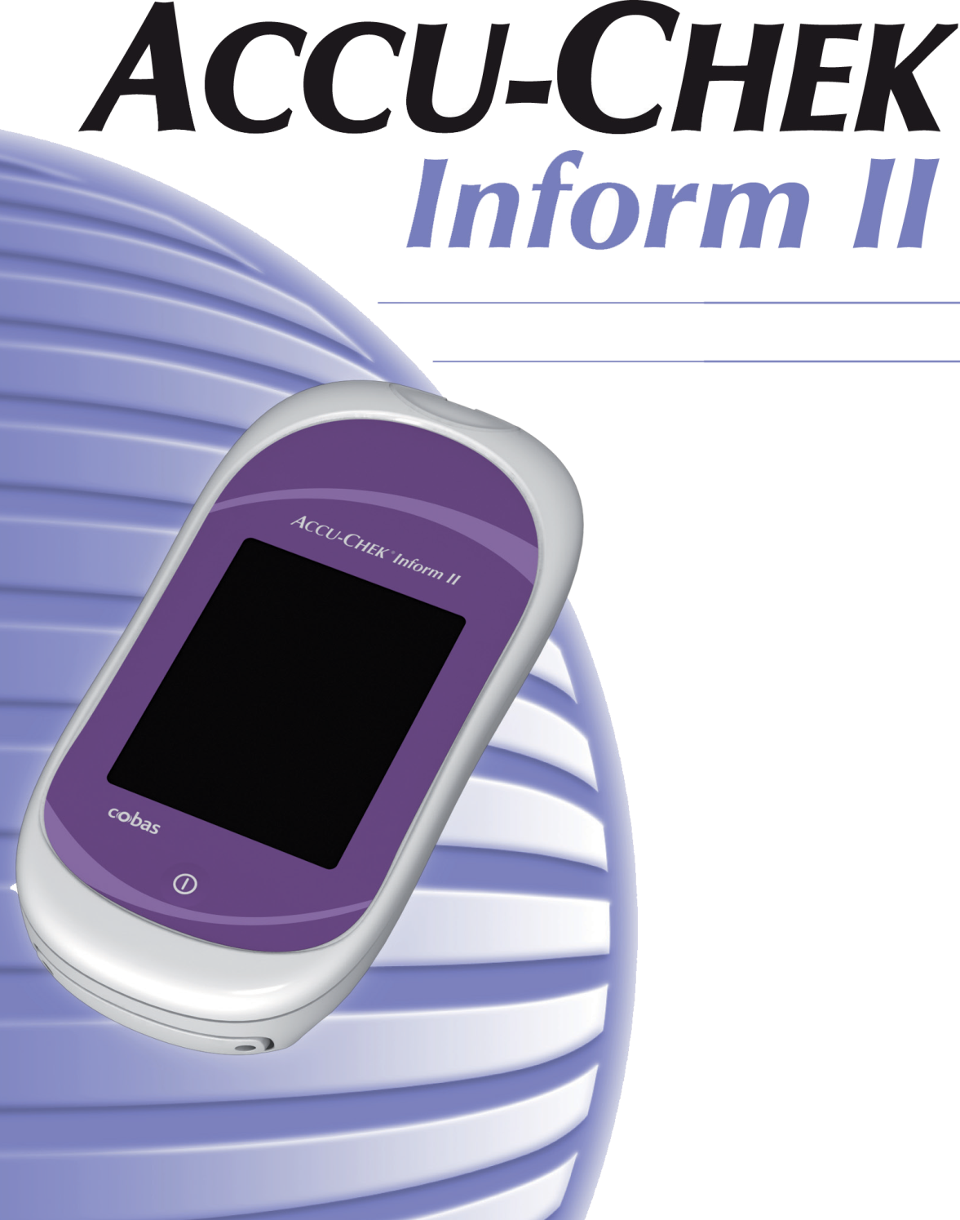
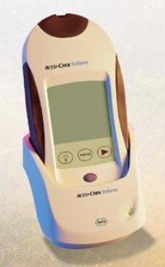
Whole Blood Glucose
Point of Care Testing
Pathology and Laboratory Medicine
BHHCS-VA

Slide 2

Accu-Chek Inform II
LOGGING IN TO THE METER
Each operator is given his/her own unique log in code
This code enters your name to the patient test result in the CPRS permanent record (comment section of the result in CPRS under the “Lab” tab)
DO NOT give your code out to anyone – you are liable if they make a mistake, as it is your name attached to the result in the patient’s chart

Slide 3
Accu-Chek Inform II
QUALITY CONTROL
QC is performed each day of testing,
if meter is dropped, or if new strips are opened
When solutions are opened, write in the 3 month outdate on Expiration stickers and affix to the QC vials
DO NOT touch tip of control bottle to the strip
Dose meter on a flat surface to prevent fluid from entering the strip port

Slide 4
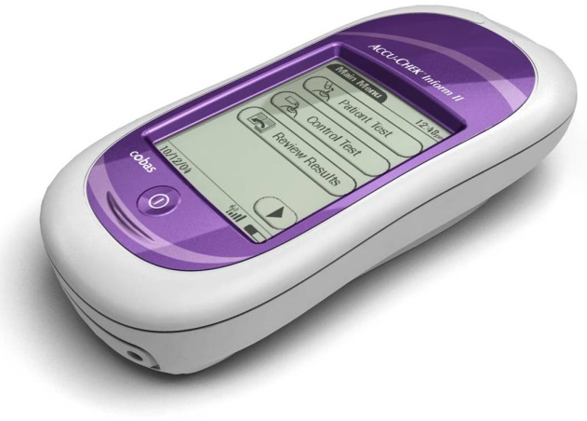
Accu-Chek Inform II Reminders
PATIENT TESTING
Use middle or ring finger for testing
Clean finger with water or alcohol and let dry thoroughly (alcohol takes 30 seconds to dry)
ALWAYS wipe away the first drop of blood
Hold meter down at an angle or keep
flat to prevent fluid from entering
the strip port.

Slide 5

Accu-Chek Inform II Reminders
CLEANING/DISINFECTING THE METER –
Meter MUST be cleaned with Germicidal Wipes
(meter must air dry for 3 minutes to disinfect)
Do not bring meter accessory box into isolation rooms
FDA requires meter cleaning after each patient test

Slide 6
Accu-Chek Inform II Patient Limitations
Hematocrit should be between 10-65%
Lipemic samples/triglycerides >1800 mg/dL may produce elevated results
Blood galactose levels >15 mg/dL will cause overestimation of blood glucose results
IV administration of ascorbic acid, resulting in a blood concentration of >3 mg/d: will cause overestimation of blood glucose results

Slide 7
Accu-Chek Inform II
Patient Limitations
This meter CANNOT be used on the Critically Ill
BHHCS defines “critically ill as either:
  MAP (Mean Arterial Pressure) <65mmHg
  Use of IV vasopressors to maintain blood pressure
If peripheral circulation is compromised, collection of capillary sample is NOT advised. Lab Draw is recommended in the following cases:
Severe hydration as a result of diabetic ketoacidosis or due to hyperglycemic hyperosmolar non-ketotic syndrome.
Hypotension / Shock
Decompensated heart failure NYHA Class IV
Peripheral arterial occlusive disease

Slide 8
Accu-Chek Inform II Reminders
ALL LAB TESTS NEED AN ORDER
Any POC testing can only be performed if there is an order for that test. [i.e. sliding scale, one-time order, blanket policy]
In emergent situations, the order can be entered after the fact

Slide 9
Additional “INFORM”ation
  SCAN-ONLY for Inpatient Areas
  One-Time-Use Bar-coded Emergency ID Cards for UCC “John Doe”
  Documentation and Notification of Critical Values

Slide 10
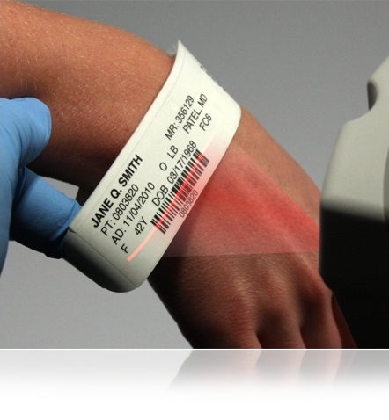
Patient Identification
For accurate patient identification, it is recommended that operators scan the SSN printed on the patient’s wristband if available
If this option is not available, and manual entry is necessary, manual entry must be done by comparing ID entered with CPRS or other permanent patient record.

Slide 11
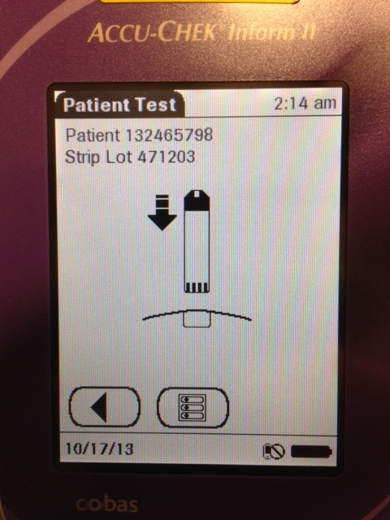
Positive Patient ID
REMINDER
Scan/enter patient ID
Scan strip bottle
The patient ID now appears
at the top of the screen for the
duration of the test, IF PATIENT
ID scanned/entered does not match armband or CPRS, etc., DO NOT PROCEED WITH TESTING…
Touch the main menu icon and go back to Step 1.

Slide 12
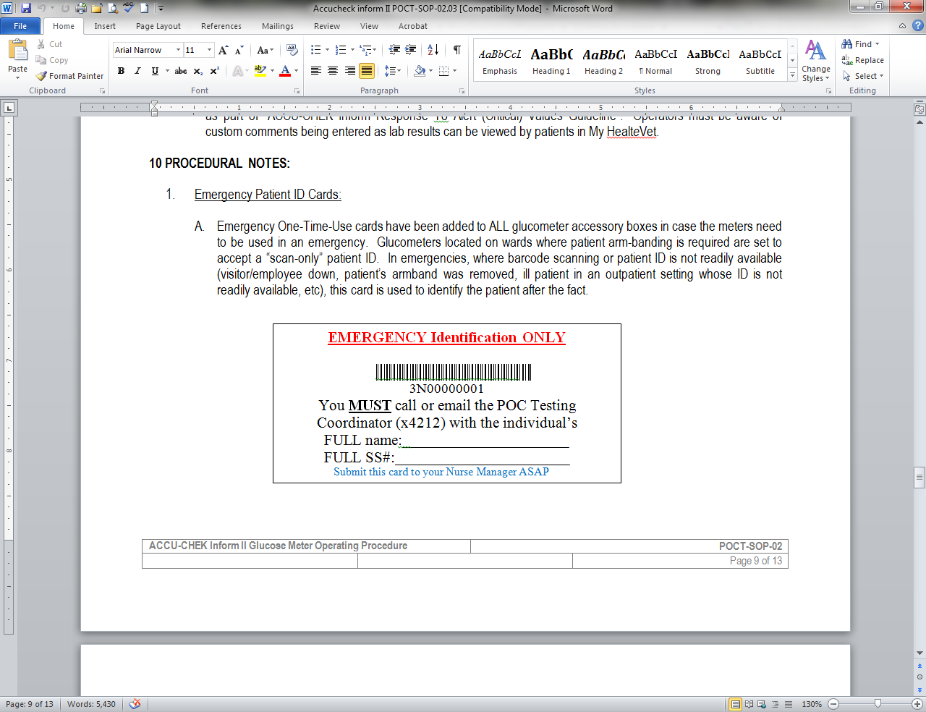
2. Emergency Identification Cards
One-Time Use Emergency Patient ID # in UCC
Corrected by LAB as soon as patient is in the system

Slide 13
Communication of Results
Verbal/Paper communication of blood sugar results is NOT PERMITTED and has led to medication errors.
Patient Identification CANNOT be verified when blood sugar results are communicated using verbal/paper communication
Prior to patient treatment, blood sugar results MUST be obtained in CPRS or by viewing the glucometer’s “Review Result” screen

Slide 14
Communication of Results
After docking the meter, most patient results appear in CPRS within 5 minutes
Exceptions to this:
Critical Values
Repeated Tests
Incorrect patient ID’s
Results with “Comments”
Computer Downtime

Slide 15
Communication of Results
If results have not crossed……
ALL RESULTS CAN BE VIEWED ON THE METER’s
“REVIEW RESULT” Screen
See next few slides for steps → → →

Slide 16
Communication of Results
Step 1 – Select “Review
Results”

Slide 17
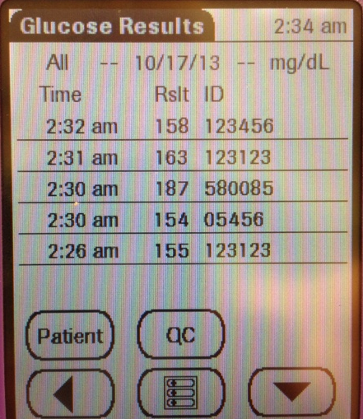
Communication of Results
Step 2 – ALL results will
appear on this screen…..
To view a specific patient,
select “Patient”
(looking for patient “123123”)

Slide 18
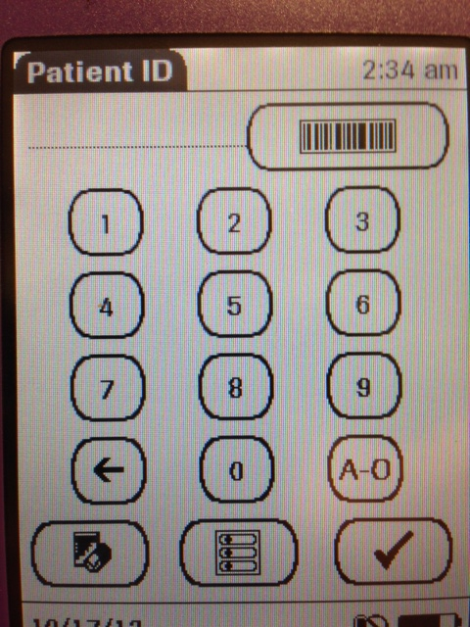
Communication of Results
Step 3 – Using the same
meter testing was
performed, SCAN the
patient’s wristband

Slide 19
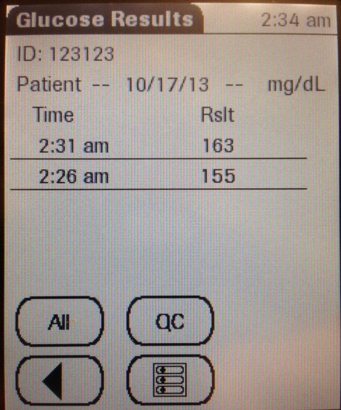
Communication of Results
Step 4 – ALL of patient
“123123” results
performed on this
meter will appear on
the screen

Slide 20
4. Documentation of Critical Values
(Critical Values <40 or >400 mg/dL, “HI” or “LO”)
PER Joint Commission, VA, and CAP Regulations:
If the Primary Caregiver (pt’s RN) is NOT performing the testing (i.e. CNA or other RN…) Critical Values MUST Be Documented by testing personnel.
Critical values MUST also be IMMEDIATELY communicated to the RN assigned to the patient.

Slide 21
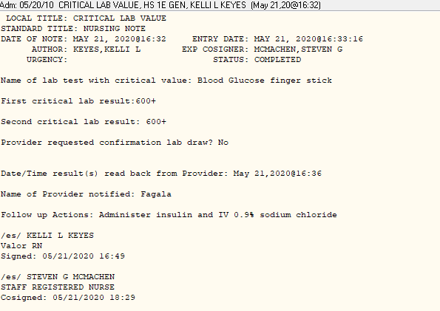
Documentation of Critical Lab Values : CLV
i.e. NA

Slide 22
Accu-Chek Inform Competency
QUESTIONS???
Contact the Ancillary Testing Coordinator

Slide 23
Accu-Chek Inform II
Thank you for your hard work
and dedicated service to
our veterans and for
keeping our patients
safe!

