Slide 1
Chemical hygiene and safety training
BHHCS Lab Systems Inc.

Slide 2
Fire safety
1. The Black Hills Health Care System Safety/Fire/Disaster program and Station Policies will be followed.
1
2. Observed unsafe conditions or hazardous work habits must be reported to your supervisor.
2
3. Be familiar with Laboratory's Chemical Hygiene Plan and Material Safety Data Sheets.
3
4. Be familiar with Laboratory's Blood Borne Pathogen's Plan.
4
5. Be familiar with Laboratory's Infection Control policy and Universal Precautions.
5

Slide 3

Fire safety
“PASS” stands for Pull, Aim, Squeeze, Sweep.
“RACE” stands for Rescue, Alert, Contain, and Extinguish (if can)
Classes A, B, C, D describe different types of fire extinguishers for different types of fires. The label on the extinguisher will indicate what type of fire to use it on. An "ABC" extinguisher will have a label, indicating that it may be used on class A, B and C fires.
Emergency telephone #’s are: FM 1-7070 and 1-6911.
HS FIRE is 2-2345, POLICE is 2-2020
Sprinkler systems trigger at 180 degrees Fahrenheit.
Location of 2 pull station fire alarms in the Laboratory, one at each exit.
Location of 4 fire extinguishers, one at front exit, one in microbiology(room 136), one outside the supervisor’ office(room 131) and one in the point of care office(room 134)

Slide 4
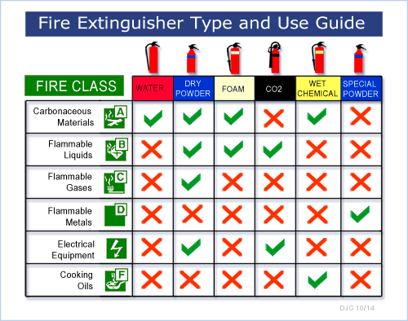

Slide 5

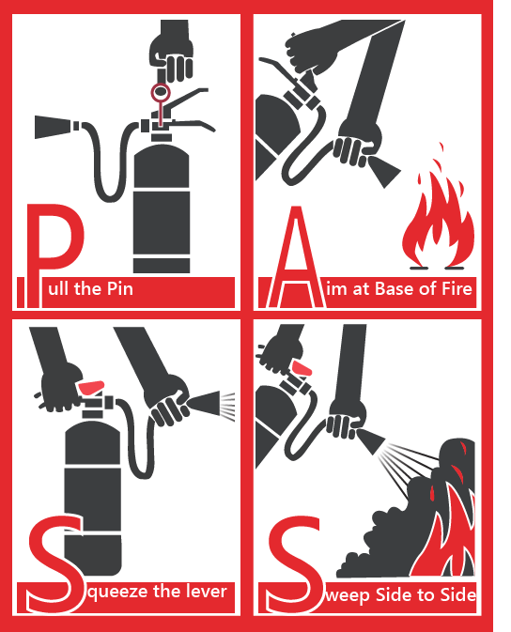
P.a.s.s.

Slide 6

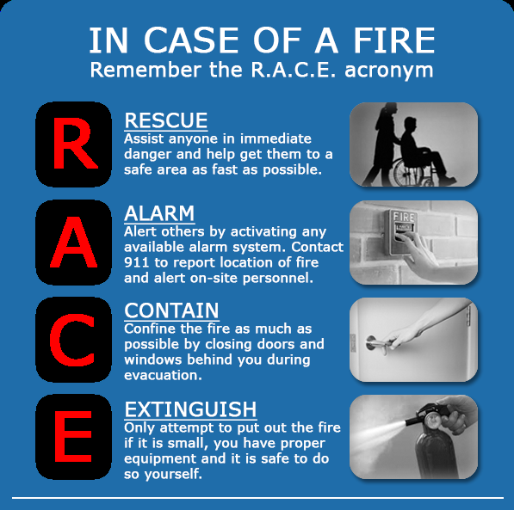
r.a.c.e.

Slide 7
Evacuation Plans
All staff are responsible for knowing the location and use of the fire alarm pull stations; fire extinguishing equipment, and their individual duties. Anyone discovering a fire will alert all the rest of the staff, than set off the fire alarm and attempt to confine and extinguish the fire.
Rescuers – Evacuate employees from the laboratory. Depending on the location of the fire evacuate out the front or back door depending which is safest from the fire.
Searchers - Check rooms for people. Turn them over to the Rescuers as you vacate the rooms in the Laboratory. Close windows and doors behind you.
Traffic Controllers (T. Controller) - Evacuate patients and families from the laboratory patient waiting room and bathroom, down the hall towards the front entrance. Instruct patients. One is stationed outside of the smoke barrier doors to the right (west) of the main department front entrance to halt traffic (traffic controller) into the danger area. One is stationed at the back laboratory exit to allow the fire department access, then they evacuate

Slide 8
Evacuation Plans
All staff: Use good judgment when performing your assignments. Do not attempt to perform your assignments if the fire or smoke makes it physically impossible.
CALL IN ALARM All staff...When the fire alarm is for the laboratory, the fire department will send a response team directly to the back exit door to assist with any evacuations. Staff (traffic controllers) are instructed to open the back exit door for the fire department.

Slide 9
Hot springs lab :
FIRE EXTINGUISHER
FIRE PULL
EYE
WASH

Slide 10
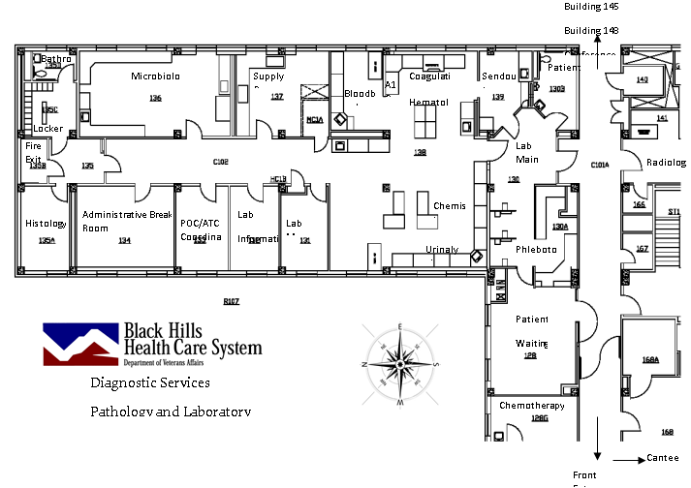
Fort meade lab
FIRE EXTINGUISHER
FIRE PULL
EYE
WASH

Slide 11
Chemical Hygiene
Observe OSHA’s Permissible Exposure Limits (PELs), the American Conference of Governmental Industrial Hygienists’ Threshold Limit Values (TLVs) as per SDS
Never consuming anything by mouth while in the Laboratory
Keeping all reagent and chemical container closures tight
Transporting “working” quantities of chemicals from their bulk storage containers into the Laboratory
Resealing chemical containers as soon as possible after use.
Label reagents and solutions properly. Label and date containers to identify contents and provide warnings. Do not remove or deface labels on original containers. Never fill a container with a material other than that called for on the label.
A secondary container needs to be labeled with the chemical identity, concentration, route of entry, health hazard, physical hazard, target organs affected, lab name, lot number, expiration date, OR:
The chemical identity and a filled-out NFPA warning diamond OR: The chemical identity and a filled-out HMIS warning label. (see below)

Slide 12
labeling secondary containers
DO NOT DESTROY OR OBSCURE PRIMARY (MANUFACTURES) CONTAINER LABELS
SECONDARY CONTAINTERS MUST BE PROPERLY LABELED

Slide 13
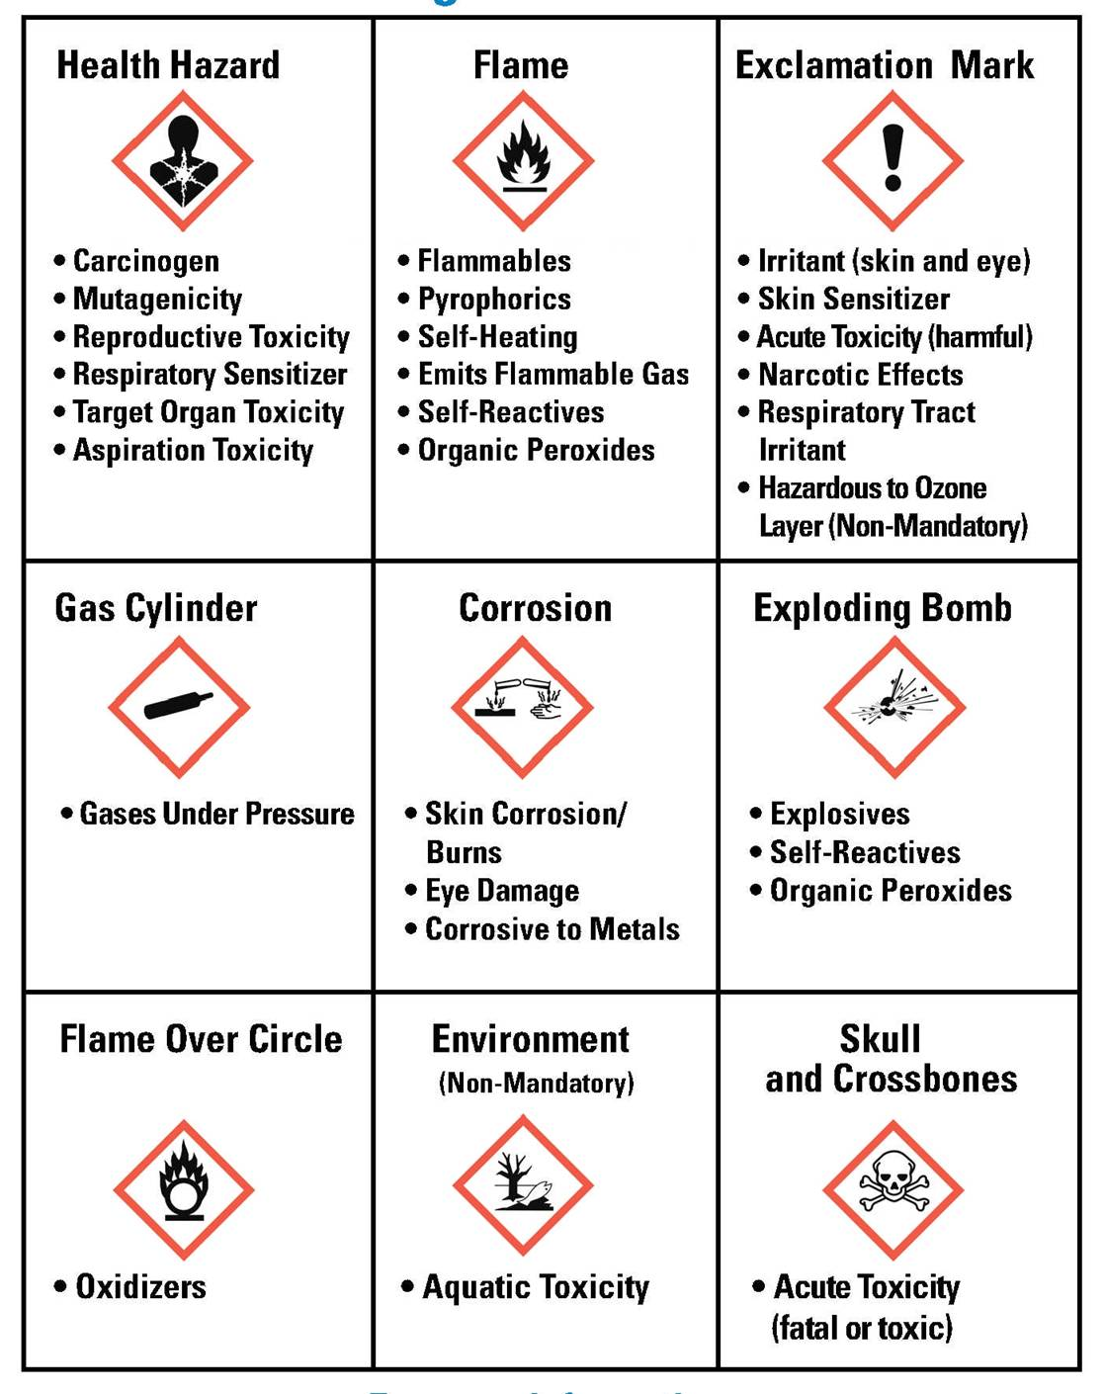

Slide 14

nfpa
The Hazard Classification Diamond was developed by a National Fire Protection Association (NFPA) to present a system of color and number coded warnings. The system was designed to help fire fighters know what hazards they may be dealing with during a fire.
The Hazard Classification Diamond was developed by a National Fire Protection Association (NFPA) to present a system of color and number coded warnings. The system was designed to help fire fighters know what hazards they may be dealing with during a fire.

Slide 15
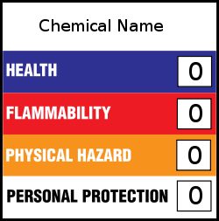
HMIS
The Hazardous Materials Identification System (HMIS) was developed by the American Coatings Association, Inc. (ACA) to help employers comply with OSHA’s hazard communication program. HMIS uses a color-coded square with four rows in which numbers are used to signal the degree of hazard.

Slide 16
Color: Rating:
Red = Fire Hazard 0 = Minimal Hazard
Blue = Health Hazard 1 = Slight Hazard
Yellow = Reactivity Hazard 2 = Moderate Hazard
White = Special Hazard 3 = Serious Hazard
4 = Severe Hazard
Special Hazard symbols include OX (oxidizer), W (reactive with water), and SA
(simple asphyxiant gas).

Slide 17
General Hood safety
Wear all necessary PPE
Only operate the UV disinfectant light with the front glass full closed.
Turn on the cabinet blower, make sure intake and exhaust ports are unobstructed
Run blower for at least 15 minutes before using cabinet
Disinfect all work surfaces with 70% alcohol of similar non-corrosive anti-microbial
Observe Universal Precautions with any flammable materials
Allow 2-3 minute air purge before and after manipulating specimens in the cabinet.
Disinfect all surfaces.

Slide 18
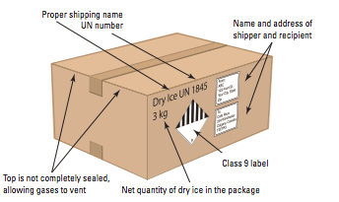
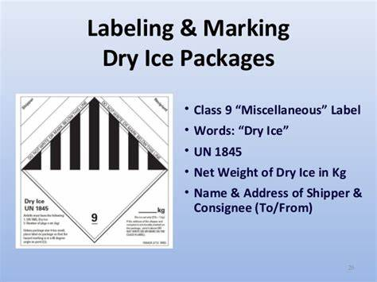
DRY ICE SHIPPING LABELING

Slide 19
Use proper PPE
Always wear the appropriate personal protective equipment (PPE): eye protective wear, laboratory coats, hand protective gloves, face shield as per manufacturers recommendations.
PPE available in the Laboratory
Nitrile barrier gloves
Insulated Hand Mitt (Handling of Dry Ice)
Face shields and goggles
Liquid resistant long-sleeved Lab coats

Slide 20
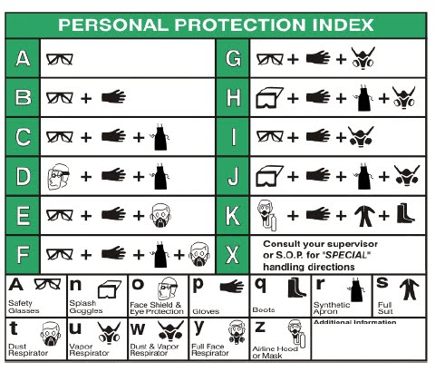
ppe

Slide 21
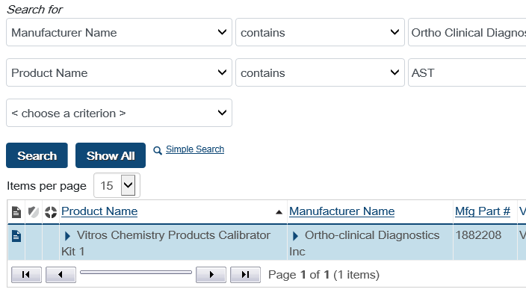
Safety data sheets
Safety data sheets available online at the following:
http://vaww.hefp.va.gov/occupational-safety-health-gems/safety-data-sheetchemical-inventory-service
Follow below link for monthly training:
http://vaww.hefp.va.gov/resources/sds-chemical-inventory-service-training

Slide 22
More sds sites:
ABBOTT
https://www.abbott.com/msds.html
BECKMAN COULTER
https://www.beckmancoulter.com/support/safety-data-sheets
INSTRUMENTATION LABORATORY
https://ce.us.instrumentationlaboratory.com/clinical-references
ORTHO
https://techdocs.orthoclinicaldiagnostics.com/TechDocs/TechDocSearch.aspx?tID=1&culture=en-us
SIEMENS
https://www.siemens-healthineers.com/en-us/services/laboratory-diagnostics/service-and-support/technical-documentation
SYSMEX
https://www.sysmex.com/us/en/Company/QualityCompliance/Pages/MSDS.aspx

Slide 23
references
https://www.osha.gov/laws-regs/regulations/standardnumber/1910/1910.1450
http://vaww.hefp.va.gov/resources/sds-chemical-inventory-service-training
https://hcm03.ns2cloud.com/sf/learning?destUrl=https%3a%2f%2fva%2dhcm03%2ens2cloud%2ecom%2flearning%2fuser%2fdeeplink%5fredirect%2ejsp%3flinkId%3dCATALOG%5fSIMPLE%5fSEARCH%26fromSF%3dY&company=VAHCM03
http://vaww.ceosh.med.va.gov/ceosh/MSDS.shtml

