Slide 1
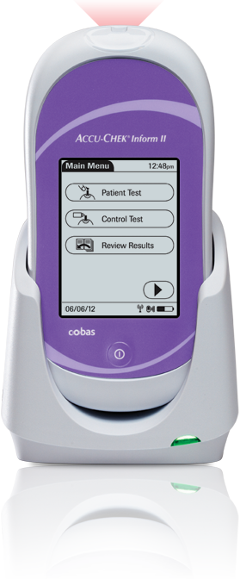
Critical Values Training
ACCU-CHEK Inform II

Slide 2
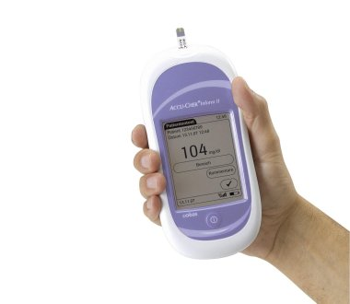
Course Objective
Upon taking this course you should be able to:
Assess critical values within the Black Hills Health Care System (BHHCS)
Take the appropriate steps in handling critical values
Report and document critical values within both the glucometer and the facility’s Computerized Patient Reporting System (CPRS)

Slide 3
Goal of Training:
Increase compliance within the BHHCS, with regards to critical value handling and reporting, in order to provide the best clinical practices to our veterans.
This Photo by Unknown Author is licensed under CC BY-SA

Slide 4
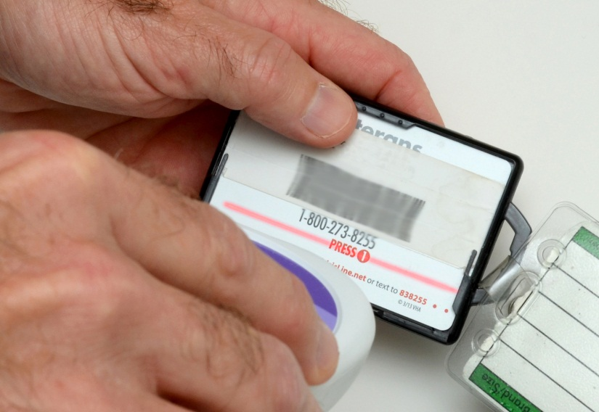
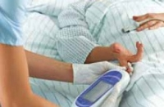
Critical Values
Critical whole blood glucose (WBG) values are defined by BHHCS as:
<40mg/dL or >400mg/dL

Slide 5
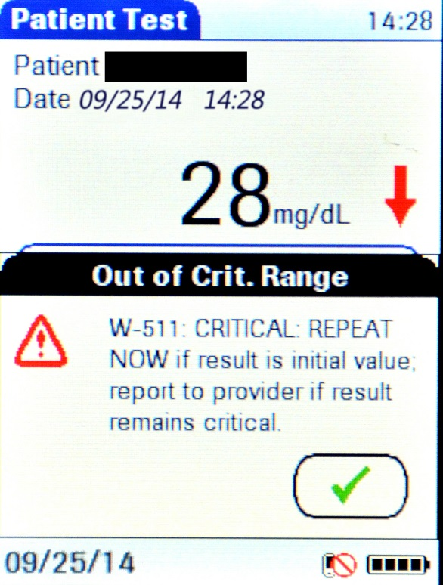
Handling Critical Values
When presented with a critical value, please perform the following steps:
Acknowledge the critical value by touching the “check box”.

Slide 6
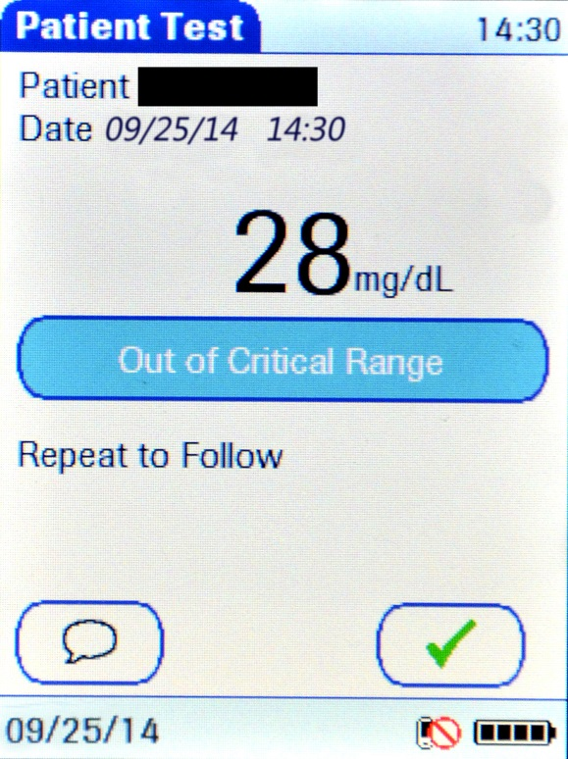
Handling Critical Values
Verify acceptance of the value obtained and the comments
selected by touching the “check box”.
Repeat the test IMMEDIATELY!

Slide 7
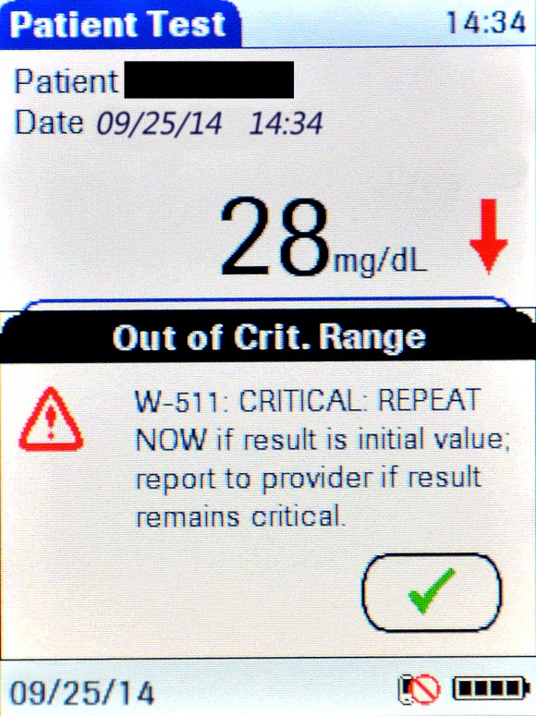
Repeating the Test
Acknowledge the critical value by touching the “check box”.

Slide 8
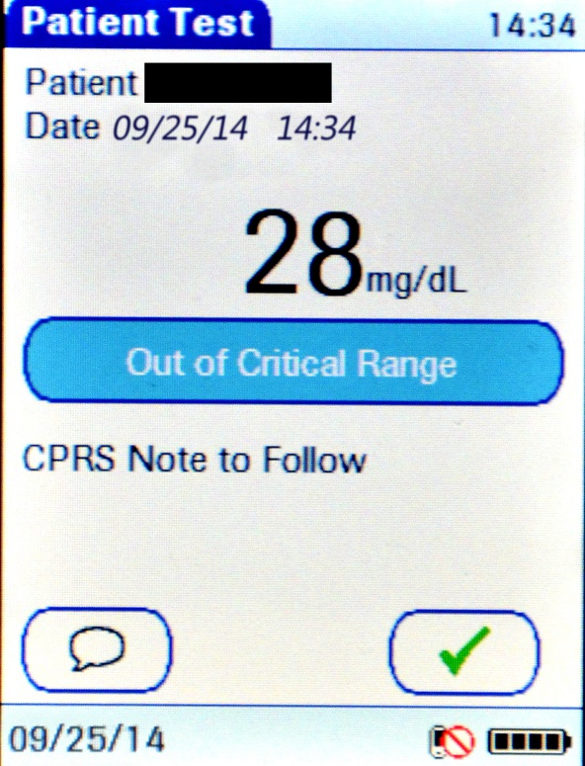
Repeating the Test
3. Verify acceptance of the value obtained and the comments
selected by touching the “check box”.
4. Notify the patient’s provider of the final critical value, and
complete the “Nursing Critical Value Note” in CPRS.

Slide 9
CPRS Documentation:
The final step of critical value handling and documentation is the completion
of the “Nursing Critical Value Note”:
Document that the value was repeated within the allotted 15-
minute time frame.
Input the final WBG value into the appropriate field.
Document that the value was communicated to the provider; the
provider’s first and last name must be provided.
4. Acknowledge that the provider “read back” the critical value.

