Slide 1
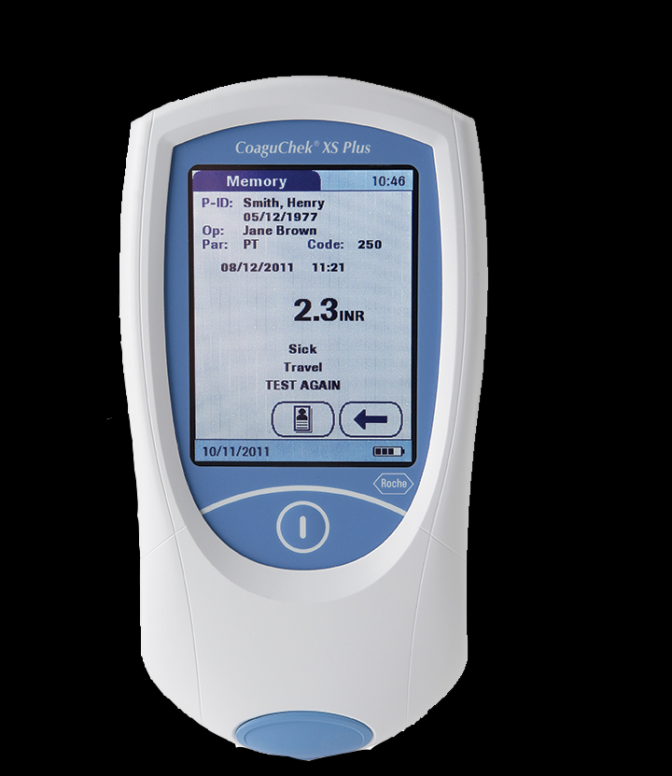
Roche CoaguChek XS Plus

Slide 2
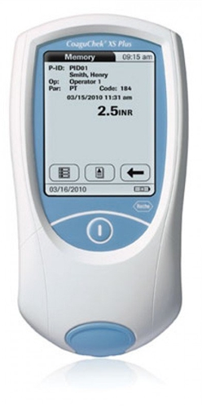
XS Plus Meter
The XS Plus meter will store 2000 patient tests and 500 QC results
Measure time in Seconds and calculates INR-International Normalized Ratio
Utilizes a rechargeable battery pack or 4 regular AA batteries.

Slide 3
Strips
Strips are sensitive to humidity and temperature, so it’s very important to immediately recap the bottle once a single strip is removed. Use within 10 minutes of removal from bottle.
Strips are stable until printed expiration date with room temperature storage.
Strips and meter should be stored and transported at +15° C to +32 °C (59 °F to 90 °F)

Slide 4
Patient Test
Wait for Meter Prompts at Each Step!
Power on meter, enter User ID (SS#), ✓
Patient ID screen, Enter patient (SS#), ✓
XS tells you to slide in strip
Strips must be inserted with a smooth, fluid motion or the meter will “error” out.
Hourglass appears-the XS is warming up the strip and doing self test. (1 min)
Must wait for hourglass to disappear. Have patience!
Operator has 3 mins to add sample, as indicated by the flashing drop icon.

Slide 5
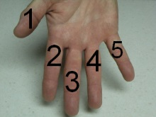
Specimen Collection
Perform fingerstick:
Use SINGLE USE DISPOSABLE LANCET ONLY
DO NOT wipe away first drop of blood.
Use the 3rd or 4th fingers.
Do not use the thumb as it has a pulse, making it unacceptable. Finger 2 is often callused, and the skin is very thin on finger 5.

Slide 6
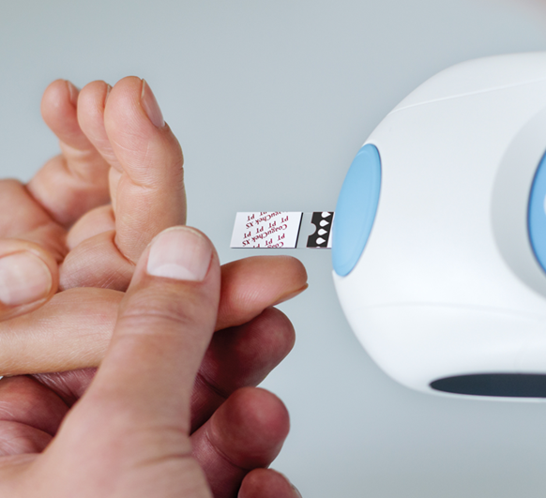
Adding sample

Slide 7
Add Sample
Sample is added to the top of the strip.
Add one hanging drop of blood to the Clear Sampling Window.
Sample moves via capillary action into the testing area of the strip… Have patience!
Meter will beep and flashing blood icon will stop when adequate sample is applied.
A level, vibration free surface is best for testing. Be careful not to drop the meter.

Slide 8
Provider DUZ
If instructed, add the Providers DUZ number to the comments field prior to downloading meter.

Slide 9
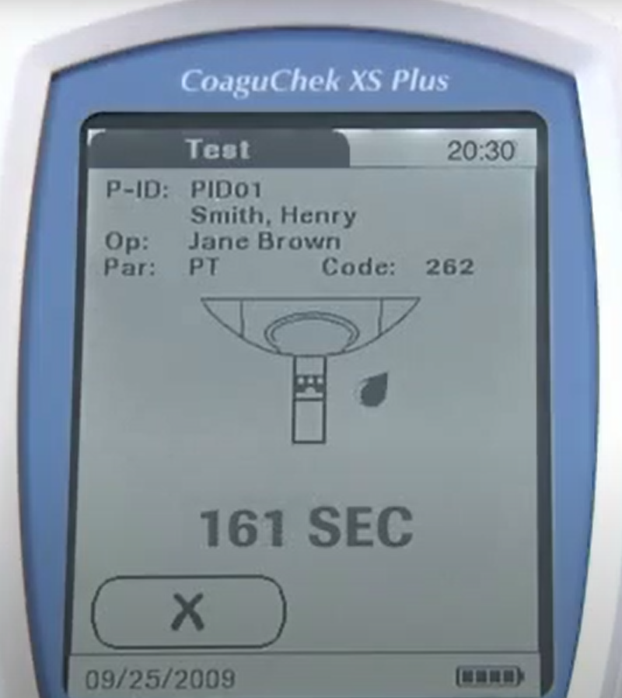
Results Screen

Slide 10
Review Results
Patient result: allows you to review the past patient results
QC result: allows you to review the past QC results.
RME: Use 70% isopropyl alcohol to wipe down the meter between each patient use.

Slide 11
Critical Value Procedure
If the patient result is > 4.0, the HBPC nurse or Lab will contact the attending Pharmacist of the result.
The Pharmacist will decide if an order for a PT/INR by venipuncture is necessary.
The nurse/Lab will draw a Blue top tube and return the specimen to the lab for processing.

Slide 12
Coding
Lab Performs Coding
Meters must be coded when a new lot of QC or strips are put into use.
Meters should be “off” when inserting and removing code chips.
Always double check that the code on the chip matches the bottle of strips and QC.
Put chip back in box when finished. Throw the chip and empty box away at the same time.

Slide 13
Quality Control (QC)
A check of the electronic components and functions every time the meter is turned on.
A check of the expiration date and lot information on the test strip.
A two-level, on-board quality control test and patient result determination within a single test chamber.
Lab Performs External QC as needed

