Slide 1
Test PowerPoint
Thursday, November 15, 2012

Slide 2
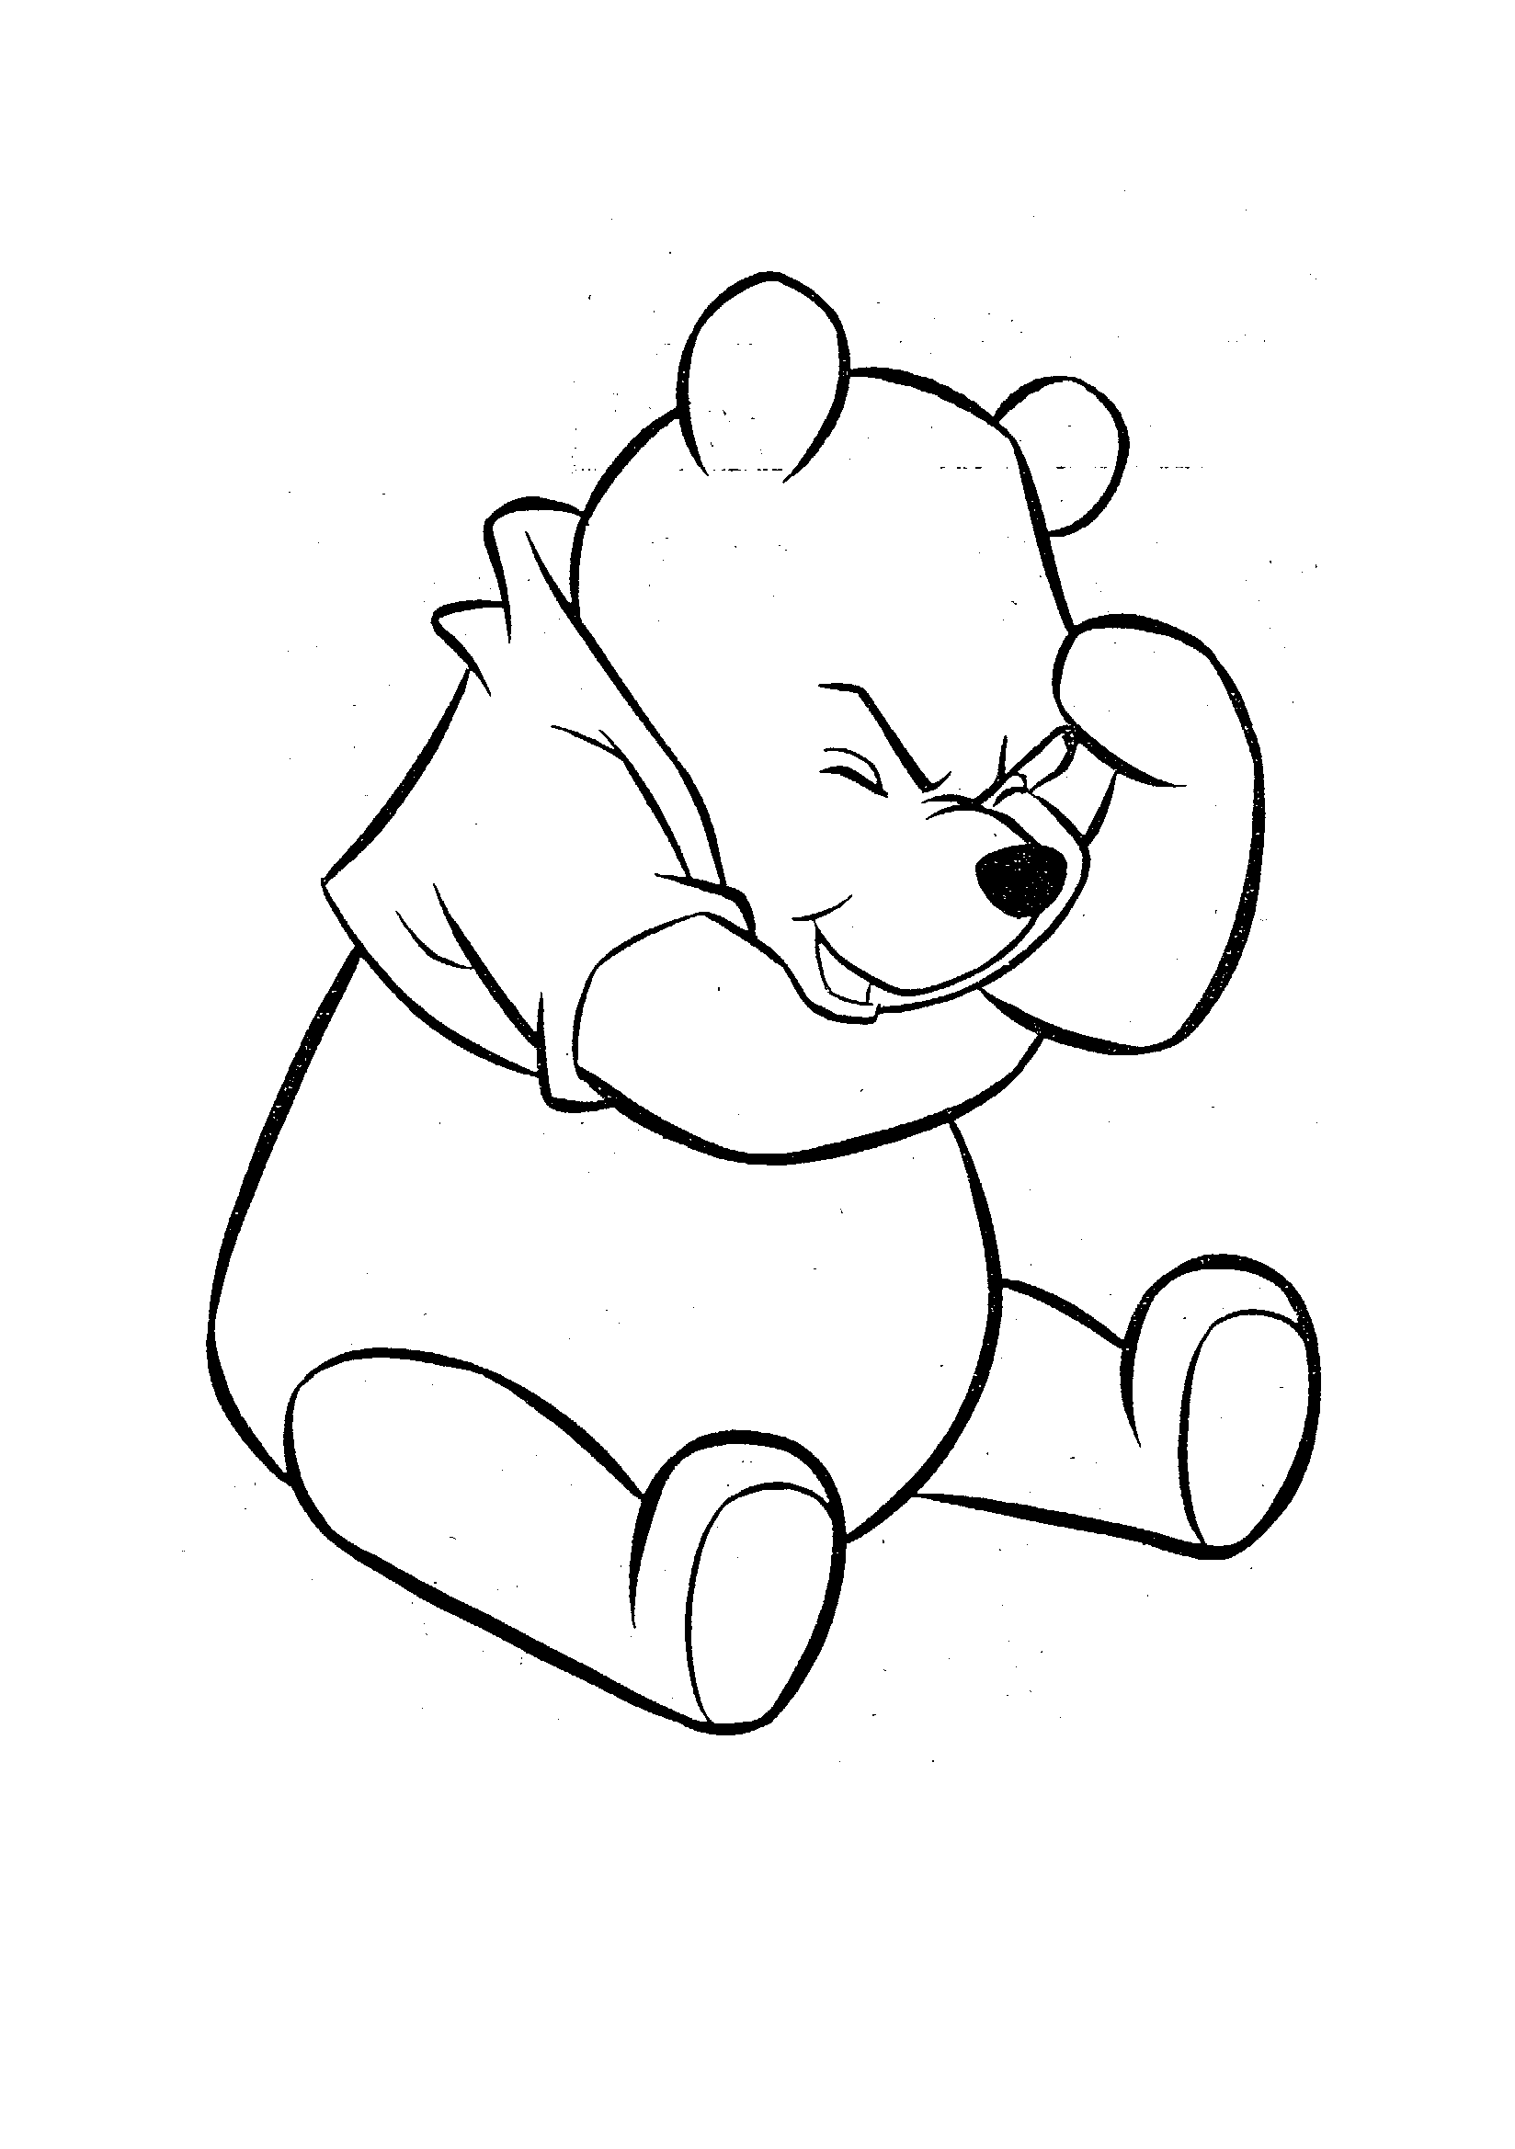
Think!

Slide 3

Adding Photographic Media
Purple Flowers
Green Lily Pads

Slide 4
This is a diagram of a process that is in SmartArt
1
1a
1b
2
2a
2b
3
3a
3b
Step 1
  Is usually followed by step 1a
  Is usually followed by step 1b
Step 2
  Is usually followed by step 2a
  Is usually followed by step 2b
Step 3
  Is usually followed by step 3a
  Is usually followed by step 3b
Google Hyperlink

Slide 5

The End

