Slide 1
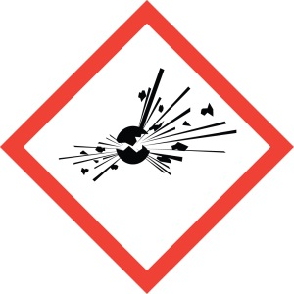
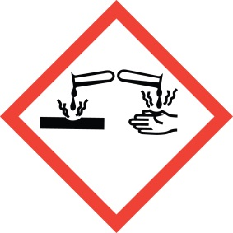
Store your chemicals safely

Slide 2
General storage rules
Do not store hazardous chemicals you will not use. Turn them in to the GEMS coordinator for disposal.
Never store chemicals near food or eating items. This includes not storing dish soap in the same cabinet as your coffee cups.
Store hazardous chemicals in a space that is only accessible to trained authorized personnel.

Slide 3
General storage rules, continued
Do not store chemicals above eye level or on the floor.
Store liquid chemicals in a tub or cabinet that will collect leaks or breakage.
Make sure containers are closed and in good condition.
Make sure all containers are labeled properly.
Read the Safety Data Sheet for more storage information.

Slide 4
Storing Flammables
If you have flammable or combustible chemicals, store any quantity, beyond what you will use quickly (today or this week), inside a flammable cabinet or locker. This includes aerosol cans that are flammable.
Never store anything that is not flammable or combustible in that cabinet or locker.
Do not overload your flammable cabinet. If any container spills, the bottom sump must be able to hold it.

Slide 5
Gas storage
Store oxygen and any flammable gasses separate from each other.
Gas cylinders must be secured in storage to prevent them from falling over. They must be transported in a rack or cart designed for cylinder transport, and must be secured to something solid when they are not in a rack or cart.
They must be stored in a well-ventilated area.
Cylinder of flammable gasses should not be stored in a flammable cabinet. Check with Safety for help on storing these cylinders properly.

Slide 6
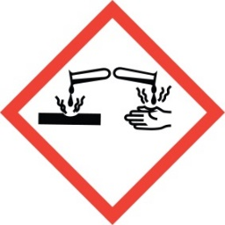
Acids and Caustics
If you have acids and/or caustics, store them separately from each other.
If you have a variety of acids and caustics, consult Industrial Hygiene for more rules on proper storage.

Slide 7
Be prepared for spills
SWIM: Stop, Warn, Isolate and Minimize. But that is not all.
Your service should have a plan for if your chemicals spill. The SDS for each chemical has information on spill procedures, or contact IH for assistance.
Make sure you have a spill kit that can be used to clean up your chemicals if they spill. Ask IH for assistance in deciding what should be included.
Make sure you have been trained on spill procedures. All staff should know what to do.

Slide 8
Some special items
If you have any of the following, consult Industrial Hygiene to see if there are more safe storage rules:
Reactive chemicals
Carcinogens
Lab chemicals
Extremely toxic chemicals
Chemicals that give off hazardous vapors

