Slide 1
Emergency Eyewash and Shower Training for Users
Use, Operation, and Inspection of Emergency Eyewash and Shower Stations

Slide 2
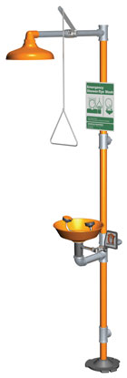
Introduction.
All employees must be familiar with the location and use of eye wash and safety showers even if their job does not involve working directly with toxic or corrosive chemicals.
Why? You may be called upon to aid a fellow employee who has had an exposure.
The distance from the location of the employee and safety device should not exceed 10 seconds walking distance. The path to the safety shower or eye wash must be unobstructed.

Slide 3
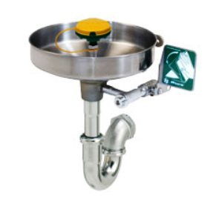
Introduction.
The path to the eye wash or safety shower cannot involve opening a door unless:
  There is always another employee present that can open the door.
  The exposed employee can exit the room without having to manually manipulate a door knob (i.e. push bar).
The location of all eye washes and safety showers must be clearly marked with a highly visible sign. The area around the safety shower and eye wash must be well lit.
The temperature of the water delivered should be between 60º and 95º F.

Slide 4
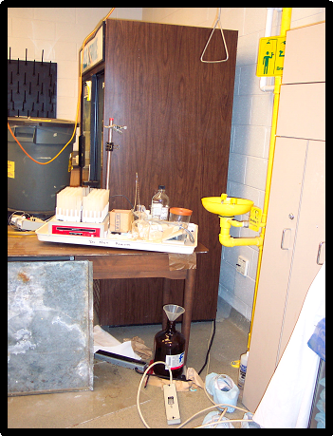
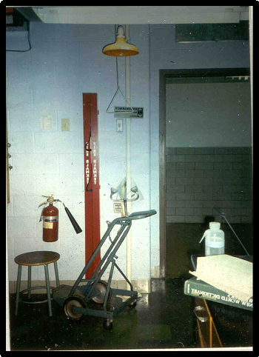
Examples of Violations.

Slide 5
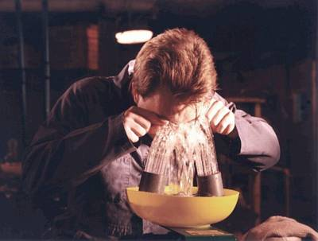
Eyewash Use Procedure.
Hold eyelids open using the thumb and index finger to help ensure that effective rinsing has occurred behind the eyelid.
It is normal to close eyes tightly when splashed, but this will prevent water or eye solution from rinsing and washing the chemical out. Eyelids must be held open.
Practice of this procedure is encouraged to help familiarize potential users with the feel of rinsing.
It will also make it easier for the user to react both promptly and properly to an emergency situation.

Slide 6
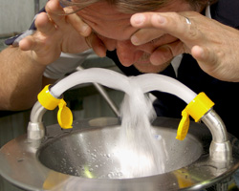
Eyewash Use Procedure.
Always wash across the eyes; this will help to avoid washing the chemicals back into the eyes or into an unaffected eye.
Water or eye solution should NOT be directly aimed onto the eyeball, but aimed at the base of the nose.
Velocity of the stream of water must be gentle, such that injury to the eye is avoided.

Slide 7
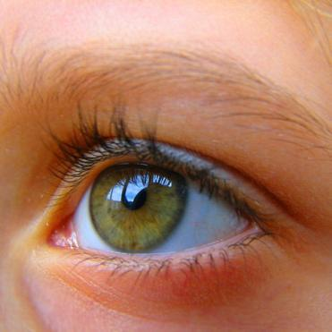
Eyewash Use Procedure.
Flush eyes and eyelids with water or eye solution for a minimum of 15 minutes. “Roll” eyes around to ensure full rinsing.
Contact lenses must be removed as soon as possible to ensure that chemicals are not trapped behind the lenses and then the eyes can be completely rinsed of any harmful chemicals.
Medical attention should be sought immediately! Ideally another person should make contact with responders or dial “911”. The sooner medical attention can be given, the chances of not sustaining permanent damage or blindness is greatly improved.

Slide 8


Regulations.
OSHA requires that suitable means for flushing and quick drenching of the eyes and body be available in any area where corrosive materials are in use. They may also be recommended for an area where certain toxic materials are used. Consult IH for this requirement.
In cases of an exposure, the initial first aid treatment is to flush affected area with water for a minimum of 15 minutes.
The ANSI (American National Standard Institute) requires that control valves be located so that they can easily be turned on and remain on until manually shut off.

Slide 9
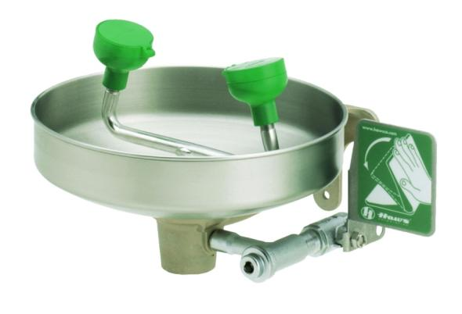
Eyewash Station Requirements.
The control valve must also:
  Be designed to ensure flow of water without requiring the user’s hand.
  Go from “off” to “on” within 1 second.
  Remain in the “on” position until manually shut off.
  Be resistant to corrosion that may inhibit the operation of the valve.
Control Valve Actuator
Control Valve

Slide 10
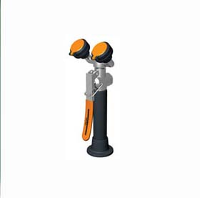
Eyewash Station Requirements.
Velocity of the stream of water must be such that injury to the eye is avoided.
Controlled flow must be provided to both eyes simultaneously.
The nozzles must be covered to prevent contamination and covers must automatically open when the unit is activated.
User must have enough room to hold both eyes open while in the stream of water.

Slide 11
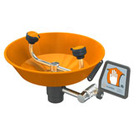
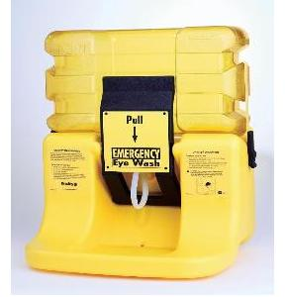
Eyewash Station Requirements.
Plumbed and self contained units
  Minimum flow rate of 0.4 gallons per minute (gpm), water nozzles 33 – 45 inches above the floor, and 6 inches from wall obstruction.
  Plumbed units should be activated once a week to flush lines.
  Self-contained units should be activated in accordance with the manufacturer’s directions.

Slide 12
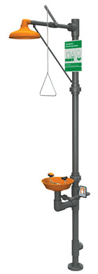
Safety Shower Requirements.
The water column must be between 82 and 92 inches with a minimum of 20 inches diameter of column and 60 inches above the surface.
Water delivered must be a minimum of 20 gallons per minute (gpm).
If an enclosure is used there must be an unobstructed minimum diameter of 34 inches.
Must be identified with a highly visible sign located in a well lit area.

Slide 13
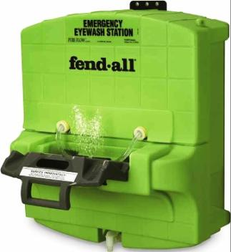
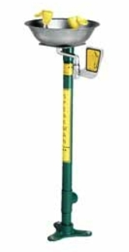
Examples of Emergency Equipment.
Eye Washes
A device used to irrigate and flush both the face and the eyes.

Slide 14
Self Contained Eyewash.
This unit must hold enough water to dispense a minimum of 0.4 gallons per minute (gpm) for a minimum of 15 minutes.
Typically contain additives to protect against bacteria, fungus, and algae available.
Manufacturer’s fluid change-out schedules shall be rigidly followed.

Slide 15
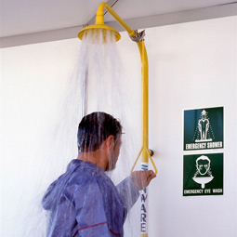
Plumbed Shower Unit.
Showers
An assembly consisting
of a shower head controlled by a stay open valve and
operated by an approved
control valve actuator.
  Remove contaminated clothing.
  Allow copious amounts of water on affected area for a minimum of 15 minutes.

Slide 16
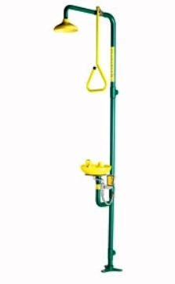
Combination Unit.
Combination units
Interconnected assembly of emergency equipment (eye wash and safety shower) supplied by a single source of flushing fluid.

Slide 17
Prevention of Accidents.
Know the chemicals that you are working with. Read the Safety Data Sheets (SDS/MSDS) and ask questions.
Know the location of the eye wash and safety shower.
Know how to operate the safety equipment, you may need to use it yourself or assist others.
Always wear required personal protective equipment (PPE).

Slide 18
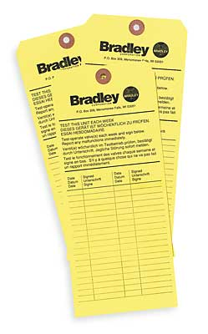
Eyewash Station Maintenance.
Eyewash Stations are required to be activated and visually inspected weekly by a trained designee of the Service or Care Line in which the eyewash station is located.
Each weekly eyewash inspection will be documented on an inspection tag attached to the eyewash station, or on a log that is readily accessible.

Slide 19
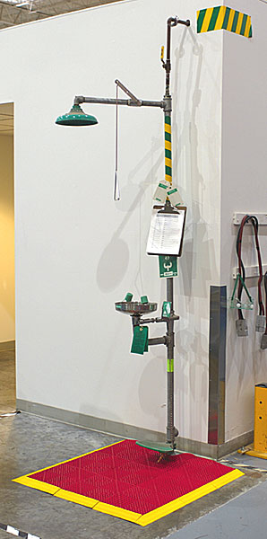
Eyewash Maintenance Criteria.
1. INSPECTION
  Criteria to inspect the eyewash station – the designated person(s) inspects the station(s) to verify that the following conditions are met:
    The eyewash station is free of obstruction
    The bowl and nozzles are free from dirt and other contamination
    The nozzles are equipped with protective covers (or fold into the unit to cover them)
    The eyewash is identified by a highly visible sign
    The inspection tag or log sheet is signed and dated

Slide 20
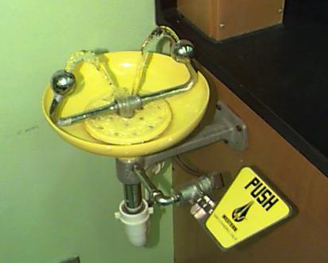
Eyewash Maintenance Criteria.
2. ACTIVATION
  Criteria to activate the eyewash station – the designated person(s) activates the station(s) for one (1) to five (5) seconds to verify that the following conditions are met:
    The eyewash is easily activated and remains on without the use of the operator’s hands
    The covers are removed by eyewash activation
    The fluid flows from both eyepieces
    The flow of fluid is of equal height
    The flow of fluid is clear after flushing
    The fluid temperature is constant and tepid
    The eyewash delivers a steady, low-pressure, stream of fluid
    The flow continues until the mechanism is returned to its resting position
    The fluid drains from the bowl/sink

Slide 21
Eyewash Maintenance Criteria.
3. DOCUMENTATION
  The designated person(s) documents the completed weekly maintenance by signing and dating the appropriate inspection tag or log sheet.
  The designated person(s) issues an emergency work order and posts the eyewash as not operational if the eyewash fails any of the above inspection criteria.

Slide 22
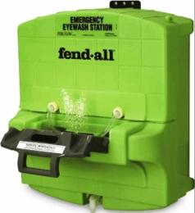
Self Contained Eyewash Maintenance Criteria.
1. INSPECTION
  All self contained eyewash station must be evaluated in accordance with the manufactures instructions.
  At a minimum the following criteria must be used to inspect the self contained eyewash station – the designated person(s) inspects the station(s) to verify that the following conditions are met:
    The eyewash station is free of obstruction
    The bowl and nozzles are free from dirt and other contamination
    The nozzles equipped with protective covers
    The eyewash is identified by a highly visible sign
    The flushing fluid is full and in good condition
    The flushing fluid has not expired
    The inspection tag or log sheet is signed and dated

Slide 23
Self Contained Eyewash Maintenance Criteria.
2. DOCUMENTATION
  The designated person(s) documents the completed weekly maintenance by signing and dating the appropriate inspection tag or log sheet.
  The designated person(s) issues an emergency work order and posts the self contained eyewash as not operational if the eyewash fails any of the above inspection criteria.

Slide 24
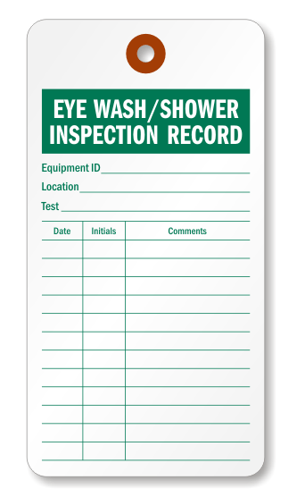
Safety Shower Maintenance.
Emergency Showers are required to be activated and visually inspected monthly. That is currently done by a contractor working for Safety.
Each monthly shower inspection will be documented on an inspection tag attached to the shower station or on an inspection log that is readily available.

Slide 25
Shower Maintenance Criteria.
1. INSPECTION
  Criteria to inspect the emergency shower – the designated person(s) inspects the station(s) to verify that the following conditions are met:
    The shower station is free of obstruction
    The shower is free from dirt and other contamination
    The shower is identified by a highly visible sign
    The inspection tag or log sheet is signed and dated

Slide 26

Shower Maintenance Criteria.
2. ACTIVATION
  For testing of emergency shower, use a shower tester tent and bucket. Use a shower tester that will assist with the monthly activation by keeping the fluid contained in a bucket.
  Criteria to activate the shower – the designated person(s) activates the shower for one (1) to five (5) seconds to verify that the following conditions are met:
    The shower is easily activated and remains on without the use of the operator’s hands
    The flow of fluid is clear after flushing
    The fluid temperature is constant and tepid
    The shower delivers a steady, low-pressure, stream of fluid
    The flow continues until the mechanism is returned to its resting position

Slide 27
Shower Maintenance Criteria.
3. DOCUMENTATION
  The designated person(s) documents the completed monthly maintenance by signing and dating the appropriate inspection tag or log sheet.
  The designated person(s) issues an emergency work order and posts the shower as not operational if the shower fails any of the above inspection criteria.

Slide 28
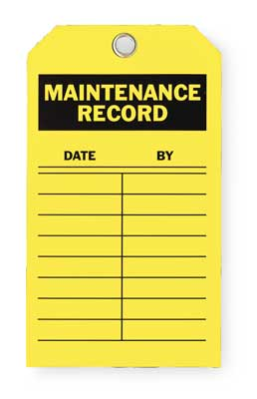
Annual Performance Testing.
All eyewash stations and safety showers are tested annually by Facilities Management Services to verify the performance of those devices in accordance with established ANSI requirements.
Each annual performance test will be documented on an inspection testing form and/or an inspection tag attached to the eyewash station/safety shower.

Slide 29
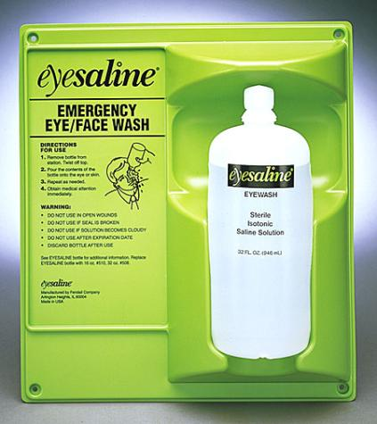
Eyewash Bottles.
Eyewash bottle stations are not authorized for use in areas where plumbed eyewash installations are feasible.
Eyewash bottles and sealed portable eyewash units have a finite water supply and are considered interim first aid, not as a replacement for additional eye washing or medical care.
The main purpose of these units is to supply immediate flushing. The injured person needs to proceed to a plumbed or self-contained eyewash to flush their eyes for the required 15-minute period.

Slide 30
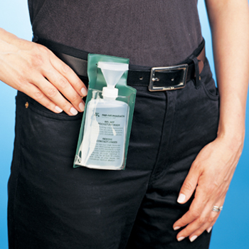
Eyewash Bottles.
Personal eyewash bottles may be considered for use:
  During an interim period until permanent eyewashes can be installed.
  For activities remote to facilities that do not allow immediate access to plumbed eyewashes.
  For remote field operations, eyewash bottles may be made available at the immediate job site to be used in conjunction with sealed portable eyewash units available on the work vehicle or truck.
  For highly mobile operations within facilities, personal eyewash bottles may be supplied on work carts for immediate first aid. Employees will be trained on the locations of the closest permanent eye wash stations to be used for sustained flushing in each work area.

Slide 31
Eyewash Bottles.
The selection and use of eyewash bottles will be evaluated and approved by Safety staff. Factors to consider in the evaluation include, but are not be limited to:
  The physical and chemical characteristics of the chemical, including the risk of injury.
  Contingencies for cold temperatures and potential for eye wash solution freezing.
  Volume of solution required for operations with a high risk of eye injury and remoteness to a plumbed eyewash to allow for longer flushing times.
Upon approval, eyewash bottles will be assigned to individual users.
The OSH section will maintain a list of designated eyewash bottle users, including the number of eyewash bottles assigned to the service, and the expiration dates of the eyewash solutions.
Supervisors are responsible for inspecting eyewash bottles weekly to ensure that all bottles are sealed and have not reached their expiration dates.

Slide 32
Resources.
For more information contact Occupational Safety and Health at:
  Lisa Woodings X 65344
  Freddie Lynch X 76864
  Nadir Khan X 66086

