Slide 1

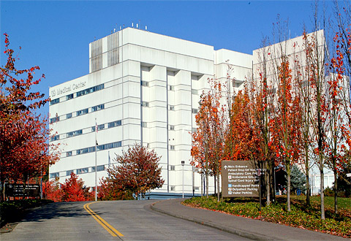
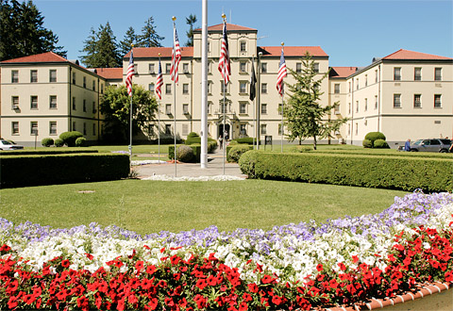
Annual Level II Hazardous Waste Management Training

Slide 2
Overview
Who needs annual training?
What is hazardous waste?
Labeling, management, & turn-in requirements
Lab cleanout requirements
Treatment requirements
Other types of wastes
Recordkeeping & other requirements

Slide 3
Who needs training?
Positions that:
  Add waste to containers
  Access and transfer wastes from satellite accumulation areas (SAAs) to central accumulation areas (CAAs)
  Label
    hazardous waste, used oil, spend antifreeze, used shop rag, & universal waste containers.
  Inspect accumulation areas & emergency response equipment
  Fill out & sign manifests
  Respond to emergencies & providing cleanup oversight
  Train new employees

Slide 4
Who needs training? (Cont.)
Department of Ecology Requirements
Level I | Level II | Level III
Designated Medical Providers | Designated Research Staff | GEMS Program Manager
 | Designated Clinical Lab Staff | Industrial Hygienist
 | Designated FMS Staff
 | Designated EMS Staff

Slide 5
What is Hazardous Waste?
Anything the federal (Environmental Protection Agency / EPA) or State (Department of Ecology / ECY) government deems hazardous to the environment
Waste designation MUST be performed on all waste to ensure proper disposal
You must provide the GEMS Program Manager (PM) information about the waste (i.e. Safety Data Sheets, process generating waste, etc.)
GEMS PM completes the waste designation however, further assistance might be needed
Waste managed by GEMS

Slide 6
What is Hazardous Waste? (Cont.)
“Listed Wastes” are specific products, or a waste from specific processes, as determined by the EPA / ECY (incl. wastes from electroplating, wood preserving, pesticide manufacturing, etc.)
“Listed Wastes” appear on the following lists:
  EPA 40 CFR Part 261 – Identification & Listing Hazardous Waste and
  WAC 173-303-9903 & 4
    Denoted with a letter (i.e. F, K, P, or U) and three numbers after (i.e. 001 – 411)

Slide 7
What is Hazardous Waste? (Cont.)
“Characteristic Wastes” are wastes that meet the below criteria and are denoted with the letter (D) and three numbers after (i.e. 001 – 043)
  Ignitability – Flash point is less than 140°F or ignitable solid, gas, or oxidizer (D001)
  Corrosivity – Aqueous and has a pH less than or equal to 2, or greater than or equal to 12.5 (D002)
  Reactivity – Is normally unstable, water reactive, explosive, or creates toxic gas, fumes, or vapor when mixed (D003)
  Toxicity – Solid waste that exhibits the characteristics of toxicity via a TCLP (D004-043)
    List is found in WAC 173-303-090(8)(c)

Slide 8
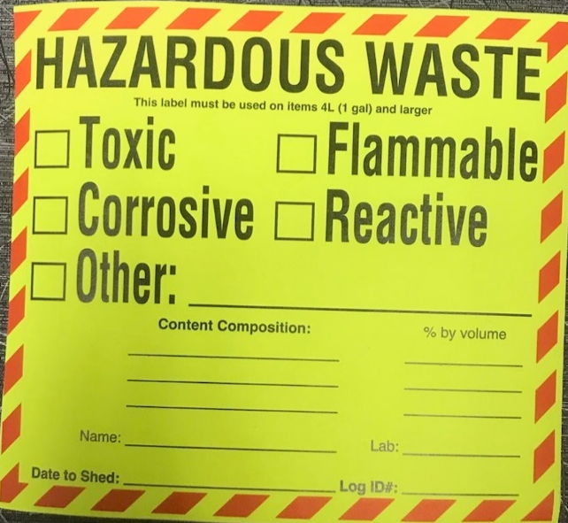
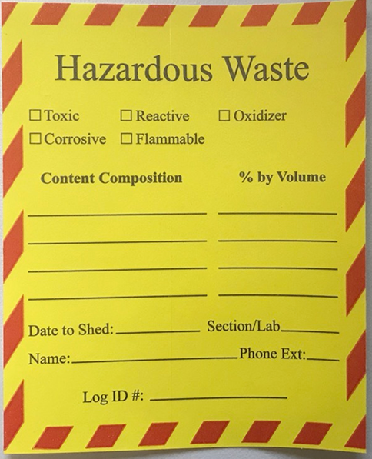
Labeling Requirements
Use 5x5” labels on containers that are 4 L (1 gal) or larger | Use 3x4” labels on containers that are smaller than 4L (1 gal) or items that need to be placed in a zip lock bag

Slide 9

Labeling Requirements (Cont.)
  How to Properly Label
  Mark Hazard(s) (Refer to section 9 & 10 of the SDS(s) to determine hazard class)
  Write all contents (incl. water) & percent by volume of each)
  Write your name & Lab / Section
  When FULL (not to exceed 55 gals)
    American Lake: contact GEMS for pick up and write pick-up date
    Seattle: date and transfer to haz-waste accumulation shed within 3 days

Slide 10
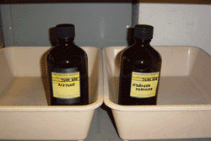
Management Requirements
Select an appropriate container for waste
  Free of rust, dents, & leaks
  Only reuse containers that have held compatible wastes
Deface all labels & place annotated label
Container must be close to point of generation & kept closed when not adding waste
Place in secondary containment to contain potential leaks /spills
Only 100% empty (no free-flowing residue) containers may be disposed of as solid waste
Do not store incompatible wastes together

Slide 11
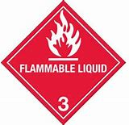

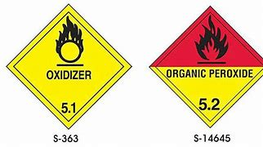







Management Requirements (Cont.)
At a minimum, store… | Away from…
Flammables & Combustibles | Oxidizers & Peroxides
Toxics: Certain toxics react w/ corrosives and even water to release toxic gases | Corrosives & Water-Reactive
Corrosive Acid | Corrosive Basic

Slide 12
Management Requirements (Cont.)
Uncontaminated Glass Waste Disposal
  Use a sturdy container (e.g. cardboard box)
  Remove or deface all labels
  Double line container with plastic bags
  Place glass in lined container
  Seal container with packaging tape
  Label “glass” or “broken glass”
  Dispose of as solid waste

Slide 13
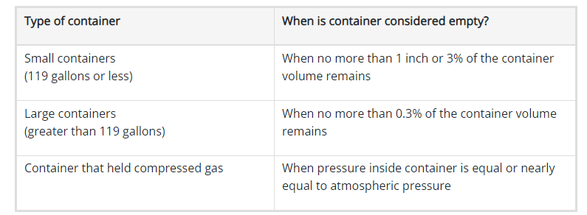
Management Requirements (Cont.)
Empty container can be disposed of as solid waste if:
  Not identified as acute hazardous waste (AHW) or toxic extremely hazardous waste (EHW)
    Waste is identified through waste designation
  Contents have been properly removed using practices commonly employed and
  Contents fall below a certain volume (See table below)

Slide 14
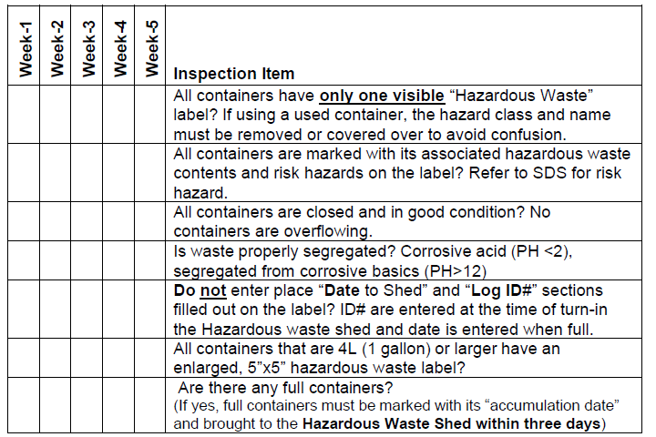
Management Requirements (Cont.)
Department selected Research & Lab Staff must:
  Know all satellite accumulation area (SAA) locations
  Conduct weekly SAA inspections (areas with 30 gallons or more)

Slide 15
American Lake (AMLK) Hazardous Waste Turn-in Requirements

Slide 16
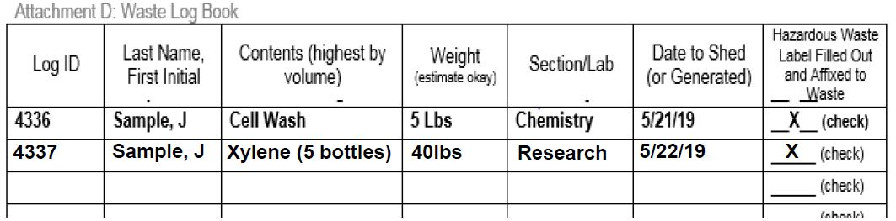
AMLK Turn-in Requirements
Schedule a pick-up with GEMS
Fill out waste log (per MCP EC-107) with:
  Log ID , Name, Contents, Weight, Section/Lab, & Date, Label Requirements
  Fill out your container’s haz-waste label with:
    Pick-up date & Log ID
Provide GEMS a copy of your waste log and SDS’s

Slide 17
Seattle (SEA) Hazardous Waste Turn-in Requirements

Slide 18
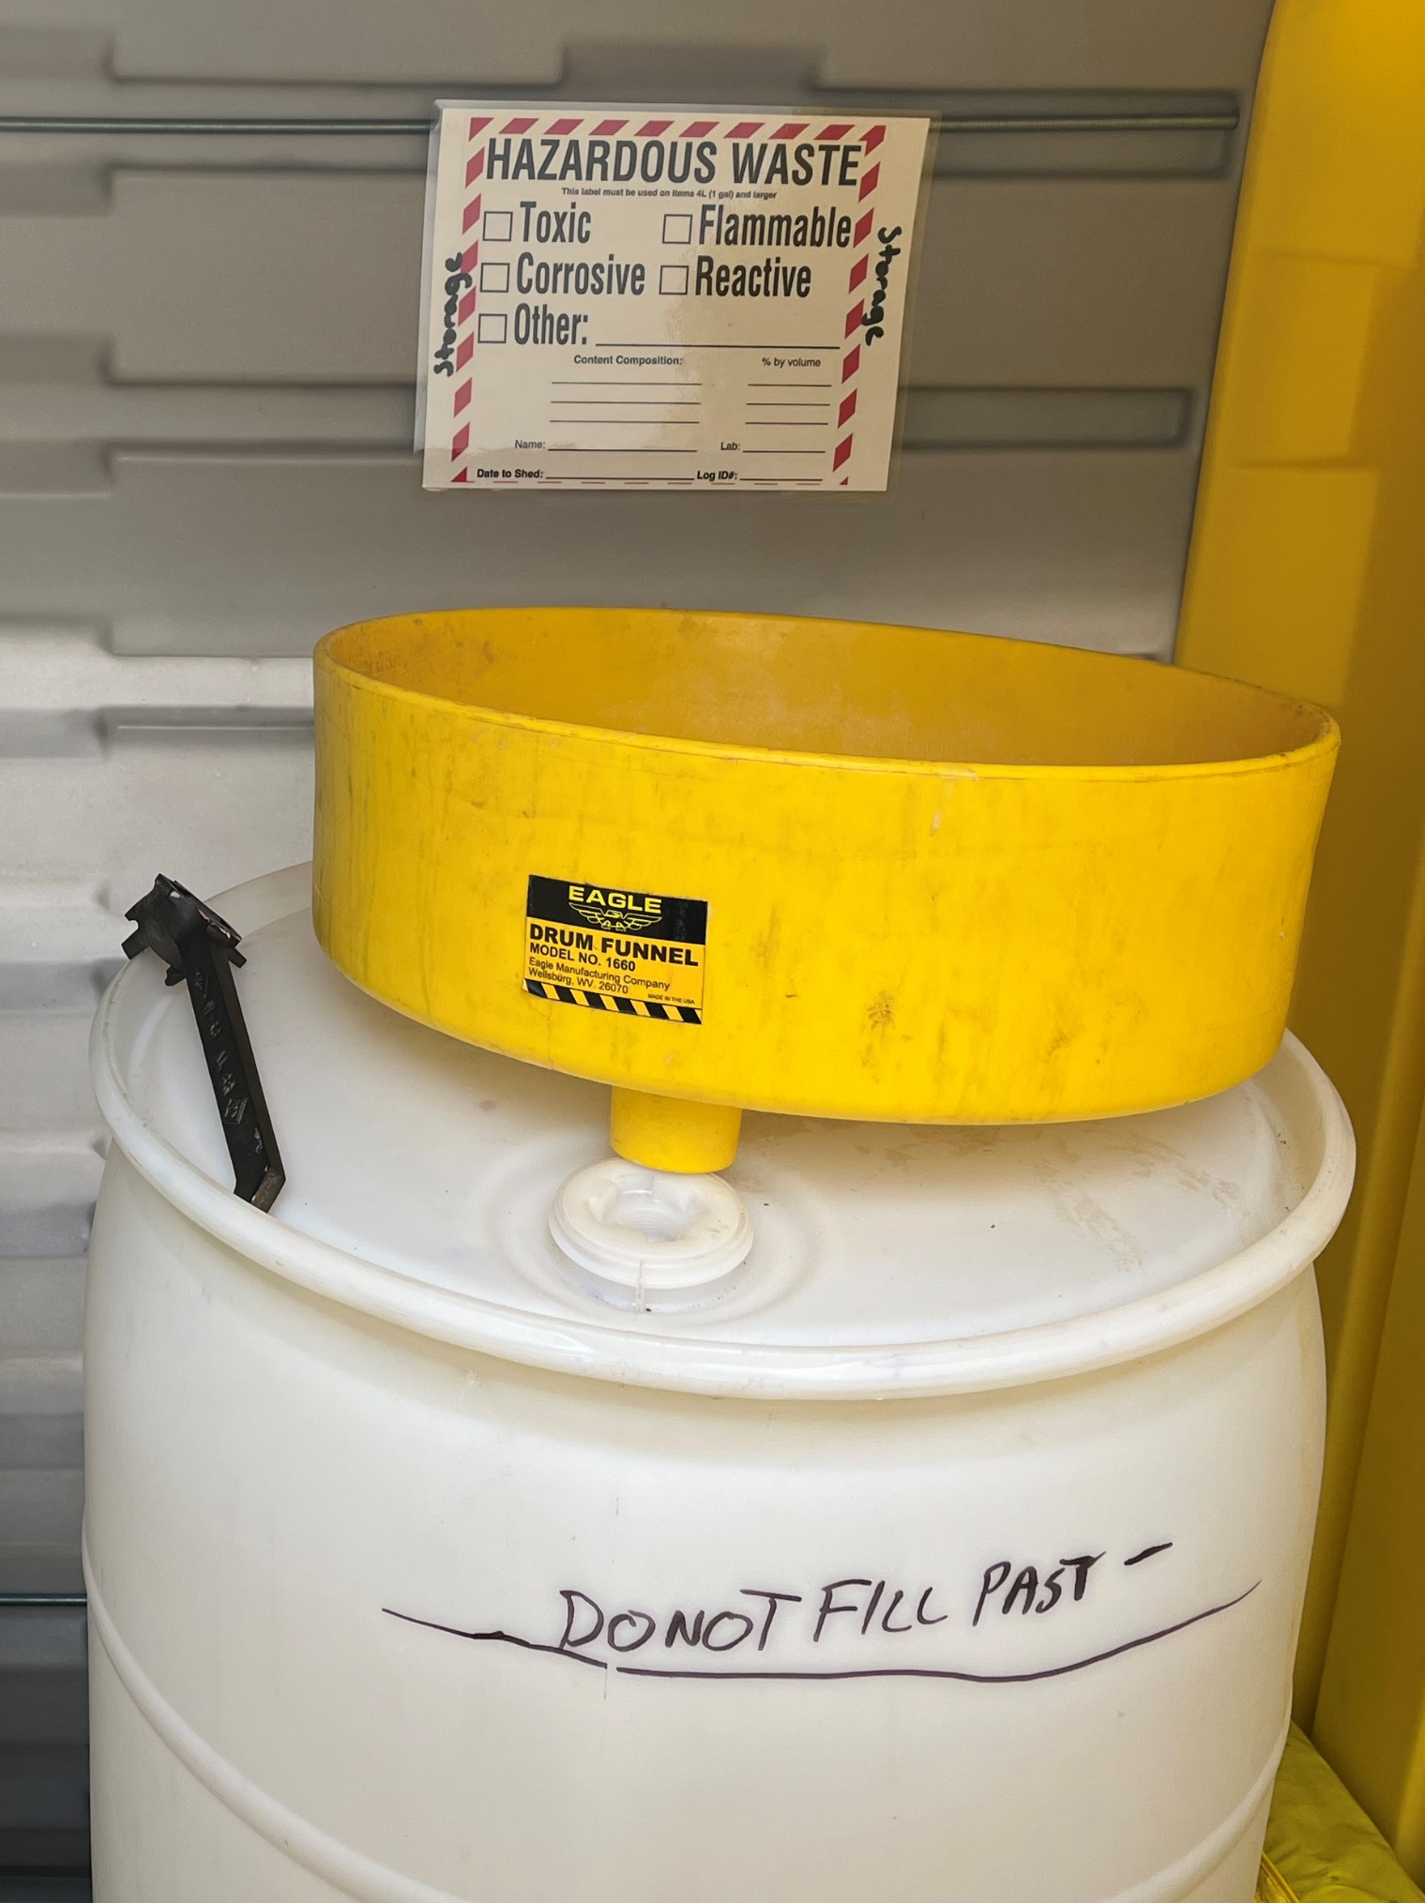
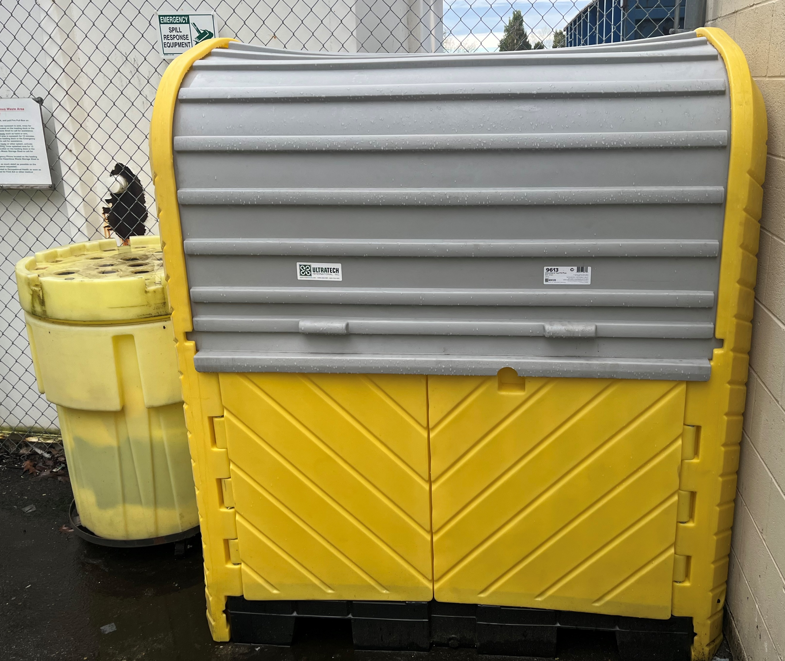
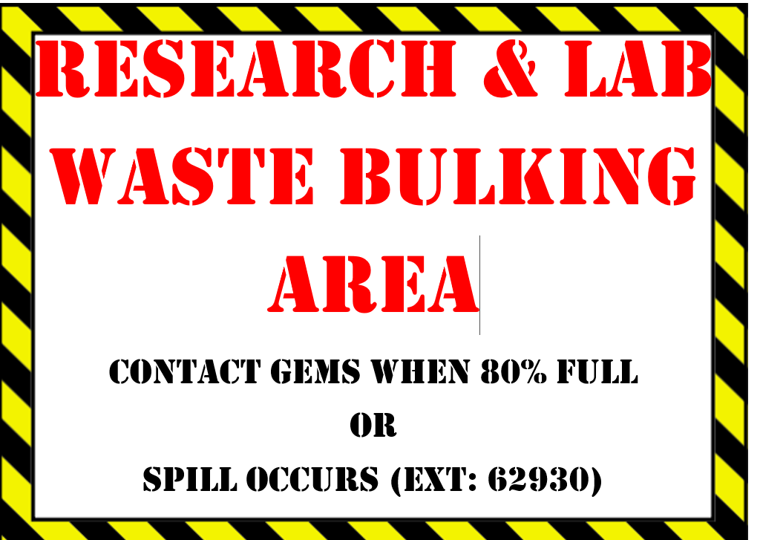
SEA Turn-in Requirements
You have 3 days when you date your container(s) to:
  Transfer it (w/ SDS) to the haz-waste shed (bldg. 1, rm B36) or
  Bulk it in the fenced area beside haz-waste shed (no SDS required)

Slide 19
SEA Haz-Waste Shed Requirements
Fill out waste log with:
  Log ID , Name, Contents, Weight, Section/Lab, & Date, Label Requirements
  Fill out your container’s haz-waste label with:
    Log ID

Slide 20
SEA Additional Requirements
All waste must be placed in secondary containment (black floor or green shelf containers
Safety
  Note emergency equipment
    Outside: fire pull station, emergency contact information
    Inside: emergency eyewash & shower, landline, fire extinguisher, emergency contact information, spill kits, & PPE
Security
  Contact GEMS for shed prox card access

Slide 21
SEA Bulking Requirements
Compatible Wastes that can be bulked
Acetone | Acetonitrile | Ethanol | Ethyl Acetate
Ethyl Alcohol | Hexanes | IHC Oil Waste | Isopropyl Alcohol
Methanol Stain Waste | Mineral Oil | Toluene | Xylene

Slide 22
SEA Additional Requirements
Safety
  Initial hands-on documented safety training required
  Personal Protective Equipment use required (Chemical resistant apron, gloves, & face shield are stored in green container)
Security
  Contact GEMS for fenced key access

Slide 23
Emergency Response
Incipient Fire
  If trained, follow (Pull Aim Squeeze Sweep) procedure
  Contact Safety and VA Police
Fire
  Pull fire alarm tab located outside of shed
  Get to a safe distance and call 911
Spill
  If yours, follow your department’s spill response procedure and call GEMS
  If not yours, follow (Stop Warn Isolate Minimize) procedure and call 911

Slide 24
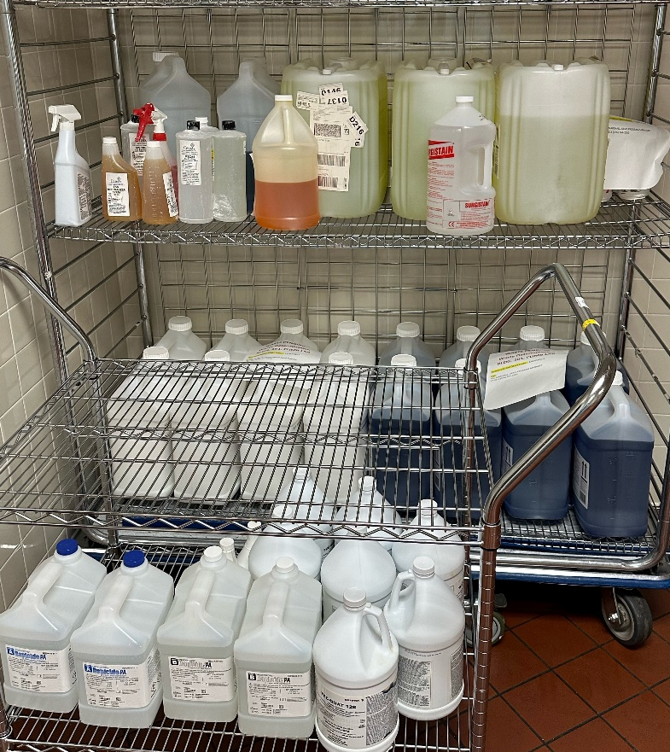
Lab Cleanout Requirements
Semi-Annual Lab Clean-Out Requirements
  Scheduled for May & Nov
  Combine compatibles & segregate incompatibles when staging
  Post sign stating, “Dangerous Waste Pending Analysis” and date
  Submit waste log form (incl: Contents, Weight in lbs., & Section) & SDS’s to GEMS PM
  Upon completion, your department will be notified for drop off / pick-up

Slide 25
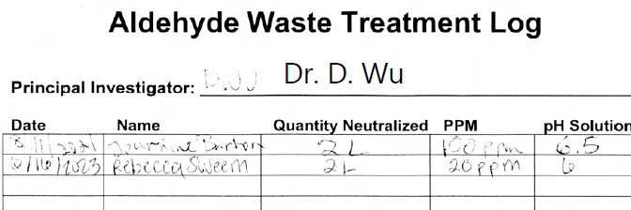
Treatment Requirements
Treatment by Generator Requirements
  Conduct department specific process & safety training
  Review, treat, & dispose of waste per SOP
  Input information into waste treatment log
Other forms of treatment: Carbon Adsorption, Elementary Neutralization, Evaporation, Filtration, Polymerization, Separation, Solidification / Stabilization
Contact the GEMS to explore potential options

Slide 26
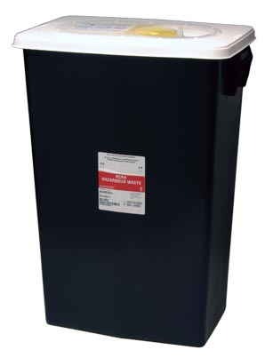
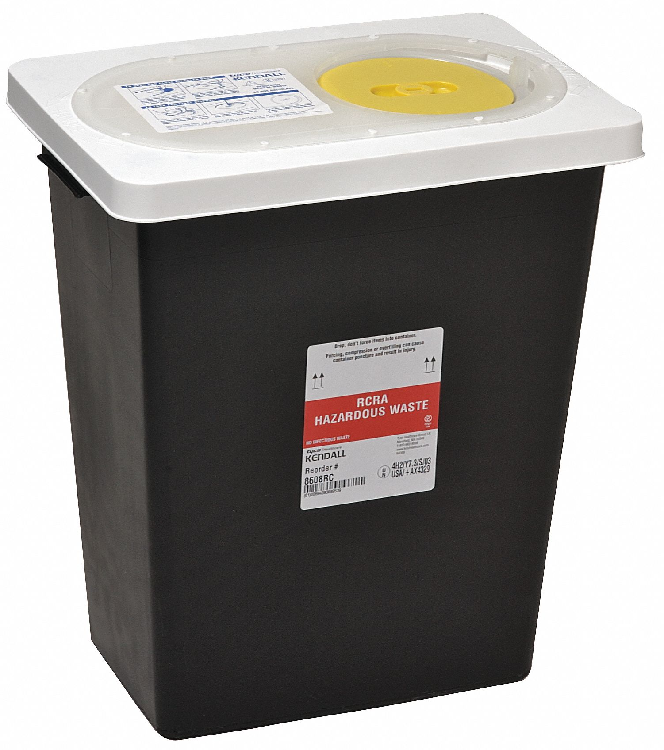
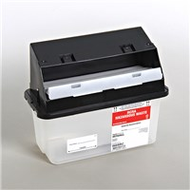
Hazardous Waste Pharmaceutical
18-gal hazardous waste pharmaceutical bins:
  Partially used and/or expired pharmaceuticals (i.e. Lindane, Warfarin, Nicotine, Melphalan, etc.)
  Bulk chemotherapy waste
8-gal hazardous waste pharmaceutical bins:
  Epinephrine, inhalers, & aerosols
Wall mounted hazardous waste pharmaceutical bins:
  Partially used and/or expired pharmaceuticals
Container must be labeled, initially dated, closed unless adding waste, & collected within nine months
Waste managed by GEMS

Slide 27
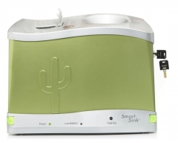
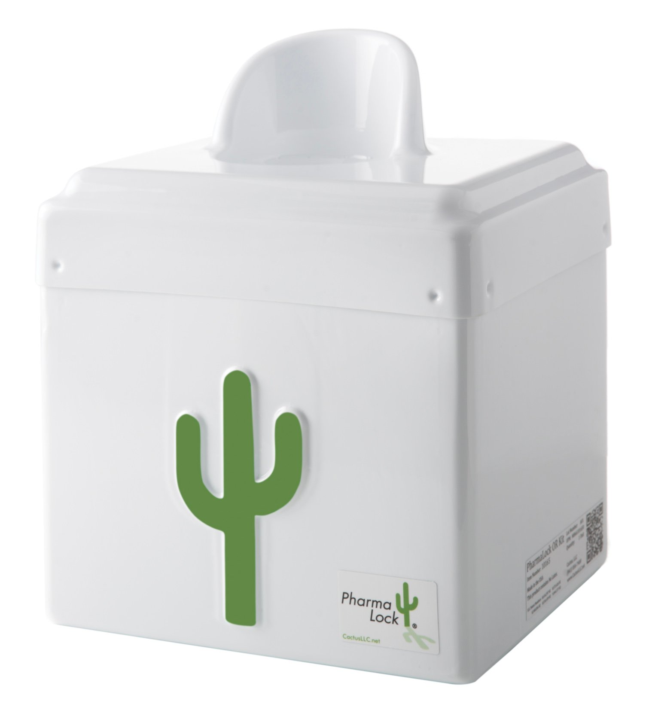
Controlled Substances
Green & Grey Container (Solids & Liquids Compartment) :
  Unused, partially used, and/or expired controlled substances (i.e. Codeine, OxyContin, Morphine, Xanax, Valium, etc.)
Blinking red lights indicate: Either or both sides are full, or battery needs to be replaced
White & Green Container (Liquids Only Compartment):
Waste managed by GEMS

Slide 28
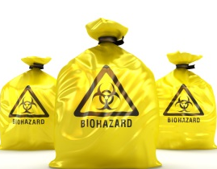
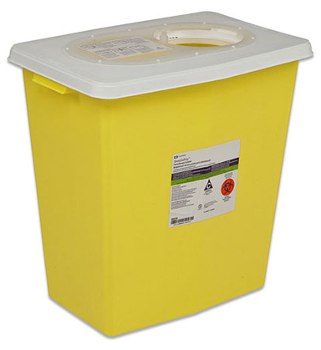
Trace Chemotherapy
Gray trace chemotherapy bins (yellow bag inside) :
  Gowns & PPE not visibly contaminated
  Wipes
  Tubing / Packing
2-gal trace chemotherapy sharps bins:
  Empty chemo vials & ampules
  Empty chemo syringes with no needles
  Chemo-contaminated cell culture plates
Containers acquired through Logistics
Container must be closed unless adding waste
Waste managed by EMS

Slide 29
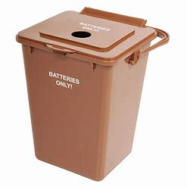
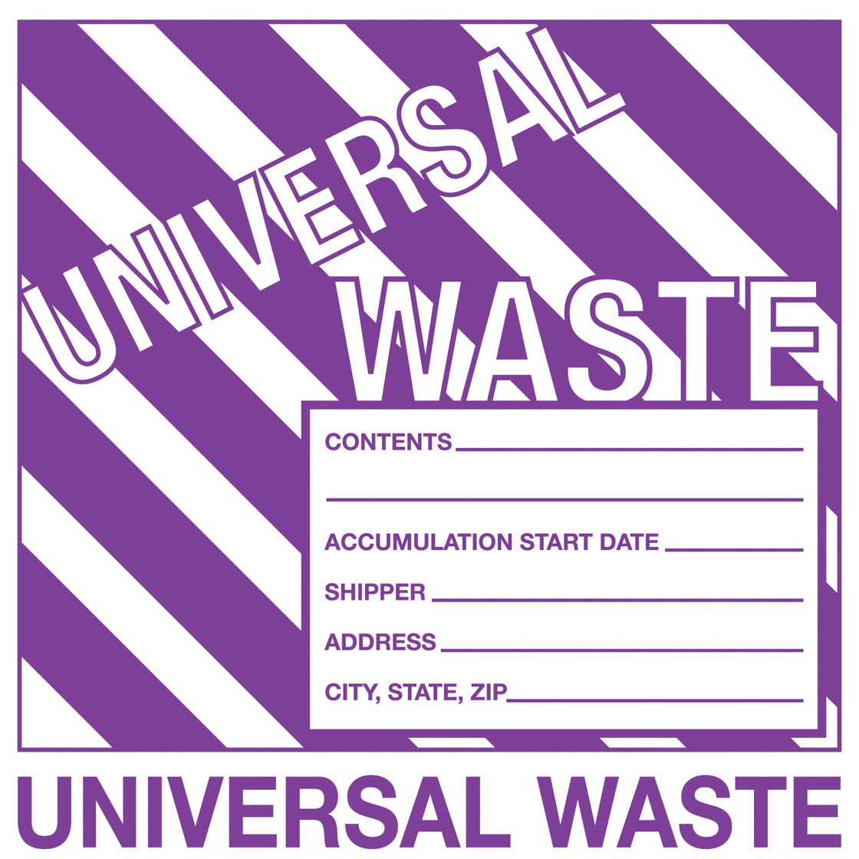

Universal Waste
2.25-gal used battery collection bins:
  Primary
    Alkaline & Carbon Zine
    Button/Coin Cell
    Lithium Metal
  Rechargeable
    Nickel-Metal Hydride / Cadmium / Zinc
    Lead-Acid
    Lithium Ion
Container must be labeled, initially dated, closed unless adding waste, & collected within nine months
Tape positive (+) terminal with non-conductive tape
Waste managed by GEMS
Used Batteries
4/17/24

Slide 30
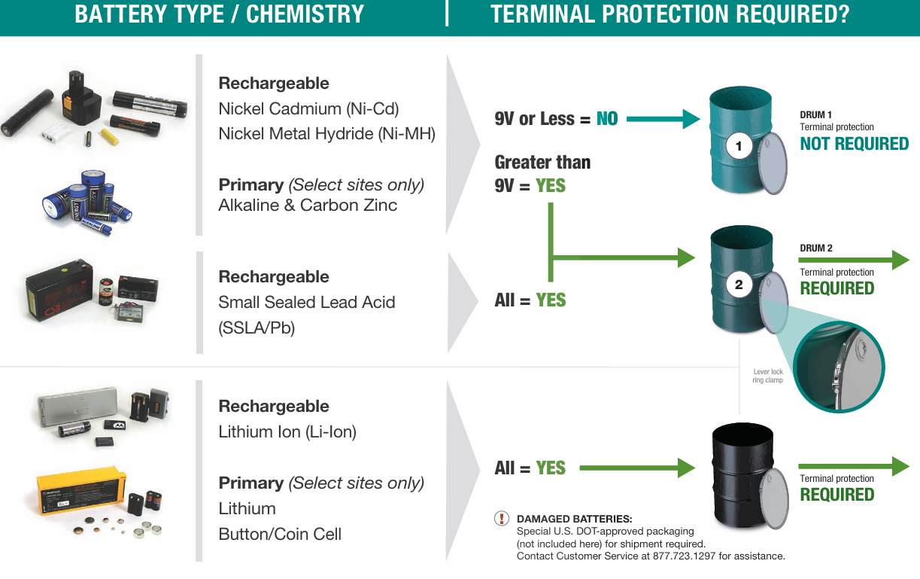

Battery Turn-in Requirements

Slide 31
Universal Waste
UN rated cardboard boxes, drums, or buckets:
  Lamps
    Fluorescent Tubes, Compact Fluorescent, High intensity discharge (e.g., mercury vapor, metal halide, high pressure sodium), Neon
  Mercury-containing equipment
    Thermometers, Thermostats, Barometers, Tilt switches, Manometers, Flame sensors
Container must be labeled, initially dated, sealed closed unless adding, & collected within nine months
Waste managed by GEMS
Used Lamps
4/17/24
Used Mercury-containing equipment
4/17/24

Slide 32
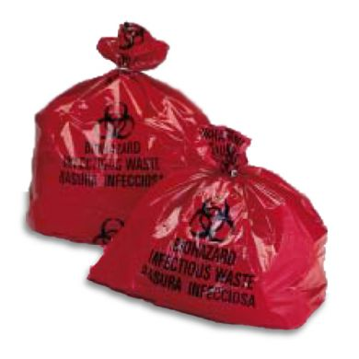
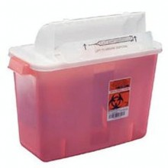
Regulated Medical Waste
Containers with regulated medical waste red bags:
  Blood & other potentially infectious material (OPIM)
  Blood tubing, bags, Hemovacs, & Pleurovacs
  Soaked, dripping, bloody dressings
  Intact glass or plastic containers with bloody fluid or OPIM
  Suction liners with bloody fluid or OPIM
  All disposable items soaked or dripping with bloody fluid or OPIM
Wall mounted regulated medical waste sharps bins:
  Empty / broken glass vials or ampoules
  Needles, Blades, Scalpels, Razors, Pins, Clips, Staples
  Empty syringes
  Trocars
  Introducers
  Guide wires
  Sharps from procedures
Container must be closed unless adding waste
Waste managed by EMS

Slide 33
Recordkeeping & Other Requirements
Records | Retention Period | Document Control
Hazardous & Universal Waste Manifests | 5 Years | GEMS
Regulated Medical Waste Manifests | 3 Years | EMS
Training Records | Ongoing for current & 3 years for former employees | TMS and/or your dept./service line supervisor
Waste Designation | 5 Years | GEMS
Waste Profile | 5 Years | GEMS
Seattle: Large Qty Generator (90 days to ship waste)
American Lake: Medium Qty Generator (180 days to ship waste)

Slide 34
Contacts
Location | Department | Title | Phone Number
American Lake | Safety | GEMS Program Manager | 253-583-3511
Seattle | Safety | GEMS Program Manager | 206-264-2930
American Lake & Seattle | Research | R&D Safety Officer | 206-277-6200
Seattle | Research | R&D Safety Specialist | 206-277-6375
American Lake & Seattle | Clinical Lab | QA/Safety Manager | 206-764-2674

Slide 35
References
Handling & Disposal of Hazardous Waste Medical Center Policy (MCP EC-107)
Regulated Medical Waste Management (SOP E-040)
WAC 173-303-200(9) Haz-Waste Training
WAC 173-303-555(3)(b) Haz-Waste Pharm Training
WAC 173-303-573 (23) Universal Waste Training
10.07.060(A) Biomedical Waste Training

