Slide 1
Provider Performed Microscopy Refresher Course
Urine sediment
Vaginal Wet prep
KOH Prep
Microscope Review

Slide 2
Urine Sediment
Urine sediment is first examined under low power to identify most crystals, casts, squamous cells and other large objects.
Next the examination is carried out at high power to identify crystals, cells, and bacteria.

Slide 3
Epithelial Cells
The occurrence of squamous epithelial cells in urine sediment is quite common and in most instances is indicative of contamination due to improper specimen collection.
Occasionally urine sediment may include other types of epithelial cells such as transitional or renal tubular. The presence of these cells is clinically significant.

Slide 4
Squamous Epithelial Cells
Not significant
These cells are large and flat, with abundant cytoplasm and small round central nuclei. Their margins are often folded or rolled into cylinders.
May appear singly or in sheets.
Reference Values: 12/lpf (low power field)

Slide 5
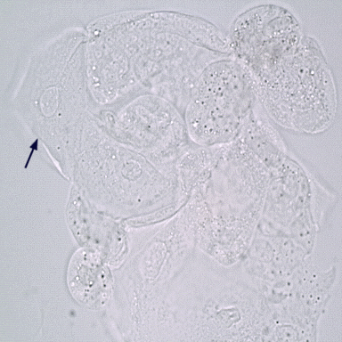
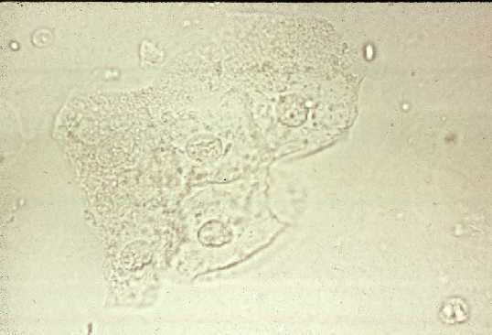
Squamous Epithelial Cells

Slide 6
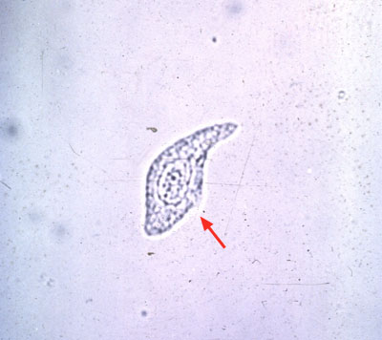
Transitional Epithelial Cells
The presence of large clumps of these cells suggest possible transitional cell carcinoma and a cytological examination may be indicated.

Slide 7
Renal Tubular Epithelial Cells
Small numbers may be seen in the normal urine, reflecting the normal sloughing of aging cells.
Epithelial cells measure 12-20 microns and are identified by their characteristic cubodial or oblong shape and large, usually eccentric nucleus.
An increased number may indicate tubular damage or necrosis.
Reference Value: Rare

Slide 8
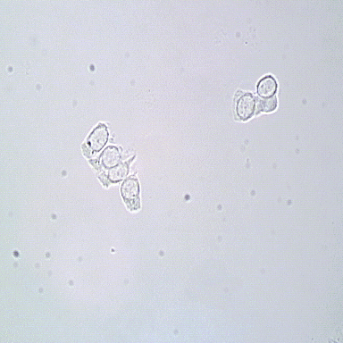
Renal Tubular Epithelial Cells

Slide 9
Squamous, Transitional & Renal Epithelial Cells

Slide 10
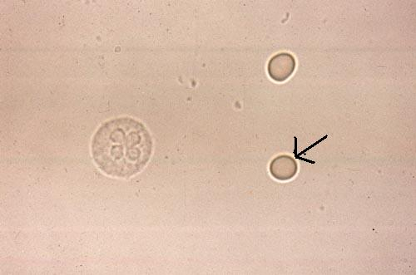
Neutrophil and Erythrocytes WBC’s and RBC’s
WBC’s appear as granular spheres about 12 microns in diameter. Nuclear detail is well defined.
RBC’s appear as pale disks.

Slide 11
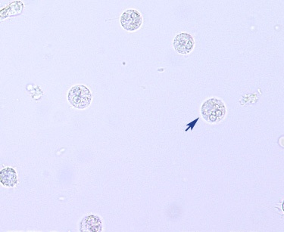
White Blood Cell
WBC’s in urine may originate from any part of the renal system. The presence of >5/HPF suggest infection, cystitis or plelonephritis.
Reference Value: <5/HPF

Slide 12
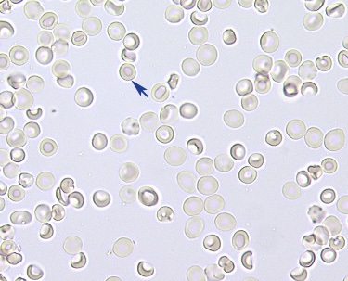
Red Blood Cell
Large numbers may be present in renal disease, lower urinary tract disease, acute appendicitis, toxic reactions to drugs, or after exercise.
Reference Values: <5/HPF

Slide 13
WBC, RBC, Squamous Epithelial

Slide 14
Crystals
Knowledge of urine pH helps with identification of crystals.
Common crystals that occur in normal urine include phosphate, uric acid and oxalates.
Important crystals include: cystine, tyrosine, leucine, sulfonamide, and ampicillin (high dose).

Slide 16
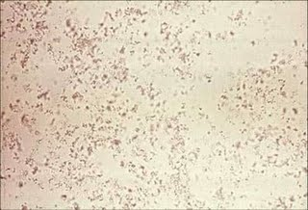
Amorphous Phosphates
Neutral to alkaline urine
Small brown granules form clumps and adhere to fibers and mucous threads. They dissolve with warmth and addition of acid.

Slide 17
Uric Acid
Acid urine
Commonly yellow brown.
Large variety of shapes
Rhombic four-sided plates
Rosettes
Lemon shapes
Large numbers may reflect increased nucleoprotein turn over especially during chemotherapy or from leukemia or lymphoma.
Some evidence of small stones lodged in ureters especially if found with raised serum uric acid.

Slide 18
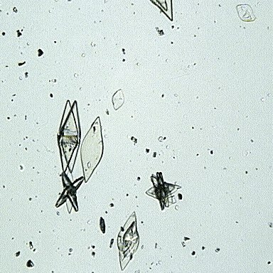
Uric Acid

Slide 19
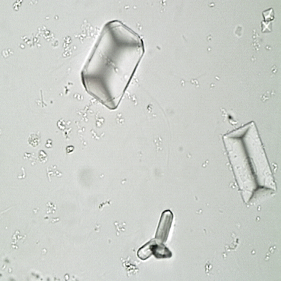
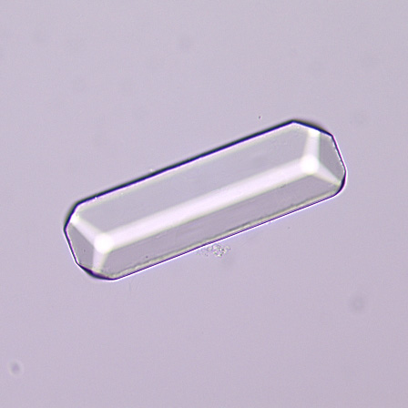
Triple Phosphate
Neutral to alkaline urine
Common form is 3-6 sided prisms or “coffin lids”
Little clinical significance

Slide 20
Tyrosine
Acid urine
Uncommon fine, silky needles that may be arranged in sheaves or clumps.
Colorless or black
Occasionally seen in patients with severe liver disease.

Slide 21
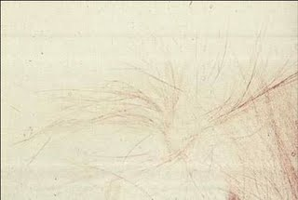
Tyrosine

Slide 22
Leucine
Acid urine
Rare, yellow oily appearing spheres with radial and concentric striations
Highly refractive brown spheres with spoke-like striations extending to the periphery.
Occasionally seen in patients with severe liver disease.

Slide 23
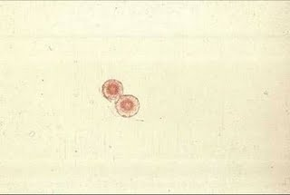
Leucine

Slide 24
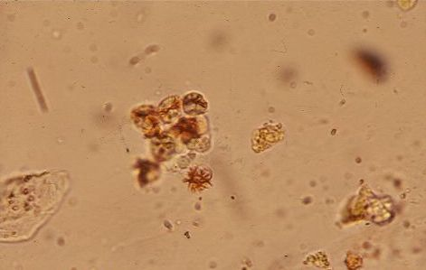
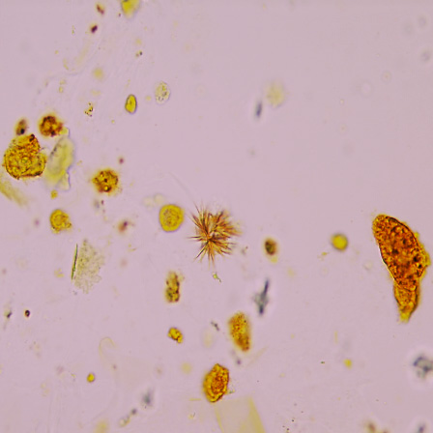
Bilirubin
Acid urine
Small reddish brown cluster; amorphous needles, rhombic plates, or cubes
Accompanies bile-stained cells

Slide 25
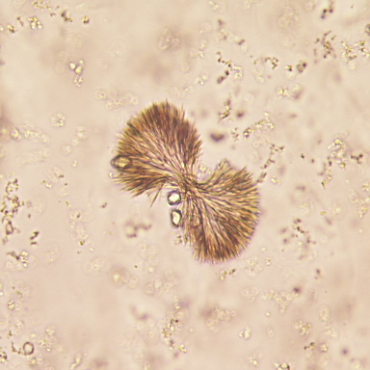
Sulfonamide
Acid urine
Rare
Various forms, depends on form of drug
Yellow-brown, occasionally colorless
Resembles sheaves of wheat with central bindings or fan-shaped

Slide 26
Calcium Oxalate
Neutral to acid pH urine
Small colorless; resembles envelopes
Smaller than RBC’s
Oval, elliptical or dumbbell forms are less common
May reflect severe chronic renal disease or ethylene glycol or methoxyflurane toxicity.

Slide 27
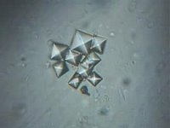
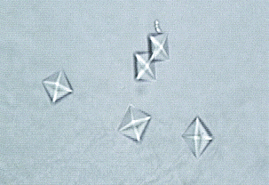
Calcium Oxalate

Slide 28
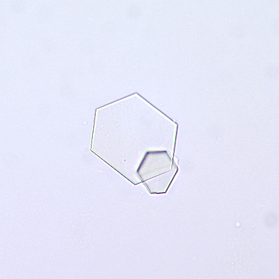
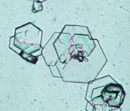
Cystine
Acid urine
Colorless, hexagonal plates, often laminated
Wide variation in size
Found in patients that have cystinuria and may be associated with cystine calculi

Slide 29
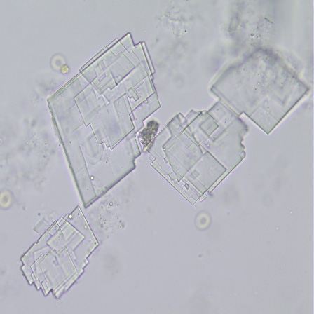
Cholesterol Crystals
Acid to neutral pH urine
Large, flat, clear rectangular plates or rhomboids, which often have a corner notch
Often accompany fatty casts and oval fat bodies

Slide 30
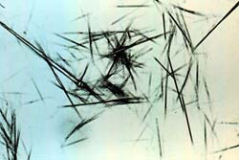
Ampicillin
Following large, intravenous doses it appears as long, slender, colorless crystals that aggregate into irregular sheaves

Slide 31
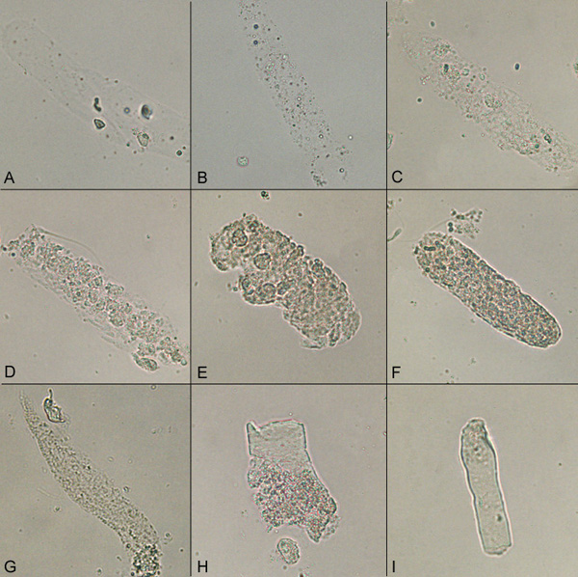
Casts
Colorless gels from protein in the tubules of nephrons
A: Hyaline cast
B: Fatty cast
C: Hyaline to finely granular cast
D: Cellular cast E: Cellular to coarsely granular cast
F: Coarsely granular cast
G: Finely granular cast
H: Granular to waxy cast
I: Waxy cast

Slide 32
Hyaline Casts
Most frequently occurring
Colorless, homogenous, transparent with the ends usually rounded
Can be seen in even the mildest renal disease
Sometimes found with exercise, fever, congestive heart failure and diuretic therapy

Slide 33
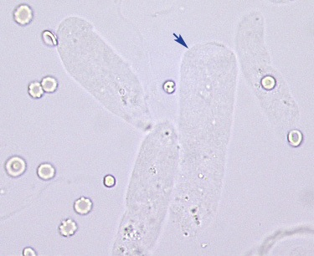
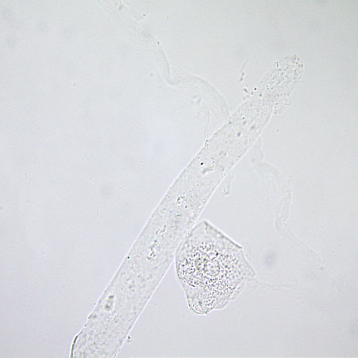
Hyaline Casts

Slide 34
Granular Casts
May contain fine or coarse granules, gray or pale yellow in color
Granules represent plasma protein aggregates that pass into the tubules from damaged glomeruli and cellular remnants from WBC’s, RBC’s or damaged renal tubular cells
Almost always indicates significant renal disease
Found in glomerular and tubular diseases and tubular interstitial disease and renal allograft rejection

Slide 35
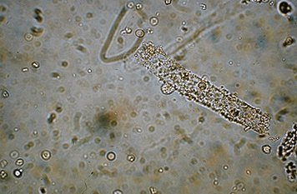
Granular casts

Slide 36
Waxy cast
Broad and stubby with blunt ends that appear broken off
Differ from hyaline in that they are highly refractile
Homogeneously smooth with sharp margins or cracked margins, indicating brittleness
Observed most frequently in patients with renal failure, but also during acute and chronic renal allograft rejection

Slide 37
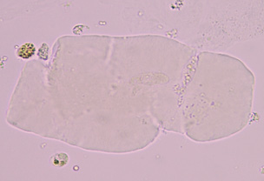
Waxy cast

Slide 38
Fatty Cast
Contain larger numbers of spherical, highly refractile fat droplets of varying size
Material is incorporated into the cast from lipid-laden renal tubular cells
Visible fat droplet is triglycerides of cholesterol esters
Common in heavy proteinuria and are a feature of nephrotic syndrome

Slide 39
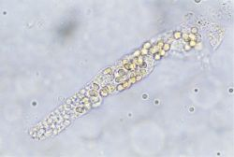
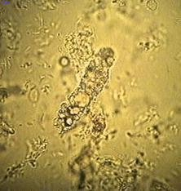
Fatty Casts

Slide 40
Red Cell Cast
Predominant cells are intact RBC’s
Brown to almost colorless
Indicates renal hematuria
Diagnostic of glomerular disease or renal parenchymal bleeding
A prerequisite for ID of the RBC cast is that red blood cell outlines are sharply defined in at least part of the cast

Slide 41
Red Cell Cast

Slide 42
WBC Cast
The cast may be crowded with cells or have only a few clearly defined cells present
They contain predominately intact segmented neutrophils with cell membranes and nuclei
Associated with neutrophilic exudates and interstitial inflammation present in the kidney

Slide 43
White Cell Cast

Slide 44
Renal Tubular Epithelial Cell Cast
Epithelial cells within matrix are usually intact and irregularly dispersed or lined up in columns that indicate the sloughing of the epithelium of an entire tubule
The matrix may be scant or difficult to visualize due to overlying cells but it must be present in order to identify a cast.
Seen in urine with acute tubular necrosis, viral disease or exposure to various drugs. May look like a WBC cast.

Slide 45
Renal Tubular Epithelial Cell Cast

Slide 46
Bacteria

Slide 47
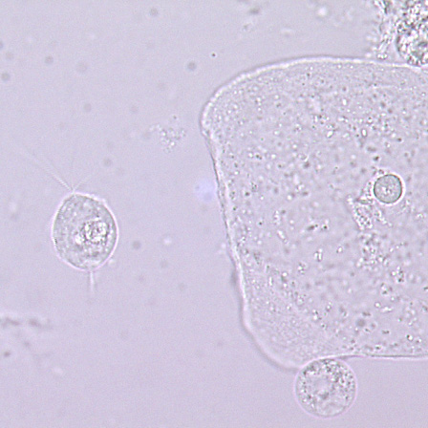
Trichomonas Vaginalis
May be present from vaginal infection
This protozoa should be searched for immediately since motility is helpful in making the appropriate identification

Slide 48
Yeast and budding yeast

Slide 49
Yeast with Hyphae

Slide 50
Fiber

Slide 51
Vaginal Wet Prep Video
uw_exam_256k.ram

Slide 52
PPM Test Procedures
A written procedure is required for each PPM test performed
Approved PPM test procedures are located on the Hopkins Policy Online Clinical Manuals, Pathology Volume 1

Slide 53
Saline and KOH Wet Preps
Specimen is a swab of vaginal mucosa or vaginal pool
Specimens should be tested with pH paper before being placed in saline
Swabs should be placed into tubes containing 0.5-1.0 ml sterile saline, then resealed
Tubes should be properly labeled
Specimens should not be refrigerated
Specimens should be examined as soon as possible after collection
If many epithelial cells are seen, a KOH preparation should be done to determine the presence or absence of yeast

Slide 54
Interpretation of Results
 | Normal | Bacterial Vaginosis | Trichomonas Vaginitis | Vaginal Candidiasos
pH | 3.8-4.2 | >4.5 | >4.5 | < 4.5
‘Whiff” | Negative | Positive | Positive | Negative
Saline | Lactobacilli Epithelial cells WBC: 2+ | Clue cells WBC: 2+ | Motile Trichomonads WBC: 2+ to 4+ | Budding yeast, Pseudohyphae Large clumps of epithelial cells WBC: 3+ to 4+
KOH | Absent | Absent | Absent | Budding yeast, Pseudohyphae present

Slide 55
Documentation of Results
Providers shall use the same terminology, reporting format and reference (normal) values.
Documentation in the clinical record shall be filed promptly and include the date, time, result and name of the individual who performed the test.
The specimen source shall be identified on the report

Slide 56
Saline Wet Prep Results Reporting Format
Test | Reported Result | Normal Range
WBC | #/ hpf | 0-5/hpf
Clue Cells | #/hpf | None
Other Cells | #/hpf (Note cell type; clumping present) | Squamous Epithelial
Bacteria | #/hpf | Predominant: Lactobacilli
Trichonomads | #/hpf | None
Yeast | #/hpf | <1/ 10 hpf

Slide 57
KOH Prep Results Reporting Format
Test | Findings | Reported Result | Normal Range
Whiff | No Odor | Negative | Negative
 | “Fishy” Amine Odor | Positive
KOH | No Trichonomads, Clue cells, Yeast/Pseudohyphae | Absent | Absent
 | Presence of yeast/pseudohyphae | Present

Slide 58
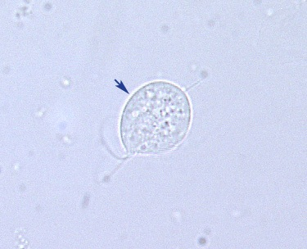
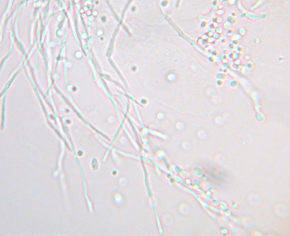
Trichomonas, epithelial cell and yeast

Slide 59
Clue Cell
Bacterial vaginosis is the most common type of vaginal infection and can sometimes be detected by the presence of “clue cells.” Clue cells are
epithelial cells entirely covered with bacteria giving the cell a “furlike”appearance.

Slide 60
Microscope Review
Specimens are placed on a glass slide with a cover slip
Cover slipped slides should only be viewed using the low or high power objective with subdued light
NEVER use the oil immersion objective to examine a wet specimen
Scan the specimen under low power first.
When you find an area of interest , switch to the high dry objective for a closer look.
Examine at least 10 fields, continually adjusting the fine focus
Dispose of slide in a sharps disposal container.

Slide 61
Microscope Maintenance
Microscope should be kept covered when not in use.
Clean the objective lenses, eyepieces and condenser daily , or after each use.
Use a high quality lens paper that has been slightly dampened with an approved lens cleaner.
NEVER use alcohol, xylene, kleenex, Kimwipes or cotton swabs or gauze
An annual service inspection and thorough cleaning by a technical representative is required.
Documentation of Equipment Maintenance is required

Slide 62
Training and Competency Assessment
Credentialed testers are required to have documented initial training and competency for each test they are authorized to perform.
Semi-annual competency assessment is required for all testing personnel
Providers are notified by e-mail with specific instructions on accession and deadline of tests.
Acceptable performance: Score of > 80%
Unacceptable performance: Score < 80% or failure to participate
Failure requires documented retraining and retesting prior to resumption of testing.

