Slide 1
Inform II Initial Training
ACCU-CHEK® Inform II
Wireless Blood Glucose Meter
ACCU-CHEK® Inform II Test Strip
Notes:
Overton Brooks - VAMC

Slide 2
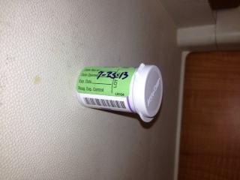

INFORM II STRIP VIAL REQUIREMENTS
QC Date (Label bottle) is required to show that quality control has been performed on new bottle of strips before patient use.
Expiration date is the manufacturer expiration date. Do not cover this date with QC Date label.
Notes:
All opened box of strips must be label with QC date and performed.

Slide 3
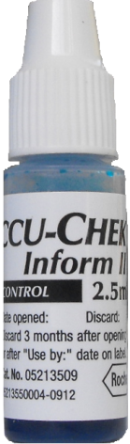
Control Bottle Requirements
Write Discard date on label of each control bottle when BOX is opened.
Controls expire three months after opening, or at manufacturer’s expiration date if it is sooner.
Be sure to include the full date on the bottle for discard date: mm/dd/yy
Notes:
Open the set of Controls, label with 3-month Dicard dating, discard as a set.

Slide 4
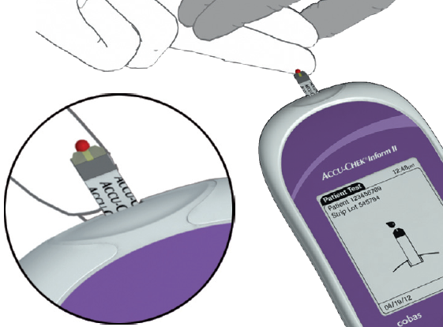
Test Strip Performance – Accu-Chek® Inform II
Accurate and precise.
0.6 microliter test sample.
Fast 5 second test time.
10-600 mg/dl assay range.
Cannot be short sampled.
No code key change with each new vial.
TRUE WIRELESS

Slide 5
Your Operator ID
You may scan Operator’s Barcoded ID or manually enter your unique ID
All operator ID’s are digits
Do not share or borrow another’s ID!
Notes:
ATC provides Operator barcoded ID label

Slide 6
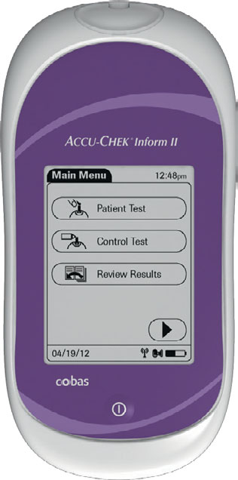
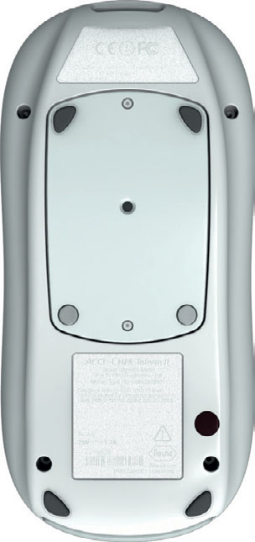
Meter Design – Accu-Chek® Inform II
Test strip port
Bar code scanner
Sealed screen and case are flat and easy to clean and disinfect.
Rechargeable battery pack
Bright backlit touchscreen display that is easy to see.
Infrared window for communicating with the base units.
On/Off button

Slide 7
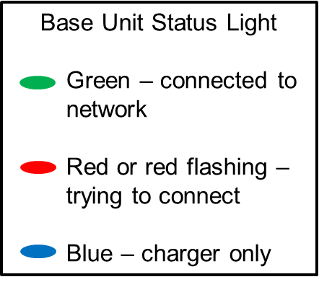
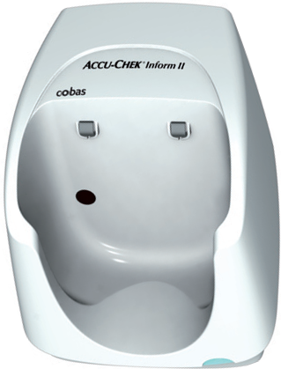
Base Unit Design – Accu-Chek® Inform II
Battery charging contacts
.
Infrared communication for the meter (if the base unit is connected)
Base unit status light – green means connected to the network

Slide 8
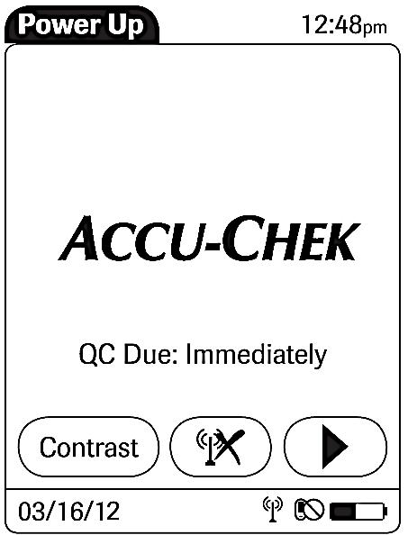


Power Up Screen
How many hours until quality control is due.
Press the Forward Arrow Button to continue.
Battery gauge
Last attempted (attempts every 10 minutes) wireless communication status icons (see below)
means the last attempt to communicate to the data management system was successful
means the last attempt to communicate to the data management system was unsuccessful or was unintentionally terminated (may need to dock the meter)

Slide 9

How to Use the Barcode Scanner
  Do not stare directly into the laser and don’t point meter toward patient’s face.
Press and release the barcode button to turn on the scanner.
Aim the laser 4-6 inches away from the barcode you want to read.
Hold the bar-coded object still while you are positioning the laser beam to read it.
ON THE PATIENT WRISTBANDS, MAKE SURE THE LASER BEAM COVERS THE WHOLE BARCODE:
The laser will stay on for approximately 10 seconds to read a bar code. If it does not read a bar code, it will then take approximately 5 seconds for it to reset; then you can attempt to read the bar code again.
Acceptable

Slide 10
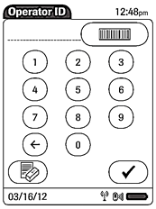
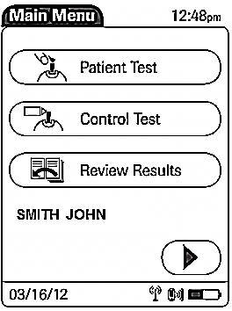
Input Operator ID and Menu Screen
If manually inputting your operator ID, the number will be displayed here.
Press and release the barcode
button to turn on bar code reader to scan your barcoded ID.
Back button (like a backspace).
To erase your entire entry, press the erase button (new button).
To scan, position the Inform 4 to 6 inches away from your bar coded badge ID.
Main Menu Screen
To perform a control test, press the “Control Test” menu item.
Your name should be displayed here.

Slide 11
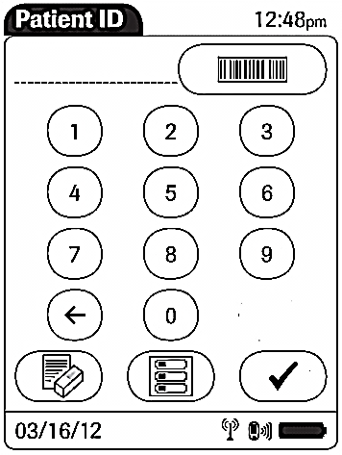
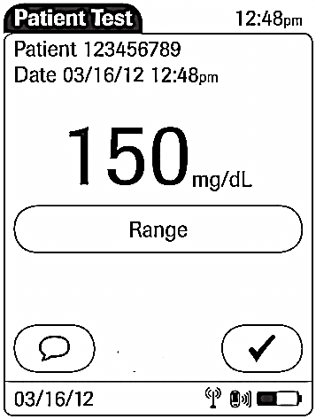
Navigation – Accu-Chek® Inform II
To display “Menu” use menu icon button on the screen.
To “Scan” use barcode icon button.
In most screens, to “Forward” to next screen use check mark icon on the screen.
To apply “Comment” use comment icon button.

Slide 12
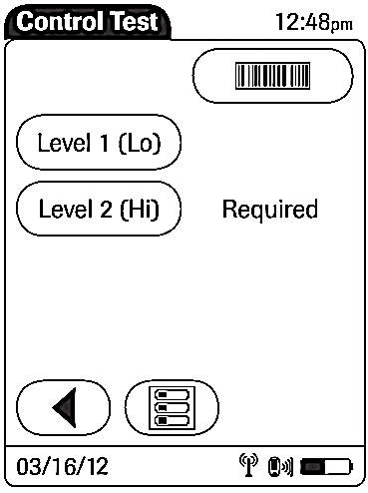
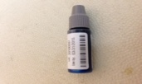
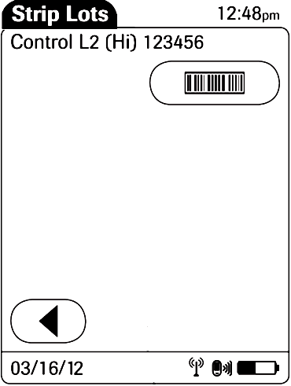
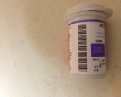
Preparing to Run Controls
Press the barcode button and scan the
REQUIRED label showing that a Level is due now.
First “Scan” the control bottle and then the strip vial for each control test.
REMEMBER: Must perform 2 control levels on each strip vial in use after 4:00 a.m. and when opening a new vial of strips.
Press barcode button to scan your barcode on the strip vial.

Slide 13
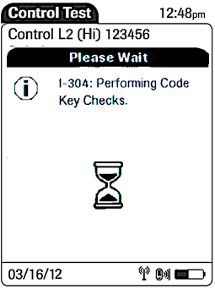
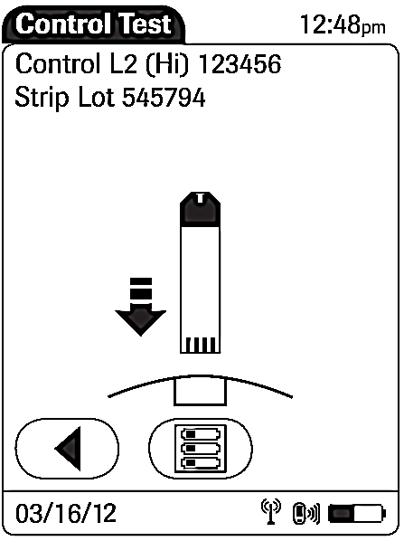
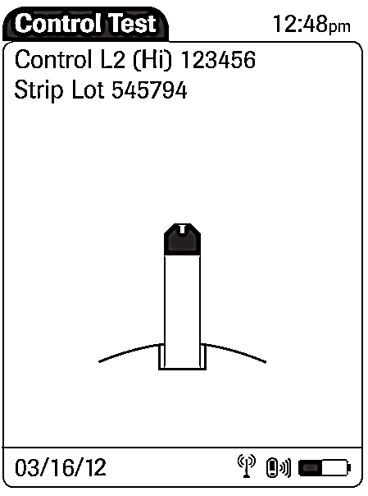
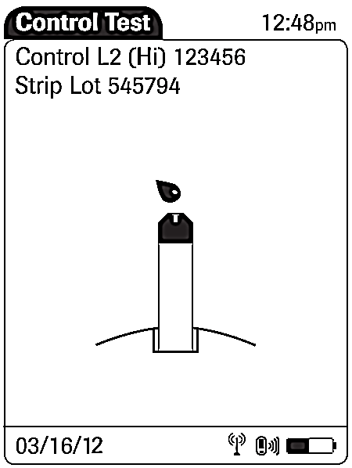
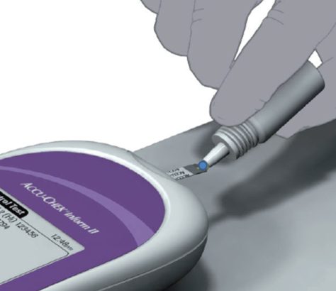
Screens While Running Controls
After the meter performs the strip integrity checks, the meter will beep again and a red blood drop will appear. Do not add sample until this drop appears.
Apply to the front edge of the
yellow reaction area
and fill the yellow window – DO NOT ATTEMPT TO PLACE SAMPLE ON THE TOP OF THE STRIP.
Squeeze small drop
Of QC solution; keep the meter level to prevent solution from entering the test strip port area.

Slide 14
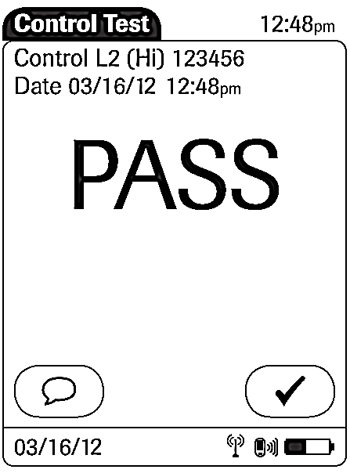
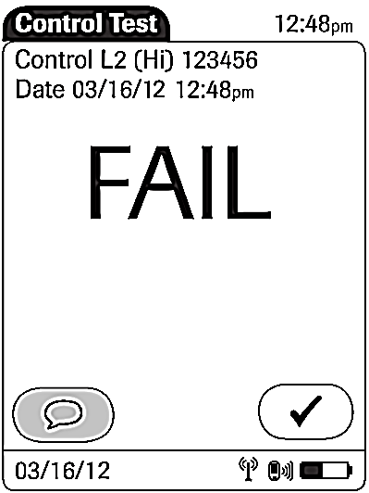
Control Results
If QC fails, you must enter a comment. The comment icon will be flashing. You will not be able to proceed until you add a comment.
If QC passes, just press the check button and continue.
As a reminder, a comment is required for QC that “Fails” and for patient results in the critical range .

Slide 15

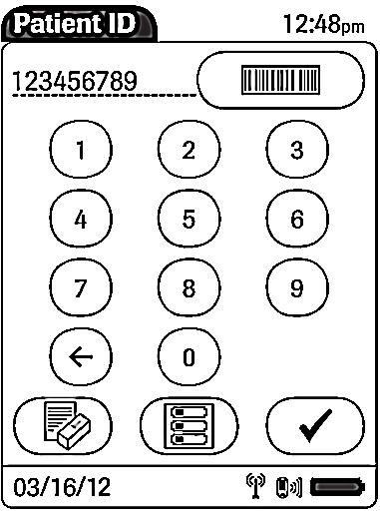
To Run a Patient Test
Press the “Patient Test” from the Main Menu.
Input the inpatient full SSN by scanning the barcode on the patient wristband, or for outpatients manually enter full SSN.
Press and release the barcode button then scan the patient wristband.

Slide 16
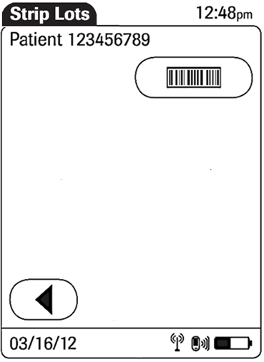
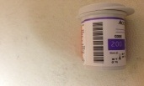
Scan the Test Strip Vial
To continue with the patient test, press the barcode to scan the strip lot.
Scan strip vial
Proceed to specimen collection

Slide 17
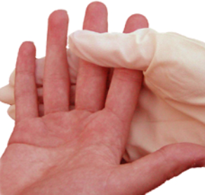
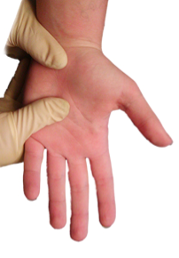
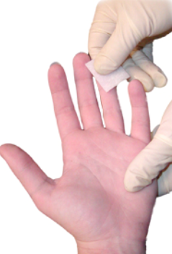

How to Collect a Proper Fingerstick Sample
1. SELECT THE FINGER SITE
Select the side of the fingertip that has not been lanced recently.
Each test should be performed from a new skin puncture. The middle or ring finger is preferred. Do not use an old puncture site.
2. ACCESS THE PUNCTURE SITE
To help insure that an adequate sample is obtained, have the patient hold his or her hand in a downward position. Applying gentle pressure, massage the inside of the patient’s hand from the palm to the base of the finger to be lanced and up to the tip of the finger.
4. Press Lancet firmly against side of fingertip.
Wipe away the first blood drop with a dry gauze pad.
Hold the puncture site downward and gently apply intermittent pressure to the surrounding tissue. Strong repetitive pressure (milking) should not be applied; it may cause tissue-fluid contamination.
3. DISINFECT THE PUNCTURE SITE
Cleanse the puncture site using a skin preparation pad. Let the solution dry before puncturing.
It is very important to make sure the puncture site is dry. Alcohol or other skin preparation ingredients may interfere with the glucose test chemistry and cause an inaccurate reading.
Notes:
Glucose meter should always be on the display screen ready for patient sample (red drop) of blood displayed, before a finger-stick is performed.

Slide 18
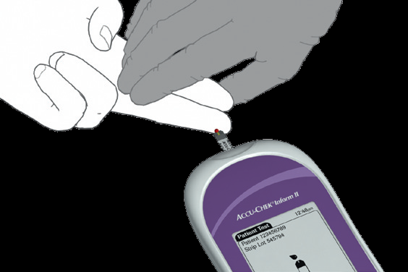
Apply the drop of blood to the front edge
  OBTAIN ADEQUATE BLOOD FROM THE PUNCTURE . Blood should cover entire yellow dosing area

Slide 19
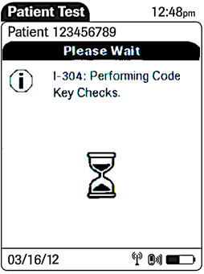
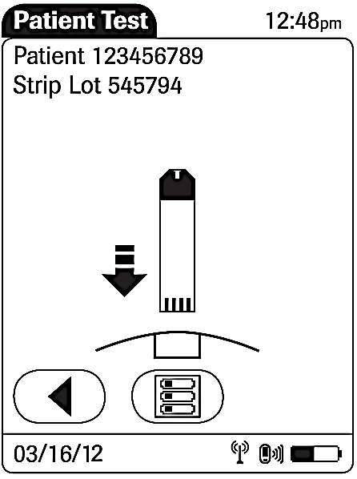
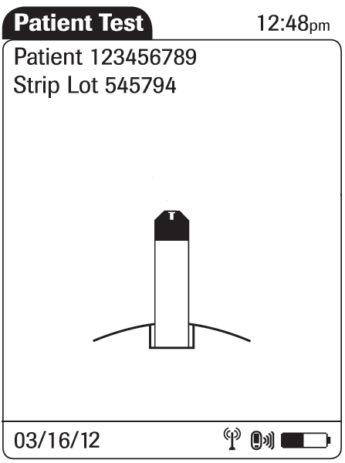
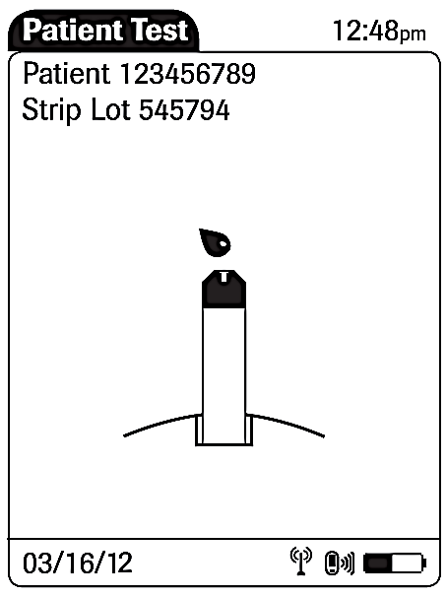
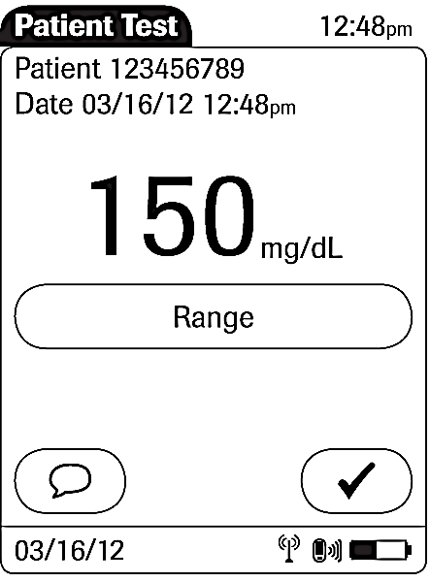
Screens While Running a Patient Test
After the meter performs the strip integrity checks, the meter will beep again, and a red blood drop will appear. Do not perform finger-stick and add sample until this red drop appears.
Code Key Checks
Insert Strip
Strip Integrity Checks
Apply Sample
You may press this button to remind you of Hospital’s test ranges.
If the comment icon is flashing, you must add 1 comment.
Press the check mark to continue.

Slide 20
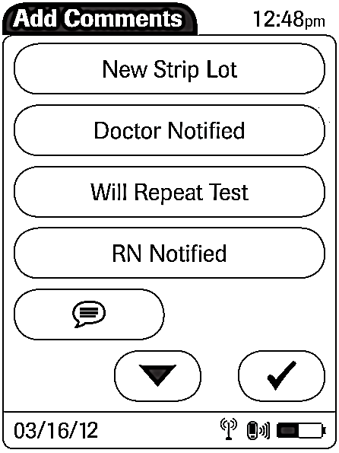
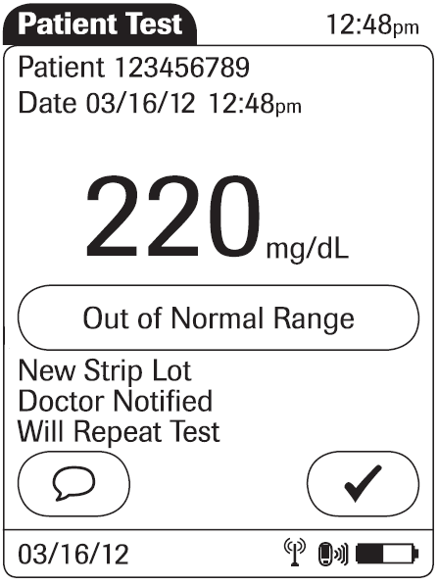
Screens Used For Adding Comment To A Test
Press the comment you want to add.
Choose comment to show intended action.
Wrong Patient tested
Notified Provider
Repeated Test
Ordered Lab
Press check mark when done.
Down button for the next 4 available comments.
use the down arrow button to scroll to the next 4 comments if needed
to de-select a comment, just press it again
you may add 1 “preprogrammed” comment per test to show intended action for Critical result <50 or 500> or result that will be repeated within 2 minutes. Only 3 comments can be added.
Notified Provider (critical comment required in meter, and CPRS template required - Notification of Glucose/ISTAT Critical Test)
Repeated Test (perform another test in 2 minutes)
press the check mark when done
ALWAYS Press check mark when done and the meter will attempt to send that result wirelessly.
Repeat Test
Notes:
Glucose CRITICAL Range
<50 and 500> add Notified Provider comment and complete CPRS Note Template

Slide 21
Meter Maintenance
Make sure the monitor is turned off, and clean meter after each patient.
Using a Clorox Bleach Germicidal Wipe for a 3-minute Wet Time, gently wipe the surfaces of the monitor horizontal and vertical, touching all surfaces. Also use wipe to clean the accessory box and testing supplies.
Ring out excess fluid from Clorox Germicidal Wipe
  Wipe every surface of the meter for cleaning.
  Wipe the sides and along the edges of the meter thoroughly.
  DO NOT allow cleaning solution to get into the test strip port at the top of the meter.
  Dry with a soft cloth or gauze.
  After cleaning the meter with the wipe, use another the Clorox Germicidal
wipe for disinfecting, and may be wrapped around the meter for the remainder of
required Wet Time for disinfection to allow the Clorox Germicidal wipe solution to
remain in contact with the meter surface (This is an FDA compliance requirement
for use of Clorox Germicidal wipe as a disinfectant)
  Be sure it’s dry before use and/or place in the docking station. For drying use a dry
  soft cloth or dry gauze.
Clean the meter bases and avoid monitor/base connectors and the base unit circuitry.
Return the monitor to the base unit when not in use.
Notes:
Q: When should you place the ACCU-CHEK meter in the docking station?
+ When it is clean and disinfectant and not in use

Slide 22
LIMITATIONS OF PROCEDURE
The ACCU-Chek Inform II test strips are for testing fresh capillary, venous, arterial, or neonatal whole blood. Cord blood samples cannot be used.
If peripheral circulation is impaired, collection of capillary blood from the approved sample sites is not advised as the results might not be a true reflection of the physiological blood glucose level. This may apply in the following circumstances: severe dehydration as a result of diabetic ketoacidosis or due to hyperglycemic hyperosmolar non-ketotic syndrome, hypotension, shock, decompensated heart failure NYHA Class IV, or peripheral arterial occlusive disease.
Use Do NOT use this meter for the hospital’s definition of critically ill patients.
Do not use glucose meter system during the intravenous infusion of N-acetylcysteine

