Slide 1
Kaiser santa rosa primary stroke center
KP Primary Stroke Centers are accredited by The Joint Commission (TJC) and certified every 2 years.
The Stroke Program Committee, the Medical Director of Neurology and the Stroke Coordinator oversee our Primary Stroke Certification.
Awards for excellent patient care are given through the American Heart Association (AHA) and the American Stroke Association (ASA)
“Get With The Guidelines” program.

Slide 2
You should know Signs and Symptoms of Stroke
Patients, family members, visitors or co-workers could have a stroke at anytime
Numbness or weakness of the face, arm or leg on one side of the body
Difficulty speaking or understanding language
Dizziness, loss of balance, or loss in coordination
Loss of, blurred or double vision
Sudden and severe headache with no apparent cause
If you suspect someone is having a stroke, call for help right away.
Every second counts!

Slide 3
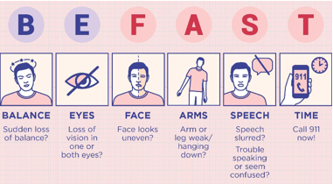
Stroke assessment

Slide 4
What does befast mean?
B: Balance- The severe, sudden onset of balance problems and ataxia (a lack of voluntary muscle movement) may indicate a stroke.
E: Eyes and Vision- Unusual trouble with sight in one or both eyes is a warning sign that someone may be having a stroke.
F: Face Drooping- Face numbness or tingling. Ask to smile and check to see if their face is crooked or uneven.
A: Arm Weakness or Leg Numbness- Similar to the face drooping warning sign, someone experiencing a stroke may feel weak or numb on one side of the body. Sudden onset of neurological deficits, especially weakness, numbness, or tingling of extremities is a clear warning sign of stroke.
S: Speech Difficulty- If the person you are with is having trouble getting their words out or understanding your words, it could indicate the start of a stroke. Speech may be garbled or slurred.
T: Time to Call- Even if symptoms appear temporarily, be sure to call for a Nurse Response immediately and pay attention to the clock. You’ll need to know the time the symptoms first appeared. There is a very narrow window of time to treat stroke. The longer one waits, the more limited the options to treat become. Damage to the brain also increases.
https://promedicahealthconnect.org/general-health/is-it-a-stroke-be-fast/

Slide 5
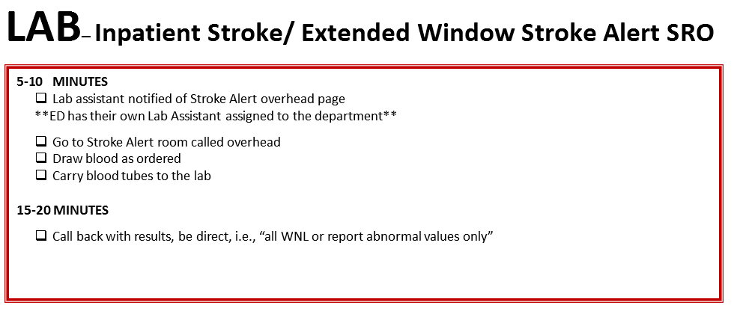
Stroke alert process

Slide 6
Why are labs important?
Lab results help to determine if a patient who is having an Ischemic Stroke (stroke caused by a clot) can receive alteplase (clot dissolving medication)
Alteplase administration improves the stroke patient’s outcome

Slide 7
Labs ordered
Standard labs ordered:
CBC
PT/PTT/INR
CHEM 7
Might also order:
Troponin
Goal for lab turn around times (TATs) are from patient arrival
to lab resulted in <= 45 minutes

Slide 8
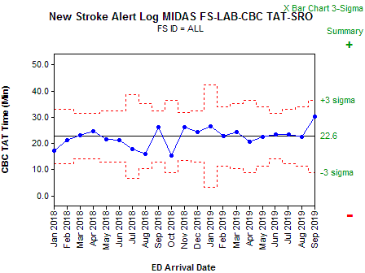
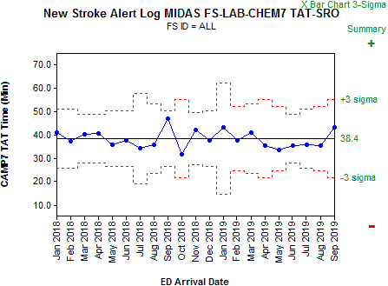
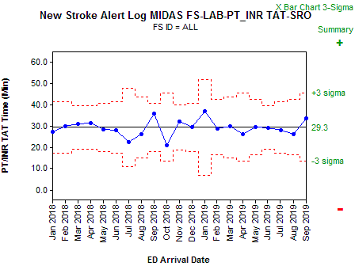
Lab Stroke Alert TATs
CBC average TAT 23 minutes
PT/PTT/INR average TAT 29 minutes
CHEM 7 average TAT 38 minutes

Slide 9
Door to needle (DTN)
Time it takes from patient arrival to alteplase administration
Administration time goals:
Regional and local <= 30 minutes
American Heart Association <= 45 minutes
The Joint Commission <= 60 minutes

Slide 10
Door to Needle
Alteplase administered 29 times in 2019
All alteplase cases were given in ED, none inpatient
TAT<=30
13/29 45%
TAT<=45
20/29 69%
TAT <=60
24/29 83%

