Slide 1
Kaiser Santa Rosa Stroke Center
KP Primary Stroke Centers are accredited by The Joint Commission (TJC) and certified every 2 years.
The Stroke Program Committee, the Medical Director of Neurology and the Stroke Coordinator oversee our Primary Stroke Certification.
Awards for excellent patient care are given through the American Heart Association (AHA) and the American Stroke Association (ASA)
“Get With The Guidelines” program.

Slide 2
You should know Signs and Symptoms of Stroke
Patients, family members, visitors or co-workers could have a stroke at anytime
Numbness or weakness of the face, arm or leg on one side of the body
Difficulty speaking or understanding language
Dizziness, loss of balance, or loss in coordination
Loss of, blurred or double vision
Sudden and severe headache with no apparent cause
If you suspect someone is having a stroke, call for help right away.
Every second counts!

Slide 3
Stroke assessment

Slide 4
What does befast mean?
B: Balance- The severe, sudden onset of balance problems and ataxia (a lack of voluntary
muscle movement) may indicate a stroke.
E: Eyes and Vision- Unusual trouble with sight in one or both eyes is a warning sign that
someone may be having a stroke.
F: Face Drooping- Face numbness or tingling. Ask to smile and check to see if their face is
crooked or uneven.
A: Arm Weakness or Leg Numbness- Similar to the face drooping warning sign, someone
experiencing a stroke may feel weak or numb on one side of the body. Sudden onset of
neurological deficits, especially weakness, numbness, or tingling of extremities is a clear
warning sign of stroke.
S: Speech Difficulty- If the person you are with is having trouble getting their words out or
understanding your words, it could indicate the start of a stroke. Speech may be garbled
or slurred.
T: Time to Call- Even if symptoms appear temporarily, be sure to call for a Nurse Response immediately and pay attention to the clock. You’ll need to know the time the symptoms first appeared. There is a very narrow window of time to treat stroke. The longer one waits, the more limited the options to treat become. Damage to the brain also increases.
https://promedicahealthconnect.org/general-health/is-it-a-stroke-be-fast/

Slide 5
Stroke Alert Process
“Stroke Alert” will be paged overhead
CLS Shift Supervisor will be responsible for coordinating the laboratory’s response
ED Lab Assistant will respond to ED Stroke Alerts
Inpatient Rounds Lab Assistant will respond to Inpatient Stroke Alerts
The Goal is to have the sample collected in less than 10 minutes of the activation of the Stroke Alert

Slide 6
Why are labs important?
Lab results help to determine if a patient who is having an Ischemic Stroke
(stroke caused by a clot) can receive alteplase (clot dissolving medication)
Alteplase administration improves the stroke patient’s outcome

Slide 7
Labs ordered
Standard labs ordered:
CBC
PT
CHEM 7
Get With The Guideline (GWTG) Stroke Goal for completion of lab results is less than 45 minutes from the time of notification
Regional TAT goal for Stroke Protime Test is <10 minutes from the time the sample are received in the laboratory

Slide 8
Door to needle (DTN)
Time it takes from patient arrival to alteplase administration
Administration time goals:
Regional and local <= 30 minutes
American Heart Association <= 45 minutes
The Joint Commission <= 60 minutes

Slide 9
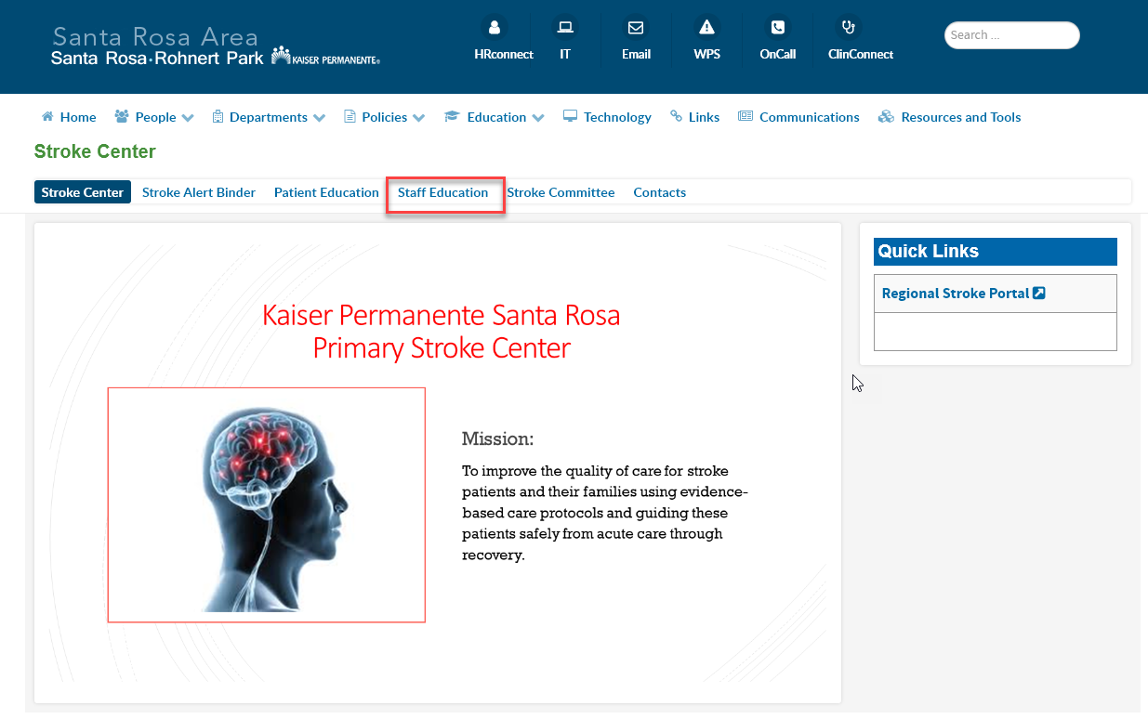
STROKE RESOURCES
Go to Santa Rosa Intranet Site
Click on Departments
Click on Stroke Center
Staff Education

