Slide 1
Stago Compact Max 3 – What’s the difference?

Slide 2
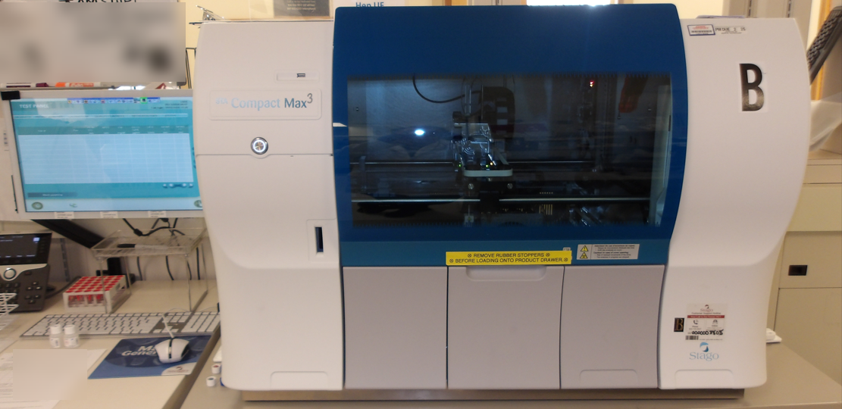
Stago Max 3 overall the general appearance hasn’t really changed.
Compact Max Software is exactly the same.
Expert software is exactly the same with a few added rules such as temperature error, HIL & level sense.
So what really changed?

Slide 3
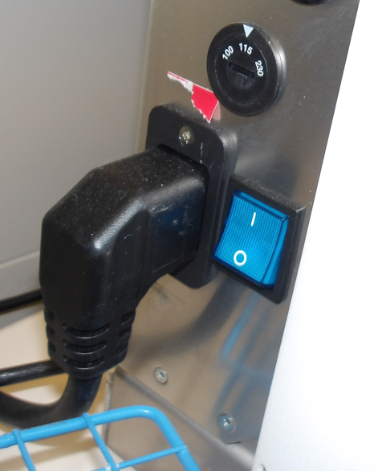
Power Button
What used to be the knob to control the volume is now the power up button.
The blue switch is still there but the process to shutdown the Compact Max relies on the shutdown of the Compact Max software and its corresponding Windows software
To start up the Compact Max the new power button is pressed for 3 seconds until the solid white ring appears.

Slide 4
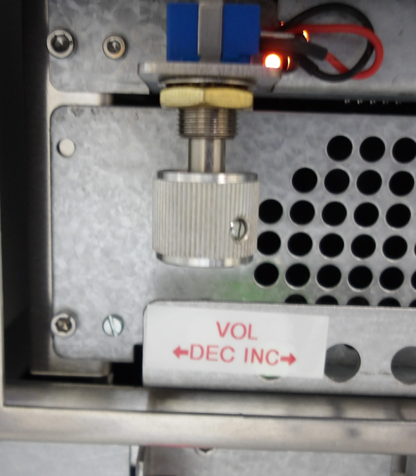
Volume control
The volume of the alarm is now controlled by a knob located inside the left panel of the instrument.
Turn left to decrease and right to increase the volume of the alarm.

Slide 5
Inside the Compact Max3
At first glance looks the same with a few minor changes.

Slide 6
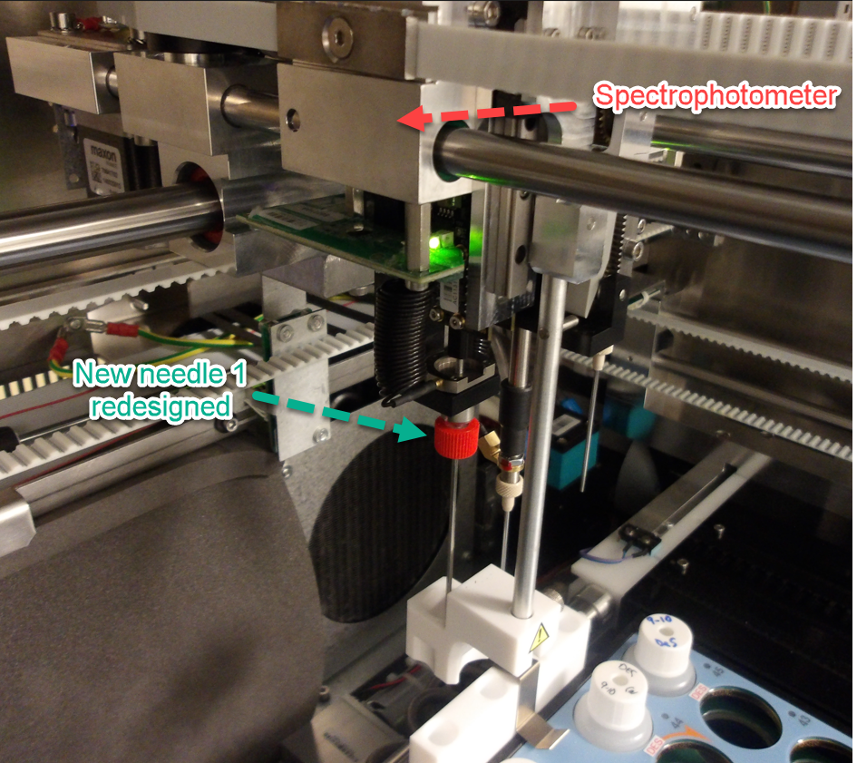
Spectrophotometer for detection of hemolysis, icterus and lipemia (HIL).
Piercing needle was redesigned to allow simpler installation by screwing it on.

Slide 7
Safety
Red safety latch when engaged will prevent the front cover from falling on someone’s head if the strut is no longer working.
Issue now is to remind CLS’s to release the latch before closing the front cover.

Slide 8
Syringe Removed
Syringe has now been replaced by a pump.
Advantage: less maintenance and one less factor to consider why your QC may be falling out.

Slide 9
Hand held scanner
Hand held scanner helpful when scanning barcodes from the cuvette reel or from reagent /control inserts instead of having to rely on the barcode reader where we scan patient samples.

Slide 10
Maintenance
Reduced amount of time to perform weekly. No more 30 minutes rinsing and cleaning wells have been reduced to 10 minutes.
Use of 0.37% chlorine solution for decontamination of wells.
N=(B/0.37)-1
N=Parts of water to add to 1 part bleach
B=% chlorine in bleach
Use of 20-40% ethanol for cleaning measurement and incubation wells.

Slide 11
No Touch Screen
Initial Software version allowed for touch screen.
As more issues were identified software upgrade were made to address the issues but eventually the ability to use the touch screen feature was disabled.

Slide 12
Challenges
New issues are being identified as we continue to use the instrument.
Hopefully all of the issues we’ve identified paves a way to smoother transitions for facilities slated to get the Max 3’s soon.

