Slide 1

Kaiser Permanente Northern California
Annual Mandatory Education 2026
General Stroke Education
KP Northern California stroke programs are Joint Commission (TJC) Disease-Specific Care Certified
Comprehensive Stroke Centers: Sacramento and Redwood City
Thrombectomy Capable Stroke Center: Santa Clara
Advanced Primary Stroke Centers: All others

Slide 2

General Stroke Education
Objectives:
  Explain use of the term BEFAST for recognizing symptoms of stroke.
  Identify medical center process for obtaining help for individuals who are experiencing symptoms of stroke. This includes patients, staff, and visitors.

Slide 3
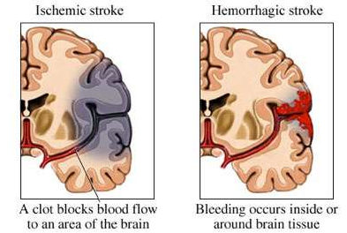
What is a stroke?
A stroke occurs when a blood vessel to a part of the brain becomes clogged (ischemic stroke) or bursts (hemorrhagic stroke)
When this occurs, the nerve cells in that part of the brain can no longer work the right way
Every part of the brain controls a specific part of the body
The part of the brain that is affected by the blockage or bleeding will determine what deficits appear (for example, trouble speaking, walking or numbness and weakness)
Figure is from the AHA (previously owned by the NSA for public stroke education) and comes from the KNC Stroke Book for Patients

Slide 4
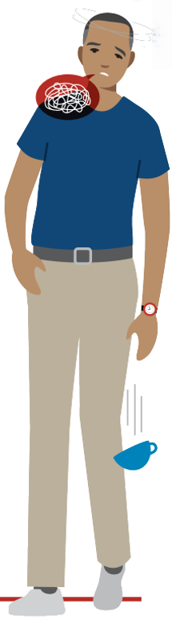
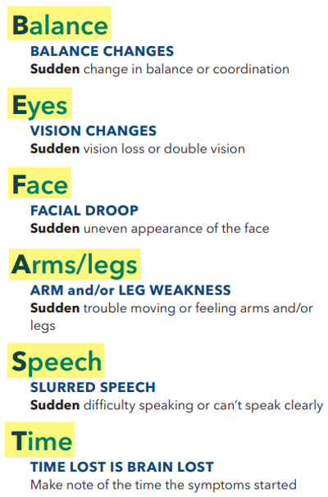
Signs & Symptoms of a Stroke:
Remember BEFAST

Slide 5
Stroke facts
Nearly 800,000 people in the United States have a stroke every year
Besides being deadly (25%), stroke is the leading cause of adult long-term disability
Over 80% of all strokes are preventable by following good health habits:
Mediterranean diet
Avoiding smoking and street drugs
Regular exercise
Getting adequate sleep
Obtaining good control or prevention of high blood pressure, diabetes and atrial fibrillation
Onset of stroke signs and symptoms are typically sudden, and most often affect one side of the body

Slide 6
Stroke facts
Each minute in a moderate size stroke can lead to a permanent loss of ~2 million brain cells without immediate and time-limited treatment
Immediate action can help prevent brain damage and long-term disability
If you or someone you know is having signs and symptoms of a stroke, it is important to activate the EMS system if outside of the hospital, or to follow your hospital’s internal alert policies
KPNC has an excellent stroke alert process, getting a specialized stroke physician expert at the bedside within minutes to provide evidence-based, emergent care

Slide 7


Stroke Labs and Turn Around Times (TATs)
PT/INR: < 15 minute
CBC: < 30 minutes
Chem 7: < 30 minutes
Our Door To IV Thrombolytic goal is < 30 min.
Timely lab draws help us ensure we get our patients (who are candidates) the life-saving treatment they need.

Slide 8


Think FAST...Act FAST!
Remember - Time is Brain…
Rapid activation of stroke alert can be critical- treatment needs to start as soon as possible!
Balance | Have they had a sudden loss of BALANCE?
Eyes | Have they lost vision in one or both EYES?
Face | Does the FACE look uneven?
Arm | Does one ARM/LEG drift down? (One-sided only)
Speech | Does their SPEECH sound strange?
Time | TIME lost is Brain lost!
Stroke Alert Process:
  If you observe signs and symptoms of stroke (in patients, staff, visitors, or family members):
  Inpatient areas: Call a rapid response
  Outpatient Areas: Call a nurse response
  code line - #000 or 3-6000

